Slide 1


CAH Network
Medical Practice Management for Hospital Administrators
April 28, 2017
L. Michael Fleischman, Principal

Slide 2
Successful Medical Practice Operations
Define Expectations. Employment does not mean alignment.
Put a physician leadership structure into place. If physicians actually possess limited control over their work, they may develop a sense that they cannot meaningfully influence healthcare.
Communicate frequently and make sure expectations are clear
Be responsive and proactive – nobody likes putting out fires all day
Set proper priorities. Physicians don't do the work they do for the benefit of the hospital — they do what they do for the patient.
Share decision-making. How can we make the clinic work more efficiently together to the benefit of the community?
“We built trust, and we gave hope.” Daniel Salinas, MD, CMO, Children’s Healthcare of Atlanta

Slide 3
Practice Management
Quality patient care
finances
telephone
regulations
scheduling appointment
ancillary services
3rd party reimbursement
personnel
professional relations
record keeping
the web
marketing
patient education

Slide 4
If you’re not serving our customers … you should be serving someone who is.

Slide 5

Reinventing Efficiency
Why do we do it this way?
What do we need to do it more efficiently?
Can we do it with less paper?

Slide 6
A Day in the Life of Dr. Smith
Delayed on rounds
Sees first patient, who was scheduled at 8:30 a.m., at 8:55 a.m.
Third patient seen for routine follow-up of minor problem presents with a “By the way…” problem. The 5-minute appointment becomes a 25-minute visit.
Messages, refills and forms pile up

Slide 7
A Day in the Life of Dr. Smith
6 p.m. - sends the nurse home after seeing last patient
Digs into the pile of paperwork
Delegates half to the nurse for tomorrow morning and sets it on the chair at the nurse’s station
Returns calls, throws forms in briefcase to do later at home, leaves for home at 7:15 p.m.

Slide 8
A Day in the Life of Dr. Smith (day 2)
Nurse shows up for work at 7:55 a.m., office opens at 8 a.m.
Nurse digs into the stack of notes and charts left by Dr. Smith
Today’s messages, refill requests and forms filter in
Nurse doesn’t have the first patient ready until 8:45 a.m., while Dr. Smith was ready to go at 8:30 a.m. — she’s already behind

Slide 9
Theory of Constraints
An organization’s performance is dependent on its few constraints, not all of its resources.
- The Goal, Eliyahu Goldratt

Slide 10
Consider
How much time do patients spend:
In your practice for a particular exam?
Actually face-to-face with a staff person while in your practice?

Slide 11

Consider
How much time does clinical staff spend:
In clinic sessions?
Face-to-face with patients during a clinic session?

Slide 12
Scheduling Patients’ and Doctors’ Time
Goals of the appointment system
Developing a realistic appointment schedule—your “art style”
Appointment scheduling techniques
Customizing schedules

Slide 13
“Huddles”
Limit huddles to 7 minutes or less
Hold the huddle in a central location, and stand rather than sit
Choose a consistent time on a daily basis. Experiment with different times of day and attendance. Don’t give up on the concept because a certain time or mix of staff doesn’t work.
You can huddle before the workday, late afternoon, after lunch, etc., and with different staff in attendance
In some, the physicians attend, while in others, the MA or RN reports back to the physician
Whether the physician physically attends or not, his or her buy-in and support of daily huddles is critical to their success and continuation

Slide 14
Suggested Huddle Agenda
Check for patients on the schedule that may require more time/assistance due to age, disability, personal demeanor, etc. Who can help?
Check for back-to-back lengthy appointments, such as physicals. How can they be worked around to prevent backlog?
Are there openings that can be filled? Chronic no-shows? Any special instructions for the scheduler?
Check over provider and staff schedule – does anyone need to leave early or break for a phone call or meeting?
Lab results, test results, notes from other physicians – are they ready in the patient’s chart? What will be the most efficient path of patient flow?

Slide 15

Appointment Scheduling = Accessibility
Timeliness of …
Preventive care appointments
Routine primary care
Specialty referrals
Urgent care
Emergency care
After-hours care

Slide 16
Today’s Standards
≤ 20 minute wait time
Immediate – Emergency
≤ 24 hours - Urgent appointment
≤ 1 week - Non-urgent, non-emergent appointment

Slide 17
Triaging
Train front office staff on the basics of triaging all appointment calls
Identify problems, duration of symptoms, acuity
Create a triage chart of the top 20 symptoms
The criteria should include the symptom, appointment urgency, and appointment length. Create codes for urgency and for appointment length.
Document the disposition of the call in patient chart

Slide 18
Self-Scheduling
Patients can log on and schedule their own appointments
Allows for patient confidentiality by showing only available appointment times
Reduces calls to the office
Available to patients 24 hours a day
Computer-illiterate individuals will object to such a system, so phone scheduling should still be made available

Slide 19

Four Approaches to Scheduling Your Time
Standard rotation
Wave
Modified wave
Open-access

Slide 20
Standard Rotation
Fixed time slots for every hour
Advantage: If honored, precise timing avoids long patient waits
Disadvantage: Inflexible, doesn’t allow for emergencies, “by the way,” no-shows

Slide 21
Wave Scheduling
All patients at the top of the hour, seen on a first-come, first-served basis
Advantage: Physician and staff all constantly busy
Disadvantage: Potential long wait times to see physician

Slide 22
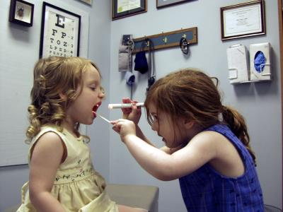
Modified Wave Scheduling
Load the top of the hour with 2-3 patients, leave time throughout the hour for work-ins, walk-ins
Advantage: Ideally physician maintains a constant supply of patients with minimal patient waiting time
Disadvantage: If not managed, schedule can book up weeks in advance

Slide 23
Modified Wave Concept of Scheduling
10:00 a.m. | New patient (or other long, time-consuming visit)
10:00 a.m. | Brief visit
10:20 a.m. | Intermediate long time-consuming visit
10:20 a.m. | Brief visit
10:40 a.m. | Work-in patient or brief visit

Slide 24
Open Access Scheduling
Leave 50-60% of slots open for same day or next day, balance of slots used for follow-up visits, testing
Advantage: Handle urgent care in stride, most patients seen same day, almost no no-shows
Disadvantage: Difficult for specialties requiring intensive patient work-up or coordination with multiple resources

Slide 26
No Shows
< 35 years old
Owe practice money
Don’t have transportation
Are repeat offenders
Non-compliant
What to do?
Dismiss from practice

Slide 27
Patient Per Hour (PPH) Rates
Doctor Session | TIME |  |  | PATIENTS
 | Start | Stop | Elapsed (in hrs. & minutes) | Seen | Per Hour
1 | 9:15 | 12:30 | 3:25 | 12 | 3.69
2 | 9:18 | 12:18 | 3:00 | 15 | 5.00
3 | 8:55 | 12:55 | 3:00 | 16 | 5.33
4 | 9:05 | 12:45 | 3:67 | 10 | 2.72
5 | 8:30 | 12:20 | 3:83 | 11 | 2.87
6 | 12:45 | 3:15 | 2:50 | 13 | 5.20
7 | 12:55 | 3:50 | 2:92 | 14 | 4.79
8 | 1:10 | 5:10 | 4:00 | 10 | 2.50
9 | 1:05 | 4:50 | 3:75 | 18 | 4.80
10 | 1:00 | 4:20 | 3:33 | 15 | 4.50
AVERAGE |  |  | 3:32 | 13.4 | 4.03
PEAK |  |  |  |  | 5.33

Slide 28

Questions to Ask
What can be delegated?
What tasks are needless?
Could more staff help?

Slide 29
Two Rules to Increase Production
Rule 1
Doctors or other providers don’t go to people or things
Rule 2
People and things come to doctors or other providers

Slide 30
Cheap Solution
Reconfigure staff
(Peak hours - peak staffing)
Work throughout the day (accessibility)
Reduce needless tasks
Discipline

Slide 31

More Expensive Solutions
Facility redesign
Ignore the problem and hope it gets better!

Slide 32
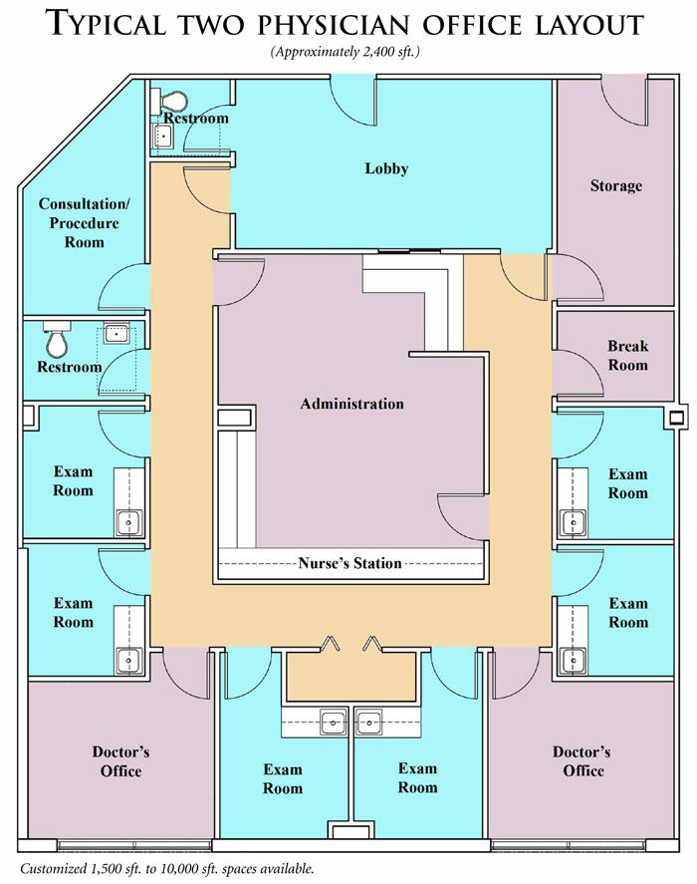
The Ideal Office Floor Plan

Slide 33

Personnel
Your biggest expense
Your biggest problem

Slide 34
Office Points of Contact with a Patient
Scheduling appointment by telephone
Greeting the patient upon arrival
Registration of new patient
Calling patient out of reception area
Examination/treatment
Patient education
Reappointment/fee presentation
Good-bye
Accounts receivable follow-up

Slide 35


Slide 36
Friendliness of the Office Staff When I Make an Appointment Is Important to Me
TRUE | 88%
FALSE | 12%
US News Poll, March 17, 2014

Slide 37
Why Patients Leave
Indifference / lack of interest | 68%
Unadjusted complaints | 14%
Staff related | 82%
Note: price, relocation, death, etc.—18%

Slide 38

Recruiting Good People
Two rules of thumb

Slide 39
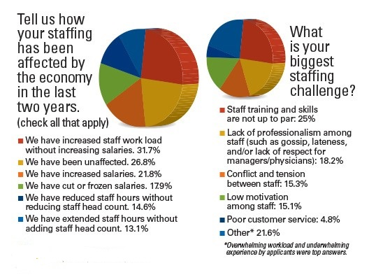
Data source: http://www.physicianspractice.com/staff-salary-survey/2015-staff-salary-survey-results-national

Slide 40
Finding Great Employees
Job descriptions
Phone screening
Personal interview
Staff “interview”
Background check (http://exclusions.oig.hhs.gov/ & http://www.employscreen.com/)
Reference check

Slide 41
Points of Caution in the Interview Process
Ask only “bona fide” job-related questions
Listen actively
Watch body language
Let the interviewee ask questions
Let the staff interview their prospective colleagues

Slide 42
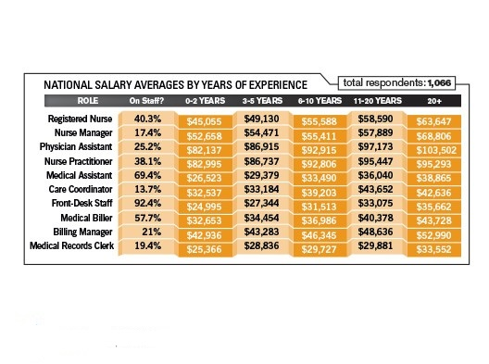
Average Salaries
Data source: http://www.physicianspractice.com/staff-salary-survey/2015-staff-salary-survey-results-national

Slide 43

Management Role
Day-to-Day Manager
  People
  Finances
Administrator
  Delegates to mid-level management
  Empowered to market/negotiate
  Advisor to physicians

Slide 44
Clinical: Equipment Interface Technician
Increased use of OP monitoring devices
Tests read from afar
Review readings to standards
Prioritize providers’ work load
Record results in EMR
Email information to patient

Slide 45
Nurse Navigators and Care Coordinators
Follow-up after office visits and hospital release
Scheduling appointments with ancillary services, specialty providers
Calling to make sure they’re taking medications
Calling to set up follow-up appointments
Critical to the success of the PCMH

Slide 46

Administrative: Certified Professional Coder
Initial and ongoing training
Conduct ongoing coding audits
Information source for physicians
Resource for staff

Slide 47
Administrative: IT Specialist
Knows all practice software applications
Trains new staff
Troubleshoots system
Develops integrated clinical/administrative reports
Documents improvement
Liaison with software vendors, web page, etc.

Slide 48
Side Bar: Physician Burnout
“70% to 80% of physician work output could be considered waste, defined as work that doesn't need to be done and doesn't add value to the patient.” - Christine Sinsky, MD, Vice President of Professional Satisfaction at the American Medical Association
“Over time, log records from physicians showed a decline in the time allocated to face-to-face visits, accompanied by an increase in time allocated to desktop medicine.” - Electronic Health Record Logs Indicate That Physicians Split Time Evenly Between Seeing Patients And Desktop Medicine, Health Affairs, April 2017

Slide 49
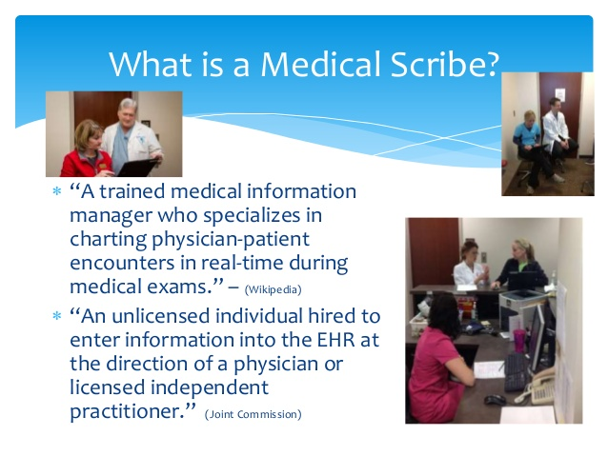
What Is a Medical Scribe?

Slide 50
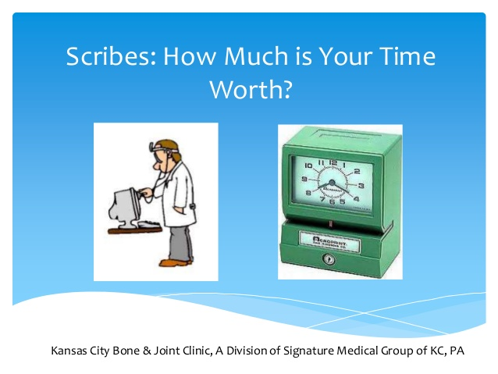
How Much Is a Scribe’s Time Worth?

Slide 51
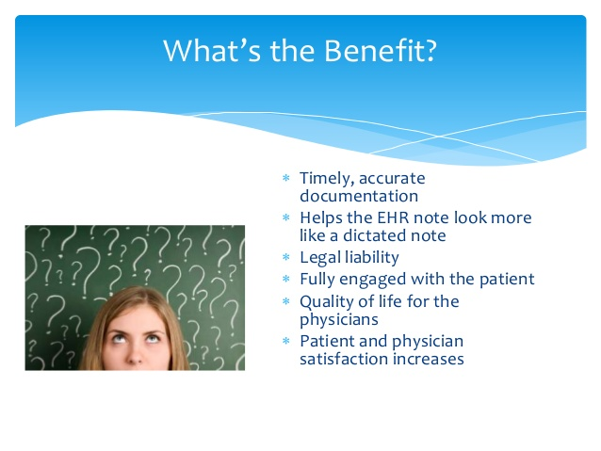
Benefit of Scribes

Slide 52
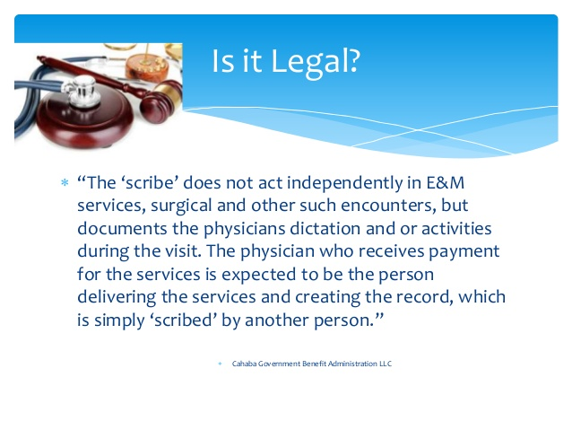
Are Scribes Legal?

Slide 53
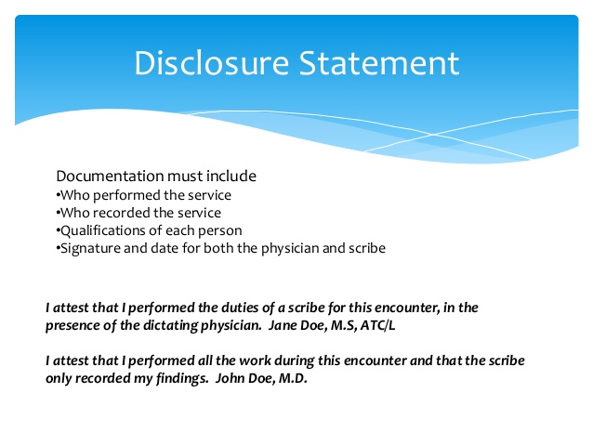
Disclosure Statement

Slide 54
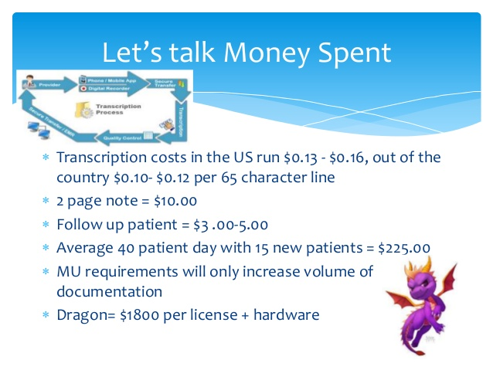
$$$

Slide 55
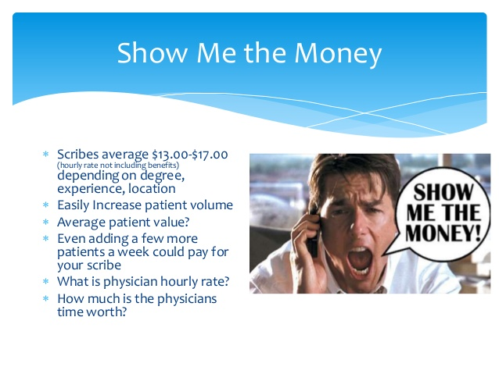
More $$$

Slide 56
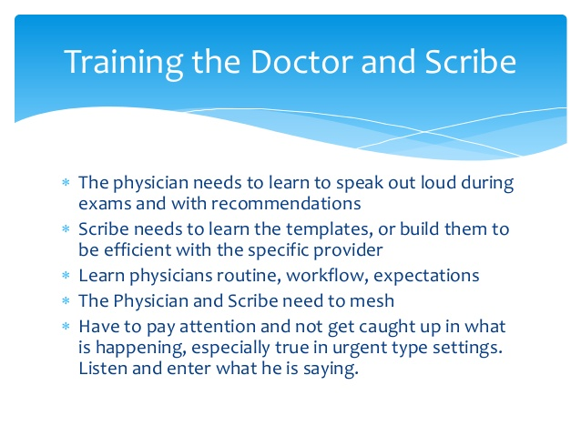
The Learning Process

Slide 57
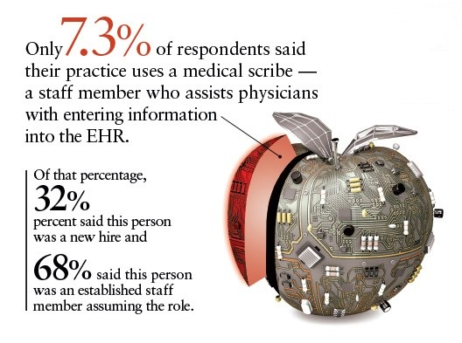
Data source: http://www.physicianspractice.com/staff-salary-survey/2015-staff-salary-survey-results-national

Slide 58
Some Important Regulatory Issues

Slide 59
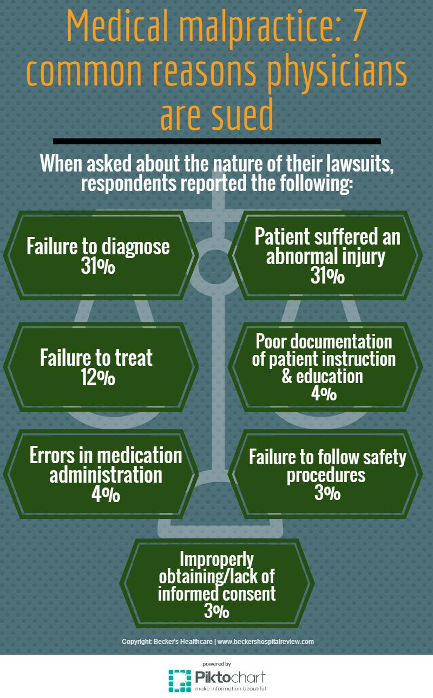

Slide 60
Terminating Patients
A patient cannot be discharged from your practice for being a
member of a legally protected class
Sex
Religion
Race
Color
National origin
Age
Pregnancy
Citizenship
Familial status
Disability
Status as a veteran
Genetics, AIDS/HIV, or sickle
Sexual preference
Gender identity

Slide 61
HIPAA in the Medical Practice
Health Insurance Portability and Accountability Act of 1996
Originally known as the Kennedy-Kassenbaum Bill
Initial focus was health insurance portability for individuals changing jobs

Slide 62

Administrative Simplification
Objective Standards:
Transactions
Unique health identifiers
Security
Code sets
Privacy
Transmission of data
Electronic signature

Slide 63
“Privacy Policy Notice”
Specific header statement
Plain language
Uses of and disclosures of PHI
Explain all of individuals’ privacy rights
List practice’s responsibilities under HIPAA
Explain to the patient that they have the right to request specific non-disclosures
Tell how to file complaints with the Office of Civil Rights

Slide 64
Authorization
Must be obtained for all uses and disclosures other than treatment, payment, operations (TPO)
Providers may NOT condition treatment on receipt of authorization
Applies to all providers, not just direct treatment providers

Slide 65

Theft of EHR
Electronic health record information can be used for billing scams that go as high as the value of the health insurance policy, to purchase prescription drugs for resale on the black market, and also for run-of-the-mill identity theft.

Slide 66
Practice Administrative Requirements
Privacy official & complaint contact
Train workforce and document training
Implement appropriate safeguards
Verify requests for disclosure
Respond to individual’s requests
Institute internal complaint policy
No retaliatory acts
Monitor systems/document policies

Slide 67

Patients Have the Right To…
Access
  Inspect and copy PHI
Amend PHI (including corrections)
  No appending information
  No psychotherapy rights
Require your practice to account for disclosures
Receive an electronic copy of their medical record

Slide 68
Disclosures to Business Associates
PHI can be disclosed to Business Associates as it relates to carrying out TPO
Covered Entity must have signed written agreements (the Business Associate Agreement)

Slide 69
Managing Government Enforcement Actions
Which government agencies may be involved
  HHS Office of Civil Rights
  FTC Bureau of Consumer Protection
  State AGs
  CMS
  Considerations:
    Are you a Medicare contractor?
    Does your state have a health breach notification statute? If not, is it PII requiring state notification?

Slide 70
Breach
Definitions, Unsecure PHI, Methodology
Breach does not include good faith, unintentional acquisition, access, or use of PHI by a workforce member of a CE, BA, or BA subcontractor.
Inadvertent disclosure to another authorized person within the entity or its business associates.
Recipient could not reasonably have retained the data.
Data is limited to a limited data set that does not include dates of birth or ZIP codes.
In the event of a “breach” of “unsecured” PHI, a Covered Entity must notify each individual whose unsecured PHI has been, or is reasonably believed to have been, breached.
A “breach” is defined as “the acquisition, access, use, or disclosure” of PHI in a manner that violates the Privacy Rule or Security Rule and which “compromises the security or privacy of the [PHI].”
“Unsecured” PHI is PHI that is “not rendered unusable, unreadable, or indecipherable to unauthorized individuals through the use of a technology or methodology specified by the Secretary.”

Slide 71
What Are the Complaints?
Impermissible uses and disclosures of protected health information
Lack of safeguards of protected health information
Lack of patient access to their protected health information
Uses or disclosures of more than the Minimum Necessary protected health information
Lack of or invalid authorizations for uses and disclosures of protected health information
Listed in order of frequency

Slide 72
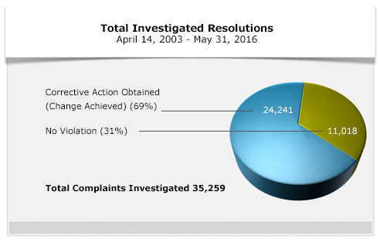
OCR Recent Enforcement
Source: www.hhs.gov

Slide 73
Compliance Goals
Establish and communicate approved uniform standards of conduct for physician and support staff
Establish internal controls that promote practice adherence to Federal and State laws and program guidelines for Federal, State and private health plans
Streamline operations so that the Practice can respond quickly and effectively to issues
Increase the accuracy and appropriateness of patient documentation

Slide 74
Compliance Goals
Promote internal communication regarding all practice issues
Establish and monitor educational/training requirements for all employees and ensure training is specific to job responsibilities
Through appropriate legal and accounting review, ensure all joint ventures, lease arrangements and outside contracting, comply with the OIG advisory opinion and Stark requirements for such arrangements

Slide 75
The 7 Essential Elements of an Effective Compliance Plan
This means that a compliance program should contain several parts in order to accomplish those objectives. The OIG has laid out seven (7) fundamental elements for an effective compliance program.
  Written Policies and Procedures. A compliance plan will set forth policies and procedures for all persons involved in the business in order to ensure compliance.
  Designated Compliance Personnel. A compliance plan will set forth the person (or persons) tasked with implementing updating the plan; training new hires and continuing personnel; conducting investigations and bringing those investigations to resolution; and reporting to leadership and/or government sources.
  Training and Education. Business personnel must be trained in compliance upon hire and regularly thereafter. Additionally, personnel must be aware of changes in law that affect how they perform their jobs.

Slide 76
The 7 Essential Elements of an Effective Compliance Plan
  Effective Communication. A crucial part of any compliance plan is to ensure that business personnel are aware of compliance issues and know how to respond should an issue arise.
  Internal Controls. The compliance officer and/or designated personnel must monitor and audit the efficacy of a business’s compliance program. If a compliance program is dormant, it is not working to protect the business and it should be appropriately updated.
  Failure of any personnel to adhere to a compliance program should result in appropriate discipline as outlined in the compliance program.
  Prompt Response. If and when a compliance issue arises, it should be flagged quickly, responded to quickly, and resolved quickly. If the business is found to be out of compliance, every day that it remains that way is another day the business is open to civil liability or criminal prosecution. Compliance should be a priority concern of any healthcare business.

Slide 77
Baseline Audit
Performed shortly after compliance plan is established

Slide 78
Periodic Audits
“Spot checks” performed routinely to ensure ongoing accuracy
Covers entire practice
Focus on new staff or on staff in new positions
May use outside consultant

Slide 79
Disclosure of Audit Results
To the owners
To practice legal counsel if corrective action needs to be taken

Slide 80

Standards of Conduct in All Areas of Practice
Conduct business in an ethical and lawful manner
Comply with all:
  Laws
  Regulations
  Policies

Slide 81
Quality of Care
Treat all patients with respect and dignity
Provide quality care at an appropriate medical necessity level, without regard for patient race, color, religion or national origin
Obtain informed consent for all services as appropriate and required
Ensure that all Practice personnel are credentialed for the services that they perform
Comply with all laws and regulations regarding patient rights and privacy
Handle patient inquiries and/or complaints in a timely and sensitive manner
Ensure that physicians conduct regular QA reviews of patient care and appropriateness of services

Slide 82
Billing Compliance
Adhere to financial policies as outlined in the Compliance Manual, related to accounts receivable management
Adhere to proper coding practices, including the appropriate use of modifiers
Bill only for services rendered
Provide adequate and legible documentation for all services rendered
Ensure proper assignment/reassignment of Medicare payments

Slide 83
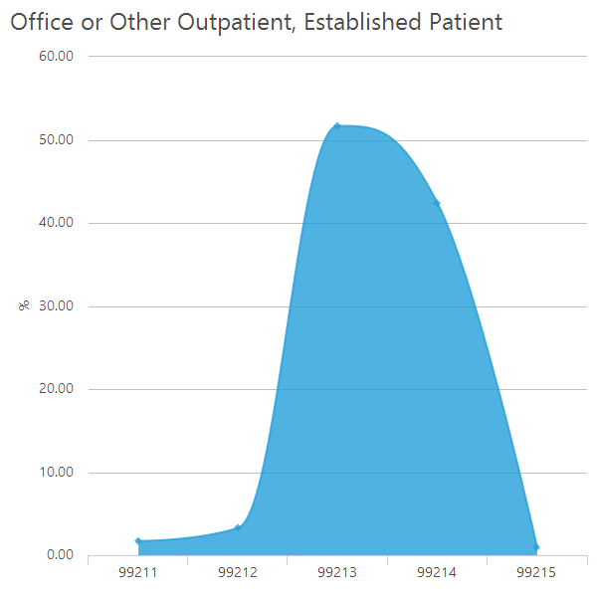
National Coding Trends Among FPs
Source: Medical Group Management Association
MGMA Physician Placement Starting Salary Survey; 2016 report Based on 2015 Data

Slide 84
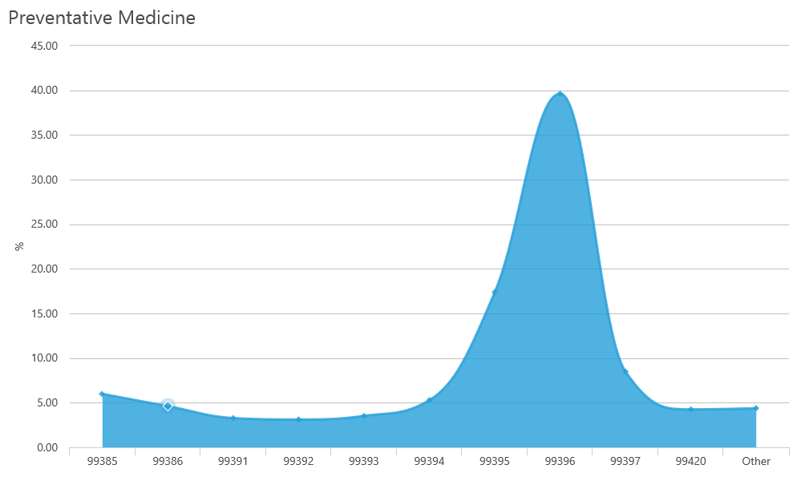
National Coding Trends Among FPs
Source: Medical Group Management Association
MGMA Physician Placement Starting Salary Survey; 2016 report Based on 2015 Data

Slide 85
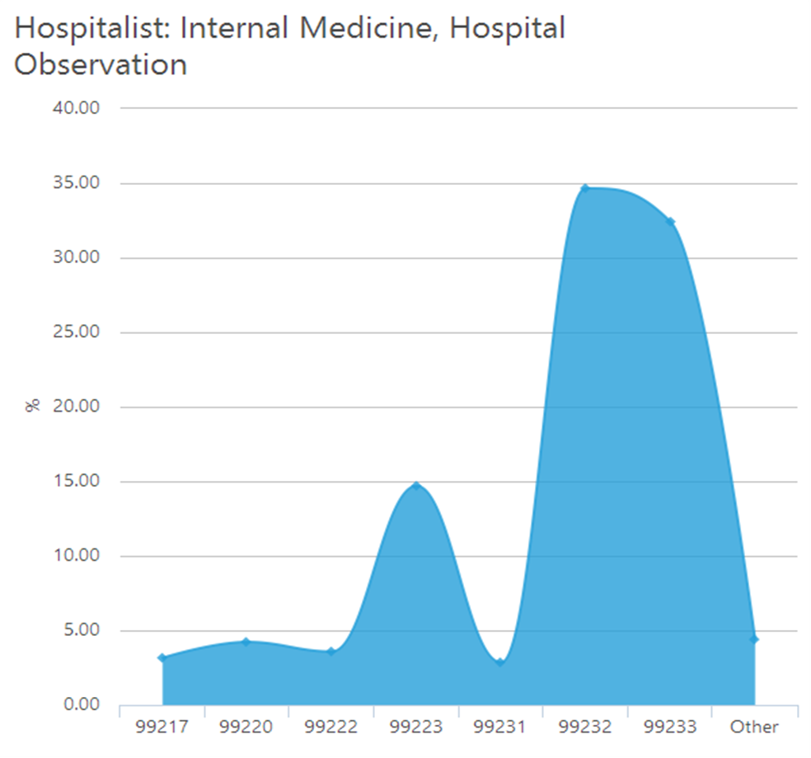
National Coding Trends Among Hospitalists
Source: Medical Group Management Association
MGMA Physician Placement Starting Salary Survey; 2016 report Based on 2015 Data

Slide 86
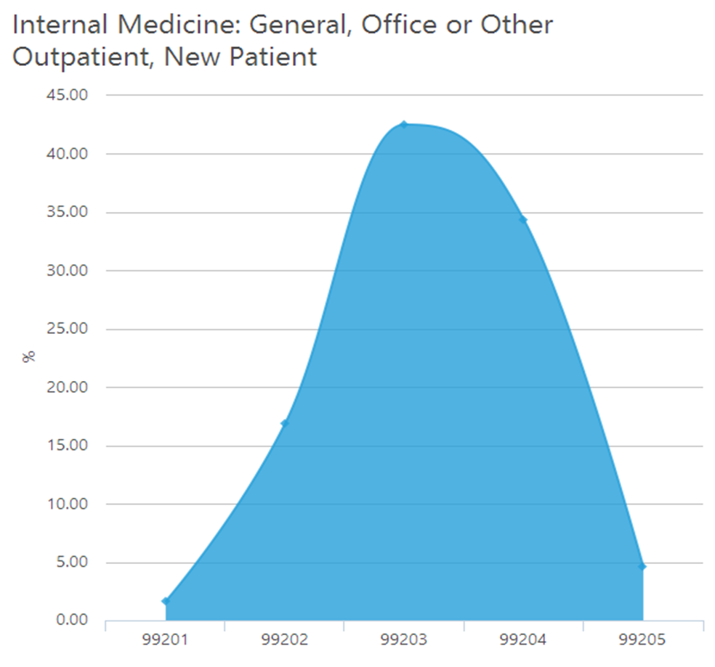
National Coding Trends Among Internists
Source: Medical Group Management Association
MGMA Physician Placement Starting Salary Survey; 2016 report Based on 2015 Data

Slide 87
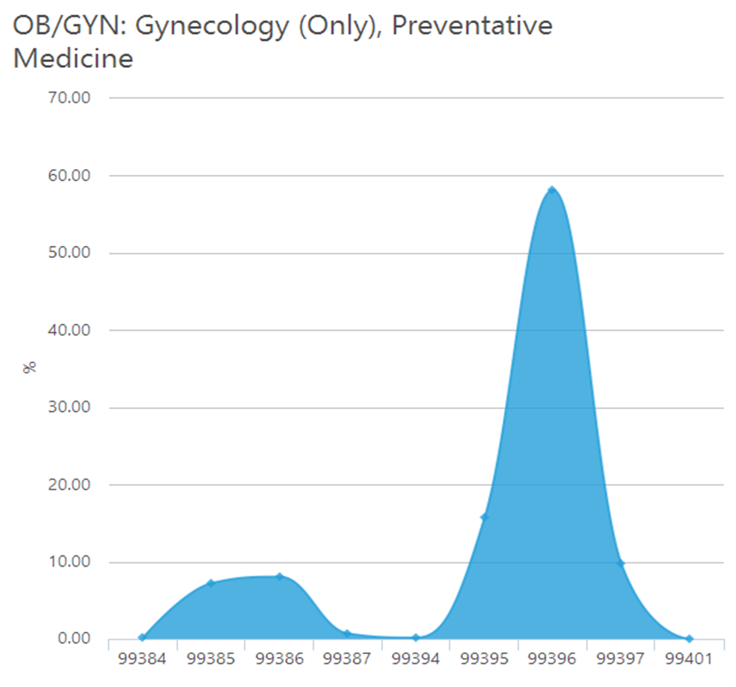
National Coding Trends Among Ob/Gyns
Source: Medical Group Management Association
MGMA Physician Placement Starting Salary Survey; 2016 report Based on 2015 Data

Slide 88
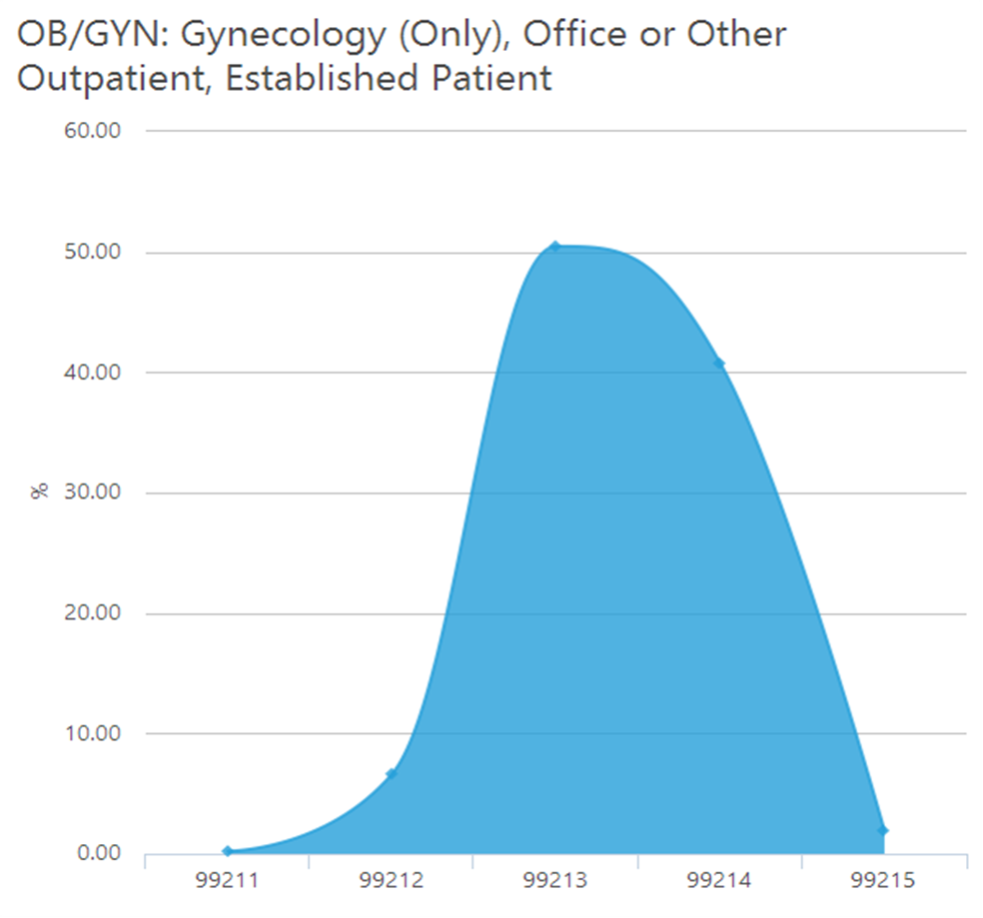
National Coding Trends Among Ob/Gyns
Source: Medical Group Management Association
MGMA Physician Placement Starting Salary Survey; 2016 report Based on 2015 Data

Slide 89
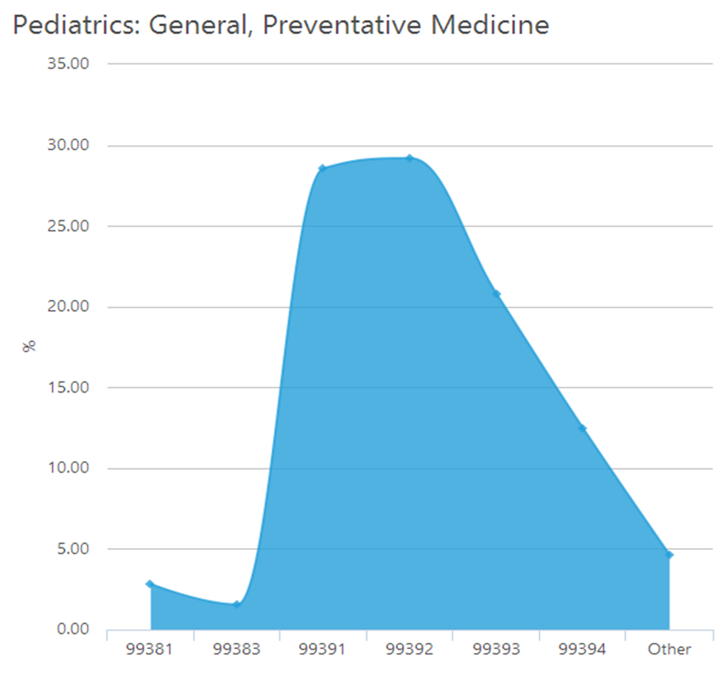
National Coding Trends Among Pediatricians
Source: Medical Group Management Association
MGMA Physician Placement Starting Salary Survey; 2016 report Based on 2015 Data

Slide 90
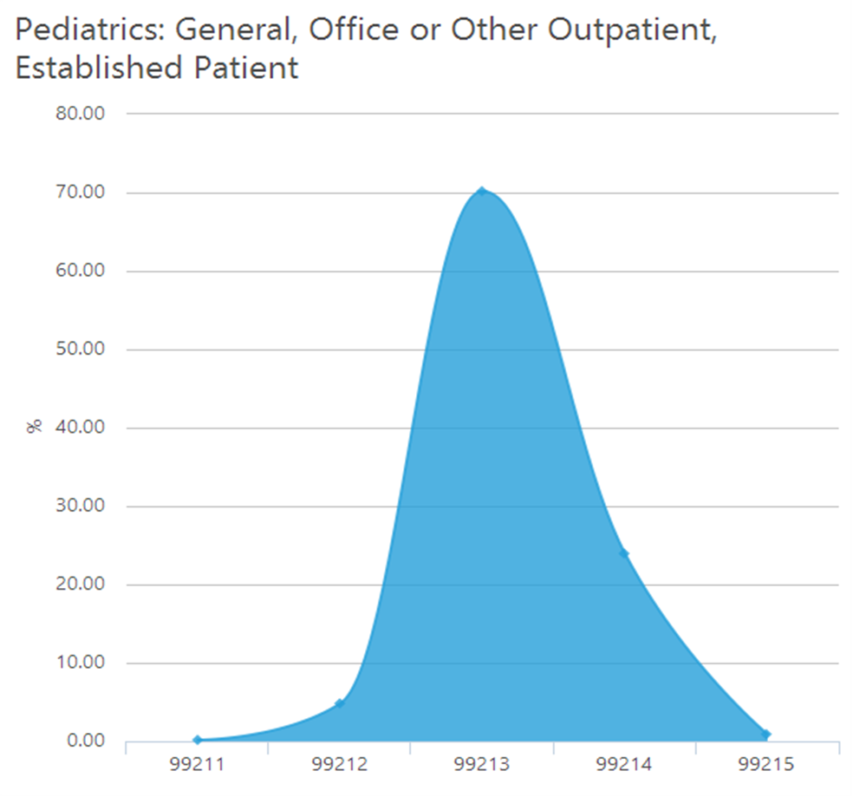
National Coding Trends Among Pediatricians
Source: Medical Group Management Association
MGMA Physician Placement Starting Salary Survey; 2016 report Based on 2015 Data

Slide 91
Physician Financial Transparency Reports (Sunshine Act)
Part of the ACA
Goal: collect information about certain “payments” drug and device companies make to physicians
“Payments” include travel, research, gifts, speaking fees, text books, consulting fees and meals
Must register in Open Payments System on CMS Portal and in Enterprise Identity Management system (EIDM)
Periodically review data and correct as needed by 12/31 of each calendar year

Slide 92
Marketing: Internal and External Techniques
Important definitions
Marketing
Advertising

Slide 93
How Patients Choose Their Physician

Slide 94
Important Factors When Considering a Doctor

Slide 95

Marketing
Identify
Anticipate
Satisfy
Profit

Slide 96
Positioning Practice: Which Services…
Set you apart?
Do your patients most utilize?
Do you see developing most rapidly?
Are most efficient and profitable for you to perform?
Remember that primary care is seasonal specialty

Slide 97

Marketing Budget
Must spend
Don’t overspend

Slide 98
Marketing Options
Web page
Social media(?)
Managed Care
Newsletter
Phone
Contacts
Brochure
Health Fairs
Giveaways
Yellow Pages

Slide 99
Marketing Plan
Collect information
  Survey patients
  Ask others
  Brainstorm
Set criteria for your plan
Build expertise and brand

Slide 100
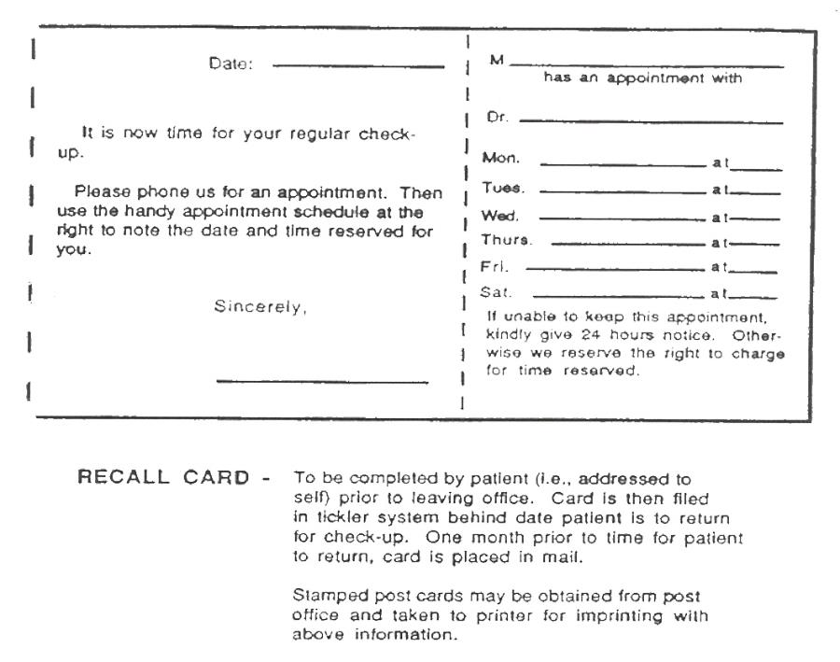

Slide 101
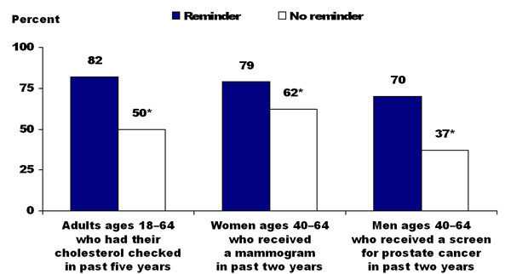
Adults Who Are Sent Reminders Are Most Likely to Receive Preventive Screening
*Compared with reminders, differences remain statistically significant after adjusting for income or insurance
Source: Commonwealth Fund 2006 Health Care Quality Survey

Slide 102
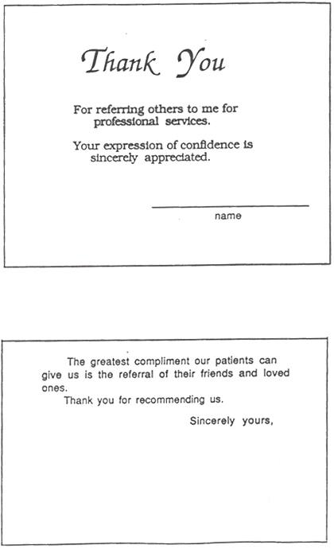

Slide 103
Social Media
Consider all practice policies that normally apply to you in offline circumstances and apply them when you're online
If you wouldn't say something loudly within earshot of patients and their families, don't say it online
Don't use social media for personal reasons on work time
Don't post patients' personally identifiable information or protected health information
Do identify your relationship with the practice if you engage in a discussion about the practice, but be sure to clarify that you are not speaking on behalf of the practice

Slide 104

Financial Systems and Controls
Establish separate funds for change and petty cash
Divide financial responsibilities
Special problem areas:
  Cash
  Accounts receivable
  Accounts payable

Slide 105
Embezzlement and Prevention of It
80-85% of practices
Bond employees
Financial controls
“Audits” by CPA

Slide 106

Embezzlement Horror Stories

Slide 107

Calculating Key Practice Financial Indicators
Revenue per physician
Overhead
Employee cost
Collection rate

Slide 108
Net Revenue per Physician (median)

Slide 109
Total Compensation per Physician

Slide 110
Non-provider Expenses per Physician

Slide 111
Total Support Staff Cost per Physician

Slide 112
Calculating Overhead
Total Expenses
(Physicians’ Salaries)
(Physicians’ Retirement)
(Depreciation)
Net Expenses | ÷ Total Revenue

Slide 113
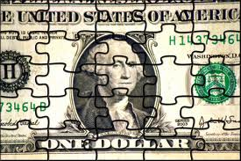
Calculating Employee Expense
Total Employee Salaries
Net Revenue

Slide 114
Calculating Collection Rate
Gross: Receipts
Charges = C/R
Adjusted: (1) Charges
<Adjustments>
Net Charges
(2) Receipts
Net Charges = Adjusted C/R
(Takes into account bona fide contractual allowances)

Slide 115
Family Medicine A/R Facts
$89,875/physician in A/R
Gross C/R: 57.64%
Adjusted C/R: 97.34%

Slide 116

Collection Procedures – Setting Expectations
Must Be …
In writing
Communicated several times to the patient
Timely
Adhered to

Slide 117
Statement Cycle
Point-Of-Service: collect co-pays before service is provided
30 days
60 days
Telephone Intervention
5-8 p.m.
Documented
90 days
120 days
Demand letter
Collection agency
Release from practice
Consider small claims court

Slide 118
Collection Letter
Dear Patient:
As of today your account balance is over 90 days old. The total balance is $_____. Please indicate how you will pay this balance:
__ Enclosed is my check or money order for the full amount.
__ Please charge the balance to my credit card using the information below.
__ Please turn my account over to a collection agency.
Failure to respond to this letter will result in the account being turned over to a collection agency and possible dismissal from this practice.
If you have questions call ___-___-____.
Thank you for your attention to this matter.

Slide 119

Patient Insurance
Obtain information in initial appointment scheduling call
Verify electronically prior to visit
Always view ID, especially on new patients

Slide 120
Capturing Charges
Office
Providers and staff are responsible for capturing all charges related to visit
Example: Patient checks out with a Dx of non-specific pharyngitis however, there is no indication of a rapid strep test
Hospital
Provider is responsible for submitting charges to practice following rounds/call
The billing staff should review hospital admissions/discharges daily to make sure all charges are captured

Slide 121
Processing
All claims are reviewed daily by an experienced staff member
Claims are submitted electronically on a daily basis
Develop tickler system to review aging claims
Follow up on outstanding claims at 30 days
Review rejections to identify the reasons and make corrections to the system as needed

Slide 122
What Is It? Not Just Another Acronym
A whole lot of acronyms to remember
  MACRA: Medicare Access and CHIP Reauthorization Act of 2015
  MIPS: Merit-based Incentive Payment System
  APM: Alternative Payment Model
  CPC+: Comprehensive Primary Care Plus

Slide 123
The Merit-based Incentive Payment System (MIPS)
Most Medicare clinicians will participate in the Quality Payment Program through MIPS
Four performance categories
Performance Category | % of Score in Year 1 | Details
Quality | 50% | Clinicians choose to report six measures from a range of options that accommodate differences among specialties and practices
Advancing Care Information | 25% | Clinicians choose to report customizable measures that reflect how they use technology in their day-to-day practice
Clinical Practice Improvement Activities | 15% | Rewards clinical practice improvements, such as activities focused on care coordination, beneficiary engagement, and patient safety
Cost | 10% | Score based on Medicare claims using 40 episode-specific measures, meaning no reporting requirements for clinicians
Source: CMS Press Office press release 4/27/16 http://www.hhs.gov/about/news/2016/04/27/administration-takes-first-step-implement-legislation-modernizing-how-medicare-pays-physicians.html

Slide 124
How Does the Money Fit In?
Track 1
  Monthly care management fee of $15 per beneficiary
  PLUS: Full FFS payments under MPFS
Here’s the math:
Average PCP Patient Panel Size | 2,300
X Monthly Management Fee | $15.00
= Annual Payments | $414,000

Slide 125
How Does the Money Fit In?
Track 1
  Monthly care management fee of $15 per beneficiary
  PLUS: Full FFS payments under MPFS
  PLUS: Performance-based incentive payments of $2.50 per month
Here’s the math:
Average PCP Patient Panel Size (60% of the panel) | 1,380
X Incentive Payments (60%) | $2.50
= Annual Payments | $41,400

Slide 126
How Does the Money Fit In?
Track 1
  Monthly care management fee of $15 per beneficiary
  PLUS: Full FFS payments under MPFS
  PLUS: Performance-based incentive payments of $2.50 per month
Here’s the math:
Management Fee | $414,000
Incentive Payments | $41,400
FFS (Median FM w/o OB Collections for Southern Region*) | $444,338
Total per PCP | $899,738
*Data from MGMA Physician Compensation Survey, 2015 Data

Slide 127
How Does the Money Fit In?
Track 2
  Monthly care management fee of $28 per beneficiary
  PLUS: Reduced FFS payments under MPFS
Here’s the math:
Average PCP Patient Panel Size | 2,300
X Monthly Management Fee | $28.00
= Annual Payments | $772,800

Slide 128
How Does the Money Fit In?
Track 2
  Monthly care management fee of $15 per beneficiary
  PLUS: Reduced FFS payments under MPFS
  PLUS: Performance-based incentive payments of $4.00 per month
Here’s the math:
Average PCP Patient Panel Size (60% of the panel) | 1,380
X Incentive Payments (60%) | $4.00
= Annual Payments | $66,240

Slide 129
How Does the Money Fit In?
Track 2
  Monthly care management fee of $28 per beneficiary
  PLUS: Reduced FFS payments under MPFS
  PLUS: Performance-based incentive payments of $2.50 per month
Here’s the math:
Management Fee | $772,800
Incentive Payments | $66,240
FFS (Median FM w/o OB Collections for Southern Region*) @ 40% | $177,735
Total per PCP | $1,016,775
*Data from MGMA Physician Compensation Survey, 2015 Data

Slide 130
How Do They Compare?

Slide 131

The Focus on Value

Slide 133
Three Aspects of Assessing Quality in Healthcare
Structure of delivery system, including physical environment, personnel, organization
Process – technical competence and appropriateness of care
Outcomes

Slide 134
The “History” of the Quality Movement
1965 – Medicare mixed quality and cost
1966 – JCOAH begins accrediting hospitals
1971 – Enactment of Professional Standards Review Organization (PSRO) program provided unified system for Medicare/Medicaid to assure appropriate, cost-effective care by physicians
1972 – Validation surveys introduced by HEW
1974 – Institute of Medicine (chartered in 1970 as part of the National Academy of Science) publishes first study on quality
1980s-1990s – Through value purchasing and utilization management, managed care companies focused on creative ways to compensate physicians

Slide 135
The “History” of the Quality Movement
1990 – National Committee for Quality Assurance (NCQA) is established
  Safeguard against under-utilization
  Evaluate plan’s infrastructure to assure continuous quality improvement

Slide 136
The “History” of the Quality Movement
1993 – HEDIS (Health Plan Employer Data and Information Set)
  Standardized 65 clinical measurements
  Access
  Patient satisfaction
  Utilization
  Health plan financial data
  Health plan management (member satisfaction)

Slide 137
HEDIS Quality Measures
Preventative and screening services
Prenatal care
Treatment of acute and chronic illness

Slide 138

Early ‘90s
Reduced fee-for-service
Capitation

Slide 139
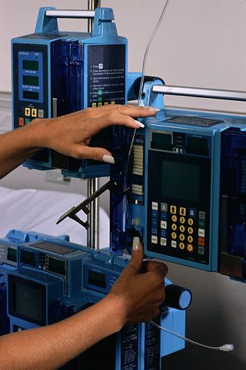
Mid ‘90s
Evidence-based medicine
State legislative mandates on care

Slide 140
Today’s Healthcare Delivery System
Issue of Quality and Cost
Lack of adherence to evidence-based guidelines
  Recommended care less than 60 percent of the time (McGlynn et al.; New England Journal of Medicine; 2003)
More isn’t necessarily better – overuse and misuse; variation
  Variation in cost per capita for Medicare beneficiaries (Dartmouth Atlas Spending Brief, February 2009, Dr. Elliot Fisher)
To err is human – building a safer health system – Institute of Medicine 2000
  “First – do no harm…,” abysmally high rates of medical errors; 98,000 deaths, $37.6 billion per year
Centers for Medicare & Medicaid Services (CMS) projects that by 2018, healthcare spending will be more than $4.3 trillion, or $13,100 per resident, and will account for 20.3 percent of Gross Domestic Product (CMS, Office of the Actuary National Health Statistics Group, 2009)

Slide 141
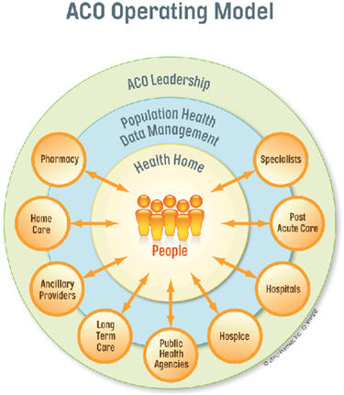
ACO Operating Model

Slide 142
“To Err is Human”
published in 2000 by
the Institute of Medicine
“Crossing the Quality Chasm”
published in 2001 by
the Institute of Medicine
Underlying Principles of P4P

Slide 143

Medicine Should Be…
Safe
Effective
Patient-centered
Timely
Efficient
Equitable

Slide 144
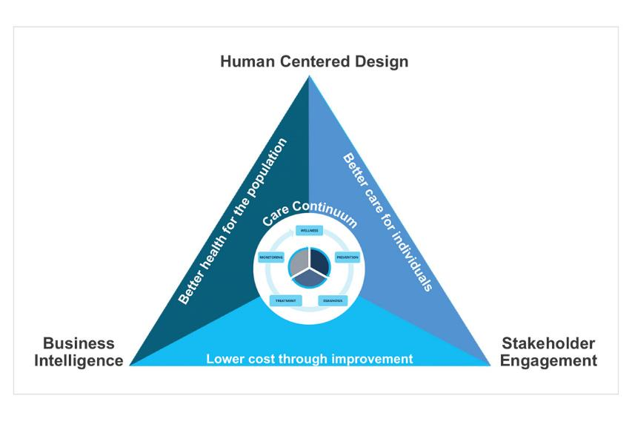
The Triple Aim

Slide 145

Why?
The “why” is a systems challenge:
  The U.S. has extremely talented and qualified healthcare professionals who have not been trained to work in teams
  The delivery system is fragmented, so information doesn’t follow patients as they move from hospitals to other sites of care
  Payment is quality-neutral
Notes:
…which is “why?” We’ve got terrific facilities here in the U.S., very well-trained professionals, so what’s going on here. What’s very clear from numerous reports from the Institute of Medicine and others, is that we haven’t begun to think and implement a health care delivery system. Health care delivery remains very fragmented, and what that means is that information doesn’t necessary easily follow individual patients as they move from one point of care another. And at best, how we pay for care is quality neutral. In other words, we don’t pay for value or quality, we pay for volume. If you do more things, you get more money.

Slide 146
Guidelines and Measures
More emphasis needs to be placed on what’s most important
We measure what we can
Identifying what counts and determining how it can be measured
Rather Than
Notes:
What’s very, very clear is that we need to continually improve measuring quality from an exercise that focuses on what’s easy to measure to one that focusing on what’s important. Focusing on the what are the most important priorities to improve the health of the American people.

Slide 147
Guidelines
Measures
Incentives
“You can get 60% of the improvement
from 15% of the change.”
- Don Berwick
Where should the busy primary care practice begin?
Where should policy makers target their incentives?
To changes that:
Produce the greatest benefit
Address the biggest quality gap
Can be implemented most easily, cheaply and safely
Notes:
We know that right now there are literally hundreds of measures out there and what many professionals are struggling with is what are the most important measures. If we’re going to make policies that reward delivery of higher quality of care, which measures should we be using. What’s clear is that we need to identify which measures produce the greatest improvements in patient’s health, which addresses the greatest gaps in quality of care, and which can be the most easily implemented so they can be a part of the routine delivery on care.

Slide 148
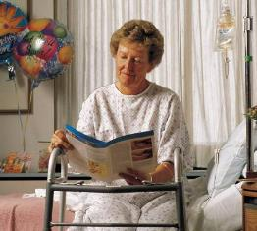

Reconciling Guidelines and Quality Measures
Developing guidelines that address a wide range of needs
Higher Risk
Higher risk patients
Lower Risk
Lower risk patients
Notes:
Most quality measures that are used now derive from clinical practice guidelines that are most often developed by professional organizations, medical professional organizations, nursing and so forth. It’s also clear that there needs to be a tighter link between the guidelines that specify how care should be provided under certain circumstances with the measures that tell us whether in fact those recommendations were followed. In addition to that, if you’re going to be focusing on improving care, you want to make sure the guidelines in quality measures address the patients, for whom there’s the greatest opportunity for improvement-those at the highest risk for poor quality.

Slide 149

What is a PCMH?

Slide 150

What Is a Patient Centered Medical Home (PCMH)?
A healthcare setting that facilitates partnerships between:
  Individual patients
  Their personal physicians
  Supportive ancillary care providers
  The patient’s family when appropriate

Slide 151
PCMH Characteristics
Patients have regular doctor or place of care that they select
Medical Home staff is familiar with the patient’s medical and social history and can easily access that information
Patient can easily contact medical home by email or phone during regular office hours
Medical home doctors and staff facilitate the coordination of care from other doctors or sources of care

Slide 152
The 7 Joint Principles of the PCMH
Defined in 2007 by the American Academy of Pediatrics, American Academy of Family Physicians, American College of Physicians, and the American Osteopathic Association
Personal physician
Physician directed medical practice
Whole person orientation
Care is coordinated and/or integrated
Quality and safety
Enhanced access to care
Payment reform

Slide 153
Categories of PCMH Implementation
Patient/Practice Partnership Support
Clinical Care Information
Care Delivery Management
Community Resources and Linkage
Performance Measurement and Improvement
Payment and Finance

Slide 154
I. Patient/Practice Partnership Support
Focus on access and communications
  Define the role and responsibility of each provider and employee in the practice
  Define the patient’s role and responsibilities
  Define specific types of appointments and how they’re met
  Can the patient count on a personal clinician?

Slide 155
I. Patient/Practice Partnership Support, cont’d.
  How are emergent and urgent situations handled?
        Define expectations for your patients and their families
  Secure patient-friendly communications including
        Call back times
        Email response times
        Phone or video conference appointments
        Define other special services provided
    How will you promote
    access and quality?

Slide 156
Considerations for Criteria
How will we coordinate care with multiple providers?
Who triages patient visits?
Do we have secure email? Who responds?
Is our website up-to-date with our communication policies?
Can we provide language support for LEP patients?

Slide 157
Principles of Team-Based Health Care
Shared goals: The team—including the patient and, where appropriate, family members or other support persons—works to establish shared goals that reflect patient and family priorities, and can be clearly articulated, understood, and supported by all team members.
Clear roles: There are clear expectations for each team member’s functions, responsibilities, and accountabilities, which optimize the team’s efficiency and often make it possible for the team to take advantage of division of labor, thereby accomplishing more than the sum of its parts.
Mutual trust: Team members earn each others’ trust, creating strong norms of reciprocity and greater opportunities for shared achievement.
Effective communication: The team prioritizes and continuously refines its communication skills. It has consistent channels for candid and complete communication, which are accessed and used by all team members across all settings.
Measurable processes and outcomes: The team agrees on and implements reliable and timely feedback on successes and failures in both the functioning of the team and achievement of the team’s goals. These are used to track and improve performance immediately and over time.

Slide 158
II. Clinical Care Information
Focus on the organization and use of
clinical information
1. Determine whether required measures are in place and how they are organized. These include:
  Up-to-date problem list with current ICD-9 (10) codes
  EHR with allergies, meds, medical Hx, surgical Hx, etc.
  Appropriate periodic assessment
  Progress notes using AAFP guidelines
  Preventive health screening and plan

Slide 159
II. Clinical Care Information, cont’d.
2. Develop tracking system in your medical record for:
  Labs
  Referrals (mammo, colonoscopy, etc.)
  Prevention
  Screening for depression, domestic violence, etc.

Slide 160
III. Care Delivery Management
Focus on promoting patient-centered care using best practice guidelines and scientific evidence
Identify a safety plan for your office and for office-based procedures
Develop proactive management strategies for:
  Appointment management
  Patient communications
  Referrals/consultation
  Surgical scheduling (including financial counseling)
  New patients
  Documenting safety guidelines and implementation

Slide 161
IV. Community Resource and Linkage
Focus is to successfully and proactively
link patients and their families
with community resources
Areas of need:
Family assistance
Community health resources
Condition-specific patient education materials
Patient self-management tools/guidance
Language services and resources
Homecare
Web-based health information

Slide 162
V. Performance Measurement and Improvement
Focus is that PCMH must have
methods of measuring performance that
quantify quality and patient safety
Identify a quality improvement (QI) team consisting of administrative staff, allied health professionals and physicians
Identify and prioritize the important elements of care and develop thresholds of acceptance
Establish effective peer review program
Physician led QI team meets routinely to evaluate performance and communicate corrective action as needed

Slide 163
V. Performance Measurement and Improvement, cont’d.
Utilize nationally identified quality measurements
Local carriers may have specific needs. Be sure to understand those.
Be practical – you can’t measure everything!
Periodically conduct patient surveys to measure:
  Patient satisfaction with all staff
  Patient perception of access
  Patient perception of other services the practice could offer

Slide 164
VI. Payment and Finance
Focus is PCMH’s use of a variety of payment mechanisms. Understand how you will be paid and the criteria on which payment will be based.
PCMH typically blends traditional FFS reimbursement with additional models
Some plans may incorporate one or more methodologies

Slide 165

Evolving Trends
If we make consumers aware of costs and make them assume more of the costs, they’ll make “smart” choices and we’ll save money

Slide 166
VI. Payment and Finance: Examples
Care coordination
Usually PMPM in addition to FFS
Fee-for-service enhancements
Depends largely on reporting requirements
Performance-based reimbursement
Meeting goals for achieving quality and utilizing evidence-based medicine
Practice overhead payments
To offset infrastructure upgrades

Slide 167
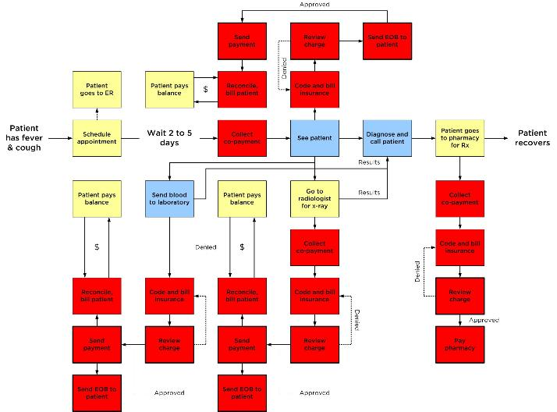

Fee-for-service Creates Waste & Dysfunction in Traditional Primary Care
Possible Pneumonia
Key:
Practice
Insurance
Patient
Provider

Slide 168

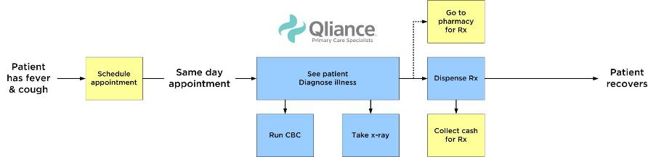

Direct Primary Care Changes the Dynamic
Direct Primary Care (DPC) provides primary care services directly to patients using a PMPM model
Operates either outside or alongside traditional insurance
  Reserves insurance for undesirable, costly events
  Lowers practice costs by eliminating fee-for-service billing
Possible Pneumonia

Slide 169
Why Direct Primary Care?
Primary care needs to break completely with the fee-for-service model (move from volume to value)
Primary care needs a business model that is stable and gives it control of its own resources
Primary care needs an environment in which it can innovate and adapt quickly to the changing environment and diversity of patient needs
Other primary care solutions have demonstrated uneven and disappointing results thus far
Hospitals and health systems are considering DPC for their employees and community employers

Slide 170
The Opportunity
Stewardship: Primary care can serve as steward of healthcare resources (the “general contractor” of the healthcare system) & reward high-performing advanced care providers
Workforce: Primary care can be a rewarding and attractive career option; DPC has potential to be a workforce generator
Innovation: Primary care can serve as a laboratory of innovation in medicine and technology
Reform: Primary care can drive more rational use of the healthcare system and align behavior with larger public policy goals
Savings: Primary care can drive dramatic and rapid savings for payers and individuals

Slide 171
Policy Barriers
Medicare and Medicaid: No current payment structure outside beneficiary out-of-pocket expense (unless part of managed care plan)
HSA/Tax policy: IRS policy out of step with ACA definition of DPC as “not insurance.” Employers, individuals with HSAs barred from utilization of DPC providers.
State legislation: WA, OR, UT, WV, NY have legislation. Some insurance commissioners appear to be permissive. Other states may need legislation.
Deductibles: Insurers do not count DPC payments toward deductibles, disadvantaging individuals & employers who buy DPC.
Entrenched payment models: FFS, E&M, RVU, fragmented additional payments for care coordination, etc.
Health IT & complexity scoring: Claims-based measures do not tell the whole story.

Slide 172
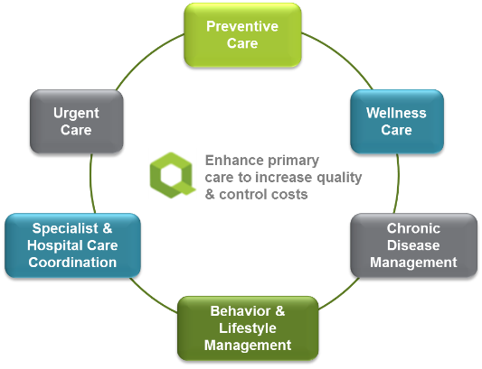
Qliance Direct Primary Care Model
    Doctors are employed, salaried; encourages focus on holistic care
Limited patient panel size
Flat monthly fee for unrestricted, 7 day/week access
    Wholly owned and operated community-based clinics
    Proprietary IT platform tailored to care delivery model, supports data integration with carriers, purchasers, and other systems
    Steward healthcare resources from the primary care level

Slide 173
Qliance vs. Non-Qliance Costs
 | Per 1,000 Qliance pts. | Per 1,000 Non-Q pts. | Difference | Savings per pt. per year
ER Visits | 81 | 94 | -14% | ($5)
Inpatient (days) | 100 | 250 | -60% | $417
Specialist Visits | 7,497 | 8,674 | -14% | $436
Advanced Radiology | 310 | 434 | -29% | $82
Primary Care Visits | 3,109 | 1,965 | +58% | ($251)*
Savings Per Patient | --- | --- | --- | $679
% Saved Per Patient |  |  |  | 20%

Slide 174
Patient Feedback
Would you recommend your provider to co-workers, friends and family members?
Do you get the care you want and need, when you want and need it from Qliance?

Slide 175
Who Are Our Customers?
Individuals
Small employers
Large employers (Expedia, Comcast, others)
Unions (UFCW 21, Seattle Firefighters)
Medicaid managed care (Coordinated Care)
Health benefits exchange (ACA)
Rapid growth in Medicaid and Exchange
(5x increase in patients in 2014 so far, from 8500 to 41,000 now)

Slide 176
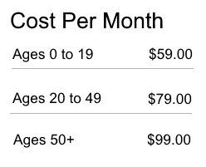
Qliance Costs

Slide 177
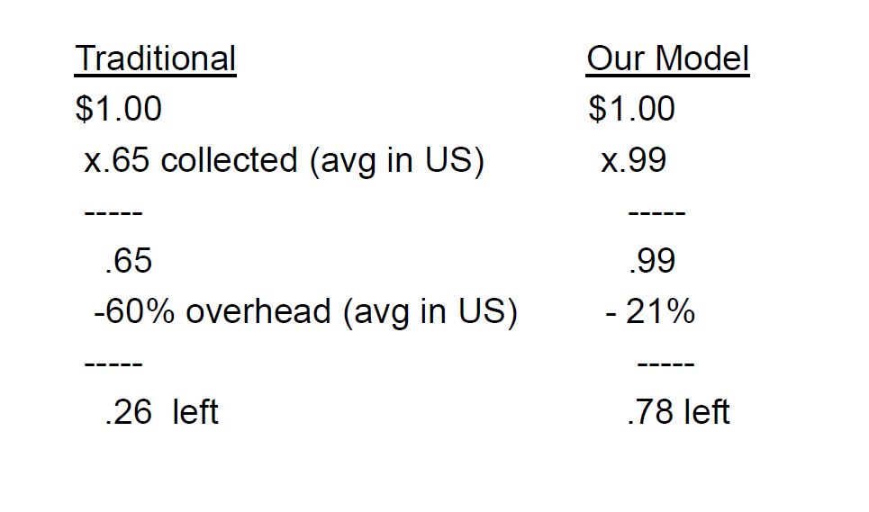
Primary Care Math

Slide 178
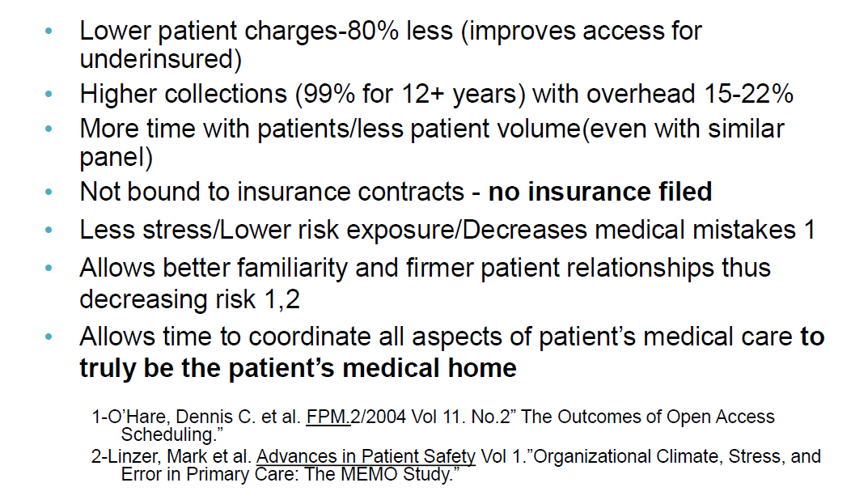
Summary of Access Healthcare Model

Slide 179
Key Problems the Model Solves
Quality metrics and value-based care are built in, with measured practices exhibiting top tier chronic disease management; better patient experience with more time
Much lower costs per patient per year, up to 80% less
Financial viability of independent practices (overhead can be as low as 20%)
Physician burnout: DPC is a much better experience for the physician (non-clinical bureaucracy/paperwork)
Workforce recruitment: med students see hope in this model
Access to primary care for most; not free but affordable

Slide 180
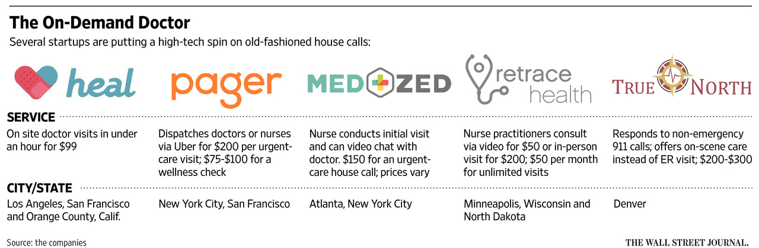
Other Evolving Business Models

Slide 181
What Level of Collaboration Is Practical?
Guidelines may need to reflect local values, disease burdens, priorities and resources
BUT WE NEED TO SHARE…
Information on how to develop clear and practical guidelines
Evidence on barriers and facilitators to implementing guidelines
Evidence about integration of guidelines in electronic health records
    Globalize the evidence,
    localize the decision-making.
Notes:
One of the questions that comes up all the time is that, are guidelines and measures actually mandates or are they guidance to practice? What’s clear is that we have room to go in terms of make sure guidelines are actually practical tools in the delivery of care everyday. It’s also clear that guidelines need to be flexible enough so that the individual needs of patients who are very unique can be accommodated and the capacity of local communities can also be accommodated. We also know that there is a great deal of opportunity to continue to work to integrate practice guidelines into electronic health records so they’re routinely available at the point of care when clinicians and patients are making decisions together.

Slide 182

Future Opportunities
The primary opportunity involves patients
  We will not improve chronic illness care without active, informed patients
  Patients as shoppers
  Women are key
Notes:
The future opportunities I see on the horizon are, first and foremost, giving patients information that they can understand so they can become an effective part of the health care team as well. We will not improve chronic illness care dramatically without the help of active informed patients. We know that a proportion of patients are increasingly interested in knowing which health care facilities and practitioners are best equipped to meet their needs. We expect that women are likely to be taking the lead here more than men because they are often the people who make health care decisions on their own behalf and on behalf of their families.

Slide 183
21st Century Health Care
Improving quality by promoting a culture of safety through Value-Driven Health Care
Information and evidence transform interactions from reactive to proactive (benefits and harms)
Actionable information available – to clinicians AND patients – “in real time”
Evidence is continually refined as a by-product of care delivery
Information-rich, patient-focused enterprises
21st Century Health Care
Notes:
At the end of the day where I think we need to be going for 21st century health care is to get to an enterprise that is information-rich but patient-focused. What I mean by that is by having information that is based on the best science available at the point of care. We can actually transform the enterprise of providing health care from one that is currently reactive to one that’s proactive that anticipates individual’s needs and actually is able to give them information about benefits and harms of potential treatments customized to their own individual circumstances. That actionable information has to be available to clinicians and patients in real time, in the same way that if you logged on to amazon.com, it give you information that is helpful to you right now, not 6 months from now. That same infrastructure can also give us the capacity to refine and improve evidence as a byproduct of care delivery so that we are continually doing a better job of making sure patients get the best care possible.

Slide 184
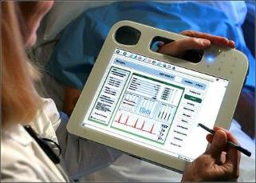
Information and Its Use
Data organization, retrieval, and analysis are key areas
  Patient encounters
  Cost-effectiveness analysis
  Learning which providers are better and worse
Look for the emergence of a data industry

Slide 185
Role of IT in Reducing Medical Errors
Percent who say …
Have you or a family member ever created your own set of medical records to ensure that you and all of your health care providers have all of your medical information?
Source: Kaiser Family Foundation / Agency for Healthcare Research and Quality / Harvard School of Public Health National Survey on Consumers’ Experiences with Patient Safety and Quality Information, November 2004 (Conducted July 7 – September 5, 2005).
Notes:
In terms of the importance of information technology, several years ago, the agency partnered with the Kaiser Family Foundation to ask patients what they saw as a result of the poor flow of information in health care and what you see here is what patients told us. Most strikingly, when asked the question, have you and your family member created your own set of medical records to ensure that you and all of your health care providers have all the right information, 1/3 of the patients said yes. We were quite stunned by that. Similarly, 70% said the coordination among different health care professionals they see is a problem. So clearly there are opportunities to improve how information can follow patients as they move from one point of care to another.

Slide 186
Personal Experience
Have you been personally involved in a situation where a preventable medical error was made in your own medical care or that of a family member?
Did the error have serious health consequences, minor health consequences, or no health consequences at all?
Notes:
When asked about issues related to medical errors, almost 1/3 of patients said they had been in a situation where preventable medical error was made in their own medical care or that of a family member. Of those patients, 21% said that there were serious health care consequences involved. So there’s a huge opportunity to improve patient safety as well.

Slide 187
9 Most Challenging Technology-related Problems Facing Medical Practices
A productivity drop due to our EHR — 15.5 %
  Lack of interoperability between EHRs — 14.2 %
  EHR adoption and implementation — 13.8 %
  Meeting meaningful use requirements — 13.3 %
  Costs to implement and use new technology — 12.8 %
  Keeping up with new technologies — 10.1 %
  Resistance to technology adoption by physicians or staff — 5%
  Keeping up with HIPAA privacy regulations/security — 4.9 %
  Training staff — 4.9 %

Slide 188
The 5 Traits of a Usable EMR
Supportiveness
The system should support workflow. It’s not about a single user: It’s about an entire practice.
Multiple users even accessing a single patient record simultaneously
Supportiveness

Slide 189
The 5 Traits of a Usable EMR
Flexibility
Not just within the system, but also with those using it
Consider the evolution of the phone. We started with one phone, then we added extensions. Then, we came up with portable phones because our work is mobile. We found that we needed phones to follow us, not us having to go to the phone.
Supportiveness
Flexibility

Slide 190
The 5 Traits of a Usable EMR
Ease of Learning/ Naturalness
Is the system burdensome and clunky? If it appears cumbersome or redundant, physicians won’t achieve the intended benefits because they just won’t use those features.
Supportiveness
Ease of learning / naturalness
Flexibility

Slide 191
The 5 Traits of a Usable EMR
Effectiveness
The future is value-based and consumer directed. Clinical data will be used to measure quality. With that in mind, it’s essential to find a system that will effectively straddle both worlds.
Supportiveness
Effectiveness
Ease of learning / naturalness
Flexibility

Slide 192
The 5 Traits of a Usable EMR
Efficiency
An EMR should save time, and even the smallest aspects of a system could mean wasted hours.
Even something as simple as keeping the electronic chart ‘open’ on the desktop can be a boon to workflow; a nurse or provider is often in one patient’s chart when a phone call interrupts their work, and they need to open another chart.
Supportiveness
Effectiveness
Efficiency
Ease of learning / naturalness
Flexibility

Slide 193

Medscape Survey
Data collected by third-party online survey collection site
Medscape surveyed 15,285 physicians across over 25 specialties from June 6, 2016 to August 8, 2016

Slide 194
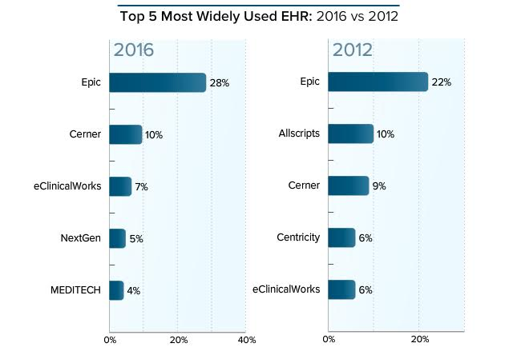
Medscape Survey

Slide 195
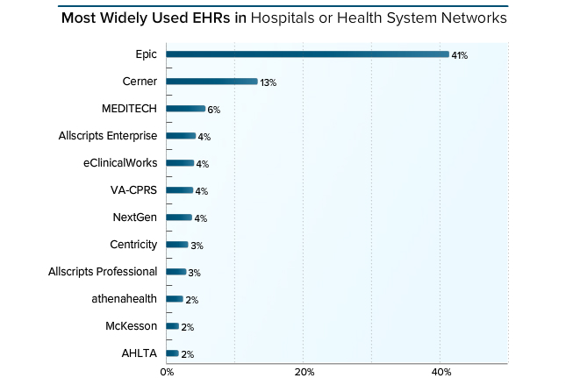
Medscape Survey

Slide 196
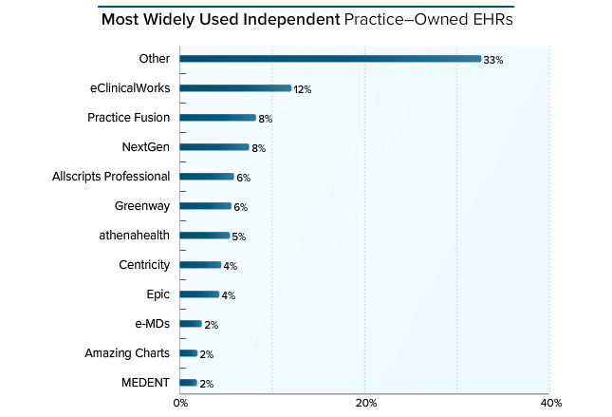
Medscape Survey

Slide 197
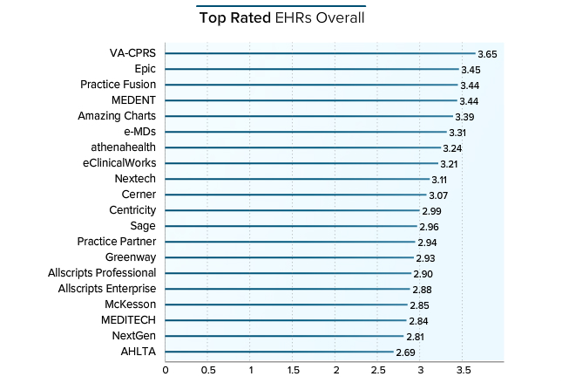
Medscape Survey
The scale used in this report is 1 to 5, where 1 = poor and 5 = excellent

Slide 198
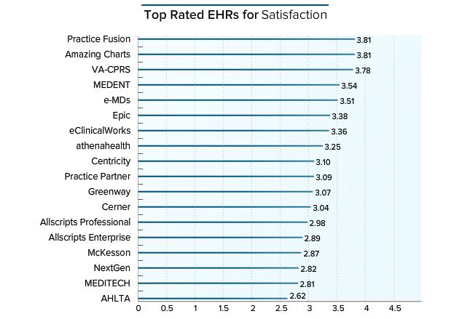
Medscape Survey

Slide 199
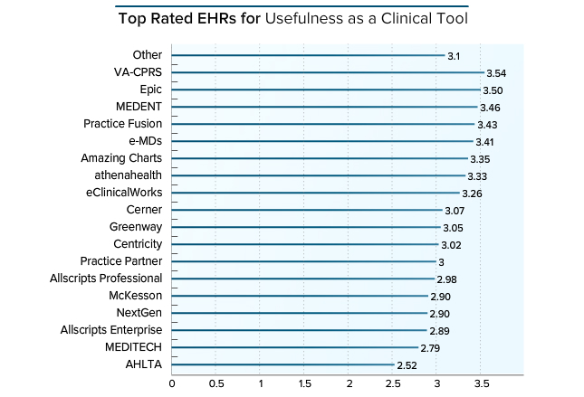
Medscape Survey

Slide 200
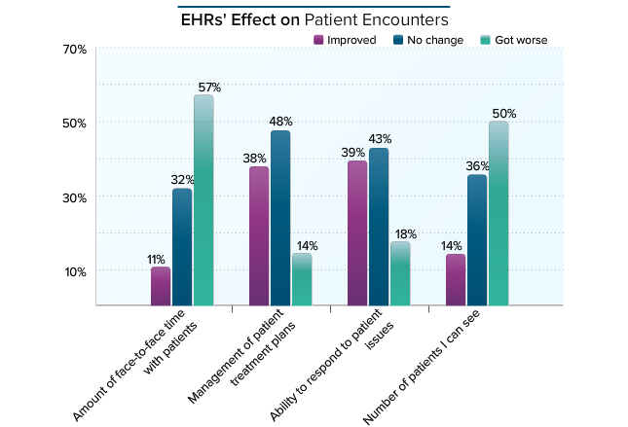
Medscape Survey

Slide 201
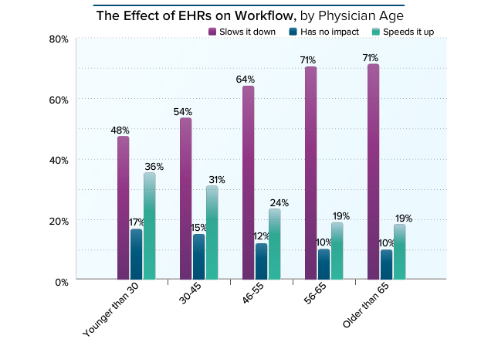
Medscape Survey

Slide 202
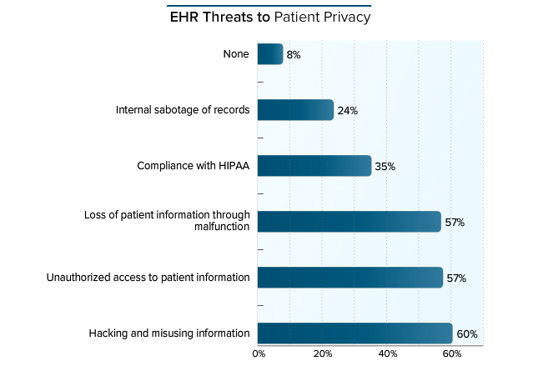
Medscape Survey

Slide 203
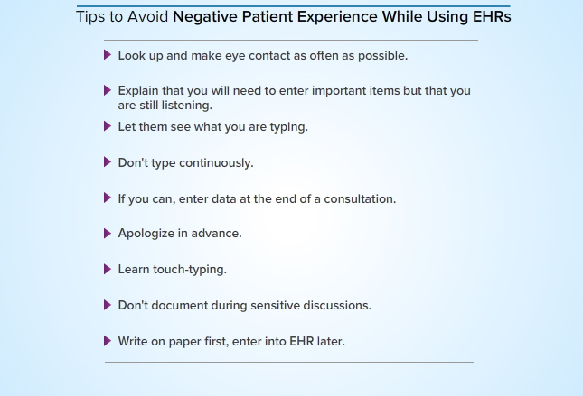
Medscape Survey

Slide 204
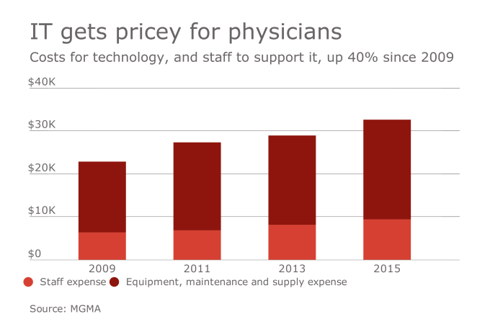
Costs of Health IT

Slide 205

Beyond a Web Page
Reducing costs
“Who is your cheapest employee?”

Slide 206
Office Points of Contact With a Patient
Scheduling appointment by telephone
Greeting the patient upon arrival
Registration of new patient
Calling patient out of reception area
Examination/treatment
Patient education
Reappointment/fee presentation
Goodbye
Accounts receivable follow-up

Slide 207

Patient Access: Administrative
Patient registration - update
Report results
Schedule appointments
Automate typical phone calls online
e-reminders
Statements/Payments

Slide 208
Patient Access: Clinical
Online support groups
Doctor online sessions
Rx refills
Ordering supplies, educational material
Nurse eTriage
Some plans now paying for online care

Slide 209
Patient Access
What do they want?
Ask them
Get e-mail addresses
What web pages do they look at/use?

Slide 210
Demand for Self-Care Supported Online
How helpful would disease management software and Internet reporting to your doctor be?
Responded “Very Helpful”
Source: HarrisInteractive.com

Slide 211
Making Money Off of Other People and Things
Clinical trials - www.clinicaltrials.gov or www.centerwatch.com
DOT physicals; drug screens; etc.
NPs and PAs - net profit of $40-60,000/year/position
Ancillaries
Home visits

Slide 212




Resources
http://www.kff.org/
http://www.commonwealthfund.org/
MedScape
http://www.medscape.com
http://www.healthleadersmedia.com/index.cfm
http://www.fiercepracticemanagement.com/

Slide 213

THANK YOU!
mfleischman@stroudwater.com
770-913-9094

