Slide 1
2018 Updates and Trends
Current Climate and Implications
John Behn, MPA
Laurie Daigle, CPC

Slide 2
Impact of Provider Based Clinics on CAHs
CMS is interpreting provider-based clinics as extensions of the hospital they bill Medicaid and Medicare under the hospital license.
CMS is pursuing a policy stating an HOPD is an extension of a hospital
CAHs within 35 miles of an HOPD is in violation of the rules.
A “Test Case”: Curry General Hospital in Oregon has until April, 2019 to prove it is a “necessary provider” or the hospital will lose its CAH designation.
http://www.currypilot.com/news/localnews/6175169-151/curry-general-could-lose-critical-access-status

Slide 3
OIG and Provider Based Clinics
Half of hospitals own at least one provider-based facility
Voluntary Attestation
CMS cannot identify on/off campus Provider Based billing
More than 75% of 50 hospitals reviewed who did not attest did not meet at least one requirement
Facilities may be receiving overpayments
Beneficiaries may be overpaying

Slide 4
New CMS Enforcement on ER Physician Standby Costs Could Threaten CAHs
CMS has recently begun to enforce a provision of Provider Reimbursement Manual §2109 indicating that in order for physician availability services costs to be allowable, the provider must demonstrate that it explored alternative methods for obtaining physician coverage but was unable to do so
In order to claim Emergency Room Availability costs, the provider must have certain specific documentation, including evidence that the provider explored alternative methods for obtaining emergency physician coverage before agreeing to physician compensation for availability services
For example, advertisements for emergency room physicians to be compensated on a fee-for-service basis placed in appropriate professional publications
CMS Auditors are enforcing this regulation in 2015 desk reviews
Lack of the above documentation could expose hospitals to Medicare audit risk, and place Medicare reimbursement in jeopardy, threatening the viability of many CAHs

Slide 5
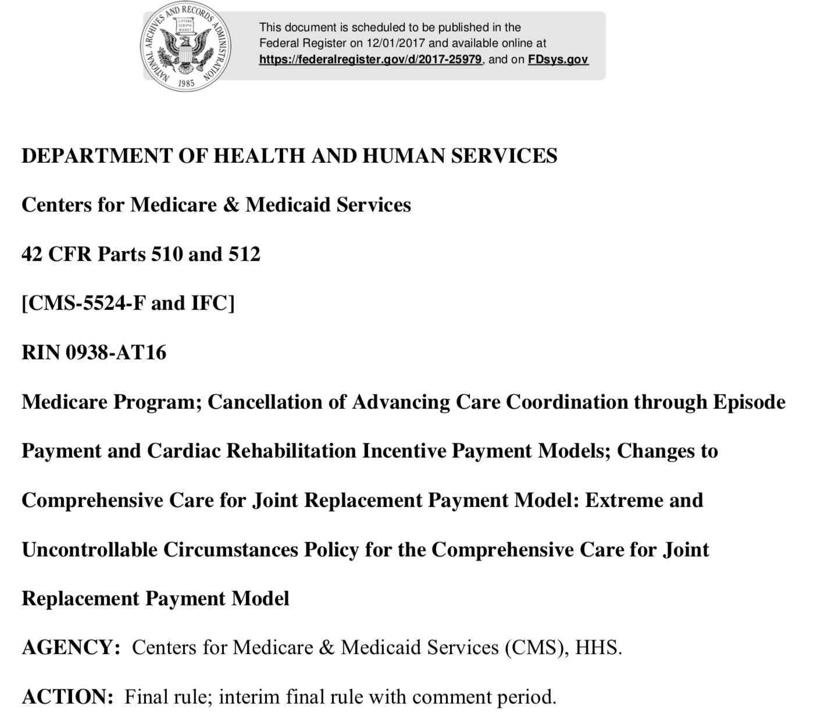
Cancellation of Episode Payment and Cardiac Rehab Incentive Payment Final Rule 12-01-2017
Specific changes to the program effective 1/1/2018 include
Cancels the Episode Payment Models (EPMs) and Cardiac Rehabilitation Incentive Payment model
Finalizes proposal to make participation voluntary for all hospitals in approximately ½ of the geographic area selected for participation in the Comprehensive Care for Joint Replacement (CJR) model, as well as all low volume and rural hospitals in all geographic service areas

Slide 6
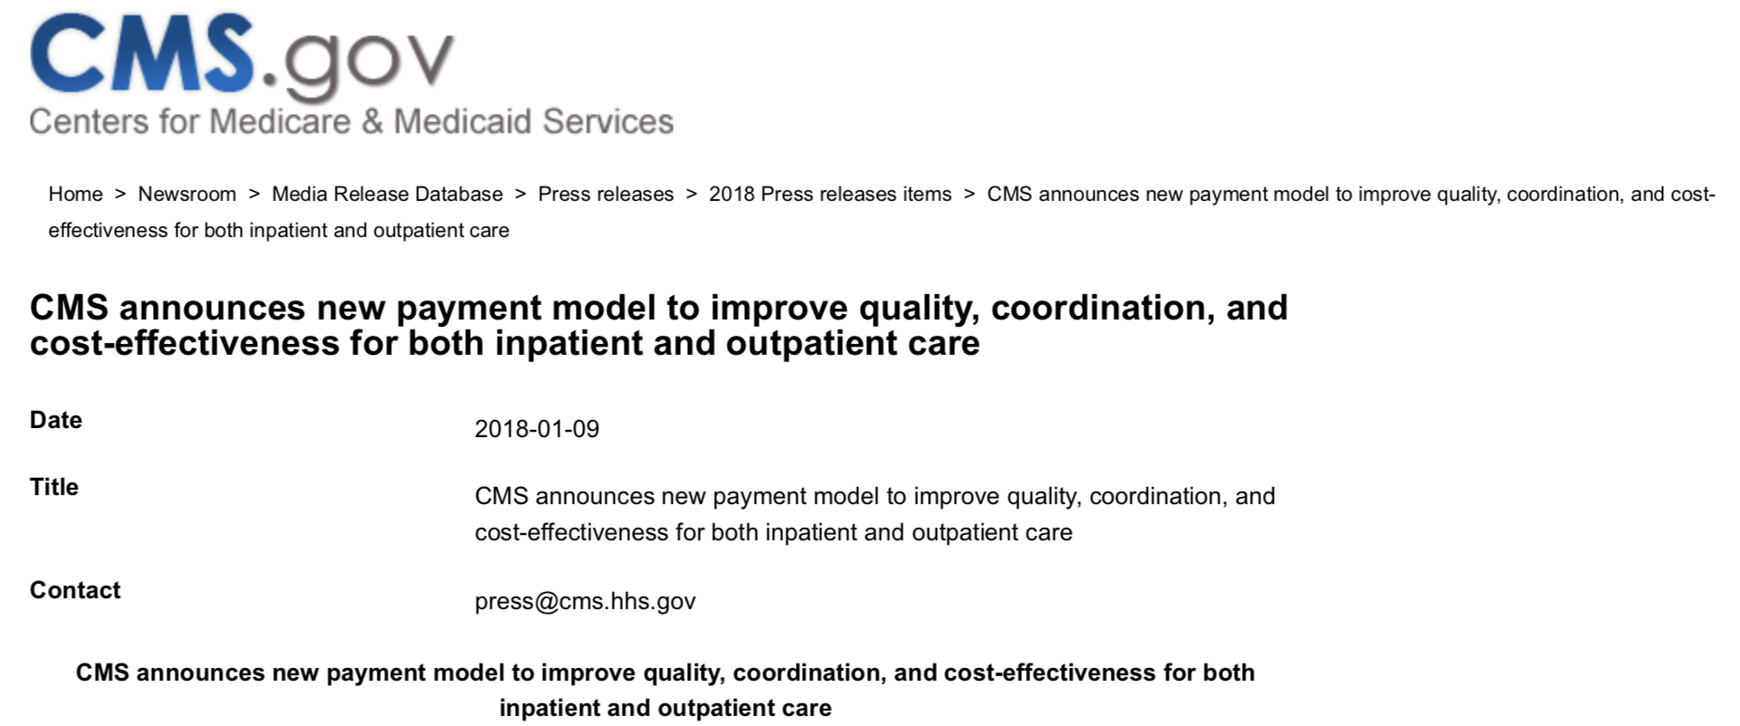
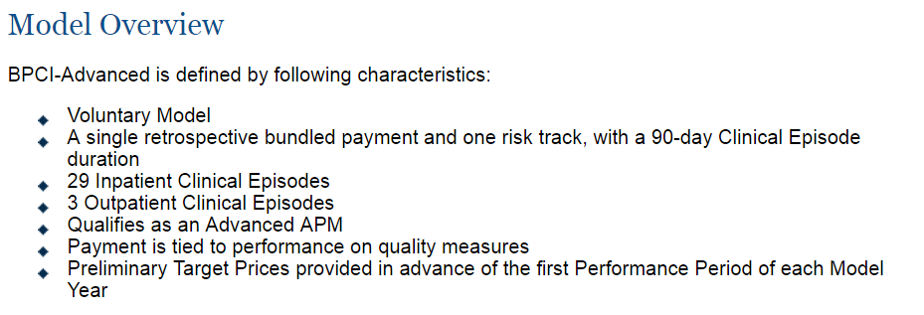
CMS Launches New Voluntary Bundled Payment Model 1/9/2018

Slide 7
CMS Allows Work Requirements for Medicaid Eligibility (1/11/2018)
CMS issued new guidance allowing states to reshape their Medicaid programs, including work/volunteering requirements for beneficiaries
Despite impending legal challenges, Administrator Seema Verma believes that "The 1115 [statute] gives broad authority to the secretary to approve state experiments and programs that promote the objectives of the Medicaid program,“ citing studies showing that employment benefits a person’s health
Arizona, Arkansas, Indiana, Kansas, Kentucky, Maine, New Hampshire, North Carolina, Utah and Wisconsin have applied for Section 1115 waivers.
Kentucky’s was accepted on 1/12/18
Indiana approved February 2nd
Arkansas accepted March 5
Further proposed to limit Medicaid expansion to 100% of the poverty limit
"Work requirements impose an additional, unnecessary barrier to allowing patients access to vital healthcare services for people who need access and coverage the most," Dr. Jack Ende, president of the American College of Physicians
Sources: CMS.gov, SMD: 18-002 RE: Opportunities to Promote Work and Community Engagement Among Medicaid Beneficiaries https://www.medicaid.gov/federal-policy-guidance/downloads/smd18002.pdf; Modern Healthcare, CMS maintains Medicaid work requirements can withstand legal challenges, Matthew Weinstock and Virgil Dickson, 1/11/18 http://www.modernhealthcare.com/article/20180111/NEWS/180119978?utm_source=modernhealthcare

Slide 8
Tax Cuts and Jobs Act (12/19/2017)
The final version of the Tax Cuts and Jobs Act drops the elimination of private-activity bonds (PABs), which many small and rural hospitals rely on to provide infrastructure funding, but still carries some bad financial news for not-for-profit hospitals
Provisions impacting not-for-profit hospitals include
Creation of a 21 percent excise tax on any compensation over $1 million paid to their five highest-paid employees—with a carve-out for certain medical professionals
Implementation of a new 1.4 percent excise tax for endowments
A requirement that unrelated business income tax be calculated separately for each business, meaning losses could not cover the taxes on gains from other lines of businesses
The end of the ability of not-for-profit hospitals to undertake a onetime advance refunding of a bond
The bill also
Repeals the ACA’s individual mandate
Reduces the medical deduction threshold to 7.5 percent of gross income for the 2017 and 2018 tax years, then returns it to the 10 percent threshold that the ACA established in 2010
For-profit hospitals are expected to largely benefit from the sharp reduction of the corporate tax rate and repeal of the corporate alternative minimum tax
Sources: HFMA, Tax-Exempt Bonds Preserved in Final Tax Bill, Rich Daly, 12/19/18

Slide 9
Bipartisan Budget Act of 2018
Congress passed the Bipartisan Budget Act, which includes the most significant health legislation since the 21st Century Cures Act
The healthcare package includes provisions that come as a relief to rural providers and those that serve seniors and other vulnerable populations, such as
An extra four years of funding for the Children's Health Insurance Program (CHIP)
A repeal of the Affordable Care Act's Independent Payment Advisory Board
A provision to accelerate the closure of what's known as the Medicare Part D "donut hole" for seniors, which increases the discount drug manufacturers have to give beneficiaries from 50% to 70%
$6 billion in funding over two years to address the opioid crisis
Funding for community health centers and expired Medicare programs for two years
A two-year delay to the already-in-effect payment cuts to Medicaid disproportionate-share hospitals
The Chronic Care Act, which opens up new flexibilities for Medicare Advantage and care for chronically ill Medicare beneficiaries
A provision to slow implementation of the Merit-based Incentive Payment System that makes providers accountable for Medicare savings
"Congress made the right choice this morning for patients and communities by voting to halt damaging cuts to hospitals that care for low-income working families and others who face financial challenges"
– Dr. Bruce Siegel, CEO of America's Essential Hospitals, which represents the nation's safety-net facilities
Source: Modern Healthcare, Beacon of light: Healthcare additions in budget law pleasantly surprise providers, Susannah Luthi, 2/9/18 http://www.modernhealthcare.com/article/20180209/NEWS/180209895/beacon-of-light-healthcare-additions-in-budget-law-pleasantly

Slide 10
Bipartisan Budget Act of 2018: Impact on Healthcare
CHIP
Extends funding for CHIP for four additional years (FY24 through FY27)
Extends the Child Enrollment Contingency Fund, the Qualifying States Option, the Express Lane Eligibility option, and continues to require states to maintain eligibility levels for CHIP children through FY27
Extends funding for the pediatric quality measures program and requires states to report on a core set of pediatric quality measures
Extends funding for the outreach enrollment grants at $48 million for FY24 through FY27 and allows a portion of the funds to be used for evaluation and technical assistance
Medicare Extenders
Two-year extension of the Geographic Practice Cost Indices (GPCI) floor through December 31, 2019
Permanent repeal of the Medicare payment cap for therapy services beginning on January 1, 2018
Five-year extension with reforms of the home health rural add-on until October 1, 2022
Five-year extension of the 2-percent urban, 3-percent rural, and 22.6-percent super rural ground ambulance add-on payments until December 31, 2022
Five-year extension of the Medicare low-volume hospital payments through September 30, 2022
Five-year extension of the Medicare-dependent hospital (MDH) program through September 30, 2022
Source: Baker Donelson, Bipartisan Budget Act of 2018: Major Impacts on Health Care, Sheila P. Burke, Amit Rao, and Sam E. Sadle, 2/9/18, https://www.bakerdonelson.com/bipartisan-budget-act-of-2018-major-impacts-on-health-care

Slide 11
Bipartisan Budget Act of 2018: Impact on Healthcare
CHRONIC Care Act
Provides Accountable Care Organizations (ACOs) the ability to expand the use of telehealth services
Allows Medicare ACOs to have beneficiaries assigned prospectively at the beginning of a performance year.
Beneficiaries may voluntarily align to an ACO in which their main primary care provider is participating.
Certain two-sided risk ACOs may make incentive payments to all assigned beneficiaries who receive qualifying primary care services
Directs Report to Congress within 18 months
GAO - The prevalence and effectiveness of Medicare and other payer medication synchronization programs
HHS Secretary - Evaluate long-term cost drivers to Medicare, including obesity, tobacco use, mental health conditions, and other factors that may contribute to the deterioration of health conditions among individuals with chronic conditions
Beginning 2020- Part D plan sponsor may submit a request to CMS for claims data under Parts A and B. to optimize therapeutic outcomes through improved medication use; improving care coordination and prevent adverse health outcomes

Slide 12
Bipartisan Budget Act of 2018: Impact on Healthcare
CHRONIC Care Act
Extends and expands the at-Home demonstration by two years,
Increases cap on participating beneficiaries from 10,000 to 15,000, and gives practices three years to generate savings against their spending targets
Permanently reauthorizes Medicare Advantage (MA) Special Needs Plans (SNPs) for vulnerable populations, provides reforms to Dual-Eligible SNPs (D-SNPs) and Chronic Condition SNPs (C-SNPs)
Expands the testing of the Center for Medicare & Medicaid Innovation (CMMI) Value-Based Insurance Design Model to allow MA plans in any state to participate in the model by 2020
Effective 2020, allows MA plans to
Offer targeted supplemental benefits to chronically ill enrollees
Include telehealth benefits in their annual bid for services that receive payment under Part B

Slide 13
Bipartisan Budget Act of 2018: Impact on Healthcare
Medicare Part B Improvement Act
Medicare payment for transition and education for home infusion beginning in 2019
Streamlines and clarifies rules for providers regarding compliance with the Stark Law
Child and Family Services and Supports Extenders
Extends the Maternal, Infant, and Early Childhood Home Visiting (MIECHV) Program at current-law level of $400 million per year for FY18 through FY22
Allows HHS to continue to use Census Bureau data for states, ensuring appropriate alternative data source when determining funding for territories
Extends the Health Workforce Demonstration Project, which provides funding to help low-income individuals obtain education and training in high-demand, well-paid health care jobs, through FY19 at the current funding level
Allows dialysis providers to seek outside accreditation, from organizations approved by Medicare, to bill Medicare for end-stage renal disease (ESRD) services
Covers speech-generating devices under durable medical equipment permanent under the Medicare program
Source: Baker Donelson, Bipartisan Budget Act of 2018: Major Impacts on Health Care, Sheila P. Burke, Amit Rao, and Sam E. Sadle, 2/9/18, https://www.bakerdonelson.com/bipartisan-budget-act-of-2018-major-impacts-on-health-care

Slide 14
Bipartisan Budget Act of 2018: Impact on Healthcare
Miscellaneous Health Care Policies
Allows mid-level providers to supervise cardiac, intensive cardiac, and pulmonary rehabilitation programs beginning January 1, 2024
Permits PAs to serve as the attending physician for hospice patients
Extends the blended site neutral payment rate for certain long term care hospital discharges for two additional years through FY19
Repeals the Independent Payment Advisory Board
Implement a HH 30-day episode for payment, beginning January 1, 2020, based on patient condition not number of treatments
Source: Baker Donelson, Bipartisan Budget Act of 2018: Major Impacts on Health Care, Sheila P. Burke, Amit Rao, and Sam E. Sadle, 2/9/18, https://www.bakerdonelson.com/bipartisan-budget-act-of-2018-major-impacts-on-health-care

Slide 15
Bipartisan Budget Act of 2018: Impact on Healthcare
Public Health Programs
Mandatory funding for community health centers from $3.6 billion per year to $3.8 billion per year for FY18 and $4 billion for FY19
$3 billion per year in FY18 and FY19 to combat the opioid epidemic
$1 billion per year in FY18 and FY19 for NIH research
Extends mandatory funding for the National Health Service Corps
Extends and increases funding for the Teaching Health Center Graduate Medical Education Program from $60 million per year to $126.5 million per year in FY18 and FY19.
Requires Congress to provide a report on the direct and indirect expenses associated with training residents at teaching health centers.
Support existing approved teaching health centers,
Award grants to establish new teaching health centers,
Prioritize qualified teaching health centers located in rural areas or serve a health professional shortage area or a medically underserved community.

Slide 16
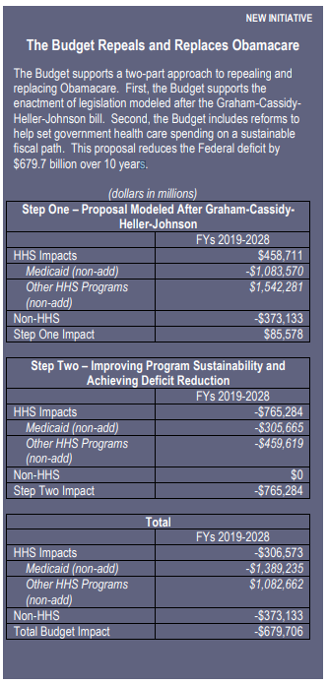
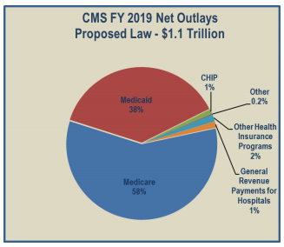
Administration’s FY2019 Budget (2/12/2018)
Sheds light on the Trump administration’s priorities
Eliminate the ACA
Deep cuts to Medicaid, SNAP, and other social assistance programs
Increased funding to battle the opioid crisis and lowering prescription drug prices for seniors
Sources: Modern Healthcare, Trump calls for $18 billion cut to HHS funding, Virgil Dickson, 2/12/18 http://www.modernhealthcare.com/article/20180212/NEWS/180219983; Center on Budget and Policy Priorities, Trump Budget Deeply Cuts Health, Housing, Other Assistance for Low- and Moderate-Income Families, Sharon Parrott Aviva Aron-Dine, Dottie Rosenbaum, Douglas Rice, Ife Floyd, Kathleen Romig, 2/14/18, https://www.cbpp.org/research/federal-budget/trump-budget-deeply-cuts-health-housing-other-assistance-for-low-and; Department of Health and Human Services FY 2019 Budget in Brief, https://www.hhs.gov/sites/default/files/fy-2019-budget-in-brief.pdf; CHEAC.org, President Trump Releases FY 2019 Budget, 2/16/18 http://cheac.org/2018/02/16/president-trump-releases-fy-2019-budget/

Slide 17
Administration’s FY19 Budget (2/12/2018) (continued)
Cuts Medicaid and subsidies for private coverage in the marketplace by $763 billion over the next decade, with cuts reaching $172 billion annually by 2028
Embraces the ACA Graham-Cassidy ACA repeal bill, then cuts funding for health coverage programs well below the already shrunken levels in that bill
Eliminates the ACA’s Medicaid expansion and subsidies, replacing this funding with a block grant whose funding would fall further and further behind current-law funding each year
Imposes a per capita cap on federal Medicaid funding for seniors, people with disabilities, and families with children
Cuts $878 million from the CDC discretionary budget
Eliminates the Preventative Health and Human Services Block Grant
Modifies Medicare prescription drug benefits to lower drug costs to beneficiaries and creates an out-of-pocket maximum
Provides $10 billion in funds to address the ongoing opioid crisis through prevention and treatment services
Cuts $688 million from the Substance Abuse and Mental Health Services Administration (SAMHSA)
Eliminates the Agency for Healthcare Research and Quality (AHRQ) which is tasked with researching and improving the effectiveness of health services; eliminates various health care training and workforce programs
Reduces Supplemental Nutrition Assistance Program (SNAP) vouchers and introduces “USDA food packages” that would include shelf-stable food products and canned goods
Eliminates the Community Services Block Grant which provides $700 million in grants for various state-based health care, food, and workforce programs
Sources: Modern Healthcare, Trump calls for $18 billion cut to HHS funding, Virgil Dickson, 2/12/18 http://www.modernhealthcare.com/article/20180212/NEWS/180219983; Center on Budget and Policy Priorities, Trump Budget Deeply Cuts Health, Housing, Other Assistance for Low- and Moderate-Income Families, Sharon Parrott Aviva Aron-Dine, Dottie Rosenbaum, Douglas Rice, Ife Floyd, Kathleen Romig, 2/14/18, https://www.cbpp.org/research/federal-budget/trump-budget-deeply-cuts-health-housing-other-assistance-for-low-and; Department of Health and Human Services FY 2019 Budget in Brief, https://www.hhs.gov/sites/default/files/fy-2019-budget-in-brief.pdf; CHEAC.org, President Trump Releases FY 2019 Budget, 2/16/18 http://cheac.org/2018/02/16/president-trump-releases-fy-2019-budget/

Slide 18
Proposed Rule Increases Access to Short-Term Health Insurance (2/20/2018)
Proposed rule by Executive Order – allow consumers to buy Short Term Health Plans any period of less than 12 months, instead of current 3 month maximum
Does not required to comply with federal requirements for individual health insurance coverage,
Insurers can reject applicants with preexisting medical problems from short-term plans, and plans may not cover services such as behavioral health and substance abuse
As a result, the proposed rule also noted that some people who switch to them from ACA coverage may see “reduced access to some services,” and “increased out of pocket costs, possibly leading to financial hardship.”
The proposed rule may also cause ACA insurance premiums to rise
Sources: HHS.gov, Trump Administration works to give relief to Americans facing high premiums, fewer choices
https://www.cms.gov/Newsroom/MediaReleaseDatabase/Fact-sheets/2018-Fact-sheets-items/2018-02-20.html; Kaiser Health News, Trump Administration Proposes Rule To Loosen Curbs On Short-Term Health Plans https://khn.org/news/trump-administration-unveils-proposed-rule-to-loosen-restrictions-on-short-term-health-plans/

Slide 19
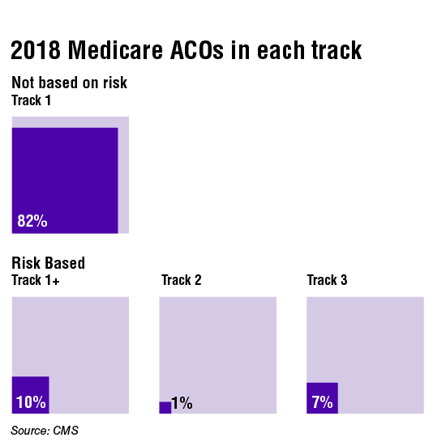
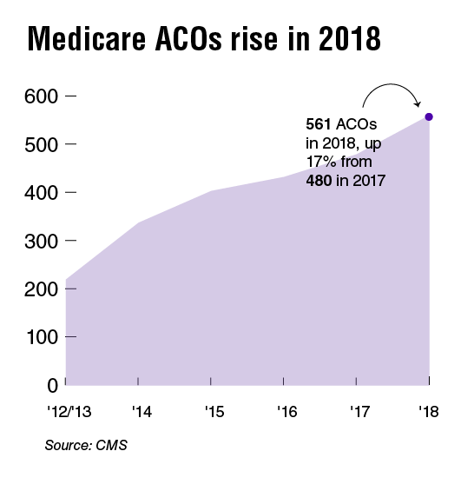
More Medicare ACOs In Risk-Based Contracts in 2018
Per CMS, about 18% of Medicare shared savings program ACOs will participate in a downside risk contract in 2018, up from just 9% in 2017
Of 561 Medicare ACOs in the program this year, 101 are in a downside risk-based contract. Of those 101, 55, have joined Track 1+, the newest risk model that doesn't require ACOs to take on as much financial risk as Tracks 2 or 3 of the program.
The number of ACOs overall in the program rose by 81 from 480 in 2017 to 561 this year. About 10.5 million Medicare beneficiaries now receive care from a clinician in a Medicare ACO, up from 9 million beneficiaries last year.
Source: Modern Healthcare, More Medicare ACOs will take on risk in 2018, Maria Castellucci, 1/9/18
http://www.modernhealthcare.com/article/20180109/NEWS/180109910?utm_source=modernhealthcare

Slide 20
Medicare ACOs Cut $1B Over Three Years
"While policy changes may be warranted, ACOs show promise in reducing spending
and improving quality," the OIG report concluded.
Accountable care organizations participating in the CMS' Medicare shared-savings program reduced spending by about $1 billion in three years per the HHS OIG
Most of the 428 ACOs in the first three years of the shared-savings program reduced Medicare spending compared to their benchmarks, and a small group of those ACOs produced "substantial" savings
82% of the ACOs also improved the quality of care they provided, based on data from the CMS on 33 individual quality measures, outperforming fee-for-service providers in 81% of the quality measures
Source: Medicare shared-savings ACOs cut $1 billion in
costs over three years, Shelby Livingston | August 29, 2017, modernhealthcare.com
OIG Report: https://oig.hhs.gov/oei/reports/oei-02-15-00450.asp

Slide 21
MIPS
January 10, 2018 - MedPAC voted 14-2 to repeal and replace MIPS, a Medicare payment system intended to improve care quality
Under MACRA, providers must currently follow one of two payment tracks: MIPS or Advanced APMs
Submitted report to Congress March 15, 2018 including proposal to eliminate MIPS
CMS estimates that up to 418,000 physicians will be submitting 2017 MIPS data
Hospital and provider groups push back
Propose voluntary value program (VVP)
"I think they're wrong," Dr. Stephen Epstein, an emergency physician at Beth Israel Deaconess Medical Center in Boston said in a tweet. "MIPS could change practice patterns by aligning incentives with performance measures."
Source: Modern Healthcare, MedPAC votes 14-2 to junk MIPS, providers angered, Virgil Dickson, 1/11/2018
http://www.modernhealthcare.com/article/20180111/NEWS/180119963/providers-angry-at-medpac-vote-to-junk-mips

Slide 22
Modernize RHC Provisions -
The National Advisory Committee on Rural Health and Human Services (NACRHHS)’s December 2017 Policy Brief focused on recommendations to modernize Rural Health Clinic provisions. Recommendations to the Secretary of HHS include:
Payment Options
Adjust the payment cap for RHCs, creating a formula for payments that ties payment cap increases to the current average cost per visit for RHCs currently under the cap.
Program Support
Provide grants to State Offices of Rural Health to support a state program that would provide technical assistance on quality reporting and other services to support the transition of RHCs to value-based care.
Services
Allow RHCs to be distant site providers for telehealth services under Medicare.
Allow all RHC (non-physician) providers to order hospice and home health services and also allow RHC providers to be attending clinicians for hospice services.
Workforce
Allow masters trained behavioral health providers to be RHC practitioners for purposes of Medicare reimbursement if they are licensed to provide those services in their state.
Lab Requirements
Publish a RFI to RHCs on current RHC laboratory needs. Based on this information, use the authority granted in Public Law 95210 to review and modernize lab requirements to reduce regulatory burden and allow flexibility.
Source: National Advisory Committee On Rural Health and Human Services: Modernizing Rural Health Clinic Provisions Policy Brief and Recommendations, December 2017 https://www.hrsa.gov/sites/default/files/hrsa/advisory-committees/rural/publications/2017-Rural-Health-Clinic-Provisions.pdf

Slide 23
Reinventing Rural Healthcare - 1/2018
Bipartisan Policy Center (BPC) and Center for Outcomes Research and Education (CORE) spoke with over 90 national thought leaders on current state of rural health care in upper Midwest. Key takeaways include:
Rightsizing
Not all communities need a CAH; communities should tailor available services to the needs of the community
Rural Funding Mechanisms
Funding mechanisms and payment models should reflect the specific challenges that rural areas face – such as small population size and high operating costs
Primary Care Workforce
With appropriate services and funding, rural communities can build sustainable diverse workforces. Alternative providers practicing at the top of their license. Communities should start young and think local for recruitment
Telemedicine Services
Telemedicine is a tool that can be used to support both rural patients and providers. Telemedicine may prove to be critical in improving provider recruitment.
Source: Bipartisan Policy Center: Reinventing Rural Healthcare: A Case Study of Seven Upper Midwest States, January 2018

Slide 24
RHC Care Management Services
Effective January 1, 2018, RHCs can receive payment for Chronic Care Management (CCM) or general Behavioral Health Integration (BHI) services
20 minutes or more of CCM or general BHI services furnished and G0511 is billed either alone or with other payable services on an RHC claim
Effective January 1, 2018, RHCs can receive payment for psychiatric Collaborative Care Model (CoCM) services
70 minutes or more of initial psychiatric CoCM services or 60 minutes or more of subsequent psychiatric CoCM services furnished and G0512 is billed either alone or with other payable services on an RHC claim.

Slide 25
Insurers’ Disruptive Growth Strategies Pose Threat to Hospitals
Per Moody’s, health insurers are engaging in new, disruptive growth strategies aimed at lowering healthcare spending that threaten the credit quality of not-for-profit hospitals
Hospitals will be vulnerable to direct competition as insurers purchase providers. The purchase of these providers (the CVS-Aetna merger is a prime example) move care away from higher-cost hospital settings.
Health insurers are moving to value-based payment models that emphasize quality over quantity of care, leaving hospitals with less volume. By owning physicians, insurers can take greater control of premiums and expenses, including those related to hospital care.
Hospital revenues and margins will come under additional pressure as insurers gain negotiating power. When negotiating contracts, insurers will benefit from increased scale. At the same time, hospitals are becoming increasingly reliant on commercial payments to cover operating costs as governmental payors reduce rates. As insurers impose more restrictions on what types of care they will provide coverage for, hospitals will be vulnerable to rising bad debt levels and fewer emergency room visits.
Source: Moody’s Investors Service, Sector in-Depth: Not-for-profit and public healthcare – US. Hospitals face new threat from health
insurers’ disruptive growth strategies

Slide 26
Insurers’ Disruptive Growth Strategies Pose Threat to Hospitals
Berkshire Hathaway, Amazon and JPMorgan Chase create a new company with the goal of providing high-quality health care for their U.S. employees at a lower cost
Will Amazon move into the mail-order drug market?
Walmart co-branded Medicare drug plan with Humana
Cigna-Express Scripts deal moving forward
CVS Health's bid for Aetna moving forward

Slide 27
Insurers’ Disruptive Growth Strategies Pose Threat to Hospitals

Slide 28
OIG Looks at Physical Therapy
March 2018 -Sixty-one percent of Medicare claims for outpatient physical therapy services that we reviewed did not comply with Medicare medical necessity, coding, or documentation requirements
By eliminating improper payments, Medicare could have saved an estimated $367 million on services provided by outpatient physical therapists from July 1 through December 31, 2013.
https://oig.hhs.gov/oas/reports/region5/51400041RIB.pdf

Slide 29
2019 IPPS Proposed Rule
Price Transparency
Proposal requires hospitals to publish a list of their standard charges online
Out-of-network billing,
Radiologists and anesthesiologists,
ED Physicians
Providers Based
Unexpected facility fees

Slide 30
2019 IPPS Prosed Rule - Meaningful Use
Change name of Meaningful Use HER incentive to “Promoting Interoperability”
Eliminates, 19 measures
“Deduplicates” 21 new measures
One new measure
Proposed effective 2021

Slide 31
2019 IPPS Prosed Rule
Remove requirement
Written inpatient admission orders as a condition of payment
Specific language indicating where certification can be found in the record
ICD-10 PCS codes
247 new codes
139 revised codes
49 deleted codes

Slide 32
Medicare Transmittals

Slide 33
New Medicare HCPCS for Remicade
Effective for claims with dates of service on or after April 1, 2018, HCPCS level II code Q5102 (injection, infliximab, biosimilar, 10 mg) will be replaced with the following:
Q5103 Injection, infliximab-dyyb, biosimilar, (inflectra), 10 mg
Q5014 Injection, infliximab-abda, biosimilar, (renflexis), 10 mg
J1745 Infliximab not biosimil 10mg has not been changed

Slide 34
CLIAA Waved Discontinued
CLIAA Waived Tests Discontinued 12/31/17
83499 – Hydroxyprogesterone, 20 (synthetic hormone) level | 86822 - Lymphocyte culture primed
84061 - Phosphatase (enzyme) level for forensic examination | 87277 - Legionella micdadei ag if
86185 - Immunologic analysis for detection of antigen | 87470 - Bartonella dna dir probe
86243 - Measurement of Fc receptor | 87477 - Lyme dis dna quant
86378 - Migration inhibitory factor | 87515 - Hepatitis b dna dir probe
86729 - Lympho venereum antibody | 88154 - Cytopath c/v select

Slide 35
CLIAA Waved Tests Added
81105 - Human Platelet Antigen 2 genotyping (HPA-2) | 81231 - CYP3A5 (cytochrome P450 family 3 subfamily A member 5) | 81362 - HBB (hemoglobin, subunit beta)
81106 - Human Platelet Antigen 3 genotyping (HPA-3) | 81247 - G6PD (glucose-6-phosphate dehydrogenase) | 81363 - HBB (hemoglobin, subunit beta)
81107 - Human Platelet Antigen 4 genotyping (HPA-4) | 81248 - G6PD (glucose-6-phosphate dehydrogenase) | 81364 - HBB (hemoglobin, subunit beta)
81108 - Human Platelet Antigen 5 genotyping (HPA-5) | 81249 - G6PD (glucose-6-phosphate dehydrogenase) | 81448 - Hereditary peripheral neuropathies (eg, Charcot-Marie-Tooth, spastic paraplegia)
81109 - Human Platelet Antigen 6 genotyping (HPA-6w) | 81258 - HBA1/HBA2 (alpha globin 1 and alpha globin 2) | 81520 - Oncology (breast)
81110 - Human Platelet Antigen 9 genotyping (HPA-9w) | 81259 - HBA1/HBA2 (alpha globin 1 and alpha globin 2) | 81521 - Oncology (breast)
81111 - Human Platelet Antigen 15 genotyping (HPA-15) | 81269 - HBA1/HBA2 (alpha globin 1 and alpha globin 2) | 81541 - Oncology (prostate)
81112 - IDH1 (isocitrate dehydrogenase 1 [NADP+], soluble) | 81283 - IFNL3 (interferon, lambda 3) | 81551 - Oncology (prostate)
81120 - IDH2 (isocitrate dehydrogenase 2 [NADP+]) | 81334 - RUNX1 (runt related transcription factor 1) | 86008 - Allergen specific IgE; quantitative or semiquantitative, recombinant or purified component, each)
81121 - IDH2 (isocitrate dehydrogenase 2 [NADP+], mitochondrial) | 81335 - TPMT (thiopurine S-methyltransferase) | 86794 - Antibody; Zika virus, IgM)
81175 - ASXL1 (additional sex combs like 1, transcriptional regulator) | 81346 - TYMS (thymidylate synthetase) | 87634 - Infectious agent detection by nucleic acid (DNA or RNA)
81176 - ASXL1 (additional sex combs like 1, transcriptional regulator) | 81361 - HBB (hemoglobin, subunit beta) | 87662 - Infectious agent detection by nucleic acid (DNA or RNA)
81230 - CYP3A4 (cytochrome P450 family 3 subfamily A member 4)

Slide 36
NDC Updates 1/1/2018
NCD20.9 Artificial Hearts | NCD160.27 Transcutaneous Electrical Nerve Stimulation (TENS) for Chronic L
NCD20.9.1 Ventricular Assist Devices (VADs) | NCD190.3 Cytogenetic Studies
NCD20.16 Cardiac Output Monitoring by Thoracic Electrical Bioimpedance (TEB) | NCD190.11 Home Prothrombin Time/International Normalized Ratio (PT/INR) for
NCD20.29 Hyperbaric Oxygen (HBO) Therapy | NCD220.4 Mammograms
NCD20.30 Microvolt T-Wave Alternans (MTWA) | NCD220.6.17 Positron Emission Tomography (FDG) for Solid Tumors
NCD20.33 Transcatheter Mitral Valve Repair (TMVR) | NCD260.1 Adult Liver Transplantation
NCD40.1 Diabetes Self-Management Training (DSMT) | NCD220.13 Percutaneous Image-Guided Breast Biopsy
NCD80.2, 80.2.1, 80.3, 80.3.1 Photodynamic Therapy, OPT, Photosensitive Drugs, | NCD270.1 Electrical Stimulation/Electromagnetic Therapy (ES/ET) for Wounds
NCD110.18 Aprepitant | NCD270.3 Blood-Derived Products for Chronic Non-Healing Wounds
NCD110.21 Erythropoiesis Stimulating Agents (ESAs) | NCD80.11 Vitrectomy
NCD110.23 Stem Cell Transplants

Slide 37
Global Surgical Days for Critical Access Hospital (CAH) Method II
CAH Method II providers should follow the same guidelines as per Part B physician services
No new policy
CWF improves the implementation of existing Medicare payment policies.

Slide 38
QMB Program
New RA reason codes to improve tracking
Persons enrolled in the QMB program have no legal liability to pay Medicare providers for Medicare Part A or Part B costsharing.
Provider cannot collect this amount from the patient.
May be billed to subsequent payer

Slide 39
United Health
United health will begin using the Optum Emergency Department Claim (EDC) Analyzer tool, which determines appropriate E/M coding levels based on data such as the patient’s presenting problem, diagnostic services performed during the visit and associated patient co-morbidities:
Applies to claims with dates of service on or after March 1, 2018
Level 4 and 5 E/M codes for members of the affected plans
May deny or down-code services deemed to be up-coded
Will not apply if:
Patient is admitted via the Emergency Room
Critical Care Codes are reported
Patient is less than 2 years old
Patient expired

Slide 40
Anthem
Effective April 15, 2018, BCBS Anthem will begin assigning prefixes that contain a combination of letters and numbers, or alpha-numeric prefixes.
Effective DOS March 1, 2018, payment for E&M services (CPT codes 99201-99215) reported with modifier 25, 57 will be reduced by 25%.
Minor surgeries are CPTs 10000-69999, with zero-10 day global period
Excludes CPT 36415, 36416, and 69210.
May 1, 2018, definitive drug testing codes (CPT® codes 80320-80377 and 83992), will be replaced with HCPCS codes G0480-G0483 and G0659.
Effective DOS January 1, 2018 frequency limits have been removed for definitive drug testing HCPCS codes G0482 and G0483.

Slide 41
Anthem Medical Policy Changes
DRUG.00080 Monoclonal Antibodies for the Treatment of Eosinophilic Conditions
GENE.00029 Genetic Testing for Breast and/or Ovarian Cancer Syndrome
SURG.00011 Allogeneic, Xenographic, Synthetic and Composite Products for Wound Healing and Soft Tissue Grafting
Grafting
SURG.00098 Mechanical Embolectomy for Treatment of Acute Stroke
DRUG.00046 Ipilimumab (Yervoy®)
DRUG.00075 Nivolumab (Opdivo®)
DRUG.00077 Monoclonal Antibodies to Interleukin-17A
DRUG.00082 Daratumumab (DARZALEX™)
GENE.00028 Genetic Testing for Colorectal Cancer Susceptibility
GENE.00035 Genetic Testing for TP53 Mutations
SURG.00145 Mechanical Circulatory Assist Devices (Ventricular Assist Devices, Percutaneous Ventricular Assist Devices and Artificial Hearts)

Slide 42
Questions?
Nothing remains constant except change itself.

