Slide 1
Influenza Vaccine:
Barbara DeBaun, RN, MSN, CIC
MBQIP Kentucky and West Virginia
July 31, 2018

Slide 2
Today’s facilitator: Barb DeBaun, RN, MSN, CIC

Slide 3
Nursing Contact Hours - Reminders
Please complete the survey, even if you do not want contact hours! Thank you!
Requirements
Complete the post-webinar Survey Monkey that will be sent to you via email.
Must have participated on the webinar for a minimum of 50 minutes
Required to complete survey to earn 1 contact hour
Contact hour certificates will be issued to you via email within one week
Provider approved by the California Board of Registered Nursing,
Provider Number CEP15958, for 1 contact hour

Slide 4
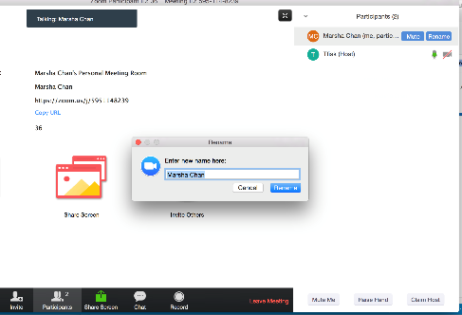
We need your FULL NAME in the Zoom platform
We need your full name under “PARTICIPANTS”
Click “Rename” next to your login name
Type your full name and save.

Slide 5
Learning Objectives
At the conclusion of this presentation, the participant will be able to:
Describe key barriers to achieving 100% compliance with influenza vaccine rates for staff and patients
Describe key success stories and examples of small tests of change

Slide 6
Polling Question #1
My primary role is:
Infection Prevention
Employee Health
Infection Prevention AND Employee Health
Quality Improvement
Pharmacy
Clinical Lab
Nursing
Other (enter in chat box)

Slide 7
2017-2018 Flu Season
High severity
H3N2-predominant season
Record-breaking levels of influenza-like illness and hospitalization rates
178 flu-related deaths in children

Slide 8
2018-2019 Influenza Vaccines
ACIP: any licensed age-appropriate vaccine
Inactive influenza vaccine (IIV)
Recombinant influenza vaccine (RIV)
Live attenuated influenza vaccine (LAIV4)
Composition:
Influenza A (H1N1) virus
Influenza A (H3N2) virus
2 Influenza B viruses

Slide 9
Polling Question #2
The MAJOR reason our staff refuse the flu shot is because they:
Believe they are not at risk
Lack knowledge regarding the risk they pose to patient
Fear vaccine side effects
Lack knowledge about vaccine efficacy
Fear needles
Believe that it ‘causes the flu’

Slide 10
Barrier vs. Excuse
Is it a barrier?
A real thing that is preventing us from being successful
Is it an excuse?
Justification for why we are not willing to do what is expected

Slide 11
Ideas from your peers

Slide 12
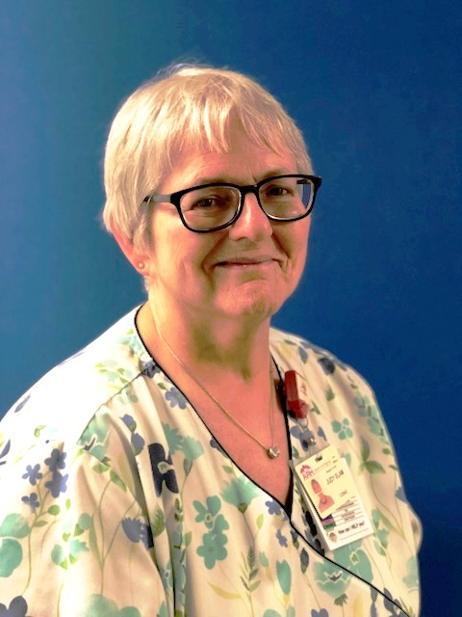
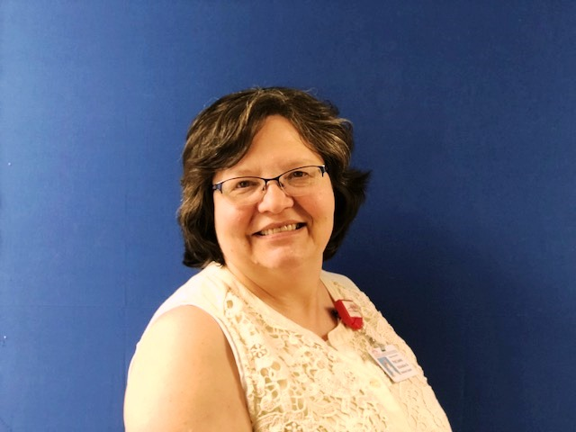
Eric Campbell, Sharon Gaston, Pat Lewis and Judy Elam

Slide 13
Hurdles and Success Stories

Slide 14
Eric Campbell and Sharon Gaston

Slide 15
Braxton County Memorial Hospital, W VA

Slide 16
Polling Question #3
We have a written AND enforced policy that states influenza vaccine is a condition of employment
Yes
No
No, but I wish we did

Slide 17
Strengths and Limitations

Slide 18
Strengths and Limitations of Education

Slide 19
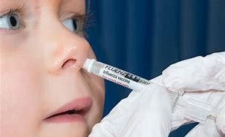
Impact of Alternatives to Shots

Slide 20
Staff want some vaccines but not others: Flu or Hepatitis A?

Slide 21
Keys to Patient Vaccination Success

Slide 22
Pat Lewis and Judy Elam

Slide 23
Morgan County ARH, Kentucky

Slide 24
Polling Question #4
We apply a ‘sticker’ to employee and physician ID badges to indicate administration of the annual flu vaccine
Yes
No

Slide 25
Badge stickers
“I Got Mine”

Slide 26
Recognition

Slide 27
Sick time or PTO?

Slide 28
Community Partnerships

Slide 29
Herd Immunity

Slide 30
1:1 Conversations and Stories

Slide 31
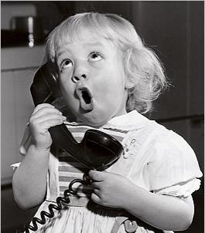
Let’s get these lines open…

Slide 32
Discussion and Tips for your Peers

Slide 33
Masking Requirements

Slide 34
Remaining barriers?

Slide 35
Influenza: this is scarier than fiction

Slide 36
MANY THANKS to Eric Campbell, Sharon Gaston, Pat Lewis and Judy Elam

Slide 37
Post-webinar Evaluation
https://www.surveymonkey.com/r/5SQ3PJT

Slide 38
Thanks
Barbara DeBaun, RN, MSN CIC
Improvement Advisor
bdebaun@cynosurehealth.org
415-823-7616

