Slide 1

MBQIP
West Virginia CAH Network
Dawn Knight, MHA
West Virginia
March 14, 2018

Slide 2
Agenda
BRN Requirements
Objectives
Kentucky State Dashboard
Getting to work – Model for Improvement
Top Opportunities in your hospital
Top Performers among us
Performance Improvement Team Work
HCHAPS Cohort report
Antibiotic Stewardship ground work

Slide 3
Nursing Contact Hours
Requirements:
Please remember to sign the attendance sheet
Complete the post-meeting Survey Monkey:
https://www.surveymonkey.com/r/X3CBLZD
Contact hour certificates will be issued to you via email within one week after completing survey
Provider approved by the California Board of Registered Nursing,
Provider Number CEP15958, for 5.5 contact hours

Slide 4
Objectives
Identify required quality indicators measured by the Medicare Beneficiary Quality Improvement Program [MBQIP]
Describe areas in need of priority focus for their state and their specific Critical Access Hospital
Describe the Model for Improvement (Aim, measures, change, PDSA)
Develop a plan for a quality improvement project that is time-specific and measurable

Slide 5

West Virginia Statewide Dashboard

Slide 6
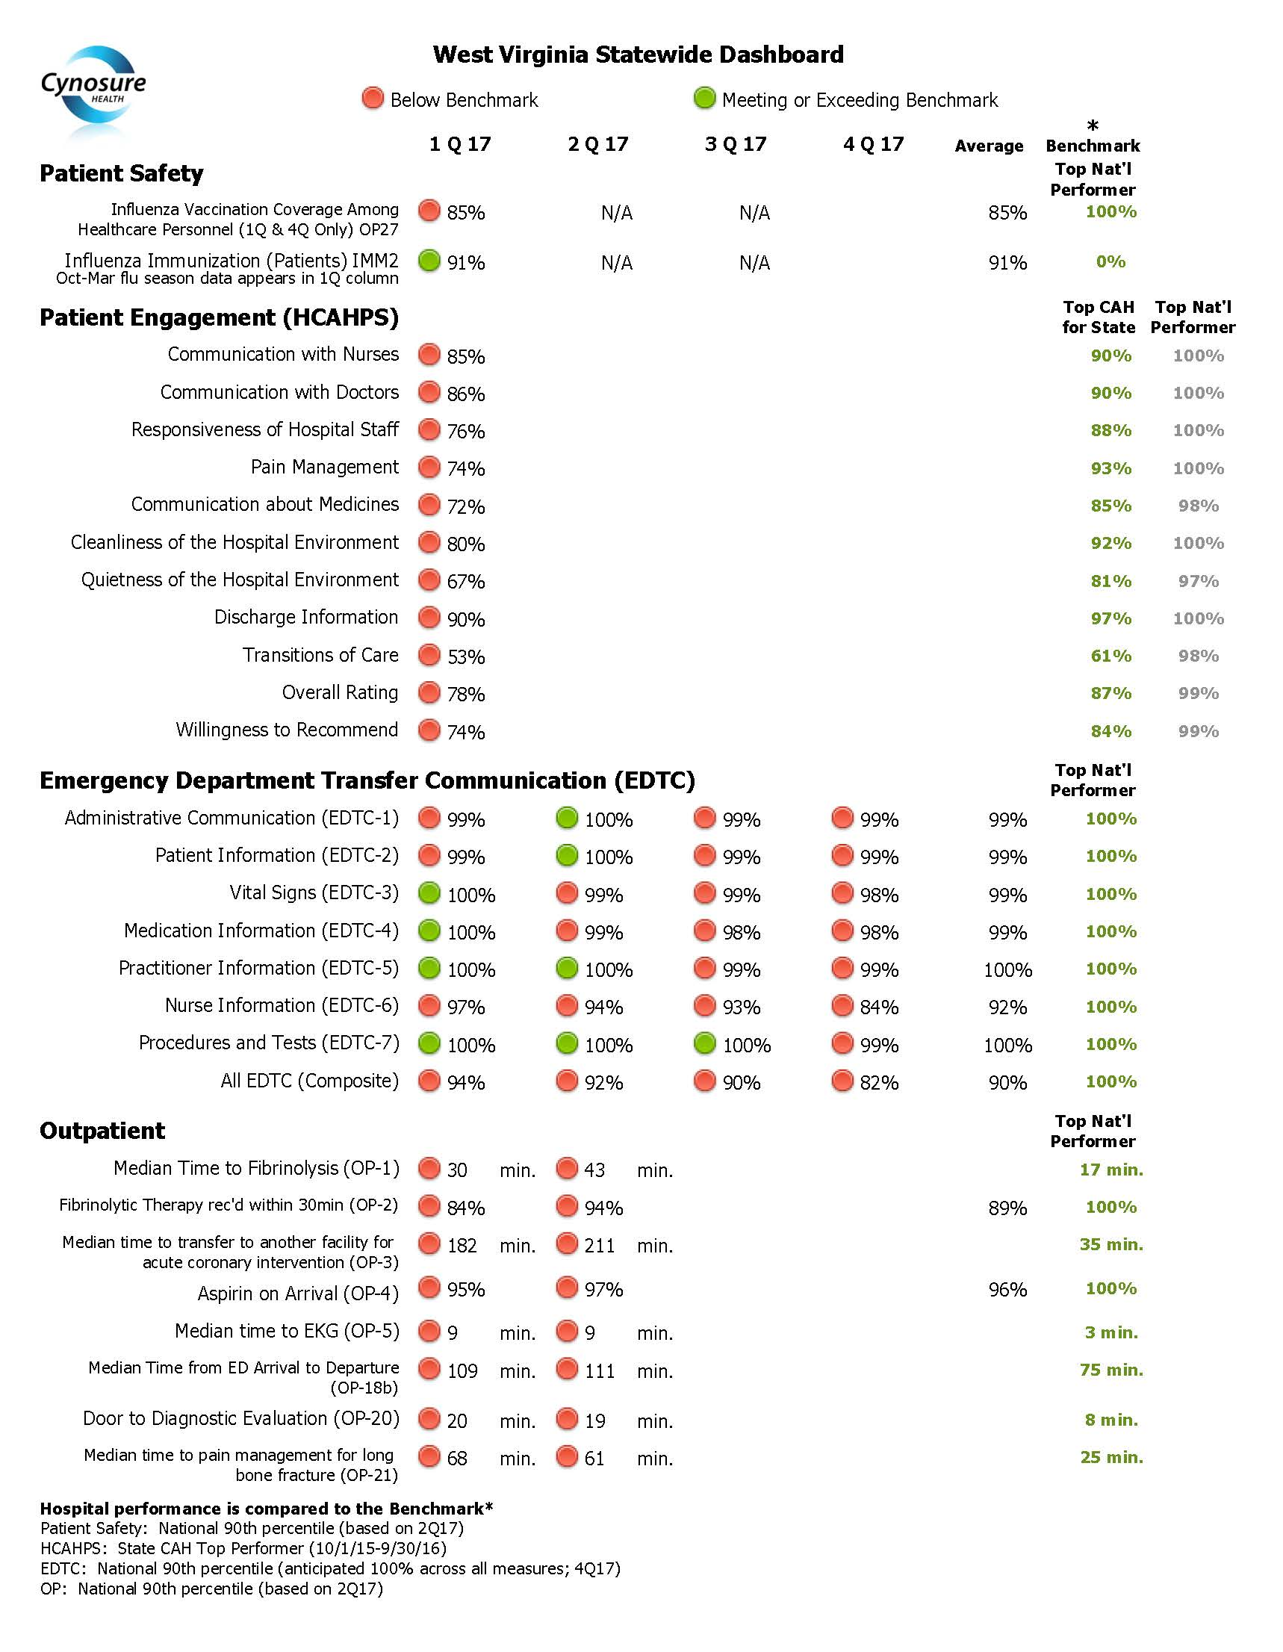

Slide 7
WV Top Opportunities:
Timing issues [EDTC & Outpatient]

Slide 8







Best Performers Among Us
    EDTC: Minnie Hamilton Health System, War Memorial, Boone memorial, Mon Health Preston memorial,
    Outpatient: St. Joseph’s
    Patient Safety: War Memorial, Boone Memorial, Mon Health Preston Memorial, Hampshire memorial, Roane General, Pocahontas Memorial

Slide 9
.
Model for Improvement Worksheets
Team break outs
Selecting your project
Apply PDSA to improve your performance

Slide 10
Model For Improvement
What are we trying to
AIM
accomplish?
How will we know that a
MEASURE
change is an improvement?
What change can we make that
Selecting Change
will result in improvement?
Act
Plan
Small Tests of Change
Study
Do
Notes:
This is the Model for Improvement that consists of 3 questions and STOC.
The First Question is “What are we trying to accomplish?” This is the team’s AIM or goal.

Slide 11
What Are We Trying to Accomplish?
Developing the team’s Goal/Aim Statement
Improve
Achieve
Increase

Slide 12

WHAT?
WHERE?
HOW MUCH?
Notes:
What are you going to do? Where (patient population); by how much? Must be measurable

Slide 13

By WHEN?

Slide 14

100% on EDTC # 6
Clear and Unambiguous Target
Notes:
Make target clear and unambiguous; keeps the team focused

Slide 15
AIM Statements
Increase patient influenza immunization rates
to 95% by January 1, 2018
Increase patient satisfaction with discharge instructions to 90% by June 1, 2018
Increase staff influenza immunization rates to 90% by January 1, 2018
Notes:
Update based upon timing…or focus area

Slide 16

What Are You Trying to Accomplish?
At your tables, for the next 5-10 minutes create an AIM Statement for a project you are working on or planning to start
-

Slide 17

Evaluation and Sharing
Did your AIM statement:
  Have a clear numerical goal?
  Have a bold but realistic goal?
  Clearly articulate what you want to achieve and by when?
Can your AIM statement be given in any elevator?
Would you change your AIM statement?
If so, what would you change and why?

Slide 18
How do you know if a change
is an improvement?

Slide 19
Model For Improvement
What are we trying to
AIM
accomplish?
How will we know that a
MEASURE
change is an improvement?
What change can we make that
Selecting Change
will result in improvement?
Act
Plan
Small Tests of Change
Study
Do
Notes:
The Second Question is “How will we know that a change is an improvement?”

Slide 20
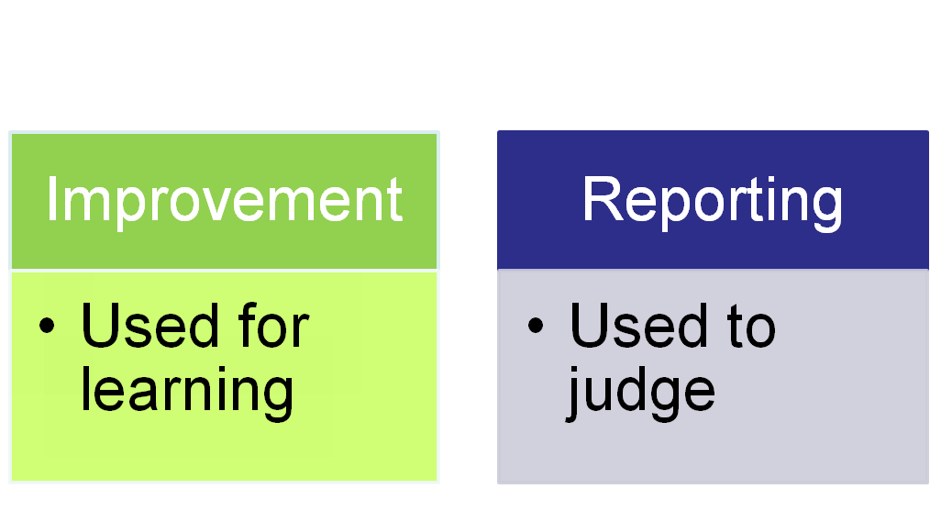
Why Measure?
How else will you know that the change(s) you made resulted in improvement?

Slide 21
Types of Measures
Outcome
Process

Slide 22

Process Measures
Outcome Measure
What you get
What you do

Slide 23
How Will We Know If A Change
Is An Improvement?
At your tables, for the next 5-10 minutes decide what measure(s) will help you know if you have made an improvement
-

Slide 24

Evaluation and Sharing
Does the measure(s) you selected allow you to understand if you have made a change?
Would you change your measurement plan?
If so, what would you change and why?

Slide 25
Model For Improvement
What are we trying to
AIM
accomplish?
How will we know that a
MEASURE
change is an improvement?
What change can we make that
Selecting Change
will result in improvement?
Act
Plan
Small Tests of Change
Study
Do

Slide 26
What changes can we make
that will result in an improvement?

Slide 27

Brainstorm
Rank
Construct Plan to Test

Slide 28
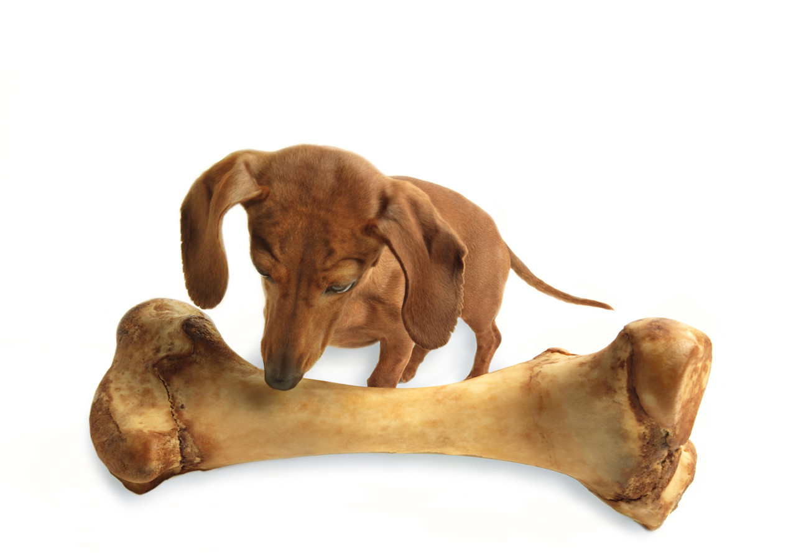
Aim BIG
Test Small

Slide 29

Collect Data

Slide 30
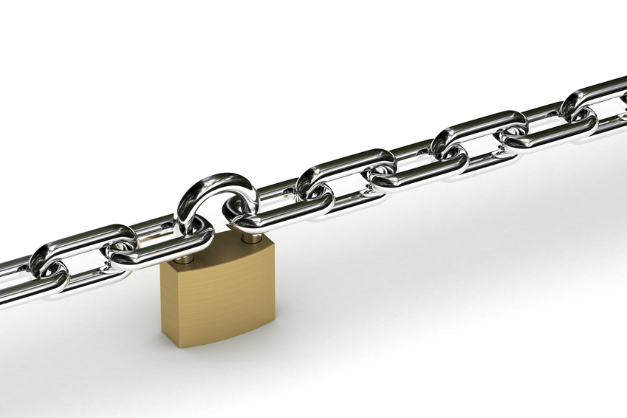
Steal Shamelessly

Slide 31
The PDSA Cycle
“What will happen if we try something different?”
“What’s next? ”
“Did it work?”
“Let’s try it!”
Notes:
Four parts of the cycle:
Plan:
Decide what change you will make, who will do it, and when it will be done. Formulate an hypothesis about what you think will happen when you try the change. What do you expect will happen?
Identify data that you can collect (either quantitative or qualitative) that will allow you to evaluate the result of the test.
Do:
Carry out the change.
Study:
Make sure that you leave time for reflection about your test. Use the data and the experience of those carrying out the test to discuss what happened. Did you get the results you expected? If not, why not? Did anything unexpected happen during the test?
Act:
Given what you learned during the test, what will your next test be? Will you make refinements to the change? Abandon it? Keep the change and try it on a larger scale?

Slide 32

Back to Work
Over the next 5-10 minutes, create 1-2 small tests of change you can implement by next Tuesday. Describe the who, what, how and the study approach.
What do you want to happen?
How will you know if it did?

Slide 33

Evaluation and Sharing
Does your test of change:
  Include a description of the test?
  Indicate who will do what, when and where?
  Describe what you want to or think will happen?
Would you change your test of change?
If so, what would you change and why?

Slide 34
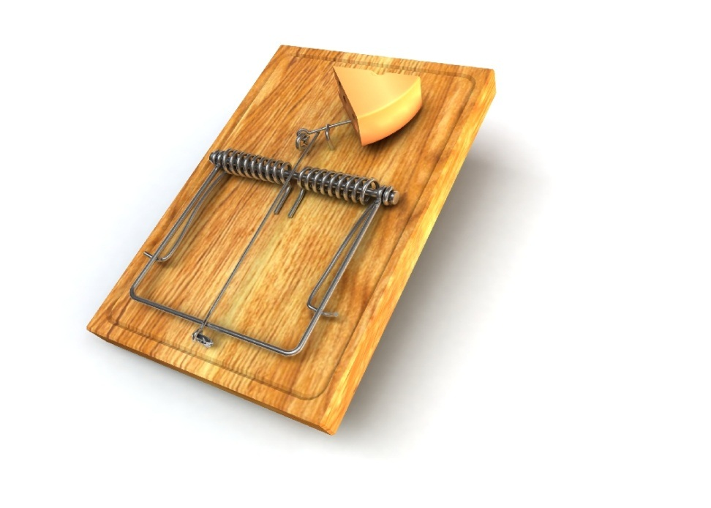
Common Traps
Plan Do, Plan Do
Do Act, Do Act
No testing, only data collection
No ramps of tests, random PDSAs
Undisciplined PDSAs, no documentation
Prediction – what are we going to learn
Beware of Cycles longer than 30 days

Slide 35
Mistakes Made In Improvement Teams
Failure to state a measurable, specific aim
Failure to tie measures to aims
Over-reliance on education and awareness
Failure to state a population focus
Failure to abandon a change that does not lead to an improvement
Failure to engage process owners on a team and solicit their ideas
Failure to make data visible to all engaged in the process

Slide 36
Antibiotic Stewardship
Quality Improvement – New 2018
Leadership Commitment – Dedicate necessary resources: HR, IT
Accountability - Appoint a single leader responsible for program outcomes
Drug Expertise - Appoint a single Pharmacy Leader
Action - Implement at least one recommended action
Tracking - Monitor Antibiotic prescribing and resistance patterns
Reporting - Regular reporting on abx use and resistance patterns
Education - Education to clinicians on optimal prescribing and resistance
https://www.cdc.gov/antibiotic-use/healthcare/implementation/core-elements.html

Slide 37
Thank you!
Don’t forget to sign the attendance sheet and complete the meeting survey!

