Slide 1
CAH Performance Improvement Network
April 2018
Dawn Knight

Slide 2
Nursing Contact Hours - Reminders
Requirements
Complete the post-webinar Survey Monkey that will be sent to you via email.
Must have participated on the webinar for a minimum of 50 minutes
Required to complete survey to earn 1 contact hour
Contact hour certificates will be issued to you via email within one week
Provider approved by the California Board of Registered Nursing,
Provider Number CEP15958, for 1 contact hour

Slide 3
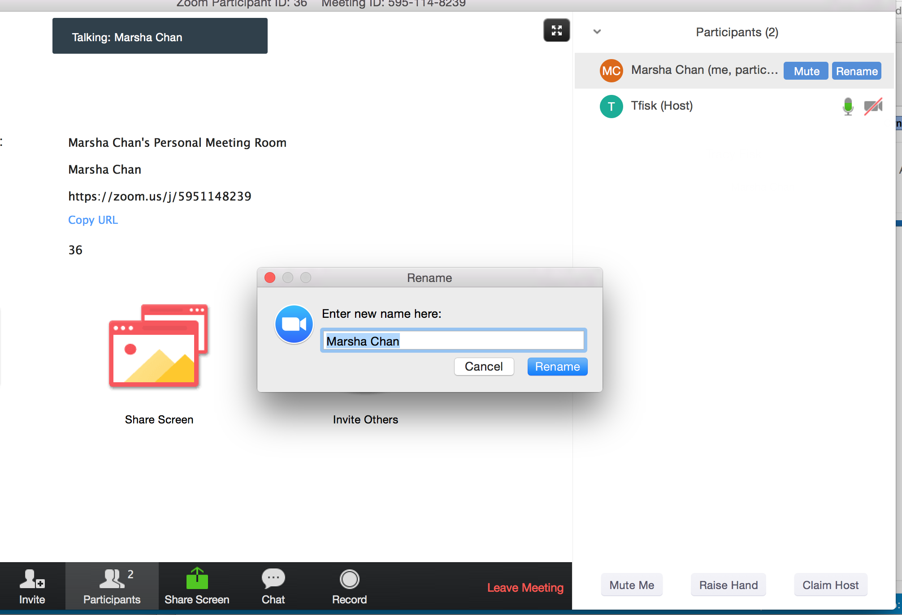
We need your FULL NAME in the Zoom platform
We need your full name under “PARTICIPANTS”
Click “Rename” next to your login name
Type your full name and save.

Slide 4
Dawn
Transparency
Learning
Seek first to understand – Then to be understood – Steven Covey
Everyone you meet
Knows something you don’t

Slide 5
Data Dive Q-Net
 | Hallie Morgan Director, Data Analysis hmorgan@wvha.org

Slide 6
Public Reporting update
Problem: Data showing as “not available” on Hospital Compare
What we Know:
A Notice of Participation (NoP) must be completed for inpatient and outpatient for data to appear on Hospital Compare
NoPs are not required for participation in MBQIP
You can identify your current NoP/public reporting status in Quality Net.
There are known issues with public reporting and data suppression

Slide 7
Public Reporting
What we don’t know:
How to fix it - further guidance will be provided as soon as possible.
Even if you have everything set up correctly – your data may still be incorrectly suppressed on Hospital Compare
In the Meantime!
Identify hospital Q-Net administrator
Determine if Notice of Participation has been submitted – inpatient and outpatient
Was public reporting selected within the NoP?

Slide 8
Public Reporting
How to Review NoP
Quality Net -> My Tasks page -> Manage/Notice of Participation -> View/Edit Notice of Participation, Contacts, Campuses
5 program types
Inpatient Notice of Participation
Outpatient Notice of Participation
Link to a 17 minute CMS Training Video – page 5 of the MBQIP Quality Reporting Guide
https://www.ruralcenter.org/resource-library/mbqip-quality-reporting-guide

Slide 9
Data Questions Deep Dive in Process
Focus on HCAHPS –
https://www.cms.gov/medicare/quality-initiatives-patient-assessment-instruments/hospitalqualityinits/downloads/hospitalhcahpsfactsheet201007.pdf

Slide 10
Items on the Survey
27 Items for experience: communication with doctors, communication with nurses, responsiveness of hospital staff, cleanliness of the hospital environment, quietness of the hospital environment, pain management, communication about medicines, discharge information, overall rating of hospital, and recommendation of hospital
[4] four items to skip patients to appropriate questions
[3] three items to adjust for the mix of patients across hospitals; and two items to support congressionally-mandated reports

Slide 11
Modes of Participation
CMS has rules of participation – Minimum requirements & approved vendors
Know your vendor – Your data may look different.
Print out your survey – consider limiting to only required questions

Slide 12
Which Patients
All payer types that meet the following criteria:
18 years or older at the time of admission
At least one overnight stay in the hospital as an inpatient
Non-psychiatric MS-DRG/principal diagnosis at discharge
Alive at the time of discharge

Slide 13
How Sampled
Basic sampling procedures – random sample of eligible discharges monthly
Survey all eligible discharges to increase your size
300 completed surveys over the 12- month period
Smaller hospitals that are unable to reach the target of 300 in a 12- months period… ALL eligible discharges and attempt to obtain as many as possible
Patients surveyed between 48 hrs & Six weeks after d/c

Slide 14
How Calculated
Data submitted is “Cleaned and analyzed by CMS” before reporting on the CMS website
http://www.hospitalcompare.hhs.gov. hospital compare website

Slide 15
How Adjusted
Calculate Unadjusted HCHAPS Scores
Measures include Six Composite Items, two global items and two individual items.
Measures are comprised of two to three questions
Top Box – Middle Box – Bottom Box
Top “Always”
Bottom “Never” & “Sometimes”

Slide 16
Boxes
Top box score is percentage of respondents giving most favorable
Bottom giving least favorable
Middle box is calculated but used for reporting unadjusted HCHAPS scores

Slide 17
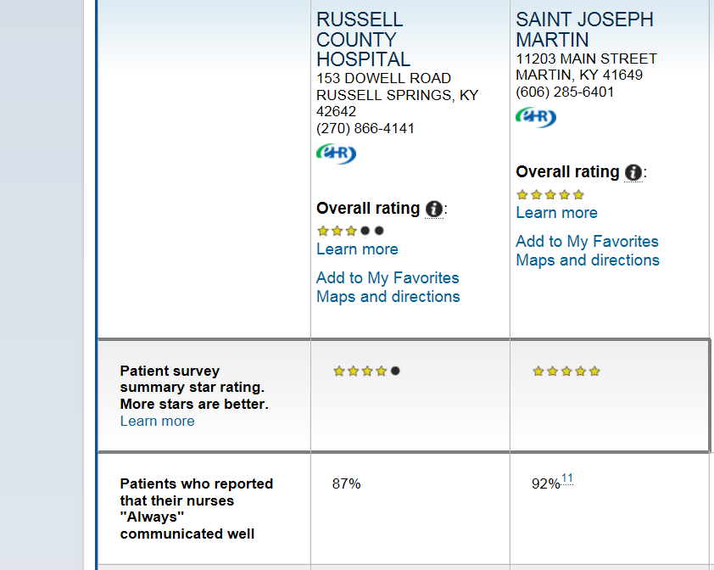

Slide 18
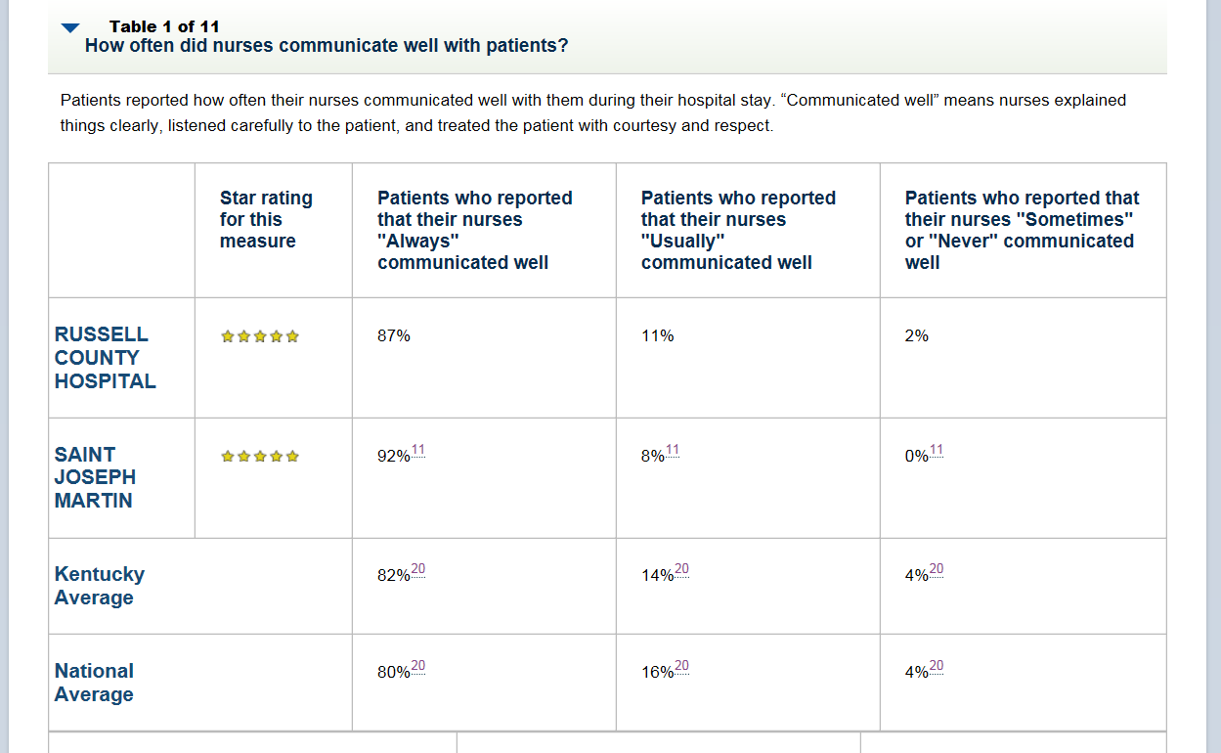

Slide 19
Adjustment variables
Intent is to remove any positive or negative influence such as
Age
Education level
Health Status etc.
Patient Mix Adjustments calculated and applied for each of the measures
Rounding rules – scores rounded to nearest whole number after all that analysis!
Service Line Break out – [Maternity, medical or surgical]

Slide 20
Adjustments
(HCAHPS) Raw Score Calculation and Adjustment Methodology
The Centers for Medicare & Medicaid Services (CMS) publishes national means and adjustment calculation of national, adjusted HCAHPS scores as reported on the www.hospitalcompare.gov
Intent is to allow fair and accurate comparisons across hospitals,
Necessary to adjust for factors that are not directly related to hospital performance.
Process allows for comparison across providers by removing the influence of patient-specific factors and biases that could be introduced by the mode of survey administration utilized (i.e., mail, telephone, mail with telephone follow-up, or interactive voice recognition).

Slide 21
Questions?

Slide 22
Nurse Contact Hours Reminder
Survey Link: Please provide Feedback ☺
https://www.surveymonkey.com/r/JR27Y53
Contact hour certificates will be issued to you via email within one week

