Slide 1
CAH Performance Improvement Network
Dawn Knight
Dawn.knight60010@gmail.com
312-340-8493

Slide 2
Webinar May 2018
Achieving Top Tier Quality though
Leadership and Board Engagement

Slide 3
Nursing Contact Hours - Reminders
Please complete the survey, even if you do not want contact hours! Thank you!
Requirements
Complete the post-webinar Survey Monkey that will be sent to you via email.
Must have participated on the webinar for a minimum of 50 minutes
Required to complete survey to earn 1 contact hour
Contact hour certificates will be issued to you via email within one week
Provider approved by the California Board of Registered Nursing,
Provider Number CEP15958, for 1 contact hour

Slide 4
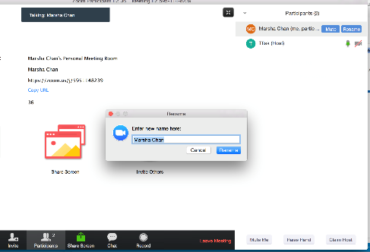
We need your FULL NAME in the Zoom platform
We need your full name under “PARTICIPANTS”
Click “Rename” next to your login name
Type your full name and save.

Slide 5
Learning Objectives
The learner will be able define one key attribute to their role in guiding the board in developing the quality strategy
The learner will be able to prepare a board educational presentation on quality
The learner will be able to use their dashboard to identify areas of opportunity and present to the board.

Slide 6
Quality Starts at the Top
The Board has ultimate responsibility for hospital quality, including clinical outcomes, patient safety, physician credentialing and customer service

Slide 7
Core Role of Governing Board
Primary Responsibility is Quality and Patient Care
Governing, as opposed to managing, means that a board carries out these primary roles:
Approving the organization’s high-level, long-range goals and priorities – Quality Strategy
Adopting major policies and making major decisions to advance the organization
Monitoring organizational performance against board-approved targets, focusing on variances
Influencing key internal and external stakeholders
http://media01.commpartners.com/NQF/12_09_11/Engaging_Hospital_Boards_in_Quality_and_Patient_Safety.pdf

Slide 8
Your Role
To achieve Top Tier Quality results you have to have the active support and attention of your Leadership & Governing Board
Active Support will demonstrate that the hospital has made it a priority to improve quality and safety

Slide 9
Tips on the Ask from Quality Leadership
Actively guide the Board in Development of the quality Strategy
Increase awareness of the National Quality agenda [ MBQIP] and your Local efforts to participate
Review established Mission/ Vision/ Values – to set the stage for alignment
Provide education on the connection between Your Quality Performance - MBQIP – Public Data – National Quality Strategy
Identify Top Tier attributes and a plan to achieve them [Goals – get alignment
Identify barriers to achievement and opportunities [resources] needed to achieve results [be specific]
Confirm Dashboard – using this as your agenda going forward
Secure Dashboard compliance and alignment of incentives
Point of Service awareness and engagement
Contract inclusion
Performance Monitoring [Job description & evaluations]

Slide 10
Culture Counts
“Get the right people on the bus”
Set the bar high
Focus on a vital few priorities
Use information, anchored by a dashboard, to drive improvement
Use the Board Quality Committee as a educational, relationship-building forum

Slide 11
Board Meeting
Insert Your Information Here
Plan 30 Min
Quality & Patient Safety Presentation
Achieving Top Tier Quality

Slide 12
Setting The Stage & Guiding the discussion
Your Board Agenda:
A call to action: The National Quality Agenda
IOM Report
Triple Aim
What is MBQIP & How do we fit in
Public Data
Confirming our Mission, Vision, Values – Alignment & Engagement
Developing our Core Aims to focus our resources on Top Tier Performance
Ongoing governance that will guide and ensure our success
Indicators & Dashboard Goal Setting
Resource identification
Frequent Reporting

Slide 13
A Call to Action
A call to action: The National Quality Agenda
IOM Report
Triple Aim
What is MBQIP & How do we fit in

Slide 15
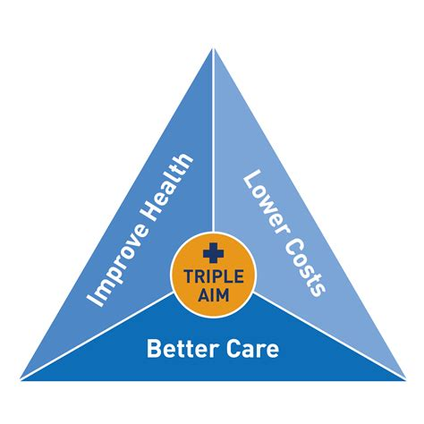
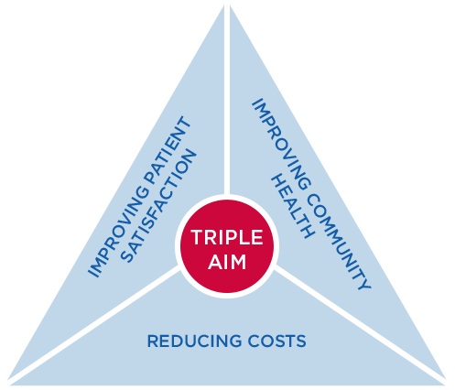
Aligning our Mission and Quality Strategy with the National Quality Agenda: Triple Aim
Our Aim: Evidenced Based
Care & Zero Harm:
Indicator:
MBQIP Quality
Metrics – EDTC & Outpatient
Our Aim: Best Patient Experience:
Indicators: HCAHPS

Slide 16
MBQIP Measures
Patient Safety Measures
Care Transitions [Emergency Department]
Influenza vaccination
Antibiotic Stewardship
Patient Engagement Measures (HCAHPS)
Outpatient Measures
Emergency Department Transfer Communications

Slide 17
MBQIP Background
The Federal Office of Rural Health Policy (FORHP) and its partners are charged with increasing current critical access hospitals (CAHs) Hospital Compare participation rates, and CAH dedication to quality improvement initiatives. Medicare Quality Improvement Program (MBQIP) seeks to increase attention on quality healthcare to all CAH Medicare beneficiaries, both inpatient and outpatient

Slide 18
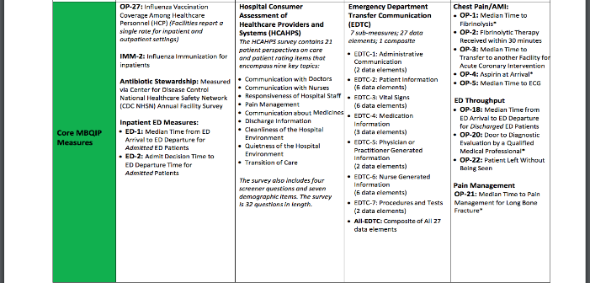
Medicare Beneficiary Quality Improvement Project [MBQIP]
Identifying Specific Indicators to align hospitals in the with the national quality strategy [Based on the call to action: Triple Aim]
OP1, OP4, OP20, OP21 retired as of 4/1/18

Slide 19
Mission Vision Values
Insert Your Language Here

Slide 20
YOUR GOAL: Align The Strategy
Not for the board
Show the board how what you are doing aligns with the existing Mission Vision Values
“To provide quality healthcare service in an atmosphere of brotherly love….”
Quality health care look like….. Achieving our goals in Patient Safety, EDTC ETC.
Be clear, specific and help remove the noise of the hospitals multiple competing priorities
Achieving Top Tier on these indicators will align our strategy with MBQIP [National agenda] and support our efforts to achieve the Triple Aim.

Slide 21
Strategy & Governance Structure
Insert Your Structure
Board of Directors
MEC
Quality Committee
Patient Safety
Patient Experience
PI Teams

Slide 22
Process of Data Gathering
Measures Defined: Numerator/Denominator
Specifications assigned: Population – Timeframe – Inclusions/ Exclusions
Abstraction guidelines [Define process]
Patient Experience [HCAHPS] through third party vendor
The data that represents our hospital’s performance [our quality story] is gathered by our team [abstraction] or through a patient satisfaction survey

Slide 23
Boone Memorial Hospital
Insert Your Data Here
If you can, go on the web to show them the data

Slide 24
Boon Memorial: Public View
Insert Your Data
Example of Data Specifics

Slide 25
Boone Memorial: How We rank in WV

Slide 26
Developing Aims
Supporting our Mission Vision Values
Alignment with National Quality Agenda
Supportive of our participation in MBQIP
Hospital Quality Strategy Priorities:
Patient Care – Evidence Based Care
Patient Satisfaction – HCAHPS
Patient Safety
Achieving Top Tier on these indicators will align our strategy with MBQIP [National agenda] and support our efforts to achieve the Triple Aim.

Slide 27
Strategy in sync
Insert Your Language Here
Triple Aim | Our Mission | Our Quality Strategy Aim | Indicators We Use [Dashboard]
Improve Patient Satisfaction | “To been seen as the best place to receive patient care” | Best Patient Experience | HCHAPS
Improving Health | “Quality Healthcare Services” | Zero Harm | Patient Safety Indicators -
Improving Health | “Quality Healthcare Services” | Evidence Based Care | EDTC Out Patient Indicators

Slide 28
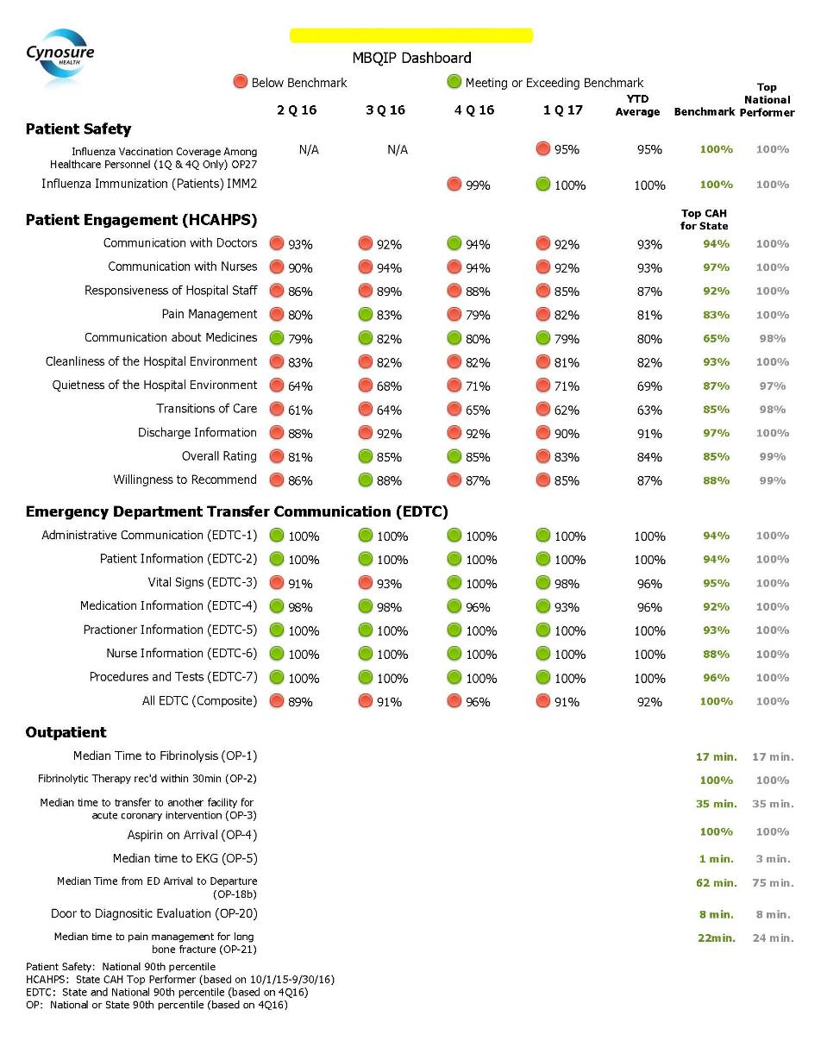
Insert Your Data

Slide 29
Achieving our Aims
Elaborate on your hospital needs to be successful
Successes
Celebrations
Opportunities
Challenges
Accountability
Transparency
Prepare the “ASK”
Approval?
Staff?
Awareness?
$$

Slide 30
Continuing the Discussion
Ongoing Board Agenda:
Quality & Patient Safety Update on Quality Priorities
Evidenced Based Care – Outpatient & EDTC
No Harm: Patient Safety Indicators [MBQIP + ]
Best Patient Experience [HCHAPS]
Results and Actions Taken
Results achieved for this quarter/ month
Actions taken to continue improvement or change Corse
Recommendations

Slide 31
Examples of Board & Leadership Support from Participating hospitals

Slide 32
Questions?

Slide 33
Follow Up
Hospital Support

Slide 34
Post-webinar Evaluation
https://www.surveymonkey.com/r/RPSYKQ3

