Slide 1
SEPSIS
Valley Health
Hampshire Memorial Hospital

Slide 2
Definition of Sepsis
The systemic inflammatory response to the presence of a documented infection or in a clinical setting with a high suspicion for infection as the cause of the change in the patient’s condition.
In other words, sepsis is defined as the presence (probable or documented) of infection together with systemic manifestations of infections (SIRS).
These patients are more acutely ill and typically require higher level of monitoring.
Documentation of an infection such as urinary tract infection, pneumonia, cholangitis, soft tissue infection, osteomyelitis, infected dialysis catheter, subphrenic abscess which may lead to sepsis should be documented.

Slide 3
Sepsis Criteria
Patient with a systemic inflammatory response to the presence of documented infection or in a clinical setting with a high suspicion for infection as the cause of the change AND
Two or more of the following in response to a variety of clinical insults:
    Fever-temp >38.3°C, < 36°C
    Tachycardia-HR >90 bpm
    Tachypnea-RR>20bpm or PaCO2 <32 mmHg
    WBC >12,000, <4,000, normal WBC with >10% bands or immature forms
**Severe Sepsis will follow a different algorithm as shown on the next 2 slides.
The next 2 slides will show an example of the Adult Sepsis, Severe Sepsis, Septic Shock Evaluation Algorithm used at Hampshire Memorial Hospital.

Slide 4
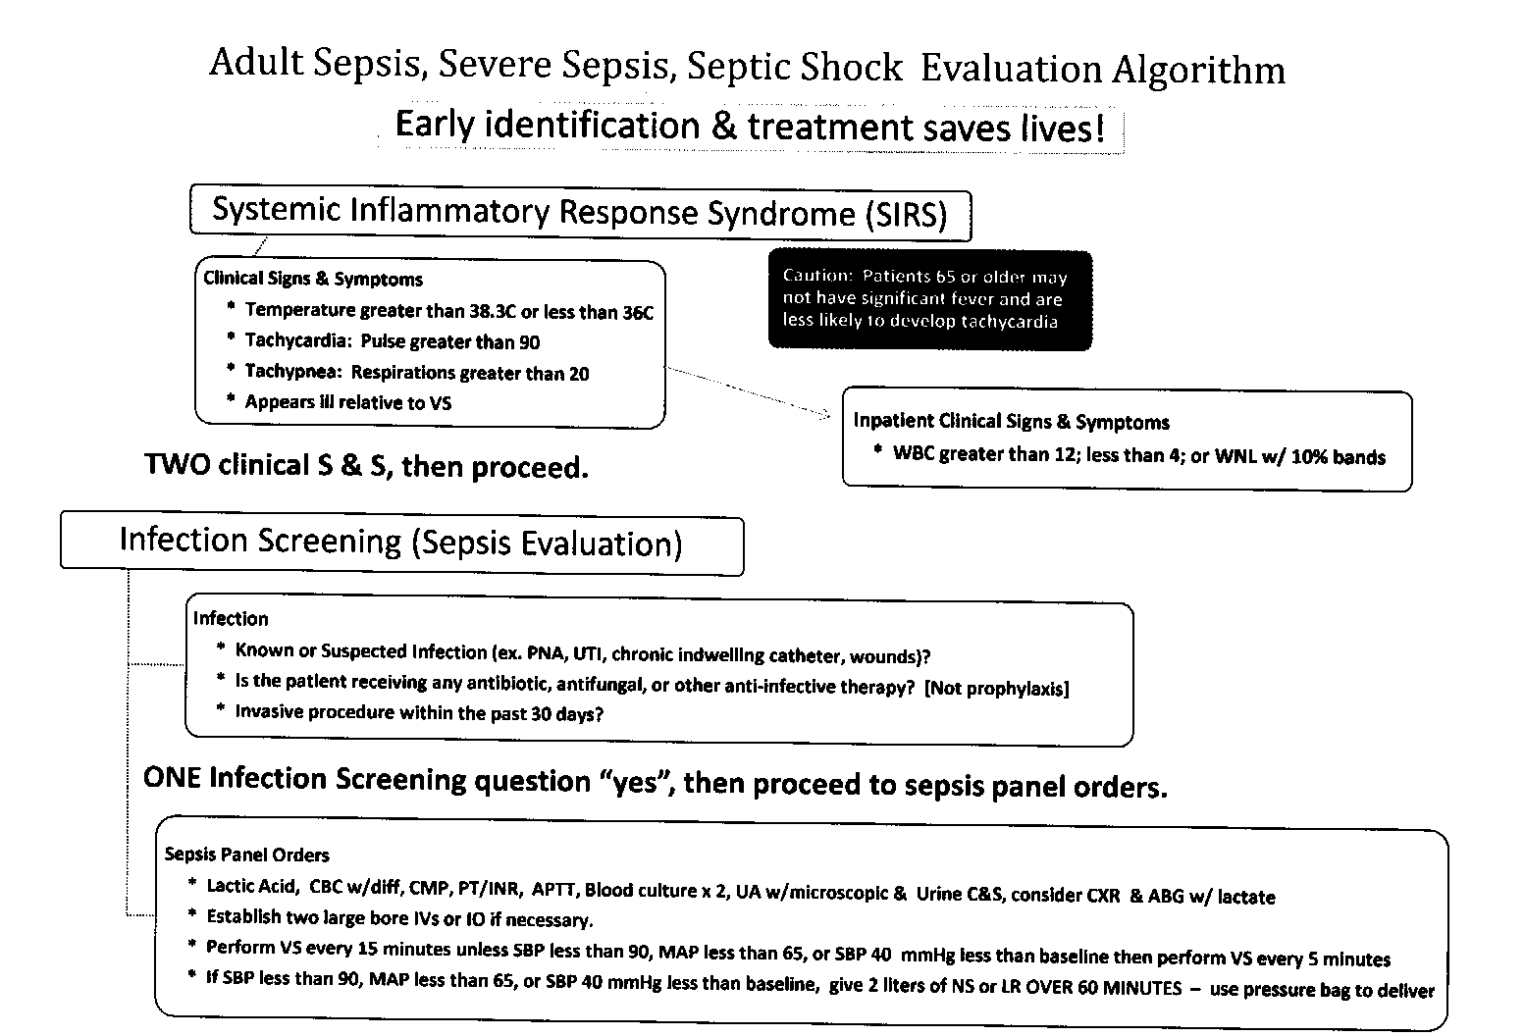
Adult Sepsis, Sever Sepsis, Septic Shock Evaluation Algorithm

Slide 5
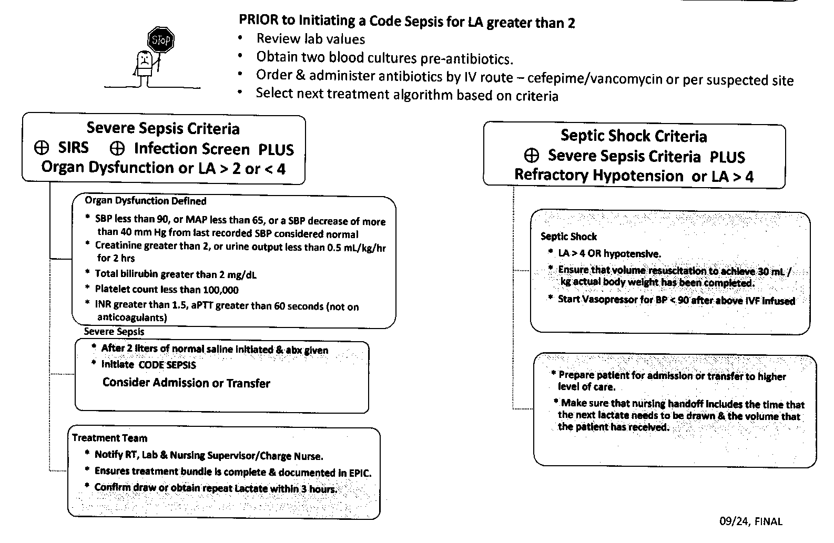
Algorithm Continued

Slide 6
Recent Changes to Algorithm 11/5/15
Severe Sepsis Criteria:
Under Organ Dysfunction Defined: Added New Respiratory failure w/Non Invasive Ventilation or Mechanical Ventilation(rev 11/15)
Septic Shock Criteria:
Lactic Acid >/= 4
Under Septic Shock: added LA >/=4

Slide 7
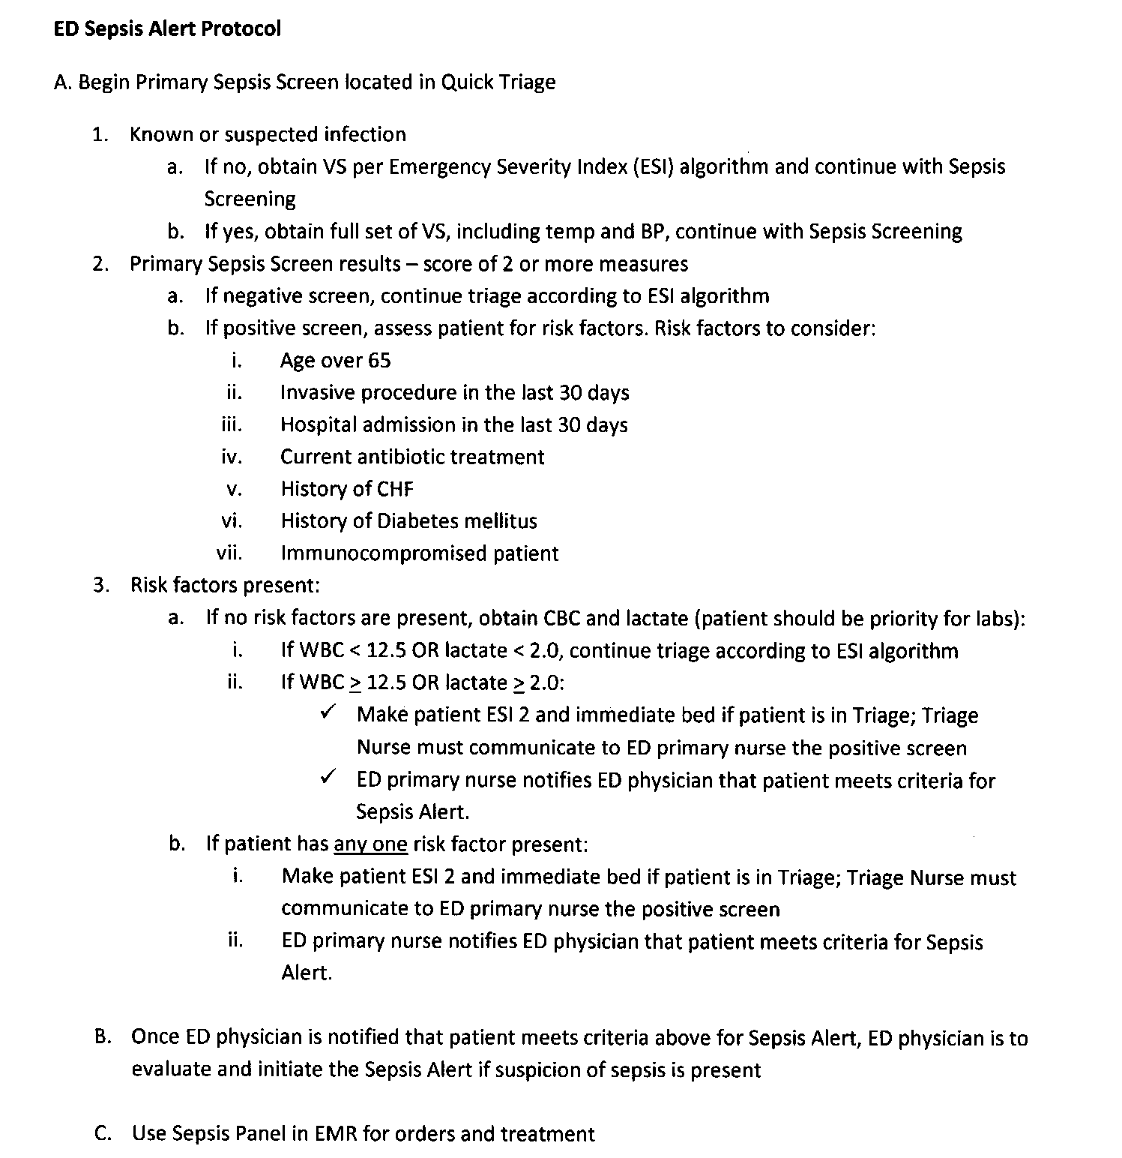
Emergency Department Sepsis Alert Protocol

Slide 8
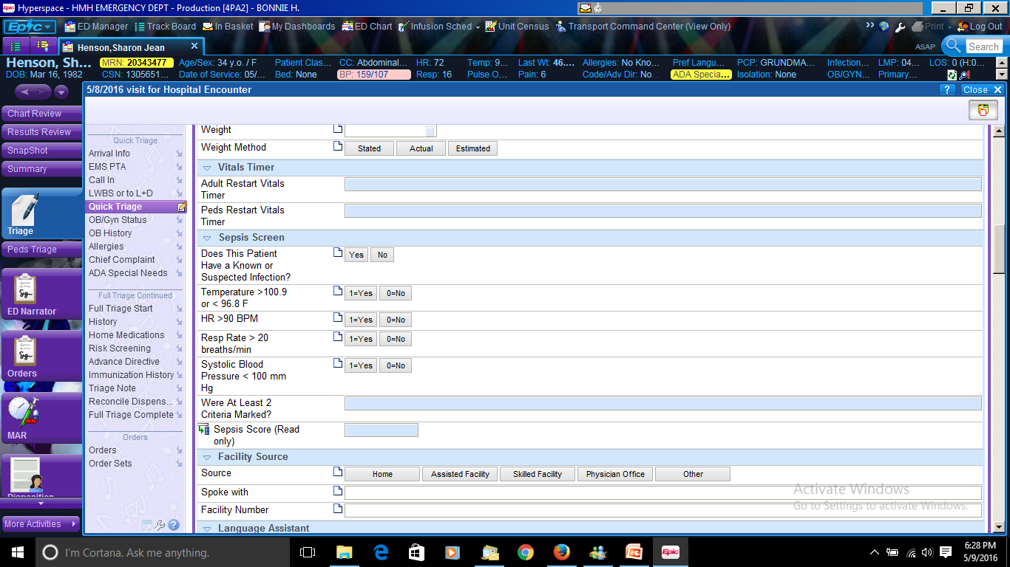
EPIC Documentation

Slide 9
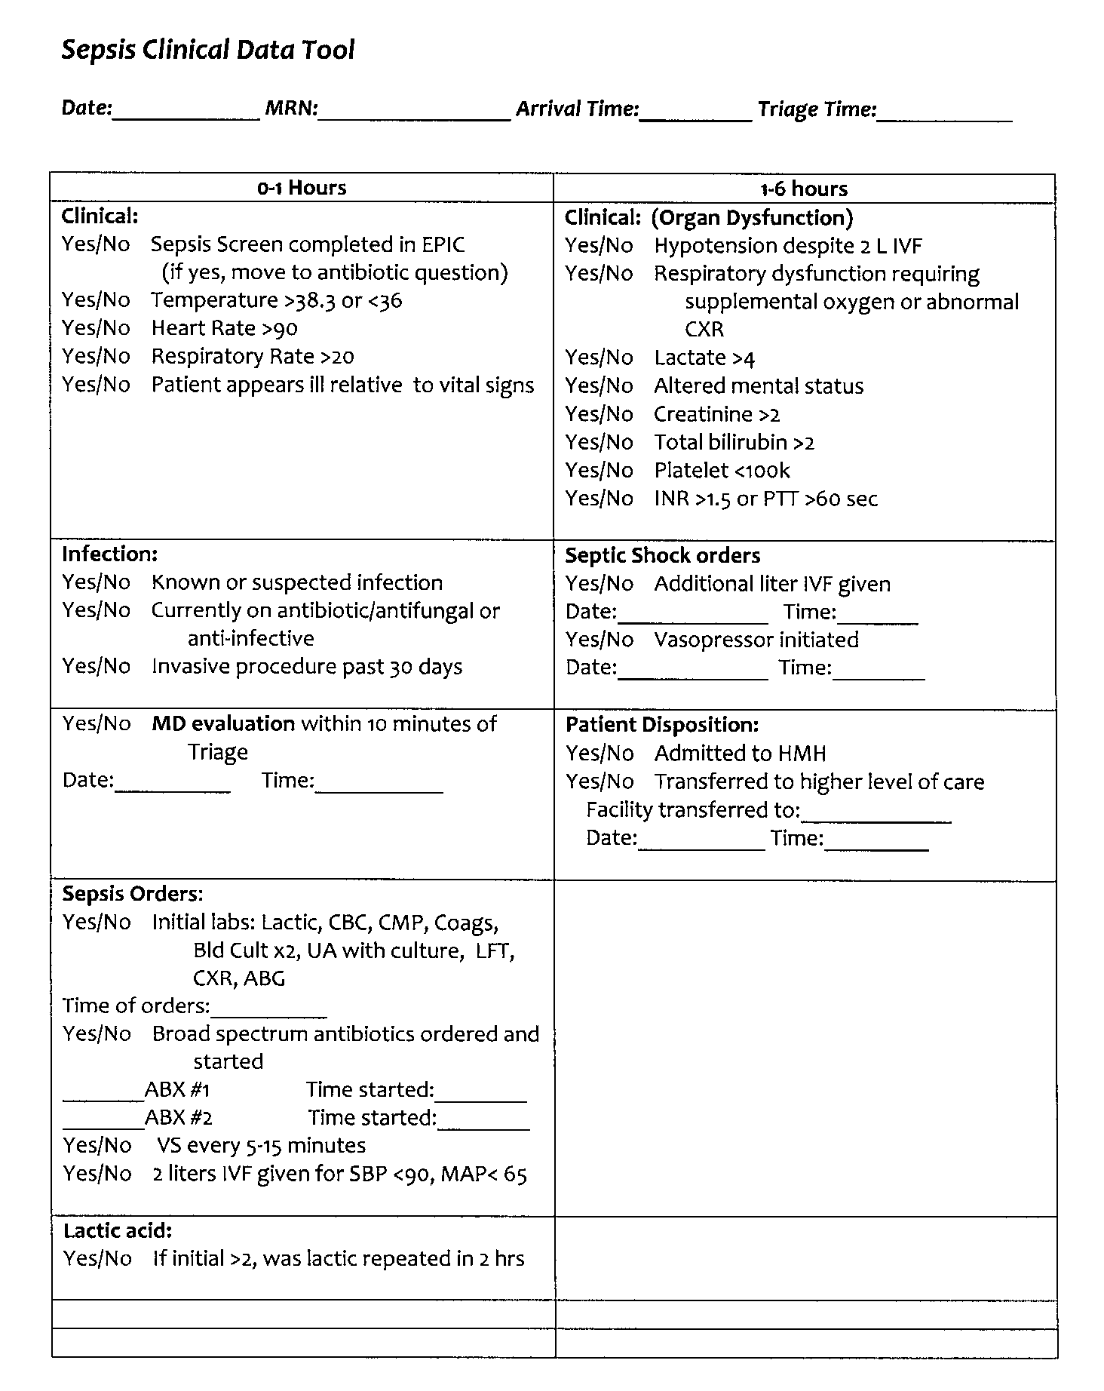
Sepsis Clinical Data Tool used by the Emergency Department

Slide 10
ER Data Collection Tool
Date | Arrival | Triage | MRN | Diagnosis | Sepsis Screen | Vital Signs | Infection Screen | MD evaluation | Time to MD eval. | Sepsis orders | Antibiotic Order time
4/4/2017 | 1634 | 1642 | 20462184 | shortness of breath | No | 37-96-18 | No | 1652 | 18 | No | 1941
4/4/2017 | 2007 | 2037 | 20298202 | abnormal lab | No | 38.6-98-36 | No | 2010 | 3 | No | 2129
4/10/2017 | 148 | 153 | 20437526 | foley problem | No | 37.6-89-24 | No | 158 | 10 | No | 420
4/10/2017 | 1338 | 1345 | 20475277 | nausea, dizziness | No | 39.5-130-20 | No | 1357 | 19 | No | 1706
4/15/2017 | 1207 | 1217 | 20208696 | weakness, cough, congestion, fever | No | 38-122-28 | No | 1232 | 25 | No | 1302
4/16/2017 | 2217 | 2218 | 20454369 | AMS, fever | No | 39.7-114-24 | No | 2227 | 10 | No | 2245
4/17/2017 | 1446 | 1448 | 20267647 | gen weakness | No | 38.5-60-20 | No | 1506 | 20 | No | 1526
4/17/2017 | 2226 | 2235 | 13721442 | fever, emesis, gen. weakness, syncope | No | 39.4-101-19 | No | 2255 | 29 | Yes
4/18/2017 | 2045 | 2046 | 20163184 | diarrhea, emesis | No | 37.6-109-22 | No | 2114 | 29 | No | 2147
4/24/2017 | 358 | 358 | 13852246 | febrile seizure | No | 40.4-185 | No | 410 | 12 | No | 410
4/24/2017 | 924 | 930 | 20517420 | shortness of breath | No | 37.9-67-28 | No | 925 | 1 | No | 931
4/29/2017 | 258 | 300 | 20448604 | shortness of breath | No | 38.7-139-23 | No | 307 | 9 | No | 437
4/29/2017 | 1911 | 1914 | 20086111 | fever, recurrent skin infections | No | 39.5-82-20 | No | 1942 | 31 | Yes | 1944
4/29/2017 | 2008 | 2010 | 20527896 | cough, fever | No | 39.4-92-20 | No | 2015 | 7 | No | 2133
 |  |  |  | n=14 | 0% |  |  |  | 15 min

Slide 11
ER Data Collection Tool Continued
Antibiotic | Antibiotic Time | 3hr goals met | IVF x 2 liters | Pressor | Lactic | Septic? | Disposition | Diagnosis | MD
Levaquin | 2010 | 216 |  |  |  |  | Admit | Pneumonia | Powers | wbc30.3 | bansd3
Zosyn, Vanc | 2209 | 119 |  |  | 1.5 |  | Transfer | Fever, chills, hyponatremia | Leskovec | wbs14.4 | bands7
rocephin | 442 | 148 |  |  | 1.63 |  | Admit | UTI, suprapubic catheter problem | Williams | wbc21.4 | bands8
flagyl, cipro | 1713 | 137 |  |  | 1.49 |  | Transfer | Exac. Crohn's disease | Coles | wbc26
rocephin | 1312 | 198 | 1 liter |  |  |  | Discharge | Pneumonia, malignancy | Coles | wbc18.7 | bands1
zosyn, vanc | 2327 | 70 | 1 liter |  | 3.19 |  | Admit | UTI | Bezzek | wbc20.3 | bands8
zosyn | 1602 | 115 | 2 liters |  | 0.68 |  | Admit | UTI | Leskovec | wbc21.2
 |  |  | 2 liters |  | 1.33 |  | Admit | syncope | Keith | wbc5.4 | bands8
zosyn, vanc | 2253 | 49 | 2 liters |  | 2.88 |  | Transfer | sepsis, neutropenia | Bezzek | wbc1.0 | bands21
rocephin | 411 | 88 |  |  |  |  | Discharge | febrile seizure, URI | Bezzek | wbc6.4 | bands21
rocephin, zith | 1004 | 74 | 2 liters | Levophed, Dopamine | 5.4 | yes | Transfer | sepsis | Syed | wbc17.8 | bands6
levaquin | 457 | 88 | 1 liter |  | 1.52 |  | Admit | pneumonia | Khan | wbc17.1 | bands21
primaxin | 2030 | 36 | 2 liters | Levophed | 1.77 | yes | Transfer | sepsis | Cummings | wbc17.7 | bands1
Levaquin | 2147 | 58 |  |  | 2.16 |  | Admit | pneumonia | Cummings | wbc16 | bands1
 |  | 99 min

Slide 12
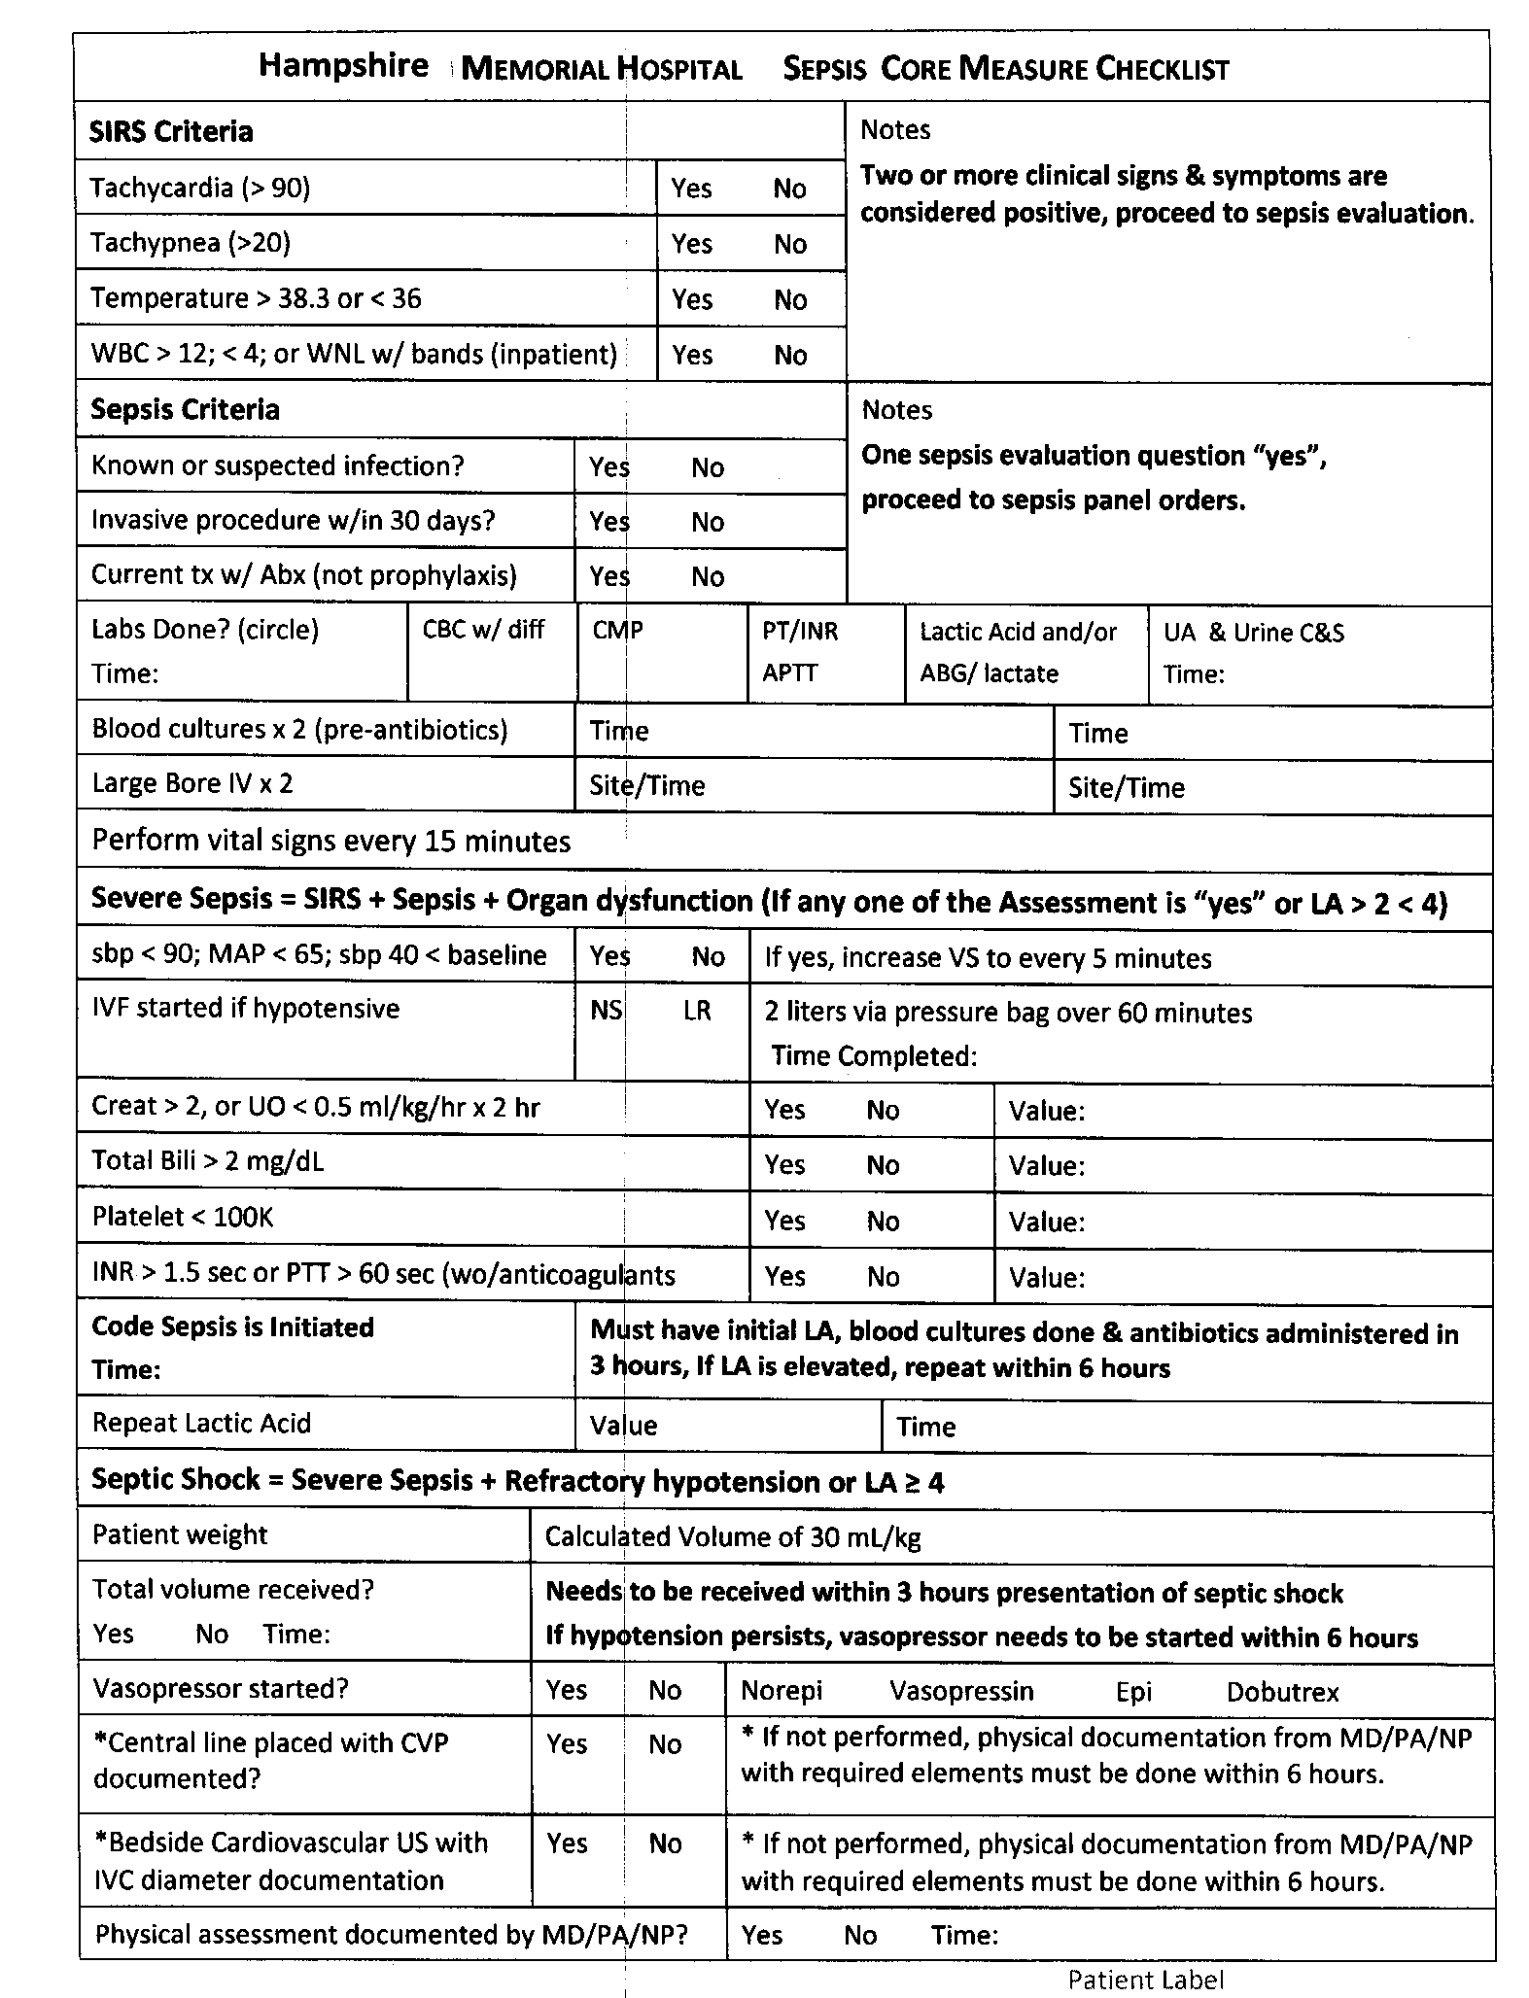
Sepsis Core Measure Checklist for Inpatients

Slide 13
Inpatient Sepsis Review-Harm Score Card
Receive list of Inpatients diagnosed with Sepsis
Identify the patients that meet the Severe Sepsis criteria
Once the clock starts for Severe Sepsis – Ensure the patient received all of the following within 3 hours:
    Blood Cultures drawn - at least one set (Y/N)
    Correct Antibiotics started after blood cultures (Y/N)
    Initial Lactic Acid drawn (Y/N)
    A minimum of at least 2 liters of Crystalloid ordered and started as a bolus/rapid infusion for patients that have hypotension (sbp<90;MAP<65:sbp40<baseline) or an initial Lactic Acid result of > 4 (Y/N or n/a)
Statement of measurement for harm score card:
    Numerator: The number of patients that have received the appropriate initial four steps in care for severe sepsis
    Denominator: Total number of patients that meet severe sepsis criteria

Slide 14
Hampshire Memorial Inpatient Sepsis Data

Slide 18
Questions
Thank you

