Slide 1
CAH Swing Bed PI/QI Pilot Project
Outcome Management Quarterly Meeting
July 24, 2018
Mary Guyot Consulting
207-650-5830 (cell/text)
maryguyotconsulting@gmail.com

Slide 2
Agenda
9:45 – 10:00 Registration
10:00 - 10:15 Welcome & Intro
10:15 - 11:00 Open discussion of challenges
11:00 - 12:00 Outcome & Benchmarking Data
12:00 - 12:45 Lunch
12:45 - 1:15 What is the data telling us?
1:15 – 2:00 Best Practice Process & Form Coding Review + Q&A
Most Frequently Asked Questions
2:00 - 2:15 Break
2:15 - 3:00 Action Planning

Slide 3
Welcome & Intro (10:00 to 10:15)
Name, Title
Hospital
Your involvement in the SB Pilot Project back at the hospital

Slide 4
Welcome & Intro (10:00 to 10:15)
From a presentation at the Reverse Site Visit Dianna Iobst attended last week
“Our perspective from the front line is that we need to find the best
possible path - so, we need information.”

Slide 5
Open Discussion of Challenges (10:15 to 11:00)
Managing our processes will pay off by improving our SB program quality!

Slide 6
Data Outcome & Benchmarking (11:00 to 12:00)
Includes Admissions from April 1, 2018 and all discharges by July 12, 2018
What can we learn about our SB program??

Slide 7
Data Outcome & Benchmarking (11:00 to 12:00)
Note
How is MEDIAN measured?
Stroudwater’s Response:
The median is generated automatically in Tableau, but by definition it is the middle number in a series of values.
Example:
Find the Median of {13, 23, 11, 16, 15, 10, 26}
Put them in order: {10, 11, 13, 15, 16, 23, 26}
The middle number is 15, so the median is 15
When the # is an even # to find the median, you take the average of the two middlemost numbers

Slide 8
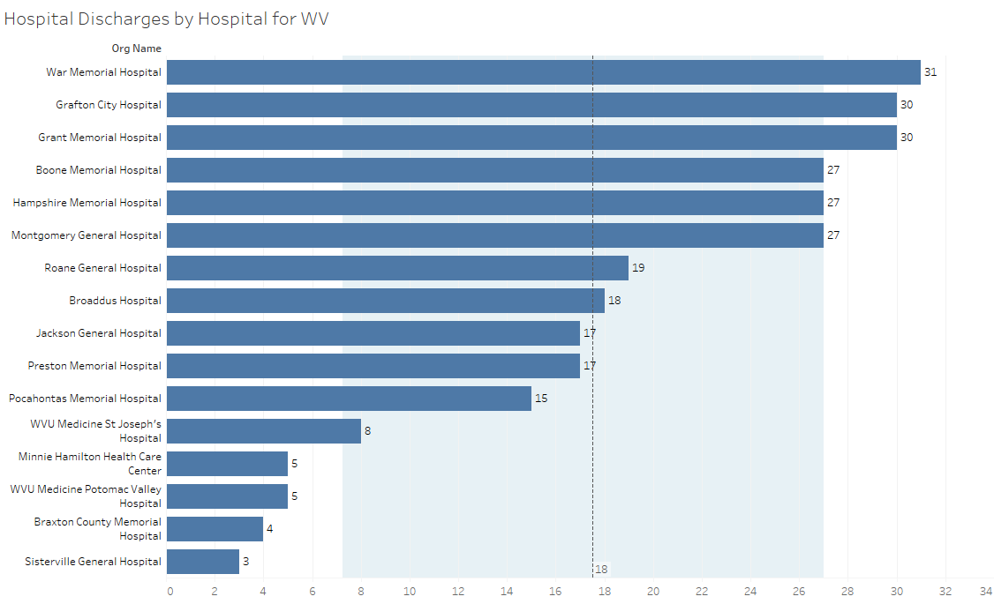
Swing Bed Discharges by Hospital
median
lower quartile
upper quartile
Waiting for data from 3 hospitals Still working on the contracts with SA

Slide 9
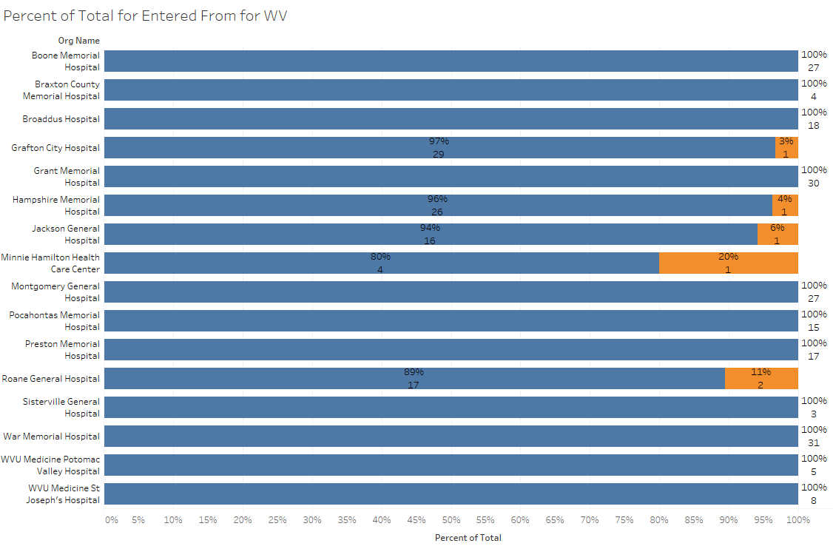
Percent of Total by Residence Pre-Acute Admission

Slide 10
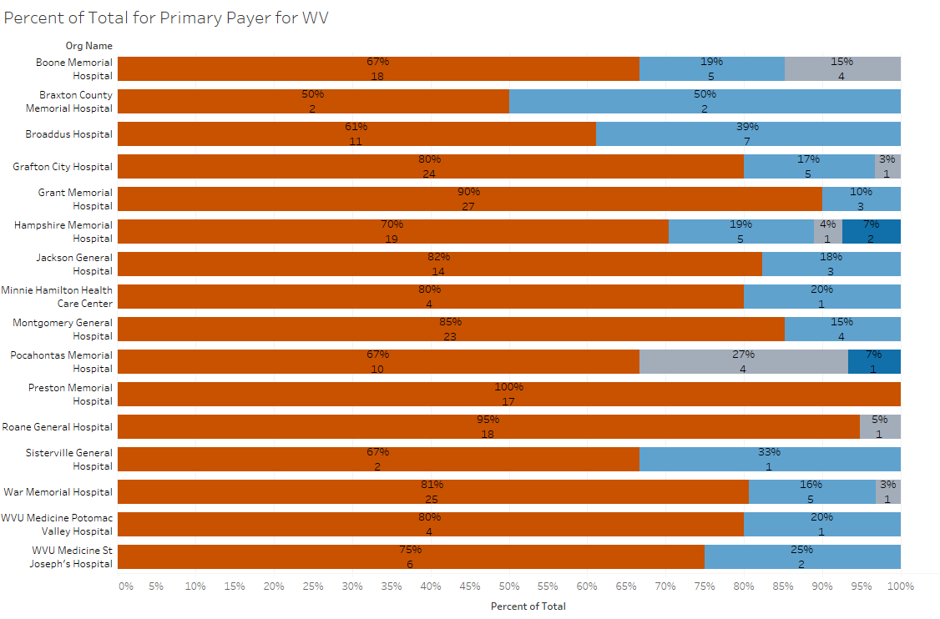
Percent of Total by Primary Payor

Slide 11
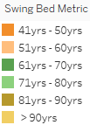
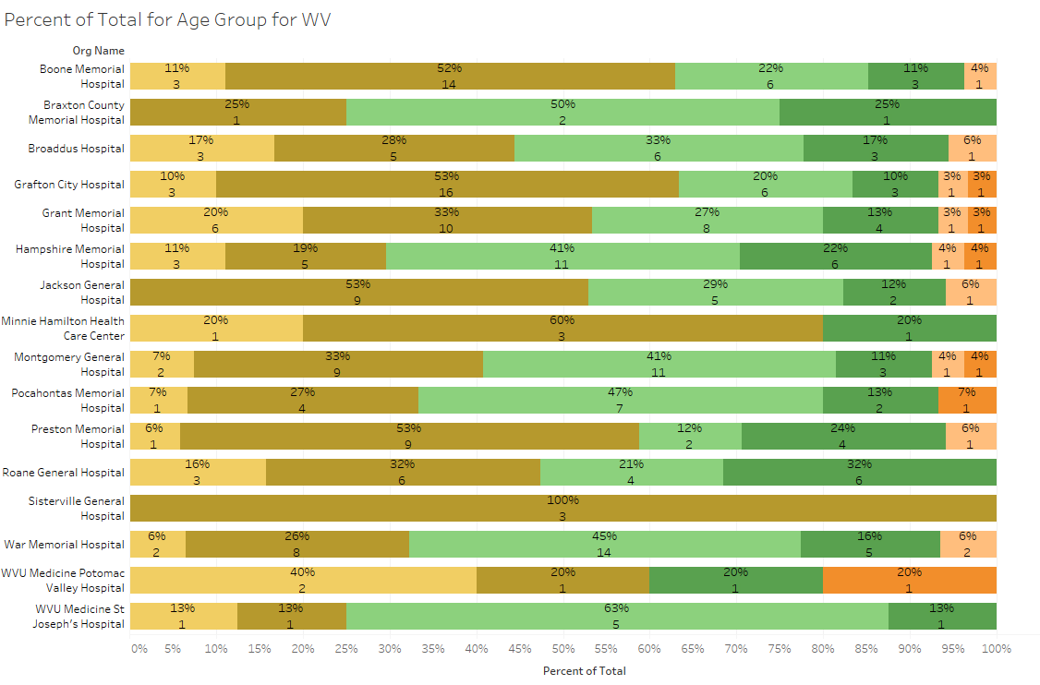
Percent of Total by Age Group

Slide 12
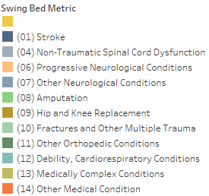
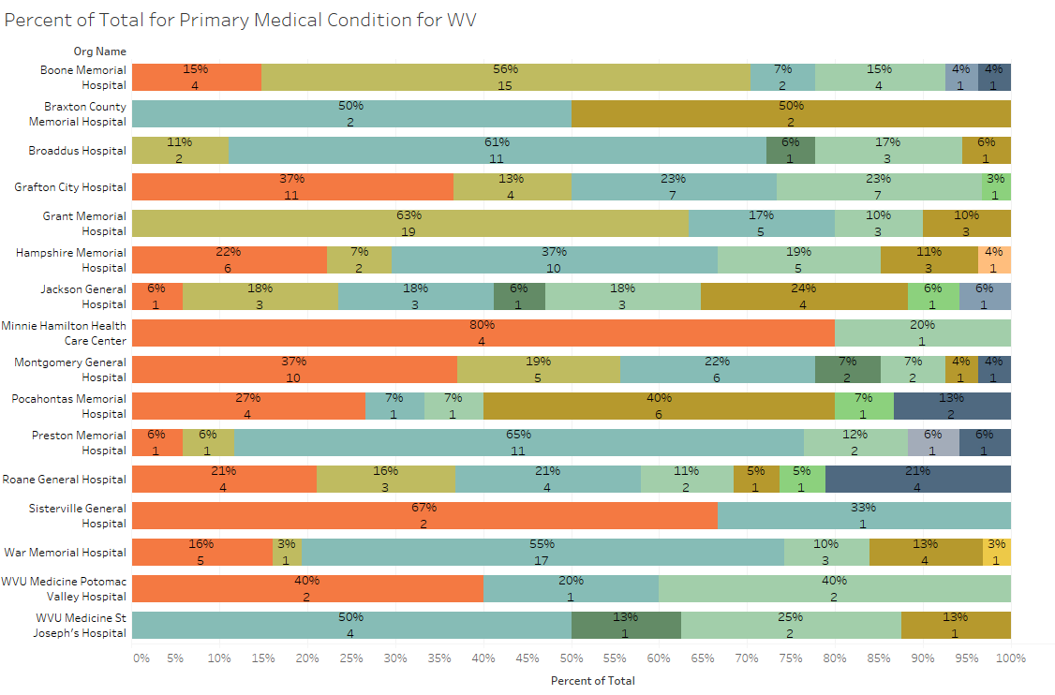
Percent of Total by Primary Medical Condition

Slide 13
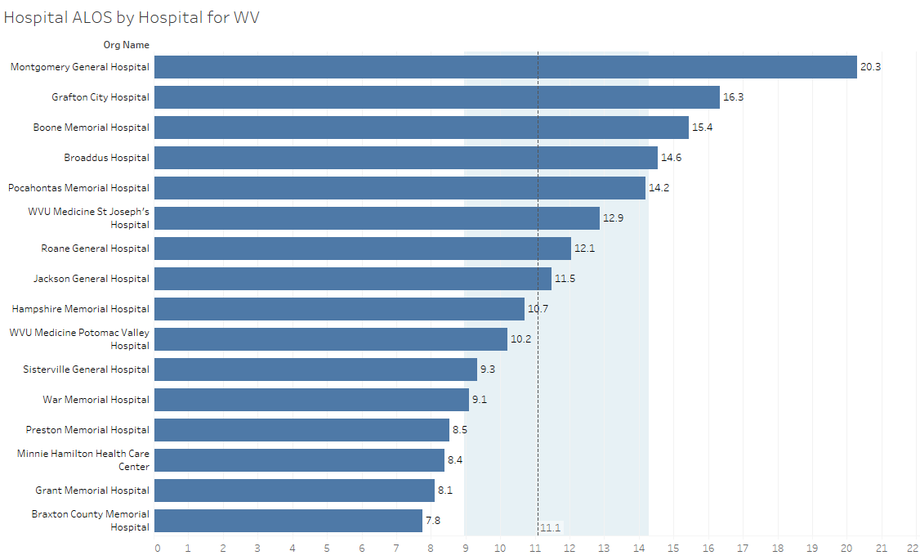
Swing Bed Average Length of Stay (ALOS) by Hospital
median
lower quartile
upper quartile

Slide 14
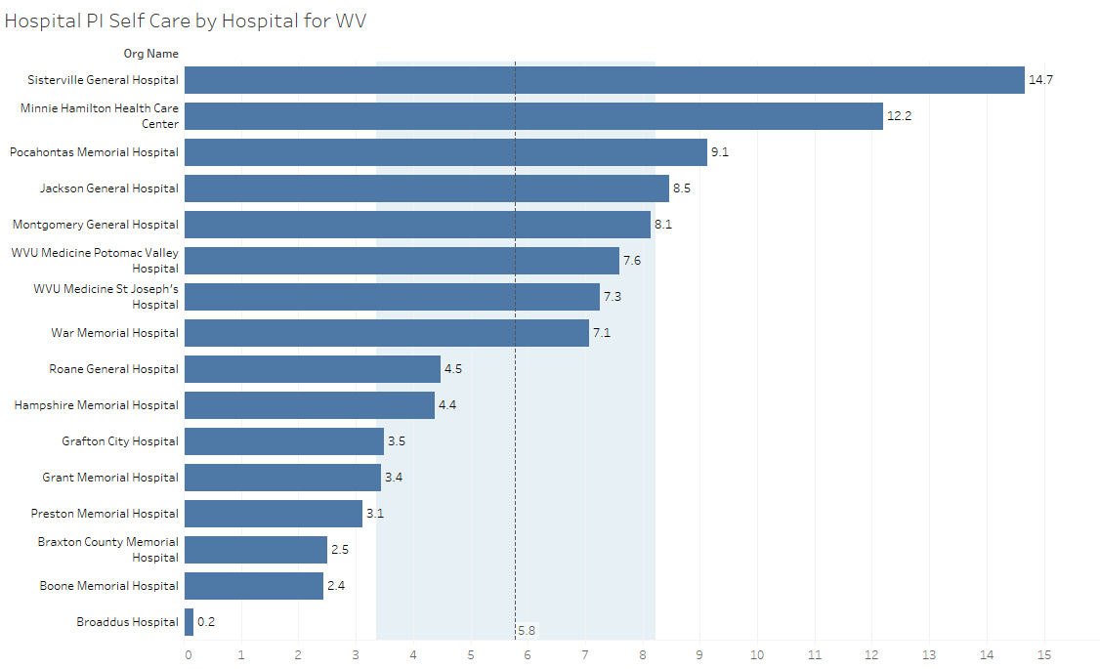
SB Performance Improvement Score for Self-Care
median
lower quartile
upper quartile

Slide 15
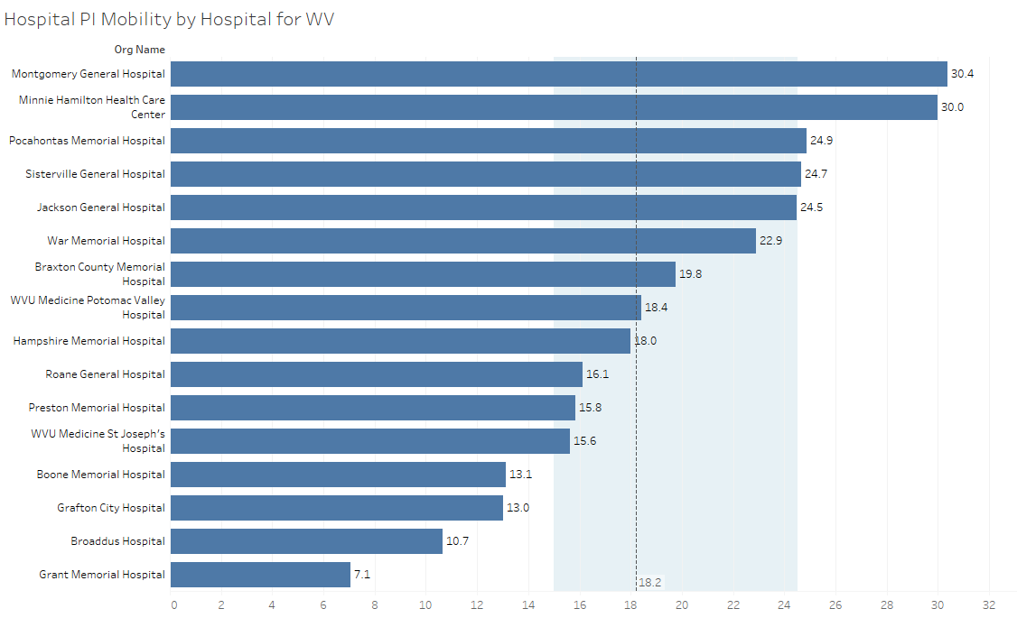
SB Performance Improvement Score for Mobility
median
lower quartile
upper quartile

Slide 16
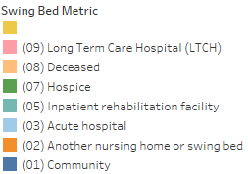
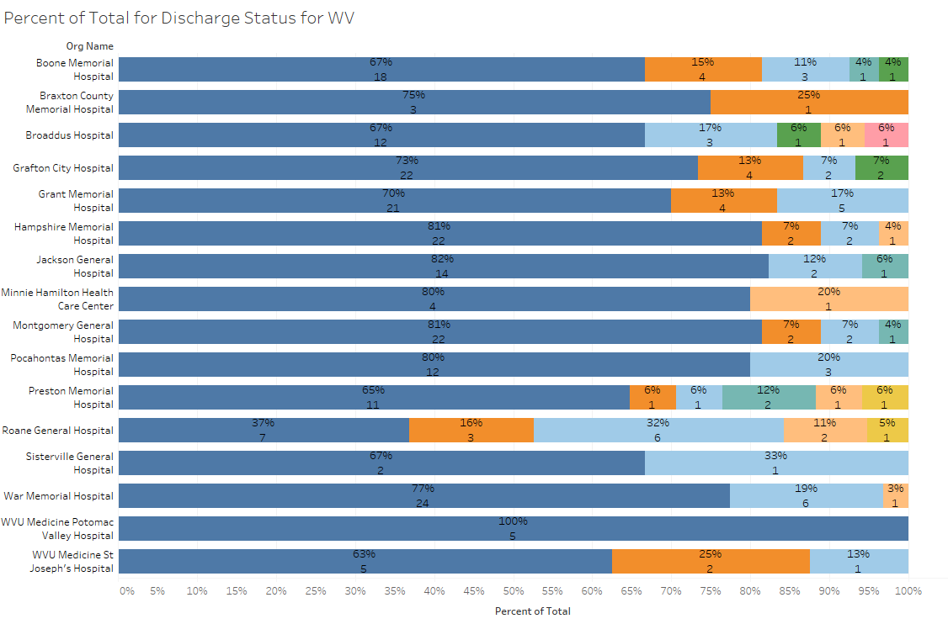
Percent of Total by Discharge Disposition

Slide 17
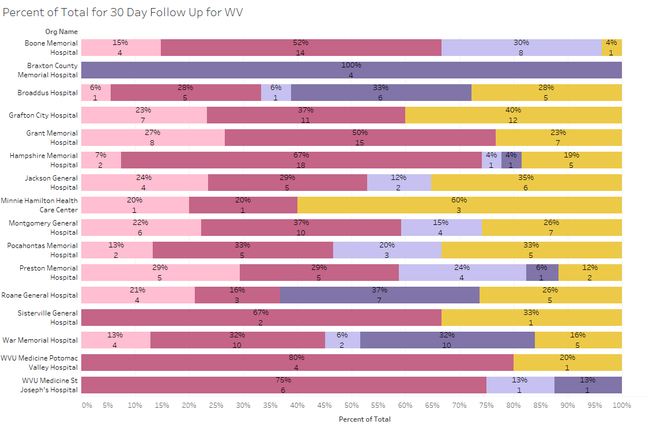
Percent of Total by 30-Day Follow Up

Slide 18
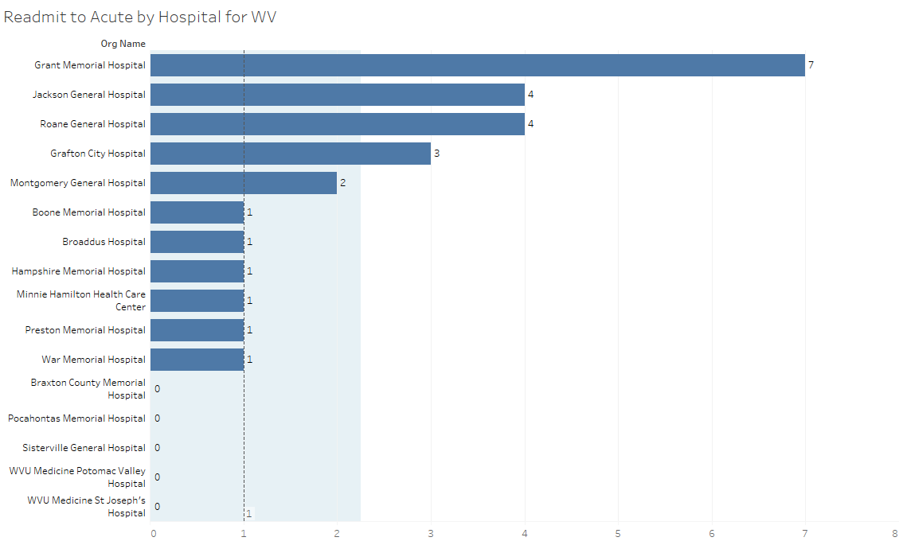
Number of Readmits to Acute by Hospital
median
lower quartile
upper quartile

Slide 19
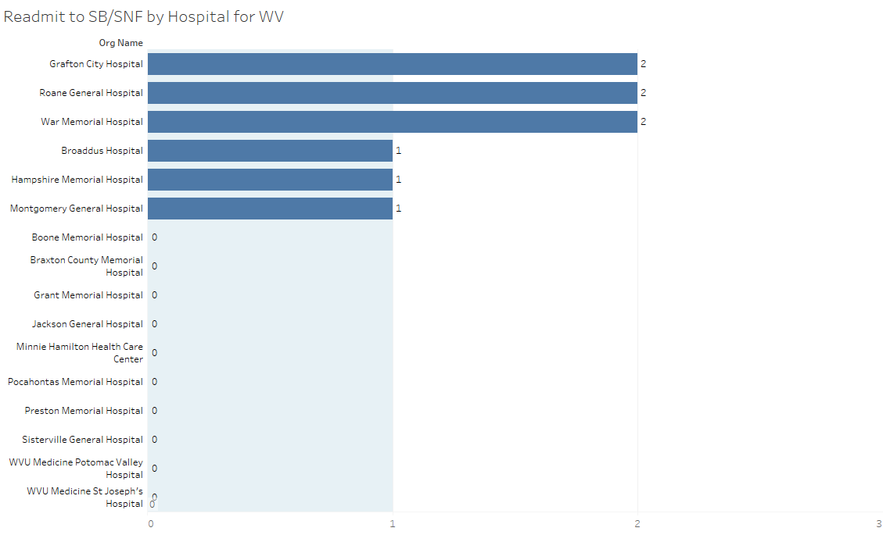
Number of Readmits to SB/SNF by Hospital
median
lower quartile
upper quartile

Slide 20
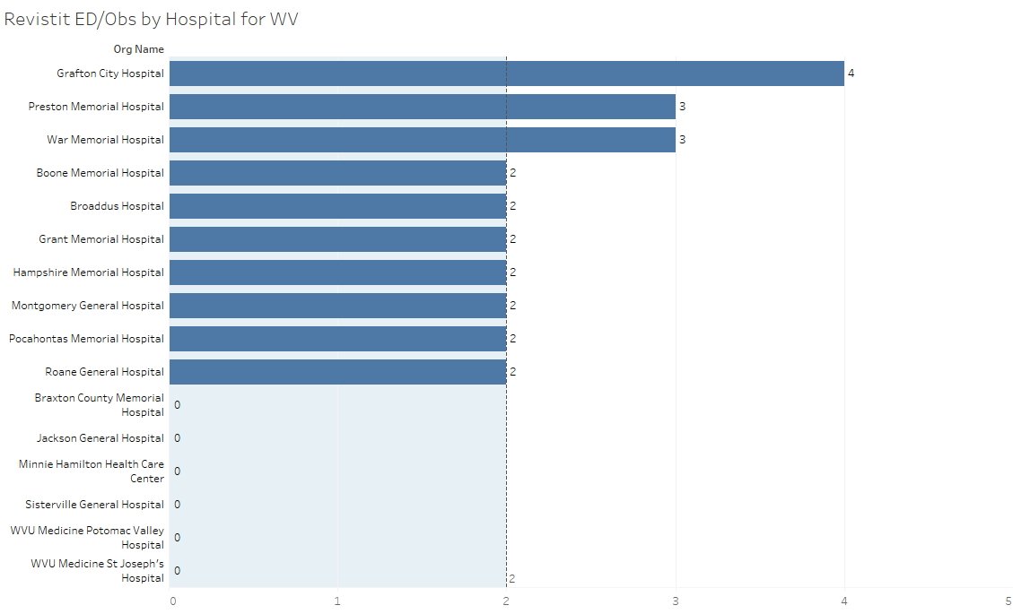
Number of Revisits to ED or Observation by Hospital
median
lower quartile
upper quartile

Slide 21
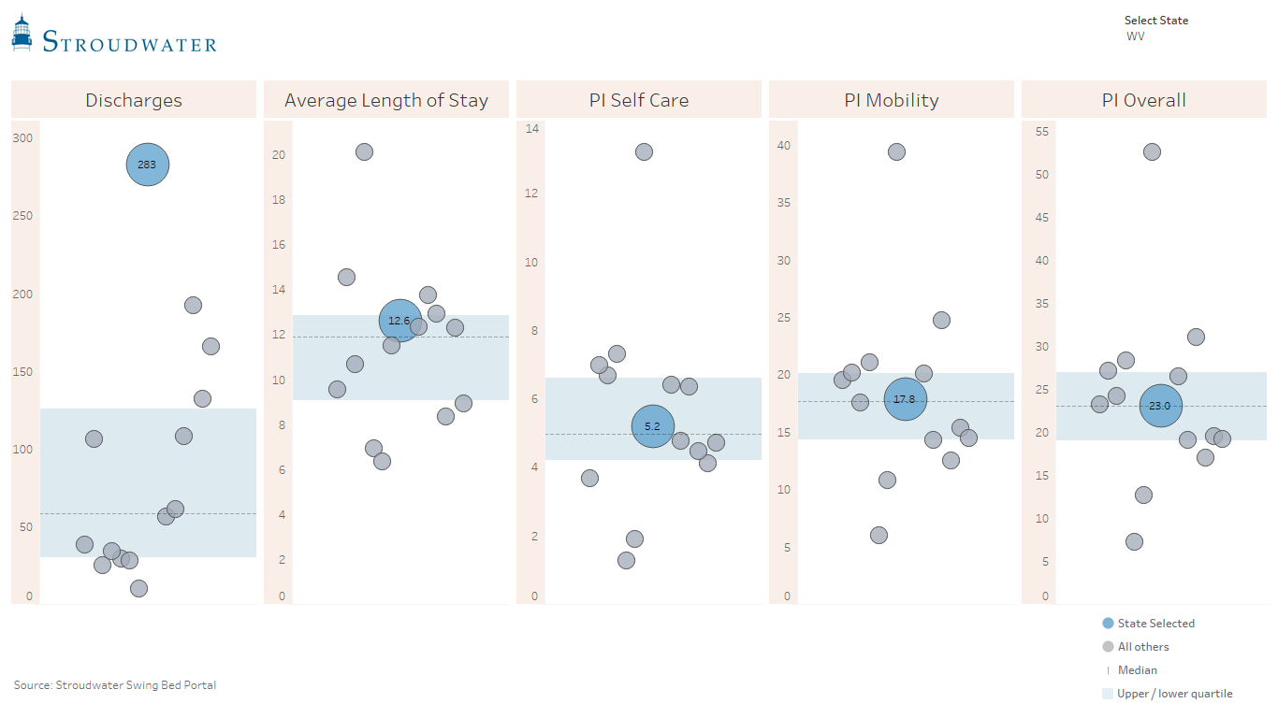
State Comparison

Slide 22
Networking Lunch (12:00 to 12:45)

Slide 23
What is the data telling us?
Preparing for your PI/QI and Leadership reports and meetings
Key components of measuring data are:
Analyzing the data (precious time waisted if we don’t – collecting data for collection sake is worth nothing if not for PI)
How do the measures impact each other?
What can we not do anything about?
What are the opportunities for process improvement? Don’t spend your time finding excuses!
Plan going forward
Data analysis involves the collection and organization of data. Then, finding correlations between that analyzed data and our SB program. It also entails the ability to spot problems and initiate preventative measures or problem solve creatively.

Slide 24
Best Practice Process
Remember that:
This pilot project is not an exercise to see if you can fill out a form!
The goal is to improve the quality of our programs
And to hopefully improve outcomes

Slide 25
Best Practice Process
Does Administration and Providers understand this pilot project and are they on board with it
Nursing & Therapy staff training
Determine who will be responsible for which sections
Limit # of nurses to participate in Admission and Discharge self-care & mobility coding
Coding of the above should be a team approach
Nursing & Therapy huddle by day 3 post admission and within last 1-2 days of discharge
Do we use the definitions of the functional measures to agree on a score?
Have we used the sample Coding scenario provided
Does our charting support what we scored the patient as?
SB Coordinator to start assessment form at the time of discharge planning assessment
Only trained staff to complete the BIMS or Memory section – must be done exactly as the form says – issues should be care planned and addressed

Slide 26
Best Practice Process (cont’)
Involve your coder in Primary Medical Condition and Comorbidities
Key staff trained to code unhealed pressure ulcers/injuries
Are we all on the same page re: patient understands/makes himself understood – do we discuss at IDT if necessary and is it care planned if there is an issue?
Do we incorporate our detailed assessments in our overall patient specific discharge goals?
Do we share the functional outcomes with our providers (admission & discharge) for them to incorporate in their progress notes?
Do we set consistent time to enter partial or completed paper forms in the Stroudwater tool? (such as every Friday) – if too busy, have we considered somebody else to do data entry ?
Do we discuss less than desired functional outcomes at the IDT meetings? What do we do with that info?
Will we run reports on a monthly basis to identify opportunities for improvement before too much time goes by?
Other??

Slide 27
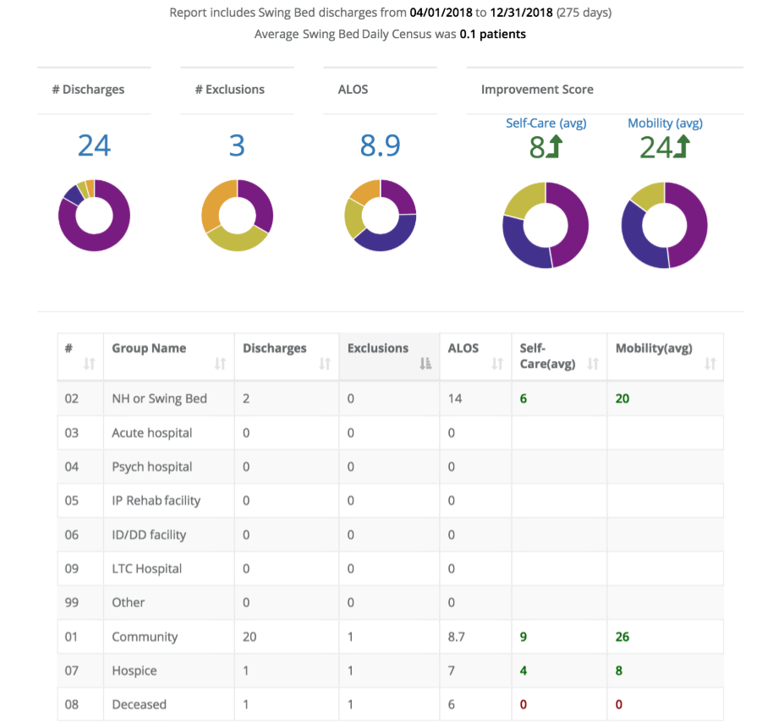
Best Practice Process (cont’)
Sample Stroudwater Hospital Data
You too can run these reports and print, transport data to excel etc…
What would you like to change from the data entry program?
What reports would you like to be able to pull?

Slide 28
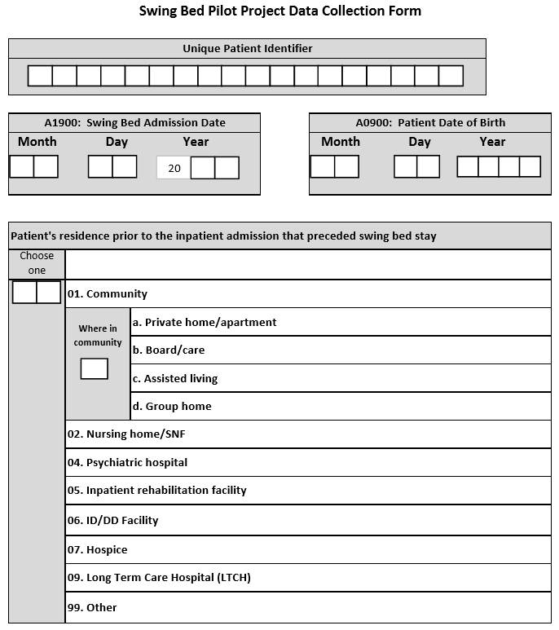
Coding Review and Q&A
A quick review of every section with Q&A
Take out the copy of the new data request form you brought
Make notes on it as we go along as needed to serve as reminders and share with the SB team

Slide 29
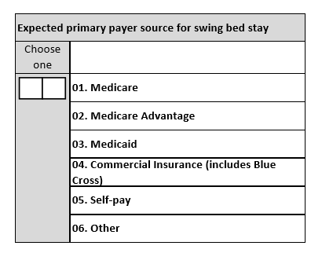
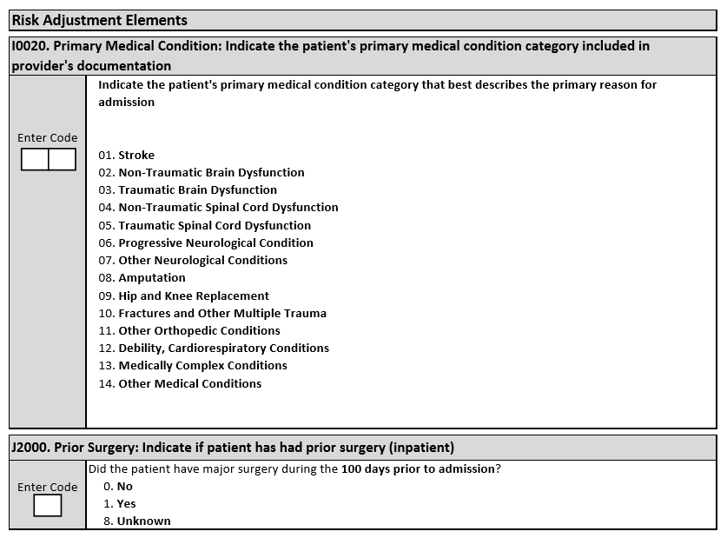
Coding Review and Q&A

Slide 30
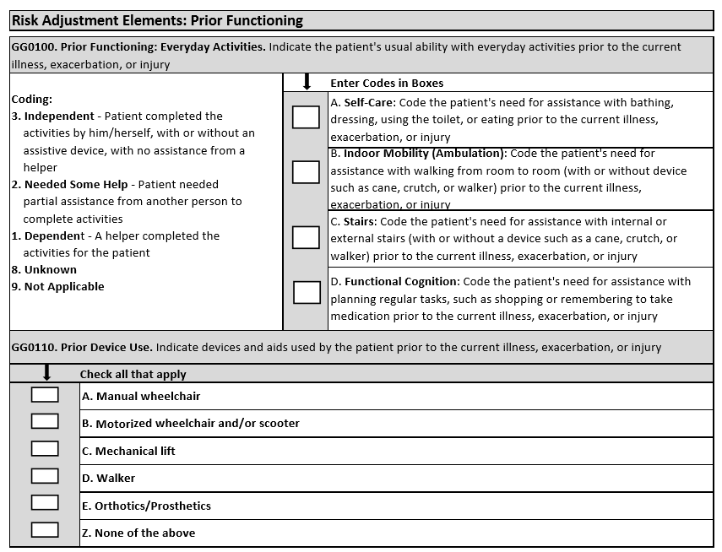
Coding Review and Q&A

Slide 31
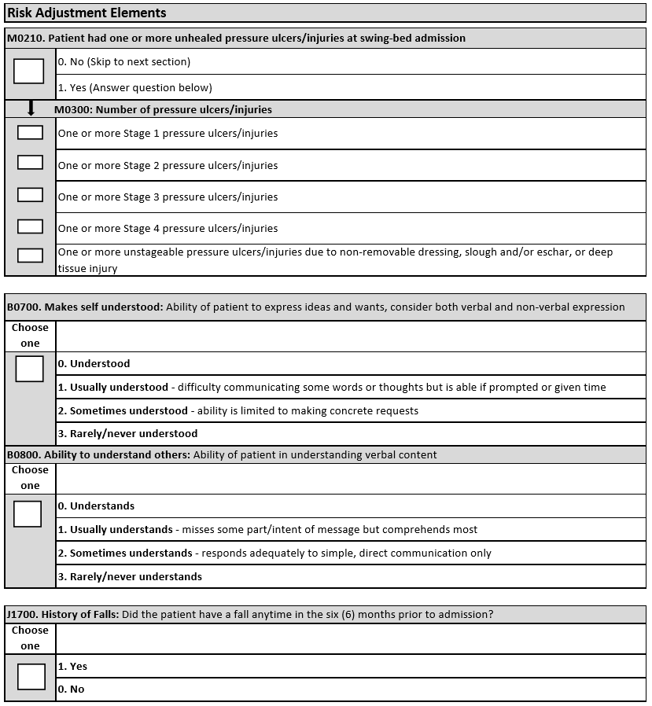
Coding Review and Q&A

Slide 32
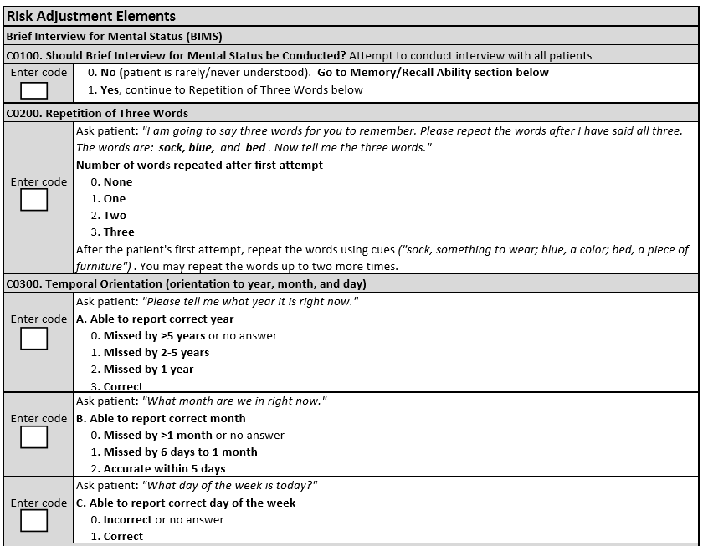
Coding Review and Q&A

Slide 33
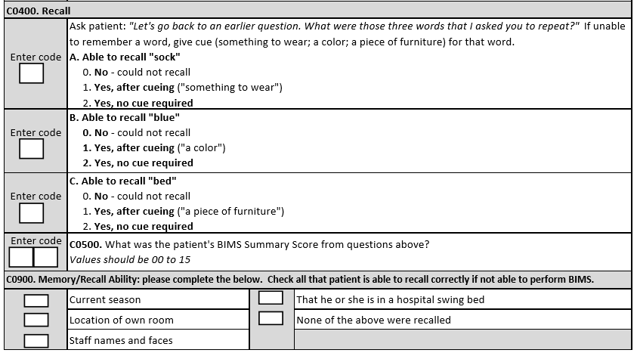
Coding Review and Q&A

Slide 34
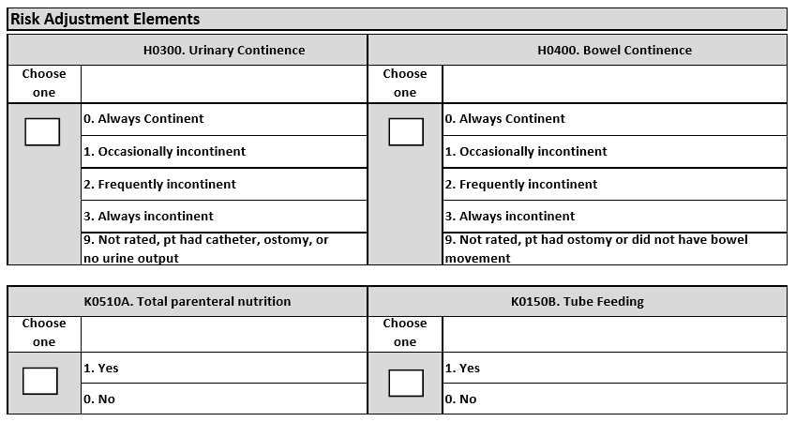
Coding Review and Q&A

Slide 35
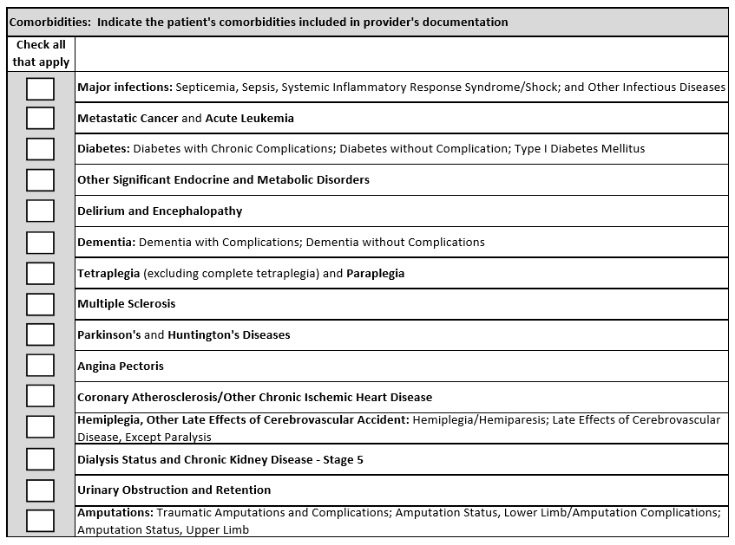
Coding Review and Q&A

Slide 36
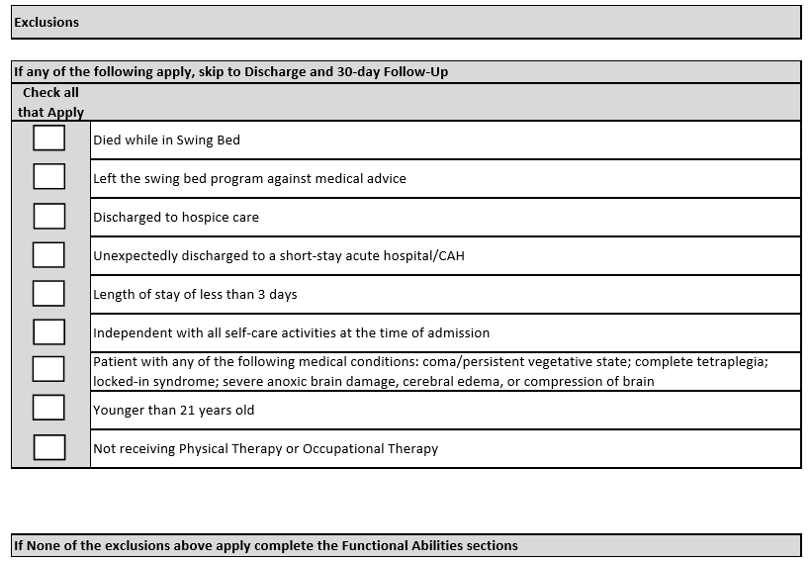
Coding Review and Q&A

Slide 37
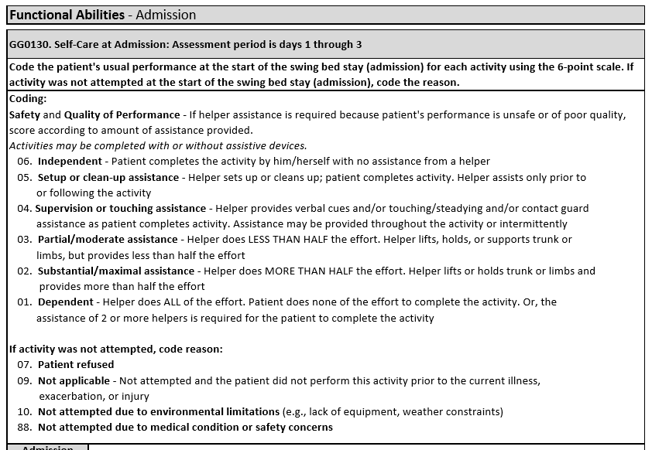
Coding Review and Q&A

Slide 38
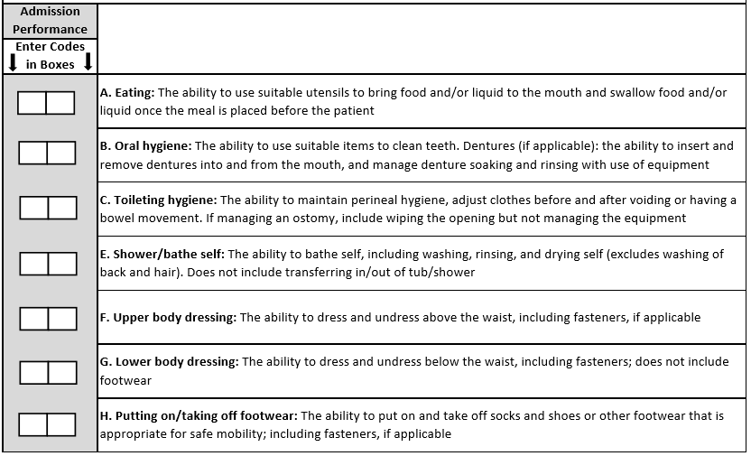
Coding Review and Q&A

Slide 39
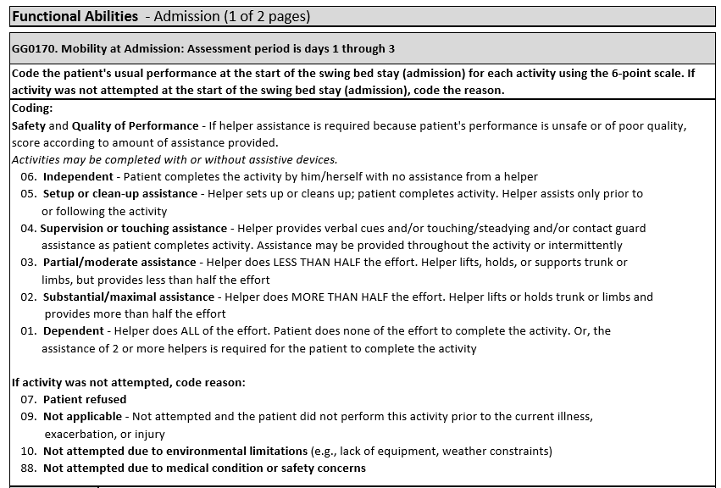
Coding Review and Q&A

Slide 40
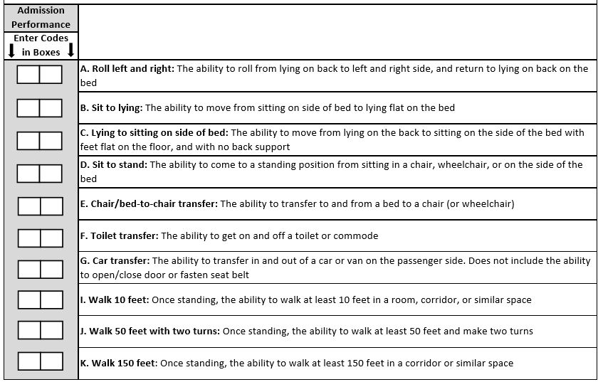
Coding Review and Q&A

Slide 41
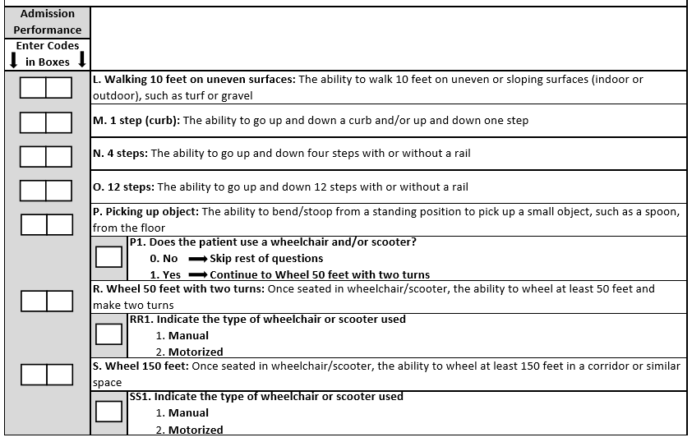
Coding Review and Q&A

Slide 42
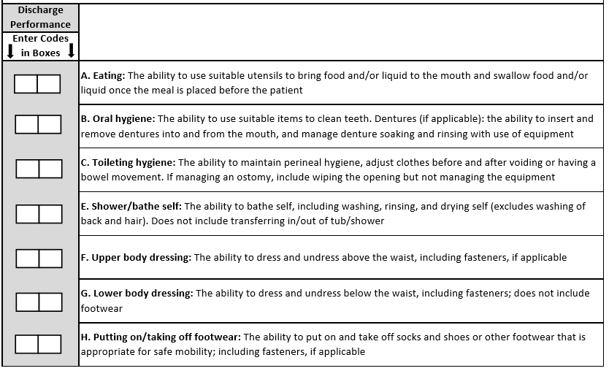
Coding Review and Q&A

Slide 43
Coding Review and Q&A

Slide 44
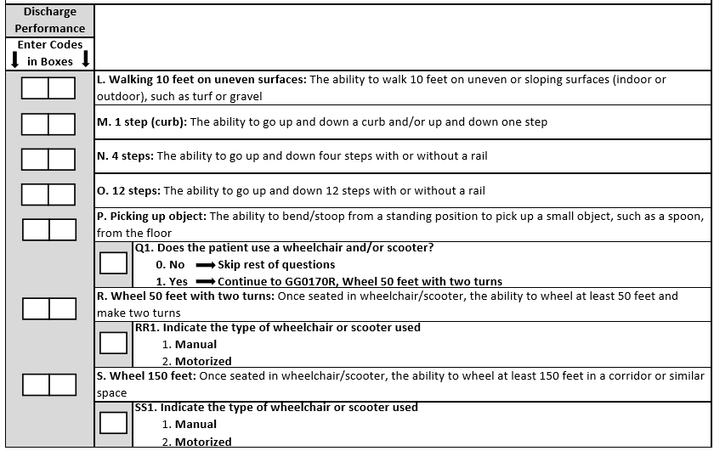
Coding Review and Q&A

Slide 45
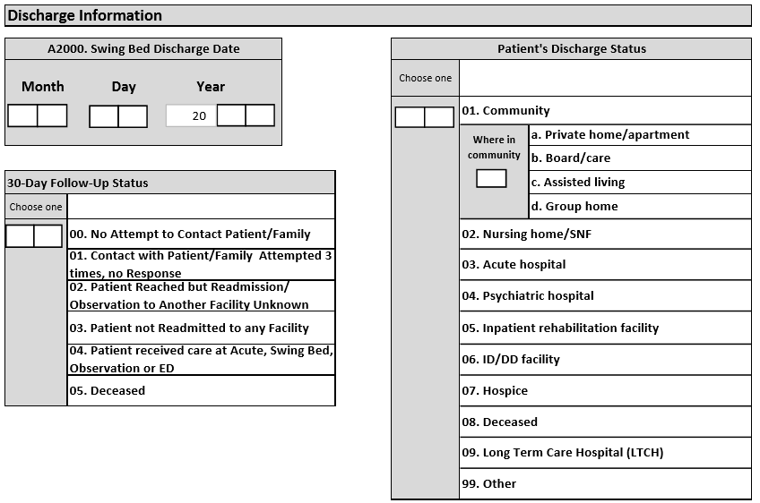
Coding Review and Q&A

Slide 46
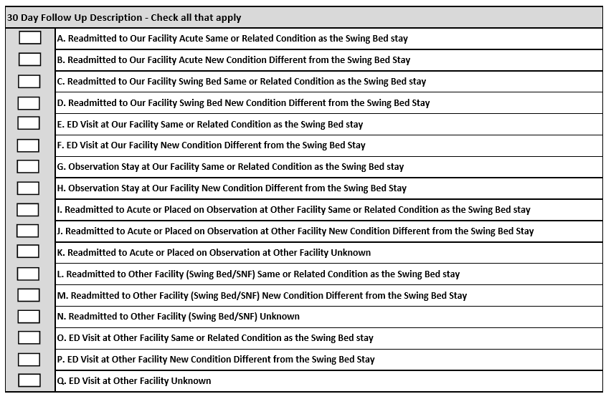
Coding Review and Q&A

Slide 47
Most Frequently Asked Questions
Q: Do we have to have data on every admissions?
A: YES
****************************************************************
Q: What if they fall into an exclusion list such as no therapy, death while in the program, discharged in 3 days or less, LAMA, D/C to hospice etc…
A: Complete all you can (preferably every sections down to “Functional Ability”
****************************************************************
Q: What if the patient was discharged unexpectedly and we only had time to do 4 of the sections?
A: It will show as incomplete – but nothing you can do unless you had good documentation and you can use the chart to complete down to the exclusion list

Slide 48
Most Frequently Asked Questions (Cont’)
Q: What if a patient had therapy but it only started on day 4 or 5, how do I document the admission Functional Assessment
A: Completed by nursing – why would we order therapy if we do not know their admission status? But should not have known the need for therapy before that?
***********************************************************************
Q: What if we did the admission functional assessment and entered the data in the system but the patient dies on day 5 which now puts him on the exclusion list – do I erase the functional data
A: No need, that info will be ignore but the rest will be used.
*************************************************************************
Q: How do I get the last column on the left to say 100%
A: Let’s discuss

Slide 49
Remaining Questions?

Slide 50
Afternoon Break (2:00 to 2:15)

Slide 51
Action Planning(2:15 to 2:55)
Time to commit!
Hospital Participant Discussion
Agree on 1 or more action title (based on level of difficulty)
Document x 2 (one for consultant and one for you) using the form provided
Report to the group
Meet with the team at the hospital to discuss lessons learn from this day, and develop an action plan using the form provided
Report outcome at the October meeting

Slide 52
Next Step (2:55 to 3:00) & THANK YOU!
Text or email me if you have any clinical questions or your team wants to conference or you run into a wall with your action plan (contact info on the cover slide). Send me what you would like the data entry program to do.
Email Paula Knowlton from Stroudwater at pknowlton@stroudwater.com for any technical questions (add a person with access to data, data entry issues, pulling reports together…)
Writing to Paula or I, PLEASE clarify which hospital you are asking about (email name is not always sufficient!!)
Work on Action Plan
Print out comprehensive reports before our next meeting to bring with you to include
# of discharges, ALOS, discharged to acute from SB, discharged to community, improvement score for self-care and mobility, and acute or SB readmission with 30 days post discharge for
All discharges from April 1 to June 30
All discharges from July 1 to Sept 30
Enter data for all July, Aug, Sept discharges by Oct 3rd or 10th depending on meeting day.
Enter 30-day follow-up data entry for all patients who have been discharged for 30 to 33 days by Oct. 3rd
Come prepared for the October meeting - October 23rd, 2018

