Slide 1
CAH Swing Bed PI/QI
Pilot Project
November 29, 2017
Mary Guyot, SB Consulting
207-650-5830 (cell/text)

Slide 2
Agenda
Introduction to the project
Purpose
Method for the pilot project
Quality Measures
Risk Adjustment
Pros & Cons of tools for measures
MDS sections for data gathering
Initial discussion for data gathering process
Next Step

Slide 3
PPS SB and SNFs Quality Measures
CMS tracks quality and cost via the MDS and FFS claims
Functional Abilities and Goals assesses the need for assistance with self-care and mobility activities (IMPACT ACT)
The information is collected at the start of a Medicare Part A stay on the 5-Day PPS assessment and is also collected at the end of the stay on the Part A PPS Discharge assessment.
Information will be posted by CMS and Discharge Planners will be required to share the info when making a referral
What data do CAH SB have regarding functional improvement?
Community discharge rate
30 days readmission post discharge
New or worsened pressure ulcers
Falls with major injury
Medicare Spending Per Beneficiary
Drug Regimen Review Conducted With Follow-Up for Identified Issues effective 10/1/18

Slide 4
What We Have Been Saying
CAHs have no quality measures to compare with others.
We must develop ways to measure the quality of care in our swing bed programs
Advocates such as NRHA, FORH or AHA Rural have no quality SB data to share with CMS

Slide 5
What We Have Been Saying
We need to have quality data to discuss with referring hospitals, payors, and our own communities
We need to have a leg up on competition!
Why wait until its mandated?
Should we not be asking for a system to measure and compare

Slide 6
CAH SB PI/QI Pilot Project

Slide 7
Introduction to the Project
PPS hospitals are required to collect patient data and provide it to CMS using the swing-bed Minimum Data Set (MDS)
CAHs are exempt from this requirement.
The limited information available on CAH swing-bed patients makes it difficult to determine whether CAH swing-bed patients differ from those being cared for in rural PPS swing-bed or SNF settings, and whether and how the quality of care being provided in those settings differs.

Slide 8
Introduction to the Project
Currently approximately 1,882 CAHs (88%) nationally provide swing-bed services.
Anecdotal evidence suggests that many CAHs collect some data on their swing-bed patients for internal quality improvement purposes
The lack of nationally comparable swing-bed quality measure data for CAHs creates problems.
CAHs are not uniformly able to demonstrate the quality of care provided to their swing-bed patients or compare it to national benchmarks.

Slide 9
Introduction to the Project
This leaves CAHs vulnerable to criticisms such as those raised by the Office of the Inspector General, which questioned whether the costs of CAH swing-bed care are too high for the Medicare program.
Although the OIG’s methods have been criticized, the Medicare program is responsible for ensuring that beneficiaries are receiving high value care, so the quality of the care being provided in CAH swing-beds is an important Medicare policy issue.

Slide 10
Introduction to the Project
The lack of quality data for their swing-bed services limits the ability of CAHs to participate in alternative payment models involving post-acute care.
Swing-bed quality of care has received little attention since a 1990 study compared the quality of care in SNFs and swing beds.
Recent studies have focused on the cost of swing-bed care and on comparing swing-bed and SNF patient characteristics and diagnoses but we do not have data though we take much of the same diagnosis

Slide 11
Introduction to the Project
CAH swing-beds also have not been included in recent quality measurement efforts.
The Improving Medicare Post-Acute Care Transformation Act of 2014 (IMPACT) requires post-acute providers, including Long-Term Care Hospitals (LTCHs), Skilled Nursing Facilities (SNFs), Home Health Agencies (HHAs) and Inpatient Rehabilitation Facilities (IRFs), to submit standardized and interoperable patient assessment data that will facilitate coordinated care, improved outcomes, and overall quality comparisons, but does not include CAH swing-beds.
Similarly, a National Quality Form (NQF) Measure Application Partnership project to select post-acute and long-term care quality measures focused on SNFs, HHAs, hospice, IRFs, and LTCHs, but did not address swing-beds.

Slide 12
Purpose of the Project
To address the gap in the literature about CAH swing-bed quality
The goal is to conduct a study to implement the pilot project to around 100 CAHs to:
Be trained on the same quality measures
Test clear guideline for measures
Determine consistent methods to collect data
Determine consistent methods to report data
Compare outcomes between these hospitals

Slide 13
Method to Design the Project
UMRHRC began the study with a review and synthesis of the peer-reviewed and grey literature on swing-bed services, and on quality measurement in SNFs, rural PPS swing-beds, and related health care settings.
They also obtained information from websites, reports, and quality measure databases of key organizations involved in quality measurement and improvement such as CMS, NQF, and the Joint Commission, to identify a comprehensive list of quality measures that are currently being used in post-acute care settings. The list included quality measures and data elements that are required by CMS for reporting by rural PPS hospital swing-bed programs and SNFs.

Slide 14
Method to Design the Project
Next, they conducted a series of key informant interviews by phone to discuss efforts to assess CAH swing-bed quality of care, including measures being used or considered by CAHs, data collection strategies, and usefulness of measures.
These interviews were conducted with:
Representatives of three CAH networks in Illinois, New York State, and West Virginia;
Four consultant groups working with CAHs on swing-bed quality issues; and
CEOs, quality improvement staff, and nurse managers who are responsible for swing-bed services at 11 CAHs and two rural PPS hospitals in ten states.

Slide 15
Method to Design the Project
UMRHRC identified the CAH networks and hospitals for interviews with input from our Expert Work Group, and through an email survey of State Office of Rural Health and Flex Program contacts in the 45 states with CAHs.
The purpose of the interviews was to:
Understand how CAHs are currently assessing the quality of care provided to swing-bed patients in their facilities, the resources they have available for quality measurement, and the challenges they face; and
Obtain their perceptions about the types of quality measures that they would find useful for measuring CAH swing-bed care, both internally and externally.

Slide 16
Method to Design the Project
The purpose of the interviews was to: (cont’)
The PPS key interviewees were asked about how they are currently assessing the quality of care provided to swing-bed patients in their facilities, and specifically about their experiences with reporting MDS data.
The key informant interview data were summarized and analyzed to identify common themes, including CAHs’ motivations to assess swing-bed quality and challenges measuring CAH swing-bed outcomes.
Based on their review of the literature, assessment of quality measures being used in other post-acute care settings, and results of the key informant interviews, they selected a preliminary set of swing-bed quality measures.

Slide 17
Method to Design the Project
They then developed an on-line survey to seek additional input from CAH quality experts on the potential measures, with a particular focus on functional status measures and tools
They invited 14 individuals with expertise in CAH quality issues, including State Office of Rural Health/State Flex Program staff, health care consultants who work with CAHs, quality improvement staff at rural hospital networks/CAHs, and representatives of NRHA, a state hospital association, and a Quality Improvement Organization to respond to the survey.
Thirteen individuals responded, and their responses were summarized and analyzed to inform further measure selection.

Slide 18
CAH SB PI/QI Pilot Project Measures
Recommended CAH Swing-Bed Outcome and Functional Status Quality Measures
For the initial set of swing-bed quality measures, the Rural Health Research Center recommends:
2 outcome measures
Discharge disposition and
Hospital readmission after a swing-bed stay
2 functional status measures
Change in self-care score and
Change in mobility score)
In addition, they recommend that CAHs collect the data elements needed to risk-adjust the self-care and mobility scores as specified below.

Slide 19
Measures # 1
Discharge disposition:
Definition: number and percent of all CAH swing-bed patients discharged to the community.
Purpose of this outcome measure is to assess whether a CAH swing-bed program is successfully returning discharged patients to the community.
Discharge disposition categories are:
Home (including a private home/apartment, board/care, assisted living, or group home facility) which may include home health services and/or outpatient therapy;
Transfer to nursing home/long term care facility; and
Transfer to higher level of care (e.g., return to inpatient acute care).

Slide 20
Measures # 1
Patients excluded from Measure # 1 are those who:
Resided in a nursing home/SNF prior to the inpatient admission that preceded their swing bed stay, and
Died during their stay in the SB program,
Left the swing-bed program against medical advice, or
Were discharged to hospice care
The CAHs that participated in the key informant interviews are informally tracking the discharge disposition of their discharged swing-bed patients, but they are not using uniform definitions (e.g., some define community as home only while others include other types of residences prior to inpatient admission; some analyze discharge settings separately by type of diagnosis, etc.).

Slide 21
Measures # 1
CMS has adopted three risk-adjusted discharge to community measures for SNF, IRF and LTCH settings.
These measures define successful discharge to the community as “discharge to home/self-care with or without home health services,”
provided the patient does not have an unplanned acute care readmission and
remains alive during the 31 days following discharge.
These measures are calculated by CMS using Medicare FFS claims data.

Slide 22
Measures # 1
For purposes of comparing risk-adjusted discharge disposition rates across CAH swing-bed programs and with other post-acute settings, UMRHRC recommends that CMS calculate risk-adjusted discharge to the community rates annually for CAH swing-bed programs using Medicare claims data, similar to the process used for other post-acute providers.
It would be useful if CMS calculated the discharge to community measure for CAH swing-bed programs using two years of claims data, as they are considering for SNFs, and already do for the discharge to community measures adopted for the IRF and LTCH Quality Reporting Programs.

Slide 23
Measure # 2
Readmissions after swing-bed stay:
Definition: rate of discharged CAH swing-bed patients who are readmitted for an unplanned hospital inpatient stay at any hospital within 30 days of discharge.
Purpose of this outcome measure is to assess whether a CAH swing-bed program is successfully preventing unplanned hospital readmissions.
The CAHs that participated in our key informant interviews recognize the importance of reducing unplanned hospital readmissions, and most are informally tracking whether their discharged swing-bed patients are being readmitted to the CAH

Slide 24
Measure # 2
CAHs are not using a uniform definition of readmissions that includes readmissions to any hospital, or risk-adjusting the data.
Respondents to our expert survey confirmed the importance of readmissions as an outcome measure, but raised questions about the need for risk-adjustment and what data CAHs would use to identify readmissions to other hospitals.
CMS currently calculates a hospital-wide all-cause unplanned risk-adjusted readmission rate for each hospital that includes all discharged medical, surgical and gynecological, neurological, cardiovascular, and cardiorespiratory inpatients using Medicare claims data, and reports this measure on Hospital Compare.

Slide 25
Measure # 2
CMS also calculates potentially preventable 30-day post-discharge readmission measures for SNFs, IRFs, LTCHs and HHAs, which are based on the hospital-wide readmission measure with some additions for post-acute settings.
However, there is no comparable readmission measure calculated specifically for swing-bed patients.
For internal quality improvement purposes, we recommend that each CAH swing-bed program track the number and percent of their discharged CAH swing-bed patients who are readmitted for an unplanned hospital inpatient stay at any hospital within 30 days of discharge, using a combination of hospital admission records and follow-up phone calls with discharged patients after 30 days post discharge as needed.

Slide 26
Measure # 2
Exclusions: Patients who left the swing-bed program against medical advice are excluded from the measure.
For purposes of comparing risk-adjusted readmission rates across CAH swing-bed programs and with other post-acute settings, we recommend that CMS calculate risk-adjusted readmission rates annually for CAH swing-bed programs using Medicare claims data, similar to the process used for other post-acute providers.

Slide 27
Outcome Measure # 1 & 2
Discussion of potential process to track data for these measures
Discharge disposition and
Hospital readmission after a swing-bed stay
What could work at your hospital?

Slide 28
Measure # 3
Change in Self-Care Score for Medical Rehabilitation Patients
Definition: This quality measure estimates the risk-adjusted mean change in self-care score between admission and discharge for CAH Medicare swing-bed patients discharged from a swing-bed.
The measure is based on the CMS functional outcome measure adopted for SNFs and IRFs under the IMPACT Act and endorsed by NQF as NQF measure #2633.

Slide 29
Measure # 3
The measure uses MDS Section GG elements (2018 version) and addresses the following self-care items:
eating,
oral hygiene,
toilet hygiene,
shower/bathing,
upper body dressing,
lower body dressing, and
putting on/taking off footwear.
All items are scored based on the level of dependence/assistance required, with a potential score range for the measure of 7 to 42

Slide 30
Measure # 3
Exclusions: The following patients are excluded from the denominator:
Patients with incomplete stays including those who are unexpectedly discharged to an acute care setting, inpatient psychiatric facility, or long-term care hospital;
Those who die;
Leave against medical advice;
Have a length of stay <3 days;
Who are independent with all self-care activities at the time of admission;
Have certain medical conditions (coma; persistent vegetative state; complete tetraplegia; locked-in syndrome; severe anoxic brain damage, cerebral edema, or compression of brain);
Are <21 years old;
Discharged to hospice; or
Who do not receive any physical or occupational therapy services

Slide 31
Measure # 4
Change in Mobility Score for Medical Rehabilitation Patients
This quality measure estimates the average risk-adjusted mean change in mobility score between admission and discharge for CAH Medicare swing-bed patients discharged from a swing-bed.
This measure is based on the CMS functional outcome measure adopted for SNFs and IRFs under the IMPACT Act, and endorsed by NQF as NQF measure #2634.

Slide 32
Measure # 4
It uses MDS Section GG elements and addresses the following mobility items:
roll left and right,
sit to lying,
lying to sitting on side of bed,
sit to stand,
chair/bed-to-chair,
ability to transfer to and from a chair (or wheelchair),
ability to get on and off a toilet or commode,
car transfer,
walk 10 feet, walk 50 feet with two turns, walk 150 feet,
walk 10 feet on uneven surfaces,
1 step (curb), 4 steps, 12 steps, and
picking up an object from the floor.

Slide 33
Measure # 4
All items are coded using a 1-6 rating scale (dependent to independent).
All items are scored based on level of dependence/assistance required, with a potential score range for the measure of 7 to 42.
Patient exclusions for this measure are the same as for Measure #3.

Slide 34
Measures #3 and #4
Data Elements Required for Risk-Adjustment
To fairly compare changes in self-care and mobility scores between admission and discharge for CAH Medicare swing-bed patients over time in a CAH, with other CAHs, and with other post-acute settings such as SNFs, it is necessary to risk-adjust the measures.
The following data elements from the revised MDS Section GG 2018 and selected items from other MDS Sections are required to risk-adjust the measures:

Slide 35
Data Elements Required for Risk-Adjustment Discussion
Age group at admission (< 54 years; 55 to 64; 65 to 74; 75 to 84; 85 to 90; > 90)
Primary medical condition category (checklist of 13 conditions and “other”) – see next slide
Prior Surgery (yes/no, major surgery during the 100 days prior to admission)
Prior Functioning: self-care and indoor ambulation (dependent, some help, independent)
Prior Device Use (checklist of 5 devices, e.g., walker, manual wheelchair, etc.)
Presence and stage of pressure ulcer(s) at admission

Slide 36
Data Elements Required for Risk-Adjustment Discussion
Primary medical condition category
Stroke (I0020, Primary medical condition category = 01)
Non-traumatic brain dysfunction (I0020, Primary medical condition category = 02) and traumatic brain dysfunction (I0020, Primary medical condition category = 03)
Non-traumatic spinal cord dysfunction (I0020, Primary medical condition category = 04)
Traumatic spinal cord dysfunction (I0020, Primary medical condition category = 05)
Progressive neurological conditions (I0020, Primary medical condition category = 06)
Other neurological conditions (I0020, Primary medical condition category = 07)
Amputation (I0020, Primary medical condition category = 08)
Hip and knee replacement (reference category) (I0020, Primary medical condition category = 09)
Fractures and other multiple trauma (I0020, Primary medical condition category = 10)
Other orthopedic conditions (I0020, Primary medical condition category = 11)
Debility and cardiorespiratory conditions (I0020, Primary medical condition category = 12)
Medically complex conditions (I0020, Primary medical condition category = 13)
Other medical condition (I0020, Primary medical condition category = 14)

Slide 37
Data Elements Required for Risk-Adjustment Discussion
Cognitive Abilities: Brief Interview for Mental Status (BIMS) score
Communication Impairment: ability to understand and be understood (rarely/sometimes/never)
Urinary Continence (occasionally, frequently, always incontinent; catheter, ostomy or no urine output)
Bowel Continence (occasionally, frequently, always incontinent; ostomy or no bowel movement)
Tube feeding or total parenteral nutrition
Comorbidities (14 hierarchical condition categories) (see next page)

Slide 38
Data Elements Required for Risk-Adjustment Discussion
Comorbidities (14 hierarchical condition categories)
Central nervous system (CNS) Infections: Bacterial, Fungal, and Parasitic Central Nervous System Infections; Viral and Late Effects Central Nervous System Infections
Other Infectious Diseases (HCC 7)
Metastatic Cancer and Acute Leukemia
Lymphoma and Other Cancers
Other Major Cancers: Colorectal, Bladder, and Other Cancers; Other Respiratory and Heart Neoplasms; Other Digestive and Urinary Neoplasms; Other Neoplasms
Dementia: Dementia With Complications; Dementia Without Complications
Mental Health Disorders: Schizophrenia; Major Depressive, Bipolar, and Paranoid Disorders; Reactive and Unspecified Psychosis; Personality Disorders
Tetraplegia (excluding complete tetraplegia) and paraplegia
Multiple Sclerosis
Coronary Atherosclerosis/Other Chronic Ischemic Heart Disease

Slide 39
Data Elements Required for Risk-Adjustment Discussion
Comorbidities (14 hierarchical condition categories) – cont’
Hemiplegia/Other Late Effects of Cerebrovascular Accident: Hemiplegia/Hemiparesis; Late Effects of Cerebrovascular Disease, Except Paralysis
Aspiration, Bacterial, and Other Pneumonias: Aspiration and Specified Bacterial Pneumonias; Pneumococcal Pneumonia, Empyema, Lung Abscess
Legally Blind
Dialysis Status and Chronic Kidney Disease - Stage 5
Chronic Kidney Disease - Stages 1-4, Unspecified: Chronic Kidney Disease, Severe (Stage 4); Chronic Kidney Disease, Moderate (Stage 3); Chronic Kidney Disease, Mild or Unspecified (Stages 1-2 or Unspecified)
Major Fracture, Except of Skull, Vertebrae, or Hip
Amputations: Traumatic Amputations and Complications; Amputation Status, Lower Limb/Amputation Complications; Amputation Status, Upper Limb

Slide 40
Pros & Cons of MDS Measures
Pros of adopting MDS measures for CAH swing-bed patients
Individual self-care and mobility items are summarized into two overall measures that assess change between admission and discharge.
The measures have been adopted by CMS for other post-acute settings (SNFs and IRFs) and approved by NQF.
The measures are aligned with IMPACT goals and would allow comparison of outcomes for CAH swing-bed patients with IRFs and SNFs (and also PPS swing-bed patients).
Detailed measure specifications (e.g., patient exclusions) are already developed.

Slide 41
Pros & Cons of MDS Measures (cont’)
Pros of adopting MDS measures for CAH SB patients (cont’)
Scoring methods and risk adjustment methods are already developed (same scale of 6 options for each item, national means for SNF comparisons).
The risk-adjustment variables include cognitive assessment.
MDS section GG is familiar to many health care providers.
There are many psychometric studies of MDS.
Recent research has shown that the ADL items on admission and discharge assessments in MDS 3.0 can be used for assessing functional improvement over the course of a post-acute SNF stay and provides empirical support for the risk-adjustment variables used for the functional status measures.21

Slide 42
Pros & Cons of MDS Measures
Cons of adopting MDS measures for CAH SB patients
Requires collection of 22 data elements (7 self-care items and 15 mobility items),
Involving more staff time than the shorter Barthel Index.
The measures need to be risk-adjusted to fairly compare outcomes across settings,
Involves collection of additional MDS data on risk factors.

Slide 43
Pros & Cons of Barthel Index Measures
Pros of adopting the Barthel Index for CAH swing-bed patients
CAH swing-bed programs in two states have begun using the Barthel Index to collect functional status data at admission and discharge and weekly.
The Index is straightforward and requires collection of fewer data elements (only 6 self-care items and 5 mobility items, and no risk adjustment data elements), involving less staff time than the MDS-based functional outcome measures.
Scoring methods are developed (scale of 5 options with varying points for each item).

Slide 44
Pros & Cons of Barthel Index Measures
Cons of adopting the Barthel Index for CAH swing-bed patients
The Barthel Index has not been adopted by CMS or approved by NQF.
Detailed measure specifications (e.g., patient exclusions) have not been developed.
No risk-adjustment methods have been developed.
The Barthel Index would not allow comparison of outcomes for swing-bed patients across CAHs or with other post-acute settings such as SNFs.
The tool was designed for stroke rehabilitation patients and research using it has focused primarily on this population; it is not clear how applicable it is to the mix of patients cared for in CAH swing-bed programs.
No cognitive status measures are included.

Slide 45
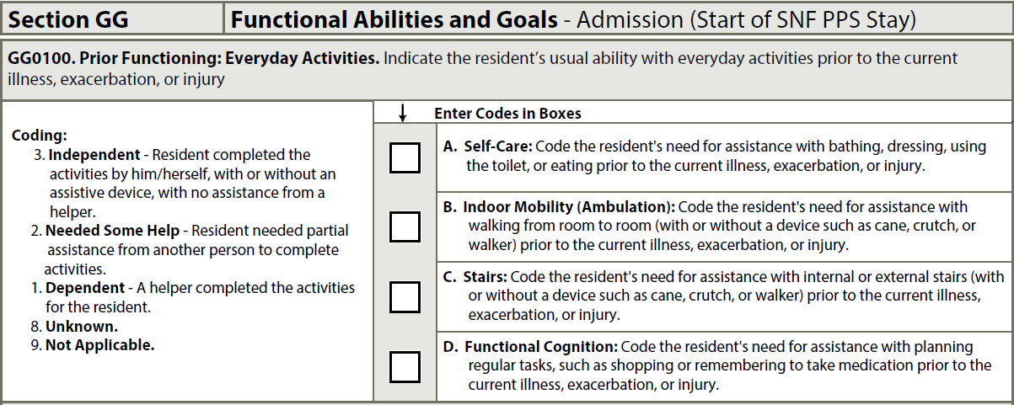
MDS Section GG

Slide 46
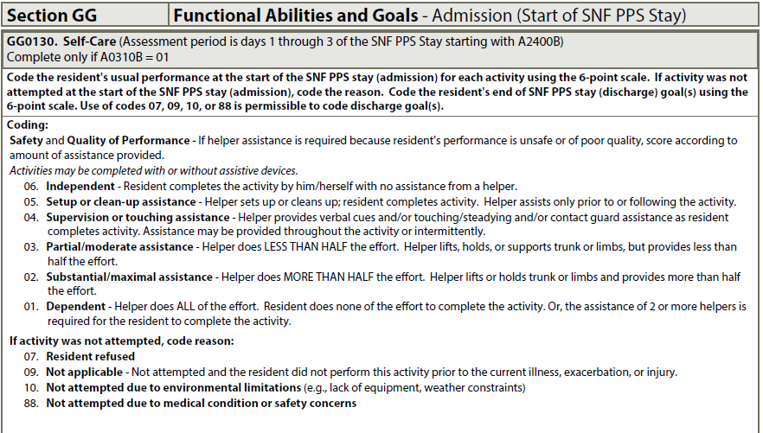
MDS Section GG (Self-Care on Admission)

Slide 47
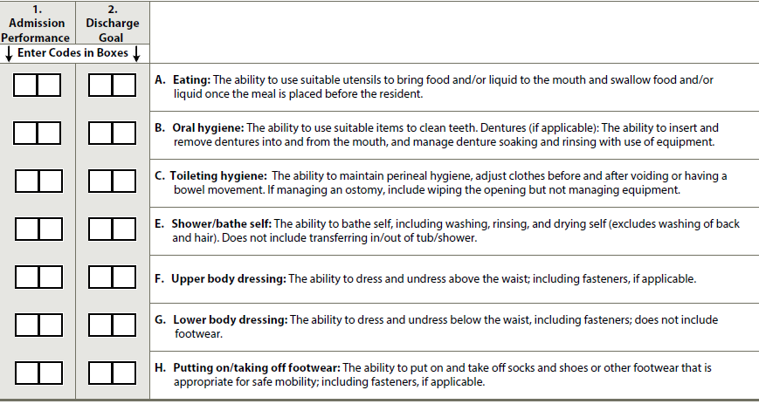
MDS Section GG (Self-Care on Admission)
Unsure if they will track Discharge Goals – does not appear so at this time
But team would be encourage to use that info for programming

Slide 48
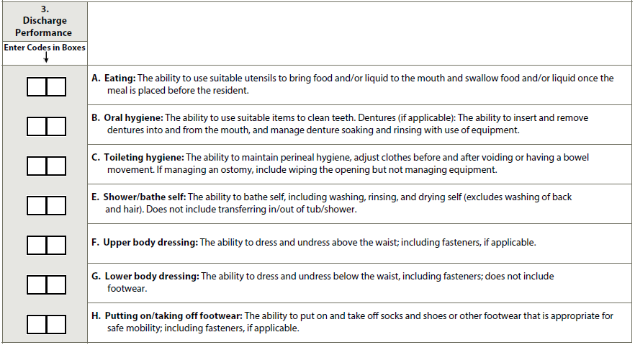
MDS Section GG (Self-Care on Admission)
Discharge Performance measuring within 1 to 3 days pre-discharge using
same coding as admission

Slide 49
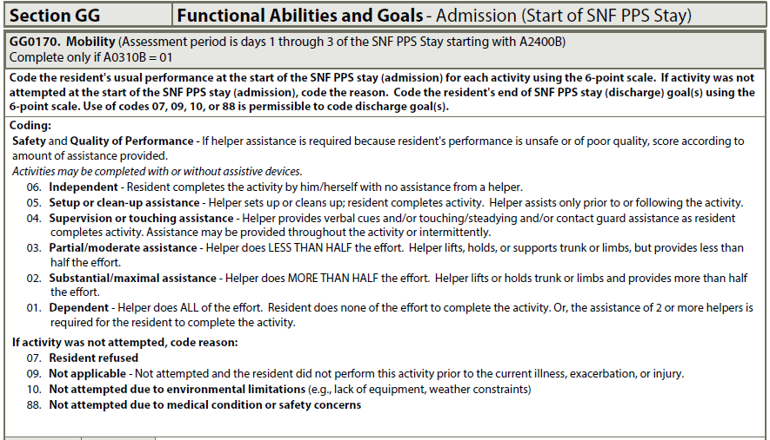
MDS Section GG (Mobility on Admission)

Slide 50
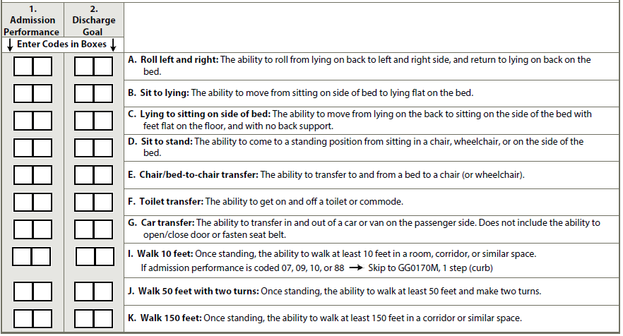
MDS Section GG (Self-Care on Admission)
Unsure if they will track Discharge Goals – does not appear so at this time
But team would be encouraged to use that info for programming

Slide 51
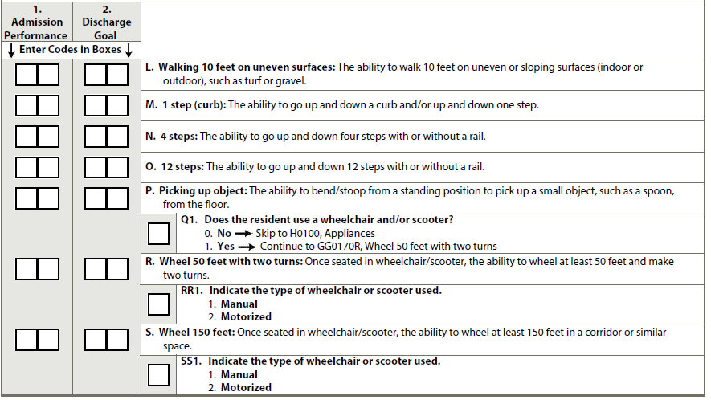
MDS Section GG (Self-Care on Admission)

Slide 52
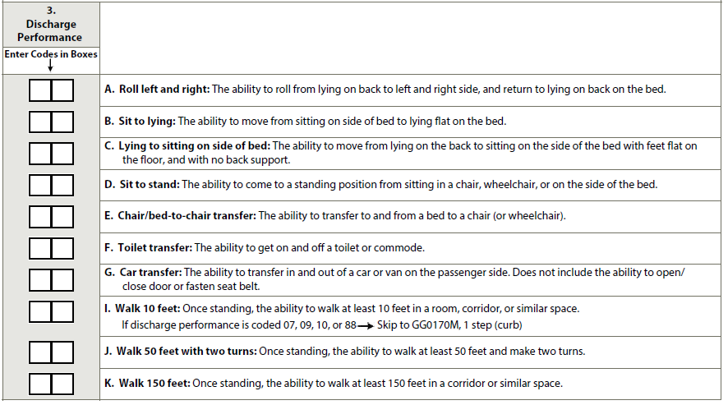
MDS Section GG (Self-Care on Admission)
The same information is completed again within 3 days pre-discharge

Slide 53
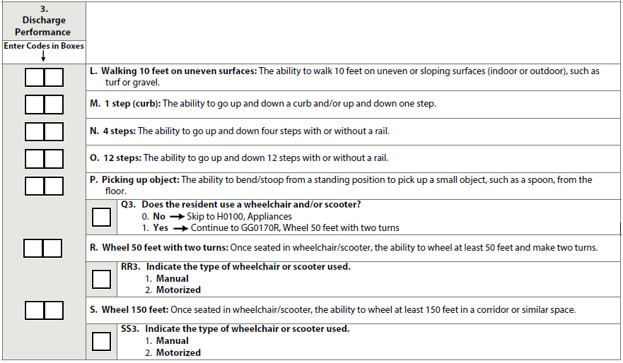
MDS Section GG (Self-Care on Admission)
The same information is completed again within 3 days pre-discharge

Slide 54
Preliminary Discussions re: Functional Measures Data Gathering
What process would work best

Slide 55
Preliminary Discussions re: Risk Adjustment Data Gathering
Age group at admission (< 54 years; 55 to 64; 65 to 74; 75 to 84; 85 to 90; > 90)
Primary medical condition category (checklist of 13 conditions and “other”)
Prior Surgery (yes/no, major surgery during the 100 days prior to admission)
Prior Functioning: self-care and indoor ambulation (dependent, some help, independent)
Prior Device Use (checklist of 5 devices, e.g., walker, manual wheelchair, etc.)
Presence and stage of pressure ulcer(s) at admission
Cognitive Abilities: Brief Interview for Mental Status (BIMS) score
Communication Impairment: ability to understand and be understood (rarely/sometimes/never)
Urinary Continence (occasionally, frequently, always incontinent; catheter, ostomy or no urine output)
Bowel Continence (occasionally, frequently, always incontinent; ostomy or no bowel movement)
Tube feeding or total parenteral nutrition
Comorbidities (14 hierarchical condition categories)

Slide 56
Potential other MDS Section for Risk Adjustment
Communication Impairment: ability to understand and be understood (rarely/sometimes/never)

Slide 57
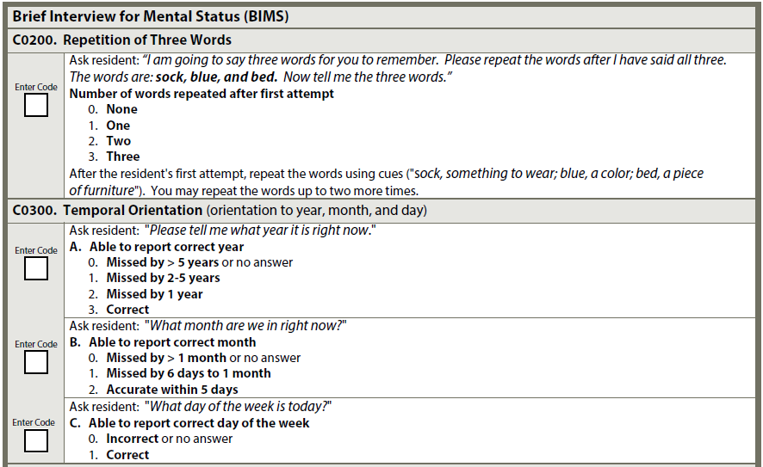
Potential other MDS Section for Risk Adjustment
BIMS + Brief Interview for Mental Status (cognitive assessment)

Slide 58
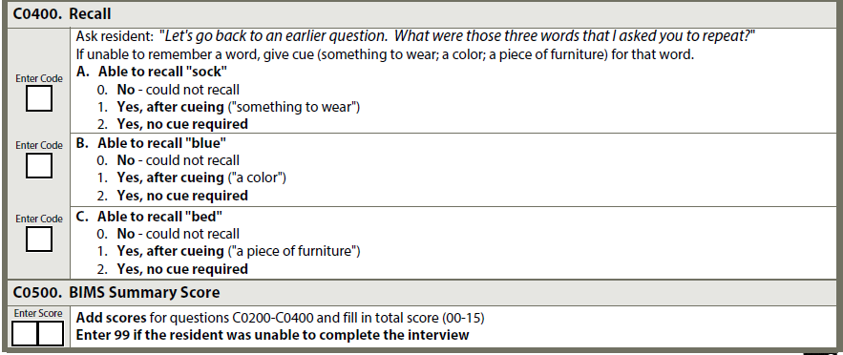
Potential other MDS Section for Risk Adjustment
BIMS + Brief Interview for Mental Status (cont’)

Slide 59
CAH SB PI/QI Pilot Project
Where to from here?

Slide 60
CAH SB PI/QI Pilot Project
At early stage of a pilot project
Plan is to provide use with guideline and data gathering format by the end of Dec.
Plan is a commitment for 1 year – no new comers to the project after the start date
Goal is to start gathering the data – now potentially delayed to March 1
UMRHR Center need to agree on:
A format for data gathering for all 4 measures
A format for risk adjusted measures
Guidelines based on CMS needed to ensure consistency between SB programs
Develop expectations re: data reporting tool and timing
Develop a process to analyze data and report back

Slide 61
CAH SB PI/QI Pilot Project
More training (Jan 23rd, 2018) – will let you know ASAP if it needs to delayed
Official tools to be used
Training re: expectations and timing
Discussion of :
Outcome of internal conversations at your hospitals,
Issues to resolve re: data collection
Review of expectations etc
Best practice for data gathering
??? Follow-up meetings in July & Sept – DTBD to review data outcome and discuss best practice

Slide 62
So what does that mean for YOUR Hospitals?
Homework:
Internal conversation with the SB rehab teams (nursing, therapy) care managers/DC Planners/SB Coordinators, HIM, and SB providers to discuss pilot project, processes that would be required to add/change, data collection etc…

