Slide 1
CAH Swing Bed PI/QI Pilot Project
Hospital Staff Training
March, 2018
Mary Guyot Consulting
207-650-5830 (cell/text)
maryguyotconsulting@gmail.com

Slide 2
Agenda
What is the SB PI/QI Pilot Project
Purpose/objectives of the project
Quality Measures, Risk Adjustment, and Readmission data
Exceptions
Basic CMS Coding rules
Breakdown of the data gathering tool
Review coding example tool
Recommended process to complete required data
Next step

Slide 3
Why a SB PI/QI Pilot Project
Swing-bed programs in rural Prospective Payment System hospitals and Skilled Nursing Facilities must submit Minimum Data Set patient data to CMS. CAHs are exempt.
CAHs are not uniformly demonstrating the quality of care provided to their swing-bed patients.
Inability to demonstrate swing bed quality potentially limits CAHs’ ability to participate in alternative payment models.
Objective is to hopefully address the gap in the literature about CAH swing-bed quality but by collecting information on all patients, we will be able to compare programs across the country much better
The goal is to conduct the study implementing the pilot project at 100+ CAHs from 10-12 States using the same assessment tool, reporting to the same place (Stroudwater Associates) and comparing data from all participating CAHs

Slide 4
Long-Term Goals & Project Timelines
Improve quality care and CAH SB outcomes
Data to use to promote your programs
To be approved by NQF and adopted by CMS
Project Timeline
Start with all SB admissions effective April 1st, 2018 and ends March 31st, 2019
It is a 1 yr. commitment for now!

Slide 5
Who Is Involved in Developing this Project?
Critical Access Hospital Swing Bed Outcomes Measurement Pilot Project Ira Moscovice, PhD (UMRHRC) Carla Wilber (Stroudwater Associates) Gregory Wolf (Stroudwater Associates) Mary Guyot (Mary Guyot Consulting)

Slide 6
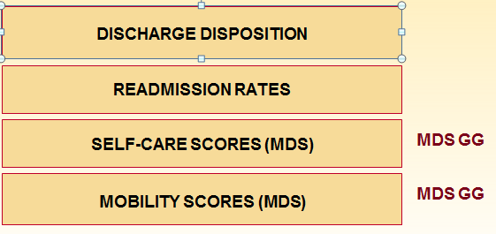
CAH Swing Bed Pilot Project Quality Measures
RISK ADJUSTMENT FACTORS (MDS)

Slide 7
Will all patients require an assessment?
For this project, every admission, regardless of payor will require all info re:
Admission Demographics
Unique ID #
DOB
Entered from
Payor source
Risk Adjustment Data
Admitting medical condition
Major surgery in past 100 days
Prior functioning status before admission to the hospital
Prior device use
Pressure ulcer/injury on admission to SB
Communication impairment
History of falls in past 6 months
BIMS Score or Memory Recall if patient can’t do BIMS
Urinary & Bowel incontinence
Tube feeding
Comorbidities
Discharge Demographics
D/C Disposition
Readmission within 30 days post discharge (same or different condition)
Includes IP admissions, ED visits, placed in Observation
Some patients will be excluded from the sections re Functionality and Mobility - see slide 20

Slide 8
??? Before we go on to Data Collection Tool & Scenarios

Slide 9
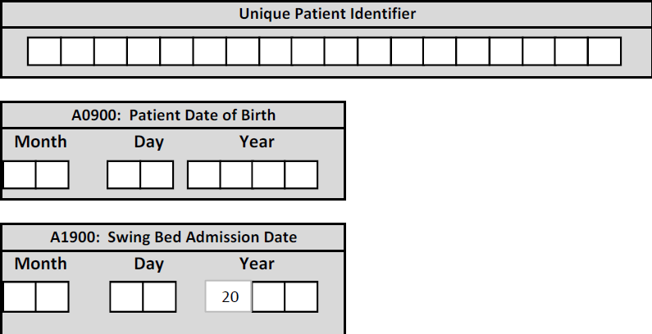
Demographics
Unique Patient Identifier as decided by hospital such as act. # or something totally different but you must have a system where you would remember how to access the info.
DOB and SB Adm. Date is self-explanatory

Slide 10
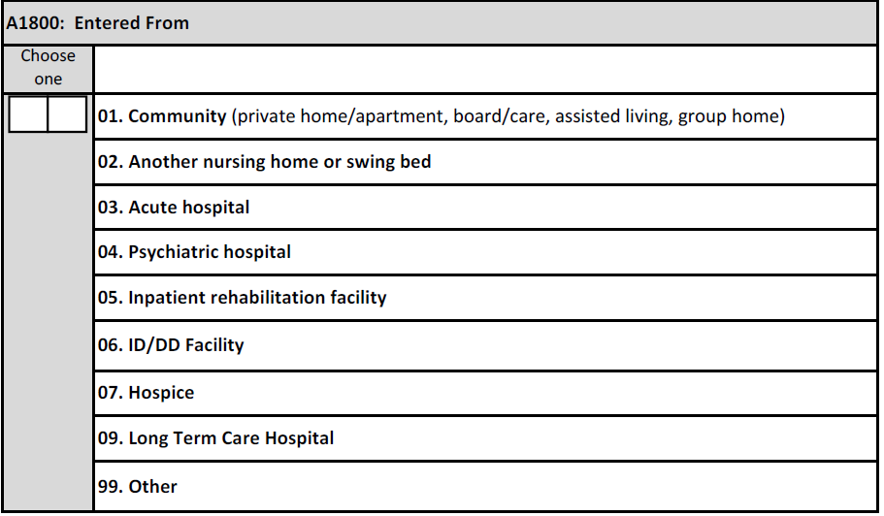
Demographics
Unique Patient Identifier as decided by hospital such as act. # or something totally different but you must have a system where you would remember how to access the info.
DOB and SB Adm. Date is self-explanatory
Self-explanatory
Any questions?

Slide 11
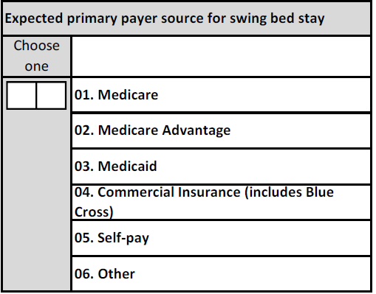
Payor
Medicare = generic/general
Medicare Advantage such as HMO
Medicaid – only applies if primary – not to be used for Medicare/Medicaid – in this case you would choose Medicare
Commercial – all other insurance
Self-pay – self-explanatory
Other = RR, VA, Prison etc…
The questions is: what will be the primary payor?

Slide 12
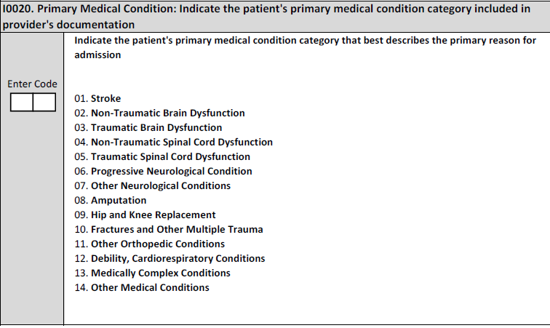
Primary Medical Condition/Reason for SB Admission
Note: PRIMARY medical condition category documented by the provider
These are for grouping purpose only – we don’t admit for a stroke but s/p stroke so any type of stroke and sequelae would be “01”
Pay attention to hip & knee replacement vs FX and other multiple trauma
Debility, Cardiorespiratory condition could be for HBP, COPD, CHF, post-CABG, Asthma, etc
Medically complex conditions – examples can be multiple medical issues post surgery, a patient who is diabetic, on dialysis and in for wound care. acquired multisystem disease…
Other is for when you cannot find a code that will fit the others
IP surgery within 100 days prior to SB admission

Slide 13
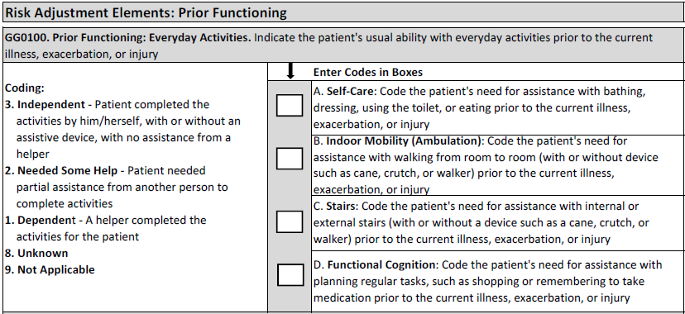
Prior Functioning – Before Hospital Admission
Independent – NO Assistance from a helper
Needed some help – self-explanatory
Dependent – a helper is a must
Unknown – only to be used if the patient cannot say and there are no family/friends… who can inform us.
Not applicable – one would expect that you would have a code 1, 2 or 3 for (A) self-care because that is a must but feasible that you would have N/A for ambulation and stairs if the patient does not do that. Same goes for functional cognition

Slide 14
Prior Device Use – Before Hospital Admission
Note: Devices & aids that the patient used prior to being admitted to acute for the current illness/medical condition
If patient was not using a device prior to hospitalization but was given a walker or w/c during the acute stay for his/her ambulation – the answer would be “Z” none of the above

Slide 15
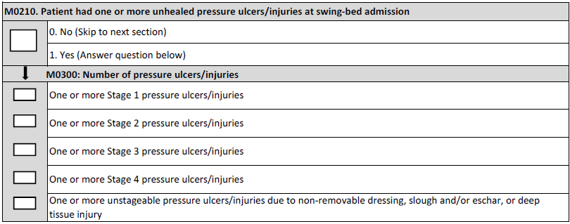
Unhealed Pressure Ulcer/Injury
Note: Pressure ulcer/Injury = pressure ulcers due to any reason and injury refers to deep tissue injury so for instance, a skin tear would not constitute a pressure ulcer/injury
The primary cause of the skin alteration is related to pressure for this purpose. For instance, mucosal pressure ulcers are not staged using the skin pressure ulcer staging system because anatomical tissue comparisons cannot be made. Therefore, mucosal ulcers (for example, those related to nasogastric tubes, nasal oxygen tubing, endotracheal tubes, urinary catheters, etc.) should not be coded here.

Slide 16
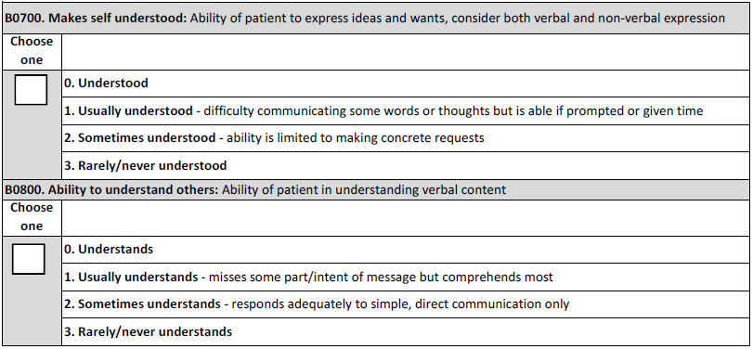
Understand/Understood - Falls
Note: clearly read the definitions – this is not assessing speaking, language or hearing – for instance, the patient does not have to be able to speak everything to be understood or usually understood if they can sign or point and/or write or need a translator.
Falls could have occurred at home, community, NH, etc or while an IP in acute.

Slide 17
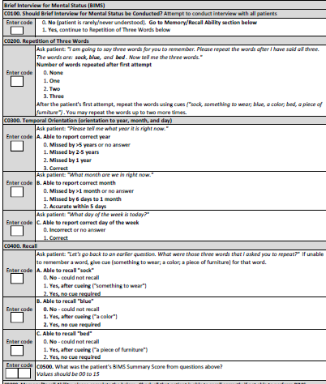
Cognitive
Note: BIMS (Brief Interview for Mental Status) should be attempted on all patients except those who are never/rarely understood
Staff must follow instructions exactly as on the tool reflects to administer BIMS
Skip to Memory/Recall only if patient cannot do BIMS
Memory/Recall section is skipped if BIMS was administered

Slide 18
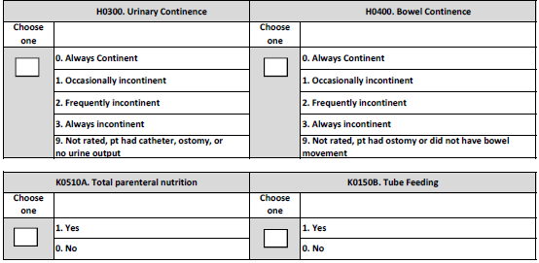
Urinary/Bowel Incontinence – TPN/Tube Feeding
Note:
# 9 is a new option - not rated, patient has a catheter, ostomy, or no urine output (such as in urinary for patients on dialysis). – This section may need all 3 days to assess – may not be able to determine in 1 or 2 days.
TPN and Tube feeding only applies if present or initiated during the SB stay – not be be counted if discontinued before SB admission

Slide 19
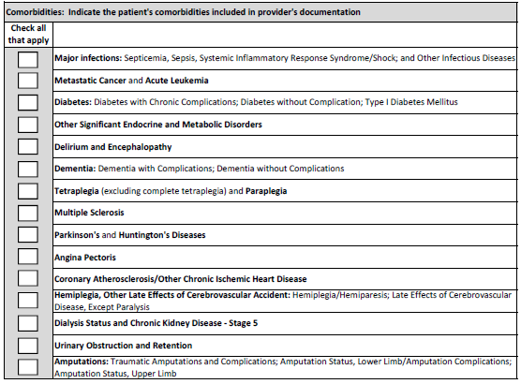
Comorbidities
Note:
Comorbidities documented by the provider in H&P or progress notes
Must be active – hx of if not impacting the treatment plan is not to be checked of.
Ok to discuss with the provider if obvious comorbidity but provider did not document

Slide 20
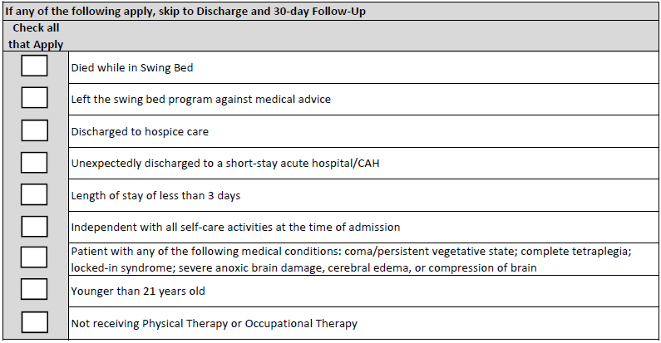
Exceptions to Full Assessment
Self Care & Mobility Data will be completed for all payors minus the following exceptions:
Still an exclusion if receiving PT for wound debridement only!

Slide 21
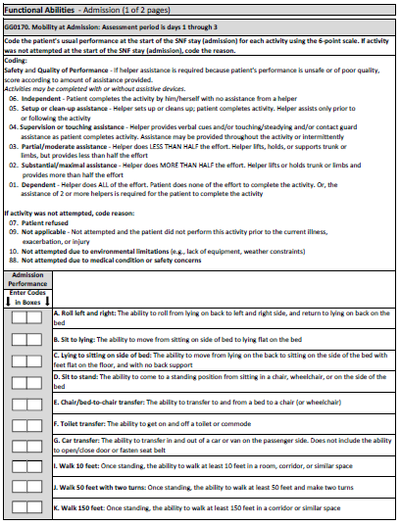
Function/Mobility
Admission assessment must be completed within 3 calendar days of admission (including day of admission)
Read the description of the items to be coded very carefully – do not read into it more than its asking (see later examples)
Carefully read the coding key descriptions and choose what best fits the patient – always look at the 2 descriptions before and after the one you think it is to make sure you have the correct one
All assessment items must be attempted to be coded – otherwise a reason for no attempt must be coded

Slide 22
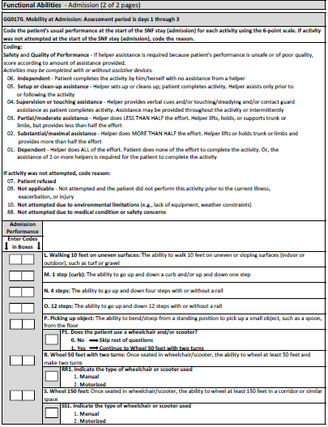
Function/Mobility
Same items will be tested on discharge
Must be completed within 3 calendar days of discharge including the day of discharge
Same coding principles apply to discharge assessments
Again, all assessment items must be attempted to be coded – otherwise a reason for no attempt must be coded
Patients should be allowed to perform activities as independently as possible, as long as they are safe for both admission & discharge assessments.

Slide 23
Basic CMS Guidelines to Coding Function & Mobility
When coding the patient’s usual performance, “effort” refers to the type and amount of assistance the helper provides in order for the activity to be completed. The 6-point rating scale definitions include the following types of assistance: setup/cleanup, touching assistance, verbal cueing, and lifting assistance.
06 - Independent ‐ Patient completes the activity by him/herself with no assistance from a helper
05 - Setup or clean‐up assistance ‐ Helper sets up or cleans up; patient completes activity. Helper assists only prior to or following the activity

Slide 24
Basic CMS Guidelines to Coding Function & Mobility
04 - Supervision or touching assistance ‐ Helper provides verbal cues and/or touching/steadying and/or contact guard assistance as patient completes activity. Assistance may be provided throughout the activity or intermittently
03 - Partial/moderate assistance ‐ Helper does LESS THAN HALF the effort. Helper lifts, holds, or supports trunk or limbs, but provides less than half the effort
02 - Substantial/maximal assistance ‐ Helper does MORE THAN HALF the effort. Helper lifts or holds trunk or limbs and provides more than half the effort
01 - Dependent ‐ Helper does ALL of the effort. Patient does none of the effort to complete the activity. Or, the assistance of 2 or more helpers is required for the patient to complete the activity

Slide 25
Basic CMS Guidelines to Coding Function & Mobility
All functions must be attempted unless there is a reason why not as follows:
07 - Patient refused – do all possible to convince them to participate
09 - Not applicable ‐ Not attempted and the patient did not perform this activity prior to the current illness, exacerbation, or injury – for instance, if patient was not doing stairs before then its NA, if patient does not ambulate or uses w/c in community then those items are NA etc…
10 - Not attempted due to environmental limitations (e.g., lack of equipment, weather constraints) – for example, there are no 12-step stairs in the hospital (gym or stairs between hospital floors etc… Remember that if the weather is not good to test outdoors on day 1, do not use “not attempted due to environmental limitations” unless the weather does not change for all 3 days
88 - Not attempted due to medical condition or safety concerns – for instance you may not be able to assess stairs within the 1st 3 days for post stroke, or maybe their medical issues are still not sufficiently stable to attempt some of the testing

Slide 26
Basic CMS Guidelines to Coding Function & Mobility
Assess the patient’s self-care status based on:
direct observation,
the patient’s self-report,
family reports, and
direct care staff reports documented in the patient’s medical record during the assessment period
Interdisciplinary team approach is recommended but regardless, a chart review should support the information reported on the tool
Coding on admission should reflect the person’s baseline admission functional status, and is based on a clinical assessment that occurs soon after the patient’s admission.

Slide 27
Basic CMS Guidelines to Coding Function & Mobility
The admission functional assessment, when possible, should be conducted prior to the person benefitting from treatment interventions in order to determine a true baseline functional status on admission.
If treatment has started, for example, on the day of admission, a baseline functional status assessment can still be conducted at that time. Treatment should not be withheld in order to conduct the functional assessment.
Activities may be completed with or without assistive device(s). Use of assistive device(s) to complete an activity should not affect coding of the activity.

Slide 28
General Coding Tips
Coding Tips for - Lying to Sitting on Side of Bed
Lying to sitting on side of bed, indicates that the patient transitions from lying on his/her back to sitting on the side of the bed with feet flat on the floor and sitting upright on the bed without back support.
The clinician is to assess the patient’s ability to perform each of the tasks within this activity and determine how much support the patient requires to complete the activity.
Clinical judgment should be used to determine what is considered a “lying” position for that patient.
If the patient’s feet do not reach the floor upon lying to sitting, the clinician will determine if a bed height adjustment or a foot stool is required to accommodate foot placement on the floor/footstool.
Back support refers to an object or person providing support of the patient’s back.

Slide 29
General Coding Tips
Coding Tips for – Chair/Bed-to-Chair
Chair/bed-to-chair transfer, begins with the patient sitting in a chair or wheelchair or sitting upright at the edge of the bed and returning to sitting in a chair or wheelchair or sitting upright at the edge of the bed.
The activities of “Sit to lying” and “Lying to sitting” on the side of the bed are two separate activities that are not assessed as part of “Chair/Bed-to-Chair”
If a mechanical lift is used to assist in transferring a patient for a chair/bed-to-chair transfer and two helpers are needed to assist with a mechanical lift transfer, then Code 01 - Dependent, even if the patient assists with any part of the chair/bed-to-chair transfer.

Slide 30
General Coding Tips
If the patient performs the activity more than once during the assessment period and the patient’s performance varies, coding should be based on the patient’s “usual performance,” which is identified as the patient’s usual activity/performance for any of the Self-Care or Mobility activities, not the most independent or dependent performance over the assessment period.
Therefore, if the patient’s Self-Care performance varies during the assessment period, report the patient’s usual performance, not the patient’s most independent performance and not the patient’s most dependent performance.
A provider may need to use the entire 3-day assessment period to obtain the patient’s usual performance.
For the Discharge assessment, code the patient’s discharge functional status, based on a clinical assessment of the patient’s performance that occurs as close to the time of the patient’s discharge as possible to capture all areas of improvement possible

Slide 31
General Coding Tips
The intention of the wheelchair items is to assess the patient’s use of a wheelchair for self-mobilization at admission and discharge when appropriate.
The clinician uses clinical judgment to determine if the patient’s use of a wheelchair is appropriate for self-mobilization due to the patient’s medical condition or safety.
Do not code wheelchair mobility if the patient only uses a wheelchair when transported between locations within the facility.
Only code wheelchair mobility based on an assessment of the patient’s ability to mobilize in the wheelchair.
If the patient walks and is not learning how to mobilize in a wheelchair, and only uses a wheelchair for transport between locations within the facility, code the wheelchair/scooter gateway items at admission and/or discharge items as follows: Does the patient use a wheelchair/scooter—as 0, No.
Answering the question in this way invokes a skip pattern which will skip all remaining wheelchair questions.
Remember that it is very possible that the patient starts with a wheelchair but no longer is the case on discharge – only walking will apply at discharge.

Slide 32
Activity Definition
Eating: The ability to use suitable utensils to bring food and/or liquid to the mouth and swallow food and/or liquid once the meal is placed before the patient
Oral hygiene: The ability to use suitable items to clean teeth. Dentures (if applicable): the ability to insert and remove dentures into and from the mouth, and manage denture soaking and rinsing with use of equipment
Toileting hygiene: The ability to maintain perineal hygiene, adjust clothes before and after voiding or having a bowel movement. If managing an ostomy, include wiping the opening but not managing the equipment
Shower/bathe self: The ability to bathe self, including washing, rinsing, and drying self (excludes washing of back and hair). Does not include transferring in/out of tub/shower

Slide 33
Activity Definition
Upper body dressing: The ability to dress and undress above the waist, including fasteners, if applicable
Lower body dressing: The ability to dress and undress below the waist, including fasteners; does not include footwear
Putting on/taking off footwear: The ability to put on and take off socks and shoes or other footwear that is appropriate for safe mobility; including fasteners, if applicable
Roll left and right: The ability to roll from lying on back to left and right side, and return to lying on back on the bed
Sit to lying: The ability to move from sitting on side of bed to lying flat on the bed

Slide 34
Activity Definition
Lying to sitting on side of bed: The ability to move from lying on the back to sitting on the side of the bed with feet flat on the floor, and with no back support
Sit to stand: The ability to come to a standing position from sitting in a chair, wheelchair, or on the side of the bed
Chair/bed‐to‐chair transfer: The ability to transfer to and from a bed to a chair (or wheelchair)
Toilet transfer: The ability to get on and off a toilet or commode
Car transfer: The ability to transfer in and out of a car or van on the passenger side. Does not include the ability to open/close door or fasten seat belt

Slide 35
Activity Definition
Walk 10 feet: Once standing, the ability to walk at least 10 feet in a room, corridor, or similar space
Note: Does the patient walk? Mr. Z currently does not walk, but a walking goal is clinically indicated.
Coding: 88 due to clinically unsafe on admission but it would be 09 N/A if she did not walk prior to his acute admission stay. Same goes to walking 50 ft and 150 ft.
Walk 50 feet with two turns: Once standing, the ability to walk at least 50 feet and make two turns
Note: The turns included in these item (walking or wheeling 50 feet with 2 turns) are 90-degree turns. The turns may be in the same direction (two 90-degree turns to the right or two 90-degree turns to the left) or may be in different directions (one 90-degree turn to the left and one 90-degree turn to the right). The 90-degree turn should occur at the person’s ability level and can include use of an assistive device (for example, cane or wheelchair)
Walk 150 feet: Once standing, the ability to walk at least 150 feet in a corridor or similar space

Slide 36
Activity Definition
Walking 10 feet on uneven surfaces: The ability to walk 10 feet on uneven or sloping surfaces (indoor or outdoor), such as turf or gravel
1 step (curb): The ability to go up and down a curb and/or up and down one step
4 steps: The ability to go up and down four steps with or without a rail
12 steps: The ability to go up and down 12 steps with or without a rail
Picking up object: The ability to bend/stoop from a standing position to pick up a small object, such as a spoon, from the floor
Wheel 50 feet with two turns: Once seated in wheelchair/scooter, the ability to wheel at least 50 feet and make two turns
Wheel 150 feet: Once seated in wheelchair/scooter, the ability to wheel at least 150 feet in a corridor or similar space

Slide 37
Examples on How to Code
See WORD document with multiple examples on how to code each item for Function & Mobility.
Recommended use of the tool
Review info as a team so that all are on the same page
Cut & paste some for testing/competency purpose
Bring to ITP meetings to assist in coding

Slide 38
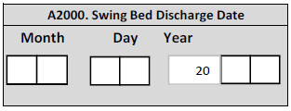
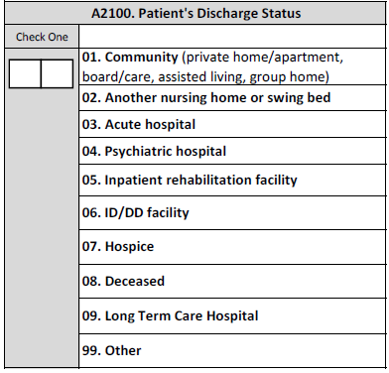
Discharge Data
Self explanatory but make sure you have a good system to enter this info for instance both D/C to home and Home with HH would be coded 01

Slide 39
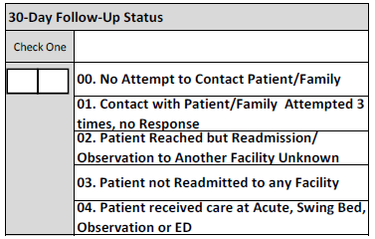
30-Day Follow-up Status
We understand that getting information regarding a hospital use other than yours may be difficult to get information from the patient hence all the choices on the next Slide. – We do expect that you will be able to get info from HIM for patients who used your CAH.

Slide 40
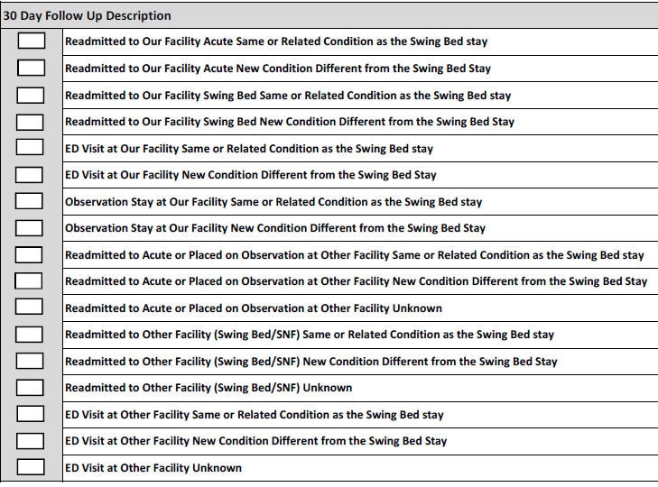
30-Day Follow-up Status
Check all that applies
Take the time to read and let’s discuss any and all questions.

Slide 41
Best Practice to code and collect data
What process would work best

Slide 42
Best Practice to code and collect data
Internal Project Manager & contact
Who initiates the data collection after admission
BIMS assessment
Staff assessment (nursing & therapy)
Coding functional items (pre-admission, within 3 days of admission and within last 3 days of the stay
Coding admission condition & comorbidities
Enter data on website
Readmission data entry

Slide 43
CAH SB PI/QI Pilot Project
Next Step
March 26 – Stroudwater webinar – not obligated if you participated today
March 29 – Stroudwater webinar – mandatory for each contact person and ideally one other person from each hospital
Please text/email me if you have any questions regarding coding and/or processes
Contact Paula from Stroudwater if issues with web-based data entry and cc Dianna Iobst and myself

Slide 44
Official Start Date
April 1st
Good Luck

