Slide 1
CAH Swing Bed PI/QI Pilot Project
Outcome Management 2nd Quarterly Meeting
October 23, 2018
Mary Guyot Consulting
207-650-5830 (cell/text)
maryguyotconsulting@gmail.com

Slide 2
Agenda
9:30 – 9:45 Networking breakfast
9:45 - 10:15 Welcome, Intro and Data Reporting
10:15 - 11:00 A review/discussion of the SB Pilot Project Coding
Q&A to assess how we are doing on Coding
11:00 - 12:00 Last quarters Action Plan Status Reporting by hospital
12:00 - 1:00 Lunch
1:00 - 1:45 Outcome & Benchmarking Data
1:45 – 2:55 What is the data telling us?
Opportunities for Improvement?
2:55 - 3:00 Next Step

Slide 3
Welcome & Intro (10:00 to 10:15)
Name
&
Hospital
# of SB discharges for each qtr.
ALOS for SB for each qtr.
D/C to Acute from SB for each qtr.
D/C to Community for each qtr.
Total Self-Care score Adm. Assessment for all D/C in the Qtr.
Total Self-Care score D/C Assessment for all D/C in the Qtr.
Total Mobility score Adm. Assessment for all D/C in the Qtr.
Total Mobility score D/C Assessment for all D/C in the Qtr.
# of Discharges reached for 30-day follow-up in past 6 months (4/1-9/30/2018)
30-Day Follow-up - # readmitted to any acute in past 6 months (4/1-9/30/2018)
30-Day Follow-up - # readmitted to SB in the past 6 months (4/1-9/30/2018)
Report the following: (from the reports you were to print)
Anybody who are having issues with pulling reports – please let me know what is not working or what report you would like to pull – to be shared with Stroudwater
Unfortunately, Stroudwater has not yet been able to add a process where you can pull self-care & mobility for only patients who did not have an exclusion

Slide 4
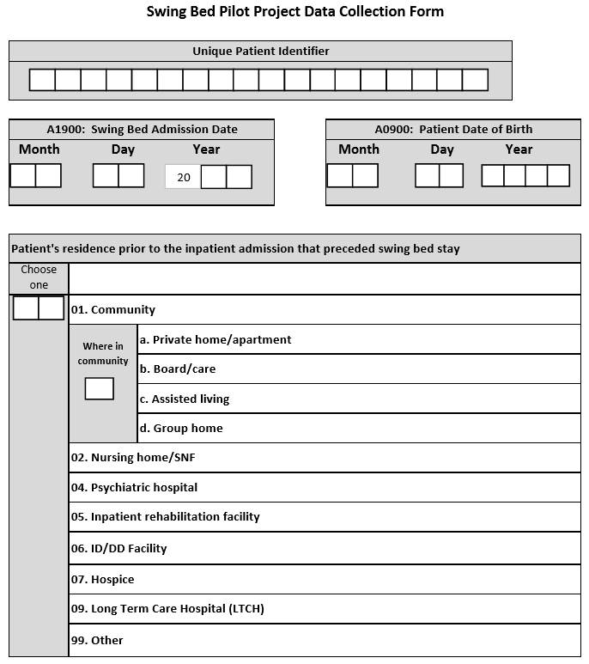
Coding Review and Q&A (10:15 – 11:00)
Unique Patient Identifier as decided by hospital such as act. # or something totally different but you must have a system where you would remember how to access the info.
DOB and SB Adm. Date is self-explanatory
Note:
Most likely, your SB patient will come from your or a referring hospitals but the question is asking “ residence prior to the Inpatient Admission that preceded the swing bed stay”
But, if they came to the hospital as a patient from any of those other places, then 02 to 09
99 = not any of the above (ie: prison)
For persons w/intellectual disability
Hospice facility or Home with hospice

Slide 5
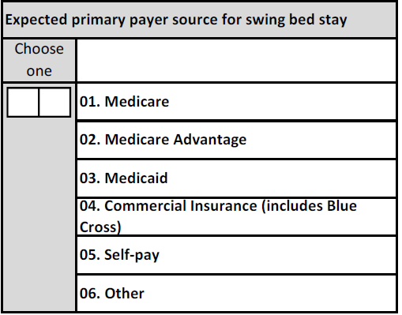
Payor
Medicare = generic/general
Medicare Advantage such as HMO
Medicaid – only applies if primary (generic or managed care) – not to be used for Medicare/Medicaid – in this case you would choose Medicare
Commercial – all other insurance
Self-pay – self-explanatory
Other = RR, VA, Prison etc…
The questions is: what will be the primary payor?

Slide 6
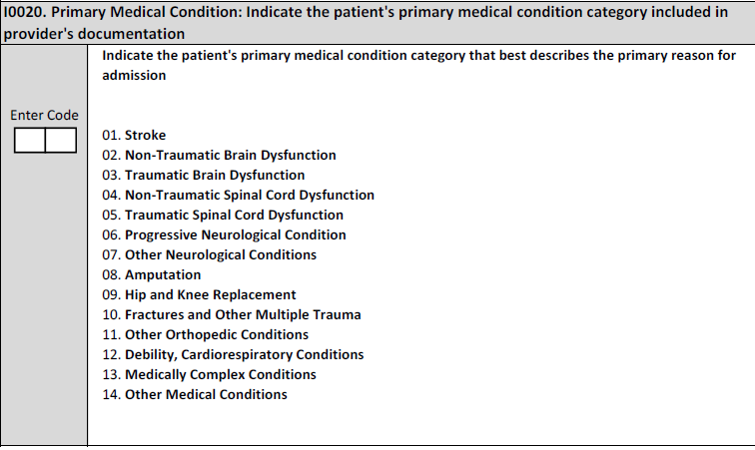
Primary Medical Condition/Reason for SB Admission
Note: PRIMARY medical condition category documented by the provider
Intent: The items in this section are intended to code diseases that have a direct relationship to the patient’s current functional status, cognitive status, mood or behavior status, medical treatments, nursing monitoring, or risk of death. One of the important functions is to generate an updated, accurate picture of the patient’s current health status.
This section will be used for Risk Adjustment
These are for grouping purpose only – we don’t admit for a stroke but s/p stroke so any type of stroke and sequelae would be “01”
Pay attention to hip & knee replacement vs FX and other multiple trauma - Note: if the hip and knee replacement is secondary to a hip fracture, code as 10, Fractures and Other Multiple Trauma. Example include hip fracture, pelvic fracture, and fracture of tibia and fibula
Debility, Cardiorespiratory condition could be for HBP, COPD, CHF, post-CABG, Asthma, etc = #12
Medically complex conditions – examples can be post multiple medical issues post surgery, a patient who is diabetic, on dialysis and in for wound care. acquired multisystem disease, septicemia… = #13
Other is for when you cannot find a code that will fit the others

Slide 7
Primary Medical Condition/Reason for SB Admission (cont’)
Steps for Assessment
Review the documentation in the medical record to identify the patient’s primary medical condition associated with admission to the facility. Medical record sources for physician diagnoses include the most recent history and physical, transfer documents, discharge summaries, progress notes, and other resources as available.
Coding Instructions
Complete only if A0310B = 01
Enter the code that represents the primary medical condition that resulted in the patient’s admission
If codes 1–13 do not apply, use code 14, “Other Medical Condition,” and proceed

Slide 8
Primary Medical Condition/Reason for SB Admission (cont’)
Medical Condition/Reason – Definitions
Code 01, Stroke = if the patient’s primary medical condition category is due to stroke. Examples include ischemic stroke, subarachnoid hemorrhage, cerebral vascular accident (CVA), and other cerebrovascular disease.
Code 02, Non - Traumatic Brain Dysfunction = if the patient’s primary medical condition category is non-traumatic brain dysfunction. Examples include Alzheimer’s disease, dementia with or without behavioral disturbance, malignant neoplasm of brain, and anoxic brain damage.
Code 03, Traumatic Brain Dysfunction = if the patient’s primary medical condition category is traumatic brain dysfunction. Examples include traumatic brain injury, severe concussion, and cerebral laceration and contusion.
Code 04, Non - Traumatic Spinal Cord Dysfunction = if the patient’s primary medical condition category is non-traumatic spinal cord injury. Examples include spondylosis with myelopathy, transverse myelitis, spinal cord lesion due to spinal stenosis, and spinal cord lesion due to dissection of aorta.
Code 05, Traumatic Spinal Cord Dysfunction = if the patient’s primary medical condition category is due to traumatic spinal cord dysfunction. Examples include paraplegia and quadriplegia following trauma.

Slide 9
Primary Medical Condition/Reason for SB Admission (cont’)
Medical Condition/Reason – Definitions (cont’)
Code 06, Progressive Neurological Conditions = if the patient’s primary medical condition category is a progressive neurological condition. Examples include multiple sclerosis and Parkinson’s disease.
Code 07, Other Neurological Conditions = if the patient’s primary medical condition category is other neurological condition. Examples include cerebral palsy, polyneuropathy, and myasthenia gravis.
Code 08, Amputation = if the patient’s primary medical condition category is an amputation. An example is acquired absence of limb.
Code 09, Hip and Knee Replacement = if the patient’s primary medical condition category is due to a hip or knee replacement. An example is total knee replacement. If hip replacement is secondary to hip fracture, code as fracture.
Code 10, Fractures and Other Multiple Trauma , if the patient’s primary medical condition category is fractures and other multiple trauma. Examples include hip fracture, pelvic fracture, and fracture of tibia and fibula.

Slide 10
Primary Medical Condition/Reason for SB Admission (cont’)
Medical Condition/Reason – Definitions (cont’)
Code 11, Other Orthopedic Conditions = if the patient’s primary medical condition category is other orthopedic condition. An example is unspecified disorders of joint.
Code 12, Debility, Cardiorespiratory Conditions = if the patient’s primary medical condition category is debility or a cardiorespiratory condition. Examples include chronic obstructive pulmonary disease (COPD), asthma, and other malaise and fatigue.
Code 13, Medically Complex Conditions = if the patient’s primary medical condition category is a medically complex condition. Examples include diabetes, pneumonia, chronic kidney disease, open wounds, pressure ulcer/injury, infection, and disorders of fluid, electrolyte, and acid-base balance.
Code 14, Other Medical Condition = if the patient’s primary medical condition category is not one of the listed categories.

Slide 11
Prior Surgery within the last 100 Days
CMS recently clarified Criteria for major surgery in the new MDS instructions as follows: – must meet all 3:
patient was an inpatient in an acute care hospital for at least one day in the 100 days prior to admission to the skilled nursing facility (SNF),
patient had general anesthesia during the procedure, and
Surgery carried some degree of risk to the patient’s life or the potential for severe disability
To be discussed

Slide 12
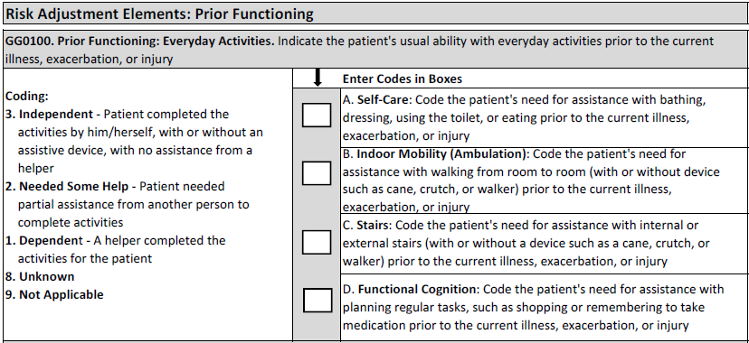
Prior Functioning – Before Hospital Admission
Record the patient’s usual ability to perform self-care, indoor mobility (ambulation), stairs, and functional cognition prior to the current illness, exacerbation, or injury.
(3) - Independent – NO Assistance from a helper
(2) Needed some help – self-explanatory
(1) Dependent – a helper is a must
(8) Unknown – only to be used if the patient cannot say and there are no family/friends… who can inform us and the medical record does not have the information
Not applicable – one would expect that you would have a code 1, 2 or 3 for (A) self-care because that is a must but feasible that you would have N/A for ambulation and stairs if the patient does not do that. Same goes for functional cognition – so, If the patient was unable to do the everyday activity prior to admission to acute, code as 9, Not Applicable

Slide 13
Prior Device Use – Before Hospital Admission
Any –mechanical, sit-to-stand, stand assist, full body lifts , stair chair
Any type
Note: Devices & aids that the patient used prior to being admitted to acute for the current illness/medical condition
If patient was not using a device prior to hospitalization but was given a walker or w/c during the acute stay for his/her ambulation – the answer would be “Z” none of the above
Code only at the start of SB PPS stay

Slide 14
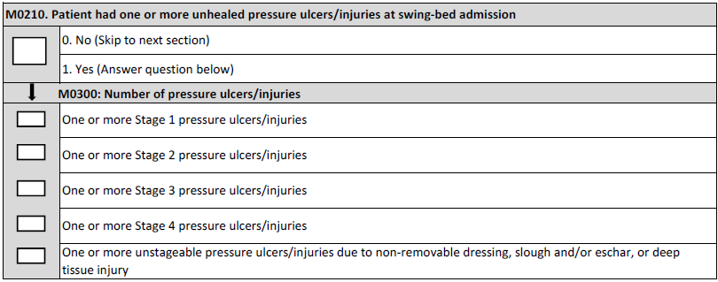
Unhealed Pressure Ulcer/Injury
Section M of the MDS was updated for October 2018 to better coincide with the National Advisory Panel on Pressure Ulcers (NPUAP) terminology – Added terms injury or injuries in relation to pressure ulcers
• Stage 1 and deep tissue injuries are called “pressure injuries because wounds are closed”
• Stage 2, 3, or 4 or unstageable due to slough or eschar are termed “pressure ulcers” since are usually open wounds
• Unstageable due to non-removable dressing or device use “pressure ulcer/injury” since could be open or closed
Note: all refers to deep tissue injury so a skin tear would not constitute a pressure ulcer/injury

Slide 15
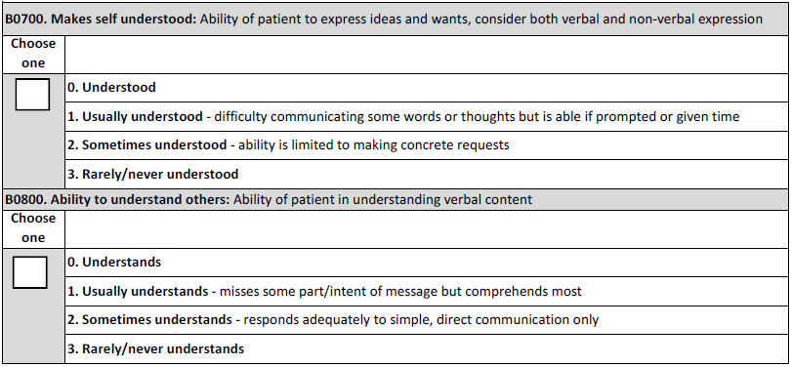
Understand/Understood - Falls
which includes writing, pointing, sign language, and cue cards.
Note: clearly read the definitions – this is not assessing speaking, language or hearing – for instance, the patient does not have to be able to speak everything to be understood or usually understood if they can sign or point and/or write or need a translator.

Slide 16
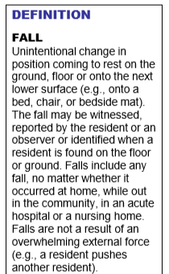
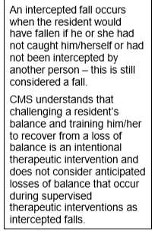
Understand/Understood - Falls
Falls could have occurred at home, community, NH, etc or while an IP in acute.

Slide 17
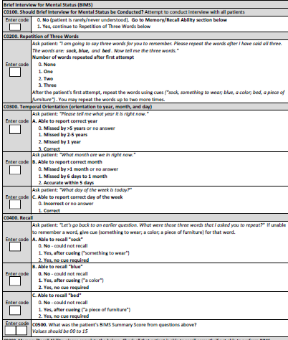
Cognitive
Note: BIMS (Brief Interview for Mental Status) should be attempted on all patients except those who are never/rarely understood
Staff must follow instructions exactly as on the tool reflects to administer BIMS
Skip to Memory/Recall only if patient cannot do BIMS
Memory/Recall section is skipped if BIMS was administered

Slide 18
Cognitive (cont’)
The items in this section are intended to determine the patient’s attention, orientation and ability to register and recall new information. These items are crucial factors in many care-planning decisions.
This information identifies if the interview will be attempted.
Most patients are able to attempt the Brief Interview for Mental Status (BIMS).
A structured cognitive test is more accurate and reliable than observation alone for observing cognitive performance.
Without an attempted structured cognitive interview, a patient might be mislabeled based on his or her appearance or assumed diagnosis.
Structured interviews will efficiently provide insight into the patient’s current condition that will enhance good care.

Slide 19
Cognitive (cont’)
Steps for Assessment
Interact with the patient using his or her preferred language. Be sure he or she can hear you and/or has access to his or her preferred method for communication. If the patient appears unable to communicate, offer alternatives such as writing, pointing, sign language, or cue cards.
Determine if the patient is rarely/never understood verbally, in writing, or using another method. If rarely/never understood, skip to C0700–C1000, Staff Assessment of Mental Status.
Determine if the patient needs or wants an interpreter. • If so, complete the interview with an interpreter.
Determine if the patient is rarely/never understood verbally or in writing. If rarely/never understood, skip to C0700 - C0100, Staff Assessment of Mental Status.
Coding Tips • Attempt to conduct the interview with ALL patients. This interview is conducted during the look-back period of the Assessment Reference Date (ARD) and is not contingent upon item B0700, Makes Self Understood.

Slide 20
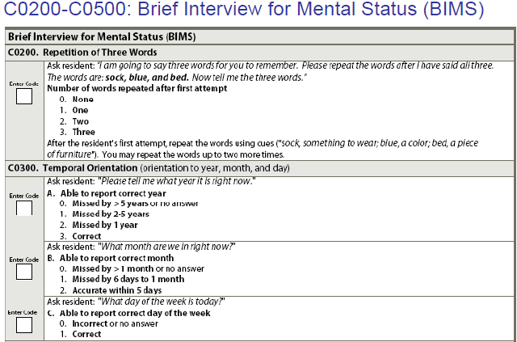
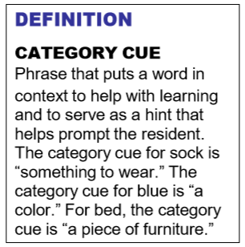
Cognitive (cont’)
The items in this section are intended to determine the patient’s attention, orientation and ability to register and recall new information. These items are crucial factors in many care-planning decisions.

Slide 21
Cognitive (cont’)
Steps for BIMS Assessment – MUST BE FOLLOWED
Ask the patient each of the 3 questions in Item C0300 separately.
Say to the patient: “I am going to say three words for you to remember. Please repeat the words after I have said all three. The words are: sock, blue, and bed.” Interviewers need to use the words and related category cues as indicated. If the interview is being conducted with an interpreter present, the interpreter should use the equivalent words and similar, relevant prompts for category cues.
Immediately after presenting the three words, say to the patient: “Now please tell me the three words.” - If the patient specifically asks for clues (e.g., “is it bingo day?”) respond by saying, “I need to know if you can answer this question without any help from me.”
After the patient’s first attempt to repeat the items:
If the patient correctly stated all three words, say, “That’s right, the words are sock, something to wear; blue, a color; and bed, a piece of furniture” [category cues].
Category cues serve as a hint that helps prompt patients’ recall ability. Putting words in context stimulates learning and fosters memory of the words that patients will be asked to recall in item C0400, even among patients able to repeat the words immediately.
If the patient recalled two or fewer words, say to the patient: “Let me say the three words again. They are sock, something to wear; blue, a color; and bed, a piece of furniture. Now tell me the three words.” If the patient still does not recall all three words correctly, you may repeat the words and category cues one more time.
If the patient does not repeat all three words after three attempts, re-assess ability to hear. If the patient can hear, move on to the next question. If he or she is unable to hear, attempt to maximize hearing (alter environment, use hearing amplifier) before proceeding

Slide 22
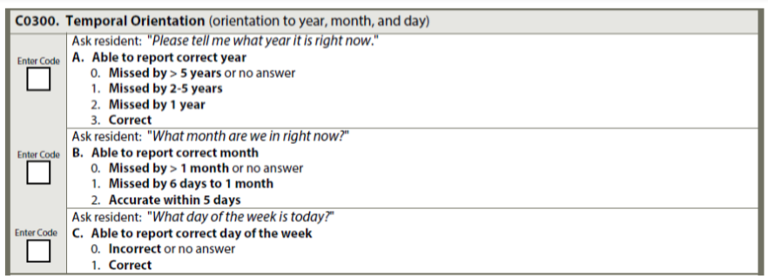
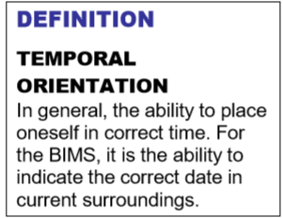
Cognitive (cont’)
Ask the patient each of the 3 questions in Item C0300 separately.
Allow the patient up to 30 seconds for each answer and do not provide clues.
If the patient specifically asks for clues (e.g., “is it bingo day?”) respond by saying, “I need to know if you can answer this question without any help from me.”

Slide 23
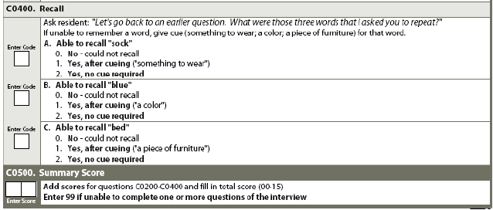
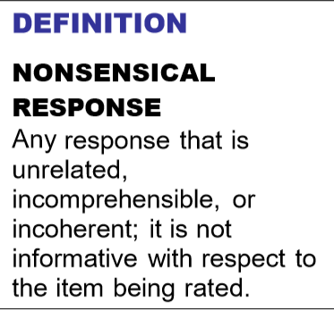
Cognitive (cont’)
Ask the patient the following: “Let’s go back to an earlier question. What were those three words that I asked you to repeat?”
Allow up to 5 seconds for spontaneous recall of each word.
For any word that is not correctly recalled after 5 seconds, provide a category cue. Category cues should be used only after the patient is unable to recall one or more of the three words.
Allow up to 5 seconds after category cueing for each missed word to be recalled.
If on the first try (without cueing), the patient names multiple items in a category, one of which is correct, they should be coded as correct for that item.
If, however, the interviewer gives the patient the cue and the patient then names multiple items in that category, the item is coded as could not recall, even if the correct item was in the list.

Slide 24
Cognitive (cont’)
Steps for Assessment
This section is completed only if the patient was not able to take the BIMS test
Ask the patient about each item. For example,
“What is the current season? Is it fall, winter, spring, or summer?”
“What is the name of this place?”
If the patient is not in his or her room, ask, “Will you show me to your room?” Observe the patient’s ability to find the way.
For patients with limited communication skills, in order to determine the most representative level of function, ask direct care staff across all shifts and family or significant other about recall ability.
Ask whether the patient gave indications of recalling these subjects or recognizing them during the look-back period.
Observations should be made by staff across all shifts and departments and others with close contact with the patient.
Review the medical record for indications of the patient’s recall of these subjects during the look-back period

Slide 25
Cognitive (cont’)
Coding Instructions for Memory/Recall
For each item that the patient recalls, check the corresponding answer box. If the patient recalls none, check none of above.
Check current season: if patient is able to identify the current season (e.g., correctly refers to weather for the time of year, legal holidays, religious celebrations, etc.).
Check location of own room: if patient is able to locate and recognize own room. It is not necessary for the patient to know the room number, but he or she should be able to find the way to the room.
Check staff names and faces: if patient is able to distinguish staff members from family members, strangers, visitors, and other patients. It is not necessary for the patient to know the staff member’s name, but he or she should recognize that the person is a staff member and not the patient’s son or daughter, etc.
Check that he or she is in a hospital swing bed: if patient is able to determine that he or she is currently at the hospital for something describe as rehab, a bed at the hospital to work on getting better before going home etc.. , in skilled care, in a swing bed etc..
Check none of above was recalled if that is the case

Slide 26
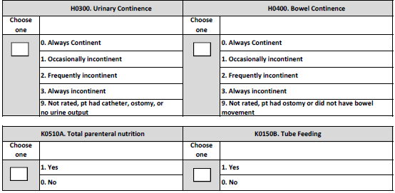
Urinary/Bowel Incontinence – TPN/Tube Feeding
Note:
Urinary/Bowel section may need all 3 days to assess – may not be able to determine in 1 or 2 days.
TPN and Tube feeding only applies if present or initiated during the SB stay – not to be counted if discontinued before SB admission

Slide 27
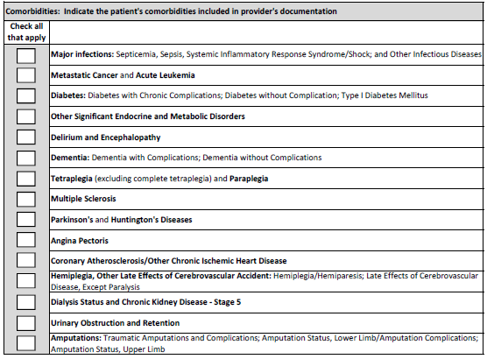
Comorbidities
This section will be used for Risk Adjustment
Note:
Comorbidities documented by the provider in H&P or progress notes
Must be active – hx of if not impacting the treatment plan is not to be checked off
Ok to discuss with the provider if obvious comorbidity but provider did not document

Slide 28
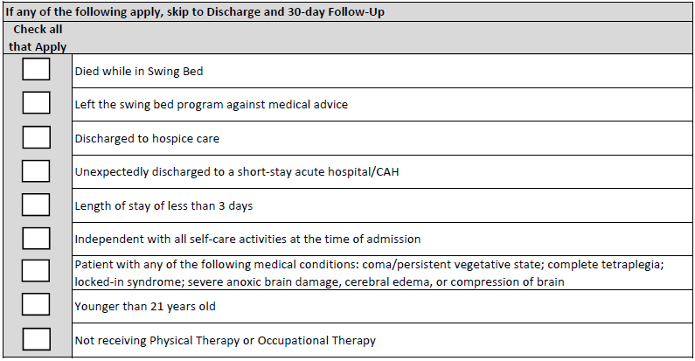
Exceptions to Full Assessment
Self Care & Mobility Data will be completed for all payors minus the following exceptions:
Regardless of hospice facility, unit, bed, home with hospice
Still an exclusion if receiving PT for wound debridement only!
If none of the above applies then complete the self care & mobility assessments

Slide 29
Function/Mobility Sections
Admission assessment must be completed within 3 calendar days of admission (including day of admission)
Coding on admission should reflect the person’s baseline admission functional status, and is based on a clinical assessment.
The admission functional assessment, when possible, should be conducted prior to the person benefitting from treatment interventions in order to determine a true baseline functional status on admission.
Treatment should not be withheld in order to conduct the functional assessment.
Activities may be completed with (if they usually use a device or safer attempted with a device) or without assistive device(s). Coding is not based on devices.
Patients with cognitive impairments/limitations may need physical and/or verbal assistance when completing an activity. Code based on the patient’s need for assistance to perform the activity safely (for example, choking risk due to rate of eating, amount of food placed into mouth, risk of falling). These are at the very lease not independent – will be coded a 5 (supervision/set up) or lower

Slide 30
Function/Mobility Sections
If the patient performs the activity more than once during the assessment period and the patient’s performance varies, coding should be based on the patient’s “usual performance,” which is identified as the patient’s usual activity/performance for any of the Self-Care or Mobility activities, not the most independent or dependent performance over the assessment period.
A provider may need to use the entire 3-day assessment period to obtain the patient’s usual performance.
An activity can be completed independently with or without devices. If the patient uses adaptive equipment and uses the device independently when performing an activity, enter code 06, Independent
Assess the patient’s self-care status based on:
direct observation,
the patient’s self-report,
family reports, and
direct care staff reports documented in the patient’s medical record during the assessment period

Slide 31
Function/Mobility Sections (cont’)
Assess the patient’s self-care performance based on direct observation, as well as the patient’s self-report and reports from qualified clinicians, care staff, or family documented in the patient’s medical record during the three-day assessment period.
CMS anticipates that an interdisciplinary team of qualified clinicians is involved in assessing the patient during the three-day assessment period
CMS defines “Qualified Clinician” as Healthcare professionals practicing within their scope of practice and consistent with Federal, State, local law and regulations”
This should not be a therapy only assessment – should be what patient’s usual performance is since admission – not just what they did with therapy
Read the description of the items to be coded very carefully – do not read into it more than its asking (see later examples) – Must be able to perform all aspects of the described items to be considered Independent.
Carefully read the coding key descriptions and choose what best fits the patient – always look at the descriptions before and after the one you think it is to make sure you have the correct one
All assessment items must be attempted to be coded – otherwise a reason for no attempt must be coded (see slides on “Exceptions”)

Slide 32
Function/Mobility Sections (cont’)
Same items will be tested on discharge
Must be completed within 3 calendar days of discharge including the day of discharge
For the Discharge assessment, code the patient’s discharge functional status, based on a clinical assessment of the patient’s performance that occurs as close to the time of the patient’s discharge as possible to capture all areas of improvement possible
Same coding principles apply to discharge assessments
Again, all assessment items must be attempted to be coded – otherwise a reason for no attempt must be coded
Patients should be allowed to perform activities as independently as possible for both admission and discharge, as long as they are safe for both admission & discharge assessments.

Slide 33
Basic CMS Guidelines to Coding Function & Mobility
When coding the patient’s usual performance, “effort” refers to the type and amount of assistance the helper provides in order for the activity to be completed. The 6-point rating scale definitions include the following types of assistance: setup/cleanup, touching assistance, verbal cueing, and lifting assistance.
06 - Independent ‐ Patient completes the activity by him/herself with no assistance from a helper
05 - Setup or clean‐up assistance ‐ Helper sets up or cleans up; patient completes activity. Helper assists only prior to or following the activity

Slide 34
Basic CMS Guidelines to Coding Function & Mobility
04 - Supervision or touching assistance ‐ Helper provides verbal cues and/or touching/steadying and/or contact guard assistance as patient completes activity. Assistance may be provided throughout the activity or intermittently
03 - Partial/moderate assistance ‐ Helper does LESS THAN HALF the effort. Helper lifts, holds, or supports trunk or limbs, but provides less than half the effort
02 - Substantial/maximal assistance ‐ Helper does MORE THAN HALF the effort. Helper lifts or holds trunk or limbs and provides more than half the effort
01 - Dependent ‐ Helper does ALL of the effort. Patient does none of the effort to complete the activity. Or, the assistance of 2 or more helpers is required for the patient to complete the activity

Slide 35
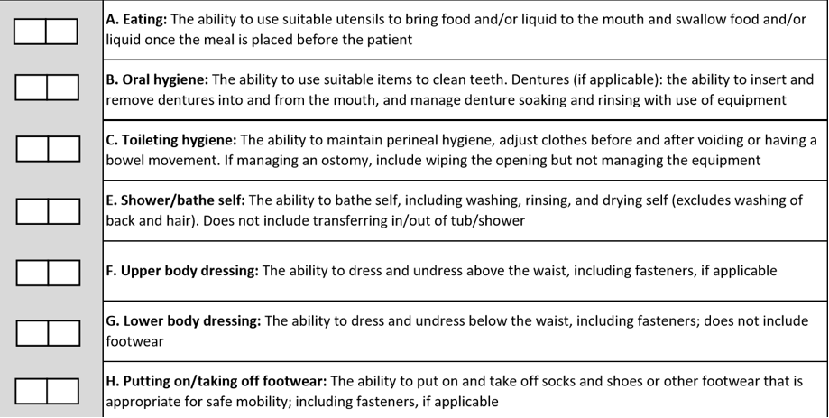
Self Care & Mobility Items To Be Coded

Slide 36
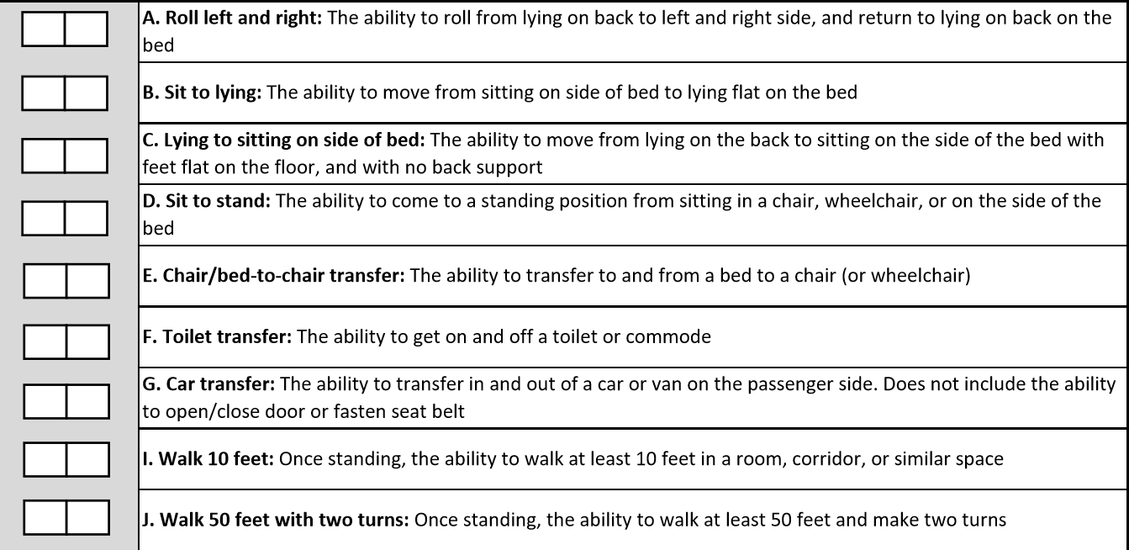
Self Care & Mobility Items To Be Coded (cont’)

Slide 37
Coding Tips
Coding Tips for – Eating
Assesses eating and drinking by mouth only
Assistance with tube feeding or TPN are NOT considered
If the patient does not eat or drink by mouth and relies solely on nutrition and liquids through tube feedings or TPN because of a new (recent-onset) medical condition, code as 88, Not attempted due to medical condition or safety concerns.
Assistance with tube feedings or TPN is not considered when coding Eating.
If the patient did not eat or drink by mouth prior to the current illness, injury, or exacerbation, code GG0130A as 09, Not applicable
For patients who have a combination of oral and tube feeding, eating should be coded on the amount of assistance the patient requires to eat and drink by mouth
If the patient eats finger foods with his or her hands, code based upon the amount of assistance provided

Slide 38
Coding Tips
Coding Tips for – Toileting Hygiene
This item pertains to both voiding and/or having a bowel movement
Toileting hygiene includes managing undergarments, clothing, and incontinence products and performing perineal cleansing before and after voiding or having a bowel movement.
Hygiene tasks can take place before and after use of the toilet, commode, bedpan, or urinal
If the patient does not usually use undergarments, then assess the patient’s need for assistance to manage lower-body clothing and perineal hygiene.
If the patient has indwelling catheter and has bowel movements, code the toileting hygiene based on the assistance needed by the patient when moving his or her bowels
If the patient completes a bladder or bowel toileting program in bed, code Toileting hygiene based on the patient’s need for assistance in managing clothing and perineal cleansing.

Slide 39
Coding Tips
Coding Tips for – Shower/Bath Self
Assessment can take place in a shower or bath, at a sink, or at the bedside (i.e., full body sponge bath)
Shower/bathe self includes the ability to wash, rinse, and dry the face, upper and lower body, perineal area, and feet. Do not include washing, rinsing, and drying the patient’s back or hair.
Shower/bathe self does not include transferring in/out of a tub/shower.
If the patient bathes himself or herself and a helper sets up materials for bathing/showering, then code as 05, Setup or clean-up assistance.
If the patient cannot bathe his or her entire body because of a medical condition, then code Shower/bathe self based on the amount of assistance needed to complete the activity

Slide 40
Coding Tips
Coding Tips for – Upper Body Dressing
Includes bra, undershirt, button-down shirt, pullover shirt, dresses, sweatshirt, sweater, nightgown (NOT hospital gown), and pajama top
Other examples: thoracic-lumbar-sacrum orthosis (TLSO), abdominal binder, back brace, stump sock/shrinker, neck support, hand or arm prosthetic/orthotic
if the patient dresses himself or herself and a helper retrieves or puts away the patient’s clothing, then code 05, Setup or clean-up assistance.
Helper assistance with buttons and/or fasteners is considered touching assistance
For both upper & lower - If donning and doffing an elastic bandage, elastic stockings, or an orthosis or prosthesis occurs while the patient is dressing/undressing, then count the elastic bandage/elastic stocking/orthotic/prosthesis as a piece of clothing when determining the amount of assistance the patient needs when coding the dressing item.

Slide 41
Coding Tips
Coding Tips for – Lower Body Dressing
Helper assistance with buttons and/or fasteners is considered touching assistance
Includes underwear, incontinence brief, slacks, short, capri pants, pajama bottoms, and skirts
Other examples: knee brace, elastic bandage, stump sock/shrinker, lower-limb prosthesis

Slide 42
Coding Tips
Coding Tips - Putting on/taking off footwear
Includes socks, shoes, boots, and running shoes
Other examples: ankle-foot orthosis (AFO), elastic bandages, foot orthotics, orthopedic walking shoes, compression stocking (on and off over foot) – Amputees may not have footwear as shoe attached
For patients with bilateral lower extremity amputations with or without use of prostheses, the activity of putting on/taking off footwear may not occur. For example, the socks and shoes may be attached to the prosthesis associated with the upper or lower leg.
If the patient performed the activity of putting on/taking off footwear immediately prior to the current illness, exacerbation, or injury, code as 88, Not attempted due to medical condition or safety concerns.
If the patient did not perform the activity of putting on/taking off footwear immediately prior to the current illness, exacerbation, or injury because the patient had bilateral lower-extremity amputations and the activity of putting on/taking off footwear was not performed during the assessment period, code as 09, Not applicable
For patients with a single lower extremity amputation with or without use of a prosthesis, the activity of putting on/taking off footwear could apply to the intact limb or both the limb with the prosthesis and the intact limb.
If the patient performed the activity of putting on/taking off footwear for the intact limb only, then code based upon the amount of assistance needed to complete the activity.
If the patient performed the activity of putting on/taking off footwear for both the intact limb and the prosthetic limb, then code based upon the amount of assistance needed to complete the activity.

Slide 43
Coding Tips
Coding Tips for - Lying to Sitting on Side of Bed
Lying to sitting on side of bed, indicates that the patient transitions from lying on his/her back to sitting on the side of the bed with feet flat on the floor and sitting upright on the bed without back support.
The clinician is to assess the patient’s ability to perform each of the tasks within this activity and determine how much support the patient requires to complete the activity.
Clinical judgment should be used to determine what is considered a “lying” position for that patient.
If the patient’s feet do not reach the floor upon lying to sitting, the clinician will determine if a bed height adjustment or a foot stool is required to accommodate foot placement on the floor/footstool.
Back support refers to an object or person providing support of the patient’s back.

Slide 44
Coding Tips (cont’)
Coding Tips for – Chair/Bed-to-Chair
Chair/bed-to-chair transfer, begins with the patient sitting in a chair or wheelchair or sitting upright at the edge of the bed and returning to sitting in a chair or wheelchair or sitting upright at the edge of the bed.
The activities of “Sit to lying” and “Lying to sitting” on the side of the bed are two separate activities that are not assessed as part of “Chair/Bed-to-Chair”
If a mechanical lift is used to assist in transferring a patient for a chair/bed-to-chair transfer and two helpers are needed to assist with a mechanical lift transfer, then Code 01 - Dependent, even if the patient assists with any part of the chair/bed-to-chair transfer.

Slide 45
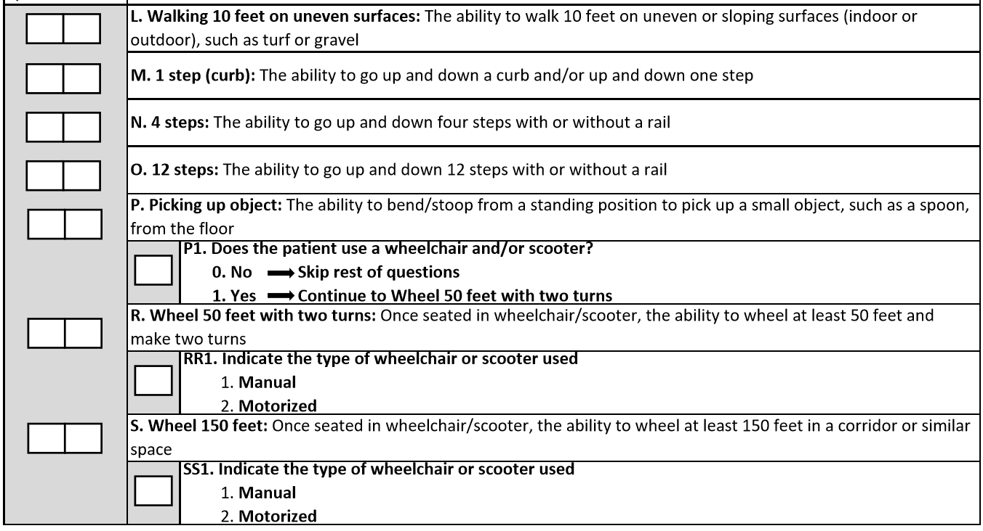
Coding Tips (cont’)
See note below
Also applies picking up from a wheelchair
If admission or discharge performance coded 07, 09, 10, or 88 for (L) Walking 10 feet on uneven surface, mark the others the same and Skip to GG0170M, 1 step (curb)

Slide 46
Items To Be Coded (cont’)
Coding Tips for Walking
Walking activities do not need to occur during one session.
Allowing a patient to rest between activities or completing activities at different times during the day or on different days may facilitate completion of the activities.
When coding walking items, do not consider the patient’s mobility performance when using parallel bars.
Parallel bars are not a portable assistive device.
If safe, assess and code walking using a portable walking device when needed.
The turns are 90-degree turns.
The turns may be in the same direction (two 90-degree turns to the right or two 90degree turns to the left) or may be in different directions (one 90-degree turn to the left and one 90-degree turn to the right).
The 90-degree turn should occur at the person’s ability level and can include use of an assistive device (for example, cane).

Slide 47
Items To Be Coded (cont’)
Walking 10 feet on uneven surfaces: The ability to walk 10 feet on uneven or sloping surfaces (indoor or outdoor), such as turf or gravel
1 step (curb): The ability to go up and down a curb and/or up and down one step
4 steps: The ability to go up and down four steps with or without a rail
12 steps: The ability to go up and down 12 steps with or without a rail
Picking up object: The ability to bend/stoop from a standing position to pick up a small object, such as a spoon, from the floor – may be picking object from a W/C if the patient is W/C bound
Wheel 50 feet with two turns: Once seated in wheelchair/scooter, the ability to wheel at least 50 feet and make two turns
Wheel 150 feet: Once seated in wheelchair/scooter, the ability to wheel at least 150 feet in a corridor or similar space

Slide 48
Coding Tips
Walk 10 feet: Once standing, the ability to walk at least 10 feet in a room, corridor, or similar space
Note: Does the patient walk? Mr. Z currently does not walk, but a walking goal is clinically indicated.
Coding: 88 due to clinically unsafe on admission but it would be 09 N/A if she did not walk prior to his acute admission stay. Same goes to walking 50 ft and 150 ft.
Walk 50 feet with two turns: Once standing, the ability to walk at least 50 feet and make two turns
Note: The turns included in these item (walking or wheeling 50 feet with 2 turns) are 90-degree turns. The turns may be in the same direction (two 90-degree turns to the right or two 90-degree turns to the left) or may be in different directions (one 90-degree turn to the left and one 90-degree turn to the right). The 90-degree turn should occur at the person’s ability level and can include use of an assistive device (for example, cane or wheelchair)
Walk 150 feet: Once standing, the ability to walk at least 150 feet in a corridor or similar space

Slide 49
Coding Tips (cont’)
The intention of the wheelchair items is to assess the patient’s use of a wheelchair for self-mobilization at admission and discharge when appropriate.
The clinician uses clinical judgment to determine if the patient’s use of a wheelchair is appropriate for self-mobilization due to the patient’s medical condition or safety.
If the patient walks and is not learning how to mobilize in a wheelchair, and only uses a wheelchair for transport between locations within the facility, code the wheelchair/scooter gateway items at admission and/or discharge items as follows: Does the patient use a wheelchair/scooter = 0 for No.
Answering the question in this way invokes a skip pattern which will skip all remaining wheelchair questions.
Otherwise said, only code wheelchair mobility based on an assessment of the patient’s ability to mobilize in the wheelchair.
Remember that it is very possible that the patient starts with a wheelchair but no longer is the case on discharge – only walking will apply at discharge.

Slide 50
Coding Function & Mobility - Exceptions
All functions must be attempted unless there is a reason why not as follows:
07 - Patient refused – do all possible to convince them to participate
09 - Not applicable ‐ Not attempted and the patient did not perform this activity prior to the current illness, exacerbation, or injury – for instance, if patient was not doing stairs before then its NA, if patient does not ambulate or uses w/c in community then those items are NA etc…
10 - Not attempted due to environmental limitations (e.g., lack of equipment, weather constraints) – for example, there are no 12-step stairs in the hospital (gym or stairs between hospital floors etc… Remember that if the weather is not good to test outdoors on day 1, do not use “not attempted due to environmental limitations” unless the weather does not change for all 3 days
88 - Not attempted due to medical condition or safety concerns – for instance you may not be able to assess stairs within the 1st 3 days for post stroke, or maybe their medical issues are still not sufficiently stable to attempt some of the testing

Slide 51
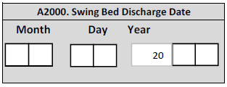
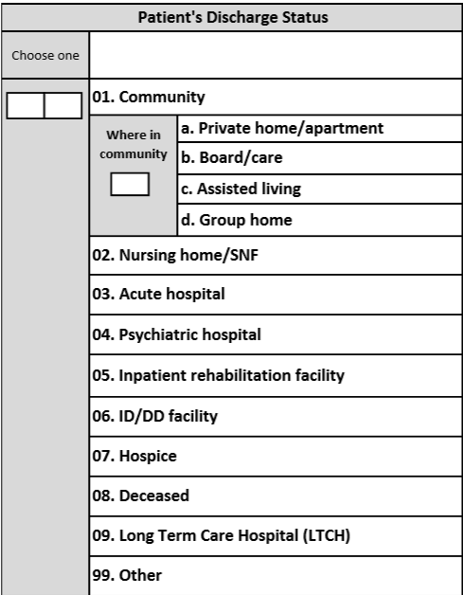
Discharge Data
Self explanatory but make sure you have a good system to enter this info for instance both D/C to home and Home with HH would be coded 01

Slide 52
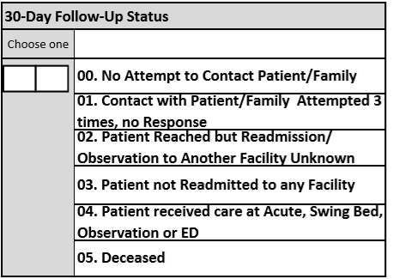
30-Day Follow-up Status
Follow-up not mandatory for this project but highly recommended (most if not all other hospitals who started this project 6 months ago are attempting the follow-up calls
We understand that getting information regarding a hospital use other than yours may be difficult to get information from the patient hence all the choices on the next Slide. – We do expect that you will be able to get info from HIM for patients who used your CAH at a minimum.

Slide 53
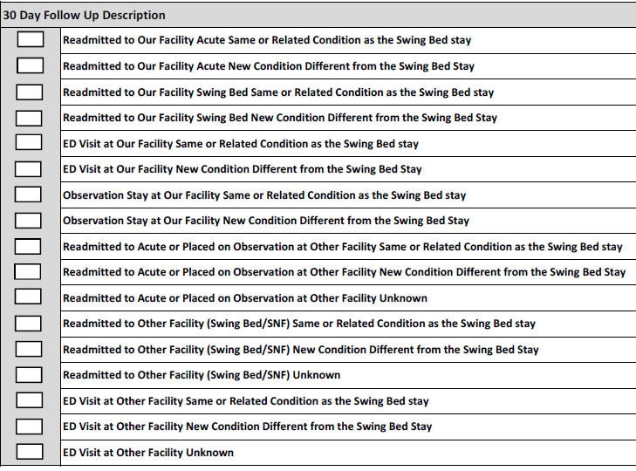
30-Day Follow-up Status
Check all that applies
Take the time to read every options

Slide 54
Examples on How to Code
See updated WORD documents with multiple examples on how to code each item for Function & Mobility
Swing Bed PI/QI Pilot Project - Coding Function and Mobility Updated 10.2018 (attachment)
Recommended use of the tool
Review info as a project team so that all are on the same page
Cut & paste some for testing/competency purpose
Bring to ITP or huddle meetings to assist in coding

Slide 55
How are we doing on our coding?
Q: Do we have to have data on every admissions?
****************************************************************
Q: What if they fall into an exclusion list such as no therapy, death while in the program, discharged in 3 days or less, LAMA, D/C to hospice etc…
****************************************************************
Q: What if the patient was discharged unexpectedly and we only had time to do 4 of the sections?
*****************************************************************
Q: What if a patient had therapy but it only started on day 4 or 5, how do I document the admission Functional Assessment
*************************************************************
Q: What if we did the admission functional assessment and entered the data in the system but the patient dies on day 5 which now puts him on the exclusion list – do I erase the functional data

Slide 56
How are we doing on our coding?
Q: Patient is nourished 100% via g-tube but the plan is to work with him to have at least partial oral feeding or removal of the g-tube by discharge
What if the patient is 50% g-tube and 50% oral?
************************************************************************
Q: Patient has had a stroke and can barely walk for a few steps safely, but the plan is to work with him to walk before D/C – do I code 88 (unsafe) or 1 (dependent) for 10 ft, 50 ft and 150 ft
*****************************************************************
Q: How do I code if the patient was able to do 10 ft with a staff member by his side and another following with a w/c in case he needs to sit down, how do I code “walk 10 ft”
*****************************************************************

Slide 57
How are we doing on our coding?
Q: Patient has significant SOB but able to walk 10 feet with helper doing more than ½ of the effort – how do I code walk 10, 50 ft and 150 feet?
****************************************************************
Q: We have a patient status post car accident who has a lot of pain when turning in bed. When assessing roll left and right (The ability to roll from lying on back to left and right side, and retun to lying on back on the bed) The patient needs max assist of 1 to turn to the left but has too much pain to be turned to his right side. Do we code this measure a “2” – max assist?
************************************************************************
Q: A patient is admitted late Friday pm for medical issues and rehab. There are no therapists working on the weekend hence patient will have been in the program for 3 days before a therapy assessment. Do we still code the admission assessment, or do we take the info from Monday’s therapy assessment?
*****************************************************************

Slide 58
How are we doing on our coding?
Q: Patient is admitted for medical issues/treatments and the need for skilled therapy was not identified until day 4 or 5 or, the patient was too sick to initiate therapy from day 1. How do we code the admission assessment – do we base it on the first 3 days or from the time therapy was requested?
****************************************************************
Q: During the 3 days for assessment, the PT noted the patient to be a level 3 (mod assist – less than ½ performed by helper) for chair/bed-to-chair transfer but the rest of the time the patient is reported to require max assist where the nursing staff must perform more than ½ of the effort as helpers. Do we code chair/bed-to-chair as 2 or 3
************************************************************************
Q: A patient is receiving medical care and rehab until day 8 at which time the therapy staff discharges the patient from their services since he has met his rehab goals but remains on the unit until day 13 to complete IV antibiotic. When is the D/C assessment completed? Based on day 6-7-8 or 11-12-13 functional level?

Slide 59
How are we doing on our coding?
Q: A patient had his 3-day assessment but was transferred back to acute care on day 5 with an expected return to SB when stable. We discharged the patient to acute on day 5 therefore this patient will be an exception, so we do not complete the discharge self-care and mobility assessment. After 3 days in acute, he is returned to SB as planned. Do we go from where we left of?
****************************************************************
Q: A patient was discharge to acute and did not return to SB. Do we complete a 30-day follow-up?
************************************************************************
Q: A patient was discharged from acute to SB with a fresh trach and 2 weeks rest from chemo and radiation therapy with a plan to then be readmitted to acute for neck surgery. Do I report this as a readmission to acute though it was planned?

Slide 60
How are we doing on our coding?
Q: A patient was admitted to acute care from an Assisted Living. After the acute care he was discharged to a Transitional Care Unit at that hospital and now he is being transferred to your SB program. How do I code his residence prior to acute?
****************************************************************
Q: Our patient was discharged home with Hospice provided by the local home health, do I code 01 – community or 07 – Hospice?
************************************************************************
Q: Should I be doing a 30-day follow-up with hospice patients discharged to a hospital, at home or in a facility/unit or NH bed for hospice?
*****************************************************************
Q: I am not clear as to who we need to complete a 30-day follow up call with. Can you please clarify?

Slide 61
How are we doing on our coding?
Q: Do we need to complete a 30-day follow up call to patients who were discharged to home (community) but with Home Health?
****************************************************************
Q: Is there a deadline as to when admissions and discharges must be entered in the web-based system?
************************************************************************
Q: Is there a time limit to complete the follow-up calls post discharge?
*****************************************************************
Q: Do any of you have a coding question??????????

Slide 62
Action Plan Status (11:00 to 12:15)
Action for improvement
What was the issue?
What was done about it?
What is the present status?

Slide 63
Action Plan Status
Boone Memorial Hospital
By Whitney Yeager
Action Plan # 1
Improve on establishing a set time for data collection
Action Plan # 2
Coordinate a better team approach to review self-care & mobility
Action Plan # 3
Educate more staff – mainly nursing documentation
Look into developing BIMs questions for nurses initial interview

Slide 64
Action Plan Status (cont’)
Braxton County Memorial Hospital
By Amy Moore
Action Plan # 1
Discharge follow-up call by Med-Surg Nurse Manager
Action Plan # 2
x
Action Plan # 3
x

Slide 65
Action Plan Status (cont’)
Broaddus Hospital
By Rebekah Hoxie
Action Plan # 1
Improve mobility documentation from nursing
Action Plan # 2
Improve care planning
Action Plan # 3
Performance improvement measures for functional activities

Slide 66
Action Plan Status (cont’)
Grant Memorial Hospital
By Diana Reel
Action Plan # 1
Collaboration between Rehab and Nursing on functional data
Action Plan # 2
Continue to educate physician for earlier admissions on SB admissions
Action Plan # 3
Review return to acute care

Slide 67
Action Plan Status (cont’)
Hampshire Memorial Hospital
By Patty Fields
Action Plan # 1
Increase rehab & nursing collaboration
Action Plan # 2
x
Action Plan # 3
x

Slide 68
Action Plan Status (cont’)
Jackson General Hospital
By Sherry Quick
Action Plan # 1
Meet with the team within 3 days of admission to resolve any discrepancies in data
Action Plan # 2
Add re-education to quarterly SB meetings
Action Plan # 3
x

Slide 69
Action Plan Status (cont’)
Minnie Hamilton Health System
By Tracy Snedgrass
Action Plan # 1
Better team approach for completing Functional Abilities
Action Plan # 2
Revise staff education for the pilot project
Action Plan # 3
x

Slide 70
Action Plan Status (cont’)
Montgomery General Hospital
By Robin McDaniel
Action Plan # 1
Review admit data with IDT to ensure consistency with data collection and goals
Action Plan # 2
Review data on a monthly basis to identify problem/trends
Action Plan # 3
x

Slide 71
Action Plan Status (cont’)
Plateau Medical Center
By Laura Kirk
Action Plan # 1
Increase team work on completion of the pilot project assessment
Action Plan # 2
Decrease reliance on Joint Replacements as main patient source
Action Plan # 3
Have data entered in web-based tool

Slide 72
Action Plan Status (cont’)
Pocahontas Memorial Hospital
By Kyna Moore
Action Plan # 1
Staff education re the project
Action Plan # 2
Staff schedule for who is ??????and available
Action Plan # 3
x

Slide 73
Action Plan Status (cont’)
Preston Memorial Hospital
By Cecilia Liston
Action Plan # 1
Decrease number of revisits to ED and Observation
Action Plan # 2
Performance improvement score for self-care
Action Plan # 3
x

Slide 74
Action Plan Status (cont’)
Roane General Hospital
By Cassandra Hildreth
Action Plan # 1
Implement a rehab model
Action Plan # 2
Decrease readmissions/transfers
Action Plan # 3
Implement IDT mtg for day 3 post admission
Action Plan # 4
Self-care mobility / PI

Slide 75
Action Plan Status (cont’)
St. Joseph Hospital
By Brenda Bauer
Action Plan # 1
Get contract finalized with Stroudwater
Action Plan # 2
Complete data entry with access to the system
Action Plan # 3
Start PI dashboard

Slide 76
Action Plan Status (cont’)
War Memorial Hospital
By Patty Fields
Action Plan # 1
Decrease the use of 88 by 25% for Indoor curb & ramp assessment
Action Plan # 2
Improve our team efforts for data collection
Action Plan # 3
X

Slide 77
Action Plan Status (cont’)
Webster County Memorial Hospital
By Michelle Holcomb
Action Plan # 1
Increase # of admissions on a constant basis
Action Plan # 2
Improve documentation
Action Plan # 3
Establish a baseline and measurable improvement of clinical outcomes

Slide 78
Action Plan Status (cont’)
WVU Medicine - Jefferson
By Barbara Sherman
Action Plan # 1
Get a completed, signed contract in time to begin data entry
Action Plan # 2
Catch up on data entry
Action Plan # 3
Use data collected to monitor effectiveness of PT/OT

Slide 79
Action Plan Status (cont’)
WVU Medicine Potomac Valley Hospital
By Melissa Wyatt
Action Plan # 1
New NP will be educated on BIMS and data collection
Action Plan # 2
Additional education for nursing staff to Improve documentation
Action Plan # 3
X

Slide 80
Networking Lunch (12:15 to 1:00)

Slide 81
Data Outcome & Benchmarking (1:00 to 2:00)
Includes Admissions from 4/1/2018 and all discharges by 9/30/2018
What can we learn about our SB program??

Slide 82
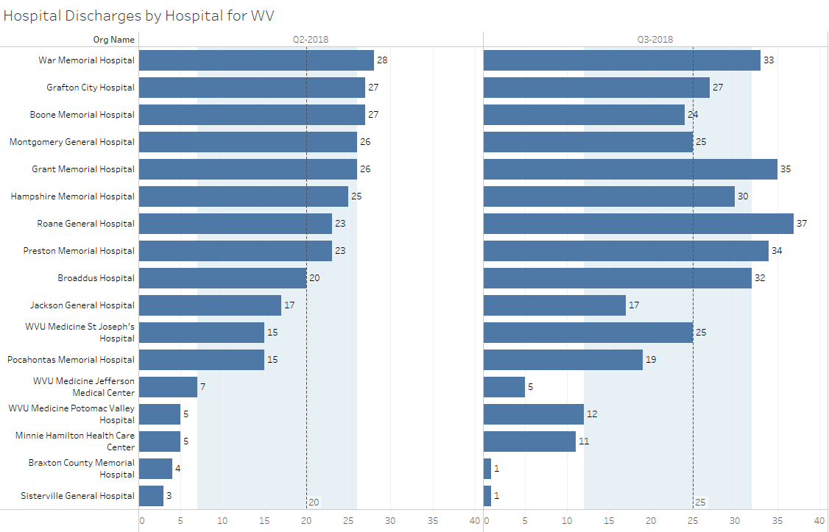
Swing Bed Discharges by Hospital
median
lower quartile
upper quartile

Slide 83
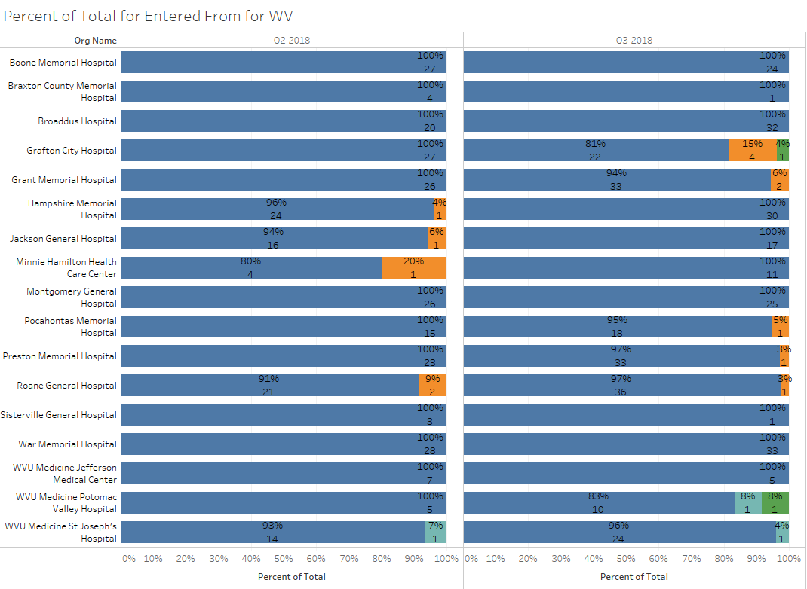
Percent of Total by Residence Pre-Acute Admission

Slide 84
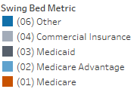
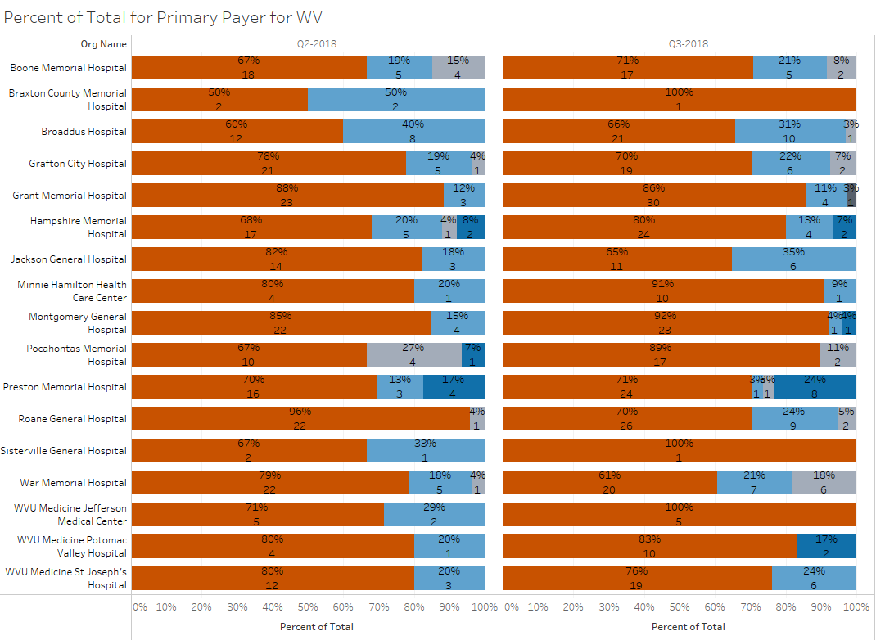
Percent of Total by Primary Payor

Slide 85
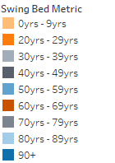
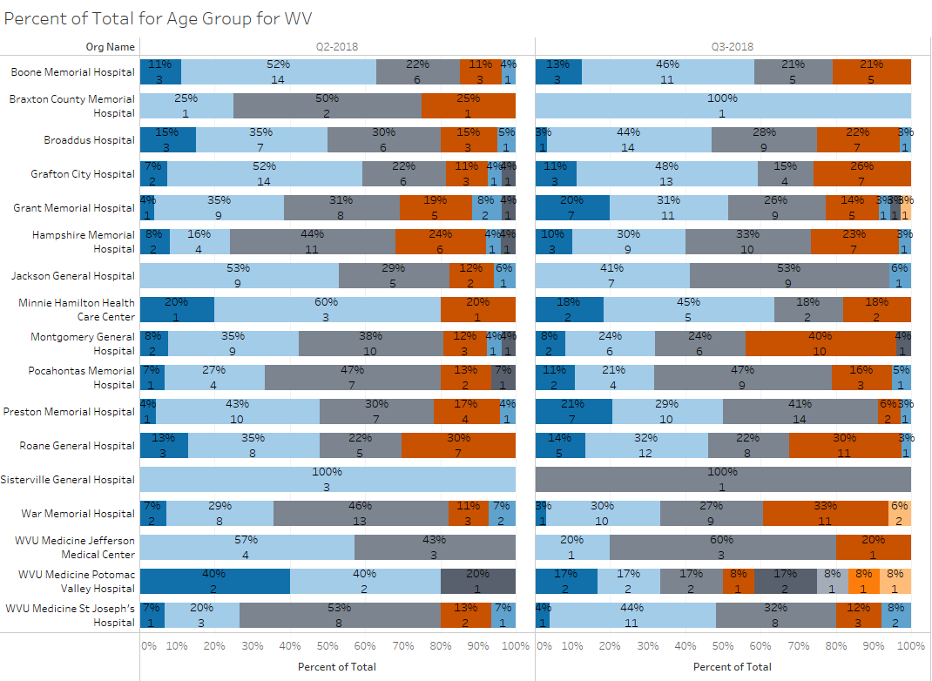
Percent of Total by Age Group

Slide 86
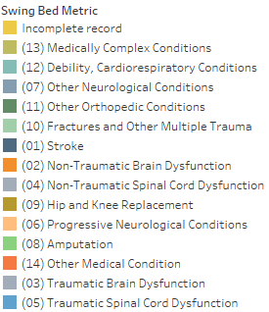
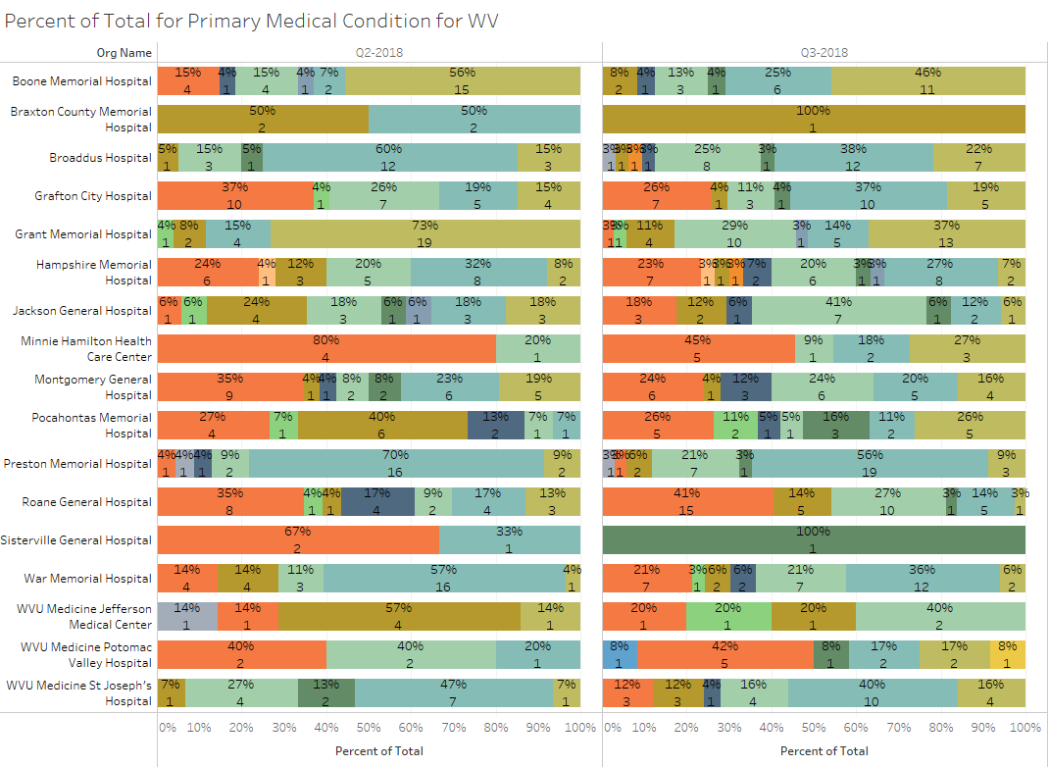
Percent of Total by Primary Medical Condition

Slide 87
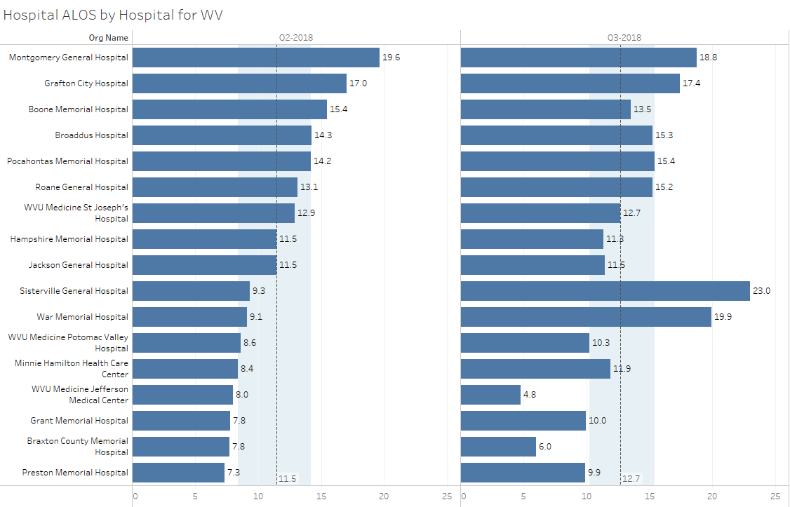
SB Average Length of Stay (ALOS) by Hospital
median
lower quartile
upper quartile

Slide 88
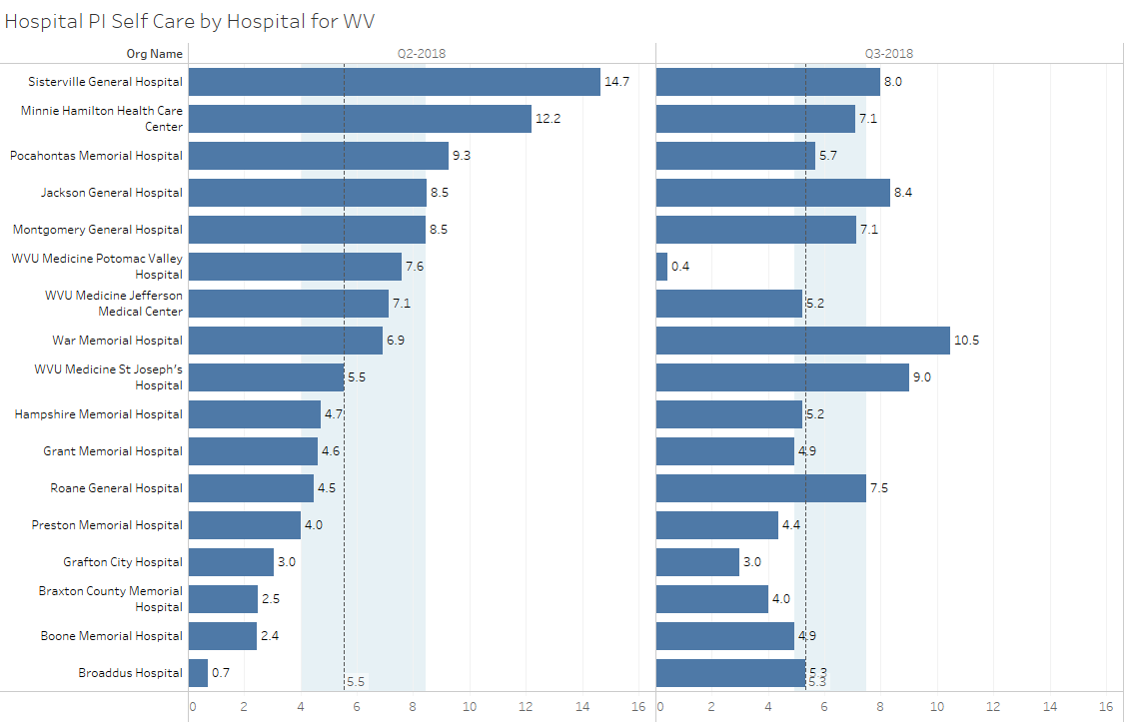
SB Performance Improvement Score for Self-Care
median
lower quartile
upper quartile

Slide 89
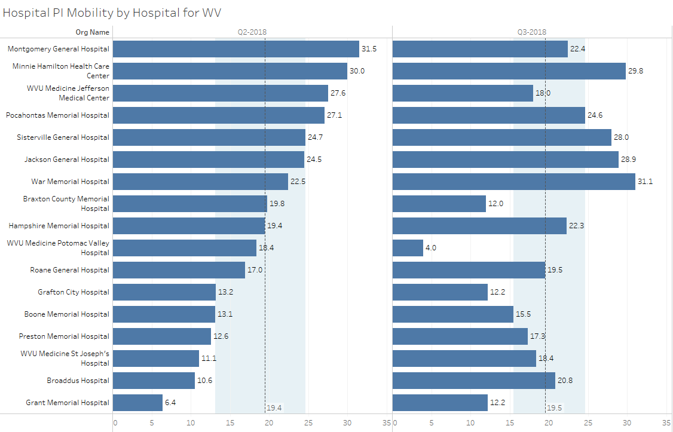
SB Performance Improvement Score for Mobility
median
lower quartile
upper quartile

Slide 90
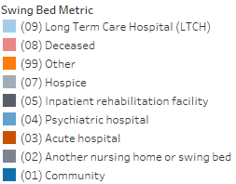
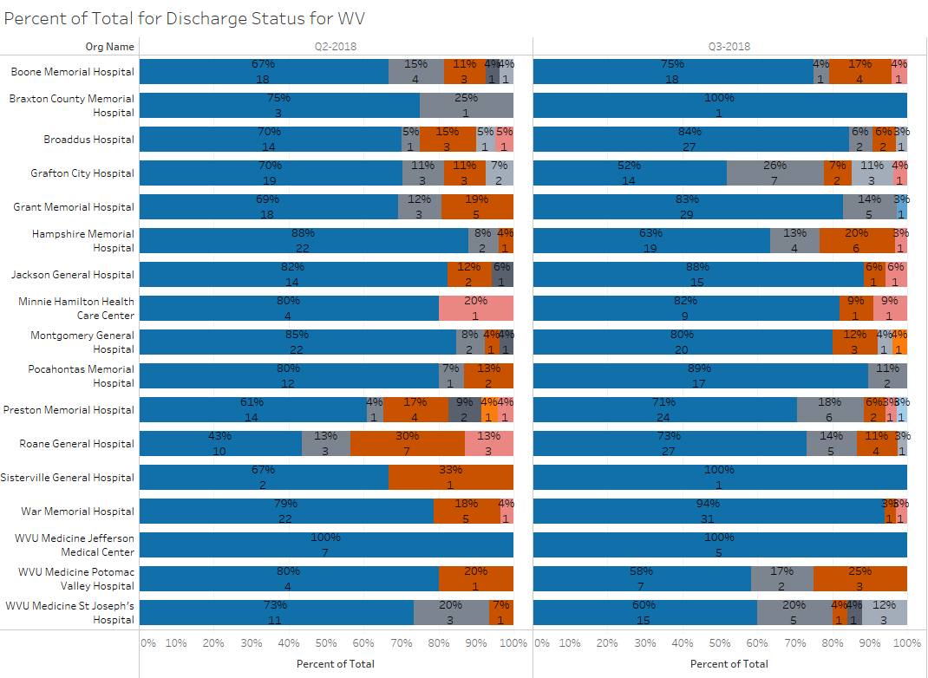
Percent of Total by Discharge Disposition

Slide 91
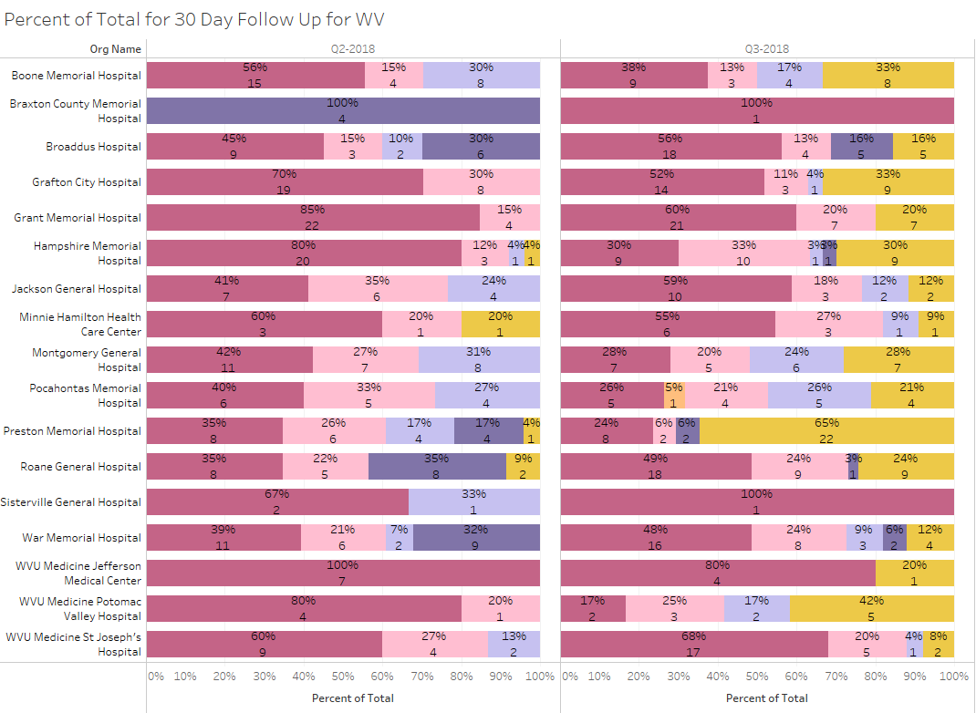
Percent of Total by 30-Day Follow Up

Slide 92
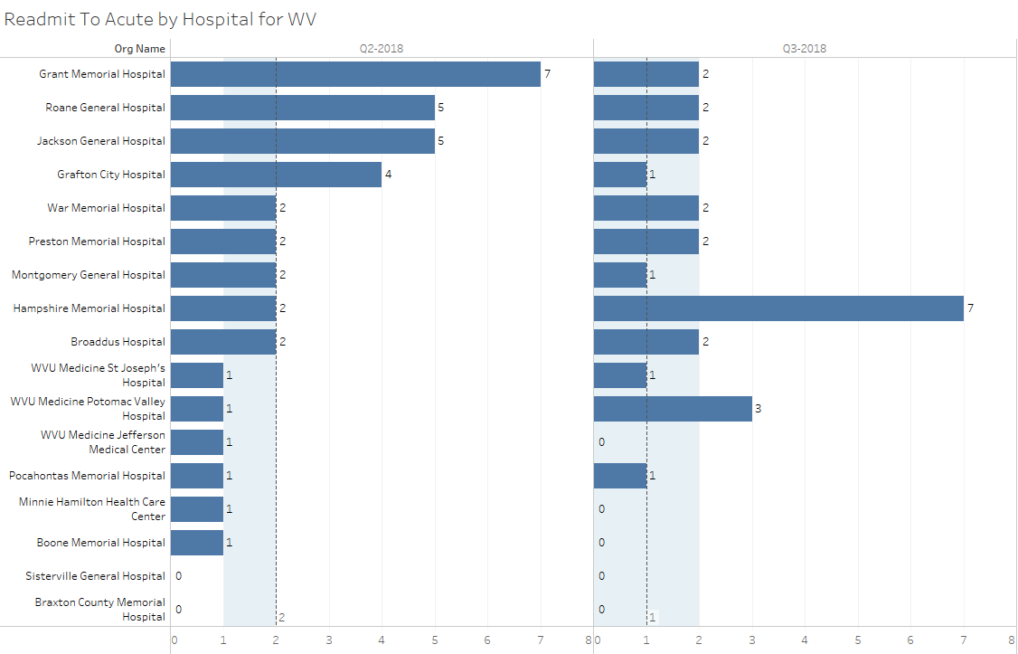
Number of Readmits to Acute by Hospital
median
lower quartile
upper quartile

Slide 93
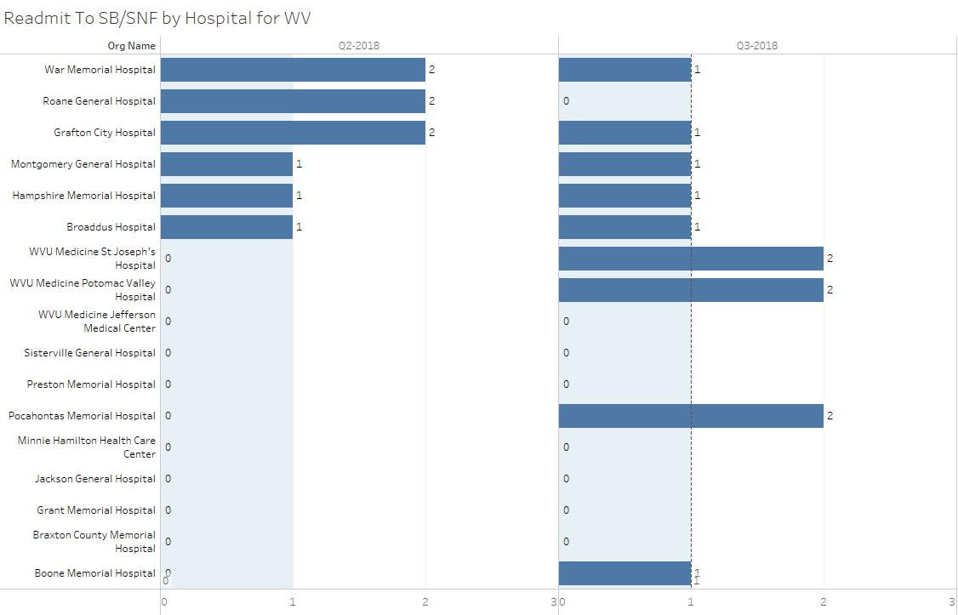
Number of Readmits to SB/SNF by Hospital
median
lower quartile
upper quartile

Slide 94
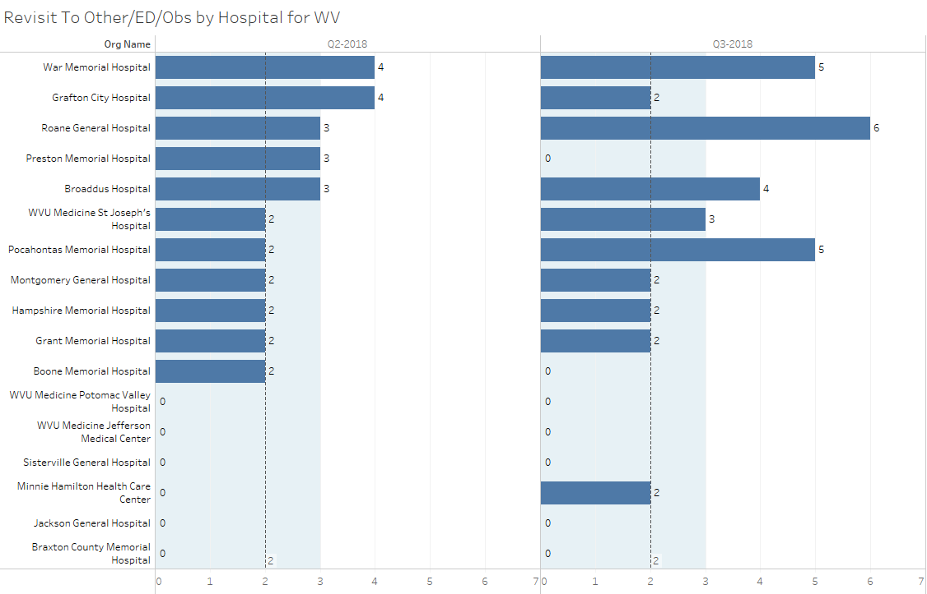
Number of Revisits to ED or Observation by Hospital
median
lower quartile
upper quartile

Slide 95
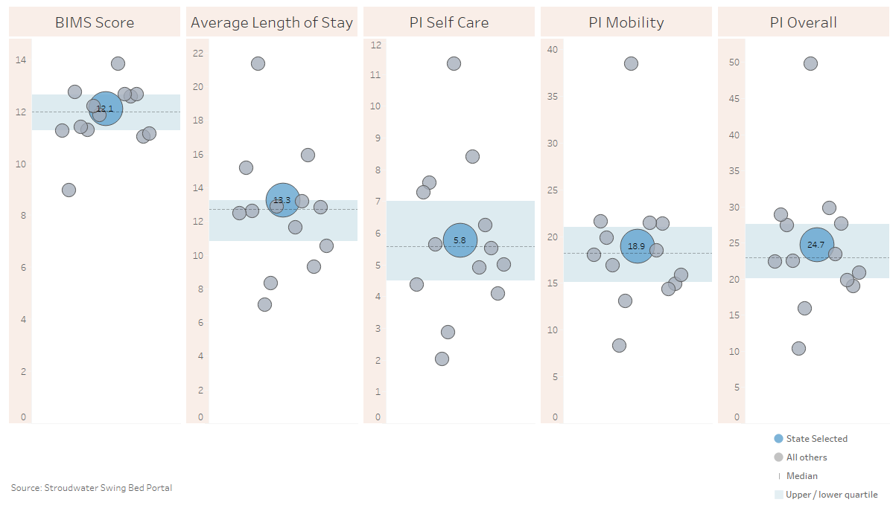
WV State Comparison for the past 6 months combined

Slide 96
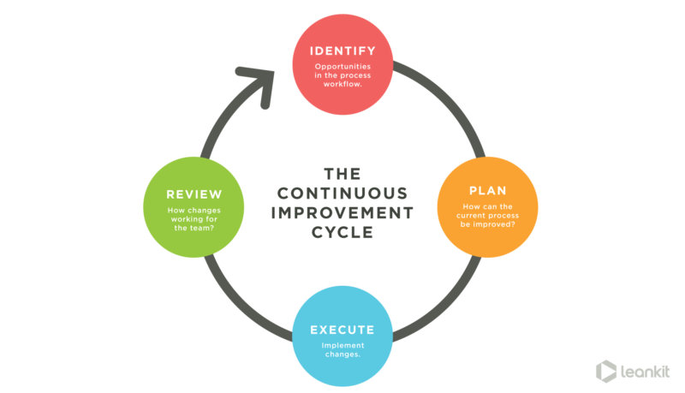
What is the data telling us? (2:00 – 2:55)
Preparing for your PI/QI and Leadership reports and meetings
What are the opportunities for WV CAHs Network hospitals.
Which score will you work on this next quarter?
(team work)

Slide 97
Next Step (2:55 to 3:00) & THANK YOU!
Continue working on your last action plan as applicable
Email Paula Knowlton from Stroudwater at pknowlton@stroudwater.com for any technical questions (add a person with access to data, data entry issues, pulling reports together…)
Write to me maryguyotconsulting@gmail.com with clinical questions or to share what you would like the web-based tool to be able to do
Writing to Paula or I, PLEASE clarify which hospital you are asking about especially if from same system (email name is not always sufficient!!)
Share the score you have committed to improve with your team and agree on a process to improve
Come prepared to share what you worked on and outcome
Enter data for all Oct, Nov & Dec discharges by Jan 4th
Enter 30-day follow-up data entry for all patients who have been discharged for 30 to 33 days by Jan 4th
Come prepared for the January meeting – Tuesday Jan 15, 2019

Slide 98
Remaining Questions?

