Slide 1




West Virginia Critical Access Hospital
Performance Improvement Network
July 13, 2017
Carla Brock Wilber, DNP, RN, NE-BC
cwilber@stroudwater.com

Slide 2
Agenda Review

Slide 3
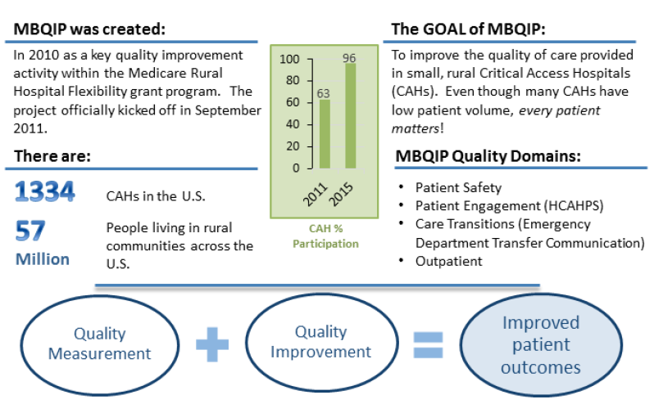

Federal Office of Rural Health Policy - MBQIP
Source: Stratis Health Rural Quality Improvement Technical Assistance │ www.stratishealth.org

Slide 4
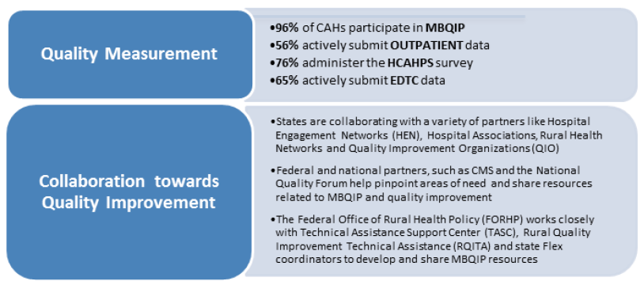
Federal Office of Rural Health Policy - MBQIP
April UPDATE - 1340 CAH’s with 1330 signed memorandums of understanding to participate
2016 participation rate is 93.5% (reporting in 2 domains)
Using Q1 2016 reporting numbers:
Patient Safety = 64%
Outpatient – 73%
HCAHPS and EDTC = 79%
Source: Stratis Health Rural Quality Improvement Technical Assistance │ www.stratishealth.org

Slide 5
MBQIP Measures
ID | Measure Name | Data Reported To
OP-1 | Median Time to Fibrinolysis | QNet via OP CART/Vendor
OP-2 | Fibrinolytic Therapy Received Within 30 minutes of ED Arrival | QNet via OP CART/Vendor
OP-3 | Median Time to Transfer to Another Facility for Acute Coronary Intervention | QNet via OP CART/Vendor
OP-4 | Aspirin at Arrival | QNet via OP CART/Vendor
OP-5 | Median Time to ECG | QNet via OP CART/Vendor
OP-18 | Median Time from ED Arrival to ED Departure for Discharged ED Patients | QNet via OP CART/Vendor
OP-20 | Door to diagnostic evaluation by a qualified medical professional | QNet via OP CART/Vendor
OP-21 | Median time to pain management for long bone fracture | QNet via OP CART/Vendor
OP-22 | Patient left without being seen | QNet via Online Tool
OP-27 | Influenza vaccination coverage among healthcare personnel | National Healthcare Safety Network Website
IMM-2 | IP Influenza immunization | QNet via CART/Vendor
HCAHPS | IP Satisfaction | QNet via Survey Vendor
EDTC | Emergency Department Transfer Communication | Stroudwater or Other

Slide 6
Sampling - MBQIP Measures
ID | Measure Name | Sampling
OP-1 | Median Time to Fibrinolysis | O-80 (Submit All)
OP-2 | Fibrinolytic Therapy Received Within 30 minutes of ED Arrival | O-80 (Submit All)
OP-3 | Median Time to Transfer to Another Facility for Acute Coronary Intervention | O-80 (Submit All)
OP-4 | Aspirin to Arrival | O-80 (Submit All)
OP-5 | Median Time to ECG | O-80 (Submit All)
OP-18 | Median Time from ED Arrival to ED Departure for Discharged ED Patients | 0-900/ qtr. ( 21/mth. or 63/qtr.) > 900/ qtr. ( 32/mth. or 96/qtr.)
OP-20 | Door to diagnostic evaluation by a qualified medical professional | 0-900/ qtr. ( 21/mth. or 63/qtr.) > 900/ qtr. ( 32/mth. or 96/qtr.)
OP-21 | Median time to pain management for long bone fracture | O-80 (Submit All)
OP-22 | Patient left without being seen | No sampling – report all cases
OP-27 | Influenza vaccination coverage among healthcare personnel | No sampling – report all cases
IMM-2 | IP Influenza immunization | See next slide
HCAHPS | IP Satisfaction | Sampling determined by certified vendor
EDTC | Emergency Department Transfer Communication | See next slide

Slide 7
Sampling - MBQIP Measures
ID | Measure Name | Sampling
IMM-2 | IP Influenza immunization | Quarterly 0-5 - Reporting encouraged 6-152 - 100% of initial pt. pop 153-764 – 153 765-1529 - 20% of initial pt. pop >1529 – 306 Monthly < 51 - 100% of initial population 51-254 – 51 255-509 - 20% of initial pt. pop >509 - 102
EDTC | Emergency Department Transfer Communication | Quarterly 0-44 - submit all cases 45 - submit 45 cases Monthly 0-15 - submit all cases > 15 - submit 15 cases

Slide 8
MBQIP Measures Reporting Periods
(Rolling 4 Quarters)
Reporting Period | Quarter Label Shown
First Quarter 2016 through Fourth Quarter 2016 Discharges | 2016 Q4
Fourth Quarter 2015 through Third Quarter 2016 Discharges | 2016 Q3
Third Quarter 2015 through Second Quarter 2016 Discharges | 2016 Q2
Second Quarter 2015 through First Quarter 2016 Discharges | 2016 Q1
First Quarter 2015 through Fourth Quarter 2015 Discharges | 2015 Q4
Fourth Quarter 2014 through Third Quarter 2015 Discharges | 2015 Q3

Slide 9
Proposed new measures for FY 2018-2021
The Federal Office of Rural Health Policy (FORHP) is proposing the following three additions to the Medicare Beneficiary Quality Improvement Project (MBQIP):
1. Addition of an antibiotic stewardship program-
This addition would allow critical access hospitals (CAHs) four years to fully implement an antibiotic stewardship program by the end of FY2021
(September 1, 2021 - August 31, 2022).
Addition of three CMS Hospital Compare Hospital Acquired Infections-
(CAUTI, MRSA, and CDI) as core measure requirements under the Patient Safety Domain
  Other HAI Measures, including CLABSI (Central Line Associated Blood Stream Infection), and SSI (Surgical Site Infection measures) will remain on the ‘additional’ MBQIP list. CAHs that provide services relevant to those measures should be encouraged to collect and submit data as appropriate.
Addition of ED-1 and ED-2 CMS Hospital Compare measures-
  Under the Outpatient Safety Domain

Slide 10

OP Core Measures

Slide 11
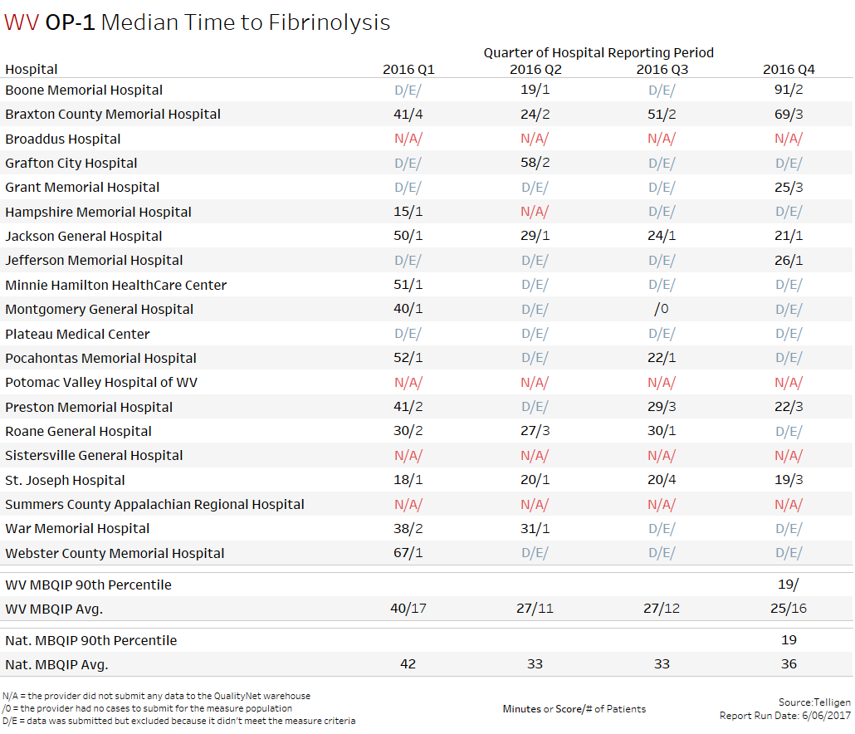
AMI Cardiac Care
Fewer minutes are better
Minutes/ # of Patients
5 Hospitals were better than the National Avg.

Slide 12
Median Time to Fibrinolysis
Measure / Name | Best Practice
OP-1 Median time to Fibrinolysis (AMI Care) | Diagnose the patient as early in the patient flow as possible (e.g. enable EMS to diagnose ST segment elevation myocardial infarction (STEMI) patients and/or notify ED of possible STEMI to initiate preparation processes) Synchronize clocks and equipment in the ED Establish local guidelines or care pathways for AMI patients Ensure the emergency physician on duty activates the reperfusion plan according to established local guidelines and care pathways.
“Quality Improvement Implementation Guide and Toolkit for Critical Access Hospitals”
Stratis Health Rural Quality Improvement Technical Assistance | www.stratishealth.org

Slide 13
Median Time to Fibrinolysis Continued
Measure / Name | Best Practice
OP-1 Median time to Fibrinolysis (AMI Care) | Treat registration for patients with AMI in a fashion similar to trauma patients with the ability to fast-track critical labs, such as creatinine and Prothrombin Time (PT)/ International Normalized Ratio (INR) test Store fibrinolytic agent in the ED and/or establish ability to reconstitute and administer fibrinolytic in the ED
“Quality Improvement Implementation Guide and Toolkit for Critical Access Hospitals”
Stratis Health Rural Quality Improvement Technical Assistance | www.stratishealth.org

Slide 14
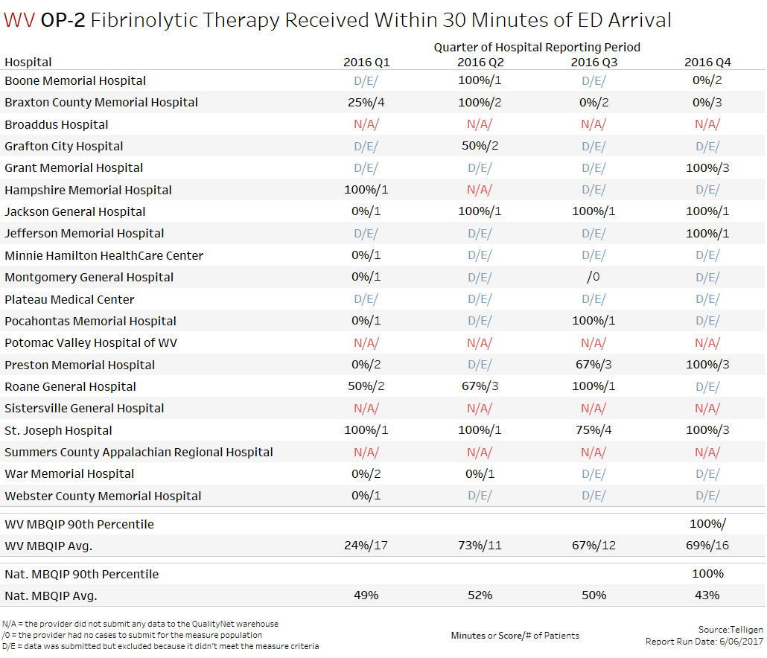
AMI Cardiac Care
Score/ # of Patients
All but 2 Hospitals were better than the National Avg.

Slide 15
Fibrinolytic Therapy w/i 30 min of arrival
Measure / Name | Best Practice
OP-2 Fibrinolytic Therapy Received Within 30 Minutes of ED Arrival (AMI Care) | Diagnose the patient as early in the patient flow as possible (e.g. enable EMS to diagnose ST segment elevation myocardial infarction (STEMI) patients and/or notify ED of possible STEMI to initiate preparation processes) Synchronize clocks and equipment in the ED Establish local guidelines or care pathways for AMI patients Ensure the emergency physician on duty activates the reperfusion plan according to established local guidelines and care pathways.
“Quality Improvement Implementation Guide and Toolkit for Critical Access Hospitals”
Stratis Health Rural Quality Improvement Technical Assistance | www.stratishealth.org

Slide 16
Fibrinolytic Therapy w/i 30 min of arrival Continued
Measure / Name | Best Practice
OP-2 Fibrinolytic Therapy Received Within 30 Minutes of ED Arrival (AMI Care) | Treat registration for patients with AMI in a fashion similar to trauma patients with the ability to fast-track critical labs, such as creatinine and Prothrombin Time (PT)/ International Normalized Ratio (INR) test Store fibrinolytic agent in the ED and/or establish ability to reconstitute and administer fibrinolytic in the ED
“Quality Improvement Implementation Guide and Toolkit for Critical Access Hospitals”
Stratis Health Rural Quality Improvement Technical Assistance | www.stratishealth.org

Slide 17
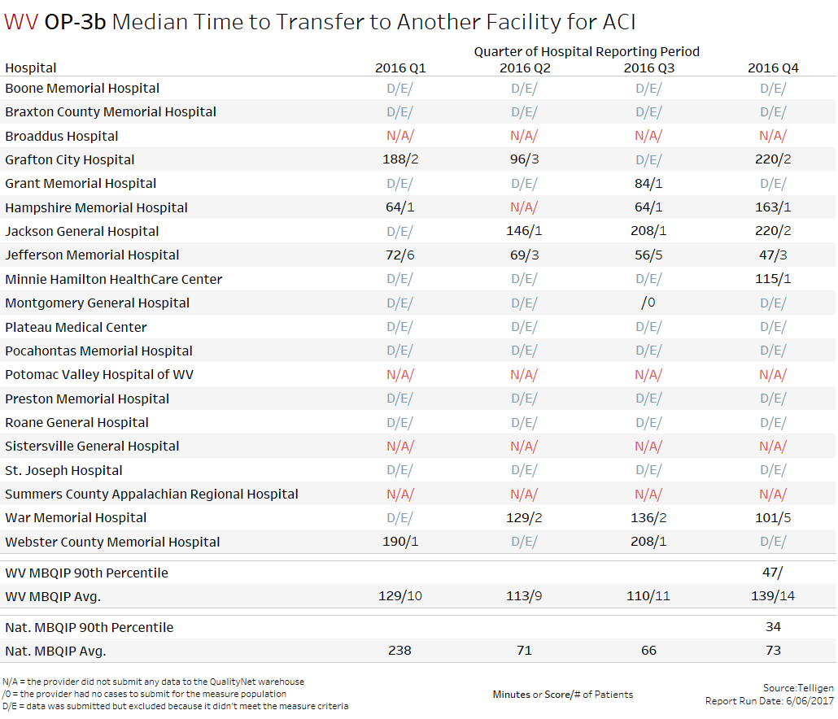
AMI Cardiac Care
Fewer minutes are better
Only 1 Hospital was better than the National Avg.

Slide 18
Median Time to Transfer
Measure / Name | Best Practice
OP-3 Median Time to Transfer to Another Facility for Acute Coronary Intervention (AMI Care) | Diagnose the patient as early in the patient flow as possible (e.g. enable emergency medical service (EMS) to diagnose STEMI patients) Synchronize equipment and clocks in the ED Work with EMS providers and regional centers to establish processes and protocols to expedite communication and transfer Establish initial and backup plan for transfer or transport to a STEMI-receiving hospital For helicopter transport, immediately activate transport during initial communication between referring hospital ED and receiving hospital regarding the need for reperfusion
“Quality Improvement Implementation Guide and Toolkit for Critical Access Hospitals”
Stratis Health Rural Quality Improvement Technical Assistance | www.stratishealth.org

Slide 19
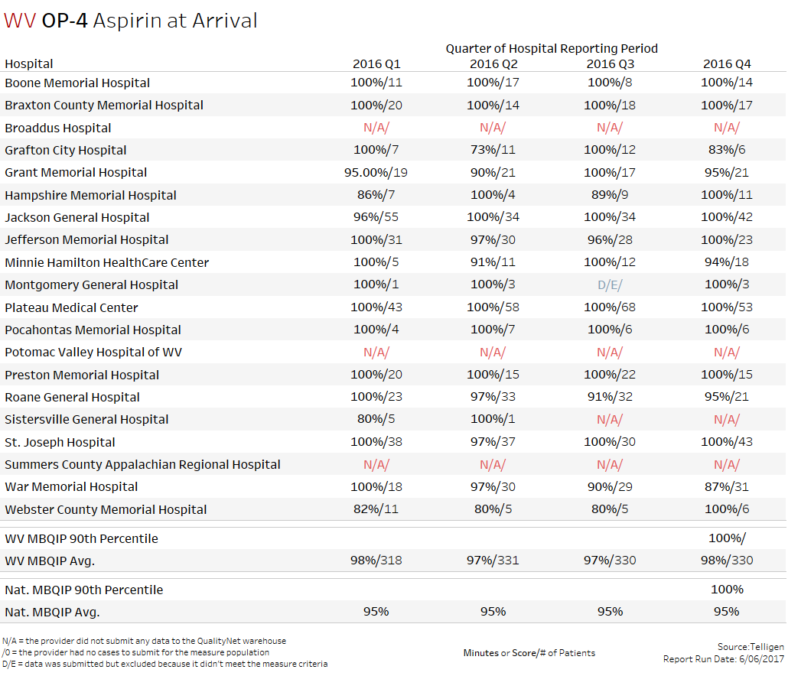
AMI Cardiac Care
All but 3 Hospitals were better than or equal to the National Avg.

Slide 20
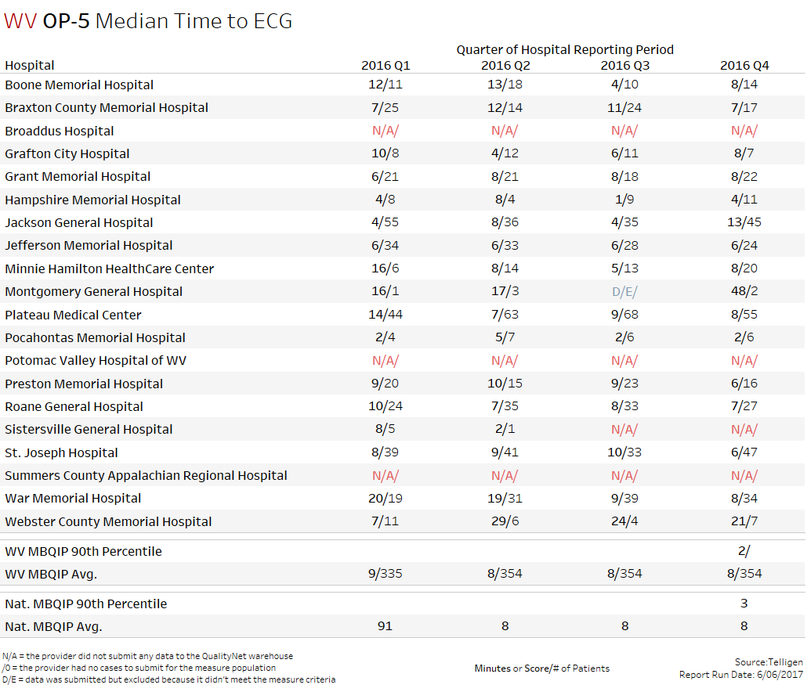
AMI Cardiac Care
Fewer minutes are better
13 Hospitals were better than or equal to the National Avg.

Slide 21
Median Time to ECG
Measure / Name | Best Practice
OP-5 Median Time to ECG (AMI Care) | Diagnose the patient as early in the patient flow as possible (e.g. enable emergency medical service (EMS) to diagnose SEMI patients and/or notify ED of possible STEMI to initiate preparation/processes) Synchronize equipment and clocks in the ED Promptly identify patients requiring ECG through nurse interview prior to registration or provide necessary training to registration personnel Specify processes and protocol for rapidly acquiring ECG, including having ECG equipment in the ED and specifying a location that affords prompt access and adequate patient privacy
“Quality Improvement Implementation Guide and Toolkit for Critical Access Hospitals”
Stratis Health Rural Quality Improvement Technical Assistance | www.stratishealth.org

Slide 22
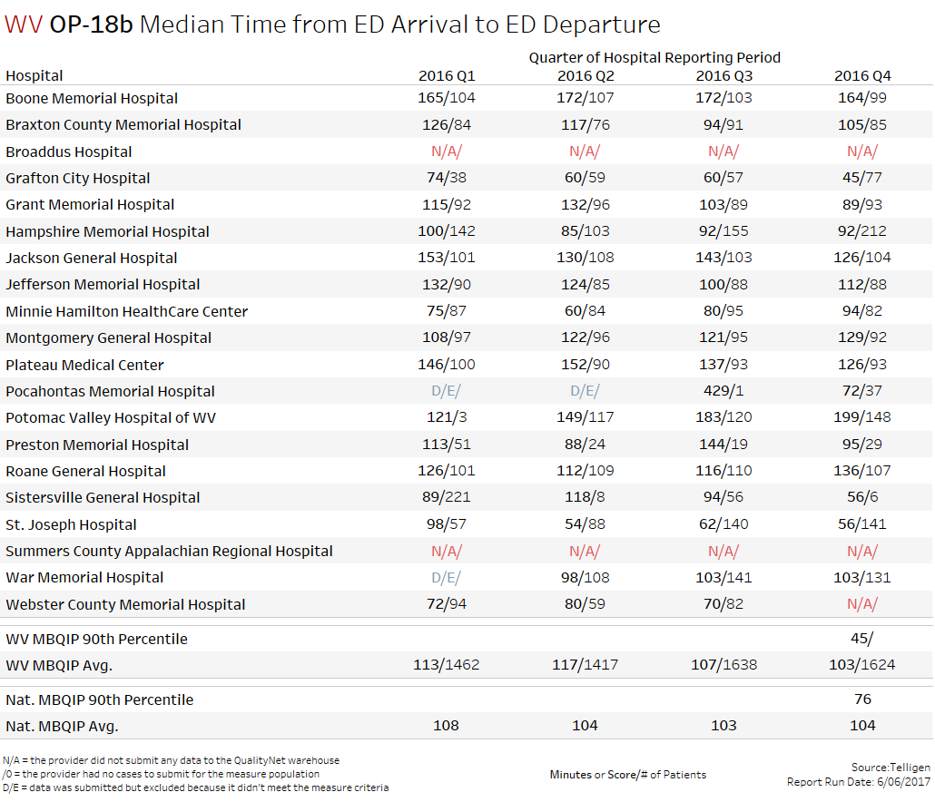
Emergency Dept.
Fewer minutes are better
9 Hospitals were better than or equal to the National Avg.

Slide 23
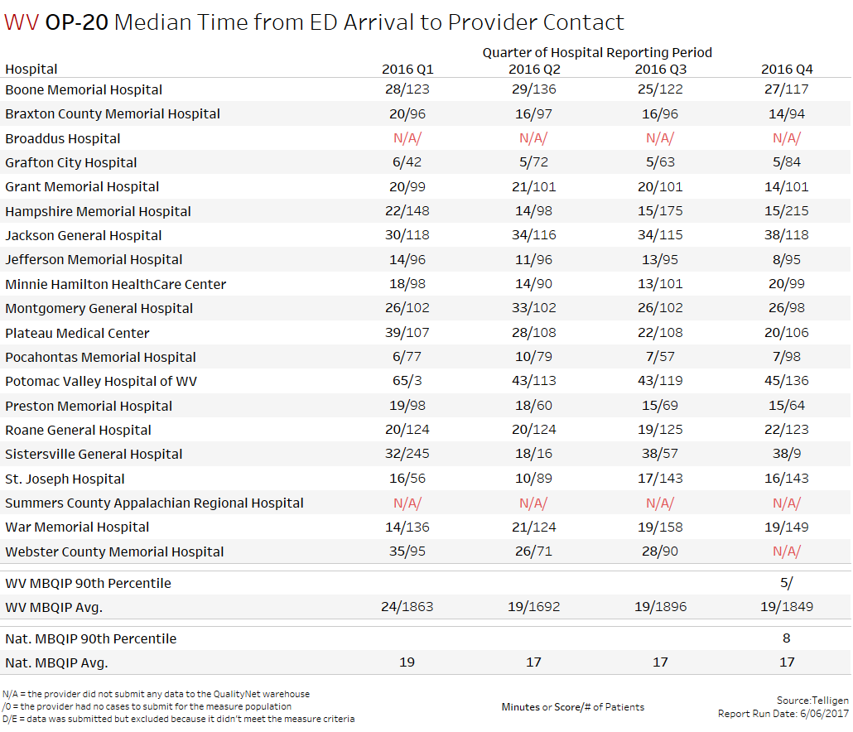
Emergency Dept.
Fewer minutes are better
8 Hospitals were better than or equal to the National Avg.

Slide 24
Door to Diagnostic Evaluation
Measure / Name | Best Practice
OP-20 Door-to-Diagnostic Evaluation by a Qualified Medical Professional | Consider implementing alternative patient flow models such as : RN triage and preliminary registration upon arrival, with bedside registration Provider/RN team evaluations upon arrival with bedside registration Low acuity patients evaluated by provider upon arrival and discharged as soon as full registration is completed Share door to qualified medical professional (QMP) evaluation data with ED managers, ED staff, and providers daily
“Quality Improvement Implementation Guide and Toolkit for Critical Access Hospitals”
Stratis Health Rural Quality Improvement Technical Assistance | www.stratishealth.org

Slide 25
Door to Diagnostic Evaluation
Measure / Name | Best Practice
OP-20 Door-to-Diagnostic Evaluation by a Qualified Medical Professional | Synchronize all staff and equipment clocks in the ED Ensure that providers consistently document the time of their first face patient assessment or exam AHRQ Patient Flow Guide AHRQ Emergency Severity Index (ESI): A Triage Tool for Emergency Department
“Quality Improvement Implementation Guide and Toolkit for Critical Access Hospitals”
Stratis Health Rural Quality Improvement Technical Assistance | www.stratishealth.org

Slide 26
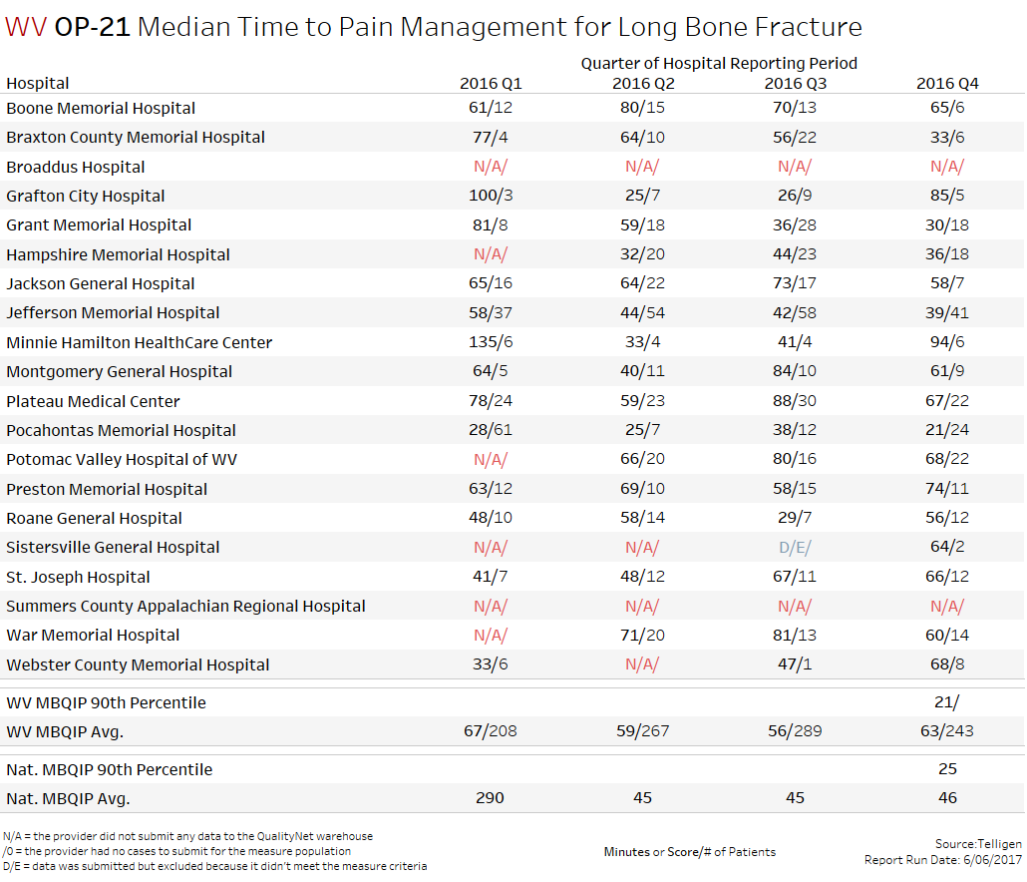
Pain Management
Fewer minutes are better
Only 5 Hospitals were better than or equal to the National Avg.

Slide 27
Median Time to Pain Management LBF
Measure / Name | Best Practice
OP-21 Median time to Pain Management for Long Bone Fracture | Provide regular nurse and provider education on the requirements for LBF pain management with frequent feedback on performance Consider implanting a nurse-driver protocol for LBF or suspected LBF Triage patients with suspected or known LBF as Emergency Severity Index (ESI) Level 2, or equivalent prioritization
“Quality Improvement Implementation Guide and Toolkit for Critical Access Hospitals”
Stratis Health Rural Quality Improvement Technical Assistance | www.stratishealth.org

Slide 28
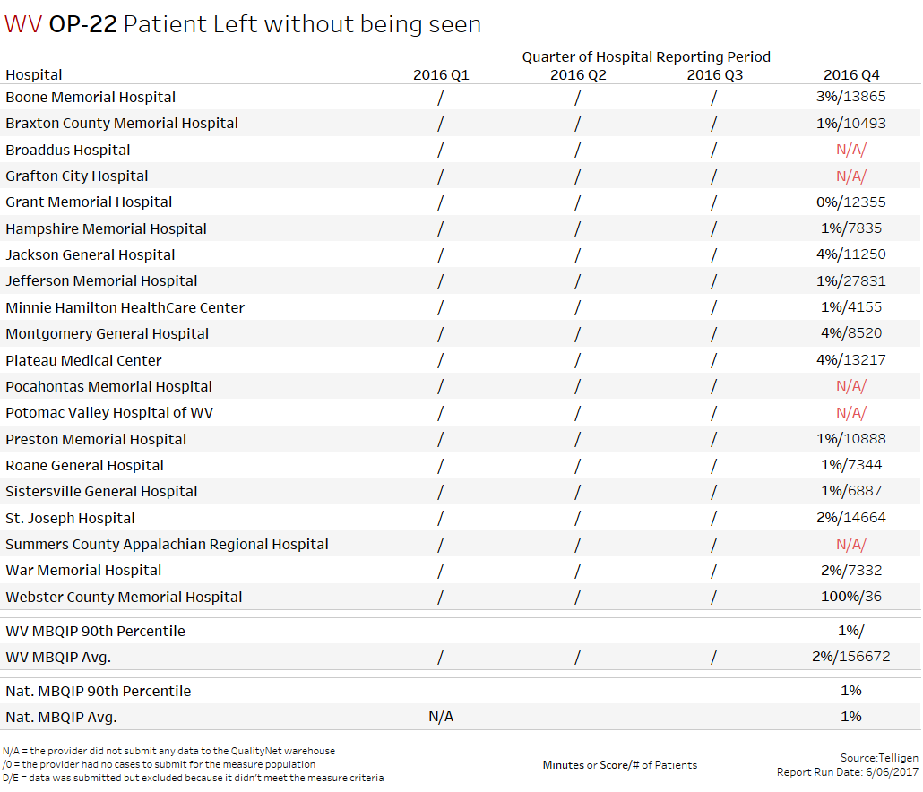
Emergency Dept.
Smaller %’s are better
8 Hospitals were at or better than the National Avg.

Slide 29
Patient Left Without Being Seen
Measure / Name | Best Practice
OP-22 Patient left without being seen | The best practices to reduce door to evaluation by QMP (OP 20) also are likely to reduce the number of patients left without being seen. Implement a process to capture patients that leave without being seen Conduct regular patient record analyses to identify and understand trends, such as a particular diagnosis or timeframe Contact patients who leave without being seen before the end of the shift or the next day to encourage them to return to the ED or seek treatment AHRQ Patient Flow Guide
“Quality Improvement Implementation Guide and Toolkit for Critical Access Hospitals”
Stratis Health Rural Quality Improvement Technical Assistance | www.stratishealth.org

Slide 30
ED-1b
Average (median) time patients spent in the emergency department, before they were admitted to the hospital as an inpatient (fewer minutes are better)
Source: Hospital Compare

Slide 31
ED-2b
Average (median) time patients spent in the emergency department, after the doctor decided to admit them as an inpatient before leaving the emergency department for their inpatient room (fewer minutes are better)
Source: Hospital Compare

Slide 32
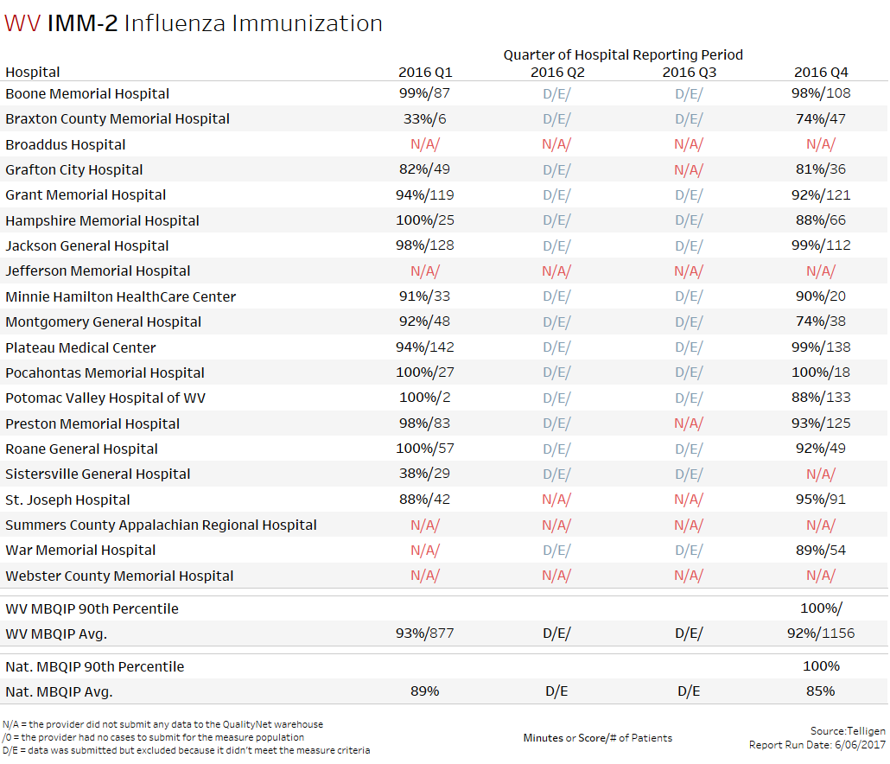
Immunization
12 Hospitals were better than or equal to the National Avg.

Slide 33
Influenza Immunization (Inpatient)
Measure / Name | Best Practice
IMM-2 Influenza Immunization (inpatient) | Offer influenza vaccination by October, if possible. Vaccination should continue to be offered as long as influenza viruses are circulating (generally October – March) Incorporate influenza vaccination status into initial patient assessment and identify a process for follow-up when needed Review influenza vaccination status in the discharge process with administration of vaccine if indicated on initial assessment and not already given during hospitalization
“Quality Improvement Implementation Guide and Toolkit for Critical Access Hospitals”
Stratis Health Rural Quality Improvement Technical Assistance | www.stratishealth.org

Slide 34
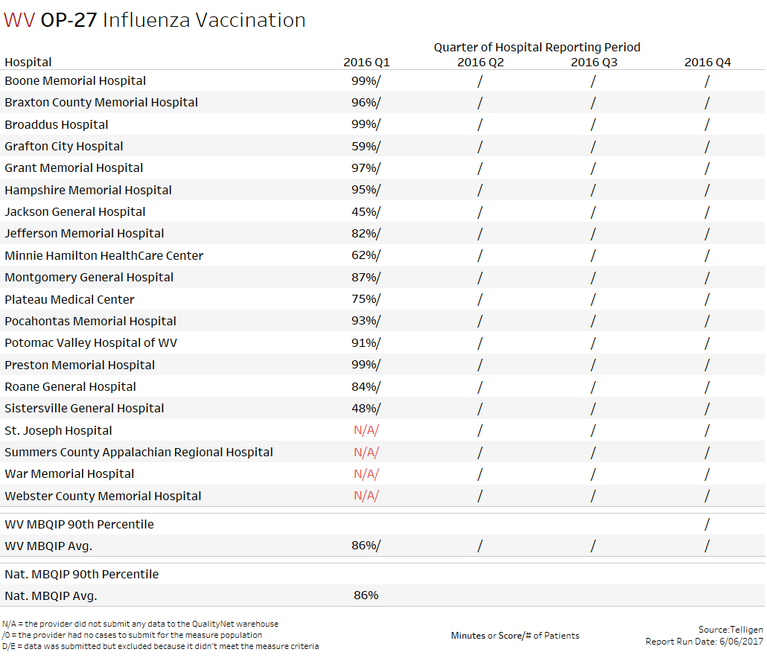
NHSN Collected Measure
Reporting not required for this quarter

Slide 35
Influenza Vaccination Among HCP
Measure / Name | Best Practice
OP-27 Influenza Vaccination Among Healthcare Personnel (HCP) | Document reasons for non-receipt of a recommended vaccine Consider steps to minimize/reduce potential for spread of vaccine preventable disease by unvaccinated employees such as the use of facemasks Declination/Refusal: consider policy for a follow-up conversation to provide resources to counter misinformation (if indicated) and advise employee on post-exposure protocols and any need to restrict or modify work
“Quality Improvement Implementation Guide and Toolkit for Critical Access Hospitals”
Stratis Health Rural Quality Improvement Technical Assistance | www.stratishealth.org

Slide 36
Influenza Vaccination Among HCP Continued
Measure / Name | Best Practice
OP-27 Influenza Vaccination Among Healthcare Personnel (HCP) | Consider an organized influenza immunization campaign to improve HCP acceptance of vaccination Provide easy access to free influenza vaccinations to all HCP on all shifts as soon as vaccinations arrive (October) Highlight the level of vaccination coverage among HCP to be one measure of a patient safety quality program that is regularly measured and reported to facility administrators and staff Consider obtaining signed declinations from personnel who decline influenza vaccination for reasons other than medical contraindications
“Quality Improvement Implementation Guide and Toolkit for Critical Access Hospitals”
Stratis Health Rural Quality Improvement Technical Assistance | www.stratishealth.org

Slide 37
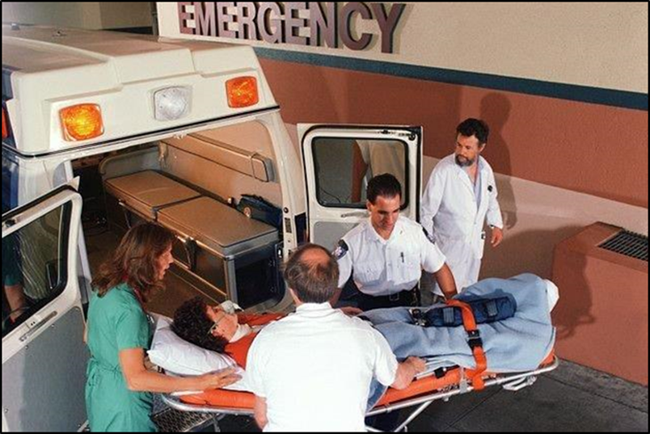
ED Transfer Communication (EDTC)
The EDTC measure evaluates the process of transfer communication through documentation of key information and the timeliness in which that information is communicated to the next setting of care.

Slide 38
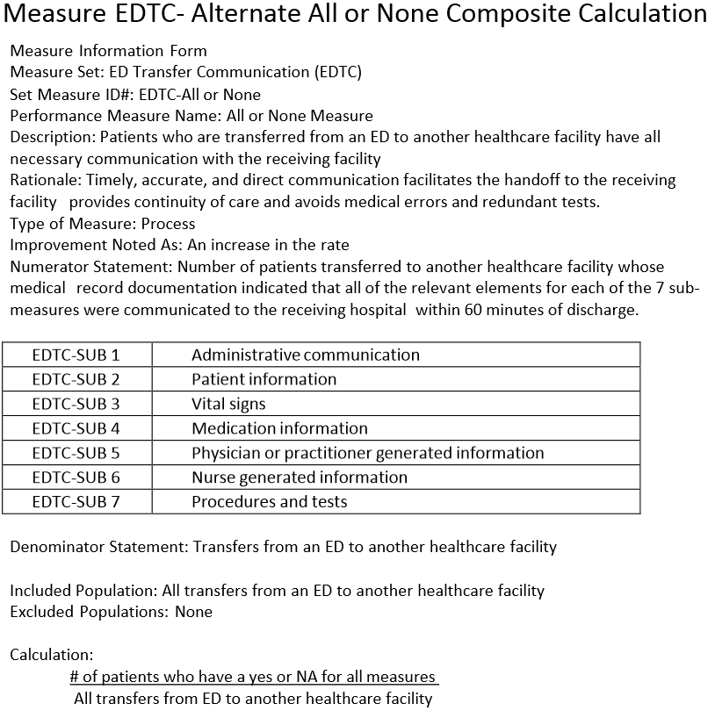
EDTC-All or None Composite Calculation
Source: Stratis Health

Slide 39
ED Transfer Communication
Measure / Name | Best Practice
EDTC Emergency Department Transfer Communication | Identify and implement a standardized process for documentation and transfer of information to the next setting of care Update paper transfer forms to ensure capture of all the required data elements and documentation that the information was communicated to the next setting of care Implement prompts and documentation in the electronic health record (EHR) to ensure elements are captured and communicated to the receiving facility, whether electronically or via a printed-paper form
“Quality Improvement Implementation Guide and Toolkit for Critical Access Hospitals”
Stratis Health Rural Quality Improvement Technical Assistance | www.stratishealth.org

Slide 40
ED Transfer Communication Continued
Measure / Name | Best Practice
EDTC Emergency Department Transfer Communication | Initiate discussions with organizations, both hospitals and long-term care centers that frequently receive patients from the ED, regarding opportunities for improved transfer communication and care for patients Develop standardized setting of care processes to report outstanding test or lab results to the next setting of care if not available prior to transfer
“Quality Improvement Implementation Guide and Toolkit for Critical Access Hospitals”
Stratis Health Rural Quality Improvement Technical Assistance | www.stratishealth.org

Slide 41
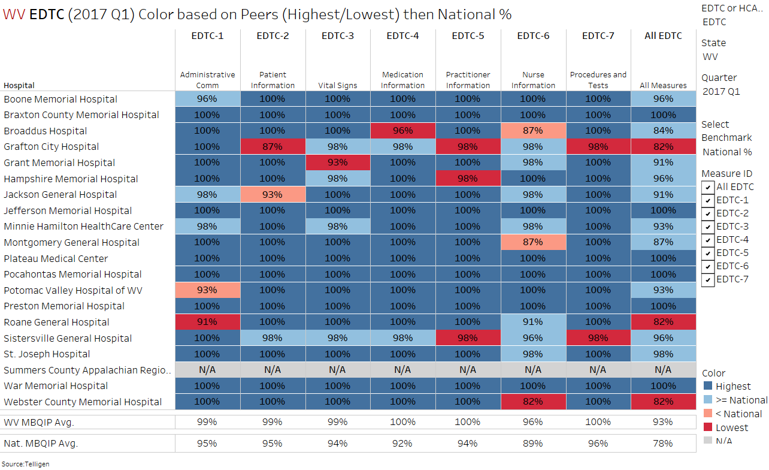
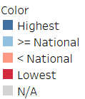
It is possible to be the lowest score among peers, but still be higher than the National Avg.
EDTC Q1/2017 Snapshot
Source:Telligen 5/24/17

Slide 42
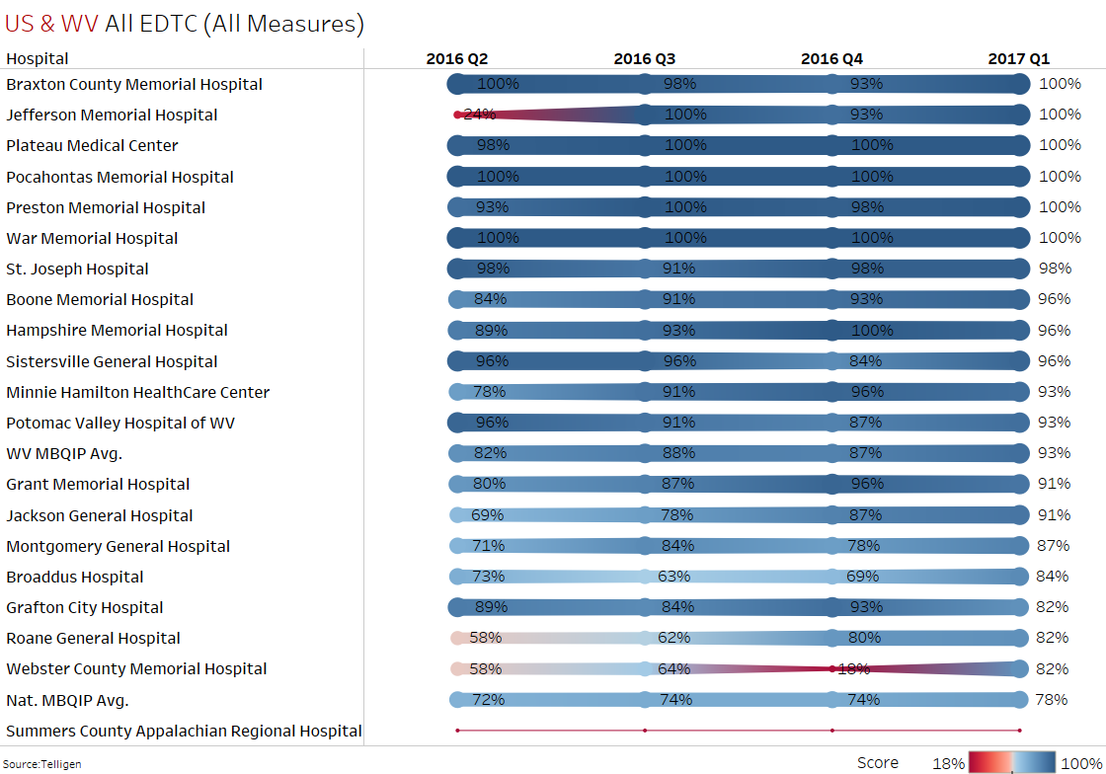
EDTC-”All EDTC Measure” Trends
Better/Equal the National Avg.
Source:Telligen 5/24/17

Slide 43
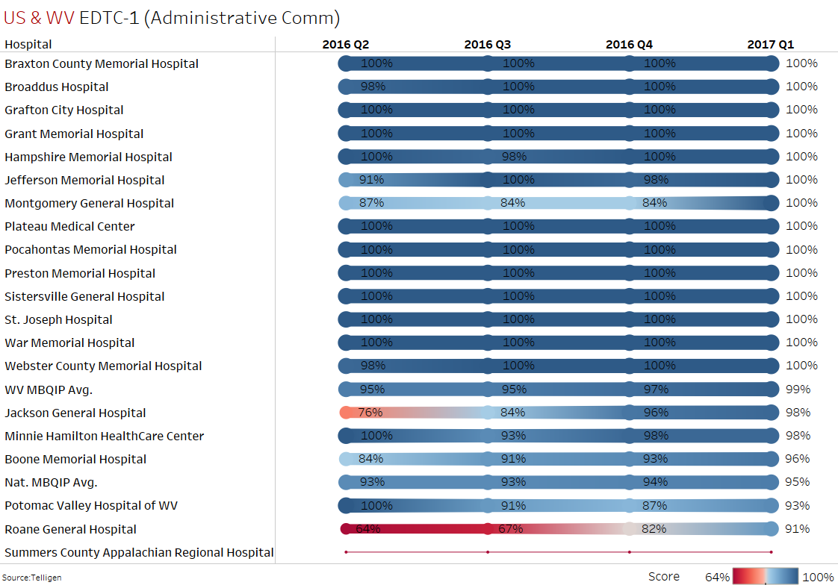
EDTC-1 Trends
Better/Equal the National Avg.
Source:Telligen 5/24/17

Slide 44
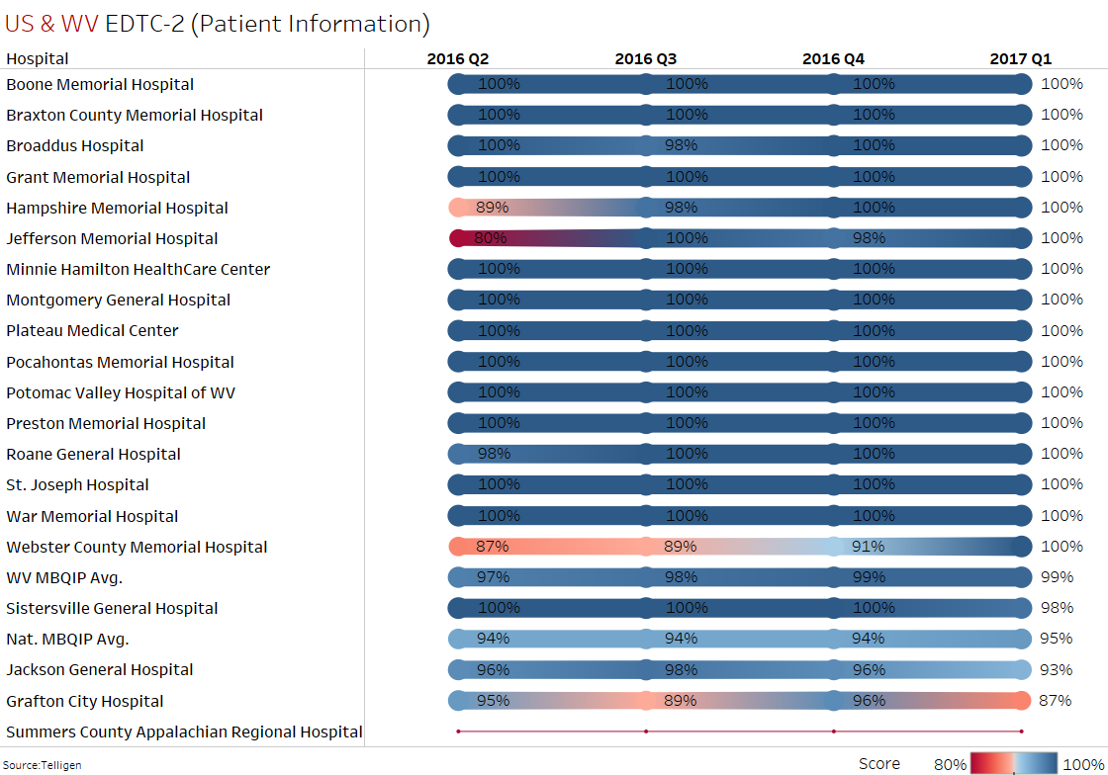
EDTC-2 Trends
Better/Equal the National Avg.
Source:Telligen 5/24/17

Slide 45
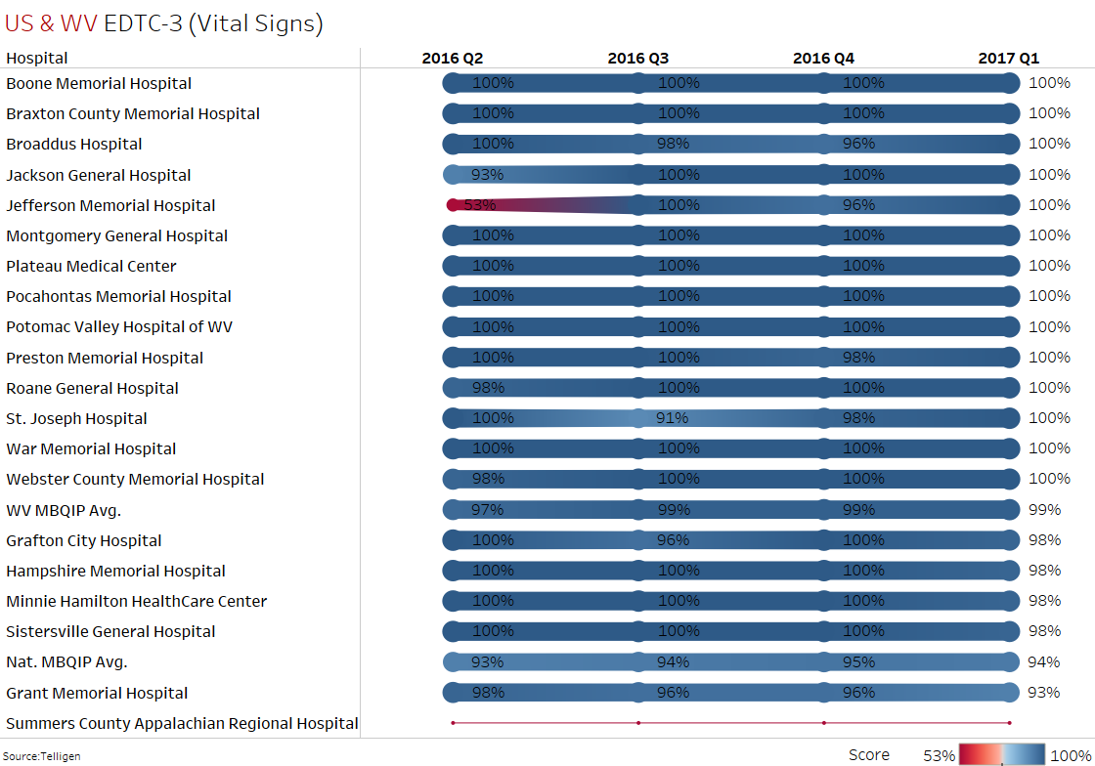
EDTC-3 Trends
Better/Equal the National Avg.
Source:Telligen 5/24/17

Slide 46
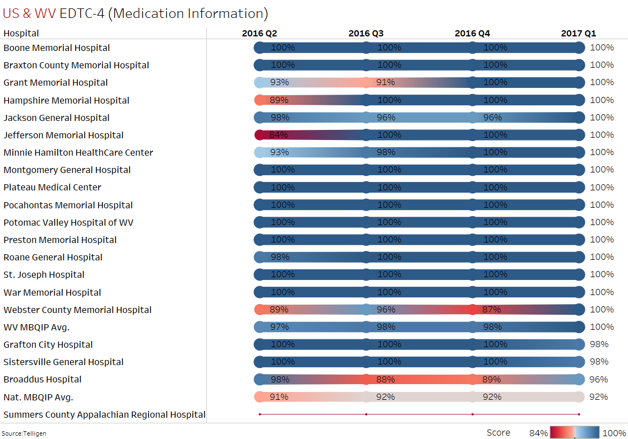
EDTC-4 Trends
Better/Equal the National Avg.
Source:Telligen 5/24/17

Slide 47
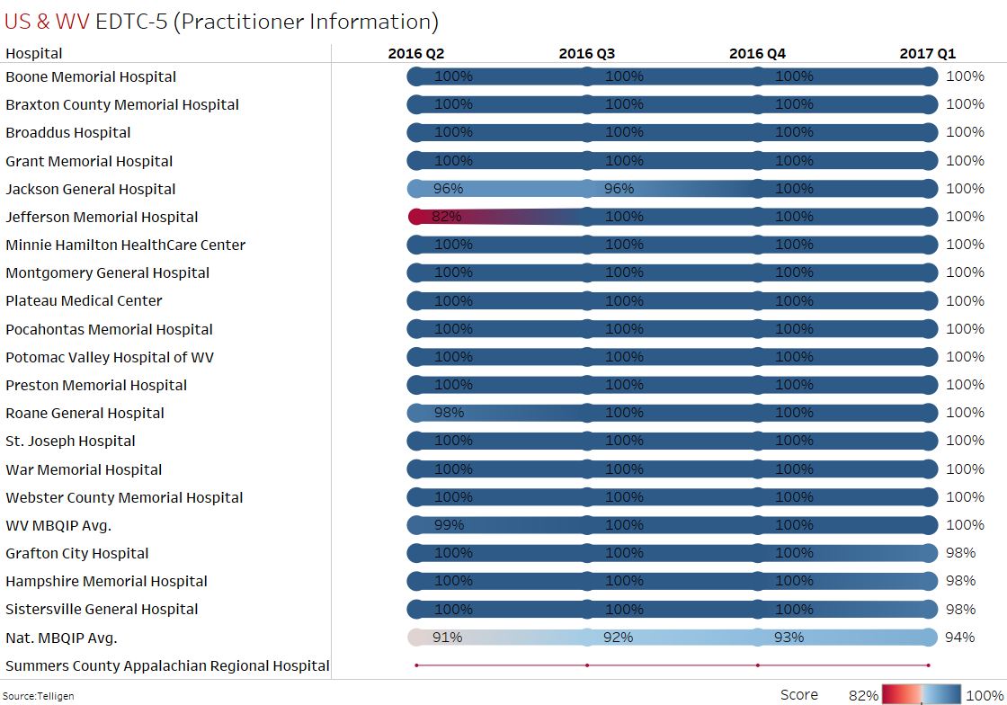
EDTC-5 Trends
Better/Equal the National Avg.
Source:Telligen 5/24/17

Slide 48
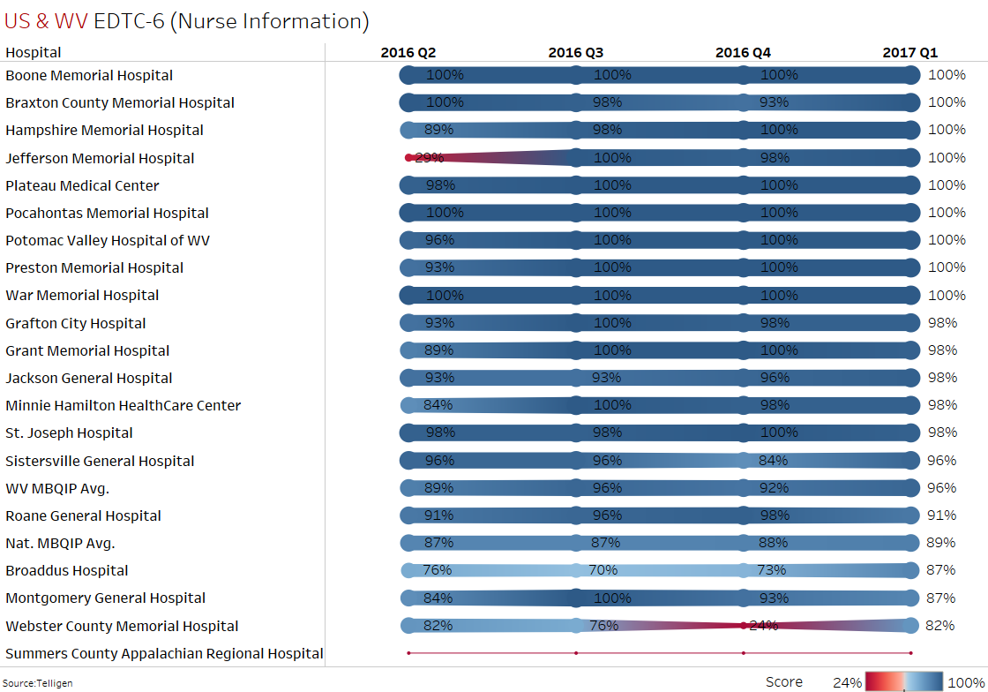
EDTC-6 Trends
Better/Equal the National Avg.
Source:Telligen 5/24/17

Slide 49
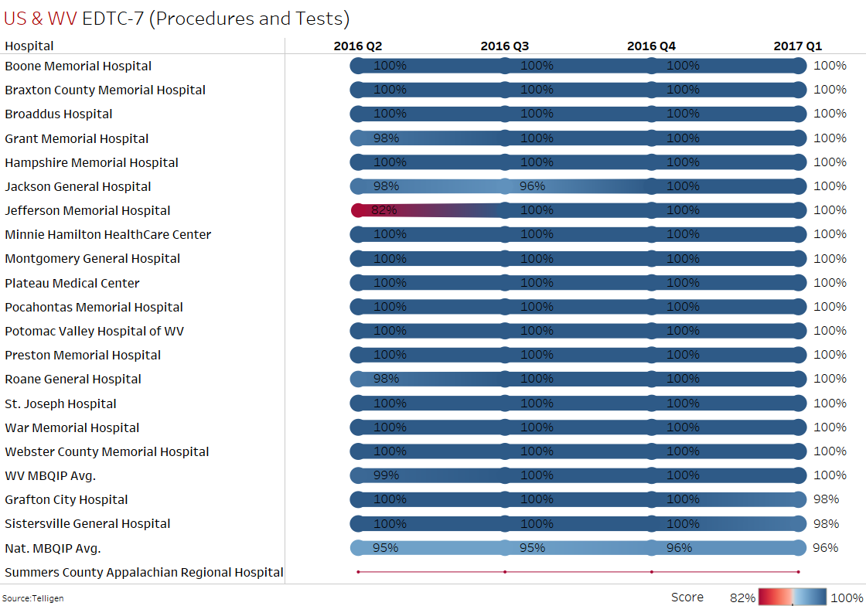
EDTC-7 Trends
Better/Equal the National Avg.
Source:Telligen 5/24/17

Slide 50
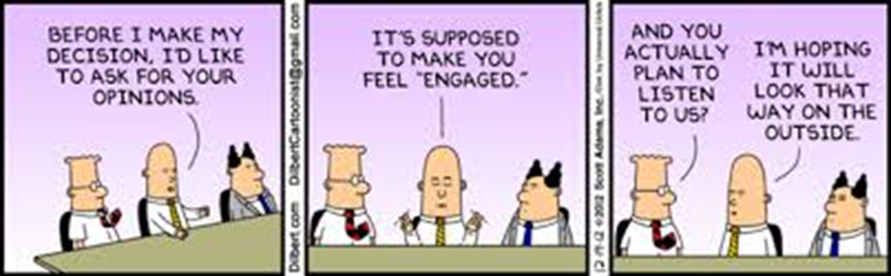
HCAHPS

Slide 51
HCAHPS General
Measure / Name | Best Practice
HCAHPS (general) | Consider exercises where staff and providers complete the HCAHPS survey based on their experience and/or knowledge of the hospital, and discuss strategies to improve patient perception on care HCAHPS response rates are positively correlated with high HCAHPS performance. Work closely with HCAHPS vendors to monitor and improve HCAHPS response rates HCAHPS website
“Quality Improvement Implementation Guide and Toolkit for Critical Access Hospitals”
Stratis Health Rural Quality Improvement Technical Assistance | www.stratishealth.org

Slide 52
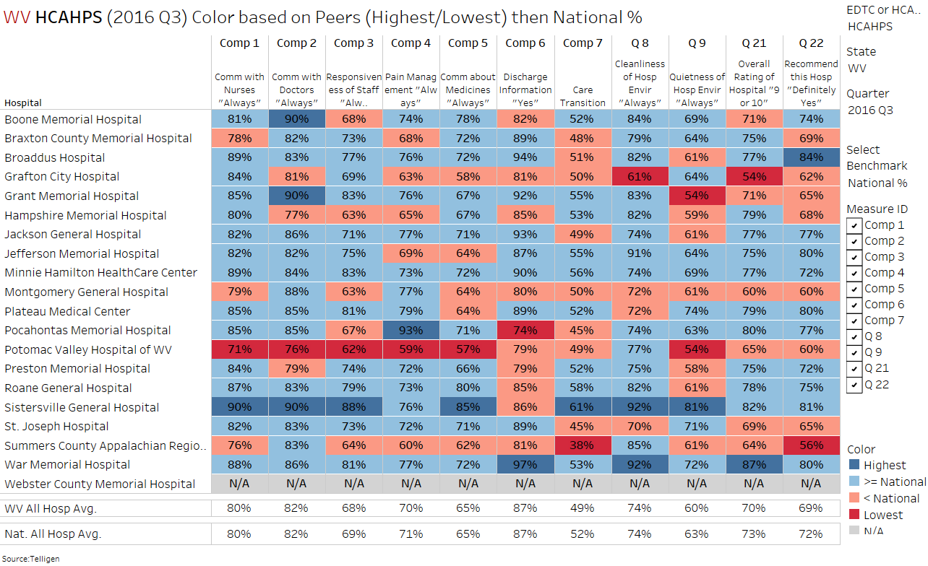
HCAHPS Q3/2016 Snapshot
Source: Telligen 4/18/2017

Slide 53

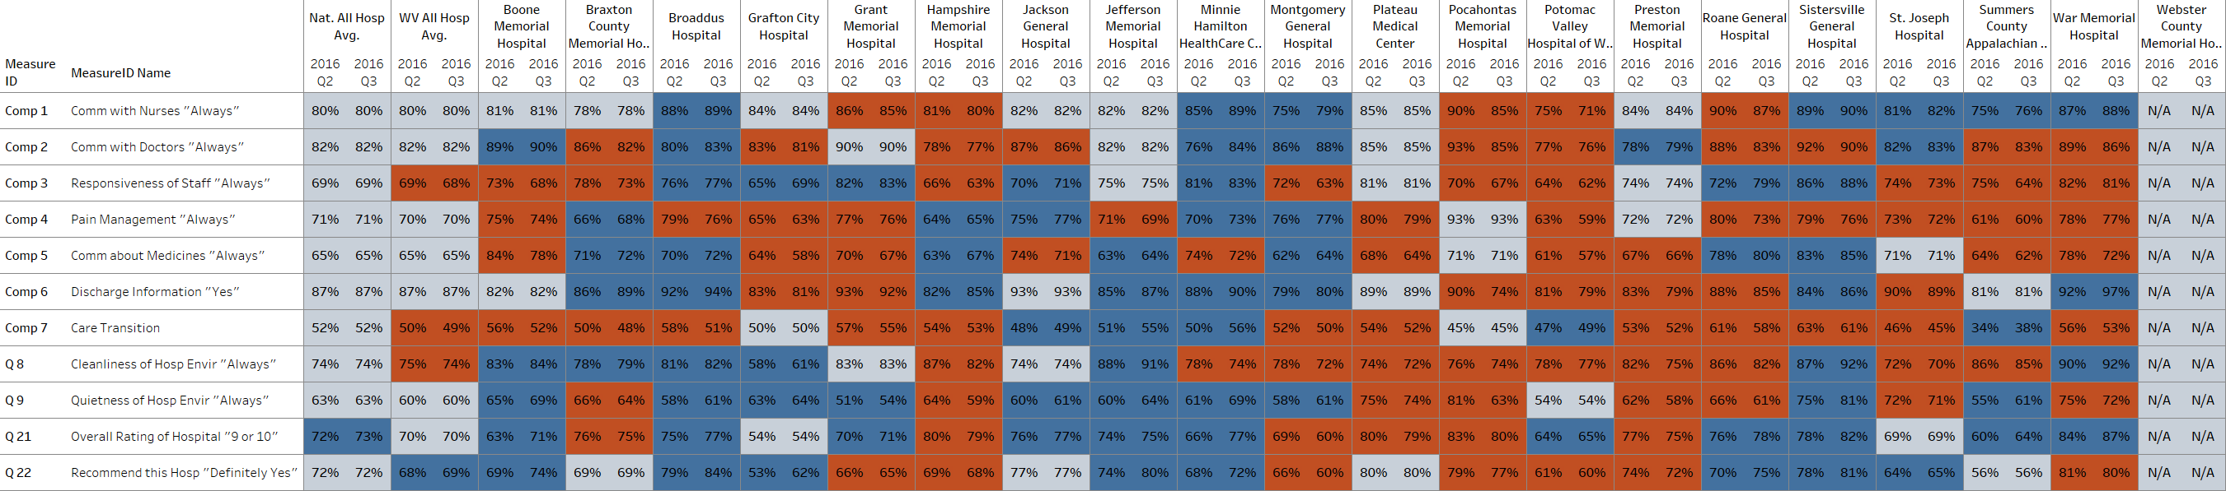
Source: Telligen 4/18/2017
Lower
HCAHPS Change Latest Two Quarters
Even
Better

Slide 54
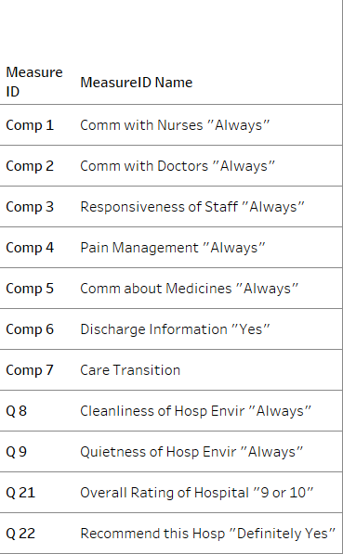
Source: Telligen 4/18/2017
Lower
HCAHPS Change Latest Two Quarters
Even
Better

Slide 55
Source: Telligen 4/18/2017
Lower
HCAHPS Change Latest Two Quarters
Even
Better

Slide 56
Source: Telligen 4/18/2017
Lower
HCAHPS Change Latest Two Quarters
Even
Better

Slide 57
Source: Telligen 4/18/2017
Lower
HCAHPS Change Latest Two Quarters
Even
Better

Slide 58
HCAHPS Star Rating Q3/2016
Source: Telligen 4/18/2017

Slide 59
HCAHPS Response Rate Q3/2016
WV return Rate Average by hospital:
A goal is to have a return rate at least 30% or more
8 WV CAHs have a return rate above 30%.

Slide 60
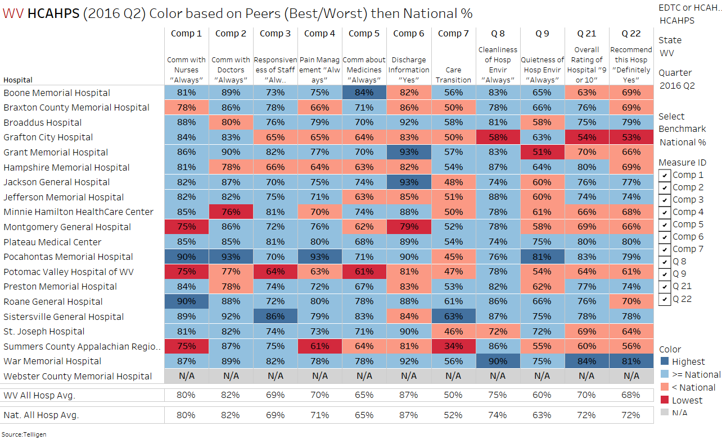
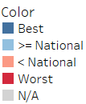
Q2/2016 HCAHPS Compared to National Avg.
Source: Telligen 4/18/2017

Slide 61
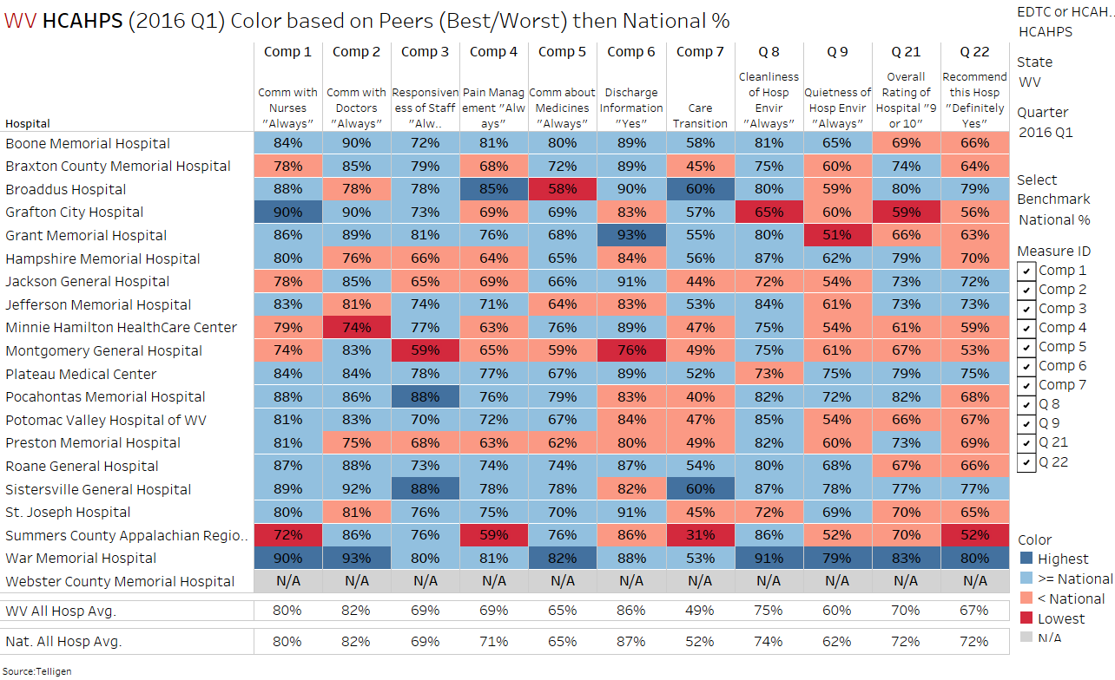
Q1/2016 HCAHPS Compared to National Avg.
Source: Telligen 4/18/2017

Slide 62
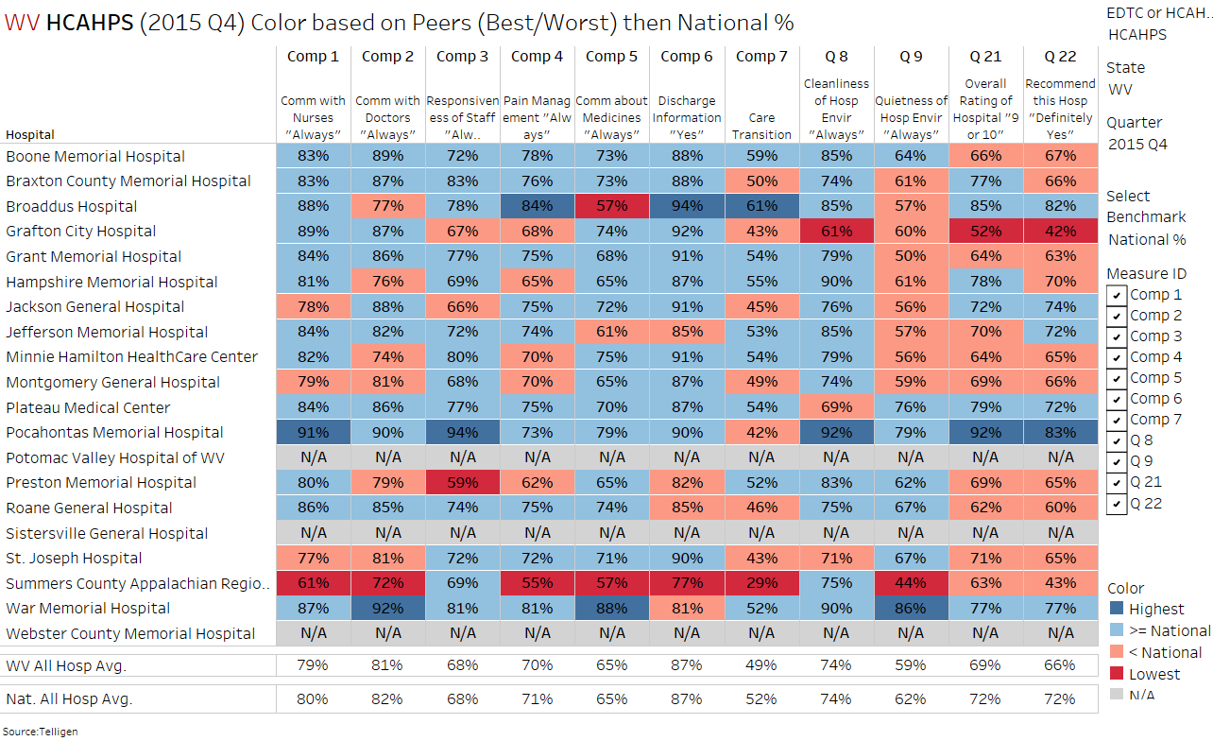
Q4/2014 HCAHPS Compared to National Avg.
Source: Telligen 4/18/2017

Slide 63
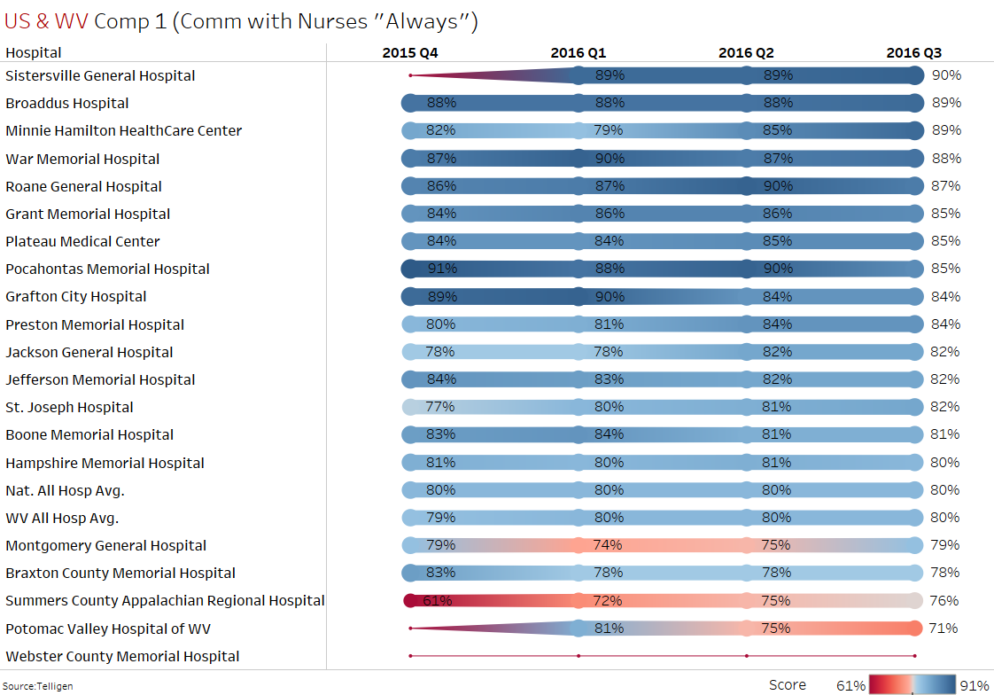
HCAHPS Trends
Better/Equal the National Avg.
Source: Telligen 4/18/2017

Slide 64
Communication with Nurses
Measure / Name | Best Practice
HCAHPS - Composite 1 Communication with Nurses | Provide staff training and promote awareness relating to empathy and effective communication Use teach-back, limit jargon and employ other health literacy principles Standardize shift change processes and/or bedside report and use as an opportunity to engage the patient and family in care Implement intentional hourly rounding Use whiteboards to communicate daily goals Use scripting for key messages and/or employ a communication frameworks such as AIDET Consider system-wide scrub/uniform colors
“Quality Improvement Implementation Guide and Toolkit for Critical Access Hospitals”
Stratis Health Rural Quality Improvement Technical Assistance | www.stratishealth.org

Slide 65
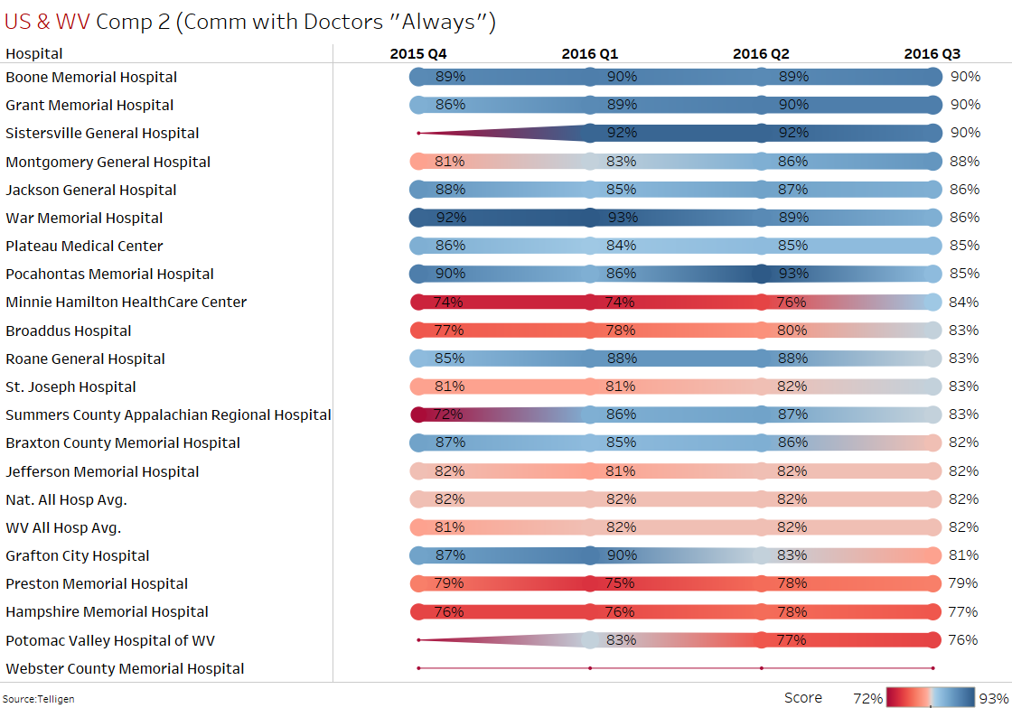
HCAHPS Trends
Better/Equal the National Avg.
Source: Telligen 4/18/2017

Slide 66
Communication with Doctors
Measure / Name | Best Practice
HCAHPS - Composite 2 Communication with Doctors | Provide staff training and promote awareness relating to empathy and effective communication Implement peer to peer mentoring Use teach-back, limit jargon and employ other health literacy principles Engage patients and families in care conferences and/or interdisciplinary rounds Use scripting for key messages and/or employ a communication frameworks such as AIDET Ensure patient feedback is shared with providers Encourage providers to sit at the bedside Provide pads/pens at the bedside for patients and family members to jot down notes
“Quality Improvement Implementation Guide and Toolkit for Critical Access Hospitals”
Stratis Health Rural Quality Improvement Technical Assistance | www.stratishealth.org

Slide 67
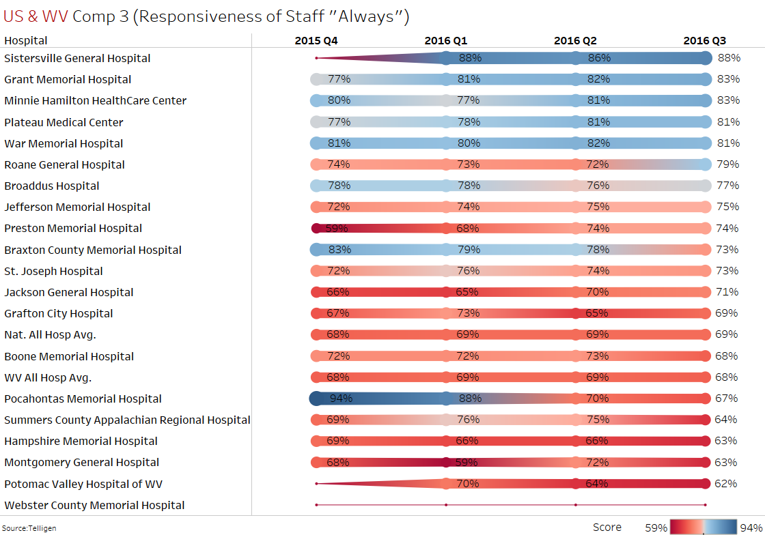
HCAHPS Trends
Better/Equal the National Avg.
Source: Telligen 4/18/2017

Slide 68
Responsiveness of Hospital Staff
Measure / Name | Best Practice
HCAHPS - Composite 3 Responsiveness of hospital staff | Establish protocols and identify accountability for responding to inpatient calls Track the type and timing of inpatient call requests to target support and response processes Implement intentional hourly rounding Establish processes and expectations regarding communication for nurses when stepping away from the floor or when assistance is needed Institute a “No Pass Zone”
“Quality Improvement Implementation Guide and Toolkit for Critical Access Hospitals”
Stratis Health Rural Quality Improvement Technical Assistance | www.stratishealth.org

Slide 69
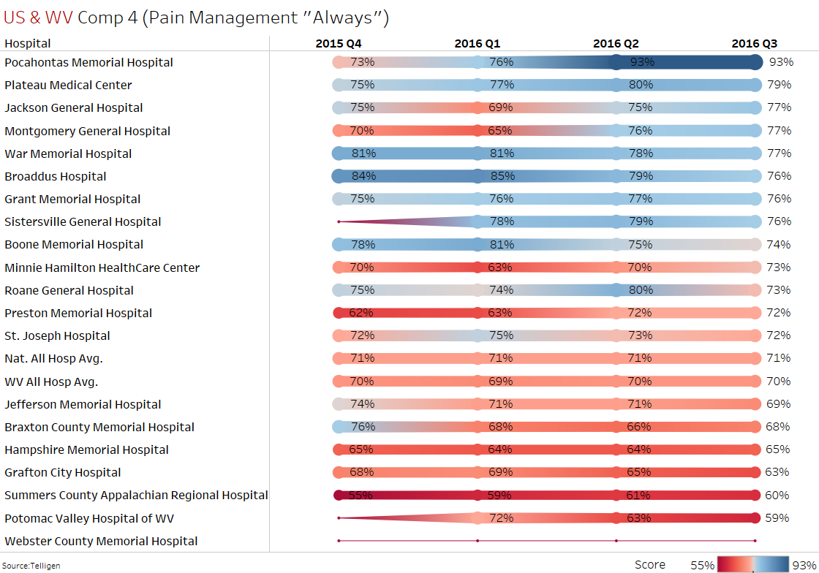
HCAHPS Trends
Better/Equal the National Avg.
Source: Telligen 4/18/2017

Slide 70
Pain Management
Measure / Name | Best Practice
HCAHPS - Composite 4 Pain Management | Consistently use a pain scale to evaluate patient perception of pain Implement intentional hourly rounding Use whiteboards for communication regarding timing and dose of pain medication Re-evaluate pain after pain medication and share this timeframe with patient/family member Offer alternative methods to manage pain and engage family and caregivers in communication about pain management
“Quality Improvement Implementation Guide and Toolkit for Critical Access Hospitals”
Stratis Health Rural Quality Improvement Technical Assistance | www.stratishealth.org

Slide 71
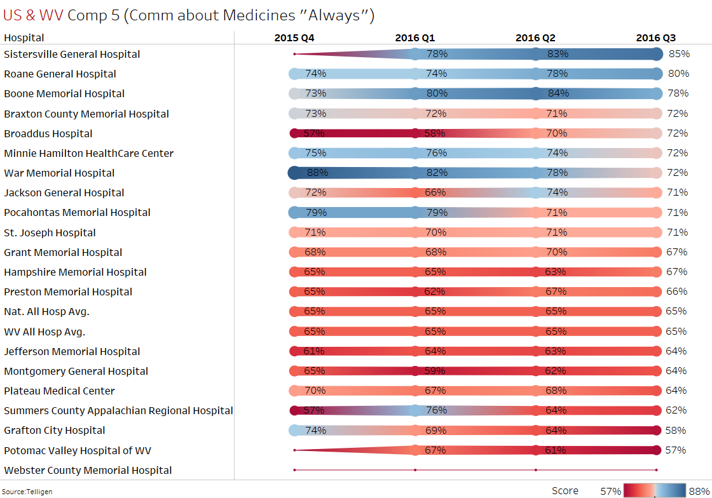
HCAHPS Trends
Better/Equal the National Avg.
Source: Telligen 4/18/2017

Slide 72
Communication About Medicines
Measure / Name | Best Practice
HCAHPS - Composite 5 Communication about medicines | Implement triggers and prompts in care processes to ensure education about medications Use teach-back to assess patient understanding Limit use of jargon and technical terms Provide nurses ready access to resources and tools regarding information about medications in patient friendly terms Consider providing a pharmacist bedside visit to review new medications Share best practices and processes among staff for communicating in difficult situations (e.g., patient doesn’t speak English or has difficulty hearing) Inquire about medications during discharge follow-up Consider the use of medication organizers
“Quality Improvement Implementation Guide and Toolkit for Critical Access Hospitals”
Stratis Health Rural Quality Improvement Technical Assistance | www.stratishealth.org

Slide 73
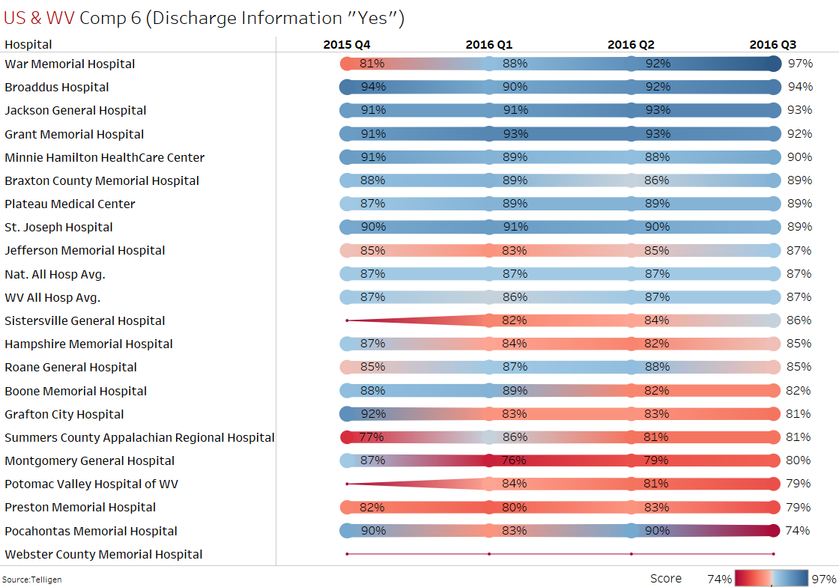
HCAHPS Trends
Better/Equal the National Avg.
Source: Telligen 4/18/2017

Slide 74
Discharge Information
Measure / Name | Best Practice
HCAHPS – Composite 6 Discharge Information | Conduct pre-discharge assessment of ability of patient and/or family to provide self-care, including: problem solving, decision making, early symptom recognition and taking action, quality of life, depression and other cognitive and functional ability factors Develop a comprehensive shared care plan using a shared decision making approach. Consider patient values and preferences, social and medical needs Throughout the patient stay, work with the patient and family to prepare for discharge and follow-up planning, including goals, questions and concerns Ensure written discharge plan is easy to read and includes only essential education on health condition, using plain language and health literacy principles Share discharge plan on whiteboards Begin completing discharge follow-up calls
“Quality Improvement Implementation Guide and Toolkit for Critical Access Hospitals”
Stratis Health Rural Quality Improvement Technical Assistance | www.stratishealth.org

Slide 75
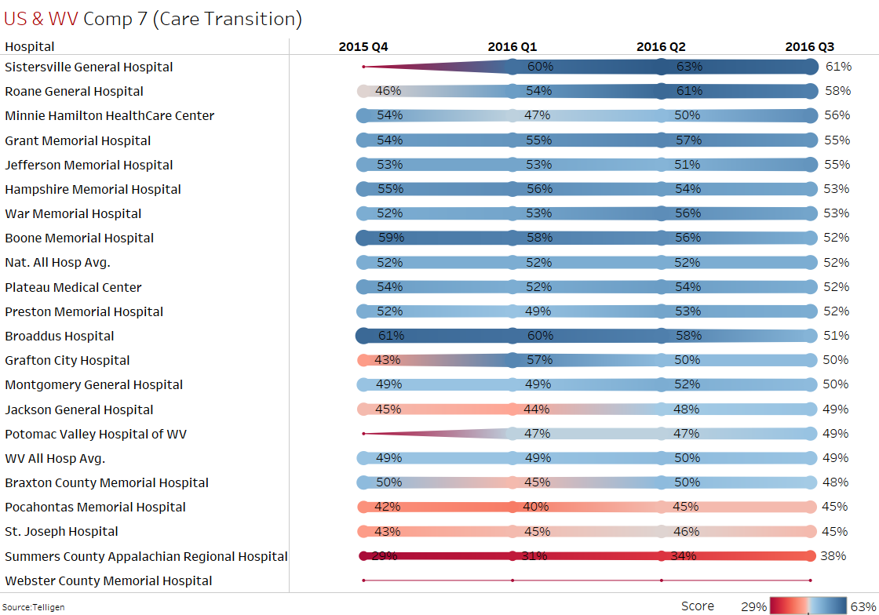
HCAHPS Trends
Better/Equal the National Avg.
Source: Telligen 4/18/2017

Slide 76
Care Transition
Measure / Name | Best Practice
HCAHPS - Composite 7 Care Transition | In addition to the above strategies: Use personal health records or patient portals to ensure patients have access to necessary information, including: lab results, radiology results, prescription refills requests and ability to email doctors, nurses and staff with questions Whenever possible, make follow-up appointments or arrangements for other services prior to discharge, always with patient and family input regarding availability and preferences Use teach-back and health literacy principles in patient education Consider developing a community care transition team Evaluate all readmissions- track and trend
“Quality Improvement Implementation Guide and Toolkit for Critical Access Hospitals”
Stratis Health Rural Quality Improvement Technical Assistance | www.stratishealth.org

Slide 77
Care Transition Continued
Measure / Name | Best Practice
HCAHPS - Composite 7 Care Transition | Conduct follow-up phone calls within 24-48 hours post-discharge to clarify patient and family understanding of medications and follow-up services Provide a written listing of medications to the patient and family including the name of the medication, dose, route, purpose, side effects and special considerations in language that is easy to understand for the patient For patients with complicated medication regimes, whenever possible, engage pharmacy staff in performing patient education, medication review and follow-up phone calls
“Quality Improvement Implementation Guide and Toolkit for Critical Access Hospitals”
Stratis Health Rural Quality Improvement Technical Assistance | www.stratishealth.org

Slide 78
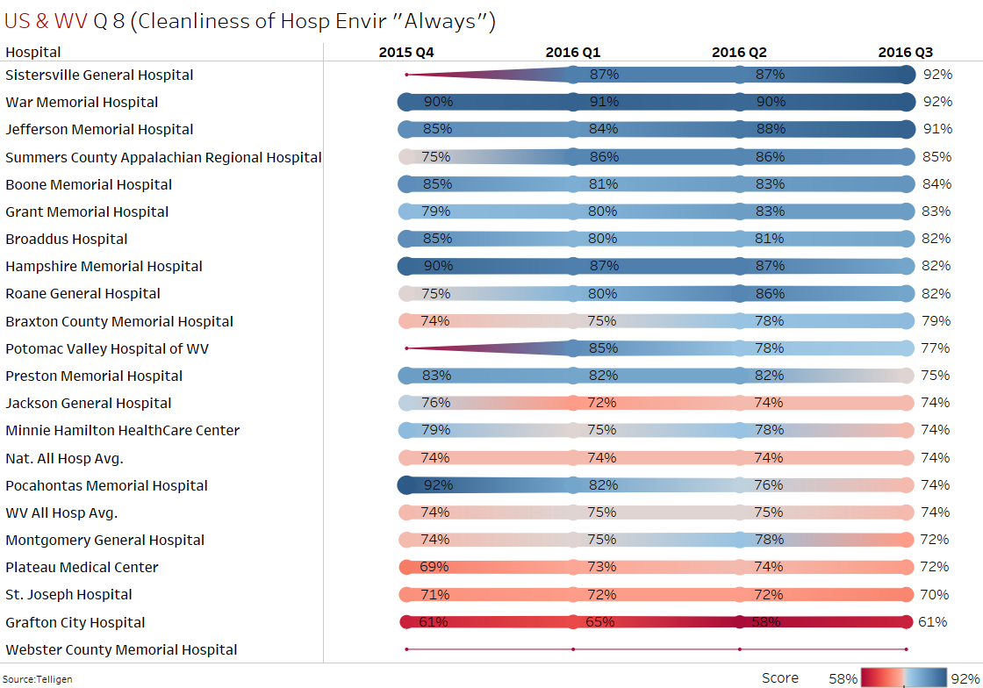
HCAHPS Trends
Better/Equal the National Avg.
Source: Telligen 4/18/2017

Slide 79
Cleanliness of Hospital Environment
Measure / Name | Best Practice
HCAHPS - Q8 Cleanliness of Hospital Environment | Clarify roles and responsibilities in responding to patient or staff concerns regarding cleanliness Designate a housekeeping quality assurance supervisor and trainer Inspect an agreed number of patient rooms on a regular basis, and follow up with cleaning staff to correct deficiencies Provide visible information in the room to let patients and families know who to contact if they have a housekeeping concern or request Provide training on communication standards and processes to cleaning staff as s part of orientation and ongoing evaluations (e.g., AIDET)
“Quality Improvement Implementation Guide and Toolkit for Critical Access Hospitals”
Stratis Health Rural Quality Improvement Technical Assistance | www.stratishealth.org

Slide 80
Cleanliness of Hospital Environment Continued
Measure / Name | Best Practice
HCAHPS - Q8 Cleanliness of Hospital Environment | Use logs to identify patients who communicate cleaning concerns. Follow-up with those patients at least daily to ensure that their room and their bathroom is cleaned to their satisfaction Implement intentional hourly rounding
“Quality Improvement Implementation Guide and Toolkit for Critical Access Hospitals”
Stratis Health Rural Quality Improvement Technical Assistance | www.stratishealth.org

Slide 81
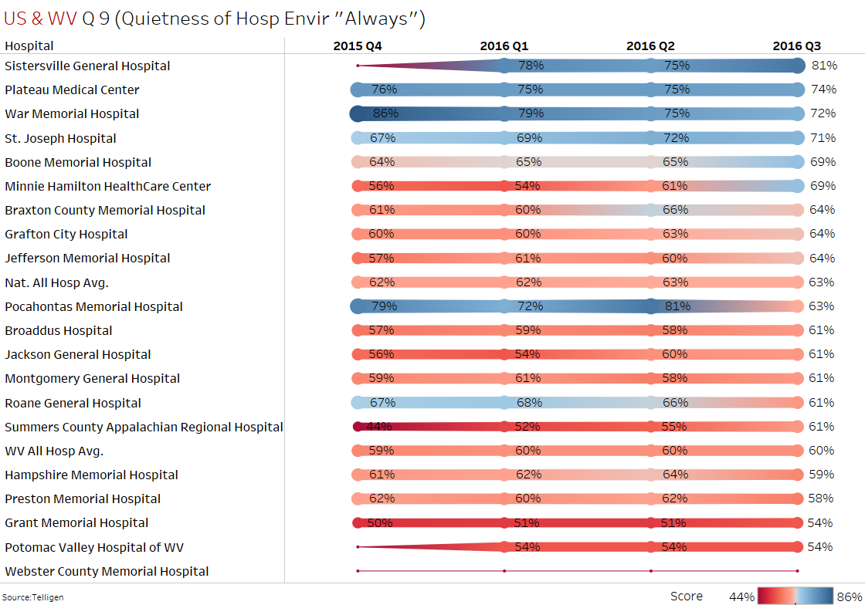
HCAHPS Trends
Better/Equal the National Avg.
Source: Telligen 4/18/2017

Slide 82
Quietness of Hospital Environment
Measure / Name | Best Practice
HCAHPS - Q9 Quietness of Hospital Environment | Utilize single patient rooms if feasible Close doors to patient rooms whenever possible Use "Quiet Zone" signs and reminders in the corridors Eliminate use of overhead paging, particularly at night Designate zones for staff conversation (e.g., nurses station) to help avoid hallway discussions that may be disruptive to nearby rooms Evaluate transport carts and replace noisy wheels and casters Consider the use of quiet packs (ear plugs, etc.)
“Quality Improvement Implementation Guide and Toolkit for Critical Access Hospitals”
Stratis Health Rural Quality Improvement Technical Assistance | www.stratishealth.org

Slide 83
Quietness of Hospital Environment Continued
Measure / Name | Best Practice
HCAHPS - Q9 Quietness of Hospital Environment | Turn down the alarm sound level on monitoring equipment if feasible or have telemetry equipment monitoring away from the patient (e.g., in the nurses station) Request that work involving heavy machinery only be done during the daytime. (e.g., use of battery powered scrubbers, buffers and other loud equipment In the evening/nighttime, use a portable lantern or flashlight to illuminate the area in which the employee is working rather than turning on the overhead lights when the patient are resting
“Quality Improvement Implementation Guide and Toolkit for Critical Access Hospitals”
Stratis Health Rural Quality Improvement Technical Assistance | www.stratishealth.org

Slide 84
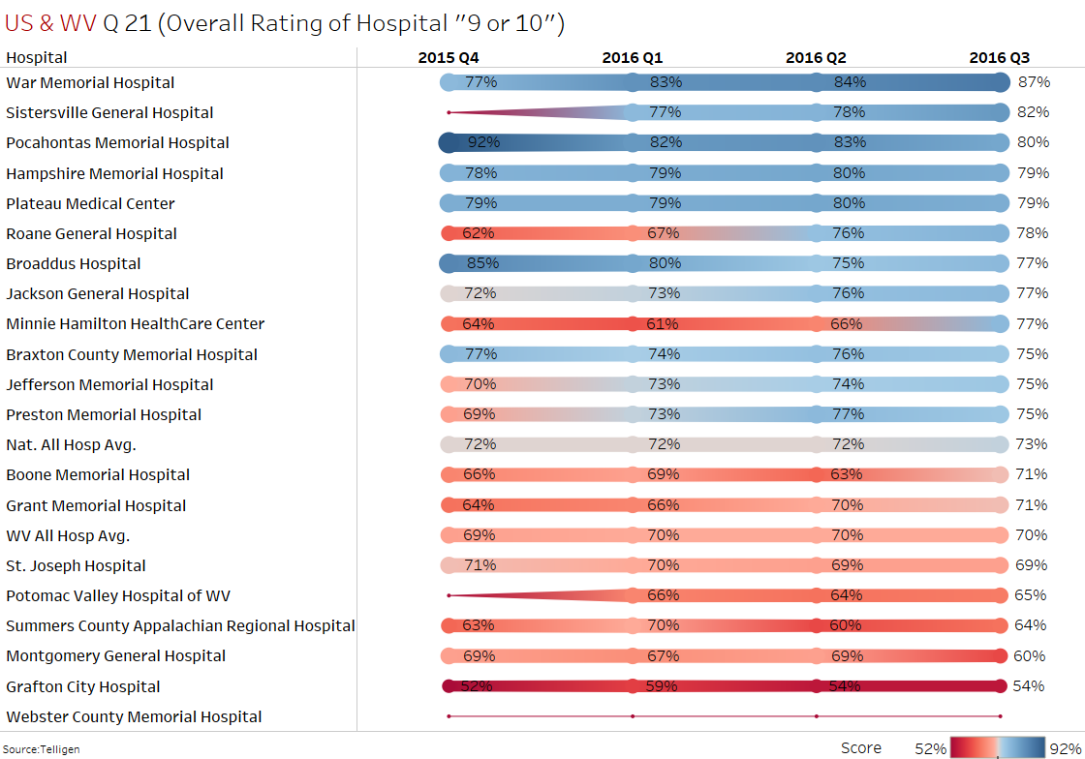
HCAHPS Trends
Better/Equal the National Avg.
Source: Telligen 4/18/2017

Slide 85
Overall Rating of Hospital
Measure / Name | Best Practice
HCAHPS - Q21 Overall Rating of This Hospital | The following areas are most strongly correlated with a high overall hospital rating and therefore most likely to support improvement in the overall rating of the hospital: Scores on Nurse Communication (see best practices above) Pain Management (see best practices in the Patient Safety Measures Summary) Responsiveness of Hospital Staff (see best practices in the Patient Safety Measures Summary)
“Quality Improvement Implementation Guide and Toolkit for Critical Access Hospitals”
Stratis Health Rural Quality Improvement Technical Assistance | www.stratishealth.org

Slide 86
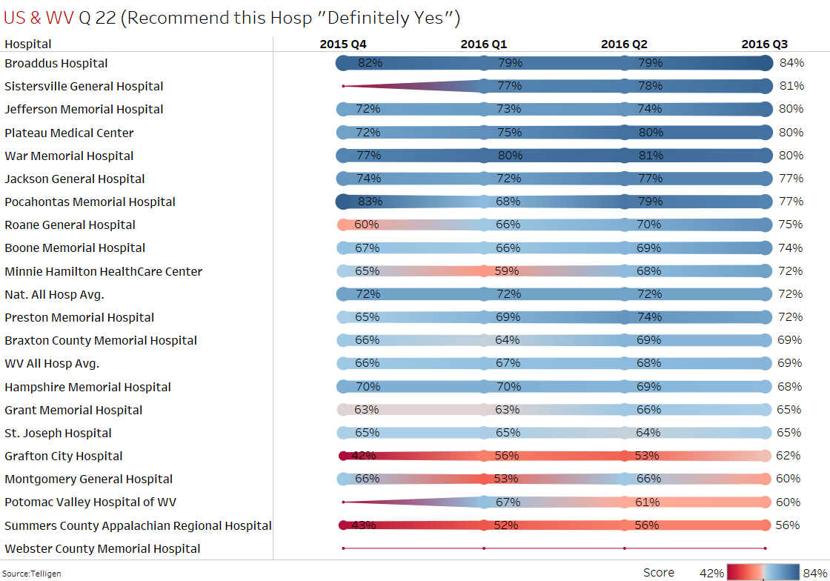
HCAHPS Trends
Better/Equal the National Avg.
Source: Telligen 4/18/2017

Slide 87
Willingness to Recommend Hospital
Measure / Name | Best Practice
HCAHPS - Q22 Willingness to Recommend This Hospital | The following areas are most strongly correlated with a high willingness to recommend: Scores on Nurse Communication (see best practices above) Pain Management (see best practices in the Patient Safety Measures Summary) Responsiveness of Hospital Staff (see best practices in the Patient Safety Measures Summary)
“Quality Improvement Implementation Guide and Toolkit for Critical Access Hospitals”
Stratis Health Rural Quality Improvement Technical Assistance | www.stratishealth.org

Slide 88
Resource Review
MBQIP Monthly e-Newsletter
https://www.ruralcenter.org/tasc/mbqip/mbqip-monthly
MBQIP Monthly is produced in support of the Federal Office of Rural Health Policy by Rural Quality Improvement Technical Assistance, a program by Stratis Health. The last 3 months (Jan/Feb/March) versions of MBQIP Monthly are available for download at the website above. Past editions of MBQIP Monthly may be obtained by emailing: tasc@ruralcenter.org
June- MBQIP Monthly-
CAHs Can! Rural Success: St. Francis Memorial Hospital, NE
Data: CAHs Measure Up – Reviewing EDTC Data Elements to Improve Performance
Tips: Robyn Quips – EDTC Clarifications
Tools and Resources: Helping CAHs Succeed in Quality Reporting & Improvement

Slide 89
Resource Review
MBQIP Reporting Guide
  https://www.ruralcenter.org/tasc/resources/mbqip-reporting-guide
ED Throughput - See website below for Abington Jefferson Health with 7 hospitals
  http://www.abingtonhealth.org/quality/measurement/emergency-department/#.Vvg02o72bVI

Slide 90
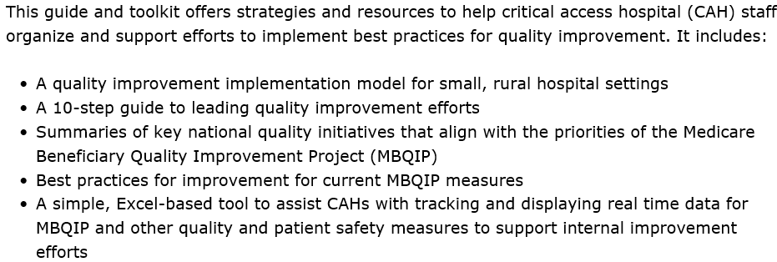
Resource Review
Quality Improvement Implementation Guide and Toolkit for Critical Access Hospitals
https://www.ruralcenter.org/tasc/resources/quality-improvement-implementation-guide-and-toolkit-critical-access-hospitals

Slide 91
Resource Review OP-27
5-Step Enrollment for Acute Care Hospitals/Facilities - http://www.cdc.gov/nhsn/acute-care-hospital/enroll.html
Training Resources for NHSN Users Already Enrolled - http://www.cdc.gov/nhsn/acute-care-hospital/hcp-vaccination/index.html
Healthcare Professional Flu Measure (OP-27) Webinar (Dec 9, 2015) https://www.ruralcenter.org/tasc/resources/healthcare-professional-flu-measure-op-27-webinar

Slide 92
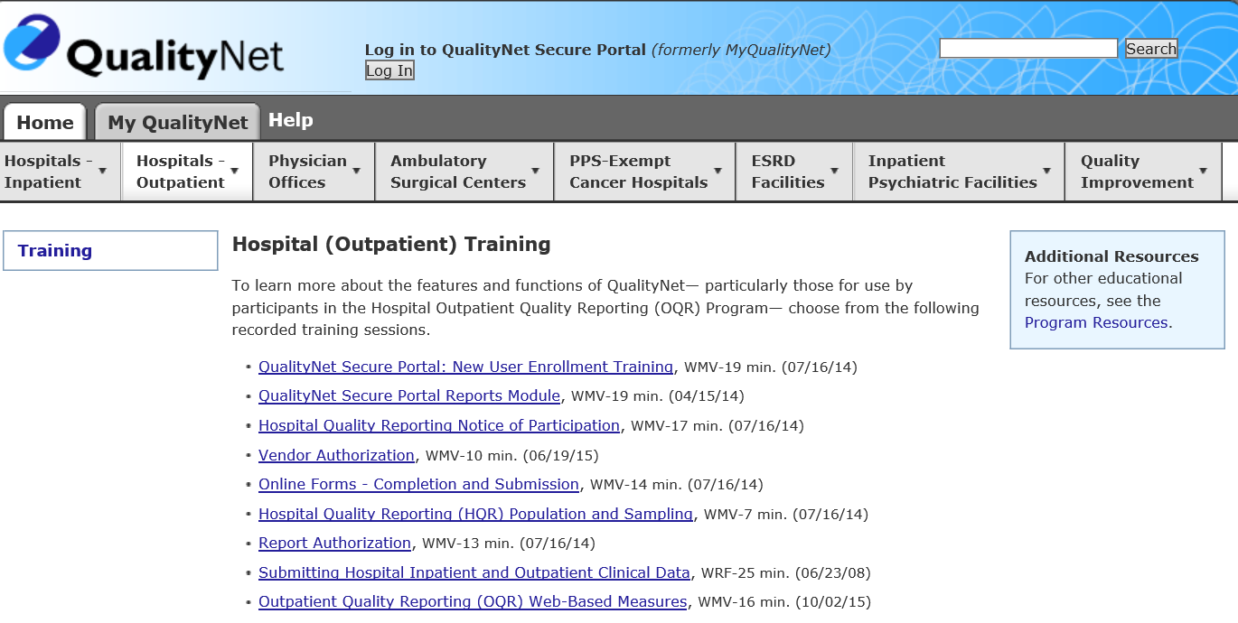
Resource Review
https://www.qualitynet.org/dcs/ContentServer?c=Page&pagename=QnetPublic%2FPage%2FQnetTier2&cid=1196690015199

Slide 93
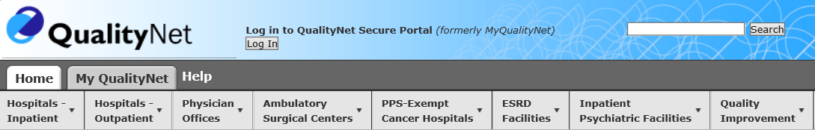
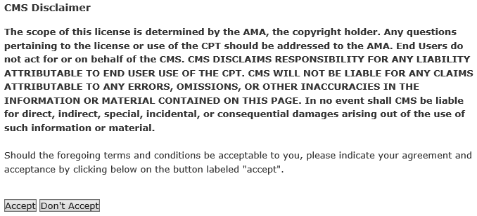
Resource-Specification Manual for MBQIP Measures
This slide includes information from the Q-Net Hospital Outpatient Quality Reporting Specifications Manuals (based on collection period) accessible as follows:
http://www.qualitynet.org/dcs/ContentServer?pagename=QnetPublic/Page/SpecsManualLicense
Then click on Hospital Outpatient
Scroll down to bottom
of the page and “accept”

Slide 94
HCAHPS resources
See CMS Website for General and Updated Info re: HCAHPS
http://www.hcahpsonline.org/home.aspx
See CMS Website for Copies of Telephone Surveys and Mailed Surveys
http://www.hcahpsonline.org/surveyinstrument.aspx
STAR RATING
http://www.hcahpsonline.org/Files/July_2016_Star%20Ratings_Tech%20Notes.pdf
HCAHPS Quality Assurance Guidelines
http://www.hcahpsonline.org/Files/QAG_V11.0_2016.pdf

Slide 95
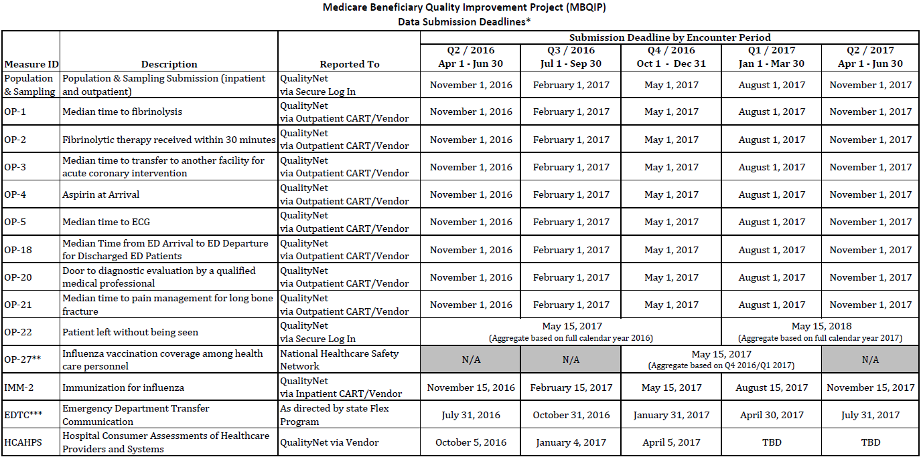

MBQIP Data Submission Deadlines

Slide 96



