Slide 1
CAH Swing Bed PI/QI Pilot Project
Outcome Management 4th Quarterly Meeting
Of the Pilot Project
April 17, 2019
Mary Guyot Consulting
207-650-5830 (cell/text)
maryguyotconsulting@gmail.com

Slide 2
Agenda
9:00 - 9:45 Welcome & Intro – Name, Hospital, Title
9:15 – 9:45 Each hospital to show reports printed from the Stroudwater tool
Issues with printing reports?
What happens to the report?
9:45 - 10:00 Last quarters Action Plan Status Reporting by hospital
10:00 – 10:15 Break
10:15 - 11:00 Continue Action Plan Presentations
11:00 – 12:00 Outcome & Benchmarking Data
12:00 - 1:00 Lunch
1:00 – 1:45 Opportunities for Improvement?
1:45 – 2:20 Discuss outcome of the SB Needs Survey
2:20 - 2:30 Next Step

Slide 3
Data Reports (9:15 to 9:45)
Who brought reports
What reports did you bring?
Issues printing reports?
What other reports would you or administration like?
How are reports used at your hospital?

Slide 4
Action Plan Status (9:45 - 11:00 w/Break)
Boone Memorial Hospital
Braxton County Memorial Hospital
Broaddus Hospital
Grant Memorial Hospital
Hampshire Memorial Hospital
Jackson General Hospital
Minnie Hamilton Health System
Montgomery General Hospital
Plateau Medical Center
Pocahontas Memorial Hospital
Preston Memorial Hospital
Roane General Hospital
St. Joseph Hospital
War Memorial Hospital
Webster County Memorial Hospital
WVU Medicine – Jefferson
WVU Medicine Potomac Valley Hospital
Last quarters Action Plan Status Reporting by hospital

Slide 5
Data Outcome & Benchmarking (11:00 AM to 12:00 PM)
Includes comparison between the 1st and the last ½ of the pilot project
Q&A + Open Discussion

Slide 6
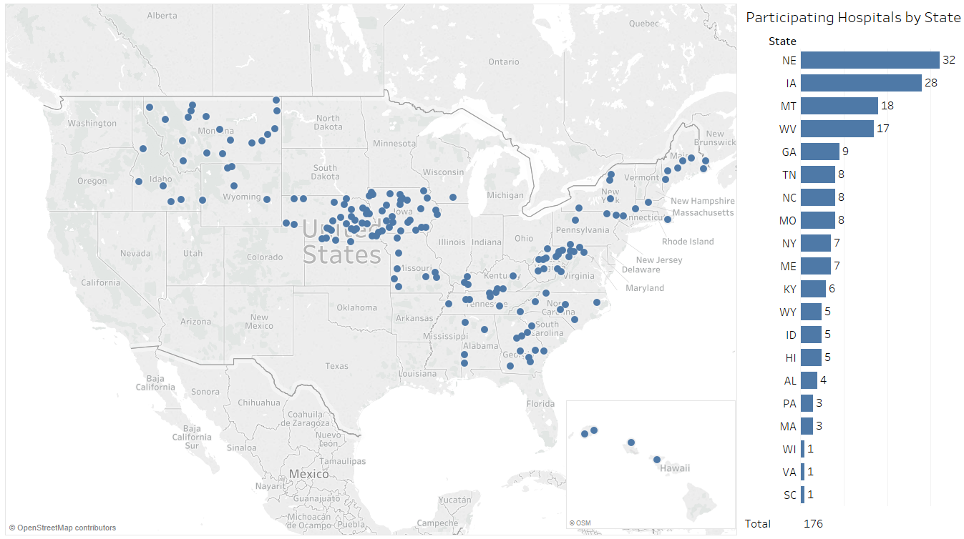
176 Hospitals Participating in Swing Bed Pilot
Source: Stroudwater Swing Bed Portal 4/1/2018 to 4/8/2019

Slide 7
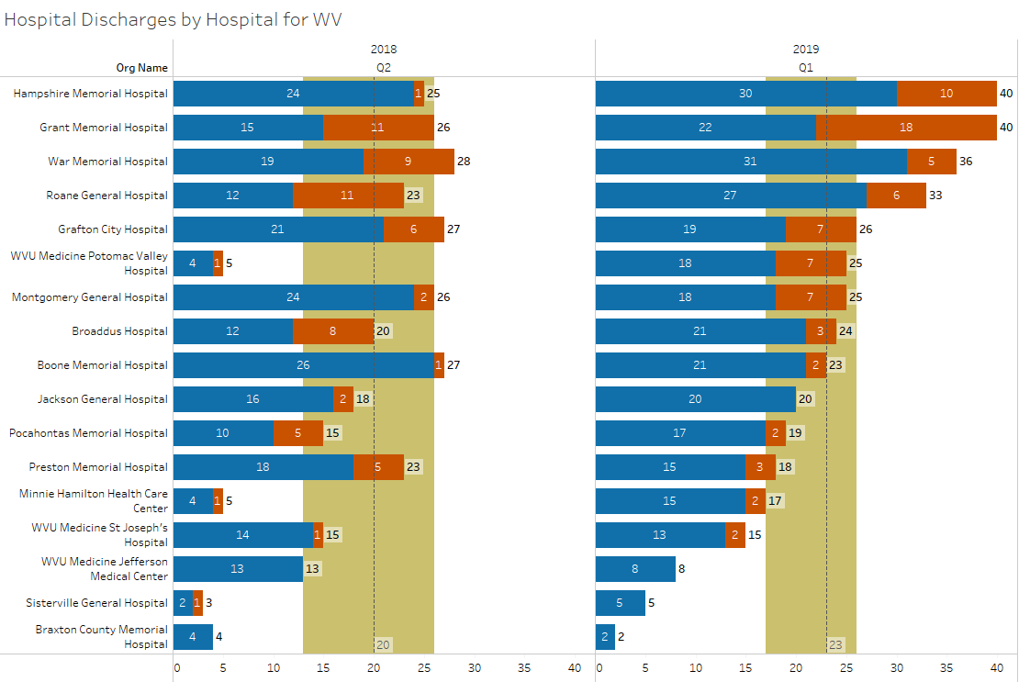
Swing Bed Discharges by Hospital
Source: Stroudwater Swing Bed Portal 4/1/2018 to 4/8/2019
median
lower quartile
upper quartile

Slide 8
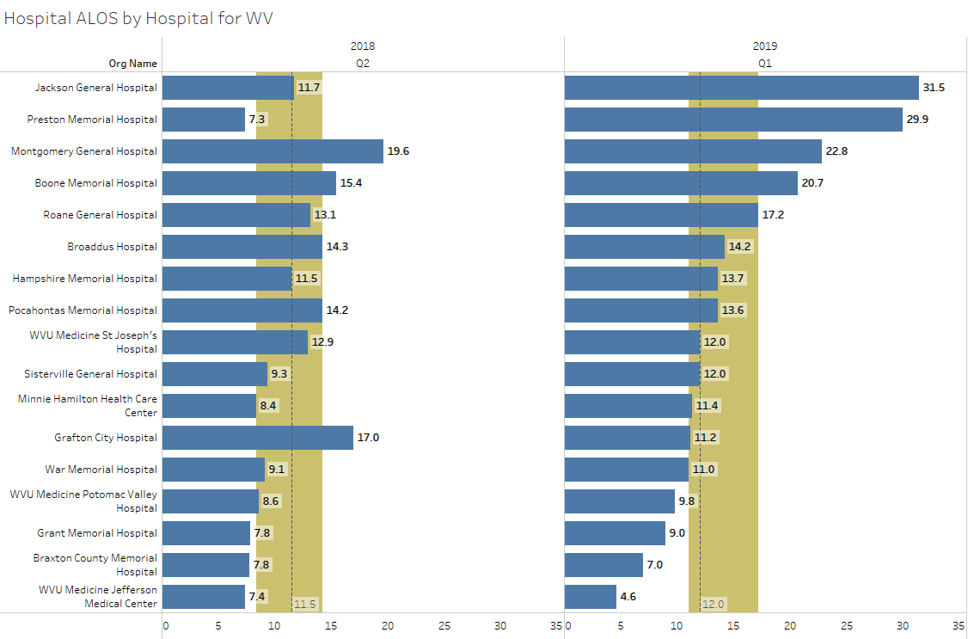
SB Average Length of Stay (ALOS)
Source: Stroudwater Swing Bed Portal 4/1/2018 to 4/8/2019
median
lower quartile
upper quartile

Slide 9
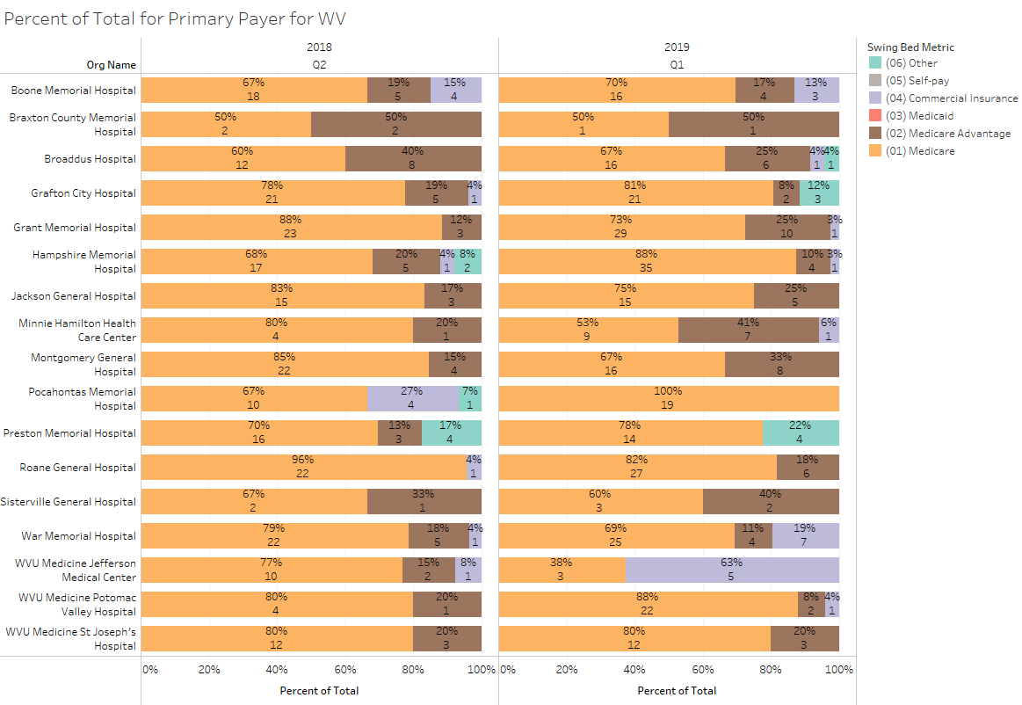
Percent of Total by Primary Payer
Source: Stroudwater Swing Bed Portal 4/1/2018 to 4/8/2019

Slide 10
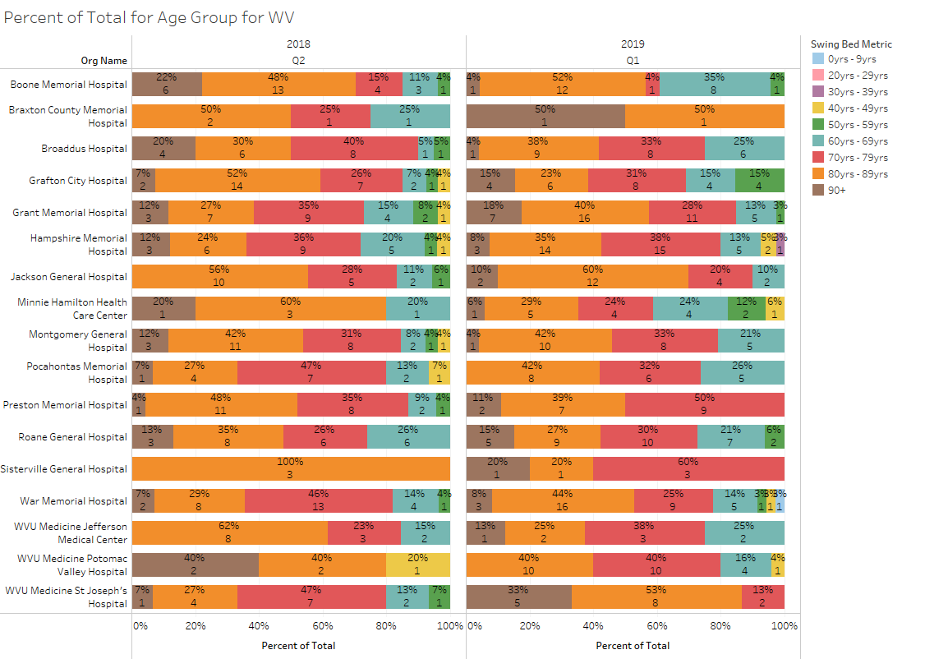
Percent of Total by Age Group
Source: Stroudwater Swing Bed Portal 4/1/2018 to 4/8/2019

Slide 11
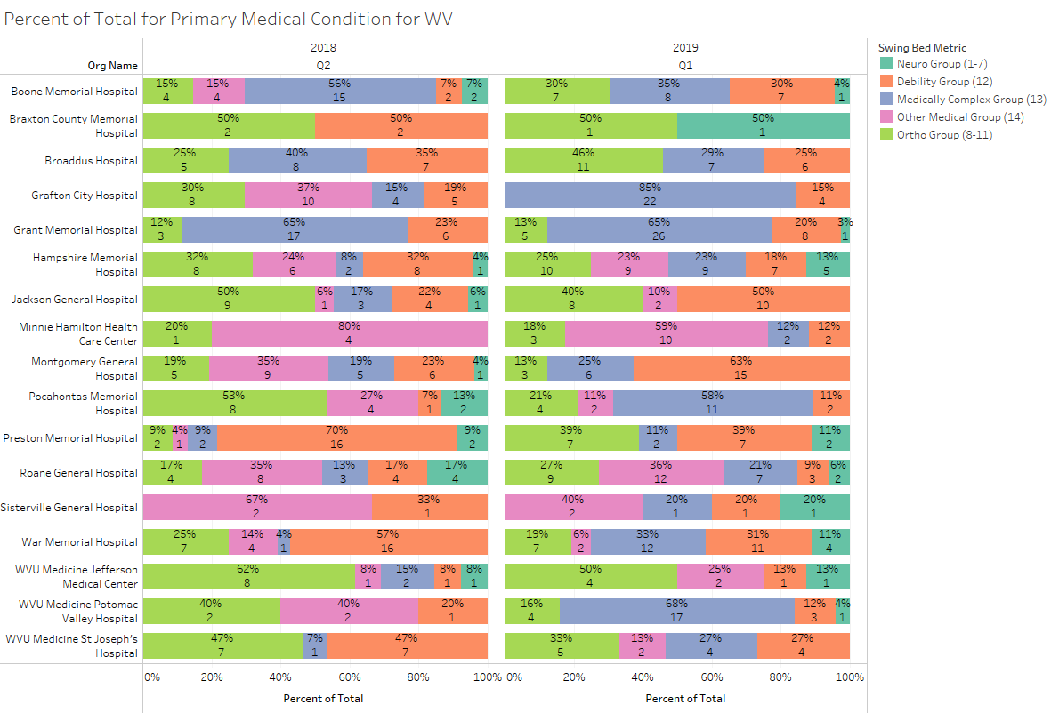
Percent of Total by Primary Medical Condition
Source: Stroudwater Swing Bed Portal 4/1/2018 to 4/8/2019

Slide 12
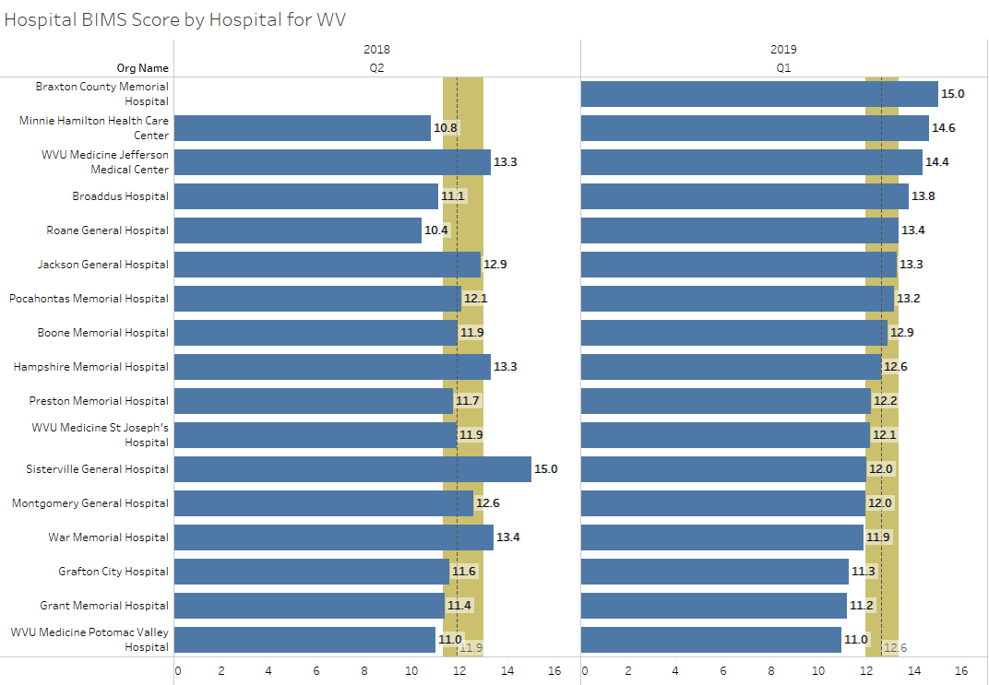
Average BIMS Score
Source: Stroudwater Swing Bed Portal 4/1/2018 to 4/8/2019
median
lower quartile
upper quartile

Slide 13
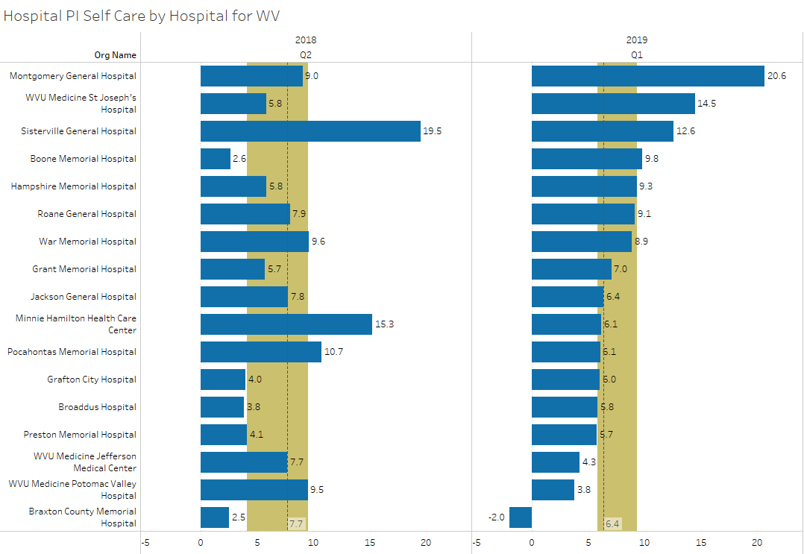
Performance Improvement Score for Self-Care
Source: Stroudwater Swing Bed Portal 4/1/2018 to 4/8/2019
median
lower quartile
upper quartile
excluded records have been removed

Slide 14
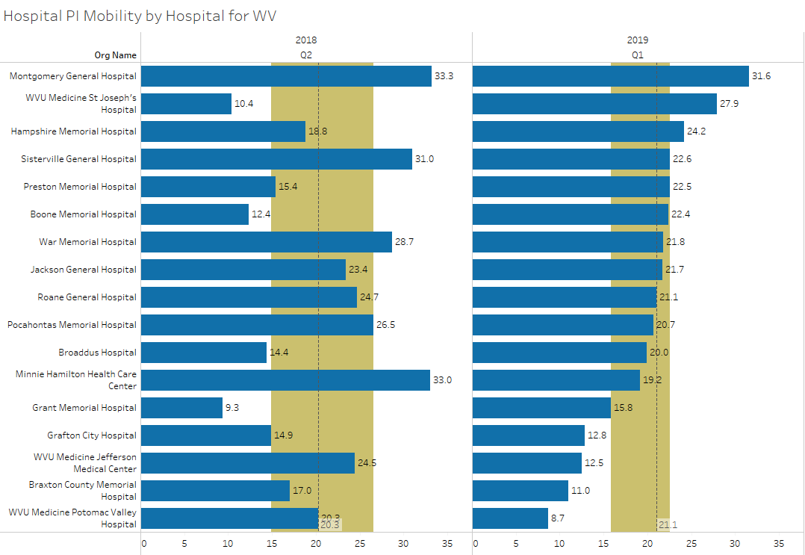
Performance Improvement Score for Mobility
Source: Stroudwater Swing Bed Portal 4/1/2018 to 4/8/2019
median
lower quartile
upper quartile
excluded records have been removed

Slide 15
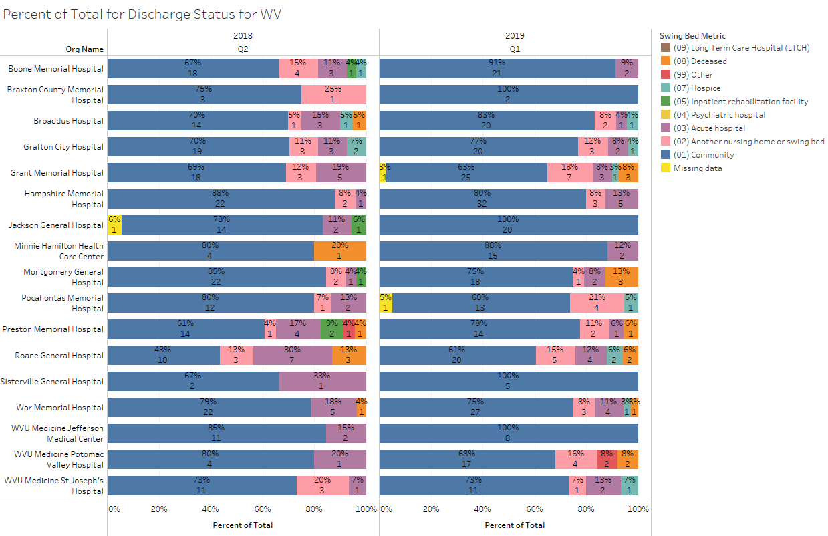
Percent of Total by Discharge Disposition
Source: Stroudwater Swing Bed Portal 4/1/2018 to 4/8/2019

Slide 16
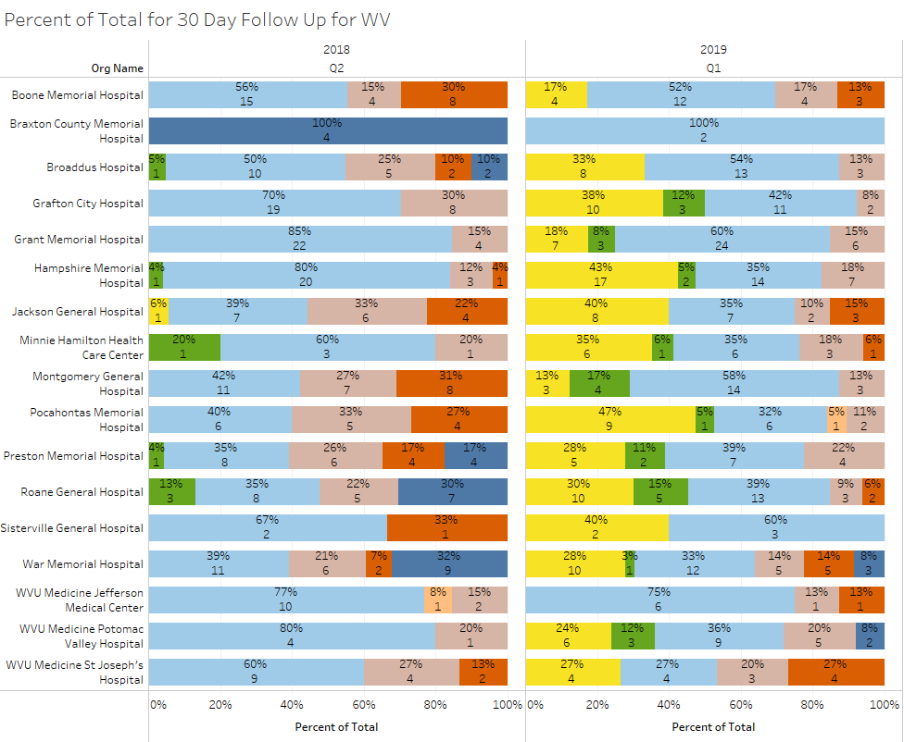
Percent of Total by 30 Day Follow Up
Source: Stroudwater Swing Bed Portal 4/1/2018 to 4/8/2019

Slide 17
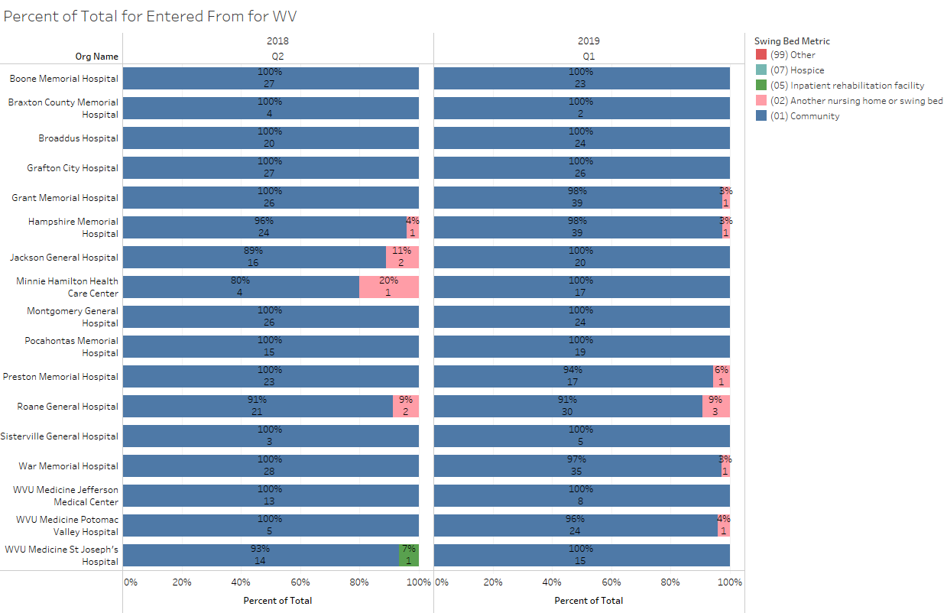
Percent of Total by Residence Pre-Acute Admission
Source: Stroudwater Swing Bed Portal 4/1/2018 to 4/8/2019

Slide 18
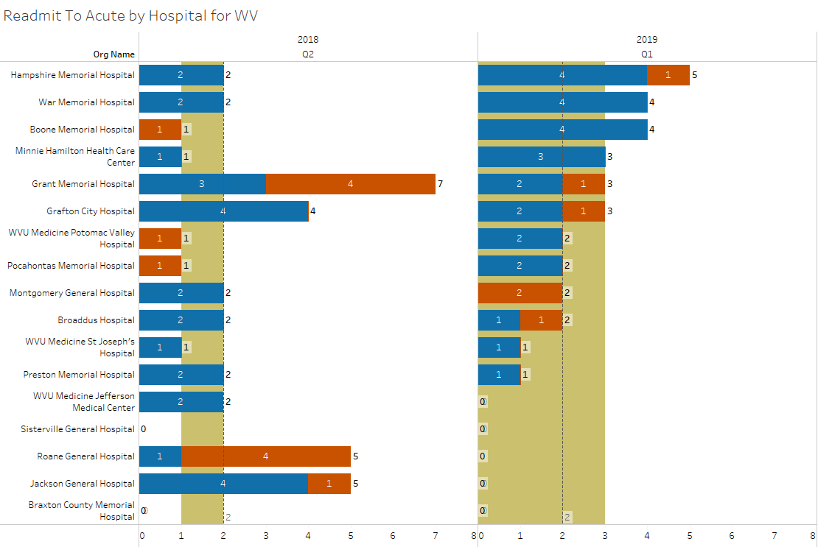
Number of Readmits to Acute
Source: Stroudwater Swing Bed Portal 4/1/2018 to 4/8/2019
median
lower quartile
upper quartile
excluded records added

Slide 19
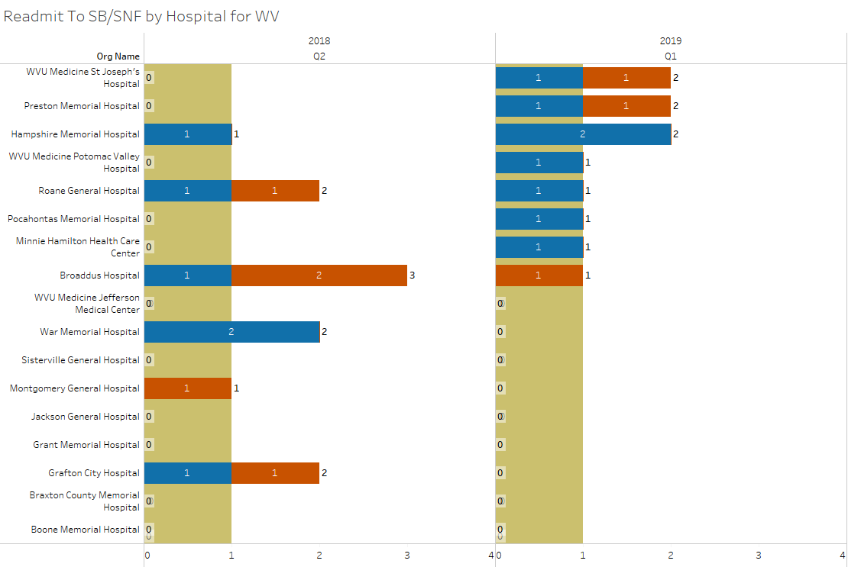
Number of Readmits to SB/SNF
Source: Stroudwater Swing Bed Portal 4/1/2018 to 4/8/2019
median
lower quartile
upper quartile
excluded records added

Slide 20
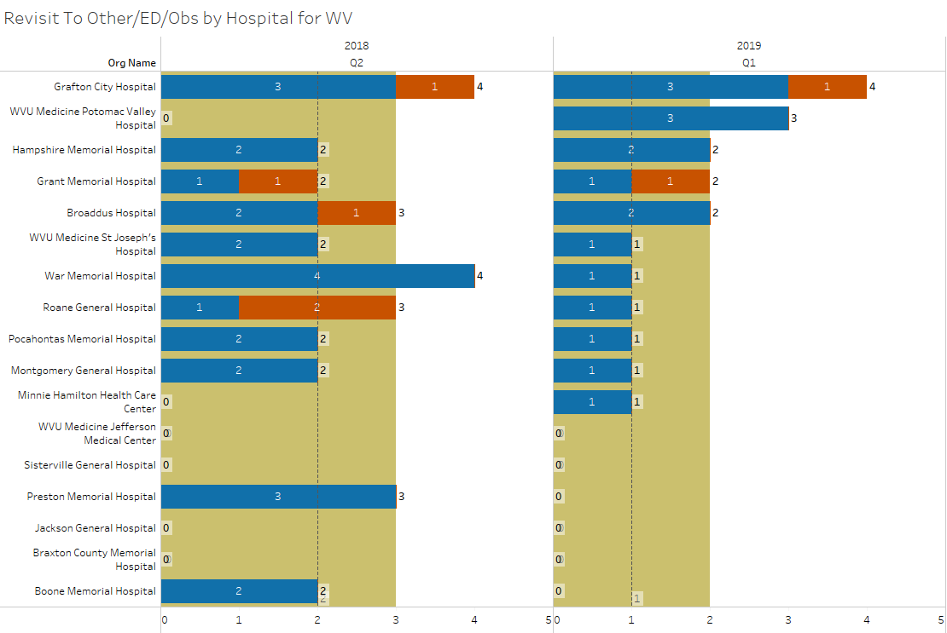
Number of Revisits to ED or Observation
Source: Stroudwater Swing Bed Portal 4/1/2018 to 4/8/2019
median
lower quartile
upper quartile
excluded records added

Slide 21
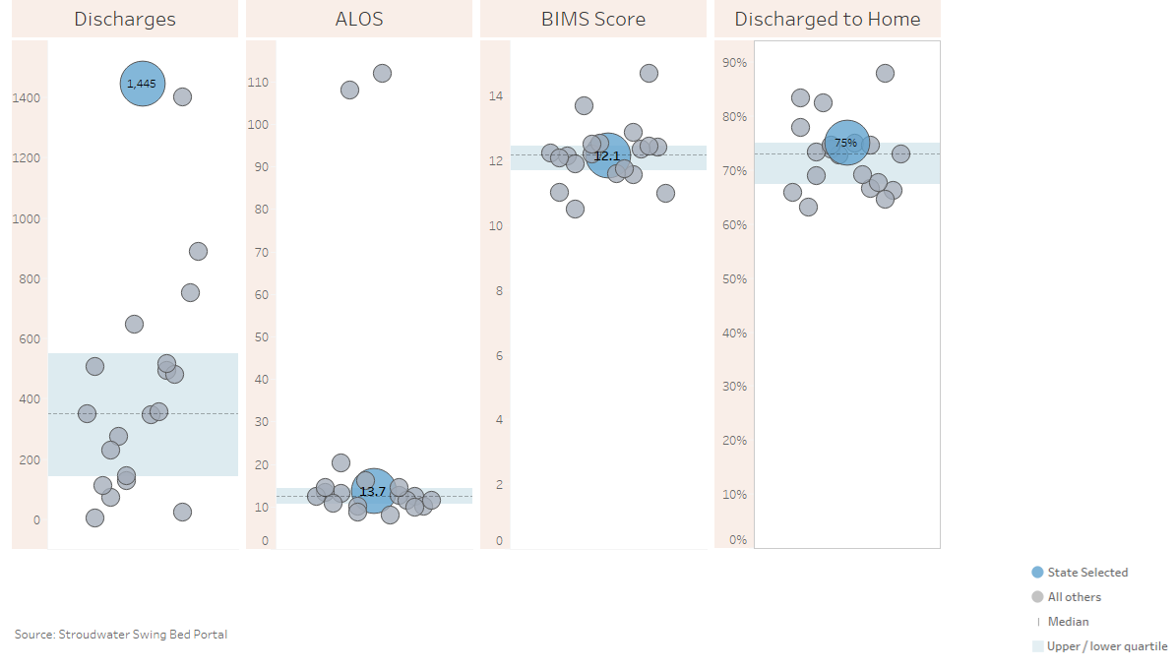
State Comparison for the last 12 months (4/2018-3/2019)
excluded records added
Source: Stroudwater Swing Bed Portal 4/1/2018 to 4/8/2019

Slide 22
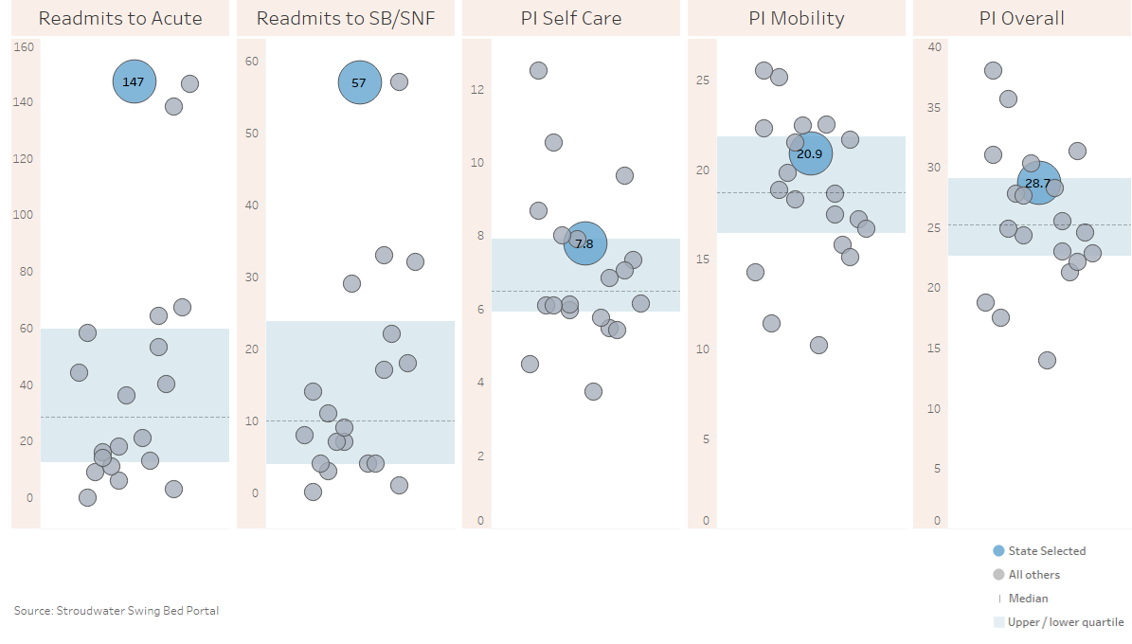
State Comparison for the last 12 months (4/2018-3/2019)
excluded records have been removed for PI scores
Source: Stroudwater Swing Bed Portal 4/1/2018 to 4/8/2019

Slide 23
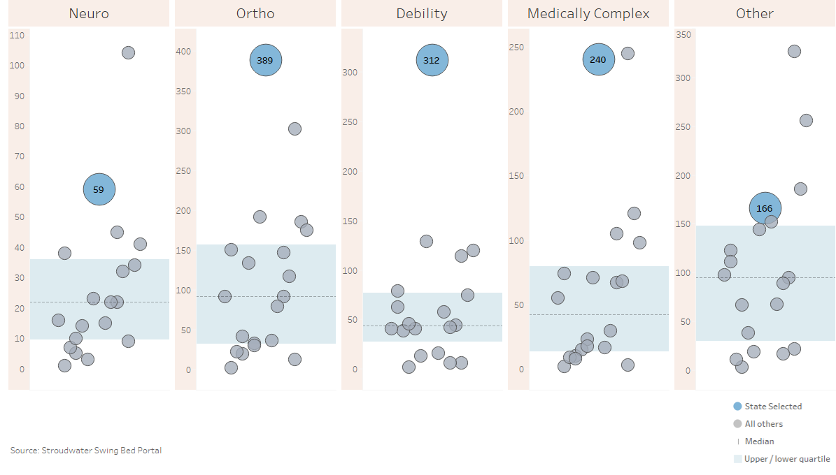
State Comparison for the last 12 months (4/2018-3/2019)- Reason for Admission (count of records)
excluded records added
Source: Stroudwater Swing Bed Portal 4/1/2018 to 4/8/2019

Slide 24
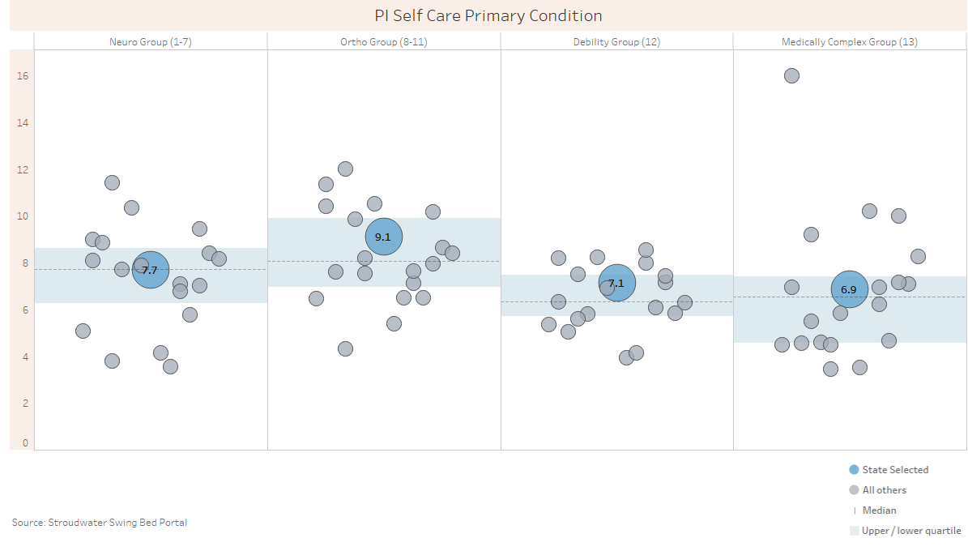
State Comparison for the last 12 months (4/2018-3/2019)- PI Self Care by Primary Condition
excluded records have been removed for PI scores
Source: Stroudwater Swing Bed Portal 4/1/2018 to 4/8/2019

Slide 25
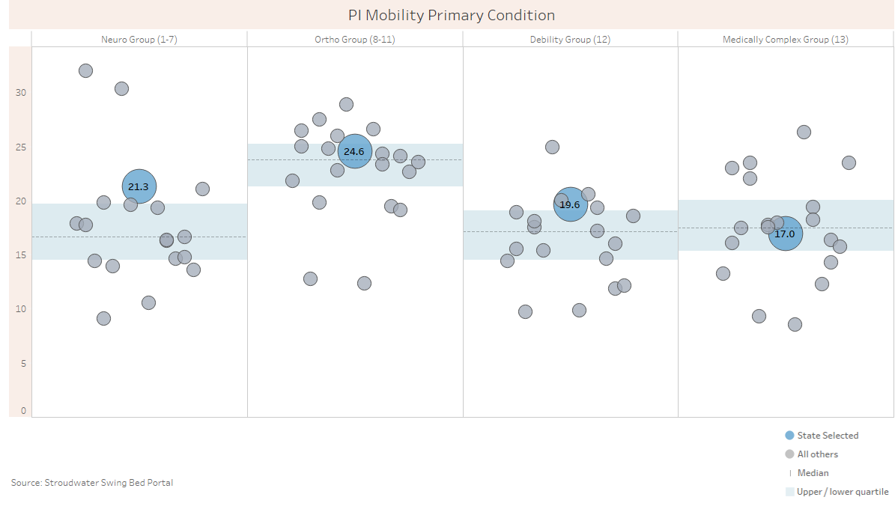
State Comparison for the last 12 months (4/2018-3/2019)- PI Mobility by Primary Condition
excluded records have been removed for PI scores
Source: Stroudwater Swing Bed Portal 4/1/2018 to 4/8/2019

Slide 26
Networking Lunch (12:00 PM to 1:00 PM)

Slide 27
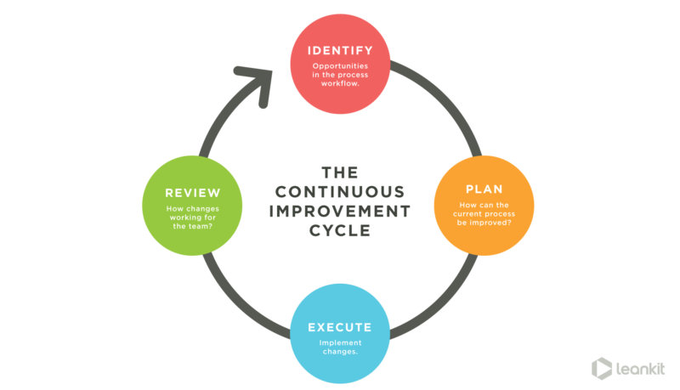
What is the data telling us? (1:00 PM – 1:45 PM)
Preparing for your PI/QI and Leadership reports and meetings
What are the opportunities for WV CAHs Network hospitals.
Which score or what processes will you work on this next quarter using a team approach)

Slide 28
Survey Outcome (1:45 PM to 2:20 PM)
Plans for 2019 - 2020
Qty Mtgs: 1/3 Benchmarking 1/3 SB training 1/3 Action Planning
Your Priorities
C
O
M
M
E
N
T
S
# 1 | # 2 | # 3 | # 4 | # 5
8 | 2 | 1 | 0 | 0 | Increasing SB Utilization
0 | 2 | 0 | 0 | 0 | Mtg with CEO
2 | 2 | 0 | 2 | 1 | Improving Functional Measures
6 | 2 | 4 | 0 | 0 | Skilled Needs Documentation
3 | 2 | 2 | 1 | 0 | Care Planning
3 | 0 | 1 | 4 | 0 | Interdisciplinary Team Approach

Slide 29
Next Step (2:20 PM to 2:30 PM) & THANK YOU!
Working on your 0pportunities for improvement
Email Paula Knowlton from Stroudwater at pknowlton@stroudwater.com for any technical questions (add a person with access to data, data entry issues, pulling reports together…)
Write to me maryguyotconsulting@gmail.com with clinical questions or to share what you would like the web-based tool to be able to do
Writing to Paula or I, PLEASE clarify which hospital you are asking about especially if from same system (email name is not always sufficient!!)
Share the measure or process you have committed to improve with your team and agree on an action plan to do so
Come prepared to share what you worked on and outcome
Enter data for all April, May & June discharges by July 5th
Enter 30-day follow-up data entry for all patients who have been discharged for 30 to 33 days by July 5th
Come prepared for the July meeting: 07/17/2019 (who should you bring to the meetings? Mark Your Calendars
July Mtg will partially be a re-orientation of key measures & CMS updated guidelines

Slide 30
Remaining Questions?

