Slide 1




WVHA Small Rural Hospital
Leadership and Management Team Seminar Series
Cost Reports for Decision Makers
May 17, 2018
Bridgeport Conference Center at Charles Pointe
Eric K. Shell, CPA, MBA

Slide 2
Presentation Overview
Objectives
Cost Report
  Structure and Logic
  Common Errors in Cost Reports
  View from the Top
Cost Reports for Decision Making
Summary/Discussion

Slide 3
Objectives
Better understand:
  The “tail of the dog”
    Cost report as an input to decision making only
    Operations drive performance
  Cost report structure
  Questions to ask preparer to ensure better accuracy
  How to use cost report to evaluate performance of distinct part units, departments, or incremental patient volume

Slide 4
Cost Report Context
Common Findings
  Over emphasis on cost report management
    Managing the “RCCs”
      “If we increase our charges, our RCCs will go down”
    “How do we increase our Medicare per diems to increase cash flow?”
  Over emphasis on expense management
    “Revenue management?? That’s what the CEO does!”
  Belief that because we are a CAH, we should operate differently than PPS hospitals

Slide 5
Objectives
Cost Report
  Structure and Logic
  Common Errors in Cost Reports
  View from the Top
Cost Reports for Decision Making
Summary/Discussion

Slide 6
Structure and Logic
Section 1861(v)(1)(A)
  “…providers of service participating in the Medicare program are required to submit annual information to achieve settlement of costs for health care services…”
Determination of Medicare (“Program”) costs for reimbursement purposes
  Accumulate statistics required for payment purposes
  Direct costs +/- reclassifications and adjustments = net expenses for allocation
  Overhead expenses are allocated to revenue-producing areas (step down) to equal fully allocated department costs

Slide 7
Structure and Logic
Determination of Medicare (“Program”) costs for reimbursement purposes (continued)
  Inpatient and swing payment basis
    Average cost per day = routine costs/total days
    Program costs = Program days * Avg. cost per day
  Inpatient ancillary and outpatient:
    Ratio of Cost to Charges (RCC) = Total Costs/Total Charges
    Program Costs = Program Charges X RCC
  Settlement = Program Costs – Deductibles & Coinsurance – Interim Payments

Slide 8
Structure and Logic
S-3 Complex Statistical Data (p 3-5)
  Purpose: Statistics on beds, acute days, discharges
51%
100%
  Title XVIII = Medicare; Title XIX = Medicaid

Slide 9
Structure and Logic
Worksheet A: Departmental Expenses (pp 8-9)
  Attribute direct expenses (salary and non-salary) to departments
    Medicare allows for most accurate methodology
    For non-cost based departments, GL detail to review appropriateness of overhead allocations is critical
  Reclassifications and adjustments to comply with Medicare cost finding principles and program requirements
    A-6 Reclassifications between departments (pp 10-13)
      Match revenue with expenses
    A-8 Adjustments
      A-8 Expenses not related to patient care (pp 14-15)
      A-8/1 Home Office Adjustment
      A-8/2 Provider-based physician adjustment (pp 16)
      A-8/3 Reasonable Cost for Therapy Provided by Outside Suppliers (17-18)

Slide 10
Worksheet A

Slide 11
Structure and Logic
Worksheet B, Part I: Cost Allocation – General Service Costs (pp 19-23)
  Purpose: Allocates costs from non-revenue producing departments to revenue producing departments based on statistics
  Values are all stated in terms of dollars
Worksheet B-1: Cost Allocation – Statistical Basis (pp 24-26)
  Purpose: Used to accumulate the statistics needed to allocate costs on worksheet B, Part I
  Values may be dollars, square feet, pounds (of laundry), etc.

Slide 12
WS B
100%
11%
100%

Slide 13
WS B
100%
7.4%
100%

Slide 14
WS B-1
11%
7.4%

Slide 15
WS B

Slide 16
Structure and Logic
Worksheet C: Computation of Ratio of Costs to Charges (pp 27-28)
  Purpose: Divides fully allocated costs for ancillary and outpatient revenue departments by total department charges (inpatient and outpatient) to determine RCC

Slide 17
Structure and Logic
Worksheet D Part V: Outpatient Costs (pp 29-30)
  Purpose: Determine Medicare outpatient costs using RCCs determined on Worksheet C * Medicare outpatient charges
Medicare OP Charges
Medicare OP Costs

Slide 18
Structure and Logic
Worksheet D-1: Inpatient routine costs (pp 31-32)
  Purpose: Determines inpatient routine costs per day
    Acute, swing, and observation bed costs (outpatient)
Worksheet D-3: Inpatient ancillary costs (pp 33-34)
  Purpose: Applies inpatient program ancillary department charges to RCCs to determine inpatient ancillary costs
    CAH
    Swing-bed SNF
    Distinct Part Units

Slide 19
NF Days
Medicare Acute Days
SNF Days
SB NF Rate
WS B FAC Costs
SB NF Carve Out
Total SB Carve Out
Net Acute Costs

Slide 20
Structure and Logic
Total Care Acute Costs
Routine Care SB Costs
Total Observation Costs

Slide 21
Structure and Logic
Worksheet D-3, Acute Ancillary Costs

Slide 22
Structure and Logic
Worksheet D-3, Swing Bed Ancillary Costs

Slide 23
Structure and Logic
Worksheet E: Reimbursement Settlements
  Wkst. E, Part B Medical and Other Health Services (p 35)
    Purpose: Compares interim outpatient payments with outpatient program costs, net of deductibles and co-pays, and determines settlement
  Wkst. E-2 CAH Swing Services (p 36)
    Purpose: Compares interim payments with SB SNF costs, net of deductibles and co-pays, and determines any amounts owed between hospital and program
  Wkst. E-3 CAH Inpatient Hospital Services (p 37)
    Purpose: Compares interim payments with acute inpatient costs, net of deductibles and co-pays, and determines any amounts owed between hospital and program

Slide 24
Structure and Logic
Worksheet E, Part B, Medicare Outpatient Cost Settlement

Slide 25
Structure and Logic
Worksheet E-2 Inpatient Swing Bed Cost Settlement

Slide 26
Structure and Logic
Worksheet E-3 Inpatient Acute Cost Settlement

Slide 27
Structure and Logic
Other Worksheets
  G Hospital Financial Statements
  H Home Health Agency Costs
  M Provider-based Rural Health Clinic
  Etc.

Slide 28
Objectives
Cost Report
  Structure and Logic
  Common Errors in Cost Reports
  View from the Top
Cost Reports for Decision Making
Summary/Discussion

Slide 29
10 Cost Reporting Errors
Cost Report Opportunities
  CAHs – Cost report becomes a significant driver of reimbursement
    Top Cost Report Errors
      Medicare Bad Debts
      Nursing Administration
      RHC Provider FTE Count
      Double Counting of Expenses
      RCC inconsistencies
      Statistical Allocation of Costs
      Physician Stand-by Costs in EDs
      Related Party Cost Allocations
      LDRP Allocations
      Administration and General Allocation

Slide 30
Cost Reporting Errors
Medicare Bad Debts
  General Principle
    Section 413.80: “..bad debts attributable to the (Program) deductibles and coinsurance amounts are reimbursable under the program.”
      Reasonable collection effort
      Debt was uncollectible when claimed worthless
      Sound business judgment established no likelihood of recovery
      Excludes physician professional services
    Opportunity
      Often hospitals do not either track Program Bad Debts and/or record them on the cost report
    Cost Report Impact
      Inpatient – Worksheet E, Part A, Rows 25-26
      Outpatient – Worksheet E, Part B, Row 34-35

Slide 31
Cost Reporting Errors
Medicare Bad Debts (continued)
  Generally target between 10% and 20% of deductibles and coinsurance as Bad Debt
11.2%

Slide 32
Cost Reporting Errors
Medicare Bad Debts (continued)
  Collection Agencies
    Not “uncollectible if collection agency still working on account”
    Agency must notify CAH that collection efforts have stopped
    CAH must document collection agency returned the account
  120 Rule
    120 days of first bill to patient before uncollectible
    Often FIs restart count with receipt of any payment

Slide 33
Cost Reporting Errors
Nursing Administration
  General Principle
    Generally CAHs include only costs and square footage of CNO and assistant in Nursing Administration row of cost report
    Line 14--This cost center normally includes only the cost of nursing administration. The salary cost of direct nursing services, including the salary cost of nurses who render direct service in more than one patient care area, is directly assigned to the various patient care cost centers in which the services were rendered. Direct nursing services include gross salaries and wages of head nurses, registered nurses, licensed practical and vocational nurses, aides, orderlies, and ward clerks.
  Opportunity
    CAHs that have included in “Nursing Administration” cost center more nursing costs than CNO/Assistant, should evaluate cost classifications
  Cost Report Impact
    Worksheet A, Worksheet B

Slide 34
Cost Reporting Errors
Nursing Administration (continued)

Slide 35
Cost Reporting Errors
Nursing Administration (continued)

Slide 36
Cost Reporting Errors
Rural Health Clinic Provider FTE Count
  General Principle
    Often CAHs overstate RHC provider FTEs used for purposes of determining productivity screen
      Provider Full Time Equivalent (FTE) (CMS Pub. 27, Sec. 503):
      Actual number of hours worked divided by the greater of:
        the hours considered to be full time, or
        1,600 hours per year
  Opportunity
    Evaluate provider FTEs to determine if clinical FTE excludes vacation, administration, non-RHC visits, etc.
  Cost Report Impact
    Worksheets M-2, M-3

Slide 37
Cost Reporting Errors
RHC Provider FTE Count (continued)

Slide 38
Cost Reporting Errors
RHC Provider FTE Count (continued)
Actual = $205.46/visit
Actual = $128.16/visit

Slide 39
Cost Reporting Errors
RHC Provider FTE Count (continued)
  Consolidate RHCs if more than one RHC

Slide 40
Cost Reporting Errors
Double Counting
  General Principle
    Costs to “below the line” cost centers should not include typical administrative costs or plant operation costs as direct costs if they also have these costs allocated through the cost report
      Common examples include electricity that is separately metered and business office operations
  Opportunity
    Hospitals should properly classify (or reclassify) expenses that will be allocated through the “step down” process to the overhead department to prevent double counting
  Cost Report Impact
    Worksheet A, Worksheet B

Slide 41
Cost Reporting Errors
Double Counting (continued)

Slide 42
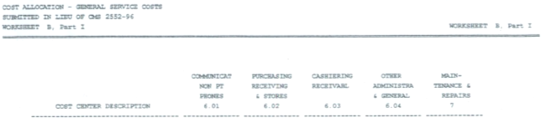
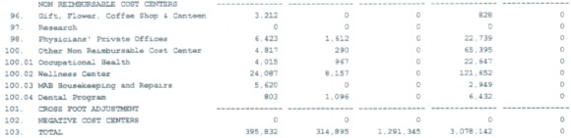
Cost Reporting Errors
Double Counting (continued)

Slide 43


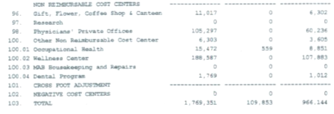
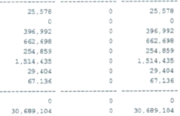
Cost Reporting Errors
Double Counting (continued)

Slide 44
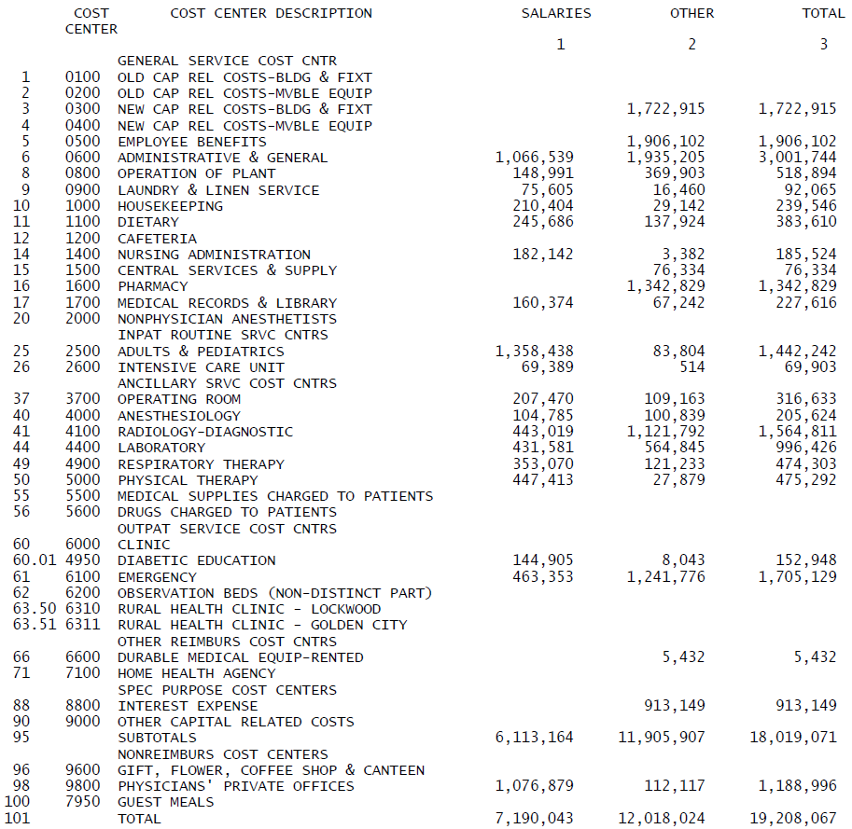
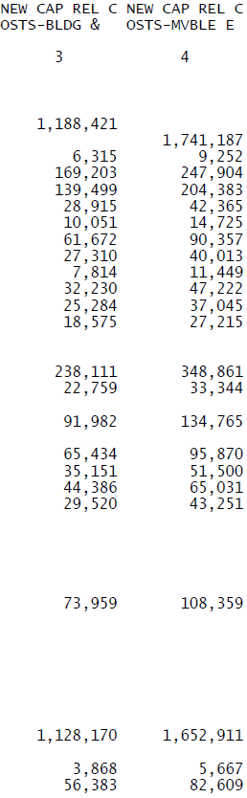
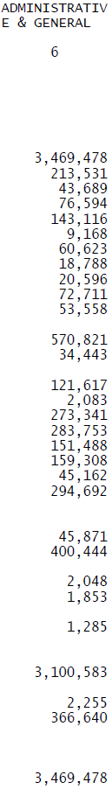
Cost Reporting Errors
Double Counting (continued)
Worksheet B

Slide 45
Cost Reporting Errors
RCC Inconsistencies
  General Principle
    Revenues and expenses must be in the same department to produce the correct RCC
    Unreasonable values result from:
      Charges in different department
      Inadequate charge capture
      Inappropriate allocation of overhead (e.g., within radiology)
      No reclassification of staff costs

Slide 46
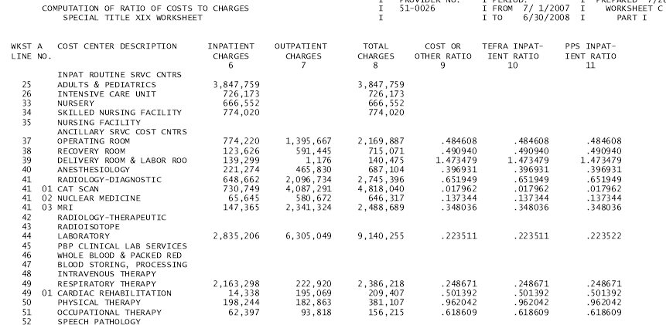
Cost Reporting Errors
RCC Inconsistencies (continued)

Slide 47
Cost Reporting Errors
RCC Inconsistencies (continued)
  Opportunities
    Evaluate RCCs against “critical values” typical to small, rural hospitals:
      Operating Room: 0.6 – 0.8
      Radiology and Lab: 0.2 - 0.4
      Physical Therapy: 0.5 – 0.75
      ER: 0.75 – 1.25
        Professional fees excluded from Charges
    Evaluate charge master
      Formal external charge master review
      Blue Cross fee schedule inflated by ???%
      Medicare APCs
    Grow patient volume by working with physicians
    Consider productivity incentives for physical therapists
    Reduce expenses
      Purchasing organizations, networks, etc.

Slide 48
Cost Reporting Errors
Statistical Allocation of Costs
  General Principle
    Accurate cost allocations of non-revenue producing cost centers, based on statistical data, are essential in determining “reasonable costs” of patient care
  Opportunity
    Hospitals that have errors in statistical data may misrepresent reasonable costs on a departmental basis
      Inappropriate costs allocated to “below the line” or low “cost-based” departments have direct negative financial impact
    Changing Statistical Bases
      Must request a change no later than 90 days before the end of the cost reporting period.
        The change must demonstrate that a more accurate allocation results
      The FI has 60 days to make a decision and notify the provider otherwise the change is accepted
  Cost Report Impact
    Worksheet B-1; Worksheet B, Part I

Slide 49
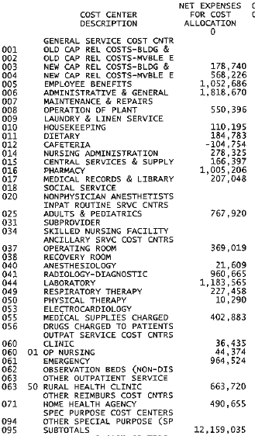
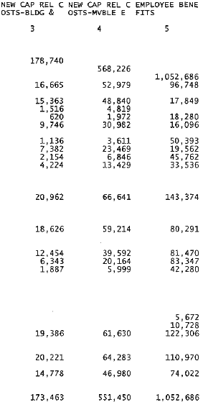



Cost Reporting Errors
Statistical Allocation of Costs (continued)

Slide 50
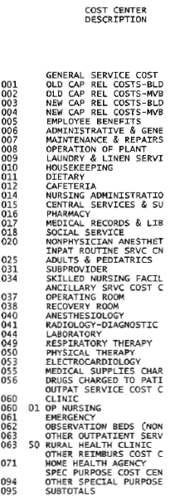
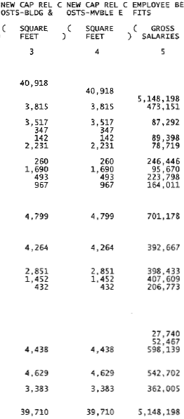
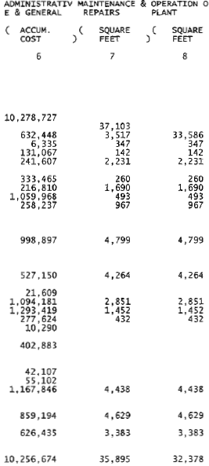

Slide 51
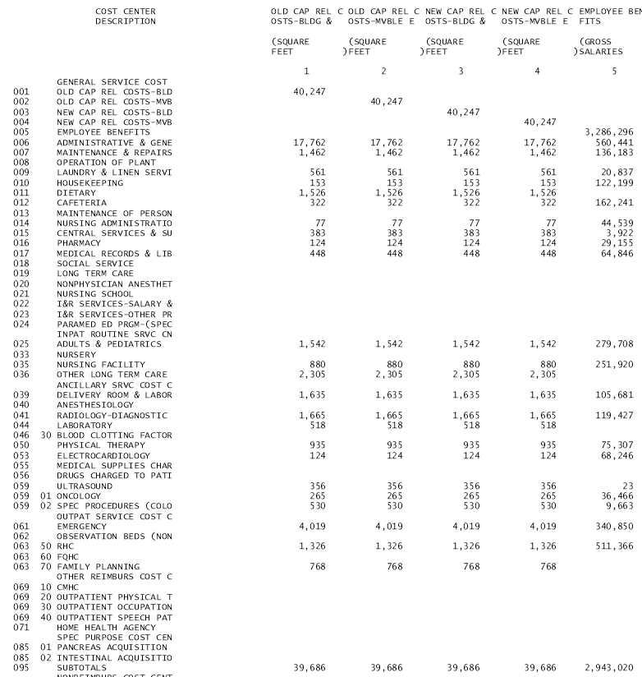
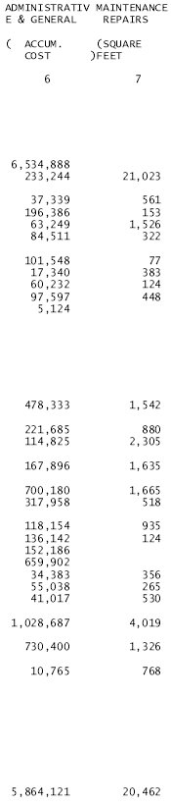

Slide 52
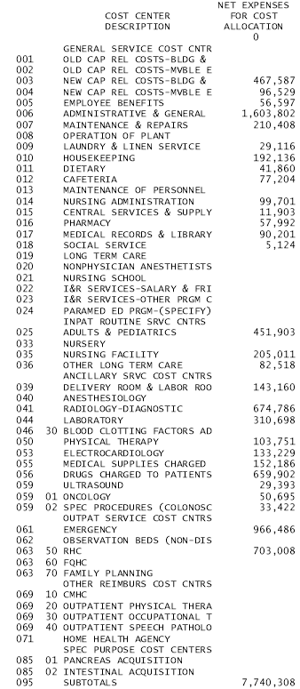
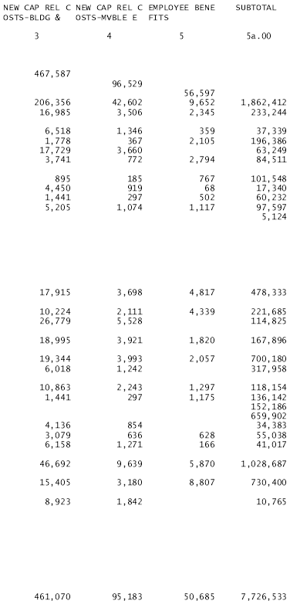
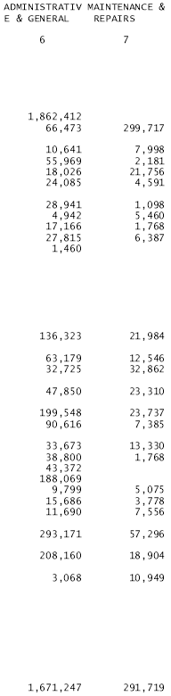


Slide 54


Slide 55
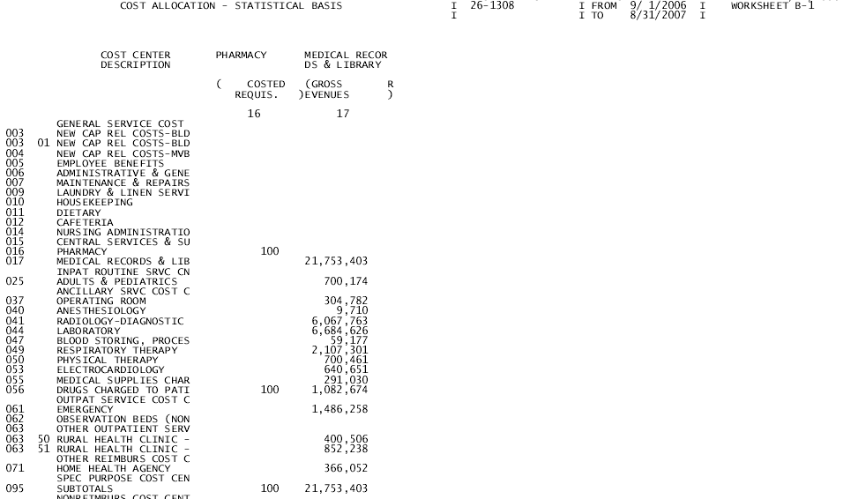

Slide 56
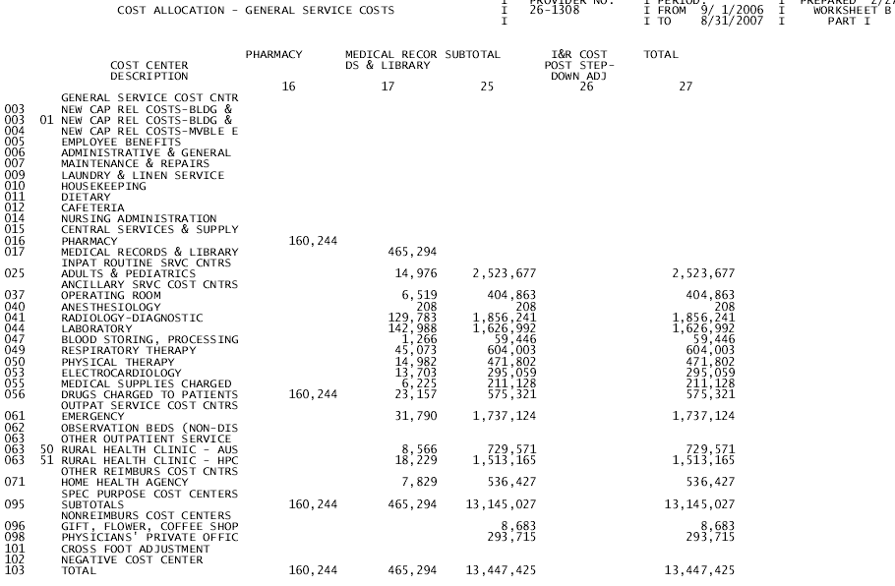

Slide 57
Cost Reporting Errors
Physician Stand-by/On Call Costs in ED
  General Principle – Stand by (On site)
    Provider Reimbursement Manual 2109: “When ED physicians are compensated on an hourly or salary basis, or under a minimum guarantee arrangement, providers may include a reasonable amount in allowable costs for ED physician availability services…”
    Certain Requirements
      No feasible alternative to obtaining physician coverage
      Immediate response to life-threatening emergencies
      Documentation
      Subject to RCE limits

Slide 58
Cost Reporting Errors
Physician Stand-by/On Call Costs in ED (continued)
  On-Call (Not on Site)
    Available to CAHs only
    Immediately available by phone, radio with 30 minute response time
    Written contract
  Physician Time Studies
    Minimal accepted
      FI approval
      One full week per month with rotating weeks
      Must be provider specific
  Opportunity
    CAHs are often able to record a portion of ED physicians salary on the cost report
  Cost Report Impact
    Worksheet A-8
    Worksheet A-8/2

Slide 59
Cost Reporting Errors

Slide 60
Cost Reporting Errors
Physician Stand-by/On Call Costs in ED (continued)
  Worksheet A-8/2
    ER with 8,500 visits per year
    So what’s the problem???
      $1,243K/$1,735K = 72% professional time
      72% X 8,760 Annual Hours = 6,280 professional hours
      6,280 hours / 8,500 ER Visits = .74 hours per visit (44 minutes)

Slide 61
Cost Reporting Errors
Physician Stand-by/On Call Costs in ED (continued)
  And what about mid-levels in ER??
    Depends on your FI?? (PRRB Decision D9, Case 07-1153, 2/25/2009)
      The Intermediary contends that the pertinent statute, 42 U.S.C. § 1395x(v)(1)(A), indicates that not all standby costs are necessary in the efficient delivery of health care services. In the context of the statute, the Secretary promulgated 42 C.F.R. §413.5 and§413.9 and CMS Pub. 15-1 §2102.1, allowing standby costs in certain circumstances which include costs associated with unoccupied beds and the allocation of costs between certified and non-certified beds (CMS Pub. 15-1 §2342), and assets that have been retired but held for emergency use (CMS Pub. 15-1 §130).4 With respect to CAHs, 42 C.F.R.§413.70(b)(4) allows standby costs associated with emergency room physicians and midlevel practitioners which does not include CRNAs. The Intermediary argues that "CRNA's standby cost is not covered by the instructions, and as a result [Medicare] does not recognize it as the normal standby cost under §413.9."

Slide 62
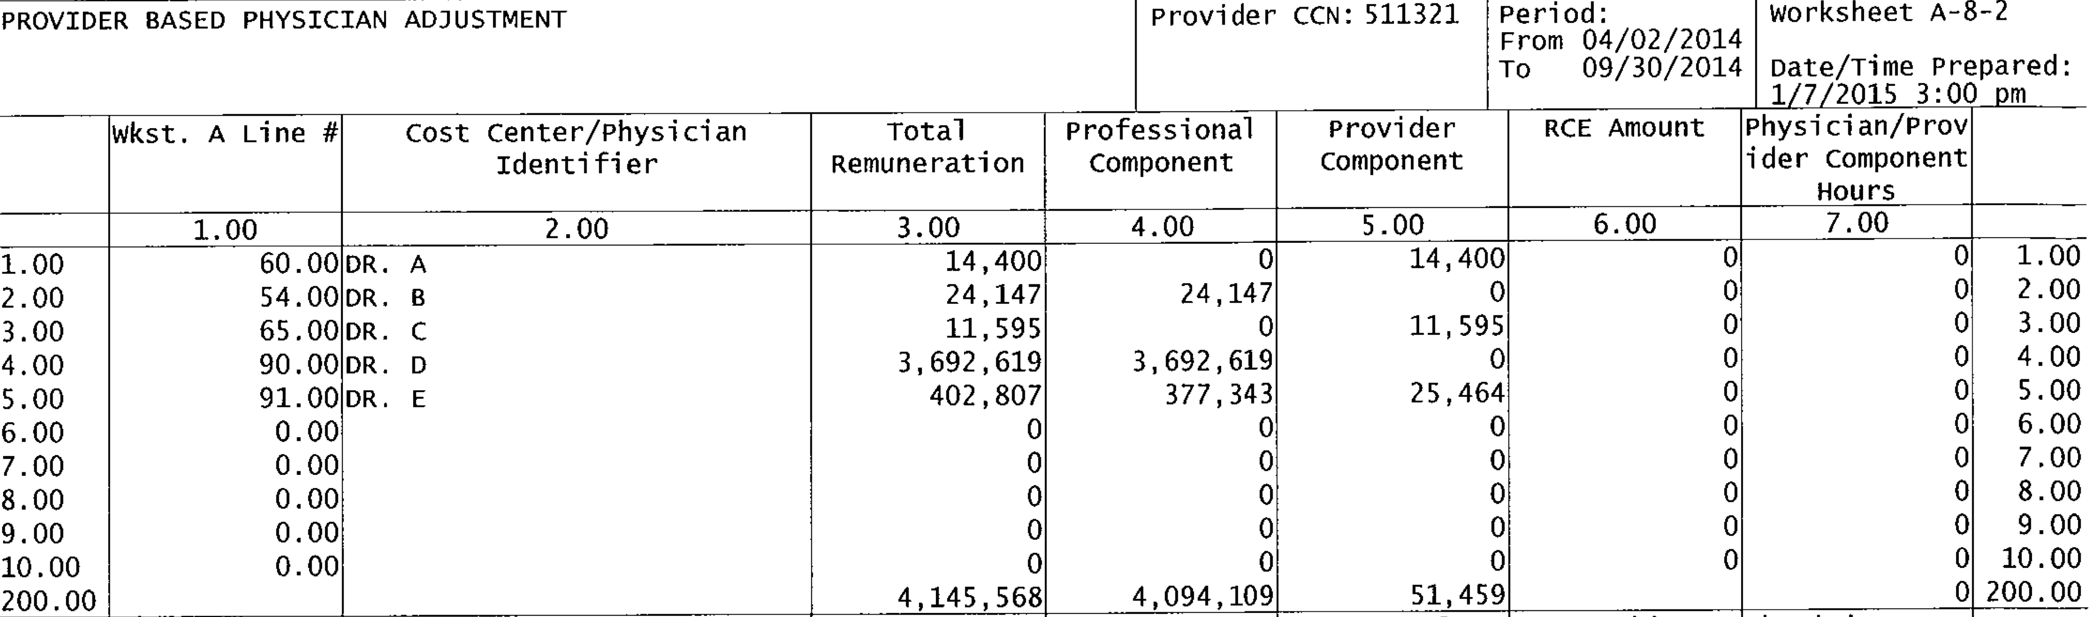
Cost Reporting Errors
Physician Stand-by/On Call Costs in ED (continued)
  ER physicians billing for professional services
  Standby time or “Total Remuneration” subject to time studies??

Slide 63
Cost Reporting Errors
Physician Stand-by/On Call Costs in ED – Best Practice

Slide 64
Cost Reporting Errors
Physician Stand-by/On Call Costs in ED – Best Practice

Slide 65
Cost Reporting Errors
Physician Stand-by/On Call Costs in ED – Best Practice

Slide 66
Cost Reporting Errors
Related Party Cost Allocations
  General Principle
    Cost applicable to home office costs, services, facilities, and supplies furnished to you by organizations related to you by common ownership or control are includable in your allowable cost at the cost to the related organizations.
  Opportunity
    Significant variation in treatment of related party costs throughout the industry
  Cost Report Impact
    Worksheets A-8/1

Slide 67
Cost Reporting Errors
Related Party Cost Allocations (continued)
Example A (6 months only)

Slide 68
Cost Reporting Errors
Related Party Cost Allocations (continued)
Example B

Slide 69
Cost Reporting Errors
LDRP Allocations
  General Principles
    Proposed FY 2004 Inpatient PPS Update (May 19, 2003)
      In order to appropriately track the days and costs of LDRP rooms, it is necessary to apportion them between the labor and delivery ancillary cost center and the routine adults and pediatrics cost center. This is done by determining the proportion of the patient's stay in the LDRP room that the patient was receiving ancillary services (labor and delivery) as opposed to routine adult and pediatric services (recovery and postpartum).
  Opportunity
    Ensure that direct costs and square footage on the cost report are accurately allocated between Acute and Ancillary
      “the hospital could calculate an average percentage of time patients receive ancillary services, as opposed to routine inpatient care during a typical month, to apply the rest of the year”
  Cost Report Impact
    Worksheets A, B, B-1

Slide 70
Cost Reporting Errors
LDRP Allocations (continued)

Slide 71
Cost Reporting Errors
LDRP Allocations (continued)

Slide 72
Cost Reporting Errors
Administration and General Cost Allocations - Subscripting
  General Principle
    If subscripting A&G costs improves accuracy of cost report, hospitals can elect a methodology that breaks down total A&G into multiple cost centers
  Opportunity
    For CAHs with multiple “below the line” cost centers, subscripting A&G often improves accuracy of cost report and reduces costs being allocated to non cost-based departments
  Cost Report Impact
    Worksheets A and B

Slide 73
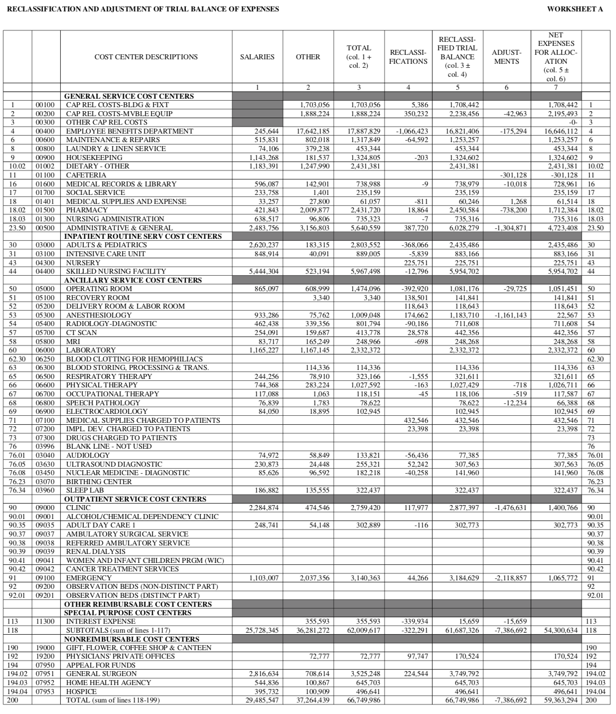
Cost Reporting Errors
A&G Allocations – subscripting A&G

Slide 74
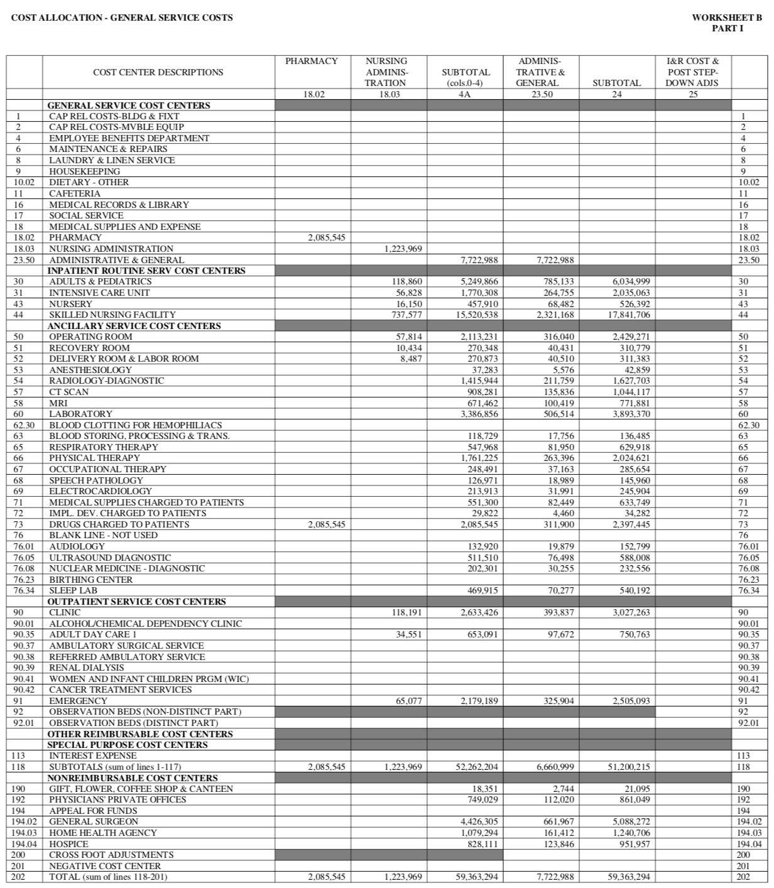
Cost Reporting Errors

Slide 75
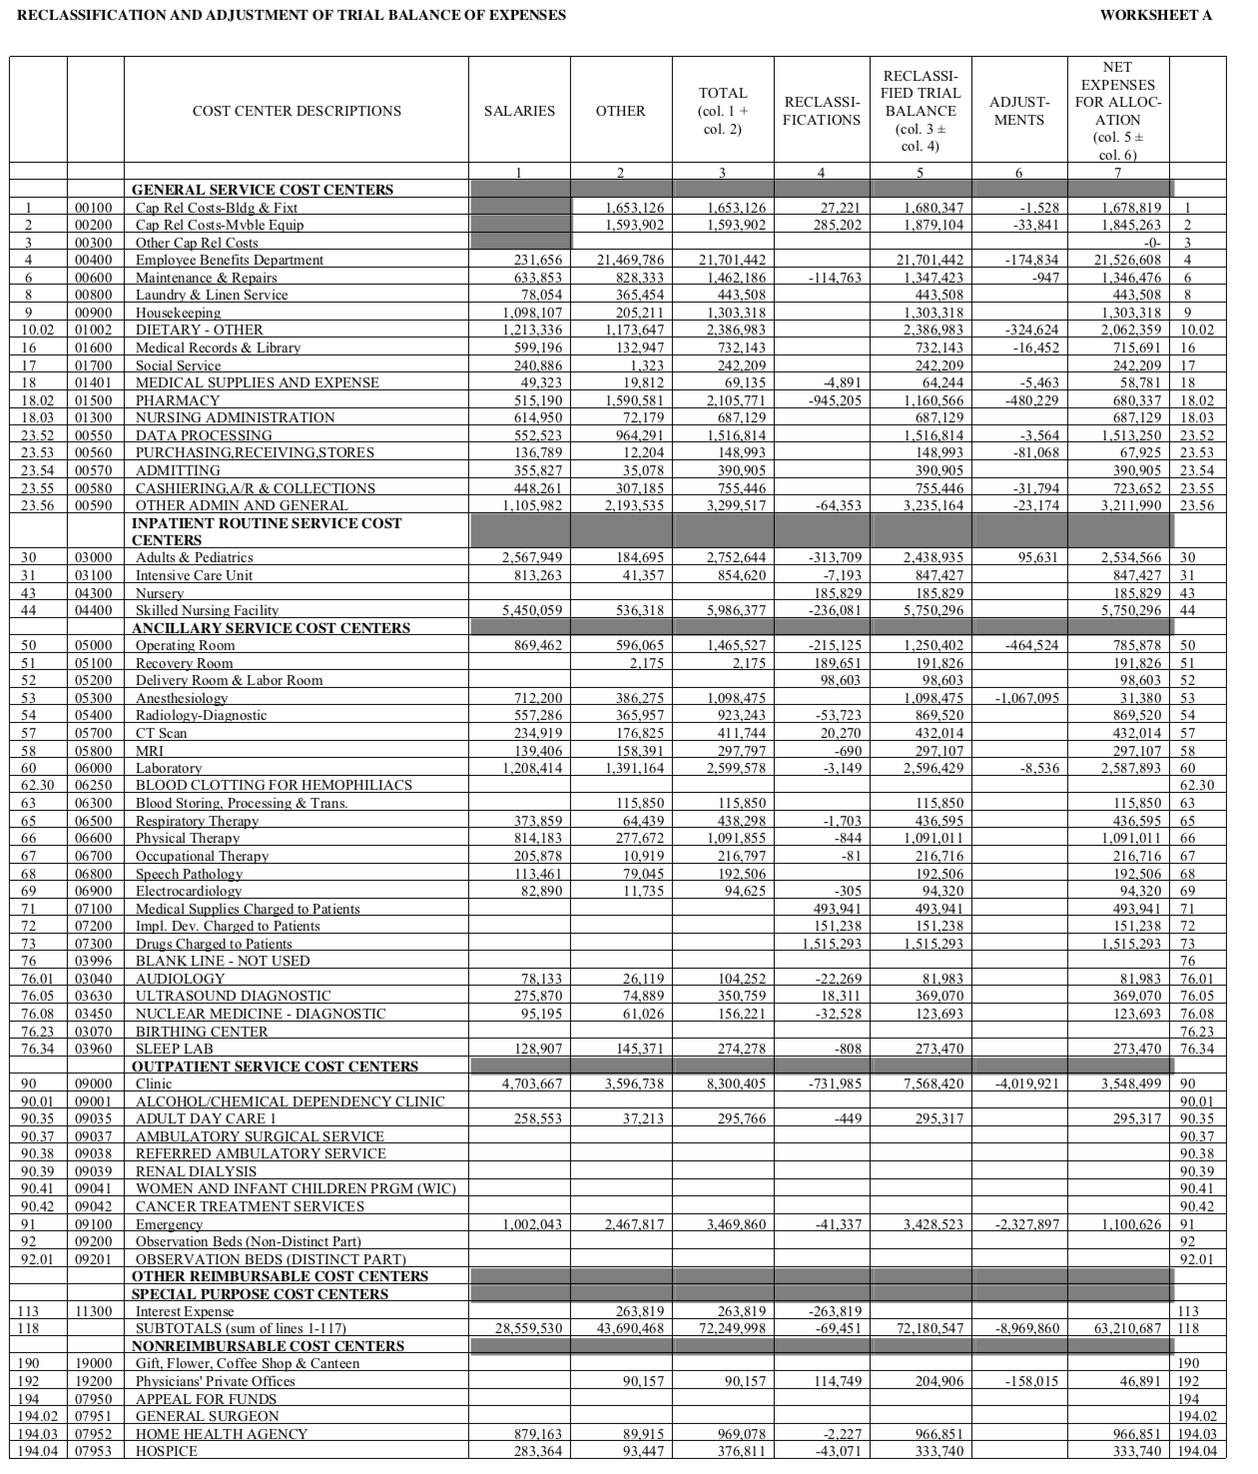
Cost Reporting Errors

Slide 76
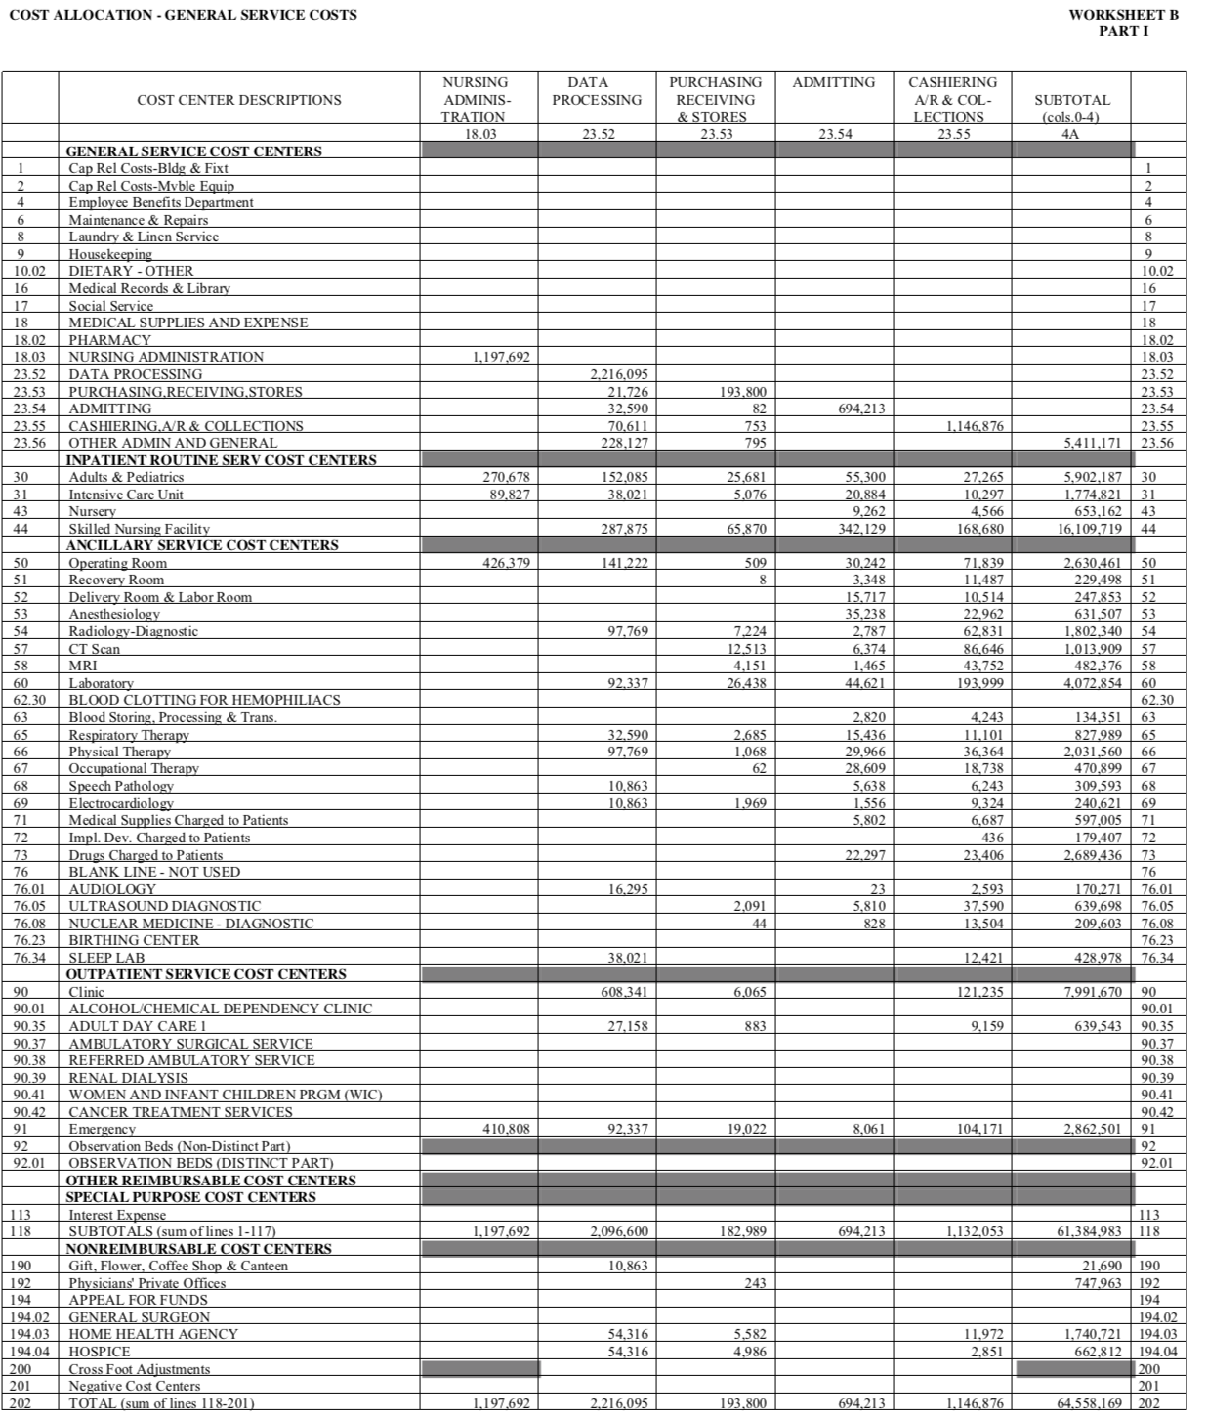
Cost Reporting Errors

Slide 77
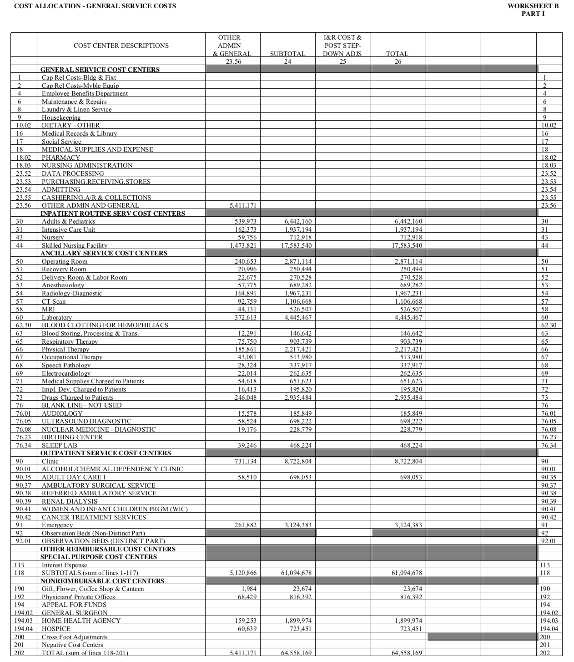
Cost Reporting Errors

Slide 78
Objectives
Cost Report
  Structure and Logic
  Common Errors in Cost Reports
  View from the Top
Cost Reports for Decision Making
Summary/Discussion

Slide 79
View from the Top
Understand logic and key components of cost reporting opens up opportunities to improve direct cost-based reimbursement
  Questions to ask in preparing cost reports:
    S-3: Are SB days on S-3, line 3 are 100% Medicare (Title XVIII and MA)
    S-3: Is observation bed statistic is listed on S-3? Is observation accumulated by hour?
    A: Are all plant operations and administration and general costs properly classified to an overhead department?
      Do any below-the-line departments include costs that should be reclassified to admin and general (e.g., business office services) or plant operations (e.g., utilities)?
    A-8-2: Is standby cost listed under provider component? Is percentage of total reasonable with understanding of ER operation?
    B-1: Has statistical basis been updated to reflect current year facility changes?
    B-1 Does the selected statistic result in reasonable allocation (e.g., Medical Records based on charges vs. time spent)?

Slide 80
View from the Top
Understand logic and key components (continued)
  Questions to ask (continued)
    B, Part I: Are below-the-line cost allocations reasonable?
    C, Part I: Are there any costs or charges allocated to 0 RCC lines?
    Are RCCs within ‘critical values’ range? For Ancillary RCCs greater than 1, evaluate charge level and/or charge capture.
    D-1: Validate reasonableness of per diem by calculating Medicare inpatient costs. If questions, check ancillary charges on D-3.
    E, Part B, E-2, and E-3: Are Medicare bad debts being claimed? Is settlement amount reasonable given changes in volume and/or expenses?

Slide 81
Objectives
Cost Report
  Structure and Logic
  Common Errors in Cost Reports
  View from the Top
Cost Reports for Decision Making
Summary/Discussion

Slide 82
Cost Reports for Evaluating Hospital Operations
  Begins with defining “profitability”
  Net Revenue less:
    Fully Allocated Costs (FAC)??
    Variable Costs??
    Incremental Costs??
  What are we evaluating?
  Distinct part unit
    E.g., nursing home; psych unit; home health, ambulance, etc.
  Department or service of hospital
    E.g., Laboratory, nursing unit, cardiac rehab
  Unit volume
    Do we want to provide this additional unit of service and at what price?
    E.g., Laboratory test
  Does it matter how we define profitability?

Slide 83
Cost Reports for Evaluating Hospital Operations
DPU – Home Health FAC and Variable Cost Example
  HH Unit incurs losses on both FAC and Variable Cost basis
    Must be targeted for improvement and mission support
WS A
WS B
FAC
Variable Costs
Variable Costs?

Slide 84
Cost Reports for Evaluating Hospital Operations
DPU – Ambulance Variable Cost Example
  Ambulance essentially breaks even
WS A
WS B
Variable Costs
FAC
Variable Costs?

Slide 85
Cost Reports for Evaluating Hospital Operations
Units of Service – Reference Lab Incremental Cost Example
  Costs
    Variable costs $1.75/test (assumed)
    Fixed costs remain constant
  Change
    250 new reference lab type tests
      Assume 9.25/test
  Outcome
    Medicare Revenue declines
    Incremental “low” paying commercial volume generates positive contribution margin
    What should we do??
WS D Prt V
WS B – Variable Costs
WS B – Variable Costs

Slide 86
Cost Reports for Evaluating Hospital Operations
Units of Service – Swing Bed Volume Example
WS S-3
WS B + WS C, IP Charges*RCC – VC
$250/Day acute; $150/day SB
  Change:
    Grow swing bed volume to ADC of 4
    Variable costs = $150/day
    Fixed costs remain constant

Slide 87
Cost Reports for Evaluating Hospital Operations
Units of Service – Swing Bed Volume Example (continued)
WS S-3
$250/Day acute; $150/day SB
  Outcome:
    Increased swing bed volume results in $208K increase in margin

Slide 88
Objectives
Cost Report
  Structure and Logic
  Common Errors in Cost Reports
  View from the Top
Cost Reports for Decision Making
Summary/Discussion

Slide 89
Summary
  Fully Allocated Costs
  Readily available in cost report
  Dangerous when used for decision making
    Do not evaluate contribution towards CAH overhead
  Variable Costs
  More difficult to determine from the cost report
  Includes lost cost-based revenue from fixed allocated costs
  Much better measure of department profitability
  Proxy for incremental or marginal costs
  Necessary for unit, department, or unit of service to cover variable costs or recognize mission support

Slide 90
Summary
  Key takeaways
  The “tail” of cost report must not wag the “dog” of operations
    Cost Report should be an input to decision making
      Better stated by Wisconsin CFO
        “Quality and service drive growth and finances – patient safety, quality improvement, customer service”
  Accurate cost reports are important so that Medicare and Medicaid reimbursement is based on true costs
  Important learning from others’ errors in cost report filings
  Understand difference between fully allocated costs and variable costs and their appropriate use in evaluating organizational performance

Slide 91

Thanks for listening!
Eric Shell, CPA, MBA
eshell@stroudwater.com

