Slide 1
CAH Swing Bed PI/QI Project
Outcome Management Qtr. 2 of 2019
July 17, 2019
Mary Guyot Consulting
207-650-5830 (cell/text)
maryguyotconsulting@gmail.com

Slide 2
Agenda
9:00 - 9:15 Welcome & Intro
9:15 – 10:00 Review & Discussion of Data from the Stroudwater Portal
10:00 – 10:15 Break
10:15 - 11:00 Continue Review and Discussion of the data
11:00 – 11:45 Last quarters Action Plan Status Reporting by hospital
11:45 - 12:45 Networking Lunch
12:45 – 1:45 What is happening in the SB PPS world? Should we make changes?
1:45 – 2:20 Action Planning for next Qtr.
2:20 - 2:30 Q&A - Next Step

Slide 3
Welcome & Intro
Name - Hospital
Title
Did you participate in the data review with the team to prepade for today?
On a 1:10 (10 being the best) where do you feel your SB program is at?
Why?

Slide 4
Data Outcome & Benchmarking
Includes comparison between the 1st and 2nd Qtr. of 2019
Review + Open Discussion re: Data Outcome

Slide 5
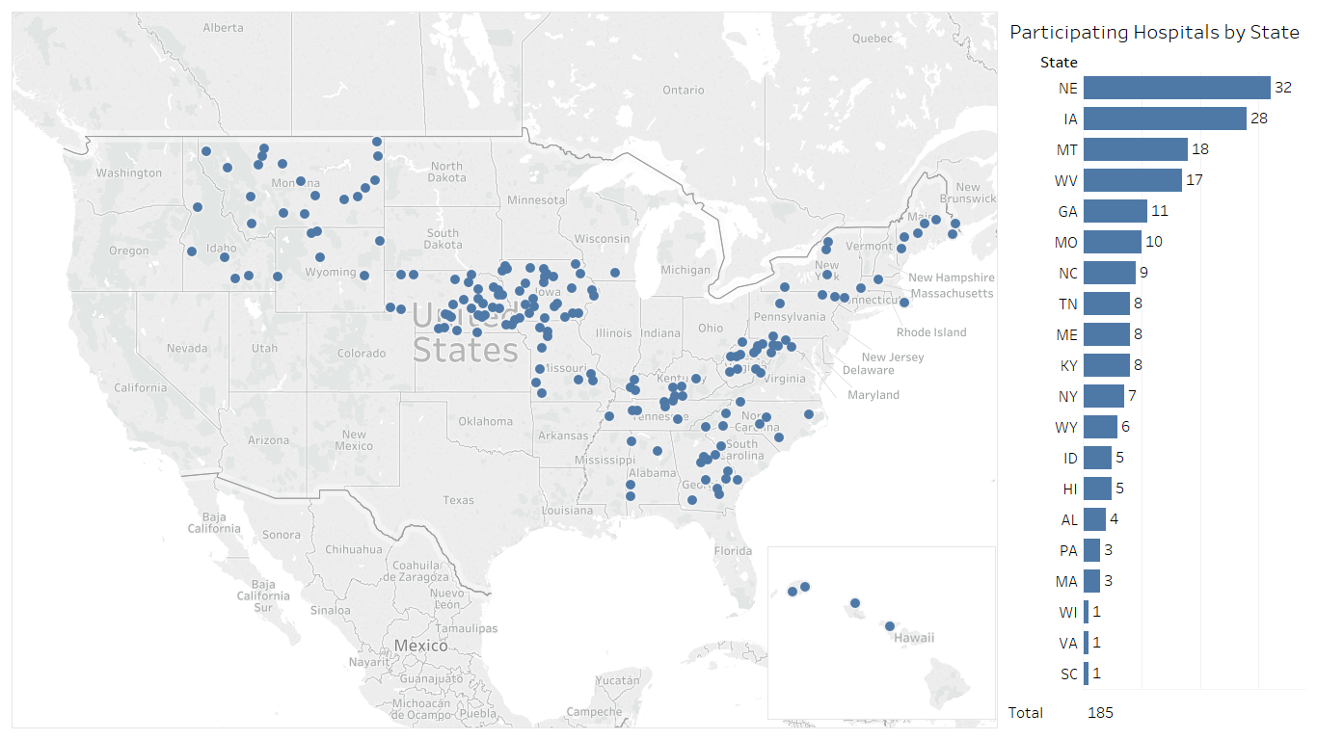
185 Hospitals Participating in Swing Bed Pilot
Now up to 209 hospitals in 21 State – Stroudwater’s goal is 300 by the end of the year
Source: Stroudwater Swing Bed Portal 4/1/2018 to 7/8/2019

Slide 6
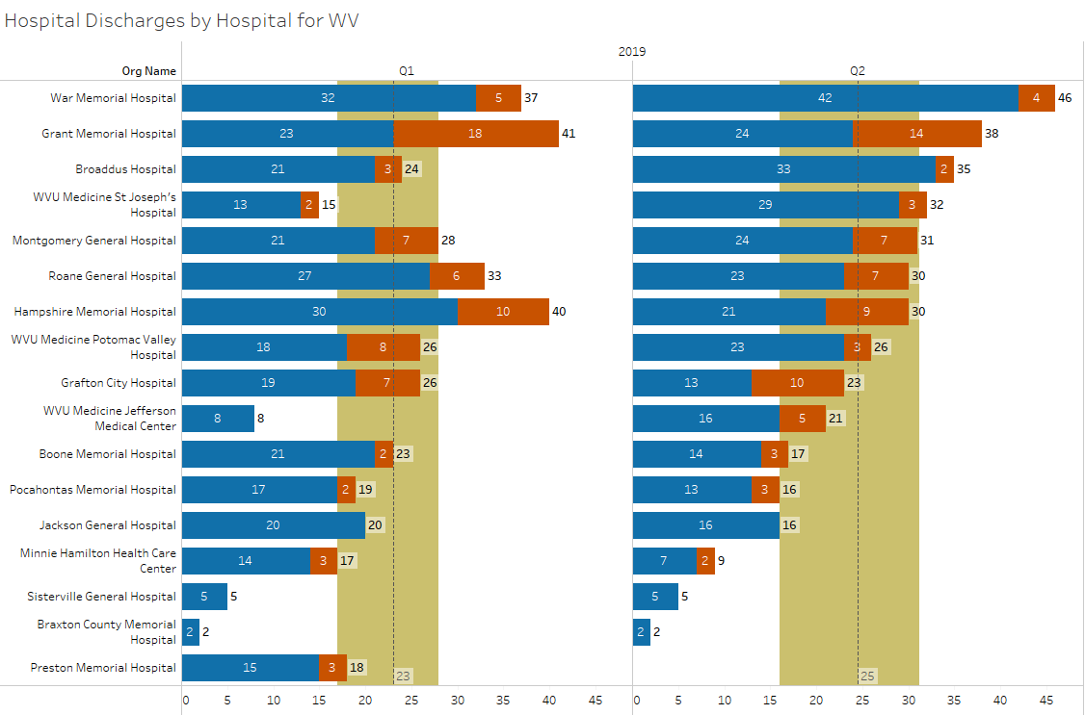
Swing Bed Discharges by Hospital
Source: Stroudwater Swing Bed Portal 4/1/2018 to 7/8/2019
median
lower quartile
upper quartile
excluded records added

Slide 7
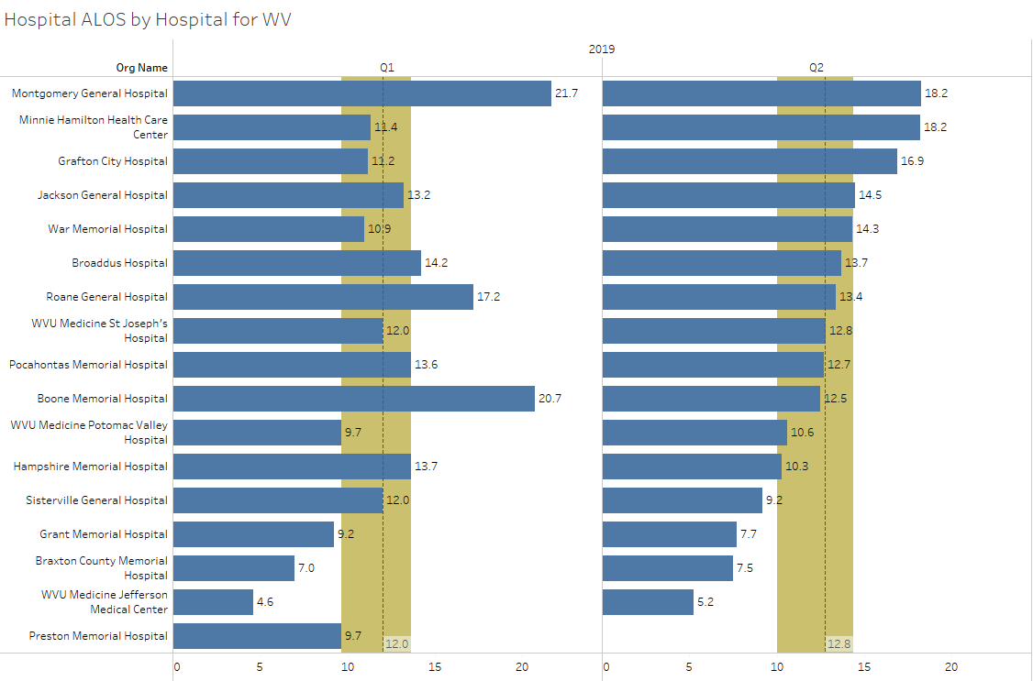
SB Average Length of Stay (ALOS)
Source: Stroudwater Swing Bed Portal 4/1/2018 to 7/8/2019
median
lower quartile
upper quartile
excluded records added

Slide 8
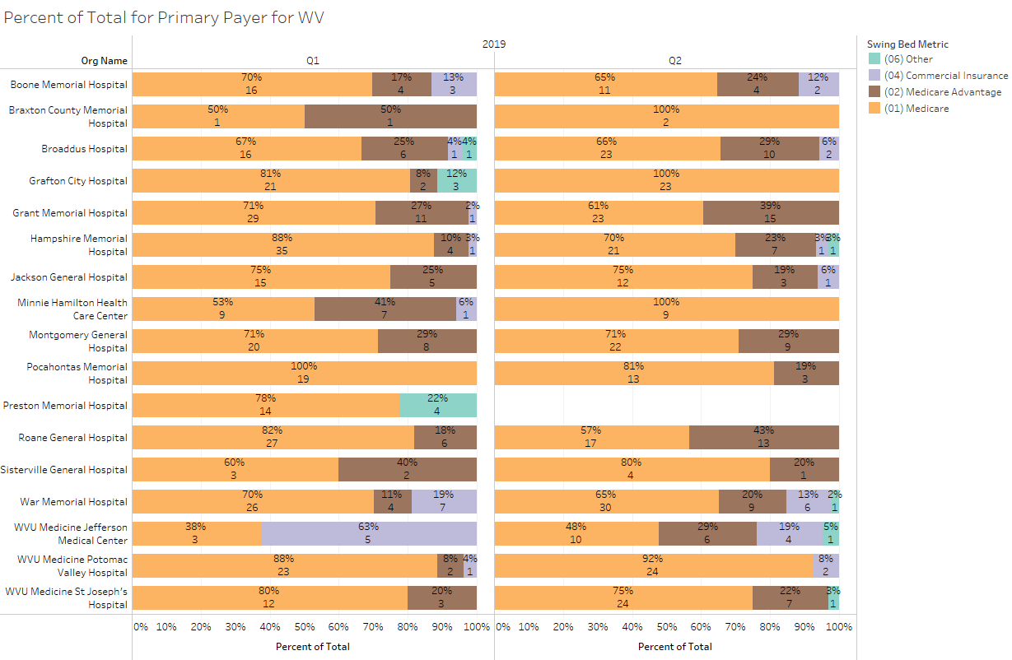
Percent of Total by Primary Payer
Source: Stroudwater Swing Bed Portal 4/1/2018 to 7/8/2019
excluded records added

Slide 9
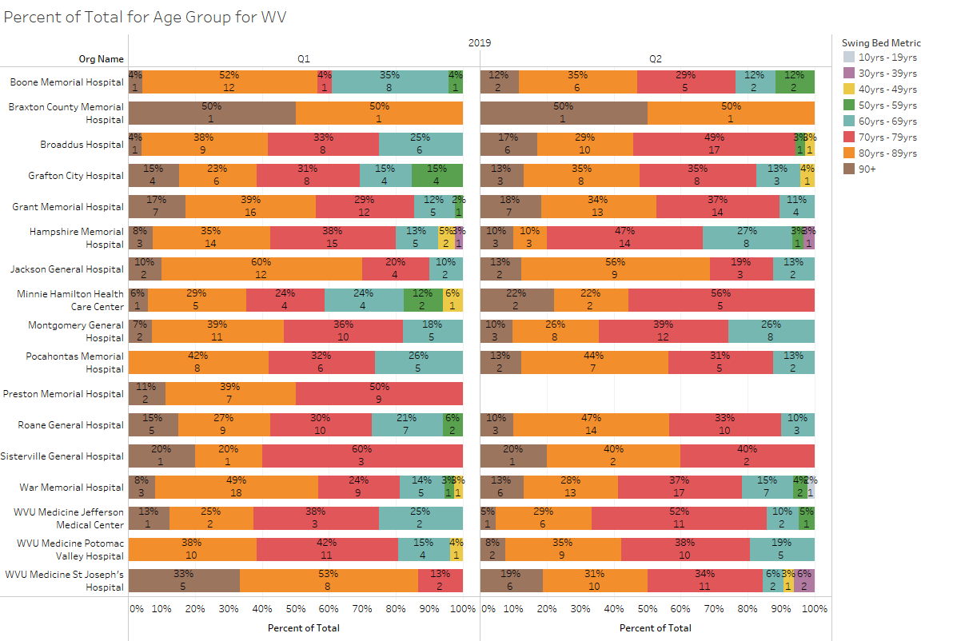
Percent of Total by Age Group
Source: Stroudwater Swing Bed Portal 4/1/2018 to 7/8/2019
excluded records added

Slide 10
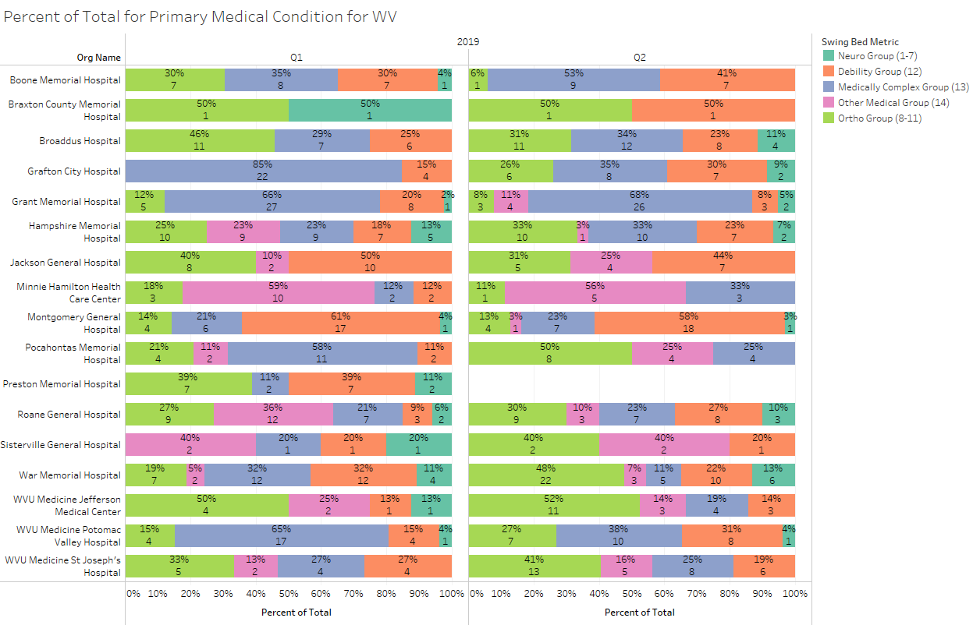
Percent of Total by Primary Medical Condition
Source: Stroudwater Swing Bed Portal 4/1/2018 to 7/8/2019
excluded records added

Slide 11
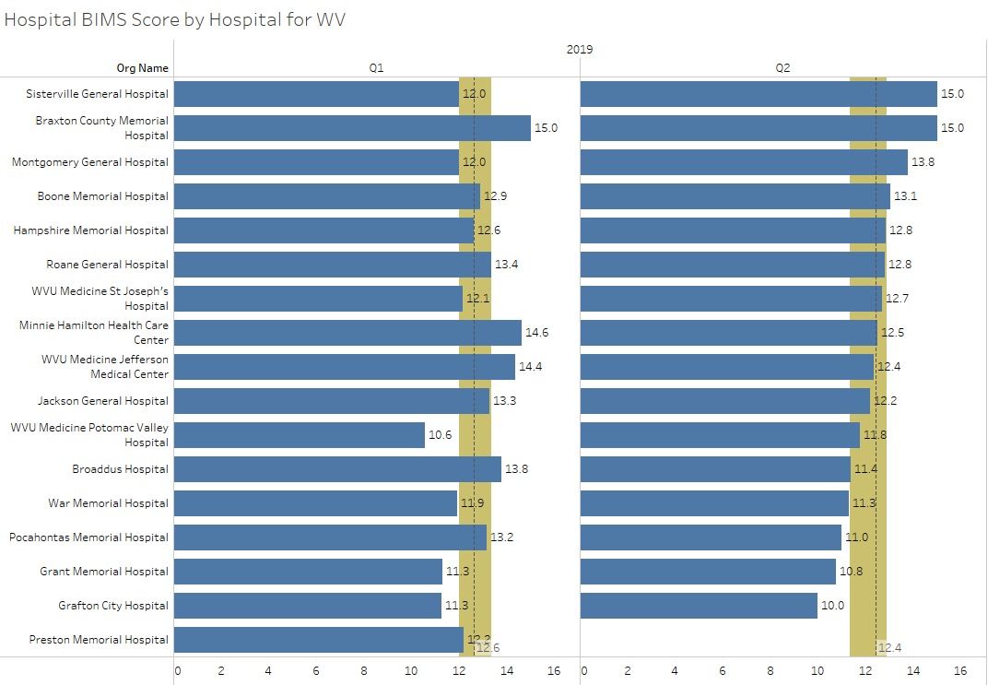
Average BIMS Score
Source: Stroudwater Swing Bed Portal 4/1/2018 to 7/8/2019
median
lower quartile
upper quartile
excluded records added

Slide 12
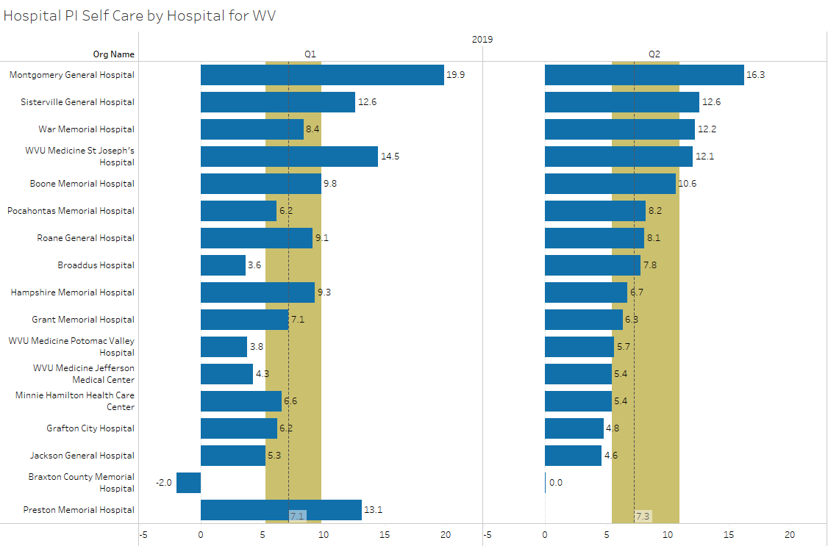
Performance Improvement Score for Self-Care
Source: Stroudwater Swing Bed Portal 4/1/2018 to 7/8/2019
median
lower quartile
upper quartile
excluded records have been removed

Slide 13
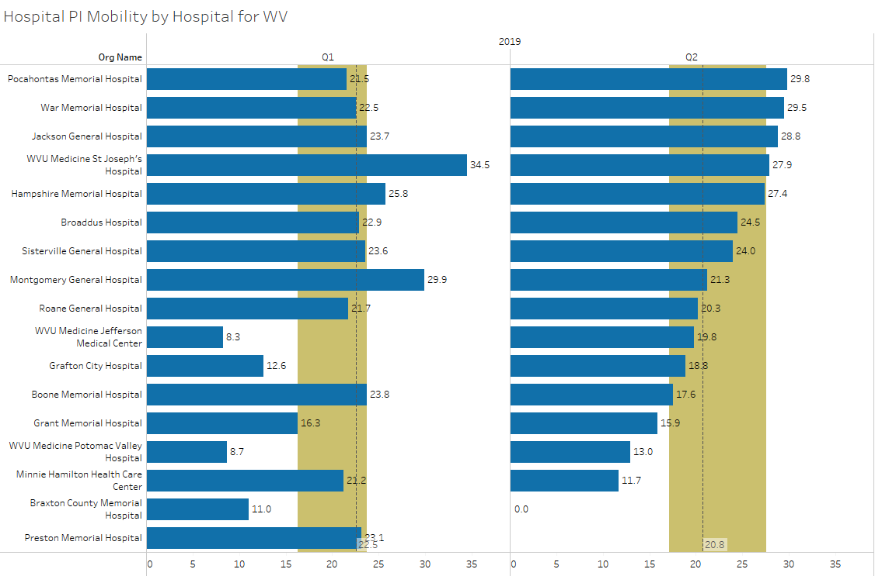
Performance Improvement Score for Mobility
Source: Stroudwater Swing Bed Portal 4/1/2018 to 7/8/2019
median
lower quartile
upper quartile
excluded records have been removed

Slide 14
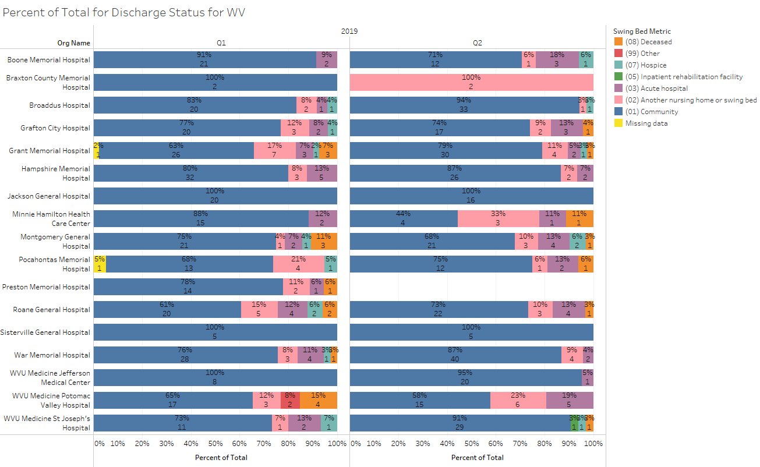
Percent of Total by Discharge Disposition
Source: Stroudwater Swing Bed Portal 4/1/2018 to 7/8/2019
excluded records added

Slide 15
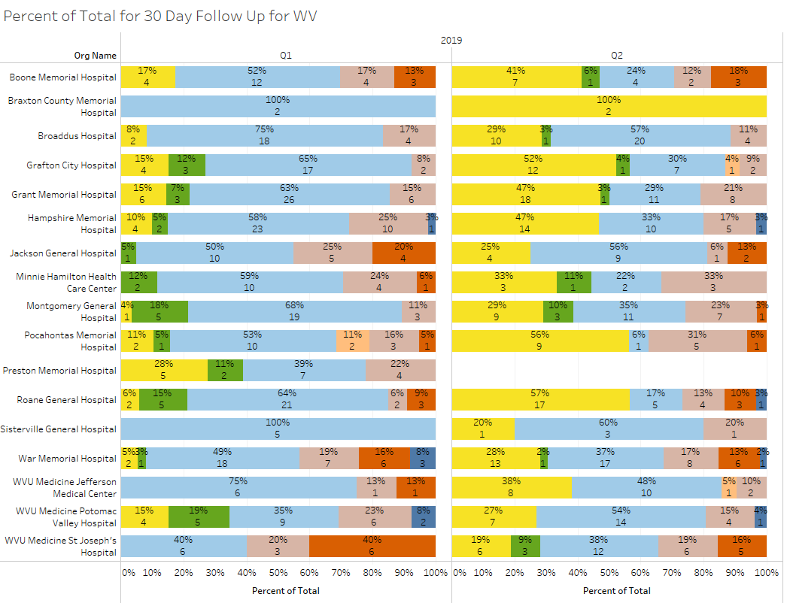
Percent of Total by 30 Day Follow Up
Source: Stroudwater Swing Bed Portal 4/1/2018 to 7/8/2019
excluded records have been removed

Slide 16
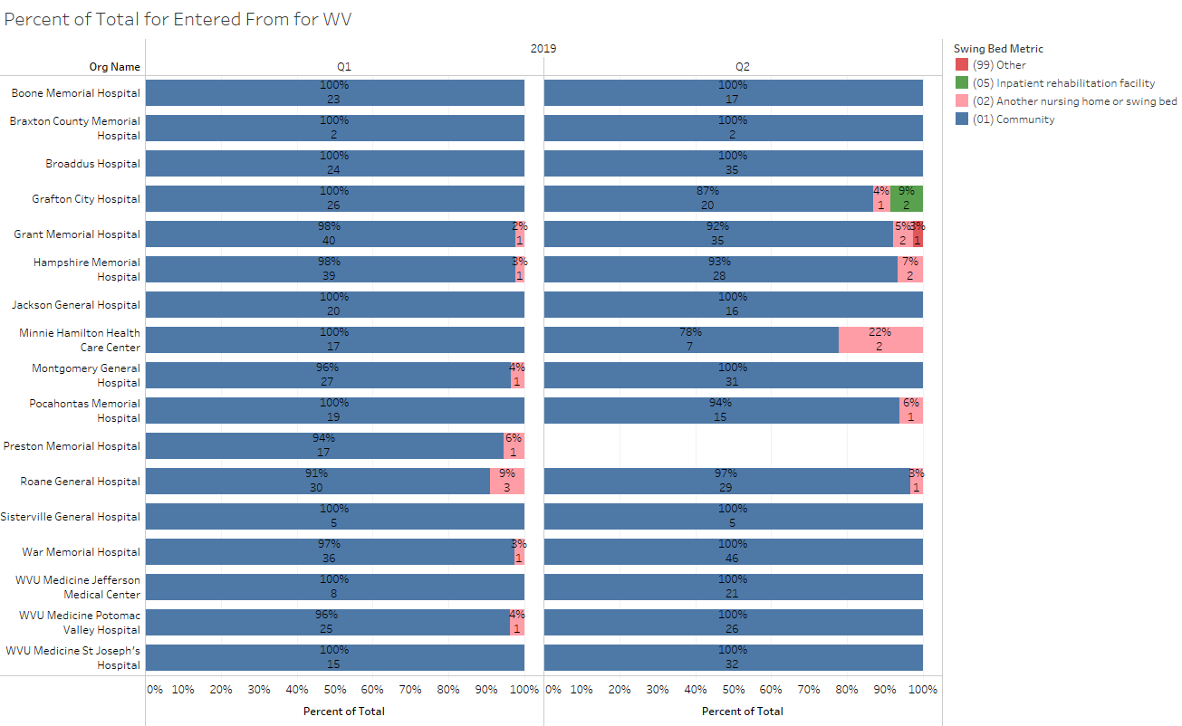
Percent of Total by Residence Pre-Acute Admission
Source: Stroudwater Swing Bed Portal 4/1/2018 to 7/8/2019
excluded records added

Slide 17
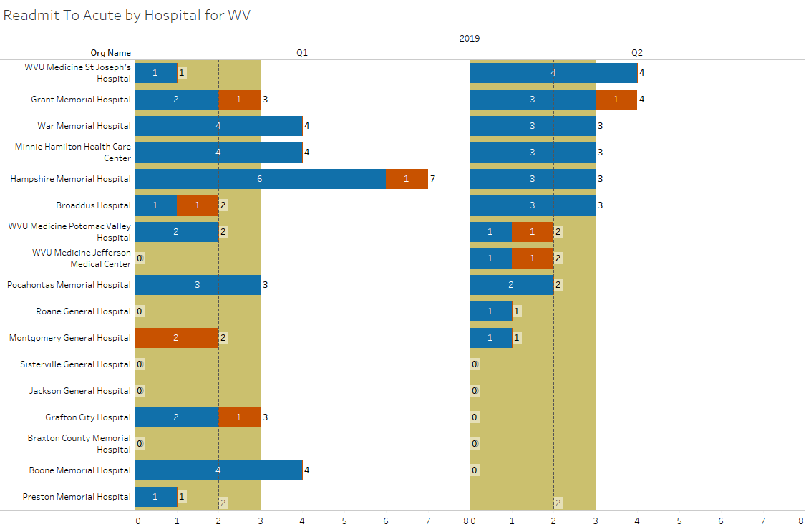
Number of Readmits to Acute
Source: Stroudwater Swing Bed Portal 4/1/2018 to 7/8/2019
median
lower quartile
upper quartile
excluded records added

Slide 18
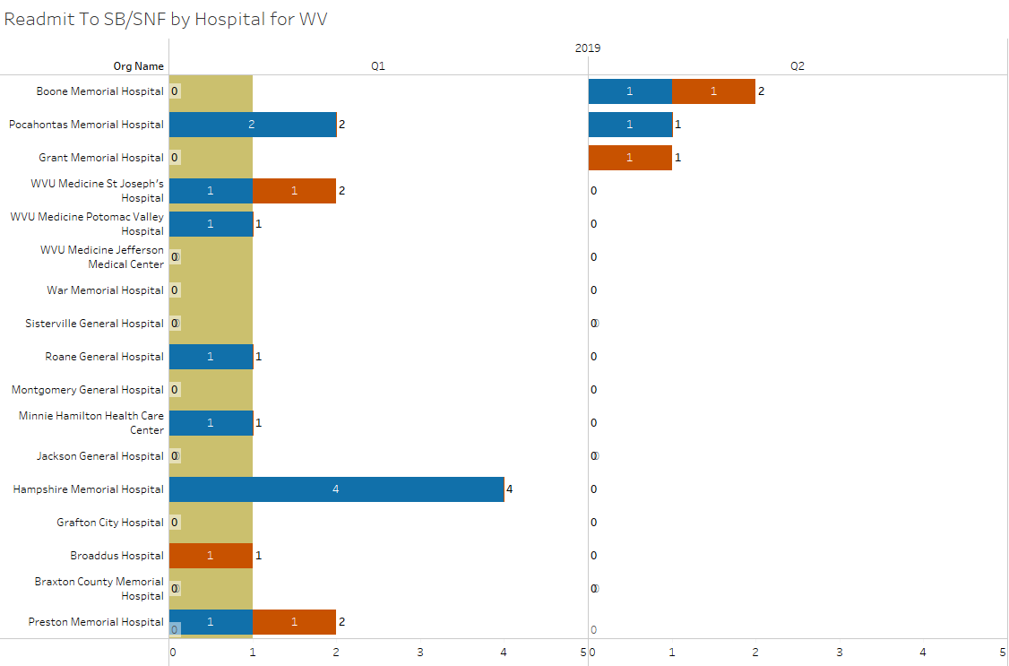
Number of Readmits to SB/SNF
Source: Stroudwater Swing Bed Portal 4/1/2018 to 7/8/2019
median
lower quartile
upper quartile
excluded records added

Slide 19
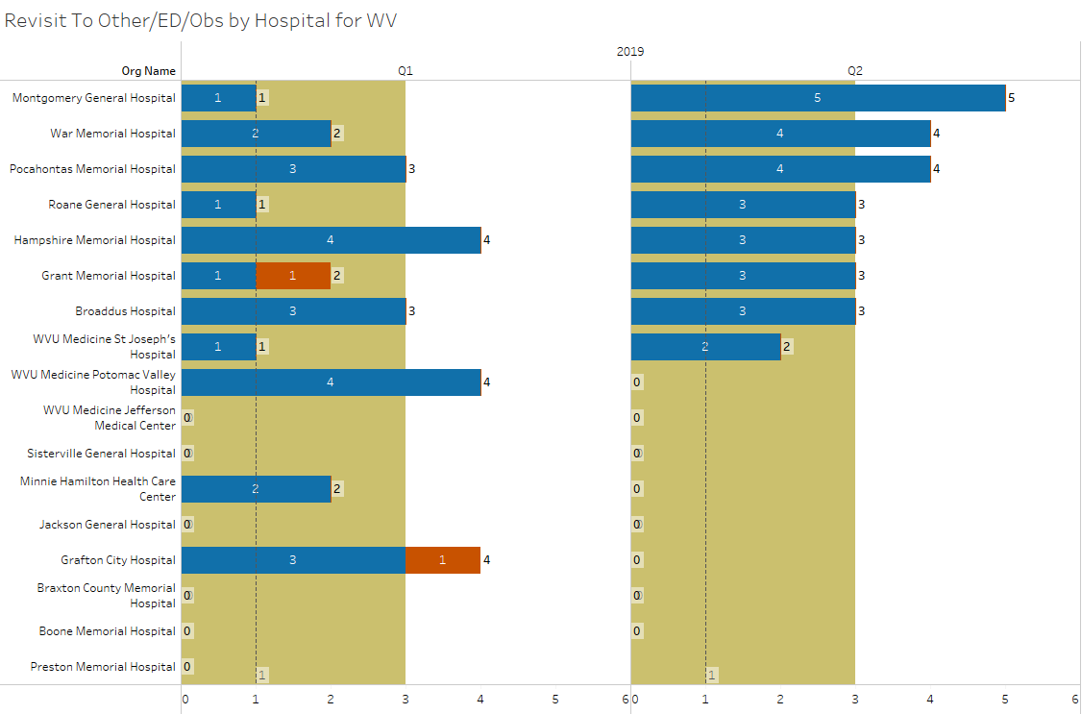
Number of Revisits to ED or Observation
Source: Stroudwater Swing Bed Portal 4/1/2018 to 7/8/2019
median
lower quartile
upper quartile
excluded records added

Slide 21
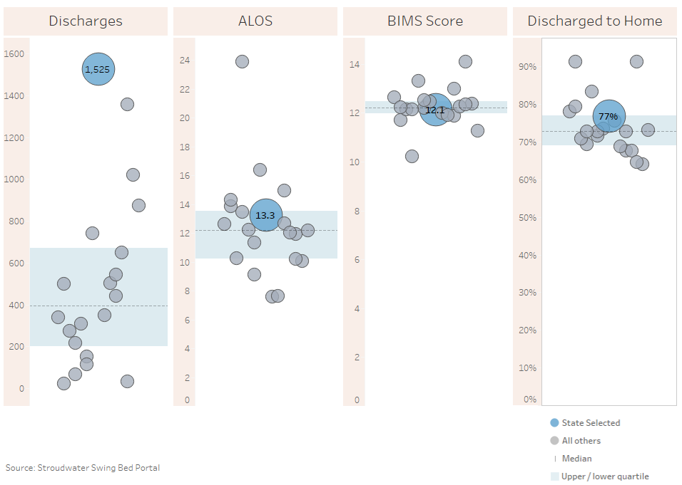
State Comparison for the last 12 months (7/2018-6/2019)
excluded records added
Source: Stroudwater Swing Bed Portal 4/1/2018 to 7/8/2019

Slide 22
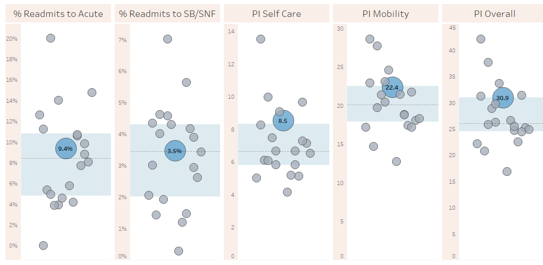
State Comparison for the last 12 months (7/2018-6/2019)
excluded records have been removed for PI scores
Source: Stroudwater Swing Bed Portal 4/1/2018 to 7/8/2019

Slide 23
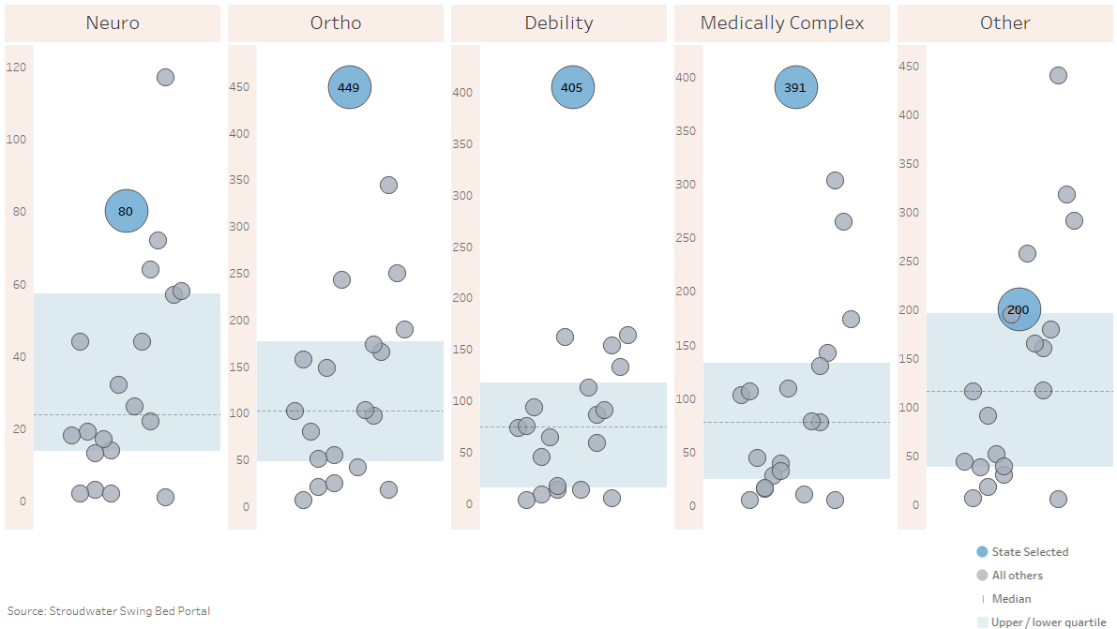
State Comparison for the last 12 months (7/2018-6/2019)- Reason for Admission (count of records)
excluded records added
Source: Stroudwater Swing Bed Portal 4/1/2018 to 7/8/2019

Slide 24
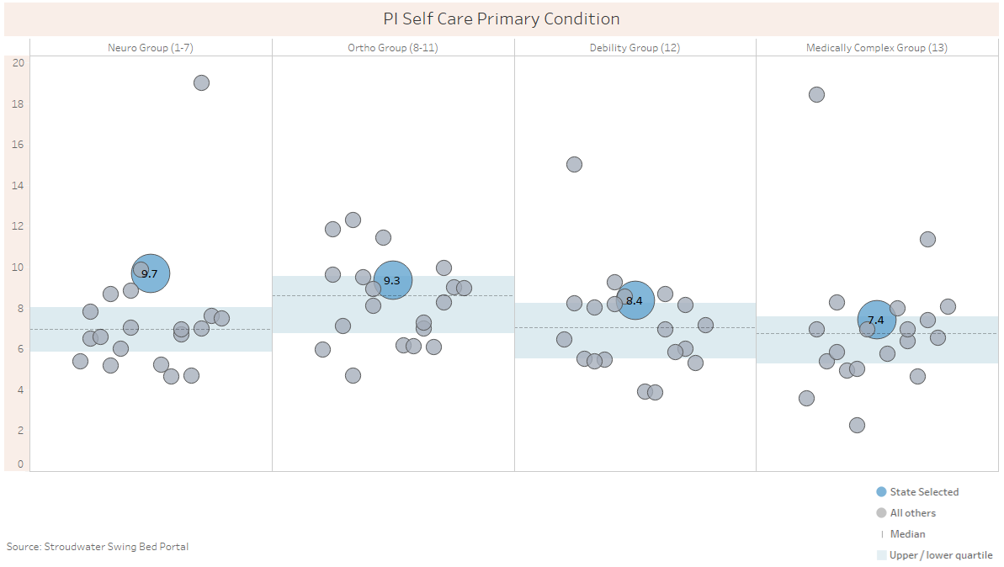
State Comparison for the last 12 months (7/2018-6/2019)- PI Self Care by Primary Condition
excluded records have been removed for PI scores
Source: Stroudwater Swing Bed Portal 4/1/2018 to 7/8/2019

Slide 25
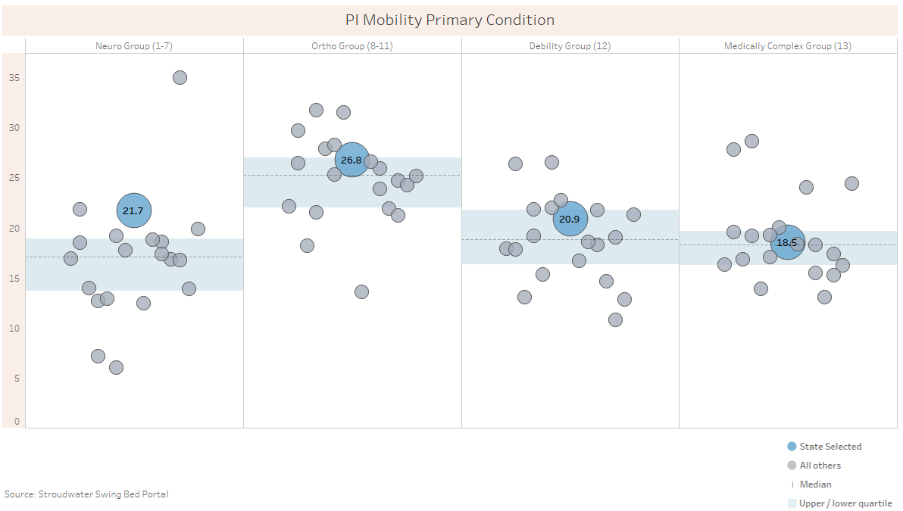
State Comparison for the last 12 months (7/2018-6/2019)- PI Mobility by Primary Condition
excluded records have been removed for PI scores
Source: Stroudwater Swing Bed Portal 4/1/2018 to 7/8/2019

Slide 26
Data Review
What questions should we be asking when doing data review which would lead to an action plan?
I need a scribe please

Slide 27
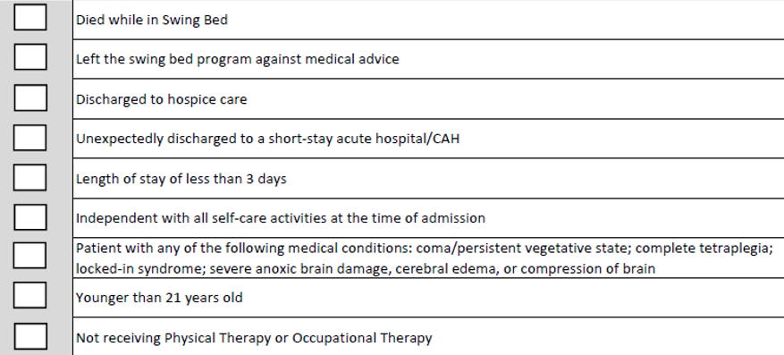
What Questions Should We Be Asking
Do we have any opportunities to increase utilization?
Is the LOS appropriate for the condition?
Who is performing the BIMS assessment? Do we know it’s done correctly?
What is our discharge planning process?
What is the process to determine the Primary Medical Condition/Reason for SB Admission?
How is the prior (pre-acute admission) level of function and devices used determined?
What other quality measures to we have and where do we stand (wound development, falls, medication errors…)
How do we determine co-morbidities? What is the documentation for such?
How many patients do we have falling in the exception list and what is our most frequent reason for such?
What is our process to
determine function?
What is our process to
determine goals & D/C disp.?
Any f/up post discharge?
What is our process for post
discharge follow-up?
Other??

Slide 28
Action Plan Status
Boone Memorial Hospital
Braxton County Memorial Hospital
Broaddus Hospital
Grant Memorial Hospital
Hampshire Memorial Hospital
Jackson General Hospital
Minnie Hamilton Health System
Montgomery General Hospital
Plateau Medical Center
Pocahontas Memorial Hospital
Preston Memorial Hospital
Roane General Hospital
St. Joseph Hospital
War Memorial Hospital
Webster County Memorial Hospital
WVU Medicine – Jefferson
WVU Medicine Potomac Valley Hospital
Last quarters Action Plan Status Reporting by hospital

Slide 30
Where is CMS at with SNFs & PPS SBs
Going from RUG Payment System to Patient Driven Payment Model (PDPM) – this will not affect how CAHs are paid – CAHs will continue being paid under cost-base reimbursement
Definition: PDPM (Patient Driven Payment Model) is:
A new case mix classification system for PPS SB/SNF patients in a Medicare Part A covered stay
Effective beginning October 1, 2019, PDPM will replace the current case-mix classification system, the Resource Utilization Group, Version IV (RUG-IV).
Issues with the current case-mix model (RUG-IV) have been identified by CMS, the Office of Inspector General (OIG), the Medicare Payment Advisory Commission (MedPAC), the media, and others:
Therapy payments under the PPS SB/SNF are based primarily on the amount of therapy provided to a patient, regardless of the patient’s unique characteristics, needs, or goals
Creates provider advantage
Payment inequities for different patient types
Patient selection being driven by payment due to disincentives to admit patient with low therapy needs
Concerns about overutilization of therapy

Slide 31
Where is CMS at with SNFs & PPS SBs
It is anticipated that PDPM, effective October 1, 2019, will improve payments made under the PPS SB/SNF in the following ways:
Improves payment accuracy and appropriateness by focusing on the patient, rather than the volume of services provided
Significantly reduces administrative burden on providers (much less MDSs to complete)
Improves PPS SB/SNF payments to currently underserved beneficiaries without increasing total Medicare payments
Payment will still be determined from the MDS and as before, MDS still will not apply to CAHs (for now at least) since CAH payments are based on cost
Important for CAHs to understand since your “competition” (SNFs or PPS SB) may change who they admit to their programs

Slide 32
PDPM vs RUG IV Classification Methodology

Slide 33
PDPM vs RUG IV Classification Methodology

Slide 34
Where is CMS at with SNFs & PPS SBs
Under the PDPM:
Six payment components are utilized to derive payment
Uses clinically relevant factors, rather than volume-based service for determining Medicare payment
Five of the components are case-mix adjusted to cover utilization of PPS SB/SNF resources that vary according to patient characteristics.
An additional non-case-mix adjusted component to address utilization of PPS SB/SNF resources that do not vary by patient.
Patient characteristics are used to assign patients into CMGs across the payment components to derive payment
Designed to “shift care from therapy to other forms of care as other categories are underutilized”
Adjusts per diem payments to reflect varying costs throughout the stay

Slide 35
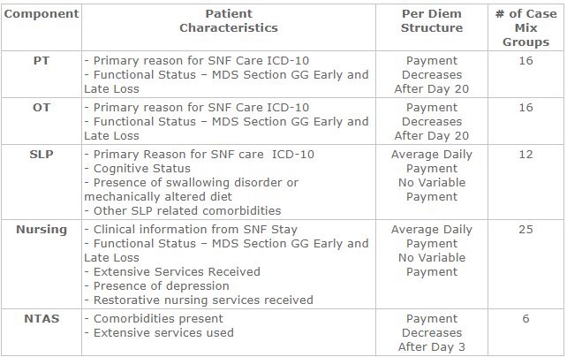
Where is CMS at with SNFs & PPS SBs
PDPM’s 5 clinically related components (from the MDS sections) are:
(Non-Therapy Ancillary)
PT, OT and SLP components are calculated regardless of whether the patient is receiving therapy or not.

Slide 36
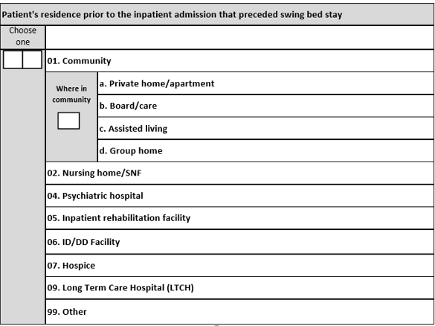
CMS changes in the MDS – Should we make changes?
CMS was going to ask about patient’s residence prior to the IP admission that preceded the SNF/SB stay but they opted to only ask as before which is where they were admitted from – this may change again by Oct. 1, 2019
I plan to recommend that we continue with this and maybe add where they were admitted from
Any Comments?

Slide 37
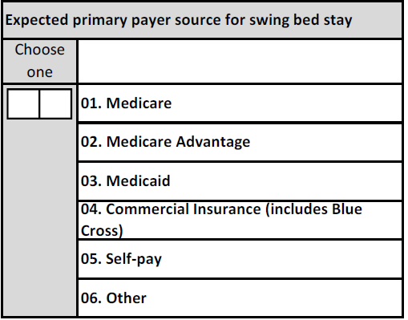
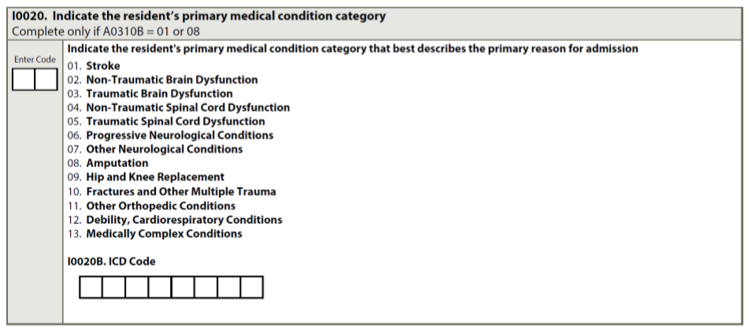
CMS changes in the MDS – Should we make changes?
Any recommendation to Stroudwater regarding payor choices?
CMS will keep the same choices for primary medical conditions – but have added primary
ICD-10 - purpose is for payment – not needed
for PI/QI

Slide 38
No Changes in Medical Condition Definition for Admission
Medical Condition/Reason – Definitions
Code 01, Stroke = if the patient’s primary medical condition category is due to stroke. Examples include ischemic stroke, subarachnoid hemorrhage, cerebral vascular accident (CVA), and other cerebrovascular disease.
Code 02, Non - Traumatic Brain Dysfunction = if the patient’s primary medical condition category is non-traumatic brain dysfunction. Examples include Alzheimer’s disease, dementia with or without behavioral disturbance, malignant neoplasm of brain, and anoxic brain damage.
Code 03, Traumatic Brain Dysfunction = if the patient’s primary medical condition category is traumatic brain dysfunction. Examples include traumatic brain injury, severe concussion, and cerebral laceration and contusion.
Code 04, Non - Traumatic Spinal Cord Dysfunction = if the patient’s primary medical condition category is non-traumatic spinal cord injury. Examples include spondylosis with myelopathy, transverse myelitis, spinal cord lesion due to spinal stenosis, and spinal cord lesion due to dissection of aorta.

Slide 39
Section I : Active Diagnosis
Medical Condition/Reason – Definitions (cont’)
Code 05, Traumatic Spinal Cord Dysfunction = if the patient’s primary medical condition category is due to traumatic spinal cord dysfunction. Examples include paraplegia and quadriplegia following trauma.
Code 06, Progressive Neurological Conditions = if the patient’s primary medical condition category is a progressive neurological condition. Examples include multiple sclerosis and Parkinson’s disease.
Code 07, Other Neurological Conditions = if the patient’s primary medical condition category is other neurological condition. Examples include cerebral palsy, polyneuropathy, and myasthenia gravis.
Code 08, Amputation = if the patient’s primary medical condition category is an amputation. An example is acquired absence of limb.
Code 09, Hip and Knee Replacement = if the patient’s primary medical condition category is due to a hip or knee replacement. An example is total knee replacement. If hip replacement is secondary to hip fracture, code as fracture.

Slide 40
Section I : Active Diagnosis
Medical Condition/Reason – Definitions (cont’)
Code 10, Fractures and Other Multiple Trauma , if the patient’s primary medical condition category is fractures and other multiple trauma. Examples include hip fracture, pelvic fracture, and fracture of tibia and fibula.
Code 11, Other Orthopedic Conditions = if the patient’s primary medical condition category is other orthopedic condition. An example is unspecified disorders of joint.
Code 12, Debility, Cardiorespiratory Conditions = if the patient’s primary medical condition category is debility or a cardiorespiratory condition. Examples include chronic obstructive pulmonary disease (COPD), asthma, and other malaise and fatigue.
Code 13, Medically Complex Conditions = if the patient’s primary medical condition category is a medically complex condition. Examples include diabetes, pneumonia, chronic kidney disease, open wounds, pressure ulcer/injury, infection, and disorders of fluid, electrolyte, and acid-base balance.

Slide 41
CMS changes in the MDS – Should we make changes?
CMS had suggested they would look at surgery for past 100 days as below
New MDS asks it as follows – no longer within 100 days – just during acute stay
If not used as a risk adjustment
indicator, is there benefit in collecting
and tracking this?
Or, do we want to add this as a
comparison between programs?
Generally, major surgery refers to a procedure that meets the following criteria:
1. the patient was an inpatient in an acute care hospital for at least one day in the 30 days prior to admission to SB/SNF, and
2. the surgery carried some degree of risk to the patient’s life or the potential for severe disability.

Slide 42
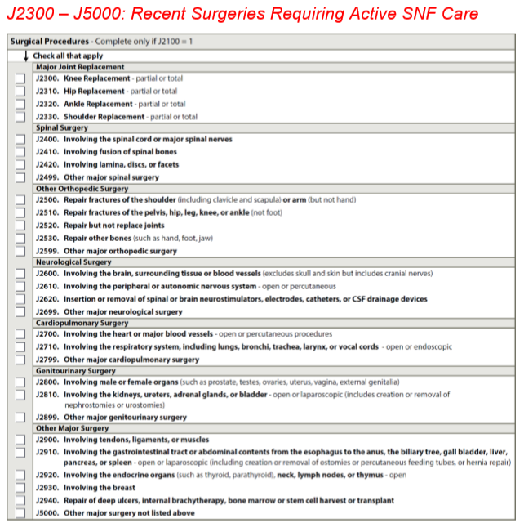
CMS changes in the MDS – Should we make changes?
CMS had added the following for payment purpose also – are to be checked if there are still needs while in SNF/SB
Do we want more specificity as this to compare between programs?

Slide 43
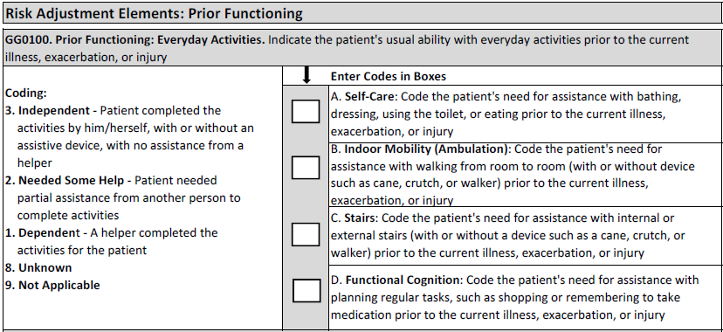
CMS changes in the MDS – Should we make changes?
If CMS does indeed use this info for risk adjustment, then we will keep for sure – would there be interest in comparing this info?
Note: Cane is not to be marked “D” Walker. If that is all they use, it would be marked “Z” None of the above

Slide 44
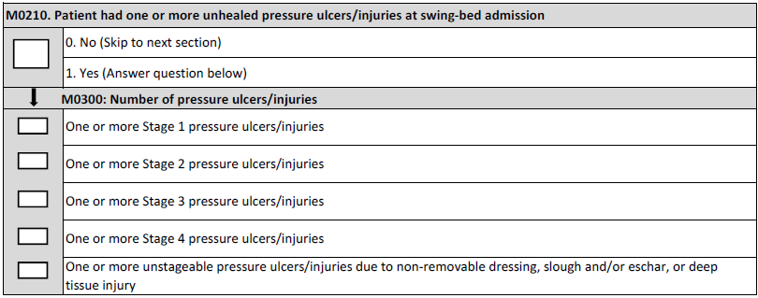
CMS changes in the MDS – Should we make changes?
Ulcers will no longer be a measure for QRP – should we remove?
Or do we want to change this and add at the beginning “Admitted for wound management – Yes of No”? Would we want to track and compare to better determine opportunities for SB utilization?
If so, are there other specific diagnosis / services we would want to add?
If BIMS is not used for Risk Adjustment, is that a helpful measure?

Slide 45
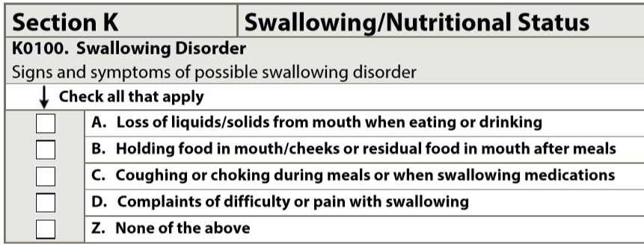
CMS changes in the MDS – Should we make changes?
If not part of risk adjustment, is there benefit in tracking?:
Falls (QI monitor)
Understand/Understood
Bowel/Bladder Incontinence
TPN / Tube Feeding (unless for more specific reason for admission)?
CMS added below – do we want to track to determine frequency?
Do we want to track and compare use of PT, OT and SLP? If so, just by discipline or days or minutes by discipline?
Do we want to add patient’s perception of pain management?

Slide 46
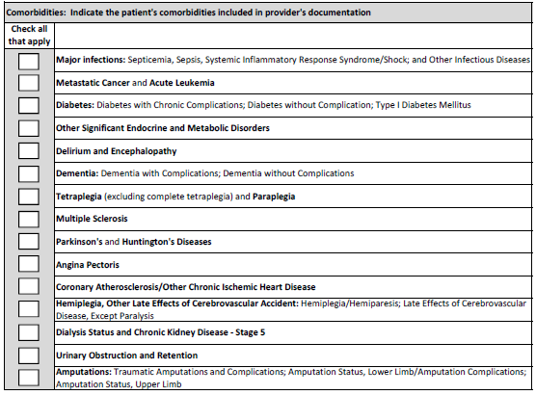
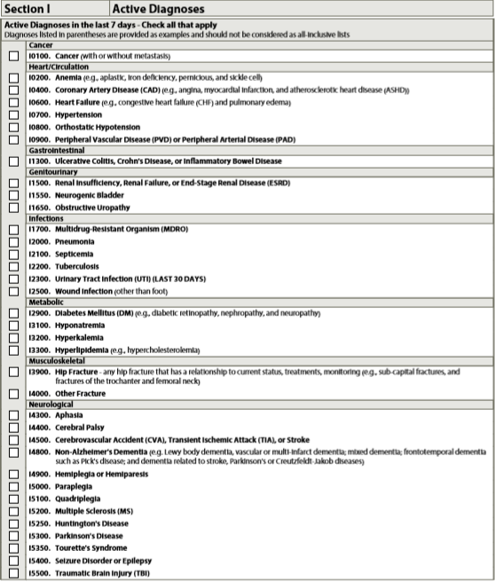
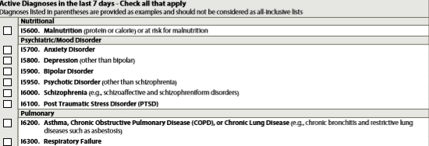
CMS changes in the MDS – Should we make changes?
This is what we presently have for comorbidities
Now
MDS for Oct 1, 2019
Unsure if this will change

Slide 47
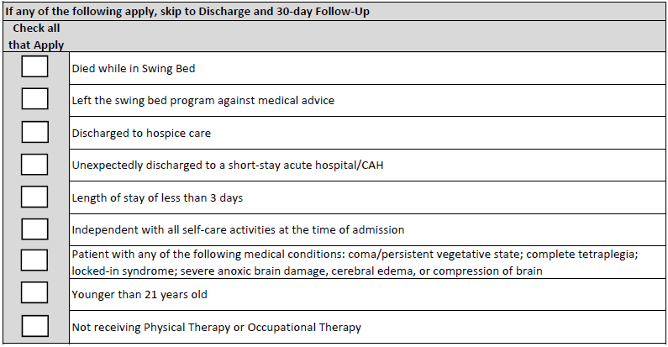
CMS changes in the MDS – Should we make changes?
This is the list of exceptions what we presently have for PI/QI – will probably not change – but ?? not receiving therapy… let’s discuss
Would there be interest in comparing this info between programs?

Slide 48
CMS changes in the MDS – Should we make changes?
No change in Functional Mobility sections but the following was reinforced or clarified:
Requires a team approach - This should not be a therapy only assessment – should be what patient’s usual performance is since admission – not just what they did with therapy
Must be completed within 3 days of admission (date of admission + 2 days)
The admission functional assessment, when possible, should be conducted prior to the person benefitting from treatment interventions in order to determine a true baseline functional status on admission.
Treatment should not be withheld in order to conduct the functional assessment
Activities may be completed with (if they usually use a device or safer attempted with a device) or without assistive device(s). Coding is not based on devices
Patients with cognitive impairments/limitations may need physical and/or verbal assistance when completing an activity. Code based on the patient’s need for assistance to perform the activity safely (for example, choking risk due to rate of eating, amount of food placed into mouth, risk of falling). These are at the very lease not independent – will be coded a 5 (supervision/set up) or lower
If the patient performs the activity more than once during the assessment period and the patient’s performance varies, coding should be based on the patient’s “usual performance,” not the most independent or dependent performance over the assessment period.

Slide 49
CMS changes in the MDS – Should we make changes?
Assess the patient’s self-care status based on:
direct observation,
the patient’s self-report,
family reports, and
direct care staff reports documented in the patient’s medical record during the assessment period
Discussion at May 2019 Section GG Training in Kansas City – If facility does not have 12 steps, but have a 4-step training step device, could use it and have the patient climb the step unit three times –not in the early release of the manual
Read the description of the items to be coded very carefully – do not read into it more than its asking – Must be able to perform all aspects of the described items to be considered Independent.
Carefully read the coding key descriptions and choose what best fits the patient – always look at the descriptions before and after the one you think it is to make sure you have the correct one
All assessment items must be attempted to be coded – otherwise a reason for no attempt must be coded (see slides on “Exceptions”)

Slide 50
CMS changes in the MDS – Should we make changes?
Same items will be tested on discharge but naturally no goal setting at discharge
Must be completed within 3 calendar days of discharge including the day of discharge
For the Discharge assessment, code the patient’s discharge functional status, based on a clinical assessment of the patient’s performance that occurs as close to the time of the patient’s discharge as possible to capture all areas of improvement possible
Same coding principles apply to discharge assessments as it did for the admission assessment and again, all assessment items must be attempted to be coded – otherwise a reason for no attempt must be coded
Patients should be allowed to perform activities as independently as possible for both admission and discharge, as long as they are safe for both admission & discharge assessments.
If helper assistance is required because the patient’s performance is unsafe or of poor quality, score according to the amount of assistance provided. Only use the “activity not attempted codes” if the activity did not occur; that is, the patient did not perform the activity and a helper did not perform that activity for the patient

Slide 51
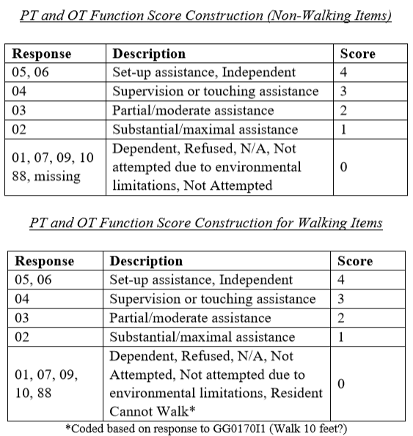
CMS changes in the MDS – Should we make changes?
Function scores are determined as follows in this chart – step 1
Should we add goal setting
to our measures?
Patients who are coded as unable to walk the 10 Ft receive the same score as dependent patients for that and all other “walk” activities to match with clinical expectations

Slide 52
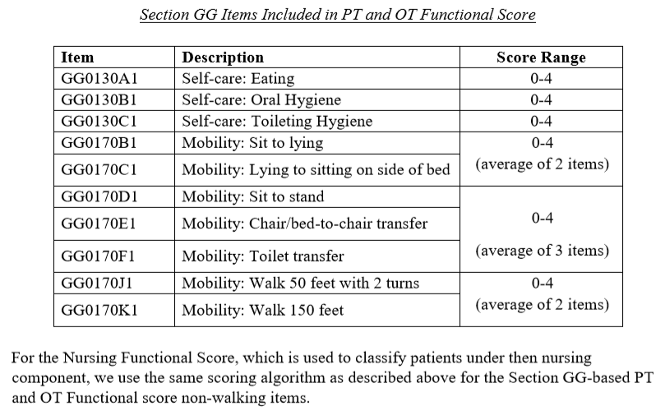
CMS changes in the MDS – Should we make changes?
Step 2 - measures functional areas with more than one item. This results in substantial overlap between the two bed mobility items, the three transfer items, and the two walking items
To adjust for this overlap, they calculate an average score for these related items.
That is, they average the scores for the two bed mobility items, the three transfer items, and the two walking items.
The average bed mobility, transfer, and walking scores are then summed with the scores for eating, oral hygiene, and toileting hygiene, resulting in equal weighting of the six activities
This scoring algorithm
produces a function score
that ranges from 0 to 24
We will review the QRP
before we finalize how we
will compare
FYI – Under PPS, CMS pays more
for patients moderate score.
Believe there is less therapy
needs with high score (closer
to Independent or low scores
(closer to dependent)

Slide 53
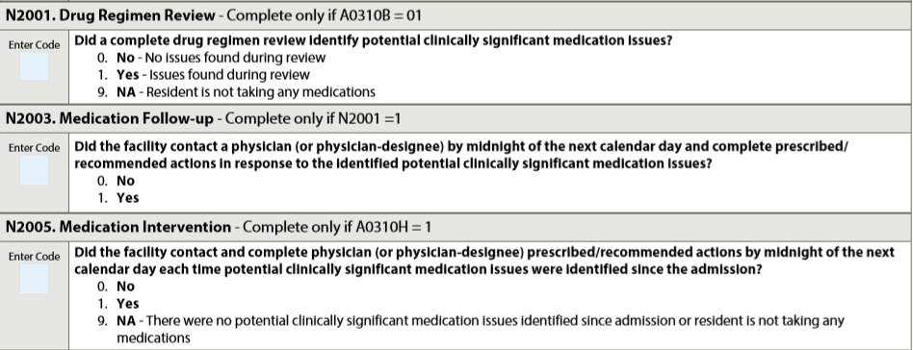
CMS changes in the MDS – Should we make changes?
One of the new QI/Measure is related to Medication Regimen Review
Should we add QI as CMS does for SNFs and PPS SBs?

Slide 54
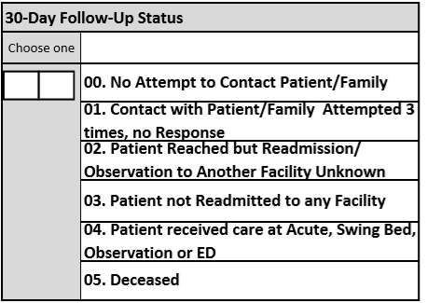
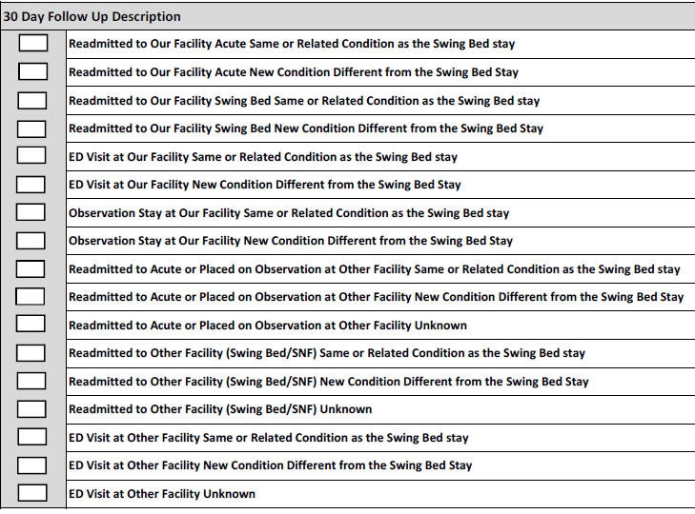
CMS changes in the MDS – Should we make changes?
Any recommended changes for follow-up calls?

Slide 55
Next Step & THANK YOU!
Working on your 0pportunities for improvement
Email Paula Knowlton from Stroudwater at pknowlton@stroudwater.com for any technical questions (add a person with access to data, data entry issues, pulling reports together…) – please cc me and Dianna
Write to me maryguyotconsulting@gmail.com with clinical questions or to share what you would like the web-based tool to be able to do
Writing to Paula or I, PLEASE clarify which hospital you are asking about especially if from same system (email name is not always sufficient!!)
Share the measure or process you have committed to improve with your team and agree on an action plan to do so
Come prepared to share what you worked on and outcome
Enter data for all July, August & September discharges by Oct. 5th
Enter 30-day follow-up data entry for all patients who have been discharged for 30 to 33 days by Oct 5th
Goal is for me to work with Stroudwater to have updated tool effective Oct 1 with all new hospitals trained
Mark Your Calendars – October 31st (on-site or webinar)
Oct plan is to offer training re: updated tool + discuss SB utilization

Slide 56
Remaining Questions?

