Slide 1

Diagnostic Stewardship
Strengthening Stewardship Through Diagnostic Excellence
Keegan Mason & Associates, LLC

Slide 2


Consulting Team
James m. keegan, MD
Randee Mason, RN, BSN, CPHQ
Keegan Mason & Associates, LLC

Slide 3
Antibiotic Stewardship includes Diagnostic Stewardship
Test Result leads to action or treatment
  Inclined to use Order Sets or Protocols
  Clinical Assessment/Critical Thinking Opportunity
Clinical examples
Keegan Mason & Associates, LLC

Slide 4

Diagnostic Stewardship for HAI Prevention
  Decreased CAUTI by 37%
  Decreased antibiotic use 40-60%
  Decreased C. Difficile by 31-58%
  Decreased antibiotic use 15-27%
  Decreased CLABSI by 36%
  Decreased antibiotic use 8-13%
Keegan Mason & Associates, LLC

Slide 5
Asymptomatic Bacteriuria (ASB)
ASB is COMMON.
Population | Prevalence
Healthy premenopausal women | 1–5%
Women 65–90 years old | 11–16%
Female long-term care residents | 25–50%
Male long-term care residents | 15–50%
Women with diabetes | 9–27%
Men with diabetes | 1–11%
People receiving hemodialysis | 25%
People with indwelling urinary catheters | > 90%
Keegan Mason & Associates, LLC

Slide 6
Treatment of ASB Is Not Beneficial And May Cause Harm
ASB does not require treatment
Randomized controlled trials have not shown that antibiotic treatment of ASB reduces subsequent risk of UTI
Treatment of ASB is associated with:
  Avoidable antibiotic-associated adverse events
  An increased risk of subsequent UTIs that may be increasingly difficult to treat due to the development of antibiotic resistance
Keegan Mason & Associates, LLC

Slide 7
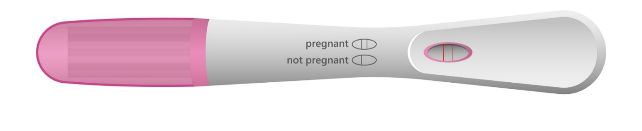
When is Screening/Treating for ASB indicated?
Guidelines recommend screening and treating for ASB in two situations:
  Early in pregnancy
    May prevent pyelonephritis, preterm labor, and low birth-weight infants
  Impending urologic procedure in which mucosal bleeding is expected
    May prevent urosepsis
Keegan Mason & Associates, LLC

Slide 8
Asymptomatic Pyuria
Pyuria is also COMMON.
Population | Prevalence
Young women | 32%
Pregnant women | 30-70%
Diabetic Women | 70%
Elderly institutionalized patients | 90%
Dialysis Patients | 90%
Patients with short term catheters | 1–11%
Patients with long term catheters | 25%
Pyuria in patients with Asymptomatic Bacteriuria is not an indication for antibiotic therapy
Other cause of pyuria to consider: sexually transmitted infections and interstitial nephritis
Keegan Mason & Associates, LLC

Slide 9
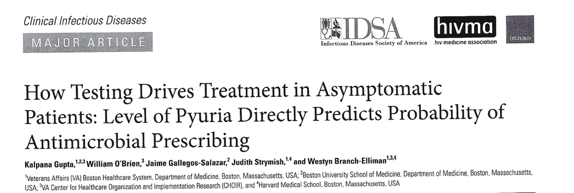
Pertinent Recent Literature
Keegan Mason & Associates, LLC

Slide 10
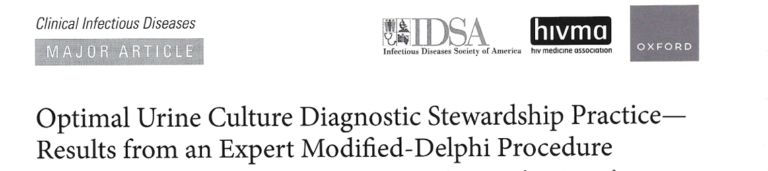
Pertinent Recent Literature
Keegan Mason & Associates, LLC

Slide 11
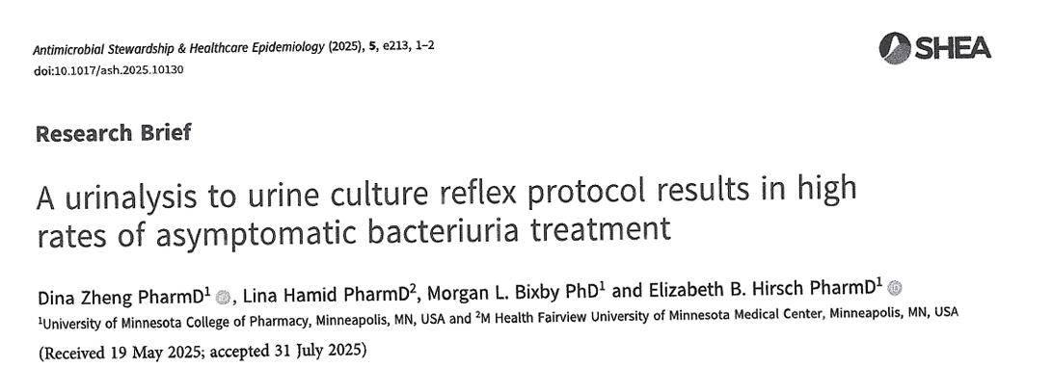
Pertinent Recent Literature
Keegan Mason & Associates, LLC

Slide 12

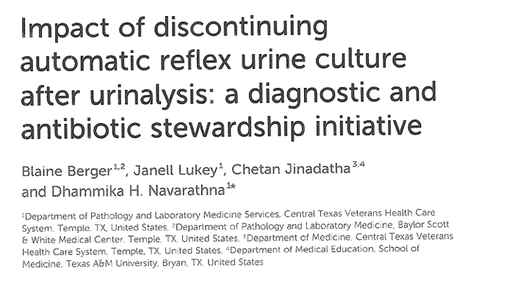
Pertinent Recent Literature
Keegan Mason & Associates, LLC

Slide 13
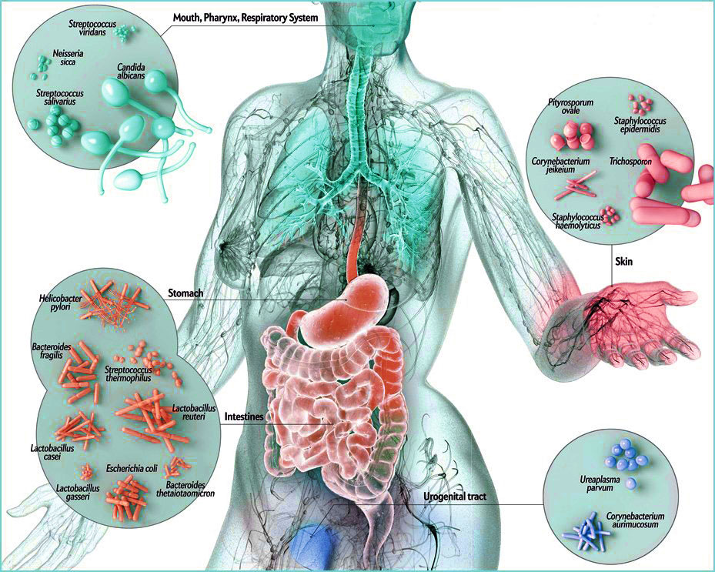
Microbiome Considerations
Normal genitourinary flora
Normal vaginal flora
Atrophic vaginitis flora
Treatment increases risk of UTI’s
Keegan Mason & Associates, LLC

Slide 14
Urinalysis and Urine Cultures
Send urinalysis (UA) (optional) and urine culture when patient has symptoms of UTI
How urine cultures are collected matters
Do not send urine cultures for
  Cloudy or foul-smelling urine
  Routinely on admission or preop
  Routinely before or after a catheter change
  As part of a fever work up if there are no signs or symptoms localizing to the urinary tract
  As a test of cure
Keegan Mason & Associates, LLC

Slide 15

Mental Status Changes and Asymptomatic Bacteriuria
Bacteriuria and delirium are each independently common in the elderly.
Although patients with a symptomatic UTI may present with delirium, falls, or confusion, these symptoms are unlikely to be the result of a UTI in the absence of urinary symptoms.
If a patient has signs of systemic infection and delirium, empiric antibiotic therapy is likely warranted.
Keegan Mason & Associates, LLC

Slide 16
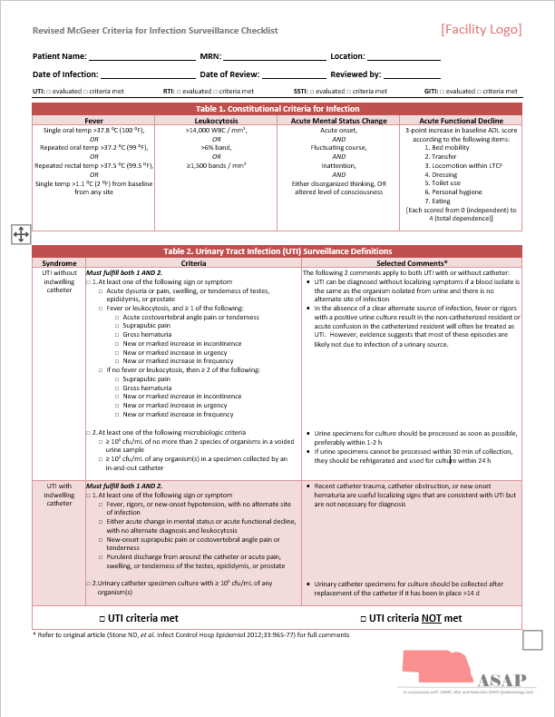
Important Considerations
Atrophic Vaginitis
LTC McGeer Criteria
#1 use of antibiotics in LTC is suspected UTI
Do not check a U/A or urine culture for cure
Indwelling catheter colonization
Keegan Mason & Associates, LLC

Slide 17

Recurrent UTI’s
Consider catheter acquired urine culture
Adequate fluid intake
Assess and treat for atrophic vaginitis
Cranberry juice
Lactobacillus containing probiotic
Keegan Mason & Associates, LLC

Slide 18

Urine Culture Results and Sensitivities in Rural Areas
90% of positive urine cultures are E. coli
Sensitivities
  Nitrofurantoin 98%
  Keflex 95%
  TMP/SMP 95%
Keegan Mason & Associates, LLC

Slide 19
Uncomplicated Cystitis Treatment
Drug | Duration Studied
Nitrofurantoin | 5 days
TMP/SMX | 3 days
Cephalexin | 7 days
Cefpodoxime | 3 days
Cefdinir | 5 days
Most patients can be treated for 3–5 days.
Back up treatment options: Ciprofloxacin and Fosfomycin
Keegan Mason & Associates, LLC

Slide 20
Take Home Messages
Send urine cultures only when you suspect UTIs based on clinical symptoms.
Asymptomatic bacteriuria is common and should not be treated in the vast majority of patients.
Select appropriate durations of therapy for cystitis, pyelonephritis, and complicated urinary tract infections.
  For uncomplicated cystitis this is generally 3–5 days.
Keegan Mason & Associates, LLC

Slide 21
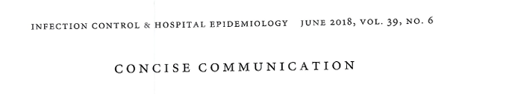
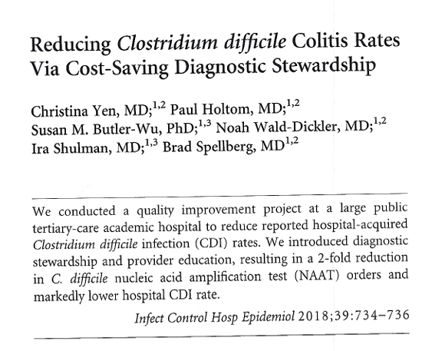
Pertinent Recent Literature
Keegan Mason & Associates, LLC

Slide 22
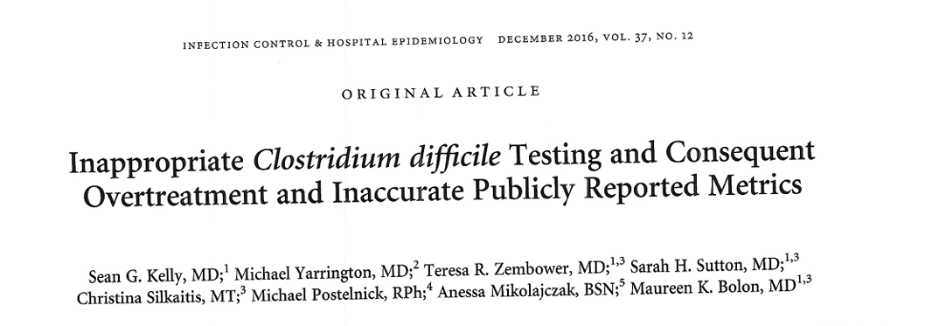
Pertinent Recent Literature
Keegan Mason & Associates, LLC

Slide 23
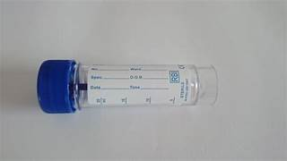
Testing to diagnosis Clostridioides difficile
Diagnostic Stewardship recommendations
  Only test if greater than 3 stools in less than 24 hours with patient not receiving laxatives.
  Do not test if patient receiving laxatives.
  Do not test formed or soft stool
  Do not recheck test within 7 days
  Do not test for cure
  Do not test asymptomatic patients.
Keegan Mason & Associates, LLC

Slide 24
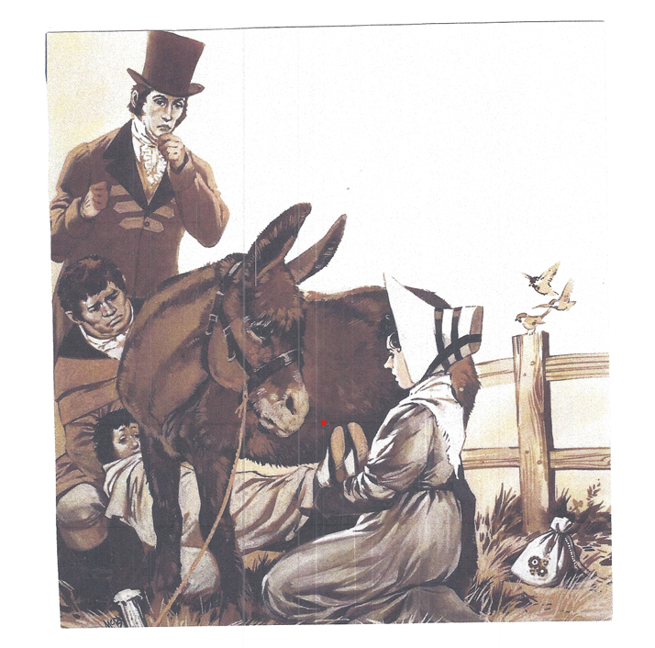
Whooping Cough/Pertussis treatment in the 1700’s
Keegan Mason & Associates, LLC

Slide 25
Questions and Discussion
James M. Keegan, MD
jkeegan@keeganmasonllc.com
Randee Mason, RN, BSN, CPHQ
rmason@keeganmasonllc.com
Keegan Mason & Associates, LLC

