Slide 1

We will get started at 1:00pm EST

Slide 2



Using Zoom
Would love to see you on video – please turn on your camera!
All lines are UNMUTED upon entry, you can MUTE yourself as needed
Click “chat” to open the chat box
Session is being recorded

Slide 3

MBQIP Summer 2020 Meeting Part Two
Barbara DeBaun, MSN, RN, CIC
Cynosure Health
West Virginia
July 15, 2020

Slide 4

BRN Contact Hours
To earn 2.0 BRN contact hours for attending today’s webinar:
  Complete and submit the post webinar Survey Monkey. A link to the survey will be sent via email after the webinar concludes.
  You must participate on the webinar for at least 100 minutes.
  Certificates will be issued via email within one week after submitting the survey.

Slide 5

Welcome from Dianna

Slide 6
Expectations
Each CAH to review HCAHPS scores and establish a goal of increasing our statewide care transition score by 5%

Slide 7

Kick it back to Barb

Slide 8
Polling Question
This best describes my ability to focus on MBQIP improvement work during the pandemic:
  I have not had a problem at all
  I am keeping up pretty well
  I am struggling

Slide 9
Learning Objectives
Describe strategies for improving patient understanding of medications
Discuss strategies for impacting patient ability to understand his/her responsibilities upon transition to home or other setting
Describe strategies for demonstrating that staff considered patient and family preferences regarding care needs upon transition to home or other setting

Slide 10
HCAHPS Composite 7 Care Transitions
During this hospital stay, staff took my preferences and those of my family or caregiver into account in deciding what my health care needs would be when I left
When I left the hospital, I had a good understanding of the things I was responsible for in managing my health
When I left the hospital, I clearly understood the purpose for taking each of my medications

Slide 11
Polling Question
Which of the three questions in Composite 7 do you score the LOWEST (WORST) in?
  Considering patient preferences
  Patient responsibility post discharge
  Understanding medications
  No difference in scores
  I don’t know

Slide 12
Polling Question
Which of the three questions in Composite 7 do you score the HIGHEST (BEST) in?
  Considering patient preferences
  Patient responsibility post discharge
  Understanding medications
  No difference in scores
  I don’t know

Slide 13

Our Journey So Far

Slide 14
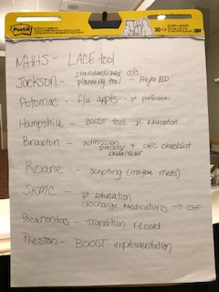
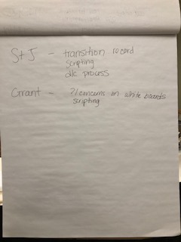
January 28, 2020 B.C.

Slide 15

April 23, 2020: We shared some small tests of change…

Slide 18
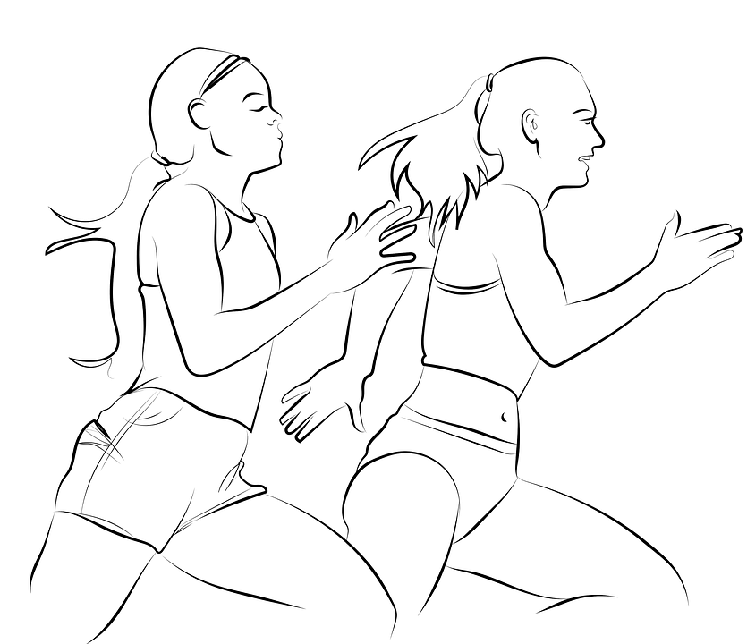
Are you ready to sprint?

Slide 19
Hospital Round Table Discussion
Which survey question is dragging you down the most?
  During this hospital stay, staff took my preferences and those of my family or caregiver into account in deciding what my health care needs would be when I left
  When I left the hospital, I had a good understanding of the things I was responsible for in managing my health
  When I left the hospital, I clearly understood the purpose for taking each of my medications
Share one or two of your small tests of change
What did you learn?
Any tools, tips, tricks to share?

Slide 20
Boone Memorial
Which survey question is dragging you down the most?
  During this hospital stay, staff took my preferences and those of my family or caregiver into account in deciding what my health care needs would be when I left
  When I left the hospital, I had a good understanding of the things I was responsible for in managing my health
  When I left the hospital, I clearly understood the purpose for taking each of my medications
Share one or two of your small tests of change
What did you learn?
Any tools, tips, tricks to share?

Slide 21
Broaddus Hospital
Which survey question is dragging you down the most?
  During this hospital stay, staff took my preferences and those of my family or caregiver into account in deciding what my health care needs would be when I left
  When I left the hospital, I had a good understanding of the things I was responsible for in managing my health
  When I left the hospital, I clearly understood the purpose for taking each of my medications
Share one or two of your small tests of change
What did you learn?
Any tools, tips, tricks to share?

Slide 22
Grafton City Hospital
Which survey question is dragging you down the most?
  During this hospital stay, staff took my preferences and those of my family or caregiver into account in deciding what my health care needs would be when I left
  When I left the hospital, I had a good understanding of the things I was responsible for in managing my health
  When I left the hospital, I clearly understood the purpose for taking each of my medications
Share one or two of your small tests of change
What did you learn?
Any tools, tips, tricks to share?

Slide 23
Grant Memorial
Which survey question is dragging you down the most?
  During this hospital stay, staff took my preferences and those of my family or caregiver into account in deciding what my health care needs would be when I left
  When I left the hospital, I had a good understanding of the things I was responsible for in managing my health
  When I left the hospital, I clearly understood the purpose for taking each of my medications
Share one or two of your small tests of change
What did you learn?
Any tools, tips, tricks to share?

Slide 24
Hampshire Memorial
Which survey question is dragging you down the most?
  During this hospital stay, staff took my preferences and those of my family or caregiver into account in deciding what my health care needs would be when I left
  When I left the hospital, I had a good understanding of the things I was responsible for in managing my health
  When I left the hospital, I clearly understood the purpose for taking each of my medications
Share one or two of your small tests of change
What did you learn?
Any tools, tips, tricks to share?

Slide 25
Minnie Hamilton Health System
Which survey question is dragging you down the most?
  During this hospital stay, staff took my preferences and those of my family or caregiver into account in deciding what my health care needs would be when I left
  When I left the hospital, I had a good understanding of the things I was responsible for in managing my health
  When I left the hospital, I clearly understood the purpose for taking each of my medications
Share one or two of your small tests of change
What did you learn?
Any tools, tips, tricks to share?

Slide 26
Mon Health Preston Memorial
Which survey question is dragging you down the most?
  During this hospital stay, staff took my preferences and those of my family or caregiver into account in deciding what my health care needs would be when I left
  When I left the hospital, I had a good understanding of the things I was responsible for in managing my health
  When I left the hospital, I clearly understood the purpose for taking each of my medications
Share one or two of your small tests of change
What did you learn?
Any tools, tips, tricks to share?

Slide 27
Montgomery General
Which survey question is dragging you down the most?
  During this hospital stay, staff took my preferences and those of my family or caregiver into account in deciding what my health care needs would be when I left
  When I left the hospital, I had a good understanding of the things I was responsible for in managing my health
  When I left the hospital, I clearly understood the purpose for taking each of my medications
Share one or two of your small tests of change
What did you learn?
Any tools, tips, tricks to share?

Slide 28
Plateau Medical Center
Which survey question is dragging you down the most?
  During this hospital stay, staff took my preferences and those of my family or caregiver into account in deciding what my health care needs would be when I left
  When I left the hospital, I had a good understanding of the things I was responsible for in managing my health
  When I left the hospital, I clearly understood the purpose for taking each of my medications
Share one or two of your small tests of change
What did you learn?
Any tools, tips, tricks to share?

Slide 29
Pocahontas Memorial
Which survey question is dragging you down the most?
  During this hospital stay, staff took my preferences and those of my family or caregiver into account in deciding what my health care needs would be when I left
  When I left the hospital, I had a good understanding of the things I was responsible for in managing my health
  When I left the hospital, I clearly understood the purpose for taking each of my medications
Share one or two of your small tests of change
What did you learn?
Any tools, tips, tricks to share?

Slide 30
Roane General
Which survey question is dragging you down the most?
  During this hospital stay, staff took my preferences and those of my family or caregiver into account in deciding what my health care needs would be when I left
  When I left the hospital, I had a good understanding of the things I was responsible for in managing my health
  When I left the hospital, I clearly understood the purpose for taking each of my medications
Share one or two of your small tests of change
What did you learn?
Any tools, tips, tricks to share?

Slide 31
Sistersville General
Which survey question is dragging you down the most?
  During this hospital stay, staff took my preferences and those of my family or caregiver into account in deciding what my health care needs would be when I left
  When I left the hospital, I had a good understanding of the things I was responsible for in managing my health
  When I left the hospital, I clearly understood the purpose for taking each of my medications
Share one or two of your small tests of change
What did you learn?
Any tools, tips, tricks to share?

Slide 32
WVU Medicine – Braxton County Memorial
Which survey question is dragging you down the most?
  During this hospital stay, staff took my preferences and those of my family or caregiver into account in deciding what my health care needs would be when I left
  When I left the hospital, I had a good understanding of the things I was responsible for in managing my health
  When I left the hospital, I clearly understood the purpose for taking each of my medications
Share one or two of your small tests of change
What did you learn?
Any tools, tips, tricks to share?

Slide 33
WVU Medicine – Jackson General
Which survey question is dragging you down the most?
  During this hospital stay, staff took my preferences and those of my family or caregiver into account in deciding what my health care needs would be when I left
  When I left the hospital, I had a good understanding of the things I was responsible for in managing my health
  When I left the hospital, I clearly understood the purpose for taking each of my medications
Share one or two of your small tests of change
What did you learn?
Any tools, tips, tricks to share?

Slide 34
WVU Medicine – Jefferson Memorial
Which survey question is dragging you down the most?
  During this hospital stay, staff took my preferences and those of my family or caregiver into account in deciding what my health care needs would be when I left
  When I left the hospital, I had a good understanding of the things I was responsible for in managing my health
  When I left the hospital, I clearly understood the purpose for taking each of my medications
Share one or two of your small tests of change
What did you learn?
Any tools, tips, tricks to share?

Slide 35
WVU Medicine – Potomac Valley
Which survey question is dragging you down the most?
  During this hospital stay, staff took my preferences and those of my family or caregiver into account in deciding what my health care needs would be when I left
  When I left the hospital, I had a good understanding of the things I was responsible for in managing my health
  When I left the hospital, I clearly understood the purpose for taking each of my medications
Share one or two of your small tests of change
What did you learn?
Any tools, tips, tricks to share?

Slide 36
WVU Medicine – St. Joseph’s
Which survey question is dragging you down the most?
  During this hospital stay, staff took my preferences and those of my family or caregiver into account in deciding what my health care needs would be when I left
  When I left the hospital, I had a good understanding of the things I was responsible for in managing my health
  When I left the hospital, I clearly understood the purpose for taking each of my medications
Share one or two of your small tests of change
What did you learn?
Any tools, tips, tricks to share?

Slide 37
WVU Medicine – Summersville Regional Medical Center
Which survey question is dragging you down the most?
  During this hospital stay, staff took my preferences and those of my family or caregiver into account in deciding what my health care needs would be when I left
  When I left the hospital, I had a good understanding of the things I was responsible for in managing my health
  When I left the hospital, I clearly understood the purpose for taking each of my medications
Share one or two of your small tests of change
What did you learn?
Any tools, tips, tricks to share?

Slide 38
War Memorial
Which survey question is dragging you down the most?
  During this hospital stay, staff took my preferences and those of my family or caregiver into account in deciding what my health care needs would be when I left
  When I left the hospital, I had a good understanding of the things I was responsible for in managing my health
  When I left the hospital, I clearly understood the purpose for taking each of my medications
Share one or two of your small tests of change
What did you learn?
Any tools, tips, tricks to share?

Slide 39
Webster Memorial
Which survey question is dragging you down the most?
  During this hospital stay, staff took my preferences and those of my family or caregiver into account in deciding what my health care needs would be when I left
  When I left the hospital, I had a good understanding of the things I was responsible for in managing my health
  When I left the hospital, I clearly understood the purpose for taking each of my medications
Share one or two of your small tests of change
What did you learn?
Any tools, tips, tricks to share?

Slide 40

Post-sprint recovery

Slide 41
Let’s Revisit Learning Objectives
Describe strategies for improving patient understanding of medications
Discuss strategies for impacting patient ability to understand his/her responsibilities upon transition to home or other setting
Describe strategies for demonstrating that staff considered patient and family preferences regarding care needs upon transition to home or other setting

Slide 42

What will YOU test next?

Slide 43
Questions
What will you test next?
How will you know if it is helping?
How will you plan your next STOC?

Slide 44
Send your plan for next steps to Dianna

Slide 45

Closing comments and next steps

Slide 46
BRN Contact Hours
To earn 2.0 BRN contact hours for attending today’s webinar:
  Complete and submit the post webinar Survey Monkey. A link to the survey will be sent via email after the webinar concludes.
  You must participate on the webinar for at least 100 minutes.
  Certificates will be issued via email within one week after submitting the survey.

Slide 47
Please complete the survey
https://www.surveymonkey.com/r/RK7SSBG

