Slide 1
Office Hours for W VA MBQIP Discussion
Barbara DeBaun, MSN, RN, CIC
Improvement Advisor Cynosure Health
February 19, 2020

Slide 2
We will get started at 1:30pm EST

Slide 3
Hi, I’m Barb…today’s facilitator

Slide 4
Office Hour Introduction

Slide 5
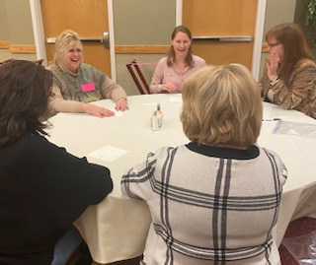
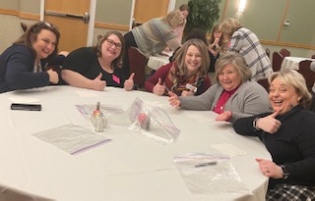
Our recent gathering in Bridgeport

Slide 6
State of the State

Slide 8
Transitions of Care

Slide 9
Understanding your care when you left the hospital
During this hospital stay, staff took my preferences and those of my family or caregiver into account in deciding what my health care needs would be when I left
When I left the hospital, I had a good understanding of the things I was responsible for in managing my health
When I left the hospital, I clearly understood the purpose for taking each of my medications

Slide 10
INTERVENTIONS Scripting: “Reminds” patient/families of the “Right” answers!
PREFERENCES
Do you have a “PREFERENCE” in home health providers?
Do you have a “PREFERENCE” in which pharmacy you use?
Do you have a “PREFERENCE” in times or days we can schedule your follow-up visit?
Do you have a “PREFERENCE” when we call to check on you after you are discharged?
RESPONSIBILITIES
You are “RESPONSIBLE” for taking your medicines and following up with your doctor as scheduled
MEDICATION UNDERSTANDING
ALWAYS provide the name, dose, purpose and side effects of each medication every single time!
I want to go over your medications again so when you get home you will “UNDERSTAND THE PURPOSE FOR TAKING EACH MEDICATION”.
Pharmacy will also speak with you about your medications before you are discharged

Slide 11
This is what we agreed to
Each CAH is expected to review HCAHPS scores and establish a goal of increasing our statewide care transition score by 5%

Slide 12
It’s your time to share…what small test of change have you explored?

