Slide 1
CAH Swing Bed Program
Documentation Guideline Webinar
April 29, 2020
Mary Guyot Consulting
207-650-5830 (cell/text)
maryguyotconsulting@gmail.com

Slide 2
Objectives
Identify Medicare Eligibility & Basic Documentation Requirements for skilled care
Recollect and discuss acceptable admission criteria for skilled care
Discuss best practice in day-to-day documentation
Determine opportunities for improvement in your EMR system

Slide 3
Disclaimer
This information was prepared with the best of intention using CMS such as State Operations Manual, Claims Processing Manual, Medicare Benefit Policy Manual and other resources for regulations and is not intended to grant rights or impose obligations. This presentation may contain references or links to statutes, regulations, or other policy materials. The information provided is only intended to be a general summary. It is not intended to take the place of either the written law or regulations. We encourage participants to review the specific statutes, regulations and other interpretive materials for a full and accurate statement of their contents.

Slide 4
Medicare Eligibility & Basic Documentation Requirements
Letter of Certification for provision of swing bed services from Medicare
Be able to demonstrate the 3 midnight stay in an acute bed of a hospital (Observation days do not count)
Skilled stay must be initiated within 30 days of the acute hospitalization unless there is documentation of medical appropriateness / physician hold delay such as in a non-weight bearing ortho patient
Must have documented skilled needs which are related to the acute stay
Diagnosis and prognosis do NOT determine what is skilled care—it is the care of the patient (service provided) that is the deciding factor
The facility must maintain clinical records on each patient in accordance with accepted professional standards and practices that are:
Complete
Accurately documented
Readily accessible
Systematically organized

Slide 5
Medicare Eligibility & Basic Documentation Requirements
Cert/Recert for each admission – There are no requirements to use a cert/recert form but QIOs state that regardless, the provider must include such in his/her documentation.
Remember that a pre-typed note stating “I certify that…” is not sufficient. Admission H&P, progress notes etc.. must support why they believe this patient needs an IP skilled care program
On-going provider progress notes must support why the patient needs to remain in the program and the projected timeframe – important that provider discuss the status of the patient with the team both for medical and functional updates related to skilled needs during their visit
Both admission and on-going documentation should be self-explanatory
Diagnosis and comorbidities must have a direct relationship to the patient’s current functional status, cognitive status, mood or behavior, medical treatments, nursing monitoring, or risk of death
The chart may be in the same record but clearly identified as a new SB stay – regardless, billing will need a new account # though same medical record #

Slide 6
Skilled Care Admission Criteria
Rendered for a condition for which the patient was receiving inpatient hospital services
Can be what the patient was admitted to acute for or developed or worsened while an inpatient (example – patient was admitted to acute with COPD and it is identified that his Parkinson has worsen and is interfering with his participation with ADLs. He will need skilled rehab to learn/relearn how to perform ADL effectively. and safely to remain/regain independence)
Service must be so inherently complex of a service prescribed for a beneficiary that it can be performed safely and/or effectively only by or under the general supervision of skilled nursing or skilled rehabilitation personnel; then the documentation must reflect potential medical complications that require the provision of the services by skilled personnel
The patient requires skilled services on a daily basis
Nursing: 7 days a week
Rehabilitation: at or >5 days a week (can be less if nursing 7 days/wk but better be well documented why he needs daily nursing – otherwise could be home with HH)

Slide 7
Skilled Care Admission Criteria (cont’)
As a practical matter daily services is best provided in an IP skilled care program and the documentation reflects such
Daily skilled services not available on an outpatient basis in the area in which the individual resides
The intensity of the therapy is more than available thru OP or HH
The medical complexity of the patient is more than could be cared for at home
Less than the 24 hour/day care would impose safety risks or an adverse impact on the patient’s medical condition.
When considering economy and efficiency, the daily skilled services can be provided only on an inpatient basis in a SB/SNF
Transportation to the closest facility would be: – An excessive physical hardship; – Less economical; or – Less efficient or effective than an inpatient institutional setting
Lack of appropriate support at home
Unsafe environment at home (cleanliness, high incidence of infection, drug use etc…)

Slide 8
Skilled Care Admission Criteria (cont’)
Examples: As a practical matter the patient requires an IP program
A patient needs skilled PT and can walk only with supervision but, has a reasonable potential to learn to walk independently. Physical therapy is available on a home care basis, but the patient would be at risk for further injury from falling, dehydration, or malnutrition because there was insufficient supervision and assistance at home – This passes the “practical matter test” as PT can be provided effectively only in the inpatient setting
Patient admitted to the SB/SNF for BID IV antibiotics every 12 hours. After his morning infusion, he drove himself to his house to care for the cat and pay his bills. He returned in the evening just in time for his PM infusion then spent his time at the entrance of the hospital with his friends. – This does not pass the “practical matter test” as IVs could be provided using home health care
Diagnosis alone should never be the sole factor in deciding that a service is or is not skilled (for instance, post major surgery patients may not all have skilled needs on an IP basis)
Prognosis alone should never be the sole factor in deciding that a service is or is not skilled hospitalization
Even if full recovery or medical improvement is not possible, a patient may need skilled services to prevent further deterioration or preserve current capabilities such in the case or a short-term end-of-life admission

Slide 9
Skilled Care Admission Criteria (cont’)
Services must be reasonable and necessary
Consistent with the nature and severity of the individual’s illness or injury
Within accepted standards of medical practice
Anticipated length of stay must be reasonable in terms of duration and quantity
Appropriate per level of caregiver
Appropriate intensity of services
Skilled rehab requires the skills of a therapist, - services which can be safely and effectively carried out by non-skilled personnel without the supervision of qualified professionals is not a skilled need
The documentation must also show that the services are appropriate in terms of duration and quantity, and that the services promote the documented therapeutic goals.
Skilled therapy can be offered even for chronic or terminal illness for:
Self-care, mobility, safety dependence
Need for assistive equipment
In other words, a patient on comfort care does not necessarily mean no therapy
Skilled need is not determined by the diagnosis or condition, it’s what you are doing about it that determines skilled level of care

Slide 10
Skilled Care Admission Criteria (cont’)
Nursing skilled needs may be direct, indirect or nursing rehab (restorative)
Nursing services are considered skilled when they are so inherently complex that they can be safely and effectively performed only by, or under the supervision of, a registered nurse or, when provided by regulation, a licensed practical (vocational) nurse
Must have individualized assessment of the patient’s clinical condition showing that specialized judgment, knowledge, and skills of an RN or LPN/LVN (when provided by regulation) are necessary
There must be documentation that shows the need for an RN or LPN based on regulation to support what the skill is, why, assessment, outcome etc… (documentation to be discussed later)

Slide 11
Skilled Care Admission Criteria (cont’)
Direct
Nursing skilled needs may be direct, indirect or nursing rehab (restorative)
Examples of direct nursing skills are:
Daily IV or IM injections and IV feeding
Enteral feeding with ≥ 26% of calories and ≥ 501 ml fluid per day
New G/J tube are considered skilled for the full 100 days if needed (let’s discuss)
Nasopharyngeal and tracheostomy suctioning – Not oral suctioning
Insertion, sterile irrigation and replacement of suprapubic catheters – Not routine maintenance of stable indwelling bladder catheters
Dressing change with prescription medication and aseptic techniques –Not changes of dressings for uninfected postoperative or chronic conditions
Treatment of decubitus ulcers, of a severity rated at Stage 3 or worse, or a widespread skin disorder
Care of a colostomy during the early post-operative period in the presence of associated complications
Initial phases of O2 administration
New RT treatment provided by RT or nursing until acute phase is managed or on a maintenance program
Heat treatments ordered by the physician as part of active treatment which require observation by nurses to adequately evaluate the patient’s progress

Slide 12
Skilled Care Admission Criteria (cont’)
Direct
Nursing skilled needs (cont’)
Examples of direct nursing skills are: (cont’)
Skilled nursing rehab/restorative on at least 6 days/week usually as a maintenance program
Range of motion (passive) or (active)
Splint or brace assistance
Bed mobility
Transfer
Walking
Dressing and/or grooming
Eating and/or swallowing
Amputation/prostheses care
Communication
To count as a skilled need, there needs to be an assessment, improvement goal, treatment plan (what and frequency), documentation of the rehab activities with outcome…, weekly reassessment
Staff providing the activities must have documented competencies in providing these services with the intent to restore the patient’s capabilities

Slide 13
Skilled Care Admission Criteria (cont’)
Nursing skilled needs (cont’)
Examples of indirect skills are:
If the documentation of the patient’s overall condition substantiates a finding that the patient’s medical needs and safety can be addressed only if the total care, skilled or not, is planned and managed by skilled nursing personnel, it is appropriate to infer that skilled management is being provided, but only if the record as a whole clearly establishes that there was a likely potential for serious complications without skilled management (Ch. 8 MBPM 30.2.3.1)
Management & Evaluation
of Care Plan
Indirect

Slide 14
Skilled Care Admission Criteria (cont’)
Observation and Assessment of Patient’s Condition
Indirect
Examples of indirect skills are:
May be coverable when likelihood of adverse change in condition require skilled nursing personnel to identify and evaluate the need for treatment modification or initiation of additional medical procedures until treatment regimen is stable
Requires documentation of what is to be observed
Patient’s condition is unstable for medical reasons – Risk for occurrence of acute problem – Skills of a licensed nurse are required on a daily basis to identify potential worsening of medical issues and to prevent return to acute. Examples: COPD, CHF, recent MI, medication changes, complications of pneumonia, immobility, post CABG surgery
Support why they need an IP program vs just getting therapy they could receive on an OP basis
May be coverable when likelihood of adverse change in condition require skilled nursing personnel to identify and evaluate the need for treatment modification or initiation of additional medical procedures until treatment regimen is stable
The fact that the patient did not develop an acute episode or complications does not mean that the stay will be denied as long as there was a reasonable probability that it might have occurred

Slide 15
Skilled Care Admission Criteria (cont’)
Indirect
Teaching and Training
Examples of indirect skills are:
Teaching and training activities, which require skilled nursing or skilled rehabilitation personnel to teach a patient how to manage their treatment regimen would constitute skilled services
Examples: Teaching the patient how to:
Self administer:
Injectable meds or a complex range of meds
Medical gases
Enteral feedings - G-tube feedings, flushes
Care for:
Ostomy - Recent colostomy or ileostomy
Central venous lines management
Prosthesis (includes gait training)
Self-catheterization
Use and care of braces, splints, and orthotics and any associated skin care
Proper care of any specialized treatments or dressings
New diabetic care: glucose monitoring, S&S of hyper & hypoglycemia, insulin, foot care, what to report when and to whom
How to become more independent in self care and mobility
Ideal to have the basics of:
Care planned education needs
What is to be covered for each topic (stop light instructions)
When done, patient/family response & continued needs
Ideally on an interdisciplinary Patient Education form where all staff document

Slide 16
Skilled Care Admission Criteria (cont’)
Therapy skilled rehab on a daily basis
Therapy services are considered skilled when they are so inherently complex that they can be safely and effectively performed only by, or under the supervision of, a qualified therapist (42CFR §409.32)
Services must meet standard of medical practice (amount and type)
The services must be considered reasonable, effective treatments for the patient’s condition and require the skills of a therapist
If the service can be safely and effectively carried out by non-skilled personnel without the supervision of qualified professionals, IT IS NOT SKILLED
Be provided with the expectation that the patient’s condition will measurably improve in a generally predictable timeframe (except for comfort care as discussed earlier) Or to establish a safe and effective maintenance program for discharge to community
Therapy skilled rehab must include the following:
Based on initial evaluation
Related to active written treatment plan based on documented reasons for such (why is it a need for this patient)
Documentation should support the need for an IP program
Performed by a qualified therapist
Physician’s order and approved treatment plan (discuss clarification order or signed treatment plan)

Slide 17
Non-Skilled Care Needs (examples)
Does not mean this is not done but there have to be other skilled needs for the patient to be here
Administration of routine oral medications, eye drops, and ointments (the fact that patients cannot be relied upon to take such medications themselves or that State law requires all medications to be dispensed by a nurse to institutional patients would not change this service to a skilled service);
General maintenance care of colostomy and ileostomy;
Routine services to maintain satisfactory functioning of indwelling bladder catheters (this would include emptying and cleaning containers and clamping the tubing);
Changes of dressings for uninfected post-operative or chronic conditions;
Prophylactic and palliative skin care, including bathing and application of creams, or treatment of minor skin problems;
Routine care of the incontinent patient, including use of diapers and protective sheets;
General maintenance care in connection with a plaster cast (skilled supervision or observation may be required where the patient has a preexisting skin or circulatory condition or requires adjustment of traction);
Routine care in connection with braces and similar devices;

Slide 18
Non-Skilled Care Needs (examples)
Use of heat as a palliative and comfort measure, such as whirlpool or steam pack;
Routine administration of medical gases after a regimen of therapy has been established (i.e., administration of medical gases after the patient has been taught how to institute therapy or the treatment becomes routine);
Assistance in dressing, eating, and going to the toilet; (unless training the patient to become more independent with ADLs)
Periodic turning and positioning in bed; and
General supervision of exercises, which have been taught to the patient and the performance of repetitious exercises that do not require skilled rehabilitation personnel for their performance.
This includes the actual carrying out of maintenance programs where the performances of repetitive exercises that may be required to maintain function do not necessitate a need for the involvement and services of skilled rehabilitation personnel.
It also includes the carrying out of repetitive exercises to improve gait, maintain strength or endurance; passive exercises to maintain range of motion in paralyzed extremities which are not related to a specific loss of function; and assistive walking. (See Medicare Benefit Policy Manual, Chapter 1, “Inpatient Hospital Services.”)

Slide 20
What Does Document Represent?
Services provided and the patient’s response
Assessment of patient’s condition and needs
Interventions to meet needs
Person-centered and comprehensive care plan
Effectiveness of treatment, education, training and services/interventions
Administration of medications and treatments
Interactions with patient, families, physicians and other healthcare personnel (document when you reach now to notify or discuss issues)
Supports Reimbursement from Medicare, Medicare Advantage and other third-party payors as well as QIOs and RAC reviews
Supports what surveyors review
Quality measures

Slide 21
Who Should Document?
Provider(s) and Consulting Specialists
Care Manager / Discharge Planner (to be covered on the 5/14/2020 webinar re: Discharge Planning
Nursing
Therapy (if applicable)
Nutrition / Dietician
Resp. Therapy (if applicable)
Social Worker (if applicable)
Pharmacist, Health Educator etc.. as applicable
What should documentation contain?

Slide 22
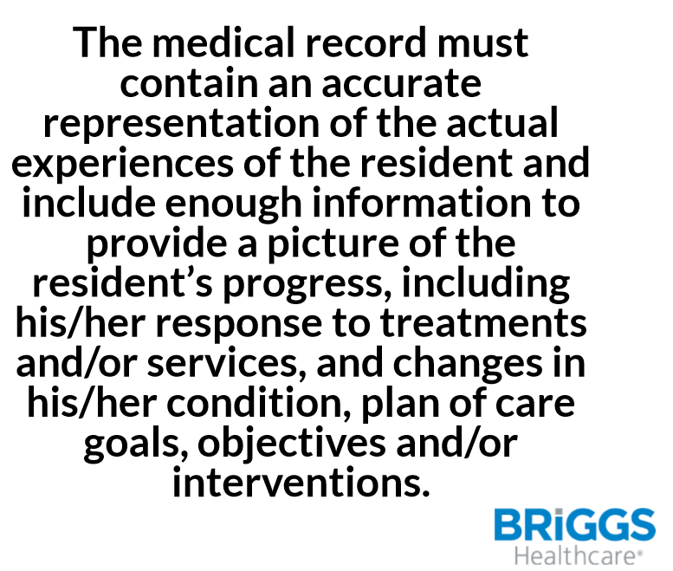
Regulatory Language –F842

Slide 23
Provider Documentation
MD/DO to write a discharge order from acute and admission orders to SB and all other orders included in the treatment plan – may not have the nurse write the medication orders based on acute list
MD/DO to complete admission H&P and treatment plan ensuring documentation to support medical necessity for an IP program within 24-48hrs based on hospital’s medical regulations
May use the H&P from acute but must have an initial progress note stating that the H&P was reviewed and current or the H&P and the Discharge Summary from acute are used to demonstrate the patient’s condition update and treatment plan
Initial progress note should have an updated picture of the patient and why does he/she need IP skilled care (if discharge summary is not complete)
For those participating in MDS or the SB PI/QI project, it is important to have physician documentation that supports the admission medical condition grouping as well as any and all comorbidities
And like in acute care, coders need documentation to support all diagnosis for the chart closing and for billing (UB-04)
Documentation needs to be more specific if the skilled need is related to management & evaluation for care plan or observation & assessment of patient’s condition

Slide 24
Provider Documentation (cont’)
All other visits in a SB may be completed and documented by a NP if allowed by your State and the hospital’s regulation – this includes documentation to support recerts or continued need for IP skilled care
All therapy (PT/OT/SLP) must be ordered by the provider and the treatment plan or clarification orders must be co-signed
MD/DO or NP examines the patient on a PRN basis thereafter but recommended no less than weekly to ensure he/she is aware of the patient status and continues to support the skilled needs as demonstrated thru documentation
Documentation of the exam and findings is required in order to bill for the visit
An order is documented for a consulting specialist
The consulting specialist documents his/her assessment, findings and recommendations and whether a follow-up is recommended or not
A medication reconciliation and discharge summary from SB is also required
See 6 documents of physician E&M documentation (attached)

Slide 25
Staff Skilled Documentation (General)
The medical record must document as appropriate:
The history and physical exam
Detailed rationale explaining the need for skilled care
Complexity of the service to be performed
The skilled services provided
The patient’s response to the skilled services
Plans for future care
Any other pertinent characteristics of the patient
Goals of Skilled Documentation:
Substantiate daily skilled care
Record treatments, therapies and patient response
Communicate between disciplines and facilitate continuity of care

Slide 26
Staff Skilled Documentation (General)
Example
Patient admitted for wound care
Whirlpool baths do not ordinarily require the skills of a qualified physical therapist. However, the skills, knowledge, and judgment of a qualified physical therapist might be required where the patient’s condition is complicated by circulatory deficiency, areas of desensitization, or open wounds. The documentation needs to support the severity of the circulatory condition that requires skilled care.
So, who is responsible to document assessments based on the skilled need?
Both PT and nursing documentation is imperative as well as dietician if applicable
PT needs to document the wound assessment and why the need for whirlpool as well as the treatment and outcome
Nursing assessment of the circulation and wound status is an important part of the patient’s skilled care

Slide 27
Staff Skilled Documentation (General)
Always document objectively
Avoid terms such as:
“normal’
“good”
“had a good night/day”
“appears”
“seems”
“generalized weakness”
“voiced no complaints”
Do not use any unapproved abbreviation – recommend you keep a laminated list of approved therapy abbreviations readily available to make it easier for the nursing staff to read therapy notes
Stay away from terminology that does not sufficiently describe the reaction of the patient to his/her skilled care such as:
This type of documentation does not provide a clear picture of the results of the treatment, nor the “next steps” that are planned.
Tolerated treatment well (better example would be: pain was managed thru knee rehab today – continue providing pain med 1 hr prior to therapy)
Continue with POC (better example - no noted cardiac arrythmia today – will continue observation for such based-on patient S&S and telemetry monitoring)
Remains stable (no S&S of post-op complication today)

Slide 28
Staff Skilled Documentation (General)
If you document information such as:
“wound healing” or “condition improved” be sure to state facts that support your documentation.
Give exact measurements and state the observations supporting the opinion “As evidenced by…”
Conflicting documentation between nursing and therapy can become an issue and may lead to payor denial
Example
PT – patient’s ambulation much improved from 2 days ago – now ambulating 50 feet with contact guard vs 20 feet max assist.
OT – patient was able to wash hair and upper body independently in shower today
Nursing - patient unable to walk – w/c used for mobility. Total care provided by nurse aide this AM
There naturally are reasons for differences in the level of assistance based on time of the day, tiredness, new medical condition, sundowning issues etc but should not be to the extent of the above statement unless followed by “why” the difference

Slide 29
Staff Skilled Documentation (General)
For patients receiving therapy, it is imperative that the nursing and therapy documentation support each other
Nursing must be aware of the functional goals in order to be able to document their observation about the functional abilities as well as their tolerance to such based on medical issues when it pertains
How is the patient doing and tolerating when turning in bed, when getting in & out of bed for any reason, walking to and from bathroom, walking in the hallway, getting dressed and undressed, brushing teeth, bathing skills, toileting skills, eating food and drinking fluids
How much assistance do they need?
Can they carry over what they worked on in therapy (for instance, if they learned how to use a reacher vs bending, are they following that when not in therapy
Add tolerance as it applies such as regarding shortness of breath and to what level. Can they carry a conversation, do they need to rest etc, head of bed needing to be at x degree up to breath better…
One should be able to determine the activity level 1-6 for self-care and mobility when reviewing the documentation
A check off sheet unless very detailed is not sufficient without supportive documentation

Slide 30
Staff Skilled Documentation (General)
Requires Critical Thinking
Nurses and therapists must use critical thinking every single day – should not depend on who is working
Consists of careful, deliberate determination of what course of action is appropriate, using evidence-based interventions that are grounded in current standards of practice.
Requires Skilled Staff Process 101
Assessment of the patient’s condition, what is causing the findings, and/or risk factors
Analysis of potential outcomes or consequences
Diagnosis – start with the medical diagnosis and apply a rehab and nursing diagnosis as applicable
Determine plan of action
Implement the plan
Evaluate the patient’s response to the action or plan
Documentation 101 - The clinical record must contain:
Usual & unusual findings and occurrences
Detailed descriptions of changes in condition based on assessments (observation, auscultation, palpation, inspection, percussion..)
Action – what did you do with the findings - Evidence of physician and responsible party notification
Proof of care provided – how did the patient react and outcome

Slide 31
Staff Skilled Documentation (General)
Therapist rehab diagnosis:
Requires application of a process of clinical reasoning which results in the identification of existing or potential impairments, limitations in activities and restrictions in participation and of factors influencing functioning positively or negatively.
Example: A 75-year-old patient was discharged from acute care due to a CVA with right sided dominant hemiplegia following an acute embolic stroke in the left MCA. His principle diagnosis for the admission to SB could be something like: Hemiparesis following cerebral infarction affecting right dominant side. (169.351)
Therapist assessments, and treatment plans should be related to the consequences of that diagnosis by documenting findings, what can and can’t he do to be as functional as possible based on his pre-hospital level of independence. The treatment plan must document the how and why based on discharge goals
As you are aware, many MAs and private payors are basing their approval or continued support for skilled care based on therapy documentation

Slide 32
Staff Skilled Documentation (General)
Setting goals:
Must be clearly written
Specific and measurable
Estimated time required
Why is the goal important
Payors like to read the following:
Clearly delineated, measurable, time-framed goals that relate to function
Description of movement or activity
Connect to specific function deficit or symptom
Measurable & time-framed (What does patient need to be doing before discharge?)
Identify who will accomplish the goal
Example
“Patient will be able to transfer out of bed without transfer board providing more than ½ of the effort with his wife’s assistance within 7 days in order to go home while no weight bearing”
In other words>
What will they be able to do that they can’t now
How much assistance will they need
How will we know when the goal is met (return-demonstration)

Slide 33
Staff Skilled Documentation (General)
Physical Therapy Documentation Example Phrases – PTProgress
https://www.ptprogress.com/physical-therapy-documentation-phrases/
Neuromuscular Re-Ed Documentation Examples
The following examples highlight treatments performed (in bold) and provide sample physical therapy documentation phrases that appropriately identify the skill involved in performing the treatment. These sample phrases may be used in the objective area (observational) or even the assessment (interpretation and judgment) section.
Quad set sequencing
“The patient demonstrates lack of quad muscle recruitment. Instructed patient in co-contraction of quads to improve motor recruitment in order to achieve greater knee extension.
Glute set sequencing with bridging
“Poor recruitment of glutes is a major factor in the patient’s lack of hip stability. Our focus was on glute activation prior to hip extension.”

Slide 34
Staff Skilled Documentation (General)
Physical Therapy Documentation Example Phrases – cont’
Abdominal contraction prior to squatting (timing)
“A change in sequencing of abdominal recruitment prior to squatting improved lumbar posture and reduced pain.”
Partial squatting on balance board
“The patient was challenged with achieving proper squat technique due to balance deficits. Progress further with removal of hand hold assist.
Single leg stance for balance
“The patient lacks balance and stability required to stand on single leg. This task is useful for meeting goals of independent dressing.”
Serratus punches in supine or into ball
“The patient demonstrates poor scapular upward rotation with reaching. Improving serratus activation through protraction will aid in upward rotation of scapulae.”

Slide 35
Staff Skilled Documentation (General)
GAIT training or ambulation? One of the most frequent procedures in rehabilitation is not always documented adequately.
PTs and PTAs providing services under Medicare need to document clearly that they are providing the skilled service of gait training.
Gait is defined as "the manner in which a person walks, characterized by rhythm, cadence, step, stride and speed.“
Taber's Cyclopedic Medical Dictionary states that gait is "the manner of walking: specific examples are ataxic, cerebellar, double step, drag-to, equine, festinating, gluteal, helicopod, hemiplegic, scissor, spastic, steppage, swing-through, swing-to, tabetic, three-point, twopoint, waddling.“
Ambulant is "able to walk, not confined to bed."
Both above definitions indicate that gait refers to the manner of walking whereas ambulation simply indicates the ability to walk.
Gait training, therefore, requires assessment of the manner of walking and instruction, with or without exercises, to improve or correct the manner of walking. Documentation of this process would generally demonstrate that a skilled
Nursing or rehab techs can ambulate a patient and report their observation such as balance, trips on feet, walker, difficulty to turn corners etc…which can support the need for continued gait training from therapy
If ambulating just for the purpose of getting stronger and being more tolerant of distance, is not indicative of a skilled need!!
Ambulation by nursing can be part of the plan while PT is working on other skilled exercise program to help the patient get stronger with goal to ambulate x feet independently before returning home where he resides alone

Slide 36
Skilled Documentation to Prevent Denials (cont’)
Rehab documentation example:
Not enough to state that the patient walked 50 feet with a walker with minimal assist 2 days ago and is walking 75 feet today.
Gaining endurance is rarely a skilled service – more of a nursing skilled need
The “skilled” part that is missing from the above note is what the therapist did to gain that improvement.
The correct documentation would read “Patient walked 75 feet with a walker and minimal assist of one person. During the walk the patient required verbal cues for proper hand placement, weight bearing was manually facilitated through the patient's right upper extremity by the therapist in order to promote proprioception and decrease neglect on the affected side.”
In other words, it's less important what the patient did; it's more important to document what the therapist did to support the treatment

Slide 37
Skilled Documentation to Prevent Denials
Reviewing a chart for medical necessity to meet skilled needs, one would look for evidence of what would qualify the patients as having skilled needs:
Medical instability or the probability of change in the patient’s condition
Evidence of risks/potential complications requiring careful supervision
Evidence that skilled licensed personnel are assessing/supervising care
Skilled Decisions
What are the skilled needs?
Is the documentation sufficient to support skilled need as an inpatient as a practical matter?
Is there daily charting?
Does charting mostly consist of a check off form with no documentation of what made the staff quantify the measure/assessment. It must be qualified also.
Discussion of what could be used in EMR system (see later slides)
Is there documentation indicating indirect skilled services that may have been captured to support the IP program
Where do we document
Example 1: Patient requires total assist x 1 nurse for eating related to enteral feeding.
Example 2: Most ADLs require substantial/max assist requiring more than ½ of effort from the staff member except with bed mobility which is dependent related to two needed to boost her up in bed
Food for thought: should our EMR have the description of the different levels followed by requiring ……. % effort from the staff member related to: ……..

Slide 38
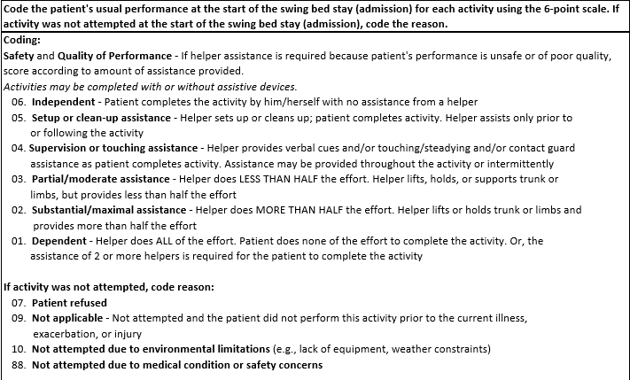
Is your EMR System Working for You?
Is your EMR system conducive to full functional assessments by nursing?
Remember that whether a hospital participates in the PI/QI project or not, we need to add documentation regarding function
Codes should be there to refer to at all times

Slide 39
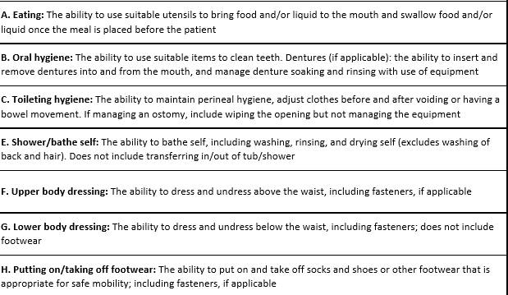
Is your EMR System Working for You?
Could we have the list of items and description as below with a space for each item on the right to give it a level for each shift
When we click to add the level, if its not “6”, there would be a drop down to explain why you consider the patient a 5 or less on your shift

Slide 40
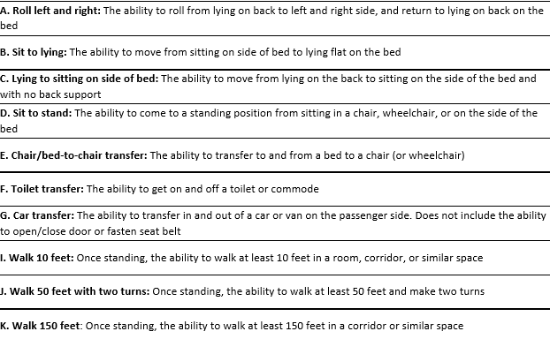
Is your EMR System Working for You?
List of items and description (cont’)
Remove “car transfer”
Replace the 3 “walk” item and change to 1 box for “Ambulation”

Slide 41
Is your EMR System Working for You?
Is your EMR system also conducive to full clinical assessments and outcome documentation?
Don’t assume that another professional will come to the same conclusion as you did when reading the chart
Can we identify the following?
What is the patient at risk for?
Are the skilled monitoring or treatment on a daily basis?
Why is the patient not medically stable?
What are the potential complications that require on-going observation and assessment?
If therapy is on an IP due to being unsafe ambulating at home – does nursing documentation support the unsteadiness, lack of safety awareness based on……
We need to document the connection for the reader
Example: – “Patient has diabetes , documented circulation issues and wears pressure stockings. He has developed open area on side of foot” This is not sufficient documentation
Requires critical thinking to determine if its vascular, due to pressure, or to his diabetes? Or, is it a skin tear from knocking the foot on the WC? – Close the loop: Finish the investigation and chart the results. Ask physician to assess as needed

Slide 42
Is your EMR System Working for You?
EMR system (cont’)
Example: Patient has a new g-tube. PEG site is dry, clean, free of odor and enteral formula is running freely. No signs and symptoms of infection noted at insertion site. HOB elevated between 30 to 45 degrees while pump is on and for one hour following. No signs of increased coughing/aspiration noted. Lungs clear to auscultation to all lobes
The above documentation demonstrate a skilled nurse who understands what to assess and how it correlates
Do we have a comprehensive system’s review where the norm, WNL is described to be checked off but and the nurse clicks on the item to described anything not WNL as different examples provided to be added at the time of the system review and/or added at anytime during the shift. (let’s discuss this concept)
Thinking out of the box - Where could we document the following?
Example for patient skilled for nursing observation, assessment and management of BS management. On insulin to scale to regulate BS. Maintained BS at …. with x units of insulin. No additional units or interventions needed. No complaints of hyper or hypoglycemia. States “he had a good day”
Should we have a space to identify skilled needs and we would document based on that – some EMR call it “problem list” – nursing can change everyday, story difficult to follow…. Could we call it “Clinical Skilled Needs” and nursing would have to document on such every shift?

Slide 43
Is your EMR System Working for You?
Pitfalls of EMR is that nurses mostly check boxes, do not qualify why they checked, do not show critical thinking, copy and paste etc….
Regardless of your system, it must:
“Paint a picture” of the patient and their ability
Must reflect the skilled service provided
Assessment of acute medical conditions (what)
Spell out your findings – demonstrate critical thinking
Description of delivered services and patient’s response, tolerance, discomfort, side effects noted
Teaching and training provided
Describe need for change of treatment or physician notification if applicable
Detail what physician/NPP ordered if applicable and
Patient’s response to change(s)

Slide 44
Denial Reasons from Various Regions/States
Provider did not document medical necessity for what skill needs and why on an IP basis
No therapy assessment and treatment plan
Assessment did not document the prior level of care compared to the present status
Poorly written goals (not functional) – does not describe what will the patient be able to do in functional, measurable terms, why/purpose/intent
Notes did not indicate a valid expectation of improvement when therapies were initiated or the reasoning for the maintenance program
Documentation did not support medical necessity for the rehab skilled needs
Therapy plan not signed by the provider and no clarification order
No support for services provided (why)
LOS not per standard for the skilled rehab
Therapy only documented what the patient did and not what they were taught to accomplish the task hence making it an unskilled service
Services not requiring a Licensed nurse, PT, OT or SLP (could be provided by a trained nursing or rehab assistant or trained family member)
Conflicting information between IDT and nursing, therapy and nursing in the way its written
Missing daily documentation
Nursing documentation not supporting the daily skilled need
No supporting rehab diagnosis on the UB-04

Slide 45
Final Questions Regarding Any Components
No Easy Task – Good Luck

Slide 46
Next Step
Recommendations:
Complete chart reviews to highlight opportunities
Review these slides and chart review findings with staff for their input
Create a documentation team to review your EMR system – could anything be improved to augment the value of what is documented by education or changing the forms
Consider being willing to present your EMR documentation forms if you like what you have or agreed to work on improvement (what?) at one of our meetings/webinar
Next webinar (mark your calendars)
Date: Thursday May 22, 2020
Time: 1:00 pm EDT
Topic: Care Management / Discharge Planning Processes

Slide 47
Stay Well !!

