Slide 1
CAH Swing Bed PI/QI Project
Outcome Management Qtr. 2 of 2020
(Webinar)
July 29, 2020
Mary Guyot Consulting
207-650-5830 (cell/text)
maryguyotconsulting@gmail.com

Slide 2
Agenda (1:00 PM to 2:30 PM)
1:00 – 2:20 Data analysis & benchmarking
Hospital input from their review
2:20 – 2:30 Next Step

Slide 3
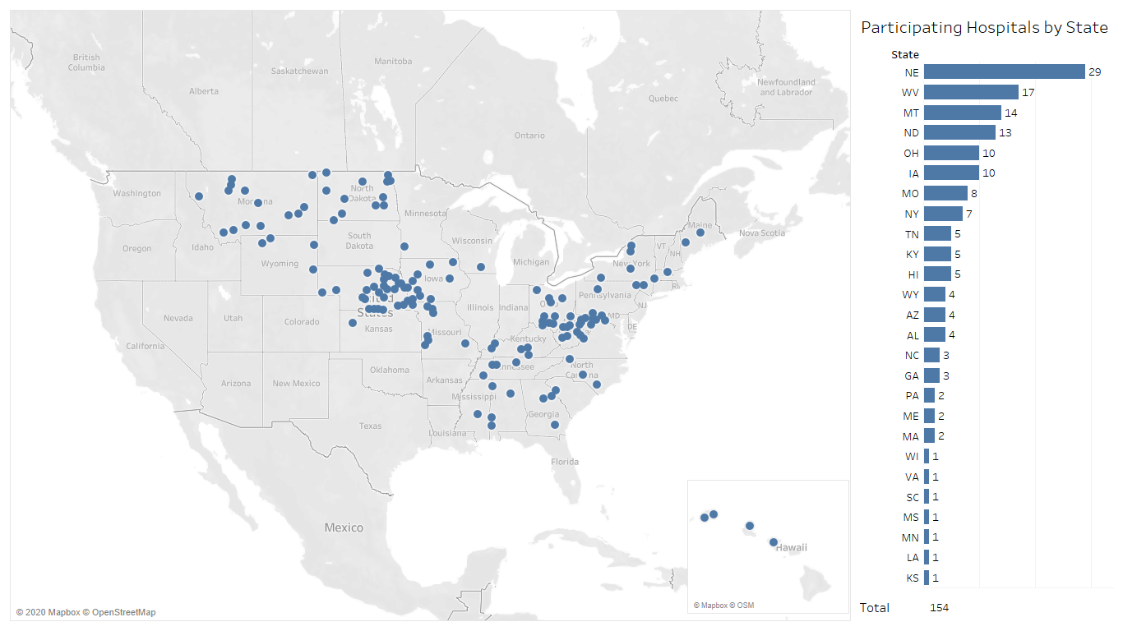
154 Hospitals Participating in Swing Bed PI/QI Project for Q4 2019 and Q1 & Q2 2020 (Comparison Group Size)
Source: Stroudwater Swing Bed Portal 10/1/2019 to 6/30/2020 pulled on 7/14/2020

Slide 4
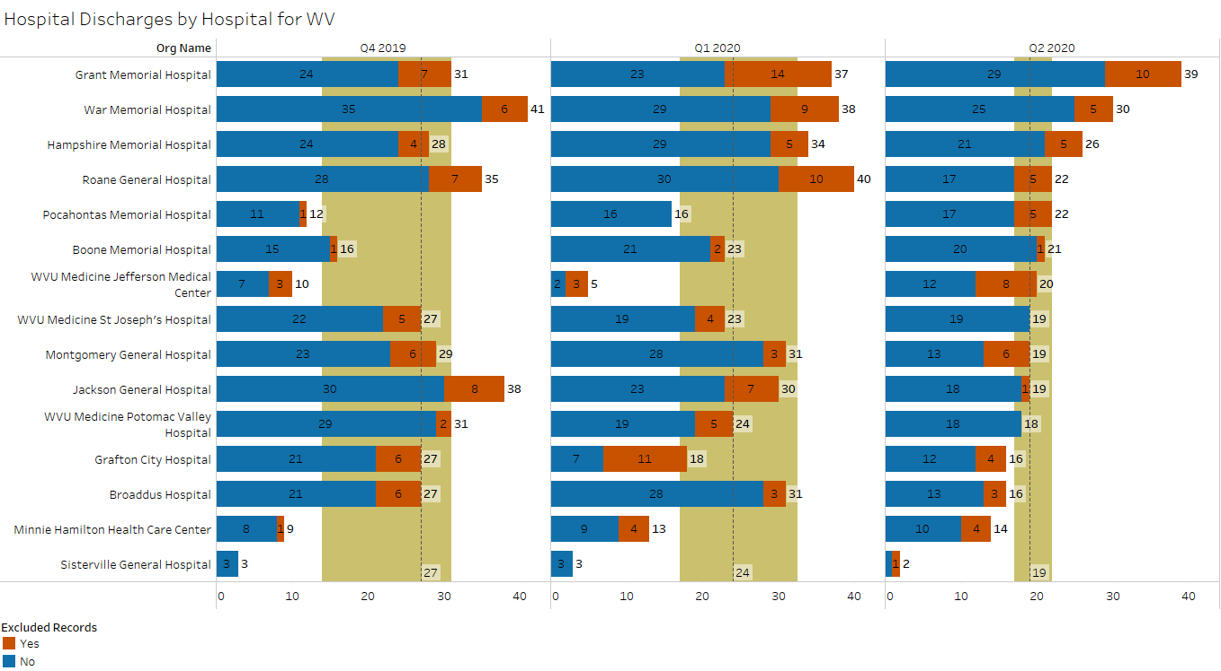
Total Swing Bed Discharges by Hospital
median
lower quartile
upper quartile
excluded records added
Source: Stroudwater Swing Bed Portal 10/1/2019 to 6/30/2020 pulled on 7/14/2020

Slide 5
Total Swing Bed Discharges by Hospital
Total CAH discharges went down
Q4 2020 had a Median of 27 down to 24 in Q1 2020 and now 19 in Q2, 2020
WV (based on the 15 hospitals w/data) had 364 discharges in Q4 2020, 366 in Q1 2020 and down to 303 in Q2 2020
Though the # of D/Cs were better for 8 hospitals in Q1 of 2020 vs Q4 2020, the % decrease between Q2 2020 vs Q4 2020 was 16.8%
Based on all 15 hospitals, the average # of D/Cs per day was 3.96 in Q4 2020, 4.02 in Q1 2020 and decreased to an average per diem of 3.33 in Q2 2020
Is the decrease all due to COVID-19? How?
3 hospitals had an upward trajectory for the 3 quarters
Grant Memorial (31-37-39) !!!!
What prevented a decrease in utilization?
Pocahontas (12-16-22) and Minnie Hamilton (9-13-14)
Are you doing anything new to increase utilization?
4 CAHs with highest total census (over all 3 quarters) of 85 or greater are as follows:
War (109) Grant (107) Roane (97) Hampshire (88) and Jackson at 87
What do you attribute the higher # of overall discharges to?
Jefferson – how do you explain the difference between the 3 qtrs.? (10-5-20)! – How did you manage going up from 5 to 20 over the last 2 qtrs. given COVID-19?
The more programs we have to promote, the better chances we have for more admissions
More on this topic during our next webinar

Slide 6
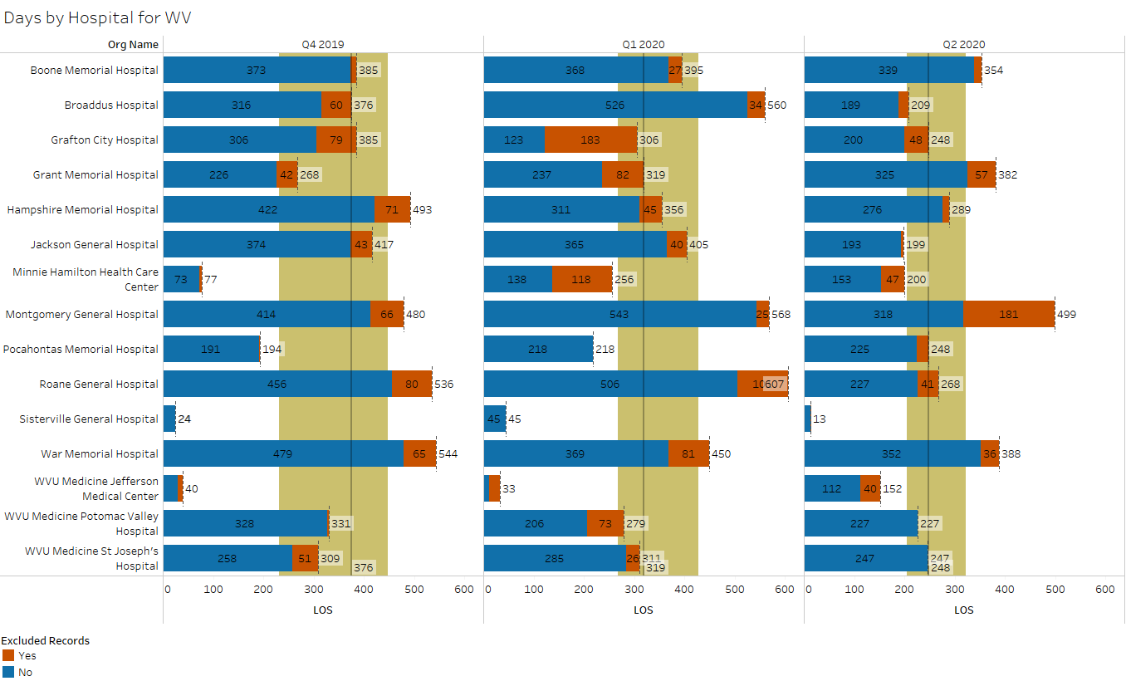
SB Number of Days
median
lower quartile
upper quartile
excluded records added
Source: Stroudwater Swing Bed Portal 10/1/2019 to 6/30/2020 pulled on 7/14/2020

Slide 7
SB Number of Days
WV median # of days over the 3 qtrs. has taken a hit was 376 - 319 - 248
7 CAHs had over 1000 days over the last 3 qtrs.:
Montgomery (1537)
What do you attribute your larger # of days though average # of discharges (79)
Roane (1411)
War (1382)
Broadus (1145)
Hampshire (1138)
Boone (1134)
Jackson (1021)
Important to recognize that # of admissions by itself does not tell the full financial story
Financially, days trumps admissions with cost-based payors
Lower workload with less admissions
May have high admission rate with low # of days if under managed care
The more programs we have to promote, the better chances we have for more days
Has any of the CAHs admitted to SB due to COVID-19?
Would like to hear your experiences

Slide 8
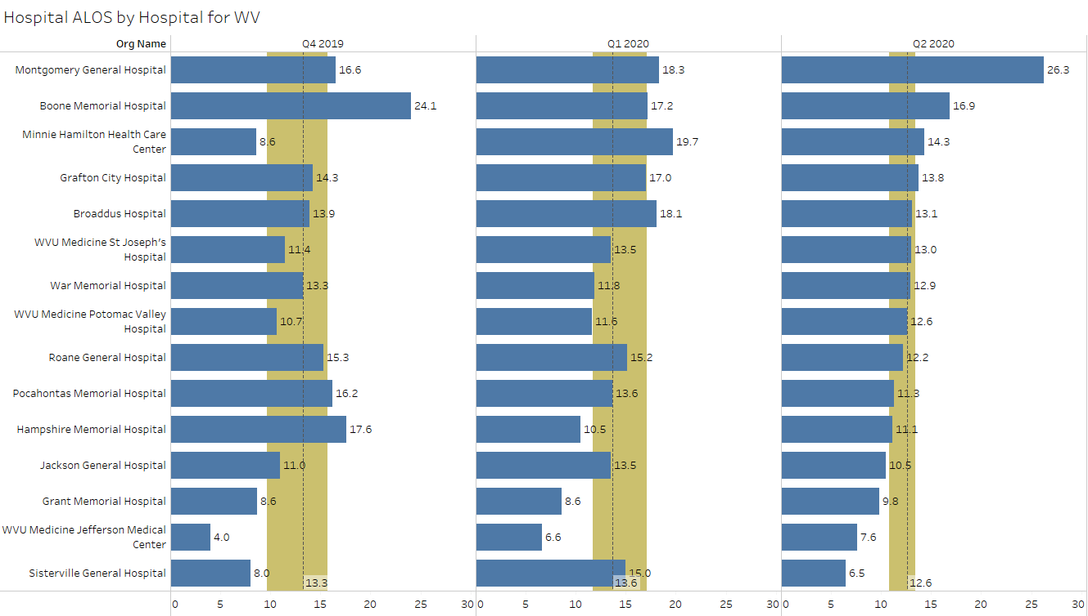
SB Average Length of Stay (ALOS)
median
lower quartile
upper quartile
excluded records added
Source: Stroudwater Swing Bed Portal 10/1/2019 to 6/30/2020 pulled on 7/14/2020

Slide 9
SB Average Length of Stay (ALOS)
SB ALOS Median remained pretty much the same Q4-13.3, Q1-13.6 but went down to 12.6 for Q2, 2020
Montgomery – what is the reason for longer ALOS in Q2 (26.3)? Did your chart review identify good documentation to support such?
Most CAHs experienced a lower ALOS this past quarter – any reason why?
Grant, Jefferson & Sistersville – why continued lower ALOS 9.8, 7.6 & 6.5 respectively
In reviewing your LOSs, important to compare based on:
Medical condition group – are we limiting who we accept for admission too much
Age group
Payor (managed care)
Functional Improvement (did we use the time needed – do we set patient goals too low)
For instance, if you have lower LOS and lower PI, could that be improved with working with them a bit longer
If you have longer LOS and yet poor PI – could something have been done differently or was it the patient’s make up
Longer LOS are great for finance
Long LOS may improve functional outcome scores
Long LOS may deter Managed Care companies, bundled payment etc…
In any case, let’s make sure the documentation supports the LOS be it very long or very short

Slide 10
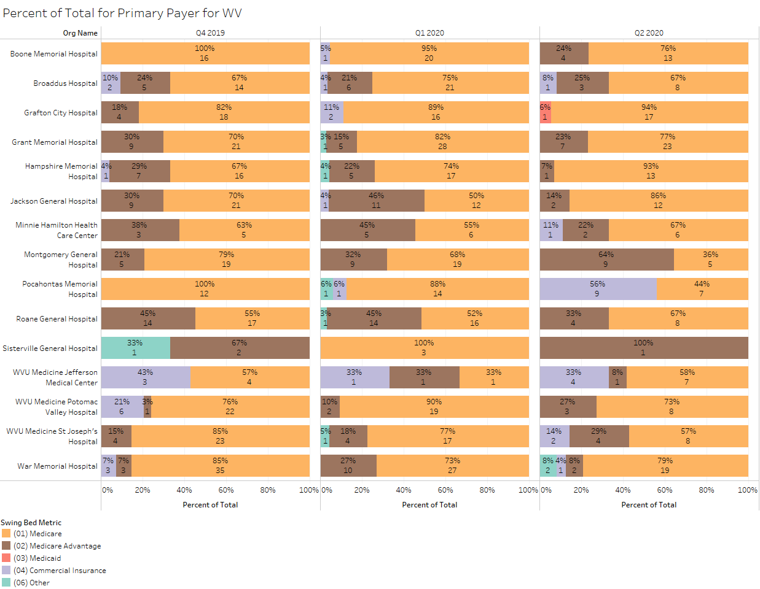
Percent of Total by Primary Payer
excluded records added
Source: Stroudwater Swing Bed Portal 10/1/2019 to 6/30/2020 pulled on 7/14/2020

Slide 11
Percent of Total by Primary Payer
Montgomery and Jackson are with 23 and 22 cases paid by MA over the past 3 quarters.
Are MAs more prevalent in your area?
Are they still paying cost?
Are you doing anything special to have more MA patients?
Montgomery – are your longer LOS for both Medicare & MA?
Jackson – do you feel your shorter LOS are due to MA?
Grafton – did you really have a Medicaid patient?
If so, how did they pay?
War – what was your “Other” payor?

Slide 12
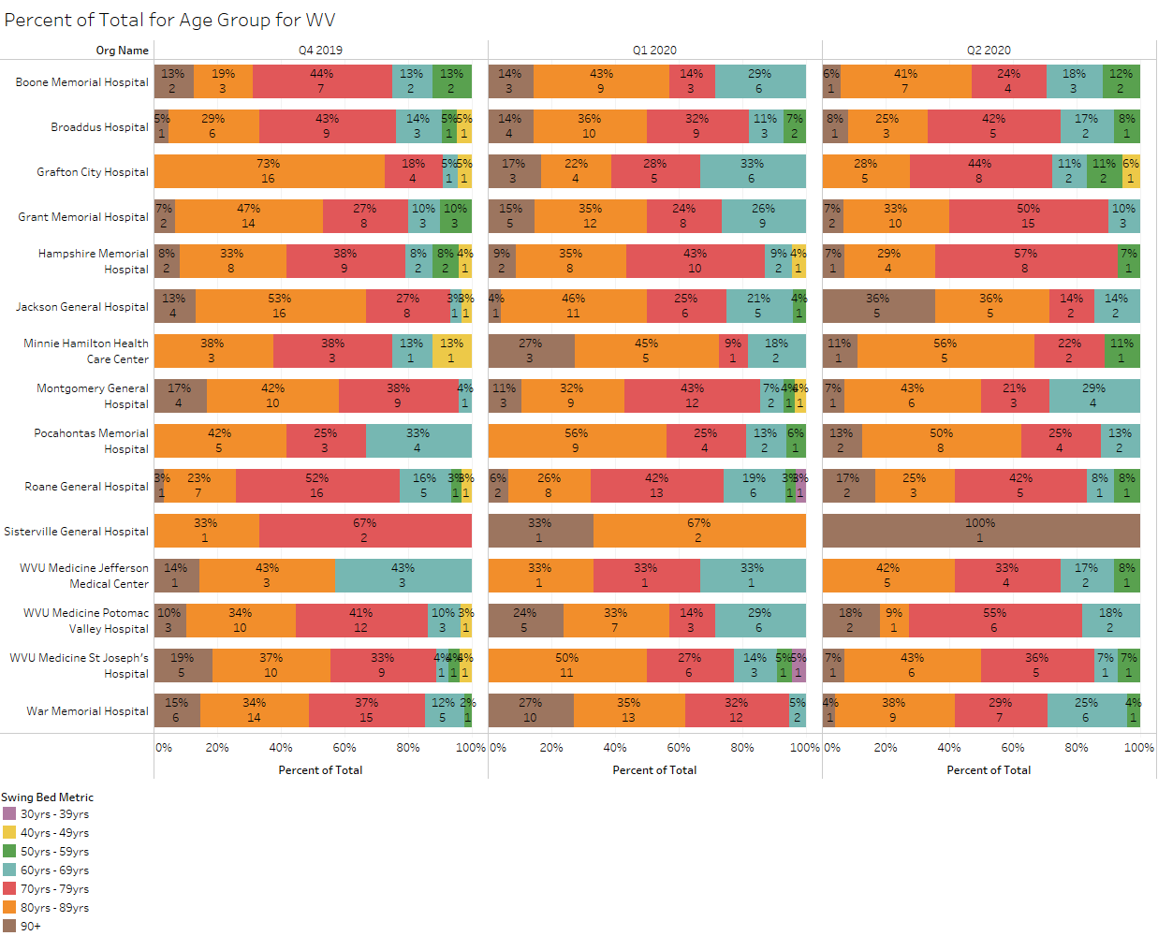
Percent of Total by Age Group
excluded records added
Source: Stroudwater Swing Bed Portal 10/1/2019 to 6/30/2020 pulled on 7/14/2020

Slide 13
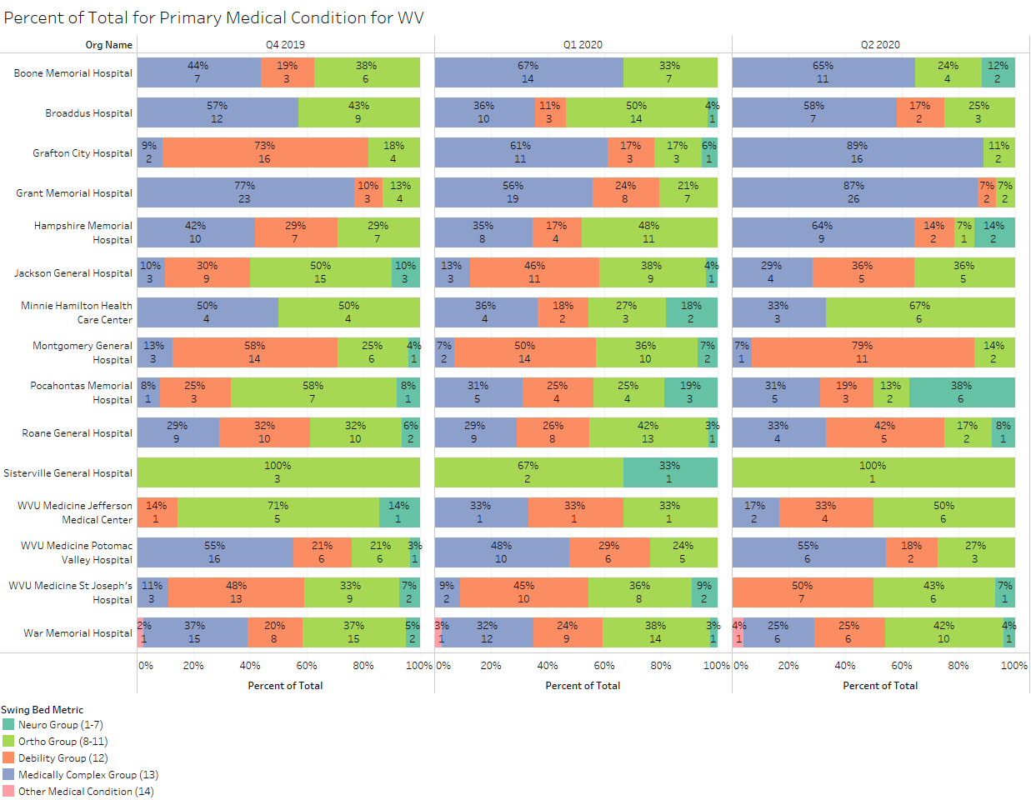
Percent of Total by Primary Medical Condition
excluded records added
Source: Stroudwater Swing Bed Portal 10/1/2019 to 6/30/2020 pulled on 7/14/2020

Slide 14
Percent of Total by Primary Medical Condition
Sorry that the form and portal still have a choice of “Other” for the time being.
The admitting diagnosis grouping should be determined/agreed to at the initial IDT meeting following the description of 1-13 groups – remember that this is not necessarily based on the acute admitting diagnosis – it must be based on what the skills are based on what grouping.
Based on this process, there should never be an “Other” used by error
War – you are the only one with an “Other” this past quarter – what was it?
Minnie Hamilton, Jefferson, St. Joseph & War had a higher % in the Ortho group in Q2 vs Q1.
Elective surgery restarted?
More patient and docs willing to keep surgical patients in the hospital?
More specifics on developing specific medical & physical rehab programs to be discussed further during our next webinar

Slide 15
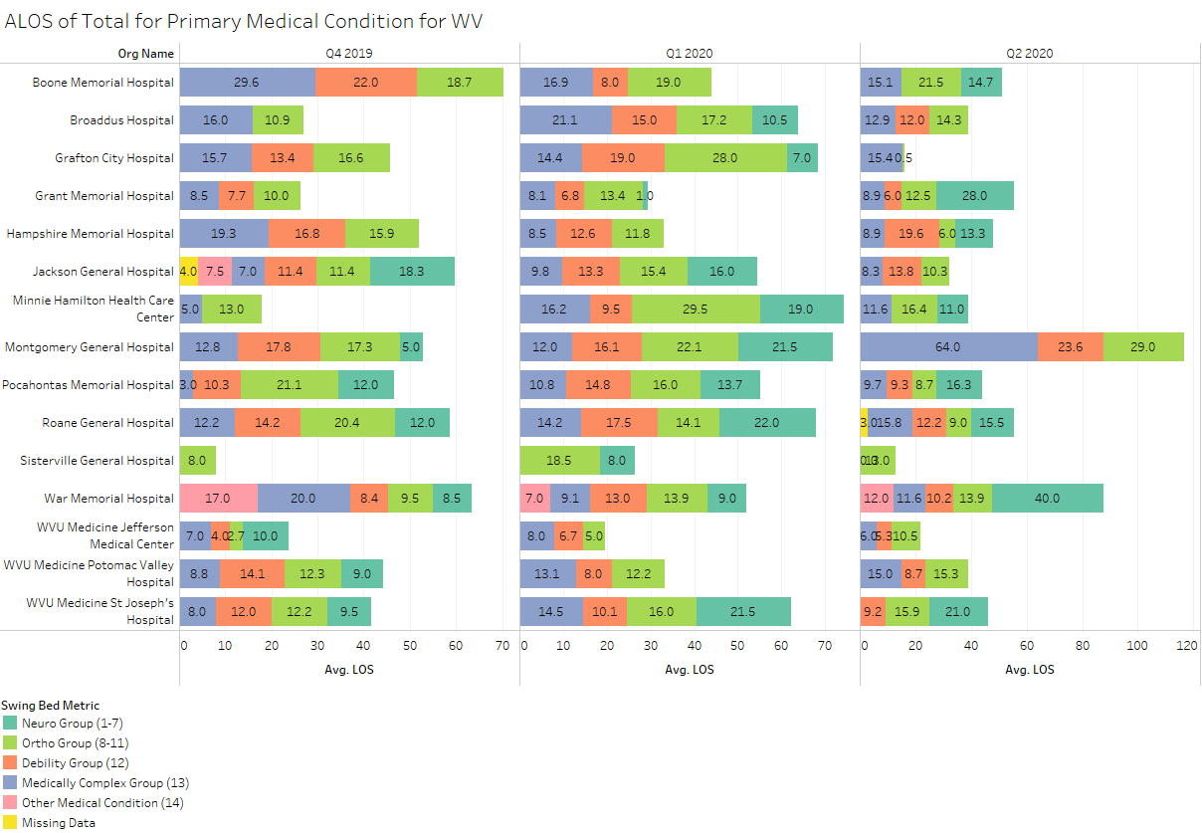
ALOS by Primary Medical Condition
excluded records added
Source: Stroudwater Swing Bed Portal 10/1/2019 to 6/30/2020 pulled on 7/14/2020

Slide 16
ALOS by Primary Medical Condition
The way to look at ALOS is to look at differences between groups – are there opportunities for improvement
If longer, can we explain why?
Did we have a complicated patient or 2 that distorted the ALOS in that group?
If shorter, how are we doing in function improvement in that group
Again and most important, do we have documentation to explain the longer or short LOS?
Any of the CAHs do a Chart Review as part of your performance improvement program?
If so, tell us more

Slide 17
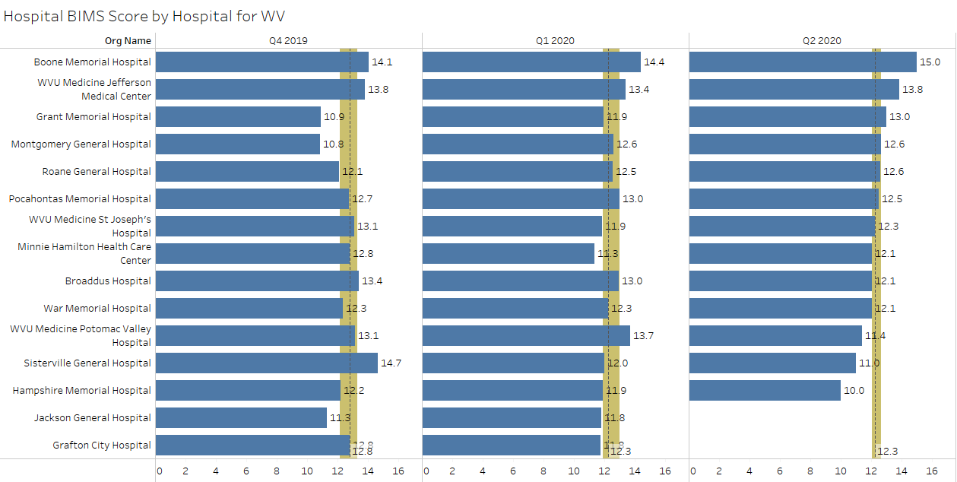
Average BIMS Score
median
lower quartile
upper quartile
As you know, this will no longer be part of the program in Oct. So, I will not report next qtr. But feel free to continue this practice
excluded records added
Source: Stroudwater Swing Bed Portal 10/1/2019 to 6/30/2020 pulled on 7/14/2020

Slide 18
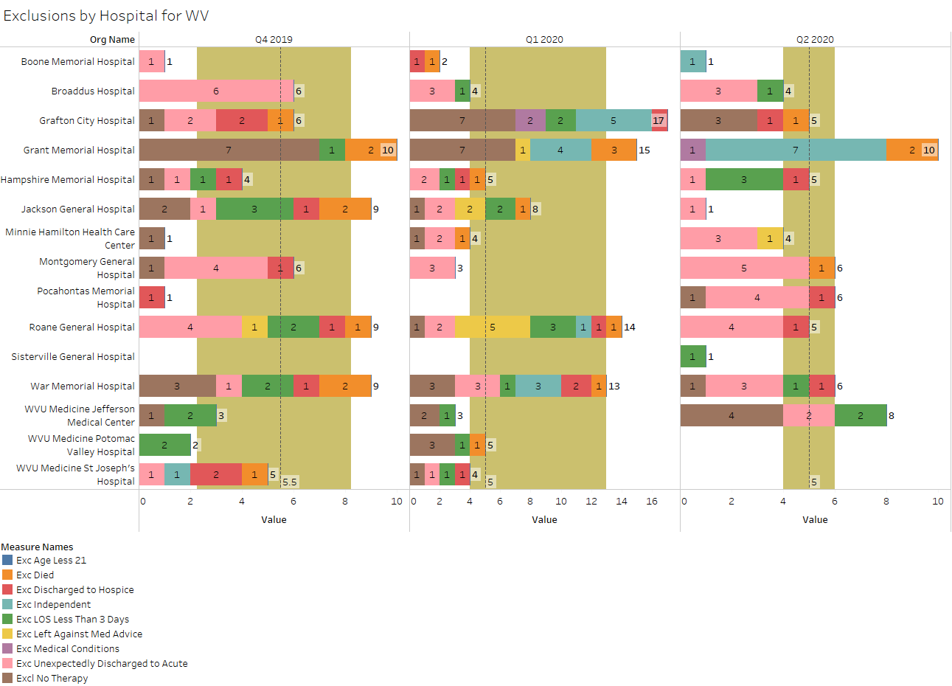
Number of Exclusions
median
lower quartile
upper quartile
Exc Medical Conditions: coma/persistent vegetative state; complete tetraplegia; locked‐in syndrome; severe anoxic brain damage, cerebral edema, or compression of brain
excluded records added
Source: Stroudwater Swing Bed Portal 10/1/2019 to 6/30/2020 pulled on 7/14/2020

Slide 19
Number of Exclusions
Over this past quarter (Q2) there were:
4 deaths (Q2) during the program vs 8 in Q1 and 9 in Q4 of 2019 but also lower census overall
Any unexpected deaths? – Any preventable deaths with better assessments?
Were they admitted for hospice?
5 patients were discharged to Hospice
2 CAHs had 8 patients who were excluded because they were independent on admission
Grant had 7 of those – please share what they were admitted for
Again, may be very appropriate and a great way to increase utilization but do make sure you have good documentation as to why they still required an IP program as a practical matter
4 hospitals had a total of 8 pts with less than 3 MN stays: Broadus, Hampshire, Jefferson & Sistersville
Please answer the following:
Was this planned such as medical management for a new drug, other treatment?? – good to meet more patients and providers needs and increases utilization
Were they unexpected and if so, why?
This version does say “check all that applies” which confuses things so, next version will have you choose 1 only and the wording will be “Planned Short Medical Management for Less than 3 days (3 midnights)” to better differentiate the reason for short stay

Slide 20
Number of Exclusions
Minnie Hamilton had 1 patient who LAMA – could it have been prevented?
Grant – you had 2 excluded due to their medical conditions such as coma, locked syndrome
Out of curiosity, what were the discharge goals?
9 hospitals had a total of 26 patients returned to acute – the highest # for these past 3 qtrs.!
Montgomery (5) – also had a higher # than usual under Medically Complex – was that a stretch for the staff?
Pocahontas (4) – higher # in the neuro group – was that new to you?
Roane (4) – pretty even distribution in medical groupings - what were the issues?
No PT/OT exclusion
Grant – all received therapy – what was different this quarter?.
Jefferson had 4 – what were their diagnosis – thinking out of the box in admitting different types of patients?

Slide 21
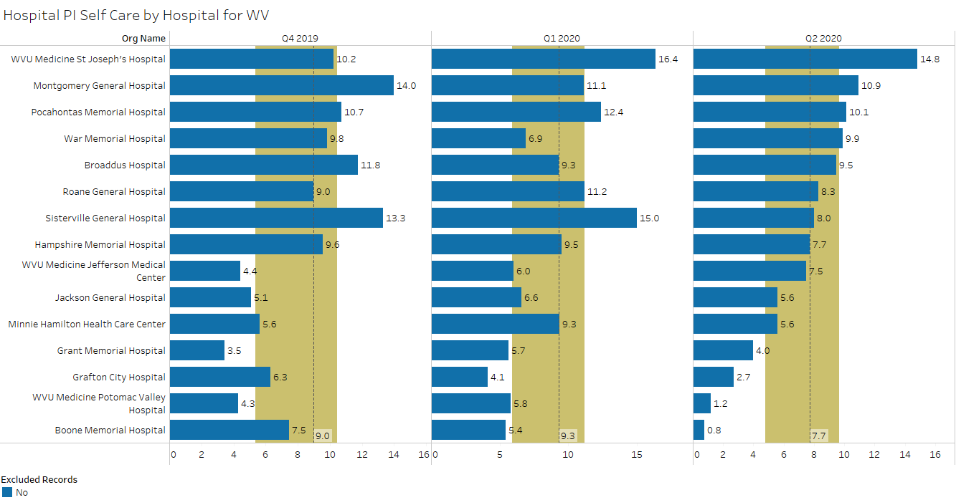
Performance Improvement Score for Self-Care
median
lower quartile
upper quartile
excluded records have been removed
Source: Stroudwater Swing Bed Portal 10/1/2019 to 6/30/2020 pulled on 7/14/2020

Slide 22
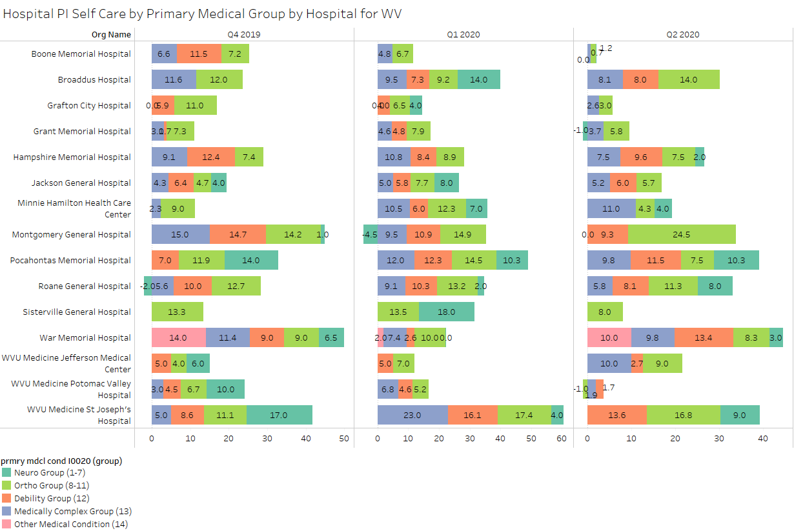
Performance Improvement Score for Self-Care by Primary Medical Condition
median
lower quartile
upper quartile
excluded records have been removed
Source: Stroudwater Swing Bed Portal 10/1/2019 to 6/30/2020 pulled on 7/14/2020

Slide 23
Performance Improvement Scores (Self-Care)
The Median improvement score for self-care decreased by 1.6 pts – went from 9.3 in Q1 down to 7.7 in Q2 but remains slightly higher than national average over the 3 last qtrs. (7.4)
Every CAH had a decrease in Self-Care in Q2 except War, Broadus & Jefferson
Boone – was your data all in? You only had 1 exclusion so there should be Functional PI data for all but 1 case
Grant & Potomac – why is there a minus in improvement on the previous slide – have you checked that out?
8 hospitals are still at or above the median for self-care improvement score – Congrats!
St Joseph (14.8), Montgomery (10.9) & Pocahontas (10.1) – what do you attribute higher #s above 10 to?
4 hospitals have PI Self-Care score of 4 or below
Grant (4), Grafton (2.7), Potomac (1.2) & Boone (0.8)
Any input on what is not working? Have you checked these possible issues
Compare the scores with ALOS,
Check it different by primary medical conditions,
What were their scores on admission – what was the room for improvement,
How much therapy (days, amount of time …) by discipline are they getting,
What is your nursing staff participation in day-to-day ADLs, ambulation, transfers etc…
Is it a certain type of patients that are keeping your scores down,
How do you differ between self-care vs mobility improvement,
What are our processes for mobility improvement vs self-care,
Has everybody (nursing and therapy) been trained to scoring functionality?
Is a team process used to agree on the admission and discharge scores

Slide 24
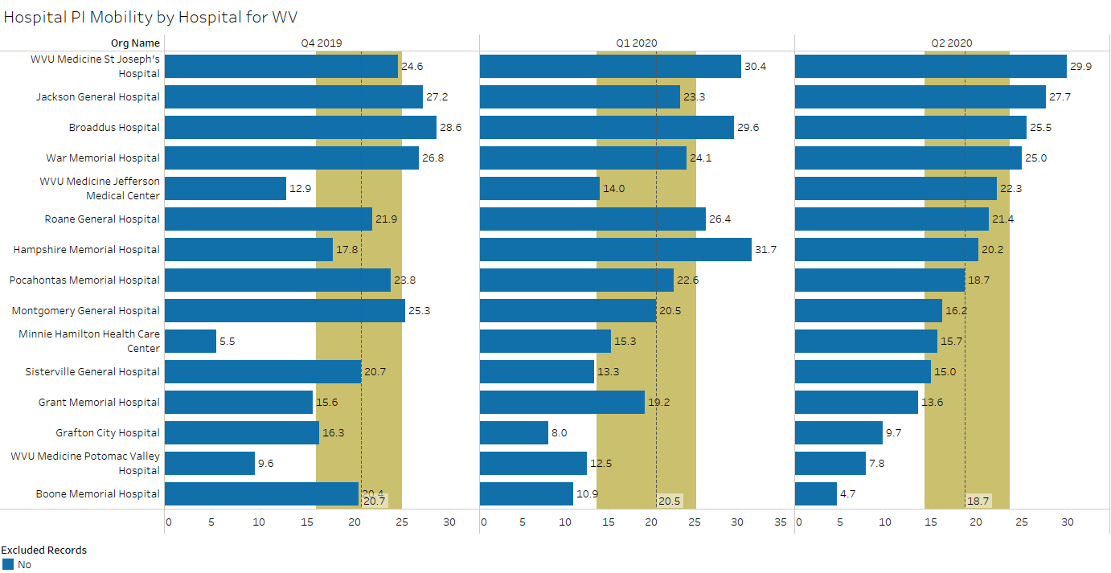
Performance Improvement Score for Mobility
median
lower quartile
upper quartile
excluded records have been removed
Source: Stroudwater Swing Bed Portal 10/1/2019 to 6/30/2020 pulled on 7/14/2020

Slide 25
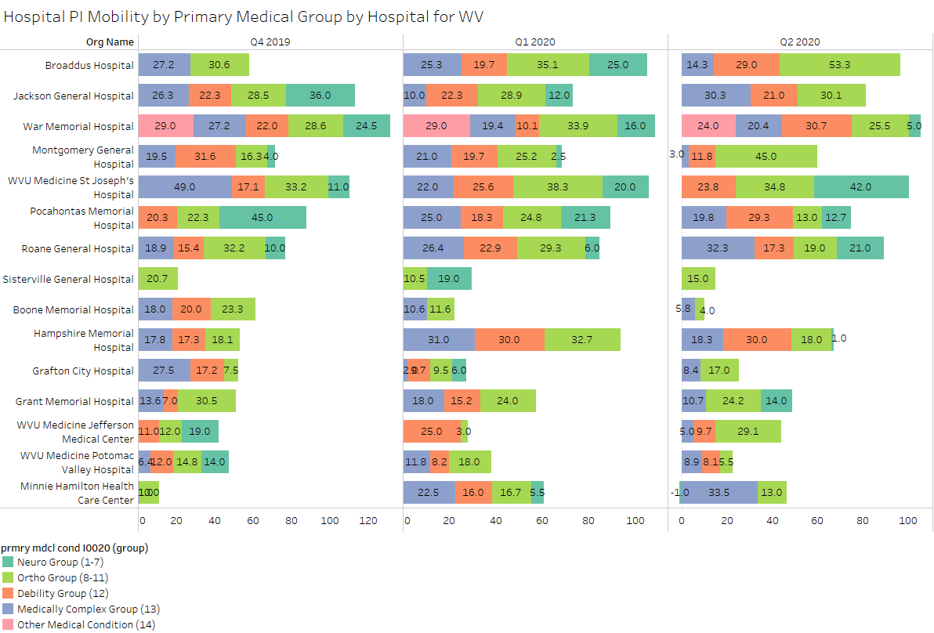
Performance Improvement Score for Mobility by Primary Medical Condition
median
lower quartile
upper quartile
excluded records have been removed
Source: Stroudwater Swing Bed Portal 10/1/2019 to 6/30/2020 pulled on 7/14/2020

Slide 26
Performance Improvement Scores (Mobility)
The Median improvement score for Mobility decreased by 1.8 pts – went from 20.5 in Q1 down to 18.7 in Q2 – slightly less than the national median for the last 3 qtrs. (19.5)
6 of the 15 CAHs had an increase in Mobility in Q2!
Jackson, War, Jefferson, Minnie, Sistersville, Grafton
St. Joseph, Jackson, Broadus & War all had a score of 25 or above
Any special processes?
Broadus – your Mobility PI scores in Ortho has seen great improvement
Q4 2019 (13.6) Q1 2020 (35.1) Q2 (53.3) – attributed to what?
Jackson – Mobility PI score in the Medically Complex group went from 10 in Q1 to 30.3 in Q2!!
Why such an improvement
Same 4 hospitals have lowest scores in Mobility as they did in Self-Care (less than 15)
Grant (13.6), Grafton (9.7), Potomac (7.8) & Boone (4.7)
Any input on what is not working?
Requires same analysis as for Self-Care.

Slide 27
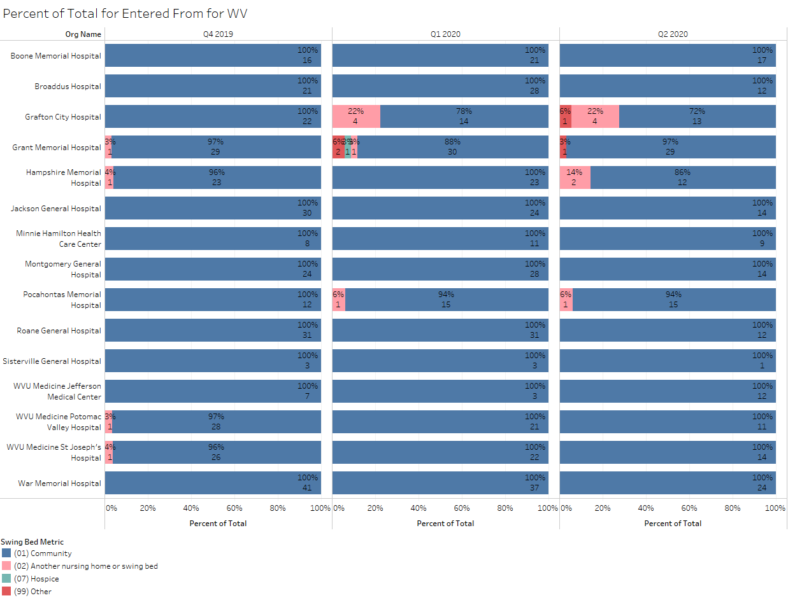
Percent of Total by Residence Pre-Acute Admission
excluded records added
Source: Stroudwater Swing Bed Portal 10/1/2019 to 6/30/2020 pulled on 7/14/2020

Slide 28
Percent of Total by Residence Pre-Acute Admission
Grafton (4) and Hampshire (2) – have you noticed that you have a larger # of patients who were in a NH before being admitted to acute and then your SB?
Do those patients return to the NH?
Have you noticed if your self-care and mobility PI are lower for those patients?
What is your LOS for those patients vs those going home?
What is the reason they go to your SB before returning to SNF?
Grafton & Grant - What is the “Other” for the originating place?

Slide 29
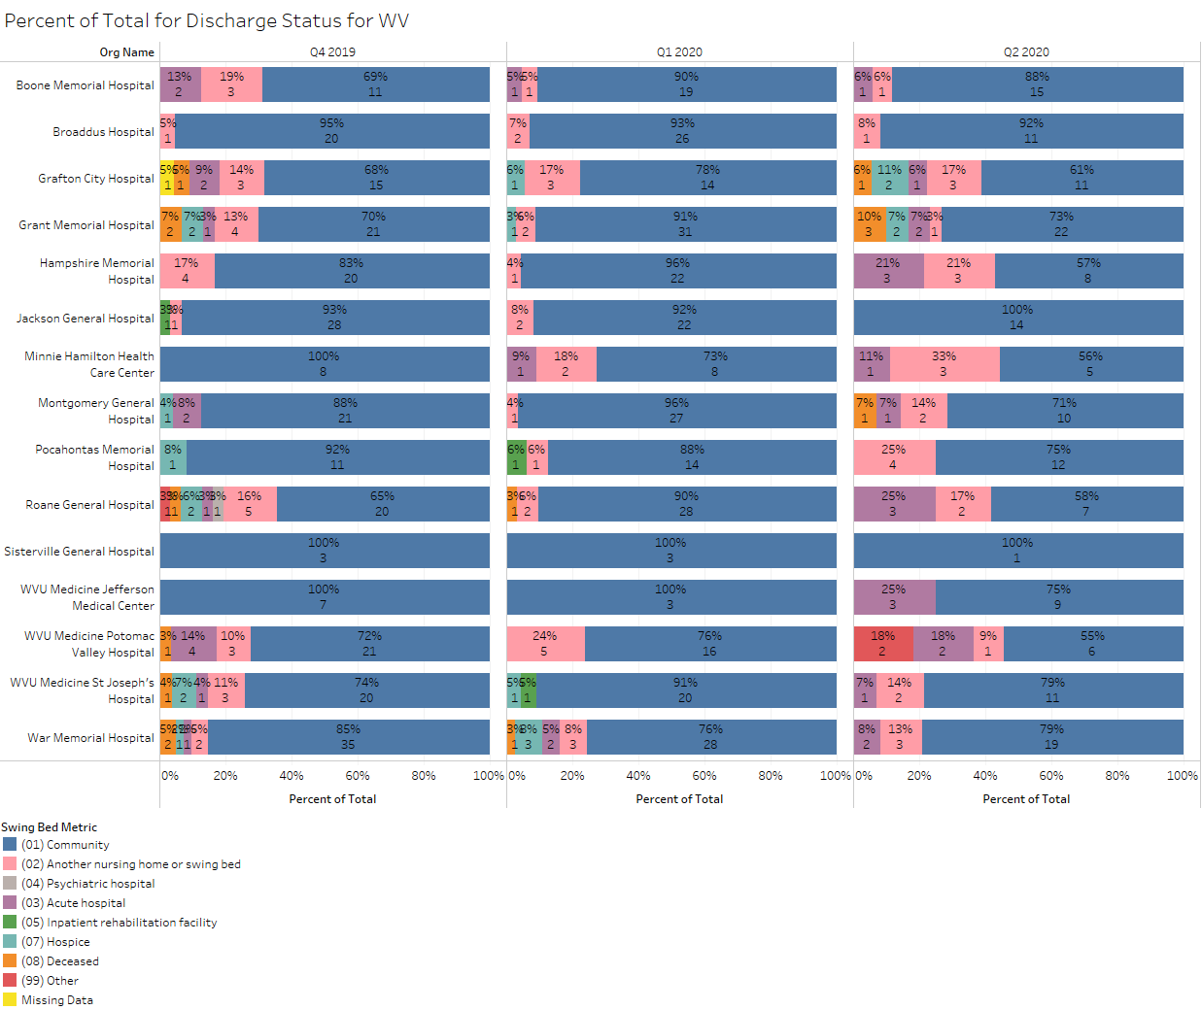
Percent of Total by Discharge Disposition
excluded records added
Source: Stroudwater Swing Bed Portal 10/1/2019 to 6/30/2020 pulled on 7/14/2020

Slide 30
Percent of Total by Discharge Disposition
Confusing data – does not jive with Exclusions – can we figure out issues?
CAH | D/C Disposition Other Than Home | Exclusions
Boone | 1 acute | 1 to acute
Broadus | 0 acute | 3 to acute
Grafton | 1 death + 2 Hospice + 1 acute + 3 NH | 1 death + 1 Hospice + 0 to acute
Grant | 1 death + 1 Hospice + 1 acute + 1 NH | 2 deaths + 0 Hospice + 0 acute
Jackson | All home | 1 acute
Minnie Hamilton | 1 acute + 3 NH | 3 acute
Montgomery | 1 death + 1 acute + 2 NH | 1 death + 5 acute
Roane | 3 acute + 2 NH | 4 acute
Jefferson | 3 acute | 2 acute
Potomac | 2 deaths + 2 acute + 1 NH | 0 deaths + 0 acute
St Joseph | 1 acute + 2 NH | 0 acute
War | 2 acute + 3 NH | 3 acute + 1 Hospice
Hampshire | 1 acute + 3 NH | 1 acute + 1 Hospice
Pocahontas | 4 NH | 4 acute + 1 Hospice
Sistersville | 1 home | 0

Slide 31
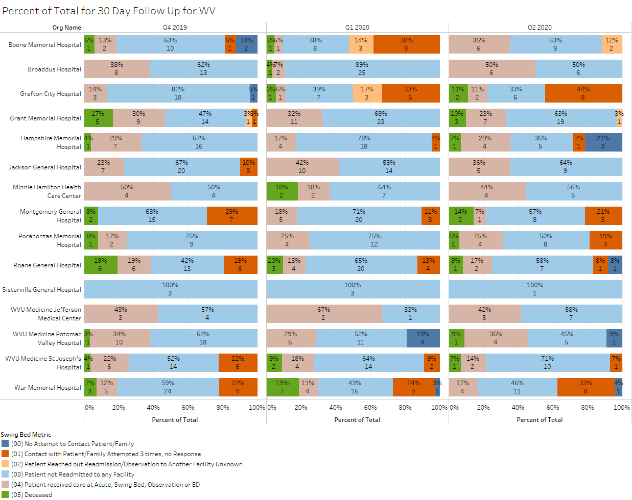
Percent of Total by 30 Day Follow Up
excluded records have been removed
Source: Stroudwater Swing Bed Portal 10/1/2019 to 6/30/2020 pulled on 7/14/2020

Slide 32
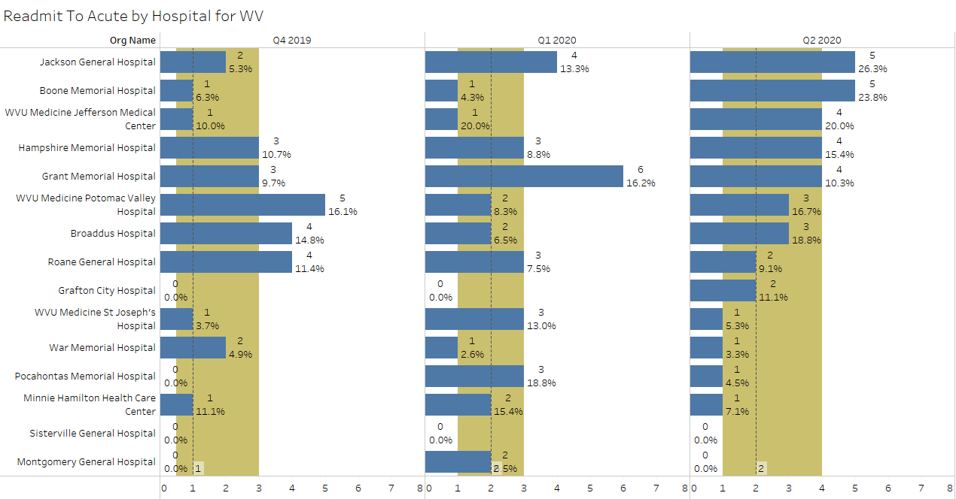
Number & Percent of Readmits to Acute from 30-day Follow Up Call
median
lower quartile
upper quartile
excluded records added
Source: Stroudwater Swing Bed Portal 10/1/2019 to 6/30/2020 pulled on 7/14/2020

Slide 33
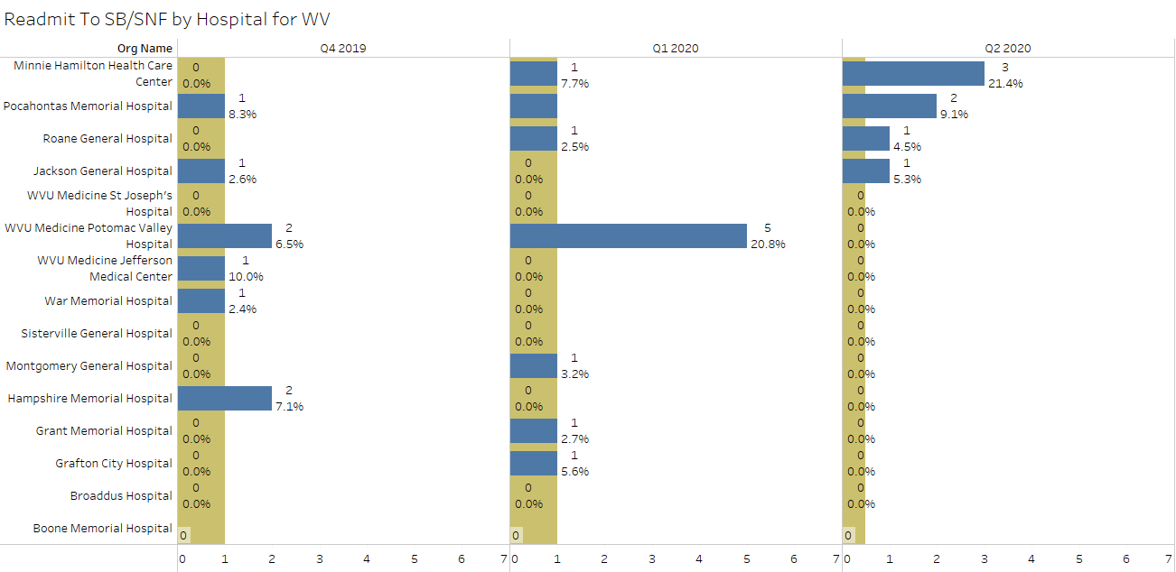
Number & Percent of Readmits to SB/SNF from 30-day Follow Up Call
median
lower quartile
upper quartile
excluded records added
Source: Stroudwater Swing Bed Portal 10/1/2019 to 6/30/2020 pulled on 7/14/2020

Slide 34
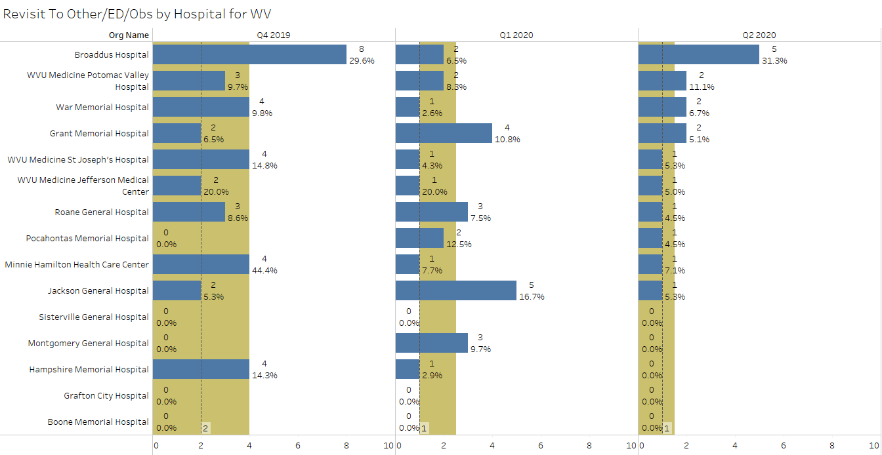
Number & Percent of Revisits to ED or Observation from 30-day Follow Up Call
median
lower quartile
upper quartile
excluded records added
Source: Stroudwater Swing Bed Portal 10/1/2019 to 6/30/2020 pulled on 7/14/2020

Slide 35
30 Day Follow Up
No attempts – Hampshire (3) Roane (1) Potomac (1) War (1) - Cause? Oversight, No time, No call info? Good job Potomac – went from 4 no attempt in Q1 down to 1 in Q2
Attempts made x 3 with no response
Grafton (Q4-0, Q1-6, Q2-8) and War (Q4-9, Q1-9, Q2-8)
Have you tried to figure out why so many are not being reached such as:
Are they told to expect a call within 24 to 72 hrs for a clinical follow-up and the 30-day follow-up
Do we tell them that we are doing this to improve our program and patient’s outcome?
Do we tell them we will be asking if they had to be readmitted anywhere or used ED and why?
Do we recheck the # to call – maybe obtain 2 tel. #s
Do we write the calls on their discharge instructions?
Do we remind them that billers do not call, only nursing so not be afraid to call
Great improvement for Montgomery (Q4-7, Q1-3, Q2) and Roane (Q4-6, Q1-4, Q1-1)!
What are you doing differently
Deaths - 8 CAHs with 13 deaths in this last qtr – expected?? Are all deaths reviewed?
War – you had 7 deaths in Q1 and 0 in Q2 – any special reason for such an improvement?
Acute, ED or SB/SNF services w/in 30 days post discharge - Broadus, Minnie Hamilton & Jefferson – all above 40%
What did your follow-up reveal?
Are all your readmits or re-visits reviewed for opportunities?
When reviewing readmits/re-visits – look at % - is it going up or down in line with utilization
Are there more readmits/revisits based on LOS, medical condition group
Could we have done anything to prevent this
Did we provide meaningful pt/family education
Did we do an appropriate medication reconciliation
Did we have clear d/c instructions
Had we done a thorough 24-72 hr post d/c clinical call? Did we respond to potential issues – most important to prevent readmissions!

Slide 36
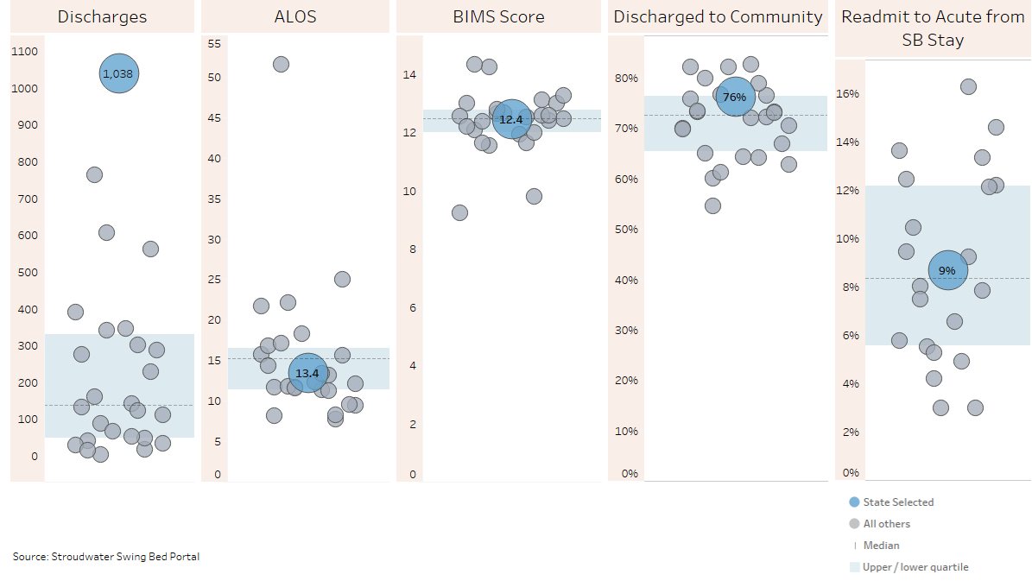
State Comparison (October 2019 through June 2020)
excluded records added
Source: Stroudwater Swing Bed Portal 10/1/2019 to 6/30/2020 pulled on 7/14/2020

Slide 37
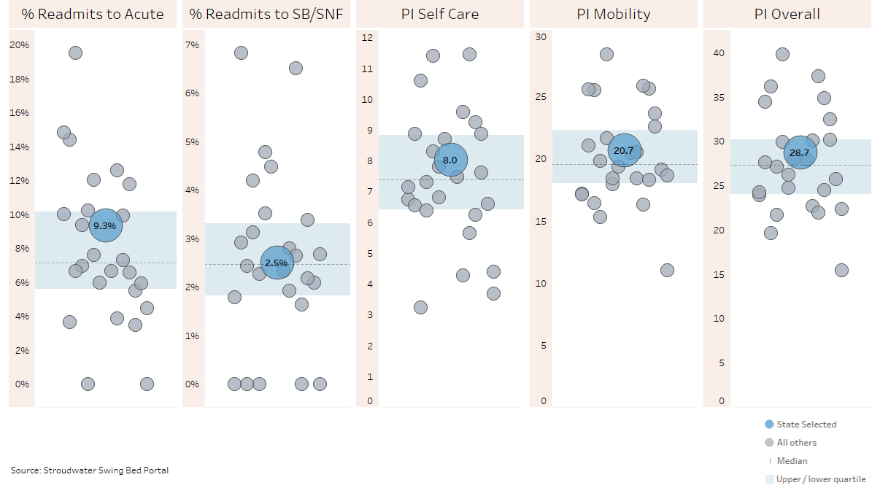
State Comparison (October 2019 through June 2020)
From 30-day Follow Up Calls
excluded records have been removed for PI scores
Source: Stroudwater Swing Bed Portal 10/1/2019 to 6/30/2020 pulled on 7/14/2020

Slide 38
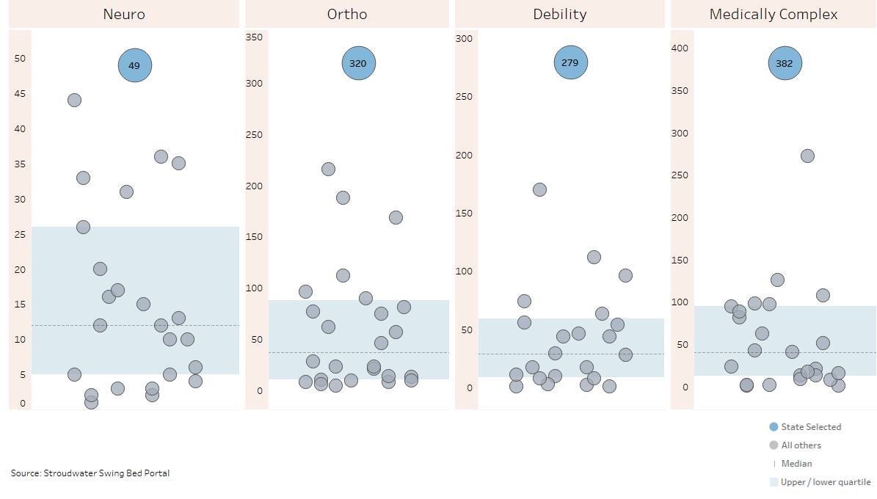
State Comparison (October 2019 through June 2020) - Reason for Admission (count of records)
excluded records added
Source: Stroudwater Swing Bed Portal 10/1/2019 to 6/30/2020 pulled on 7/14/2020

Slide 39
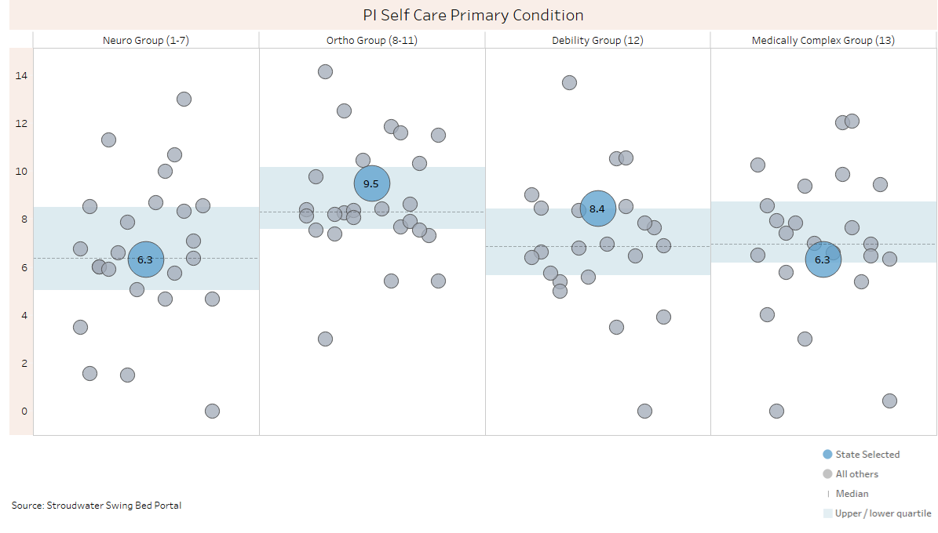
State Comparison (October 2019 through June 2020) PI Self-Care by Primary Condition
excluded records have been removed for PI scores
Source: Stroudwater Swing Bed Portal 10/1/2019 to 6/30/2020 pulled on 7/14/2020

Slide 40
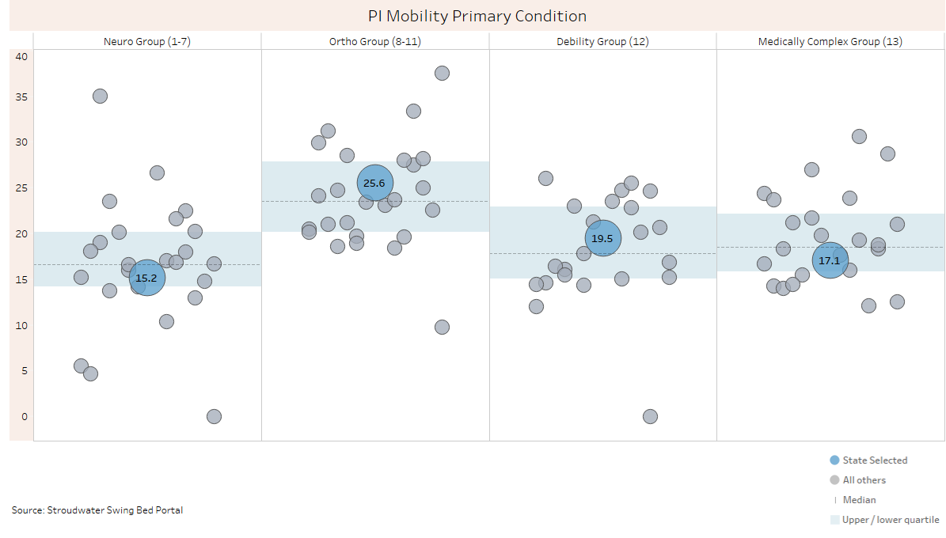
State Comparison (October 2019 through June 2020) PI Mobility by Primary Condition
excluded records have been removed for PI scores
Source: Stroudwater Swing Bed Portal 10/1/2019 to 6/30/2020 pulled on 7/14/2020

Slide 41
Next Conference Calls
Date: Wednesday August 5, 2020
Time: 1:00 PM to 2:00 PM
Topic: Overview of Updates to the Project effective 10/1/2020
Recommend that at the very least the hospital PI Director & SB Coordinator participate in this call but all are invited.
Agenda Why Update
Overview of the 2 options
Looking for volunteers for a deep review of the forms
Next step for updated training

