Slide 1
Swing Bed Program Management Self Assessment Outcome December 6, 2022
Mary Guyot Consulting
maryguyotconsulting@gmail.com
(207) 650-5830 (cell/text)

Slide 2
Disclaimer
These “best practices” are based on this consultant’s 30 yrs. of experience with for profit companies and work with hospitals who specifically wanted to improve every aspect of their SB programs
Some of these “best practices” may be more difficult given the SB rehab is offered in an acute care unit but it should not stop us to strive to make these happen.
Yes, it is more difficult to work with nurses that have both acute care patients and rehab patients especially if not trained in rehab!
Yes, it is more difficult to work with therapists who are also charged to offer acute therapy and grow the OP business!
Yes, it is more difficult to manage a SB program without the administration team support who do not understand the difference between acute care and SB rehab!
Regardless, it is our role to offer the most effective skill rehab program possible for our community residents
It’s the right thing to do!

Slide 3
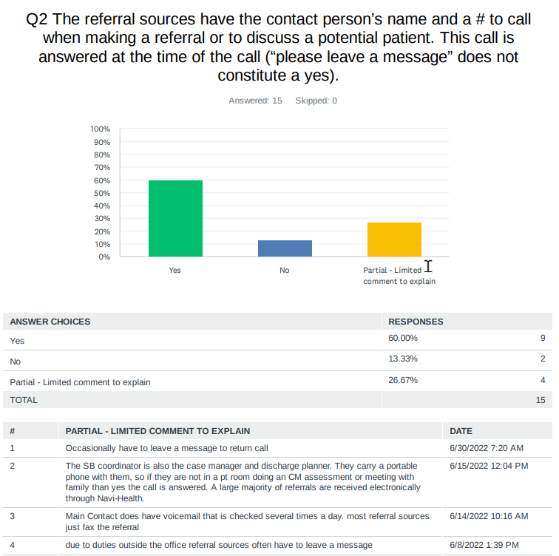
Crucial for referral sources to easily reach you – asking them to leave a message does not tell them when you will get back to them – if they have choices for SB/SNF, they may move on.
Best way to increase referrals is to be very responsive to the referring sources
If they only use fax or emails or special referral system, then those must be monitored at all times.
War – please tell us about the portable phone system you have
Minnie Hamilton – tell us about referral system which loads to your email and linked to your cell tel.
Any question/comments from others?

Slide 4
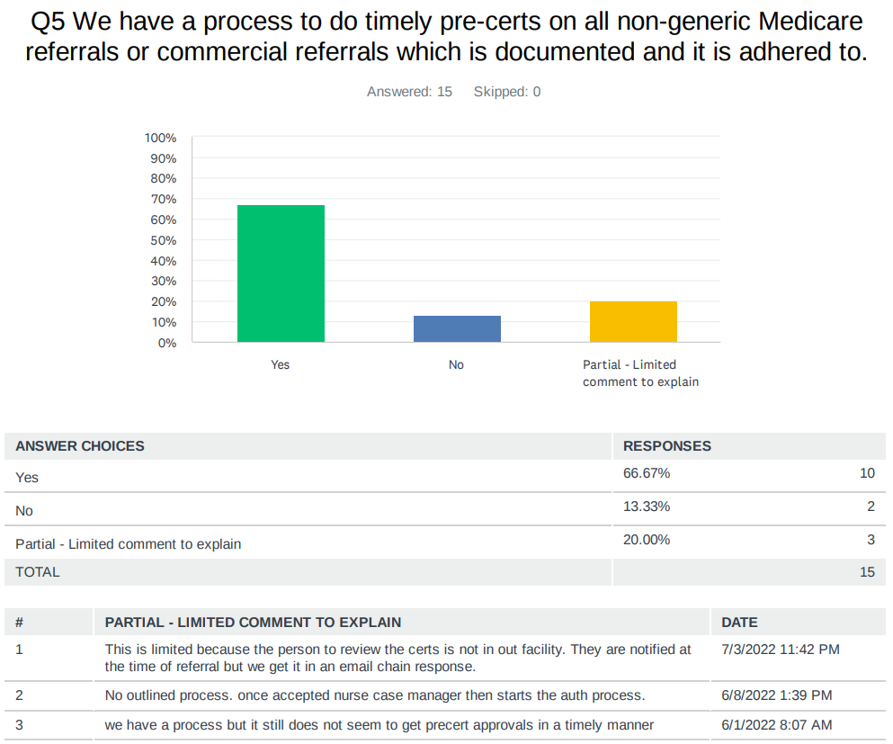
Missing a pre-cert can be very costly
Time is of essence to not lose the referral
Please comment further
Jefferson: “This is limited because the person to review the certs is not in our facility. They are notified at the time of referral, but we get it in an email chain response.”
Roane: No outlined process. Once accepted nurse case manager then starts the auth process.
Webster: We have a process, but it still does not seem to get pre-certs approvals in a timely manner
Any question/comments/suggestions from any of the CAHs?

Slide 5
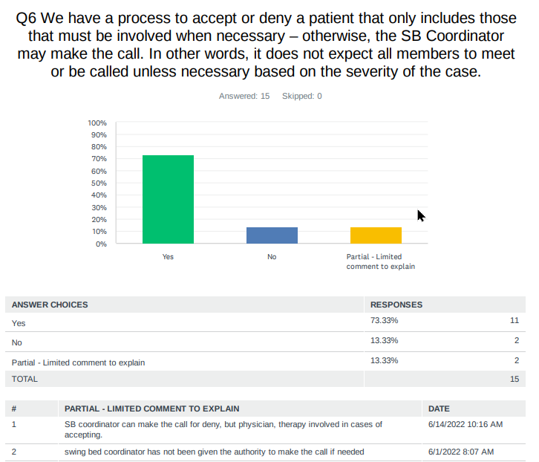
Requiring a team to make the decision regardless of the case often causes unnecessary delays for clinical approval
All: Who can quickly tell us your process for internal approval
Broaddus & Webster: what is your process if the SB Coordinator cannot approve?
Jackson, Grafton, St. Joseph stated limited access to the physician at times in Q7. Has that stopped you from getting the patient?
Any other question/comments/suggestions from any of the CAHs?

Slide 6
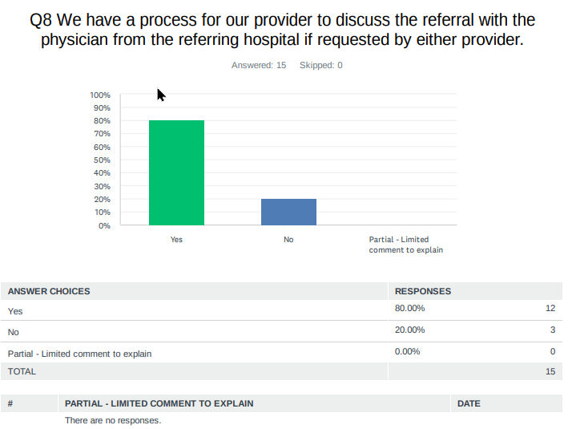
It is a requirement to have the referring and accepting physician be able to discuss the referral as needed.
Roane. St Joseph & Webster: you answered No – is it because you have no process, or somebody does not allow this to happen?
Any question/comments/suggestions from any of the CAHs?

Slide 7
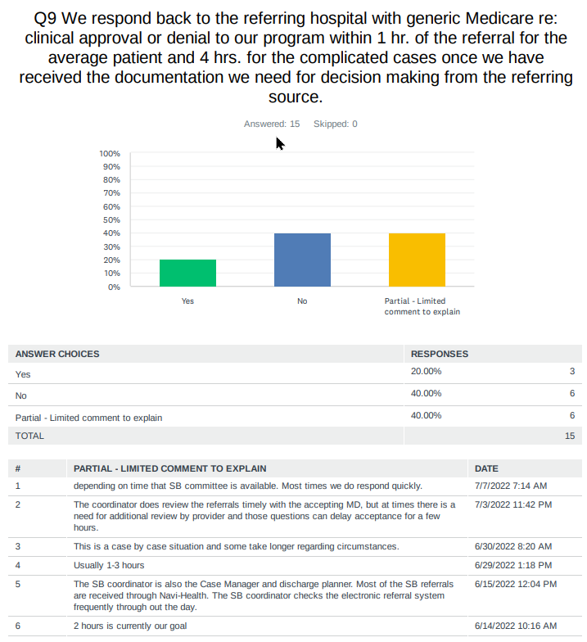
It is important and courteous to let the referring hospital know ASAP as to whether we will clinically accept the patient or deny.
40% said this does not occur. Based on responses, it appears that the issue is more with the 1 hr. requirement and yes, that is flexible based on the case
Jackson, Roane, Hampshire, Boone, St Joseph & Webster: you answered No with no comment – is it because you do not call back until you have both clinical and financial approval or did it have to do with the 1 hr. timing, have no process, or somebody does not allow this to happen?
Any question/comments/suggestions from any of the CAHs?

Slide 8
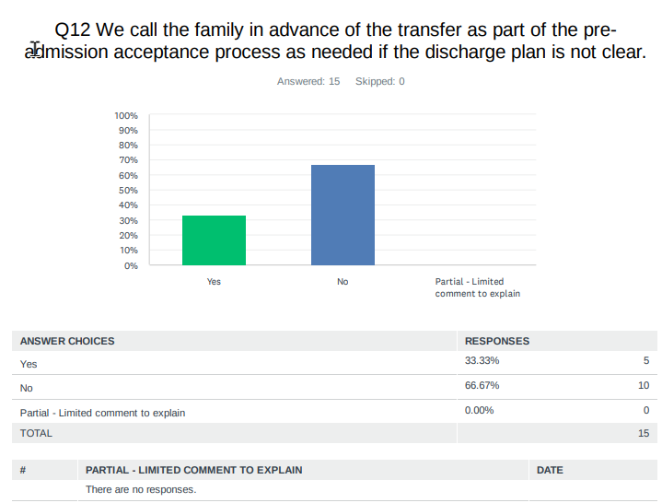
66.67 CAHs do not have a practice to call the family in advance of the transfer as part of the pre-admission acceptance process as needed if the discharge plan is not clear.
The practice of calling the family often prevents discharge issues
Jackson, Grant, Pocahontas, Preston, & Roane : you answered YES – kudos. Tell us more about your process
On Q13 it asked whether you explain expectations of SB while still in acute – Roane, you noted that the SB program is discussed but need to provide more detailed information on expectations. Tell us more.
Any question/comments/suggestions from any of the CAHs?

Slide 9
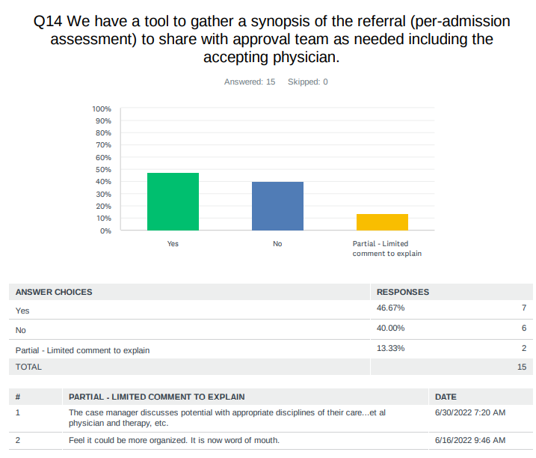
The # 1 complaint I used to get from nurses of hospitals I consulted with was the lack of communication regarding new admissions.
As we know, strong communication is key to preventing issues – we cannot rely on word of mouth.
Grant, Jefferson, Sistersville, Grafton, War, Boone & Hampshire you answered YES you have a tool– kudos. Tell us more a bit more but mostly would you agree to send your tool to me and I will add mine to be sent out to all?
Q15 – asks for whether we share the tool with nursing and therapy, but do we also tell them when to expect a patient?
Any question/comments/suggestions from any of the CAHs?

Slide 10
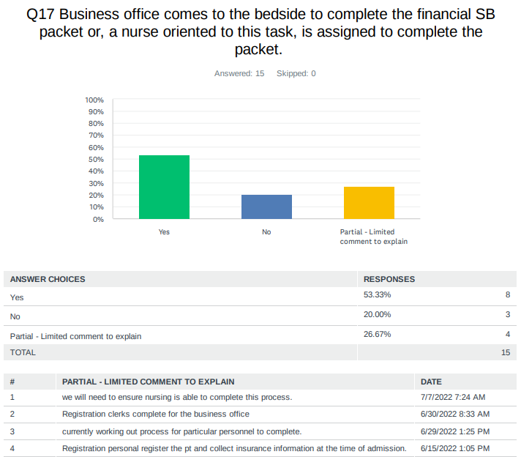
If not the business office, registration clerk or nursing assigned to complete the admission paperwork, who is responsible?
Minnie Hamilton, Jackson, Jefferson, Preston, Roane, St. Joseph, Broadus, Hampshire & Webster you answered YES that you do bedside registration for clinical permission to care, and financial responsibility as needed. Please tell us more.
Any question/comments/suggestions from any of the CAHs?

Slide 11
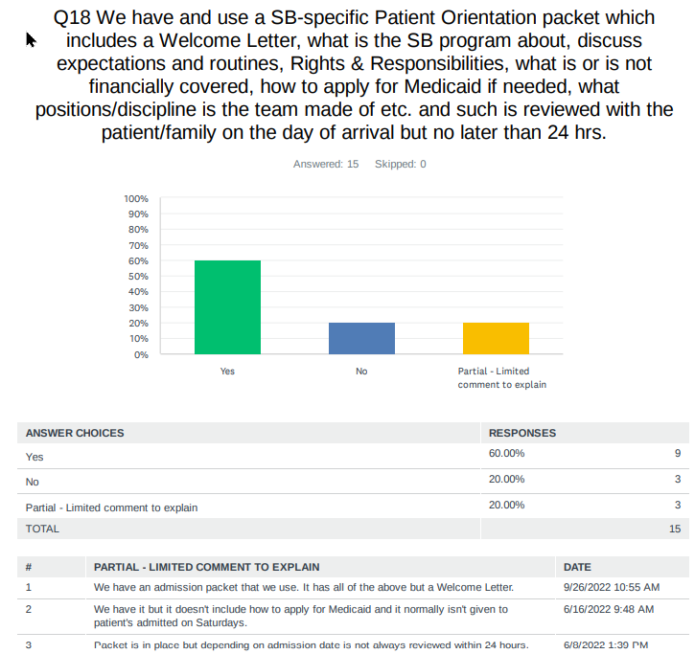
Kudos for those of you who comply with those Medicare requirement regardless of the day they are admitted
Content, sample and process wiill be further discussed during the upcoming SB training.
Kudos on Q19 – 20 – 21 for all having:
a new nursing assessment on admission regardless of being admitted from your CAH or not
a process for thorough medication reconciliation
A process for care planning on admission and on-going

Slide 12
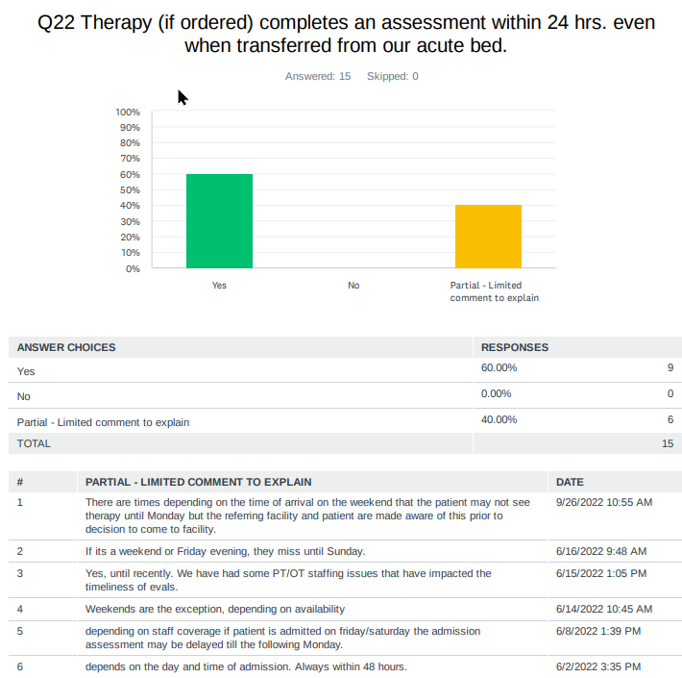
There were no “Nos” but many had comments
Know that if the patient is only admitted for therapy, they need to start within the next day if not the day of admission
There has to be nursing skill needs if therapy does not start right off.
Bares discussion
Any question/comments/suggestions from any of the CAHs?

Slide 13
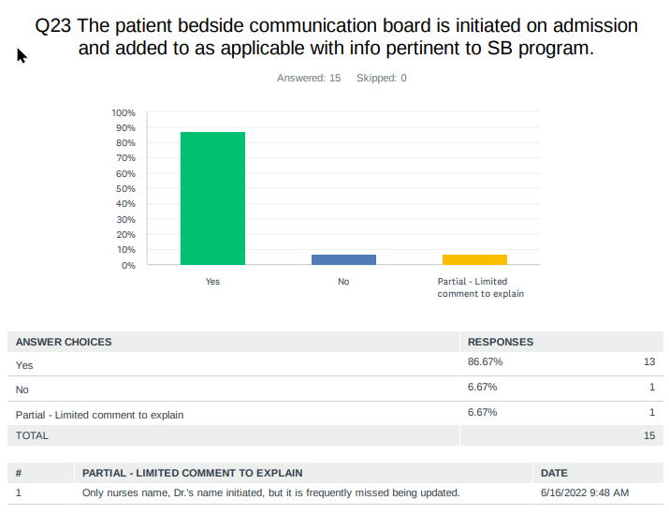
Minnie Hamilton: no communication board or not used as intended?
St. Joseph – only room for names or the rest is not used?
For all who said yes, any interest in sharing a picture of what you use with all the CAHs?
Anybody feel that you truly have a good communication board and have a process in place, and it's adhered to? Can you share please.
Any question/comments from any of the CAHs?

Slide 14
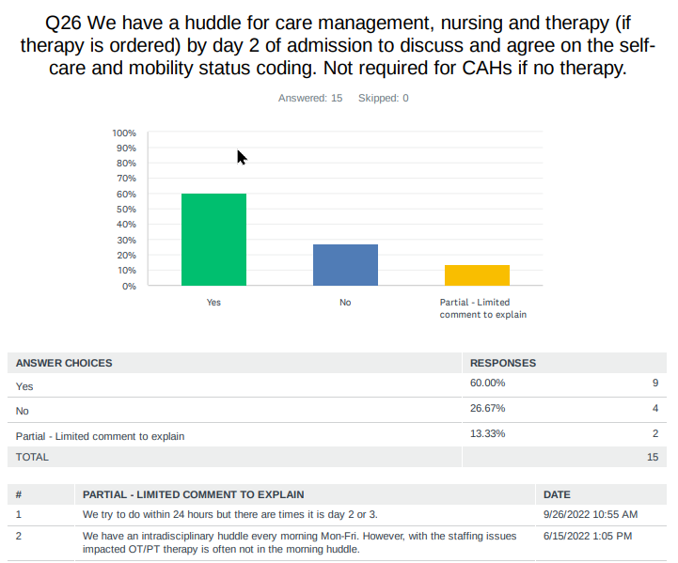
Jackson, Roane, Boone, Broadus, Memorial
How do you agree on self-care and mobility status for patients with therapy?
Which of you feel you have a good process to agree on self-care and mobility score and would like to share?
Any question/comments/suggestions from any of the CAHs?

Slide 15
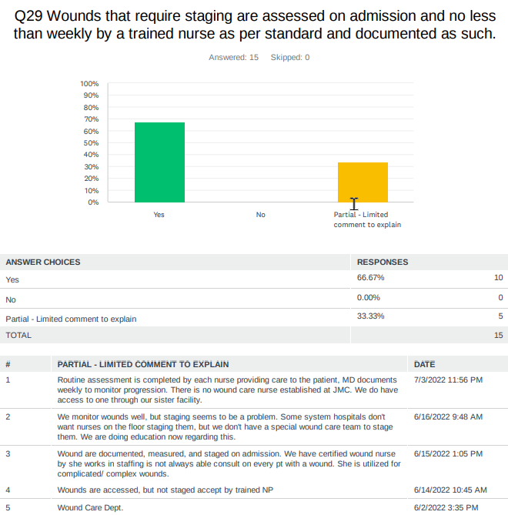
CMS expects wound assessments on admission and at least weekly thereafter
Stagging is a requirement, and they define such in the MDS manual
Some of you have such completed by your NP and others have access to a wound specialist at least for more complicated cases.
It is not recommended that staging be done by all staff
The recommendation is that you identify at least 2 nurses for 7-day coverage and provide them with training for consistency based on CMS definition
Can anyone share how you have provided training and what is your process to ensure consistency – a wound nurse specialist is not a requirement
Any question/comments/suggestions from any of the CAHs?

Slide 16
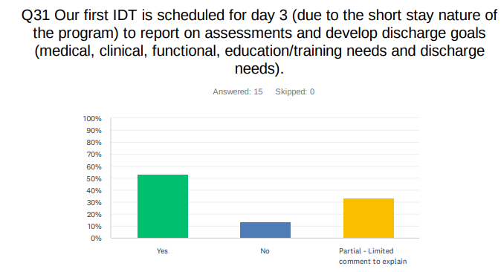
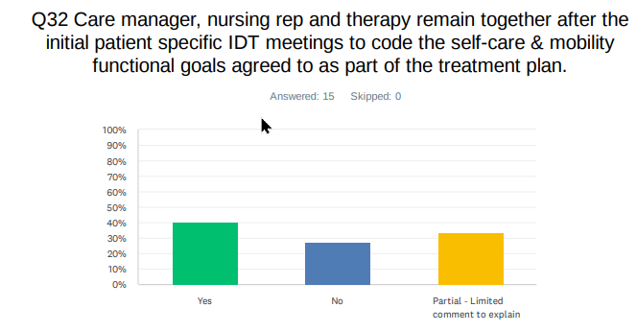
Both of these best practices distinguishes skill rehab from acute care.
They are both very important to have the team, including the patient and family to be on the same page.
Can make a big difference in the patient outcome.
This will be discussed in further details during the upcoming SB training series.
Any question/comments/suggestions from any of the CAHs?

Slide 17
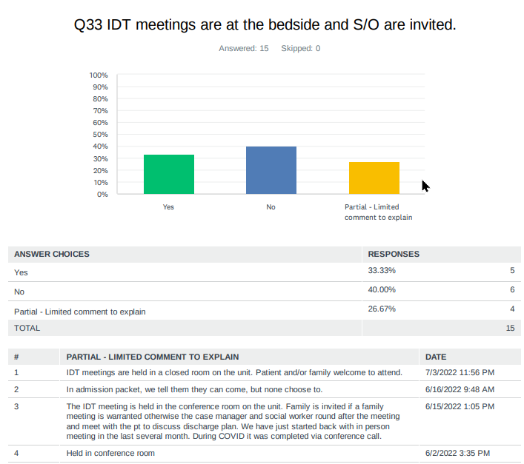
Bedside IDT meetings with invitation to S/O is not a regulation but a nice approach to involve the patient and families
Admittedly, this is very difficult and even more so in an Acute care unit.
Minnie Hamilton, Jackson, Pocahontas, & Sistersville – all answered YES
Please share your process – what works, what are the challenges?
Any question/comments/suggestions from any of the CAHs?

Slide 18
Next Step
Calling it quits for today
Thank you for sharing today and asking questions
Next Zoom meeting is scheduled for
Date: Friday December 9, 2022
Time: 1:00 – 2:30 PM ET
Look for zoom link to be emailed to you
But I am looking for recommendations on how we will accomplish reviewing all of these “best” practices (we are only up to Q33 of 106 with only one more session) – and we need to start the SB Training in January.

