Slide 1
CAH Swing Bed QAPI 101
Mary Guyot
Mary Guyot Consulting
maryguyotconsulting@gmail.com
(207) 650-5830 (cell/text)

Slide 2
Thank You!
Participating in the WV CAH Network QAPI Project is not mandatory., but hopefully helpful for your CAH PI program
The Swing Bed QAPI Project consists of collecting data to determine opportunities for improvement in your SB program
We applaud you for trying to not only offer SB for a financial reason but also wanting to ensure you have a quality program which you can improve on and promote internally and externally
Thank you for your participation in this webinar today as part of your orientation to this project or as a refresher
The goal for today is to ensure that every participating CAH starts on the same page for QAPI 2022-2023
There will be an emphasis on common misunderstanding, entry errors etc and how outcomes may be negatively impacted

Slide 3
Today’s Plan
Review of what QAPI is and its purpose
QAPI Measures
5 Key PI Benchmarked Measures
Data Collection Form Coding / Overview
Self-Care & Mobility Scoring
Improvement & Risk-Adjusted Scores
Goal Setting
PI Measure Definitions
Data Form Concurrent Coding Management Processes
Next Step

Slide 4
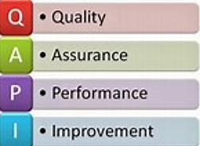
QAPI Definition & Purpose
Any good PI program continuously looks for improvement in their process both in what and how we measure to determine outcomes
Having quality measures assigned to a swing bed program should be no different than any other services the hospital offers such as Surgery, Lab, Radiology, Rehab, Dialysis etc…
SNF have QAPI using the MDS documentation and can promote their programs thru NH Star Rating in NH Compare but CAH SB had nothing of the kind
With Stroudwater, we created a data collection tool and an on-line portal to enter the data including risk-adjusted functional measures based on CMS methodology
The goal of QAPI is to :
Quantify our own program’s quality
Benchmark with other CAHs and SNFs
Use the data to promote our programs and
Provide quality measure data to referring sources when they refer a patient for skill rehab as required by CMS
WV CAH Network meets on a quarterly basis for an on-site meeting or Zoom meeting to review the benchmarked data and discuss best practice

Slide 5
QAPI Benchmarked Measures
Utilization
Average Length of Stay (ALOS)
Average Daily Census (ADC)
Entered to SB from?
Payor
Age group
Primary Medical Condition and ALOS based on CMS list of 13 groups
Clinical program and ALOS (from a list of 18)
Therapy utilization (% and by discipline)
# and type of excluded patients from the Functional Measures
Return to acute, Left Against Medical Advice (LAMA), Functionally Independent on Admission, Comatose, Received no therapy (except wound care), Death. D/C to Hospice, Planned 3 day or less Admission, Younger that 21 y.o.
Self-Care: Raw score and Risk-Adjusted score
Mobility Raw score and Risk-Adjusted score
% of functional Goals Met
Discharge by Discharge Disposition
% of Clinical Post-Discharge Follow-Up
30-Day Post-Discharge Follow-Up - % return to acute, unexpected ED visit
Fall-Rate
Medication Reconciliation
Influenza Vaccine
Pneumococcal Vaccine
Acquired Pressures Ulcers/Injury
Nosocomial Infection

Slide 6
QAPI 5 Key Benchmarked Measures
Return to Acute during the SB stay
Self-Care Risk-Adjusted Score
Mobility Risk-Adjusted Score
Discharge to the Community
Return to Acute within 30 days post SB Discharge

Slide 7
Data Collection Form & Coding

Slide 8
Overview
We determine utilization and quality measures based on the data which in turn can be reported and used to benchmark yourself with past months/years and with other similar rural hospitals as well as SNFs
Data by itself without consistent coding processes, an accurate reflection of the patients, outcomes and improvement plans does not make for a quality program
Coding incorrectly not following criteria skews benchmarking data
To be meaningful, we must first of all be on the same page for coding and take the time to analyze the data internally
These slides contain the training for all sections so please file it as UPDATED for you or new staff to refer to. Due to time constraints, we will skim over the areas where there no longer seems to be issues completing the form
It will require for you to go back, read and digest

Slide 9
Section 1: Identification Information (A thru E)

Slide 10
Patient Identification (Parts A-B-C)
Unique Identifier #: anything works as long as you remember the system you use so that you may be able to refer back to the medical record – Many choose to use the patient’s account #. NEVER use the Patient’s Medical Record #
Admission Date: This is much improved but please double-check that you entered the month and year correctly – we have records of patients discharged before they were admitted!!
DOB: Please double-check the year – based on wrong input, we have had records of young children and “ancient” patients!!
Risk
Adjuster

Slide 11
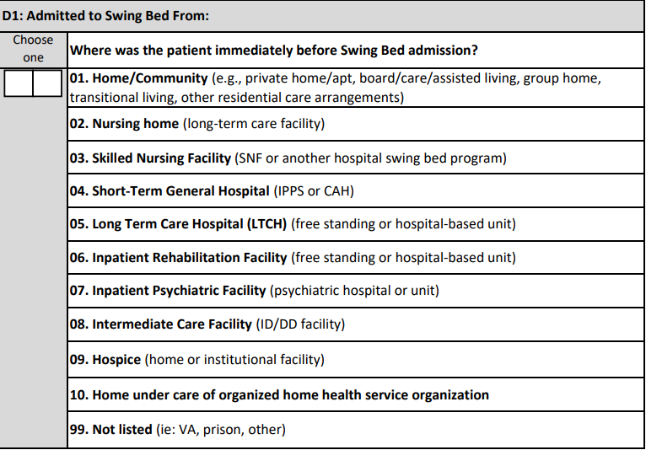
Admitted to Swing Bed From… (Part D 1)
Admitted to SB From? This asks where the patient was immediately before being admitted to SB to be in line with the MDS
Tracking this info can also help you to see if your marketing efforts beyond referring hospitals are working.
Note: Do make sure you know if they came from (02) LTC or from their short-term SNF (03)
Not to be confused with Long-Term Care

Slide 12
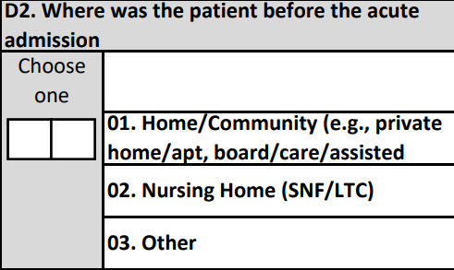
Admitted to Acute From… (Part D 2)
Where was the patient before the acute admission?
This allows to better compare discharge disposition with pre-hospitalization for Home and NH
Programs wanted to know of those who were discharged to a NH – was this where they came from in the first place. Now you can report on that.

Slide 13
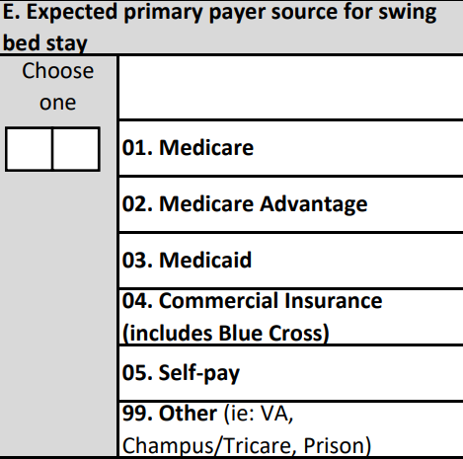
Payors (Part E)
Should be self-explanatory – do not assume, should match what is reported on the claims form (UB-04)
We have been noticing Medicaid as a payor which was a concern since they usually do not pay for SB unless you are also licensed as a LTC provider. But it is getting more common in certain areas that there is Medicaid/Manage Care and they indeed pay for SB.
If you have Medicaid/Manage Care (regardless of what they call themselves), do make sure you know how they pay: cost-based or per diem contract not unlike some Medicare Advantage
Regardless of straight Medicaid or Medicaid/Manage Care – check the Medicaid

Slide 14
Section 2: Risk-Adjustment Elements

Slide 15
Risk Adjusters (Overview)
Risk adjustment promotes fair and accurate comparison of healthcare outcomes across patients and providers
Using risk adjusters (RA) allows us to better benchmark. As we all know, a patient with a severe stroke should not be compared with a pneumonia patient unless its risk-adjusted
For this project, Stroudwater uses risk adjusters for mainly self-care and mobility measures.
Risk adjusters used for this project are as follows: (other than age, they are found in Section2)
Age
Major surgery within the last 100 days
Prior functioning
B&B continence
Pressure ulcers
Fall history
TPN/Tube feeding
Patient communication
Comorbidities
Code appropriately to ensure accurate outcome based on risk adjusters
Non-identified risk-adjuster will most likely give you lower Functional Improvement Scores
NOTE: CMS also uses BIMS to benchmark, but we found, based on the pilot project, that the risk adjuster for BIMs was not worth the effort and staff time to continue the BIMS assessment for CAH swing bed programs. You may feel free to continue the BIMS assessment in your programs, but it will not be entered in the portal

Slide 16
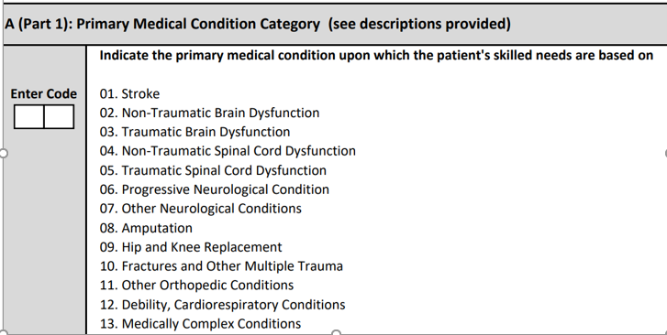
Primary Medical Condition (Part A)
See CMS’ definition of each of the 13 Primary Medical Condition on the next 2 slides.
Risk
Adjuster
The patient may have different issues that fall into more than 1 choice hence why you must concentrate on the primary admitting diagnosis with skill care needs for which you are admitting the patient. For instance, a patient may be admitted for post-hip replacement and have COPD. This would be coded as (09) Hip & Knee Replacement and not (12) Debility, Cardiorespiratory Conditions
This should be discussed with the provider and the team during the initial IDT meeting at the time you are discussing the skilled needs The providers documentation should support the primary medical condition. This cannot be decided by the team only.
The primary diagnosis from the HIM coder should be on the same vein
Remember that the skill needs should be shared with patient/family and all staff to improve communication and ensure pertinent documentation

Slide 17
Primary Medical Condition Definitions
Code 01, Stroke = if the patient’s primary medical condition category is due to stroke. Examples include ischemic stroke, subarachnoid hemorrhage, cerebral vascular accident (CVA), and other cerebrovascular disease.
Code 02, Non - Traumatic Brain Dysfunction = if the patient’s primary medical condition category is non-traumatic brain dysfunction. Examples include Alzheimer’s disease, dementia with or without behavioral disturbance, malignant neoplasm of brain, and anoxic brain damage.
Code 03, Traumatic Brain Dysfunction = if the patient’s primary medical condition category is traumatic brain dysfunction. Examples include traumatic brain injury, severe concussion, and cerebral laceration and contusion.
Code 04, Non - Traumatic Spinal Cord Dysfunction = if the patient’s primary medical condition category is non-traumatic spinal cord injury. Examples include spondylosis with myelopathy, transverse myelitis, spinal cord lesion due to spinal stenosis, and spinal cord lesion due to dissection of aorta.
Code 05, Traumatic Spinal Cord Dysfunction = if the patient’s primary medical condition category is due to traumatic spinal cord dysfunction. Examples include paraplegia and quadriplegia following trauma.
Code 06, Progressive Neurological Conditions = if the patient’s primary medical condition category is a progressive neurological condition. Examples include multiple sclerosis and Parkinson’s disease.

Slide 18
Primary Medical Condition Definitions (cont’)
Code 07, Other Neurological Conditions = if the patient’s primary medical condition category is other neurological condition. Examples include cerebral palsy, polyneuropathy, and myasthenia gravis.
Code 08, Amputation = if the patient’s primary medical condition category is an amputation. An example is acquired absence of limb, toes
Code 09, Hip and Knee Replacement = if the patient’s primary medical condition category is due to a hip or knee replacement. An example is total knee replacement. If hip replacement is secondary to hip fracture, code as fracture.
Code 10, Fractures and Other Multiple Trauma , if the patient’s primary medical condition category is fractures and other multiple trauma. Examples include hip fracture, pelvic fracture, and fracture of tibia and fibula.
Code 11, Other Orthopedic Conditions = if the patient’s primary medical condition category is other orthopedic condition. An example is unspecified disorders of joint.
Code 12, Debility, Cardiorespiratory Conditions = if the patient’s primary medical condition category is debility or a cardiorespiratory condition. Examples include chronic obstructive pulmonary disease (COPD), asthma, and other malaise and fatigue.
Code 13, Medically Complex Conditions = if the patient’s primary medical condition category is a medically complex condition. Examples include diabetes, pneumonia, chronic kidney disease, open wounds, pressure ulcer/injury, infection, and disorders of fluid, electrolyte, and acid-base balance.

Slide 19
Primary Medical Condition Coding Examples
Example #1: Ms. K is a 67-year-old female with a history of Alzheimer’s dementia and diabetes who is admitted after a stroke. The diagnosis of stroke, as well as the history of Alzheimer’s dementia and diabetes, is documented in Ms. K’s history and physical by the admitting physician.
Coding: Section 2 A (part 1) would be coded 01, Stroke
Rationale: The physician’s history and physical documents the diagnosis stroke as the reason for Ms. K’s admission
***********************************************************************************************************
Example #2: Mrs. E is an 82-year-old female who was hospitalized for a hip fracture with subsequent total hip replacement and is admitted for rehabilitation. The admitting physician documents Mrs. E’s primary medical condition as total hip replacement (THR) in her medical record. The hip fracture resulting in the total hip replacement is also documented in the medical record in the discharge summary from the acute care hospital.
Coding: Section 2 A (part 1) would be coded 10, Fractures and Other Multiple Trauma.
Rationale: Medical record documentation demonstrates that Mrs. E had a total hip replacement due to a hip fracture and required rehabilitation. Because she was admitted for rehabilitation as a result of the hip fracture and total hip replacement, Mrs. E’s primary medical condition category is 10, Fractures and Other Multiple Trauma.

Slide 20
Primary Medical Condition Examples (cont’)
Example #3: Mrs. H is a 78-year-old female with a history of hypertension and a hip replacement 2 years ago. She was admitted to an extended hospitalization for idiopathic pancreatitis. She had a central line placed during the hospitalization so she could receive TPN. She also received regular blood glucose monitoring and treatment with insulin when she became hyperglycemic. During her SNF stay, she is being transitioned from being NPO and receiving her nutrition parenterally to being able to tolerate oral nutrition. The hospital discharge diagnoses of idiopathic pancreatitis, hypertension, and malnutrition were incorporated into Mrs. H’s SNF medical record.
Coding: Section 2 A (part 1) would be coded 13, Medically Complex Conditions.
Rationale: Mrs. H had hospital care for pancreatitis immediately prior to her SNF stay. Her principal diagnosis of pancreatitis was included in the summary from the hospital. All other items are treatments due to pancreatitis
*************************************************************************************************************
Example# 4: Mr. J is a 85 y.o. male with history of cardiovascular disease but well managed. He was admitted for a hip replacement with the plan for a short SB stay for rehab to allow for a safe return home. He lives alone and has 8 steps to his front door. While in acute care post surgery, he developed a mild stroke which made rehab a bit more challenging. He was transferred to SB for rehab of both post-ortho and stroke. The provider’s notes simply refers to the SB admission post hip replacement and stroke. The team does not know what to choose for a primary medical condition.
My response: Discuss with physician for the need to identify a primary since the coders will also need such. Not seeing the patient, it appears that the hip replacement is more of an issue since he had a mild stroke. On the other hand, if the stoke was extensive and key aspect of the rehab, I probably would choose Stroke as primary as would the coder and post hip as secondary for SB.

Slide 21
Major Surgery (Part B)
Risk
Adjuster-
Major surgery may have occurred anytime in the past 100 days up until their admission to swing bed
Includes major surgery while the patient was in acute care
CMS has a very limited definition for major surgery:
Required at least 1 overnight stay in the hospital – one would assume that it could be as an IP or OP overnight stay since for example, hip surgeries are now frequently an overnight stay only, yet, has some degree of risk to the patient
The surgery carried some degree of risk to the patient’s life or the potential for severe disability
Recommend you discuss with the PCP and HIM Coder if you have difficulty deciding on whether a surgery is considered major or not

Slide 22
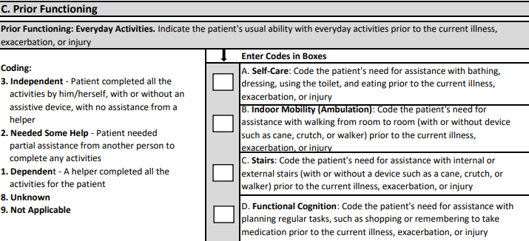
Prior Functioning (Part C)
Ask the patient or his or her family and review the patient’s medical records describing the patient’s prior functioning with everyday activities before they got sick even if they were sick for 3 weeks before admission to acute.
Do not just use “yes” ‘No” questions
Risk
Adjuster
This could be completed by the care manager at the time of the admission nterview or by the therapist if involved – should be reviewed during the 1st
IDT meeting
(3) Independent – NO Assistance from a helper what-so-ever
(2) Needed some help – in any amount - (amount of help needed is not taken into account – just whether they need a helper or not)
(1) Dependent – a helper is a must – w/out the helper, the activity would not occur
(8) Unknown – only to be used if the patient cannot say and there are no family/friends… who can inform us and the medical record does not have the information
(9) Not applicable – one would expect that you would have a code 1, 2 or 3 for (A) self-care because that is a must but feasible that you would have N/A for ambulation and stairs if the patient does not do that. Same goes for functional cognition – so, If the patient was unable to do the everyday activity prior to admission to acute, code as 9, Not Applicable

Slide 23
Prior Device Use (Part D)
Ask the patient or his/her family and review the patient’s medical records
Have them explain why they use the device
Walker of any type – does not include canes
Does not apply to devices given to them during the acute hospitalization
If patient was not using a device prior to acute hospitalization but was given a walker or w/c during the acute stay for his/her ambulation – the answer would be “Z” none of the above
Ensure that the device is required for their mobility – for instance, if husband had a chair lift before passing and wife now uses it because its easier though not required to go from sit-to-stand, “C” Mechanical Lift would not be checked off
If the patient was using a walking cane, then check “Z” – none of the above

Slide 24
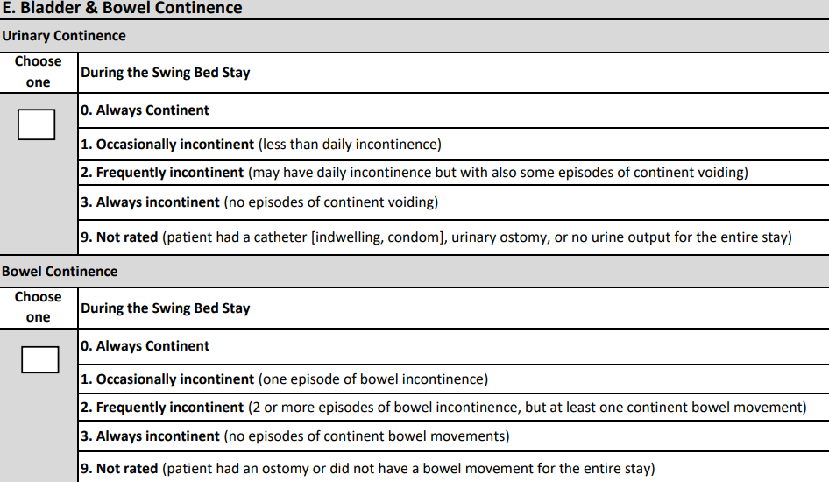
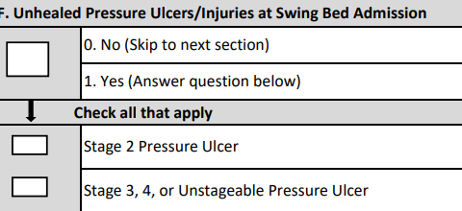
Bladder & Bowel Continence (Part E)/ Pressure Ulcer (Part F)
Do read the definitions carefully in order to assign the proper code
Both are Risk
Adjuster
Tracked to serves as a risk factor only

Slide 25
Fall History (Part G)
Both are Risk
Adjuster
DEFINITIONS for Falls
FALL - Unintentional change in position coming to rest on the ground, floor or onto the next lower surface (e.g., onto a bed, chair, or bedside mat).
The fall may be witnessed, reported by the patient or an observer or identified when a patient is found on the floor or ground.
Falls include any fall, no matter whether it occurred at home, while out in the community, in an acute hospital or a nursing home.
Falls are not a result of an overwhelming external force (e.g., a patient pushes another patient).
An intercepted fall occurs when the patient would have fallen if he or she had not caught him/herself or had not been intercepted by another person –this is still considered a fall.
Note: CMS understands that challenging a patient’s balance and training him/her to recover from a loss of balance is an intentional therapeutic intervention and does not consider anticipated losses of balance that occur during supervised therapeutic interventions as intercepted falls.

Slide 26
Fall Coding Examples
Section J : Health Conditions
On admission interview, Mrs. J. is asked about falls and says she has "not really fallen." However, she goes on to say that when she went shopping with her daughter about 2 weeks ago, her walker got tangled with the shopping cart and she slipped down to the floor.
Coding: Code 1, Yes.
Rationale: Falls caused by slipping meet the definition of falls.
On admission interview a patient denies a history of falling. However, her daughter says that she found her mother on the floor near her toilet twice about 3-4 months ago.
Coding: Code 0, No
Rationale: If the individual is found on the floor, a fall is assumed to have occurred but, this was more than 1 month ago
On admission interview, Mr. M. and his family deny any history of falling. However, nursing notes in the transferring hospital record document that Mr. M. repeatedly tried to get out of bed unassisted at night to go to the bathroom and was found on a mat placed at his bedside to prevent injury the week prior to the transfer to SB .
Coding: Coded 1, Yes
Rationale: Medical records from an outside facility document that Mr. M. was found on a mat on the floor. This is defined as a fall

Slide 27
Fall Coding Examples (cont’)
Section(cont’) J : Health Conditions
Medical records note that Miss K. had hip surgery 5 months prior to admission to the nursing home and before being admitting to acute then SB. Miss K.’s daughter says the surgery was needed to fix a broken hip due to a fall.
Coding: Code 0, No
Rationale: Miss K. had a fall related fracture, but it was 5 months prior to admission (earlier that in the past month)
Mr. O.’s hospital transfer record includes a history of osteoporosis and vertebral compression fractures. The record does not mention falls, and Mr. O. denies any history of falling.
Coding: Coded 0, No
Rationale: The fractures were not related to a fall
Ms. P. has a history of a “Colles’ fracture” of her left wrist about 3 weeks before the SB admission. Her son recalls that the fracture occurred when Ms. P. tripped on a rug and fell forward on her outstretched hands.
Coding: Code 1, yes
Rationale: Ms. P. had a fall-related fracture less than 1 month prior to entry.

Slide 28
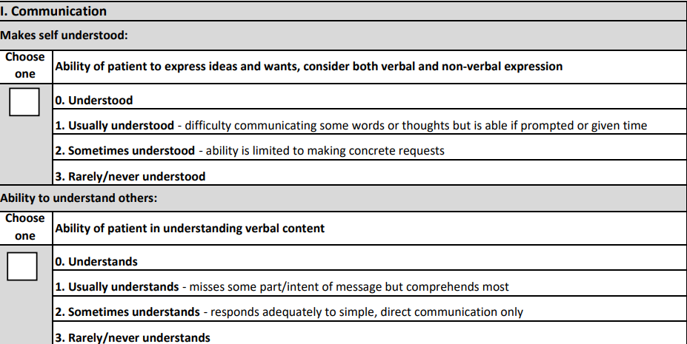
TPN / Tube Feeding (Part H) / Communication (Part I)
Section J : Health Conditions
Do not count if they had such in acute but discontinued before being admitted to SB
Both are Risk
Adjuster
Consider discussing as a team during the first IDT meeting to determent what best fits the patient
See next 2 slides on tips for assessment
Documentation should support findings

Slide 29
Communication (Makes self Understood)
MAKES SELF UNDERSTOOD - Able to express or communicate requests, needs, opinions, and to conduct social conversation in his or her primary language, whether in speech, writing, sign language, gestures, or a combination of these. Deficits in the ability to make one’s self understood (expressive communication deficits) can include reduced voice volume and difficulty in producing sounds, or difficulty in finding the right word, making sentences, writing, and/or gesturing
Problems making self understood can be very frustrating for the patient and can contribute to social isolation and mood and behavior disorders.
Unaddressed communication problems can be inappropriately mistaken for confusion or cognitive impairment.
Steps for Assessment
Assess using the patient’s preferred language or method of communication.
Interact with the patient. Be sure he or she can hear you or have access to his or her preferred method for communication. If the patient seems unable to communicate, offer alternatives such as writing, pointing, sign language, or using cue cards.
Observe his or her interactions with others in different settings and circumstances.
Consult with the primary nursing staff (over all shifts) and the patient’s family and speech-language pathologist if involved

Slide 30
Communication (Ability to Understand Others)
ABILITY TO UNDERSTAND OTHERS - Comprehension of direct person-to-person communication whether spoken, written, or in sign language or Braille. Includes the patient’s ability to process and understand language. Deficits in one’s ability to understand (receptive communication deficits) can involve declines in hearing, comprehension (spoken or written) or recognition of facial expressions.
Inability to understand direct person-to-person communication
Can severely limit association with others
Can inhibit the individual’s ability to follow instructions that can affect health and safety
Steps for Assessment
Assess in the patient’s preferred language or preferred method of communication
If the patient uses a hearing aid, hearing device or other communications enhancement device, the patient should use that device during the evaluation of the patient’s understanding of person-to-person communication.
Interact with the patient and observe his or her understanding of other’s communication.
Consult with direct care staff over all shifts, if possible, the patient’s family, and speech-language pathologist (if involved in care).
Review the medical record for indications of how well the patient understands others.

Slide 31
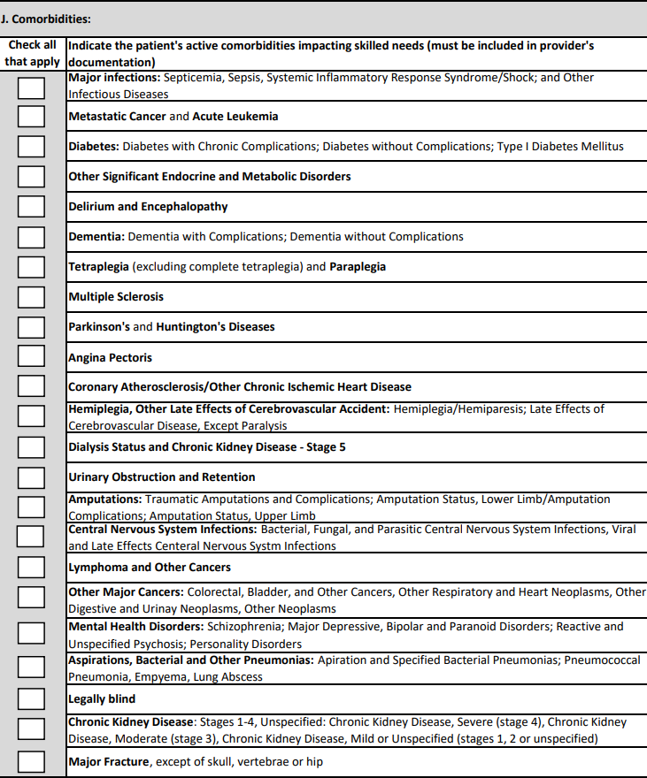
Comorbidities (Part J)
This list is based on what CMS considers potentially impacting outcomes hence why they are used as risk adjusters. It does not contain all possible comorbidities – only those proven to impact outcomes
ACTIVE diagnosis/comorbidity =
Physician-documented diagnoses that have a direct relationship to the patient’s current functional status, cognitive status, mood or behavior, medical treatments, nursing monitoring, or risk of death during their stay
Must be supported in the providers documentation along with what makes them “Active” in H&P, progress notes, orders etc…
Consists of diagnosis remaining active in SB since admission
Essential that diagnoses communicated verbally are documented in the medical record by the physician to ensure follow‐up
This is not the primary admitting condition/ diagnosis but rather a cause of such or a sequela. For instance, patient in acute being treated for cancer and now too debilitated to go home w/out rehab. Primary Condition would be #11 (Debility) and you would check of cancer on this list
Risk
Adjusters

Slide 32
Comorbidities (cont’)
Diagnostic information, including past history obtained from family members and close contacts, must also be documented in the medical record by the physician to ensure validity and follow‐up and must be active during the SB stay to be checked of
DO NOT code from symptoms listed in licensed nursing notes
DO NOT code diagnoses added by therapists unless signed by the physician
DO NOT guess/assume or estimate what you think the physician meant without asking the physician for clarification
As for all diagnosis, the HIM coder should be able to assist as needed
Diagnosis are made by Physicians (Attending physician, covering physicians, Radiologists, Specialists, etc.) • Nurse Practitioners • Clinical Nurse Specialists • Physician Assistants
Diagnosis may be found in
History and Physicals (hospitals and SB)
ER records and other hospital records such as Observation prior to admission
Discharge summaries
X-ray and Lab reports
Surgical reports
Physician progress notes
Transfer records

Slide 33
Section 3: Therapy Utilization & SB Programming

Slide 34
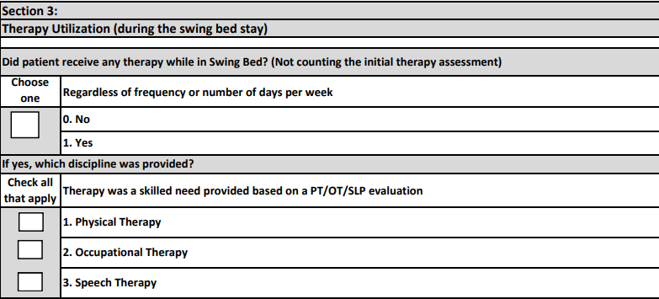
Therapy Utilization
Check “yes” regardless of frequency but there must be documented evaluation prior to treating
Check “no” if only included a one time visit for evaluation and development of a nursing management plan when skilled rehab interventions are not necessarily warranted
This section is to help management understand therapy utilization at a basic level. Ideally, we would track minutes as per CMS
Only intended for patients receiving multiple days of therapy
Scenario: – patient is skilled for nursing 7 days per week but also receives therapy 3 x/wk. This would count as a yes even though it would not serve as an admission skill since therapy is not provided at least 5 days/week
Allows you to look at self-care & mobility outcome status based on therapy disciplines involved
Allows benchmarking for therapy utilization with other networks and project participants

Slide 35
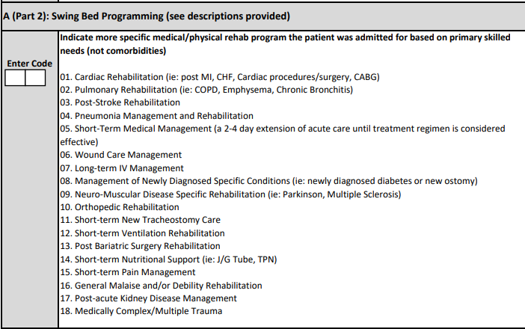
Clinical Programs
See next 2 slides for definitions
Coding this section should be a team approach such as the initial IDT meeting
This list should help you better identify the type of patients you may admit or what opportunities do you have to increase your services
Can be used to promote your services
The choice of the program is based on the major reason you are admitting the patient for – what are the treatments or skills needs related to?

Slide 36
Clinical Programs Definitions

Slide 37
Clinical Programs Definitions (cont’)
Having a good understanding of potential Clinical Programs is a must:
to be better able to describe the types of patients you can or want to accept in your program,
to better meet the service area residents’ needs
to promote your program (part of your marketing plan)
to increase utilization

Slide 38
Clinical Programs Examples
Q: There may be times that multiple choices would be appropriate, and we would have to have some guidelines for consistent selection of a single program description versus an option to select multiple programs that could be running concurrently.
Example # 1: A patient was admitted to swing bed with a full thickness diabetic foot ulcer S/P resection of a metatarsal that required 6 weeks of IV antibiotics, wound care, and PT/OT for training for mobility and ADLs with non-weightbearing precautions to the extremity. Could it not be wound care, long-term IV antibiotics, and orthopedic?
A: The program would be # 10 “Ortho Rehabilitation”. In this case, the IV antibiotic and therapy are treatments related to his Orthopedic surgery

Slide 39
Clinical Programs Examples (cont’)
Example #2: A patient was admitted with an acute compression fracture and requiring short-term pain management while also requiring rehabilitation to learn strategies for spinal protection and/or use of a spinal orthotic while performing basic mobility and ADLs. Could it not be short term pain management and orthopedic rehabilitation?
A: The program would be # 10 “Orthopedic Rehab”. Again, in this case, the therapy and pain management are treatments to deal with his acute compression fracture
Example #3: A patient was admitted with complicated GI condition, warranting TPN for several weeks while also requiring rehabilitation due to extended hospital course. Could it not be short-term nutritional support and general malaise and/or debility?
A: The program would be #14 “Short-Term Nutritional Support”. This is the primary reason he is admitted to SB. He is secondarily debilitated, and we are looking for the primary reason for SB.

Slide 40
Clinical Program Examples (cont’)
Q: Can you please give examples of how Section 2 A (part 1) and (part 2) may differ
Example #1: Mrs. V was hospitalized for gram-negative pneumonia. Since this was her second episode of pneumonia in the past six months, a diagnostic bronchoscopy was performed while in the hospital. She also has Parkinson’s disease and rheumatoid arthritis. She was discharged to a SNF for continuing care.
Coding: Section A (part 1) is coded as 13, Medically Complex Conditions
(part 2) is coded as 04 – Pneumonia Management & Rehab
Example #2: Mrs. O, a diabetic, was hospitalized for sepsis from an infection that developed after outpatient bunion surgery. A central line was placed to administer antibiotics. She was discharged to a SNF for continued antibiotic treatment and monitoring.
Coding: Section A (part 1) is coded as 13, Medically Complex Conditions
(part 2) is coded as 07, Long-Term IV Antibiotic
Example #3: Mrs. H was hospitalized for severe back pain from a compression fracture of a lumbar vertebral body, which was caused by her age-related osteoporosis. She was treated with a kyphoplasty that relieved her pain. She was transferred to SB after discharge because of her mild dementia and need to regulate her anticoagulant treatment for atrial fibrillation.
Coding: Section A (part 1) is coded 10, Fractures and Other Multiple Trauma
(part 2) is coded as 05, Short-term Medical Management

Slide 41
Section 4: Exclusions

Slide 42
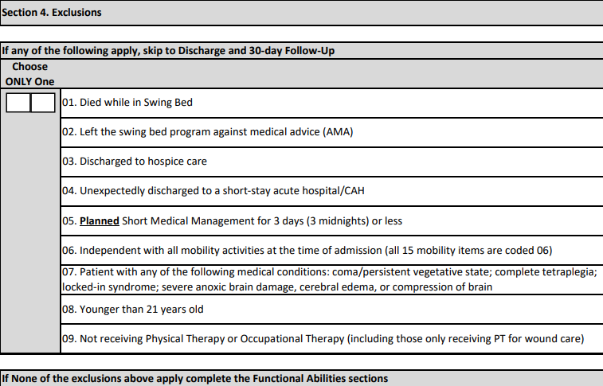
Exclusions
Patients who fall into one of 9 potential exclusions are not included in the Self-Care & Mobility scoring!
Choose the one most appropriate
If the patient fell into an exclusion from the beginning, then there is no need to complete Self-Care & Mobility Assessment
If they did not fall into an exclusion, complete admitting Self-Care & Mobility – and then if they fall into an exclusion such as LAMA, return to acute etc.. – then there is no need to complete the D/C Self-Care and Mobility assessments
Allows quantifying reasons for exclusions
When choosing one only when multiple would apply, put your data analysis hat on and think of what data would be more pertinent for program management
For instance, an independent patient who leaves AMA – you would want to choose 02 because that is more crucial for your hospital to track
A planned short stay (05) who was readmitted to acute (02) – choose 02
A patient not receiving therapy (09) who died while in SB (01) – choose 01
A 21 y.o. patient (08) with no therapy (09) – I would choose 09 because age groups are tracked elsewhere

Slide 43
Section 5 & 6: Functional Activity Assessments

Slide 44
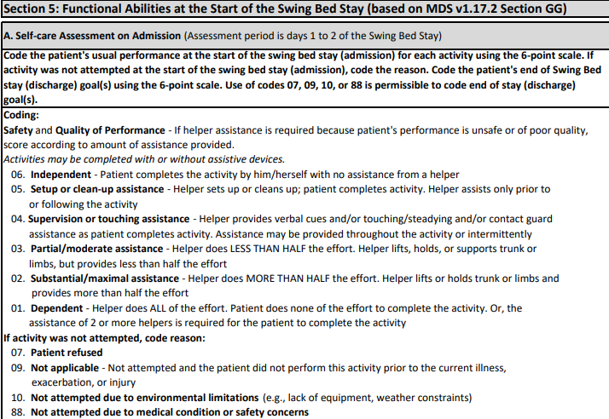
Section 5: Self-Care & Mobility
Remember that documentation must support the level chosen
The form by itself is not sufficient for documentation

Slide 45
Function Levels
When coding the patient’s usual performance, “effort” refers to the type and amount of assistance the helper provides in order for the activity to be completed. The 6-point rating scale definitions include the following types of assistance: setup/cleanup, touching assistance, verbal cueing, and lifting assistance.
06 - Independent ‐ Patient completes the activity by him/herself with no assistance from a helper
05 - Setup or clean‐up assistance ‐ Helper sets up or cleans up; patient completes activity. Helper assists only prior to or following the activity
04 - Supervision or touching assistance ‐ Helper provides verbal cues and/or touching/steadying and/or contact guard assistance as patient completes activity. Assistance may be provided throughout the activity or intermittently
03 - Partial/moderate assistance ‐ Helper does LESS THAN HALF the effort. Helper lifts, holds, or supports trunk or limbs, but provides less than half the effort
02 - Substantial/maximal assistance ‐ Helper does MORE THAN HALF the effort. Helper lifts or holds trunk or limbs and provides more than half the effort
01 - Dependent ‐ Helper does ALL of the effort. Patient does none of the effort to complete the activity. Or, the assistance of 2 or more helpers is required for the patient to complete the activity

Slide 46
Coding Self-Care & Mobility Exceptions
Exception Codes for Functional Assessment
All functions must be attempted unless there is a reason why not as follows:
Note: It is expected that the documentation in the chart supports reasons for not assessing all items. So, when using any of these exception codes, there should be documentation to back up the reason for not assessing
07 - Patient refused – do all possible to convince them to participate and you cannot infer thru clinical data and observation/interviews. Note: If the patient is refusing because he/she is afraid or doubting their ability, they should be scored as Dependent
09 - Not applicable ‐ Not attempted and the patient did not perform this activity prior to the current illness, exacerbation, or injury – for instance, if patient was not doing stairs before such as bed/chair ridden at home then its NA If patient does not ambulate or uses w/c in community then the walking scores are NA etc… Should only be used if the patient will not ever attempt this activity ever again (now or in the future).
This should not be used because it was not attempted or because its not directly part of the plan of care. Do not code 09 as N/A if the patient is not walking now, but therapy and nursing have goals for the patient to walk prior to discharge. Instead code it as 88 (not attempted due to medical condition or safety concerns)
10 - Not attempted due to environmental limitations (e.g., lack of equipment, weather constraints) – for example, there are no 12-step stairs in the hospital (gym or stairs between hospital floors etc… Remember that if the weather is not good to test outdoors on day 1, do not use “not attempted due to environmental limitations” unless the weather does not change for all 3 days
88 - Not attempted due to medical condition or safety concerns – for instance you may not be able to assess stairs within the 1st 3 days for post stroke, or maybe their medical issues are still not sufficiently stable to attempt some of the testing such as a patient w/DVT to LLE on bedrest and unable to safely attempt transfer and ambulation

Slide 47
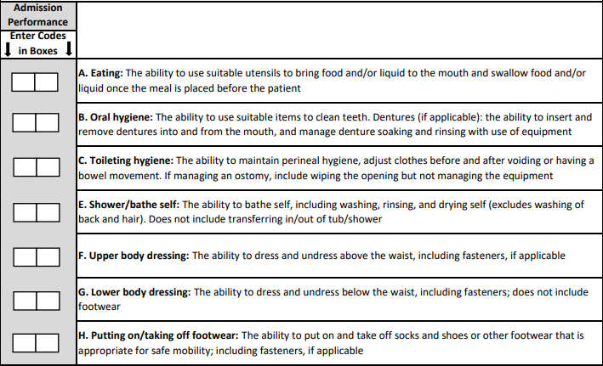
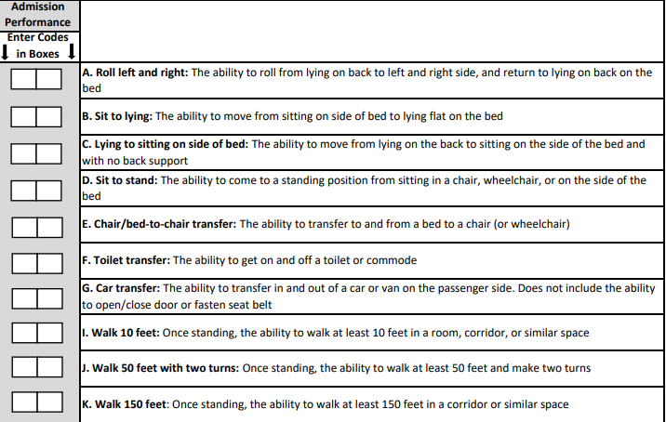
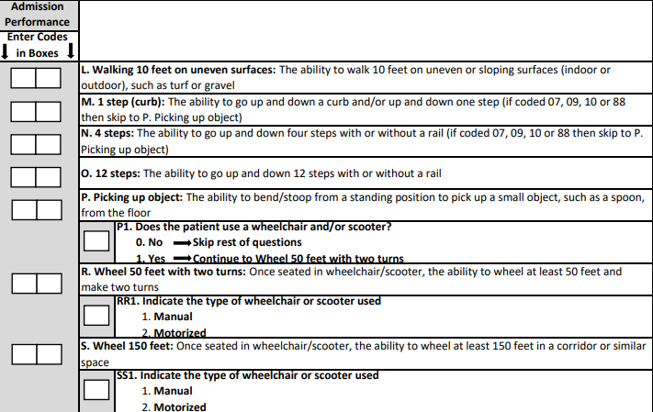
Self-Care & Mobility Assessments
Section 5 - Same information is assessed on admission & discharge

Slide 48
Basic Guidelines in Coding Section 5 & 6
Admission assessment must be completed within 3 calendar days of admission (including the day of admission)
Coding on admission should reflect the person’s baseline admission functional status and is based on clinical assessment
The admission functional assessment, when possible, should be conducted prior to the person benefiting from treatment interventions in order to determine a true baseline
Not all items have to be assessed in one sitting – some you may have to delay due to the patient’s condition and/or weather… hence the 3 days
Treatment should not be withheld in order to conduct the functional assessment
Activities may be completed with (if they usually use a device or safer attempted with a device or without assistive device(s)). Coding is not based on devices used
Patients with cognitive impairments/limitations may need physical and/or verbal assistance when completing an activity. Code based on the patient’s need for assistance to perform the activity safely (for example, choking risk due to rate of eating, amount of food placed into mouth, risk of falling). These are at the very lease not independent – will be coded a 5 (supervision/set up) or lower

Slide 49
Basic Guidelines in Coding Section 5 & 6 (cont’)
If the patient performs the activity more than once during the assessment period and the patient’s performance varies, coding should be based on the patient’s “usual performance,” which is identified as the patient’s usual activity/performance for any of the Self-Care or Mobility activities, not the most independent or dependent performance over the assessment period
The team may need to use the entire 3-day assessment period to obtain the patient’s usual performance for all measures ie: patient too tired to complete the assessment on day 1 or weather is bad, and you do not have a car simulator…
Assess the patient’s self-care status based on:
direct observation,
the patient’s self-report,
family reports, and
direct care staff reports documented in the patient’s medical record during the assessment period
CMS anticipates that an interdisciplinary team of qualified clinicians is involved in assessing the patient during the three-day assessment period
CMS defines “Qualified Clinician” as Healthcare professionals practicing within their scope of practice and consistent with Federal, State, local law and regulations”
So, a PTA or COTA may not assess but can contribute their observation etc same as a CAN/PCA would

Slide 50
Basic Guidelines in Coding Section 5 & 6 (cont’)
This should not be a therapy only assessment – should be what the patient’s usual performance is since admission on all shifts – not just what they did with therapy
Ideally this is a stand-up meeting the day after all admission assessments have been completed - with SB Coordinator, nursing and therapy rep that know the patients at which time each item is discussed, and levels agreed to. Night shift should include patient’s functional status at the morning report to get the full picture
Read the description of the items to be coded very carefully – do not read into it more than its asking (see later examples) – Must be able to perform all aspects of the described items to be considered Independent
Carefully read the coding key descriptions and choose what best fits the patient – always look at the descriptions before and after the one you think it is to make sure you have the correct one – If you can read, you should be able to do this as long as you are oriented to the basic guidelins
All assessment items must be attempted to be coded – otherwise a reason for no attempt must be coded (see slides on “Exceptions” for this section) – later, we will share the impact of using “exceptions”
See attachments for Coding Examples, Probing Question Examples etc… This should be used when helping nursing to determine the level (will be provided with these slides)

Slide 51
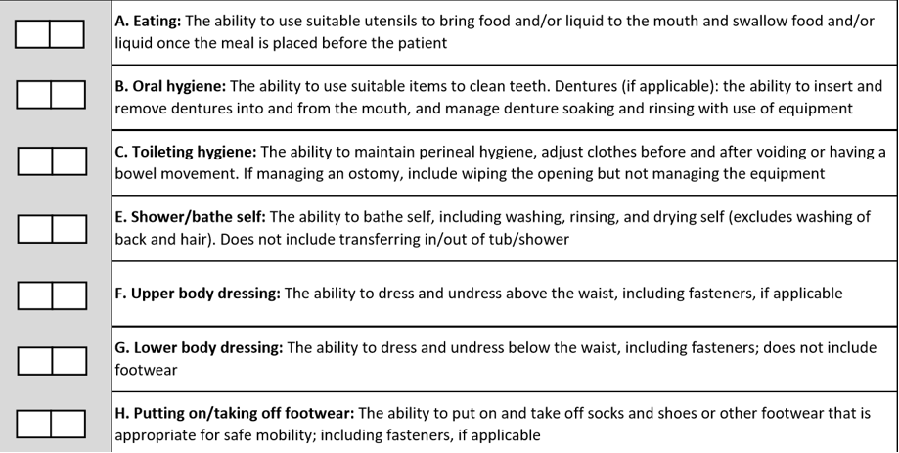
Self Care & Mobility Items To Be Coded
Self-Care Items

Slide 52
EATING:
Assess eating and drinking by mouth only
Assistance with tube feedings or TPN is not considered when coding Eating
If the patient does not eat or drink by mouth and relies solely on nutrition and liquids through tube feedings or TPN because of a new (recent-onset) medical condition but with plans to discontinue at some point, code as 88, Not attempted due to medical condition or safety concerns
If the patient did not eat or drink by mouth prior to the current illness, injury, or exacerbation, code eating as 09, Not applicable
For patients who have a combination of oral and tube feeding, eating should be coded on the amount of assistance the patient requires to eat and drink by mouth
If the patient eats finger foods with his or her hands, code based upon the amount of assistance provided

Slide 53
Coding Tips
TOILETING HYGIENE:
This item pertains to both voiding and/or having a bowel movement
Toileting hygiene includes managing undergarments, clothing, and incontinence products and performing perineal cleansing before and after voiding or having a bowel movement
Hygiene tasks can take place before and after use of the toilet, commode, bedpan, or urinal
If the patient does not usually use undergarments, then assess the patient’s need for assistance to manage lower-body clothing and perineal hygiene
If the patient has indwelling catheter or does not urinate due to dialysis and has bowel movements, code the toileting hygiene based on the assistance needed by the patient when moving his or her bowels
If the patient completes a bladder or bowel in bed, code Toileting hygiene based on the patient’s need for assistance in managing clothing and perineal cleansing

Slide 54
Coding Tips
SHOWER / BATH:
Assessment can take place in a shower or bath, at a sink, or at the bedside (i.e., full body sponge bath)
Shower/bathe self includes the ability to wash, rinse, and dry the face, upper and lower body, perineal area, and feet. Do not include washing, rinsing, and drying the patient’s back or hair.
Shower/bathe self does not include transferring in/out of a tub/shower.
If the patient bathes himself or herself and a helper sets up materials for bathing/showering, then code as 05, Setup or clean-up assistance.
If the patient cannot bathe his or her entire body because of a medical condition, then code Shower/bathe self based on the amount of assistance needed to complete the activity

Slide 55
Coding Tips
UPPER & LOWER BODY DRESSING:
The following items are considered a piece of clothing when coding the dressing items:
Other upper body dressing examples: thoracic-lumbar-sacrum orthosis (TLSO), abdominal binder, back brace, stump sock/shrinker, upper body support device, neck support, hand or arm prosthetic/orthotic.
Other lower body dressing examples: knee brace, elastic bandage, stump sock/shrinker, lower-limb prosthesis. o Footwear examples: ankle-foot orthosis (AFO), elastic bandages, foot orthotics, orthopedic walking boots, compression stockings (considered footwear because of dressing don/doff over foot).
For both upper & lower - If donning and doffing an elastic bandage, elastic stockings, or an orthosis or prosthesis occurs while the patient is dressing/undressing, then count the elastic bandage/elastic stocking/orthotic/prosthesis as a piece of clothing when determining the amount of assistance the patient needs when coding the dressing item

Slide 56
UPPER BODY DRESSING:
Includes bra, undershirt, button-down shirt, pullover shirt, dresses, sweatshirt, sweater, nightgown (NOT hospital gown), and pajama top
If the patient dresses himself or herself and a helper retrieves or puts away the patient’s clothing, then code 05, Setup or clean-up assistance.
Helper assistance with buttons and/or fasteners is considered touching assistance = 04
LOWER BODY DRESSING:
Helper assistance with buttons and/or fasteners, buckling the belt, attaching the suspenders to the pants are all considered touching assistance = 04
Includes underwear, incontinence brief, slacks, short, capri pants, pajama bottoms, and skirts
Other examples: knee brace, elastic bandage, stump sock/shrinker, lower-limb prosthesis

Slide 57
Coding Tips
PUTTING ON / TAKING OFF FOOTWEAR:
Includes socks, shoes, boots, and running shoes
Other examples: ankle-foot orthosis (AFO), elastic bandages, foot orthotics, orthopedic walking shoes, compression stocking (on and off over foot)
For patients with bilateral lower extremity amputations with or without use of prostheses, the activity of putting on/taking off footwear may not occur.
For example, the socks and shoes may be attached to the prosthesis associated with the upper or lower leg
If the patient performed the activity of putting on/taking off footwear immediately prior to the current illness, exacerbation, or injury, code as 88, Not attempted due to medical condition or safety concerns.
If the patient did not perform the activity of putting on/taking off footwear immediately prior to the current illness, exacerbation, or injury because the patient had bilateral lower-extremity amputations and the activity of putting on/taking off footwear was not performed during the assessment period, code as 09, Not applicable

Slide 58
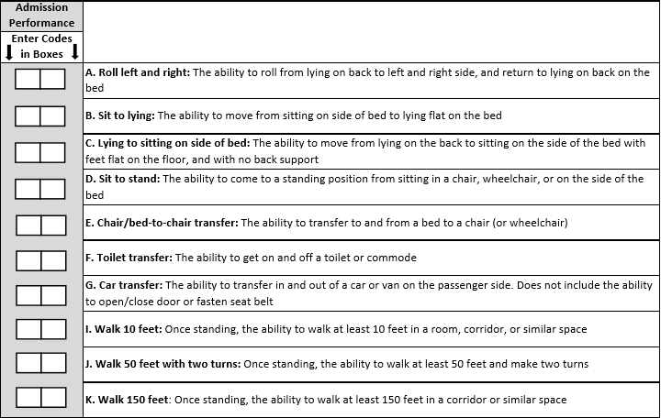
Self Care & Mobility Items To Be Coded (cont’)
Mobility Items
Lying flat on bed at level normal for that pt.
Flat on floor or on stool if bed cannot be adjusted

Slide 59
ROLLING LEFT TO RIGHT:
Patient demonstrates being able to lie on back and turn left, return to back and turn to right then return to the back – must be able to do both w/out assistance – if he can do 1 side but not the other, level at how much assistance did you have to give for the other side
If can go one side but not the other due to pain or tubes etc then put 88
SITTING TO LYING FLAT:
Lying Flat = to what is usual for that patient – if they need bed up at 30 % due to breathing issues then that is “their flat”
LYING TO SITTING ON SIDE OF BED
Lying to sitting on side of bed, indicates that the patient transitions from lying on his/her back to sitting on the side of the bed with feet flat on the floor and sitting upright on the bed without back support.
The clinician is to assess the patient’s ability to perform each of the tasks within this activity and determine how much support the patient requires to complete the activity.
Clinical judgment should be used to determine what is considered a “lying” position for that patient.
If the patient’s feet do not reach the floor upon lying to sitting, the clinician will determine if a bed height adjustment or a foot stool is required to accommodate foot placement on the floor/footstool.
Back support refers to an object or person providing support of the patient’s back.

Slide 60
CHAIR / BED-TO-CHAIR:
Chair/bed-to-chair transfer, begins with the patient sitting in a chair or wheelchair or sitting upright at the edge of the bed and returning to sitting in a chair or wheelchair or sitting upright at the edge of the bed.
The activities of “Sit to lying” and “Lying to sitting” on the side of the bed are two separate activities that are not assessed as part of “Chair/Bed-to-Chair”
If a mechanical lift is used to assist in transferring a patient for a chair/bed-to-chair transfer and two helpers are needed to assist with a mechanical lift transfer, then Code 01 - Dependent, even if the patient assists with any part of the chair/bed-to-chair transfer by holding the railing etc….
CAR TRANSFERS
The Car transfer item includes the patient’s ability to transfer in and out of the passenger seat of a car or car simulator
For item regarding car transfer, use of an indoor car can be used to simulate outdoor car transfers.
These half or full cars would need to have similar physical features of a real car for the purpose of simulating a car transfer, that is, a car seat within a car cabin.
The Car transfer item does not include transfers into the driver’s seat, opening/closing the car door, fastening/unfastening the seat belt
In the event of inclement weather or if an indoor car simulator or outdoor car is not available during the entire 3-day assessment period, then use code 10, Not attempted due to environmental limitations
If at the time of the assessment the patient is unable to attempt car transfers and could not perform the car transfers prior to the current illness, exacerbation or injury, code 09, Not applicable.
But, if the patient could get in and out of a car prior to the hospitalization but unsafe to try now due to mobility limitation, then cade “88” - unsafe

Slide 61
Coding Tips
WALKING:
Walking activities do not need to occur during one session
Allowing a patient to rest between activities or completing activities at different times during the day or on different days may facilitate completion of the activities
When coding walking items, do not consider the patient’s mobility performance when using parallel bars
Parallel bars are not a portable assistive device
If safe, assess and code walking using a portable walking device when needed
The turns are 90-degree turns.
The turns may be in the same direction (two 90-degree turns to the right or two 90-degree turns to the left) or may be in different directions (one 90-degree turn to the left and one 90-degree turn to the right).
The 90-degree turn should occur at the person’s ability level and can include use of an assistive device (for example, cane).

Slide 62
WALKING 10 FEET :
Once standing, the ability to walk at least 10 feet in a room, corridor, or similar space
Note: Does the patient walk? Mr. Z currently does not walk, but a walking goal is clinically indicated.
Coding: 88 due to clinically unsafe on admission
But it would be 09 N/A if he did not walk prior to his acute admission stay. Same goes to walking 50 ft and 150 ft.
WALKING 50 FEET W/2 TURNS:
Once standing, the ability to walk a total of at least 50 feet (1 way or go and return) and make two turns (left and right or 2 lefts and 2 rights)
WALKING 150 FEET
Once standing, the ability to walk at least 150 feet in a corridor or similar space (again 1 way or go 75 FT and return)

Slide 63
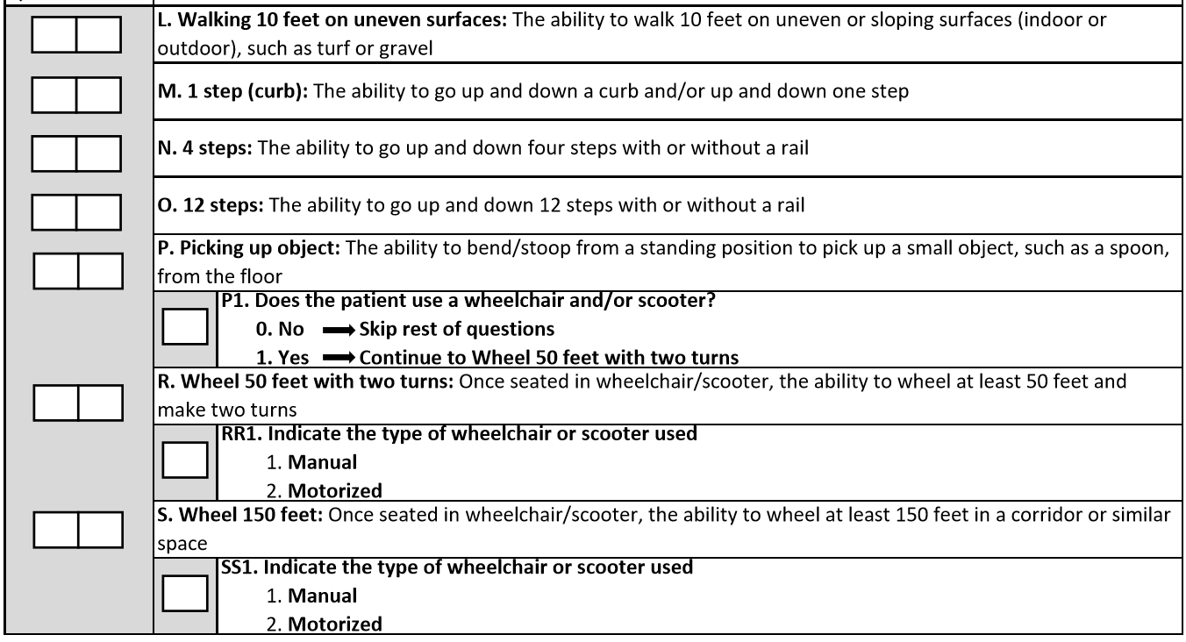
Mobility Items To Be Coded (cont’)
Mobility Items (cont’)
Also applies to picking up from a wheelchair

Slide 64
WALKING 10 FEET ON UNEVEN SURFACES:
The ability to walk 10 feet on uneven or sloping surfaces (indoor or outdoor), such as turf or gravel
1 STEP CURB:
The ability to go up and down a curb and/or up and down one step
4 STEPS:
The ability to go up and down four steps with or without a rail
12 STEPS:
The ability to go up and down 12 steps with or without a rail – can be in the gym or hospital staircase or in the community if you are taking the patient out
PICKING UP AN OBJECT:
The ability to bend/stoop from a standing position to pick up a small object, such as a spoon, from the floor – may be picking object from a W/C if the patient is W/C bound – remember that it is ok if they need a reacher to pick up the object – we are not measuring the need for device or not
WHEEL 50 FEET W/2 TURNS:
Once seated in wheelchair/scooter, the ability to wheel at least 50 feet and make two turns (see description of 90 degree turn on previous slide)
WHEEL 150 FEET
Once seated in wheelchair/scooter, the ability to wheel at least 150 feet in a corridor or similar space

Slide 65
Coding Tips
The intention of the wheelchair items is to assess the patient’s use of a wheelchair for self-mobilization at admission and discharge when appropriate.
The clinician uses clinical judgment to determine if the patient’s use of a wheelchair is appropriate for self-mobilization due to the patient’s medical condition or safety.
If the patient walks and is not learning how to mobilize in a wheelchair, and only uses a wheelchair for transport between locations within the facility, code the wheelchair/scooter gateway items at admission and/or discharge items as follows: Does the patient use a wheelchair/scooter = 0 for No.
Answering the question in this way invokes a skip pattern which will skip all remaining wheelchair questions.
Otherwise said, only code wheelchair mobility based on an assessment of the patient’s need and ability to mobilize in the wheelchair.
Remember that it is very possible that the patient starts with a wheelchair but no longer is the case on discharge – only walking will apply at discharge.

Slide 66
Self Care & Mobility Coding on Discharge
Discharge Functional Activity Assessment (Sect. 6)
Same items will be assessed on discharge except no goal setting
Must be completed within 3 calendar days of discharge including the day of discharge
For the Discharge assessment, code the patient’s discharge functional status, based on a clinical assessment of the patient’s performance that occurs as close to the time of the patient’s discharge as possible to capture all areas of improvement possible
Usually done the day prior or day of the discharge at a stand-up mtg
Same coding principles apply to discharge assessments
Again, all assessment items must be attempted to be coded – otherwise a reason for no attempt must be coded using the exception code list
Patients should be allowed to perform activities as independently as possible for both admission and discharge, as long as they are safe for both admission & discharge assessments.
Remember that even if the patient was coded on admission as 07 (refused), 10 (environmental issue). 88 (medically unsafe) does not mean it is automatically the same at discharge – on the contrary, hopefully those reasons would not apply by discharge.

Slide 67
Discharge Functional Activity Assessment (cont’)
Q: What if we had a patient who left against medical advice and over the weekend - how can we score the car transfer for instance?
A: When the patient leaves AMA or returns to acute unexpectedly or dies while on the unit - there is no need to complete a D/C functional assessment since they will be excluded from the Improvement & Risk-Adjusted scores.
Once you complete Section 4: Exclusions - remember that if they meet any reasons to exclude them, you do not have to score Self-Care & Mobility on admission or discharge. You would skip to Section 7.
In the same vein, if they did not meet any exclusions and you do the admission functional assessment but then they leave AMA, return to acute or die, you do not have to complete the D/C Functional Assessment. You do have to go back to Section 4 and add the new exclusion.
Q: What if they go home as planned but they do not have a car and we do not have a car simulator, how do we test car transfer?
A: If no family is available, nothing stops a therapist from using their own car.
Q: What if a patient is D/C'ed home via ambulance, do we have to test care transfer.
A: If the patient needs to know how to transfer once home and is going home by ambulance due to lack of other transportation, they should still be tested unless still totally unsafe in which case you would put 88 but you would have to be sure this patient is safe to be discharged to home.
Do remember that every time you do not test an item on D/C, you get a score of 1 - same as they were on admission and limiting your opportunities to demonstrate improvement as expected

Slide 68
Self Care & Mobility Coding on Discharge
Improvement Score
The improvement score (raw score) is the difference between the total admission assessment scores and the total discharge assessment scores
The change in function score for Self-Care is the difference between the total discharge self-care score (7-42) and the total admission self-care score (7-42)
The change in Mobility function score is the difference between the total discharge self-care score (15-90) and the total admission mobility score (15-90)
Discharge Self-Care & Mobility Coding | QRP Score
06 | 06
05 | 05
04 | 04
03 | 03
02 | 02
01, 07, 09, 10, 88, missing | 01
Exclusion codes are the same for the discharge as they were for admission
Note that “dependent” and exclusion scores are all = 01
This has a potential of impacting your total improvement score
Too many of these on admission wrongfully assigned may give you a false high improvement score
Too many of these on discharge will give you a low improvement score

Slide 69
Risk-Adjusted Score
As stated earlier, the raw scores are risk adjusted to promote fair and accurate comparison of healthcare outcomes across patients and providers
Using risk adjusters (RA) allows us to better benchmark. As we all know, a patient with a severe stroke should not be compared with a pneumonia patient
Risk Adjusters from Section 2 are applied to the raw scores of Section 5 (Functional Assessment) to equalize the playing field as CMS uses it for SNFs
7 to 42 for Self-Care total of the 7 assessment items and
15 to 90 for Mobility total of the 17 assessment items
Percentage of patients that met or exceed the expected performance improvement score is what is considered the Risk-Adjusted score based on research CMS had done

Slide 70
Analyzing Outcomes
Analyzing Outcomes
First look at the scores themselves
Are the baseline admission scores too high? Potential reasons:
Are we only admitting high functioning patients giving it less room for improvement
Is Section 5 derived solely by rehab?
Has our staff (therapy & nursing) been trained using CMS’s expectation on how to measure such as we did today?
Do the staff understand the language or continue using how we were trained before SB?
Are we basing our scores on only one component of the measure vs scoring on the most affected component
Are we assuming vs truly assessing specific items like eating, oral hygiene and rolling right and left etc
Do the discharge performance scores seem too low, it might be due to:
Do we take the time to set goals at the IDT meeting and share with all staff?
Are Section 5 items addressed and discussed routinely during weekly rehab and IDT meetings?
Is Section 5 performance a focus of the team
Do we not treat using the rehab model?
Are Section 5 items not assessed at discharge yielding a score of 1 for all unassessed items
Are there too many items using the Exception scores – again assigning a score of 1
Is Section 5 being written solely by nursing at discharge?
Do we alt the program before the patient is ready
Other…

Slide 71
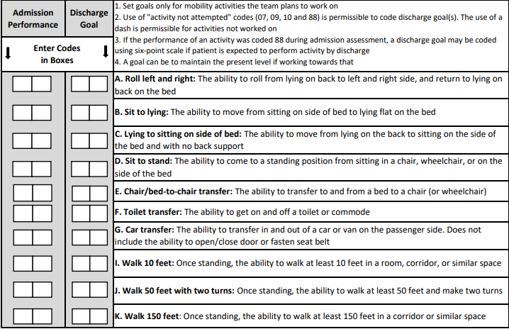
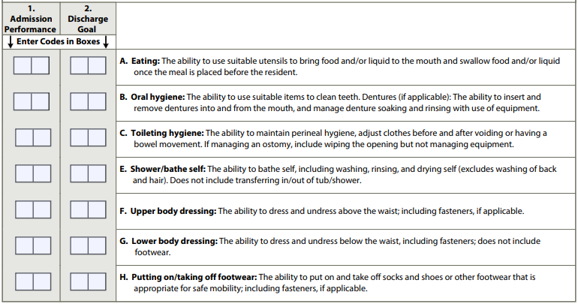
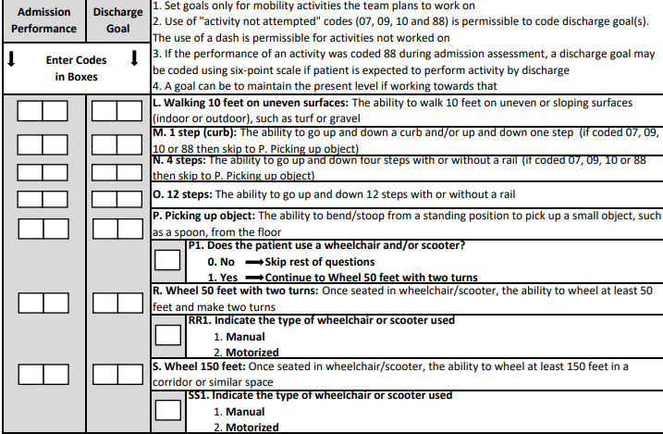
Goal Setting

Slide 72
Impact of Section GG on Quality Outcome
Setting Goals
Section GG is one of the MDS items from where functional outcomes are reported nationally
Some call it a Therapy Report Card but should be an interdisciplinary score card
Section GG is what Stroudwater is replicating for CAHs in Section 5
The focus of this quality measure is functional improvement for patients admitted to SB with an expectation of functional improvement due to skill services, including physical and occupational therapy.
Some skilled patients may receive skill care, but not physical or occupational therapy services, and these patients are excluded in the QRP measure calculation as they are in QAPI.
Setting realistic and aggressive discharge goals and tracking how we are doing on a daily/weekly basis to achieve the established care-planned Section 5 goals is the road to success
Not all items require a goal – CMS states that at least 1 item must have a discharge goal otherwise subject to a penalty – we are following CMS’s direction
Only stands to reason that most patients in skill care should have at least 1 self-care or mobility items to improve and usually at least a handful of items or more are applicable
CMS does allow using a goal score the same as on admission because all you plan to do is maintain them at that level
CMS goes on to say that at times, its even feasible that the goal would be lower than baseline because you expect the patient to become more dependent as time goes on – especially with worsening medical issues
Exception scores can also be used when appropriate
A dash is even acceptable if its not part of the treatment plan

Slide 73
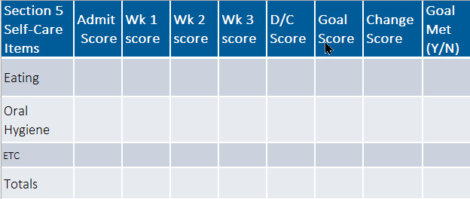
Goals do not impact the outcome measurement methodology – it serves as a tool to have everyone on board as to what we are working on functionally for each individual patient
Should improve direction and communication between all parties including the patient/family and staff
Should improve nursing documentation by increasing observation, assessments and reporting on how the patients are doing towards those goals
Shift reports should allude to not only clinical update, but also functional update based on goals
Goals should be set by day 3 which should coincide with your first IDT meeting
Understandably, there will be other goals than function goals such as medical management of their condition
Treatment plan and all goals should be shared with the patient/family, all members of the IDT and bedside nursing staff
The only way to determine how you are doing with outcomes is to pull your outcomes, review the trends and discuss results openly and collaboratively
Create the same for Mobility

Slide 74
Percentage of Goals Met
What its your process to set goals?
Is it a team approach (nursing & therapy)?
Do we base on a strong pre-admission status assessment? And discharge disposition?
Are the care plans with patient specific interventions?
Are our LOS based on an ITD team approach?
Do we share goals with the patient, family and all unit staff caring for SB patients?
Do we review admission assessment score, compared to the day of IDT and to goal set on a weekly basis?
Do we set lower scores then we should be based on risk-adjusters or lack there of? - do we set too low expectations for our patients (What if it was your mom you wanted to discharge to home. What would you want her to be able to accomplish?

Slide 75
Section 7: Discharge Information & Post Discharge Follow-Up

Slide 76
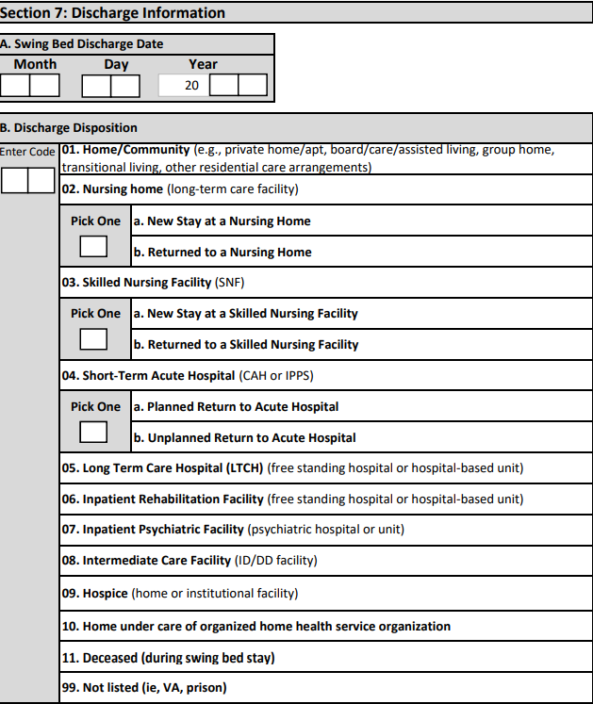
Section 7 (Part A – B): Discharge Information
Section 7: Discharge Information
Please double check that you have the date correct – we have seen discharges before being admitted and others looked like they were in SB forever!
We have broken down new and return to NH and SNF
We broke down planned and unplanned return to acute directly from the SB stay
Please remember to go back and check your exclusion list when completing the discharge disposition section – Return to acute, Discharged to Hospice and Deceased should be marked on the exclusion list as such to exclude those patients from the Functional measures PI determination

Slide 77
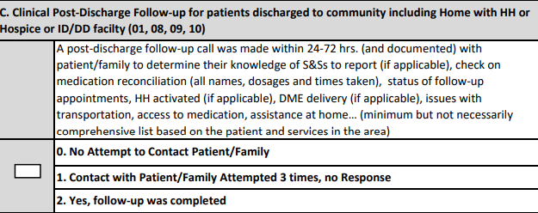
Section 7 (Part C) - Clinical Post-Discharge Follow-Up
Post-discharge clinical follow-up calls w/in 24-72 hrs. based on conditions, needs etc,,, has shown to prevent readmissions
Clinical follow-up calls are to be made for D/Cs to community, home w/HH, hospice and ID/DD facilities (Intellectual Disability Facilities)
Note: #1) Attempt x 3 = 3 times, not 2 – if 2 attempts only then mark ( 0 ) no attempt
Ideally, the last IDT meeting includes a discussion as to when we should schedule a follow-up call (24-72 hrs based on condition, discharge disposition support available, concerns you may have etc…)
If the policy of the hospital is to follow-up on all discharges within a week, be sure to get their results and mark as done.
If you feel certain patients should be followed up sooner, please do so. It’s the right thing to do
Hospitals should have a set of specific questions including comments as in the descriptive box above
The caller should be trained in conducting these interviews
The patient should be notified at discharge to expect this call and the purpose – discuss a time better than others they can expect you – allows them to have meds in reach as well as instructions you provided
Over and above tracking calls, SB programs should track outcome of the calls to look for opportunity for improvement on their side and refer back to, when analyzing readmissions

Slide 78
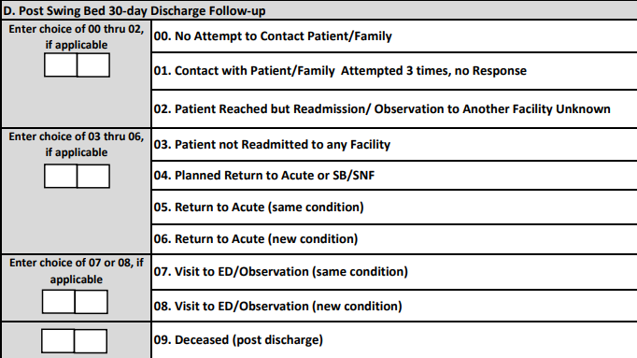
Section 7 (Part D) Post-Discharge 30-Day Follow-Up
Patients should be told to expect this call – ask for a best # to call – any time of the day or day to not call…
Some add the Clinical Follow-up call to the D/C instructions
Note If death within 30 days is applicable – do review if this was expected as part of your PI plan
Planned return to acute would be for instance – surgery scheduled in 3 weeks post discharge
Planned return to SB could be the post hip surgery who came to SB for non-weight bearing transfer training etc.. Then discharged to home with a planned return to complete therapy when surgeon allows to be weight bearing
Return to acute: same or new condition. CMS obtains this information for SNFs based on hospital claims. It is assumed that it is based on the primary diagnosis the patient had on the first admission compared to the primary diagnosis upon their return within 30 days – so, base your answer on what the patient/chart tells you compared to the primary diagnosis of the acute admission before they came to SB

Slide 79
Post-Discharge 30-Day Follow-Up Examples
Visit to ED/Observation (same or new condition) – Apply the same logic as above but based on the reason the patient was admitted to SB
Example 1: a patient was hospitalized for a hip fracture and developed fluid overload post-operatively with exacerbation of CHF. The patient is then transferred to swing bed for orthopedic rehab after compensating/stabilizing the CHF, and this remained stable throughout the swing bed stay. Two weeks following discharge from swing bed, the patient is evaluated in the emergency department for CHF. Would this count as a “same condition” since CHF would be considered a secondary condition in this example?
A: Until further clarification, we would say “New” condition since his primary diagnosis was related to his hip and not his CHF
Example 2: patient was admitted for surgery, tolerated well – would not have had the need to be transferred to SB except he had exacerbation of his CHF a few days before discharge and now was transferred to SB for CHF management. After 5 days, the patient is discharged home but returns to ED for CHF within 2-3 weeks
A: Since the patient was admitted to SB for CHF, this would be coded as “same” condition
Note: If the patient went to ED then admitted, do not check ED/Observation. Check the box for 04-05 or 06 – this will prevent double counting patients - mark as a readmission to Acute

Slide 80
Section 8: Other Quality Measures

Slide 81
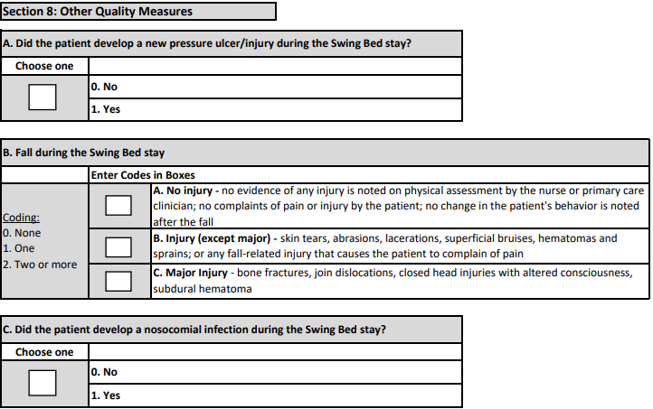
Other Quality Measures – (Part A – B – C)
Only looking at new pressure ulcer/injury
Every box needs to have a “0”, “1” or “2”
Nosocomial infection determination is based on the hospital’s P&Ps
DEFINITIONS
FALL – see definition of Falls on next slides

Slide 82
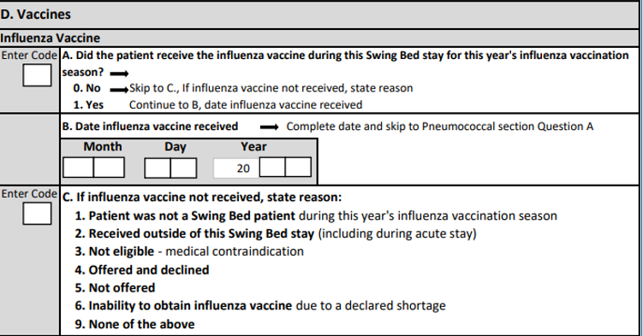
Section 8 (Part D) Influenza Vaccines
A full 8-character date is required.
If the date the influenza vaccine was received is unknown or not available, a single dash needs to be entered in the first box.
Influenza can occur at any time, but most influenza occurs from October through May. However, patients should be immunized as soon as the vaccine becomes available and continue until influenza is no longer circulating in your geographic area
Regardless of whether the patient was transferred from your own CAH or another hospital, it is important to check on the status of the patient’s vaccination

Slide 83
Influenza Vaccines (cont’)
Influenza Vaccine Coding Tips and Special Populations
Information about the current influenza season can be obtained by accessing the CDC Seasonal Influenza (Flu) website. This website provides information on influenza activity and has an interactive map that shows geographic spread of influenza:
http://www.cdc.gov/flu/weekly/fluactivitysurv.htm
http://www.cdc.gov/flu/weekly/usmap.htm
Facilities can also contact their local health department website for local influenza
The annual supply of inactivated influenza vaccine and the timing of its distribution cannot be guaranteed in any year. Therefore, in the event that a declared influenza vaccine shortage occurs in your geographical area, patients should still be vaccinated once the facility receives the influenza vaccine while the patient is still there – ideally, the PCP’s office would be notified that the vaccine was not available
A “high dose” inactivated influenza vaccine is available for people 65 years of age and older. Consult with the patient’s primary care physician (or nurse practitioner) to determine if this high dose is appropriate for the patient.

Slide 84
Influenza Vaccines (cont’)
Steps for Vaccination Assessment
Review the patient’s medical record to determine whether an influenza vaccine was received while in the acute stay for this year’s influenza vaccination season. If vaccination status is unknown, proceed to the next step.
Ask the patient if he or she received an influenza vaccine outside of the facility for this year’s influenza vaccination season. – Recommend this being a question asked when transferring a patient to SB from another facility during the flu season – ask for copy of the record
If vaccination status is still unknown, proceed to the next step.
If the patient is unable to answer, then ask the same question of the responsible party/legal guardian and/or primary care physician. If influenza vaccination status is still unknown, proceed to the next step.
If influenza vaccination status cannot be determined, administer the influenza vaccine to the patient according to standards of clinical practice. - Do check with the provider and hospital’s policy
Note: Code 3, Not eligible—medical contraindication: if influenza vaccine not received due to medical contraindications. Influenza vaccine is contraindicated for a patient with severe reaction (e.g., respiratory distress) to a previous dose of influenza vaccine or to a vaccine component. Precautions for influenza vaccine include moderate to severe acute illness with or without fever (influenza vaccine can be administered after the acute illness) and history of Guillain-Barré Syndrome within six weeks after previous influenza vaccination.

Slide 85
Section 8 (Part D) Pneumococcal Vaccines
If pneumococcal vaccination status cannot be determined, administer the recommended vaccine(s) to the patient, according to the standards of clinical practice
If the patient has had a severe allergic reaction to a pneumococcal vaccine or its components, the vaccine should not be administered.
If the patient has a moderate to severe acute illness, the vaccine should be administered after the illness.
If the patient has a minor illness (e.g., a cold) check with the patient’s physician before administering the vaccine

Slide 86
Pneumococcal Vaccines (cont’)
Coding Tips
Specific guidance about pneumococcal vaccine recommendations and timing for adults can be found at
https://www.cdc.gov/vaccines/vpd/pneumo/downloads/pneumo-vaccinetiming.pdf
“Up to date” in item O0300A means in accordance with current Advisory Committee on Immunization Practices (ACIP) recommendations.
For up-to-date information on timing and intervals between vaccines, please refer to ACIP vaccine recommendations available at —
https://www.cdc.gov/vaccines/schedules/hcp/index.html
http://www.cdc.gov/vaccines/hcp/acip-recs/index.html
https://www.cdc.gov/pneumococcal/vaccination.html
If a patient has received one or more pneumococcal vaccinations and is indicated to get an additional pneumococcal vaccination but is not yet eligible for the next vaccination because the recommended time interval between vaccines has not lapsed, O0300A is coded 1, yes, indicating the patient’s pneumococcal vaccination is up to date.

Slide 87
Pneumococcal Vaccines Examples
Examples for Pneumococcal Vaccination
Example #1: Mr. L., who is 72 years old, received the PCV13 pneumococcal vaccine at his physician’s office last year. He had previously been vaccinated with PPSV23 at age 66.
Coding: code 1, yes;
Rationale: Mr. L, who is over 65 years old has received the recommended PCV13 and PPSV23 vaccines.
Example #2: Mrs. B, who is 95 years old, has never received a pneumococcal vaccine. Her physician has an order stating that she is NOT to be immunized.
Coding: code A - 0, no; and B would be coded 1, not eligible.
Rationale: Mrs. B. has never received the pneumococcal vaccine; therefore, her vaccine is not up to date. Her physician has written an order for her not to receive a pneumococcal vaccine, thus she is not eligible for the vaccine.

Slide 88
Pneumococcal Vaccines Examples (cont’)
Examples for Pneumococcal Vaccination
Example #3: Mrs. A, who has congestive heart failure, received PPSV23 vaccine at age 62 when she was hospitalized for a broken hip. She is now 78 years old and was admitted to SB one week ago for rehabilitation. She was offered and given PCV13 on admission.
Coding: code A as 1, yes ; skip to next section
Rationale: Mrs. A received PPSV23 before age 65 years because she has a chronic heart disease and received PCV13 at the Assisted Living she resides at because she is age 65 years or older. She should receive another dose of PPSV23 at least 1 year after PCV13 and 5 years after the last PPSV23 dose (i.e., Mrs. A should receive 1 dose of PPSV23 at age 79 years but is currently up to date because she must wait at least 1 year since she received PCV13).
Example #4: Mr. T., who has a long history of smoking cigarettes, received the pneumococcal vaccine at age 62 when he was living in a congregate care community. He is now 64 years old and is being admitted to SB for chemotherapy and strengthening. He has not been offered any additional pneumococcal vaccines.
Coding: Code A as 0, no ; and B would be coded 3, Not offered .
Rationale: Mr. T received 1 dose of PPSV23 vaccine prior to 65 years of age because he is a smoker. Because Mr. T is now immunocompromised, he should receive PCV13 for this indication. He will also need 1 dose of PPSV23 8 weeks after PCV13 and at least 5 years after his last dose of PPSV23 (i.e., Mr. T is eligible to receive PCV13 now and 1 dose of PPSV23 at age 67).

Slide 89
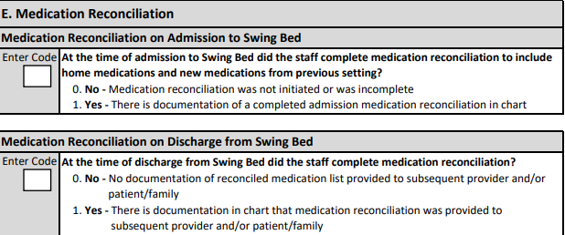
Section 8 (Part E) Medication Reconciliation
Thorough Drug Regimen Review including Medication Reconciliation along with patient/family education and provision of tools for home administration could go a long way in preventing side effects and ED visit or readmissions due to issues caused by duplication or missed doses
A Medication Reconciliation is a component of the DRUG REGIMEN REVIEW
Drug Regimen Review Definition - A drug regimen review includes medication reconciliation, a review of all medications a patient is currently using, and a review of the drug regimen to identify, and if possible, prevent potential clinically significant medication adverse consequences. The drug regimen review includes all medications, prescribed and over the counter (OTC), nutritional supplements, vitamins, and homeopathic and herbal products, administered by any route. It also includes total parenteral nutrition (TPN) and oxygen.
Hopefully your pharmacist is completing and documenting the drug regimen review
If nursing is completing the medication reconciliation component, this is shared with the pharmacist and confirmed, updated if necessary
Best practice dictates that a comprehensive medication reconciliation is completed and documented as well as passed on to the patient and next provider – this too should be documented

Slide 90
CAH SB Program PI Plan
The only other documentation for your SB program PI that is recommended but not part of this project are your internal analysis of the following:
Reviews of LAMA and unexpected deaths during the program or w/in 30 days post discharge,
Outcome of the Clinical follow-up calls (based on questions asked),
Reviews of return to acute during the program or within 30 days post discharge, and
Reviews of visits to ED/Observation within 30 days post SB discharge
Adding the above to your PI plan would render a comprehensive program
Your CAH PI Minutes would include:
QAPI reports from the portal,
Outcome from the above reviews if applicable
Analysis, plan and outcome of components in need of process improvement as applicable for:
Return to Acute, D/C to Community, Readmission to acute within 30-days post D?C
Goal setting
Self-Care & Mobility Functional outcome (Improvement and Risk-Adjusted)
Others as applicable (falls, decubitus ulcer/injury, nosocomial infection, vaccination, medication reconciliation)
Allows you a 5-key Quality measure report for the Choice Letter - reach out to Paula Knowlton (pknowlton@stroudwater.com) if you need training/retraining on how to pull this report

Slide 91
PI Measure Definitions

Slide 92
PI Measure Definitions
# of Discharges = Total number of discharges includes the number of excluded patients
# of SB Days = Total number of days where there are patients in swing bed for time period
Average Daily Census = Total swing bed days divided by calendar days in period
Average Length of Stay = LOS is calculated for each patient (discharge date – admission date) then is averaged over all patients for the ALOS
Discharged by Entered From = % of discharges by where the patients was immediately before their swing bed admission
Discharges by Primary Payor = % of discharges by the type of payor
Discharges by Age Grouping = % of discharges by age grouping
Groups are: 1) Less than 50 y.o. 2) 50-64 3) 65-74 4) 75-84 and 5) 85 and above
Discharges by Primary Medical Group = % of discharges by Primary Medical Condition Groups (13 groups)
The 13 groups were further grouped as follows: 1) Neuro Group (1-7), 2) Ortho Group (8-11), Debility/Cardiopulmonary Conditions and 4) Medically Complex Conditions

Slide 93
PI Measure Definitions (cont’)
Note: Highlighted measure definitions in the next few slides = 5 Key PI Measures which should be shared with referral care managers/discharge planners (be it from your own CAH or elsewhere) based on CMS requirement as well data to promote your program
***********************************************************************************
ALOS by Primary Medical Group = LOS is calculated for each patient (discharge date – admission date) for each Primary Medical Condition grouping, then is averaged for the ALOS for each grouping
Discharges by Clinical Programs = % of discharges by clinical program (18 programs)
ALOS by Clinical Programs = LOS is calculated for each patient (discharge date - admission date) for each specific Clinical Program the program admitted to, and then is averaged for the ALOS for each programs
Discharges by Therapy Received = % of total discharges that received therapy (any discipline)
Discharges by Type of Therapy Received -= % of discharges that received therapy by type of therapy
Exclusions (from the Functional Improvement Scores) = Total number of exclusions and why the patient was excluded – from this, amongst others, is where we report the Return to Acute during the SB Stay

Slide 94
PI Measure Definitions (cont’)
Performance Improvement Score for Self-Care = Score is the difference between admission and discharge scores for each activity summed for every patients and divided by number of discharges without excluded patients (not risk adjusted)
Performance Improvement Score for Self-Care (Risk-Adjusted) = Percentage of patients that met or exceed the expected performance improvement score
Self-Care Improvement Score by Clinical Programs = Score is the difference between admission and discharge scores for each activity summed and divided by number of discharges without excluded patients for each primary medical condition you admitted to
Self-Care Improvement Score by Clinical Programs (Risk-Adjusted) = Percentage of patients that met or exceeded the expected performance improvement score by Clinical Program
Performance Improvement Score for Mobility = Score is the difference between admission and discharge scores for each activity summed for every patients and divided by number of discharges without excluded patients (not risk adjusted)
Performance Improvement Score for Mobility (Risk-Adjusted) = Percentage of patients that met or exceed the expected performance improvement score
Mobility Improvement Score by Clinical Programs = Score is the difference between admission and discharge scores for each activity summed and divided by number of discharges without excluded patients for each primary medical condition you admitted to

Slide 95
PI Measure Definitions
Mobility Improvement Score by Clinical Programs (Risk-Adjusted) = Percentage of patients that met or exceeded the expected performance improvement score by Clinical Program
% of goals met = Goals are set for activities that the patient is working on improving. Percentage of total goals set divided by total goals met or exceeded x 100
Discharges by Discharge Disposition = % of all discharges by disposition category (important to know what each category includes) – from which % D/C to Community is calculated – Community = Home (private, boarding with family/friends, Boarding Home, Home with HH), Assisted Living, ID/DD Facility
Clinical Post-Discharge Follow-Up = % of all discharges who meet criteria for a clinical follow-up call (D/C to community, home w/HH, hospice and ID/DD) that received a clinical post-follow.
30-Day Post-Discharge Follow-Up = % of all discharges that met the criteria to receive a 30-day post discharge call: Community, Home w/HH, ID/DD and Hospice from where % of Unplanned Return to Acute within 30-days Post Discharge is derived
Falls Rate = (# of falls/number of days in period) * 1,000 - Thus, number of falls per 1,000 patient days
Medication Reconciliation = % of total discharges that had documented medications reconciliation on admission and at discharge

Slide 96
PI Measure Definitions
Acquired Pressures Ulcers/Injury = Rate of Pressure Ulcers/Injuries per 1,000 patient days
Nosocomial Infections = Rate of Nosocomial per 1,000 patient days
Influenza Vaccines = Percentage of patients that received vaccine, has an acceptable reasons for not receiving or it was not offered (be sure to review what is an acceptable reason in earlier slides)
Pneumococcal Vaccine = Percentage of patients that received vaccine, has an acceptable reasons for not receiving or it was not offered (be sure to review what is an acceptable reason in earlier slides)

Slide 97
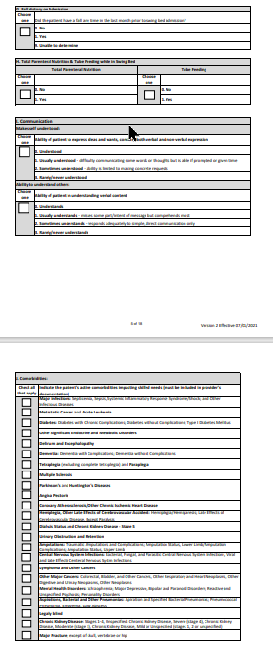
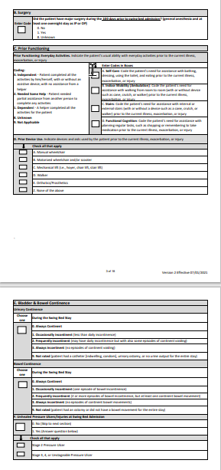
Concurrent Coding Best Practice

Slide 98
Concurrent Coding Data Form Management
When using the Stroudwater’s Data Abstraction Form concurrent coding is the best practice in lieu of chart data abstraction at the end of each month or quarter.
Following this schedule will ensure that:
your data is up to date on a monthly basis,
It will give you an opportunity to look at your outcomes real time and
give you an opportunity to update your internal improvement plans

Slide 99
Concurrent Coding Steps
Care Manager/Discharge Planner to complete the following sections during the initial discharge planning assessment: Section 1 A-B-C-D1-D2-E and Section 2 B-C-D-F-G-I
While Care Manager reviews the chart for provider documentation and in preparation for the initial ITD meeting, she/he completes Section 2 A, 2 J and Section 3 (SB Programming) using definitions provided and discussion with the provider as necessary
Initial Stand-Up mtg after the Acute D/P mtg - for CMgr/Nurs with Therapy (usually the day after admission once all assessments are completed) to discuss and agree on Section 5 A-B (Admission Performance)
1st IDT mtg – on Day 3
Care Manager to review data above obtained during the admission D/C planning assessment,
Therapy, nursing, pharmacist, dietician, and RT to share synopsis of their assessments
Agree on general overall D/C goals
All other but CMgr, nursing rep, and therapy may leave the IDT mtg. and the rest review functional admission score and agree on Section 5 A-B (D/C functional goals)
Weekly IDT mtg 1 week from the initial mtg where amongst other items, the performance is discussed in relations to the D/C goals

Slide 100
Concurrent Coding Steps (cont’)
Day of Discharge
CMgr, Therapy and Nurs. to discuss and complete Section 3 and Section 6
CMgr/Nurs. to complete Section 2 E and H, review Section J for additional documentation of comorbidities and Section 8 A-B-C
CMgr completes Section 4 and Section 7 A-B
CMgr marks calendar for preferred call back w/in 72 hrs post D/C and sends info to the caller if other than her/himself
Day 1 post D/C – CMgr./Nurs. review the chart to complete Section 8 D and E
Day 2 or 3 (Preferably w/in 24-72 hrs.) – follow-up call is made by Care Mgr or designee and complete Section 7 C
Preferably between day 31 to 33 post discharge, Care Manager or designee makes the 30-day post SB discharge call and completes Section 7 D
Within 1 week post SB discharge, the data from the completed form is entered in the Stroudwater portal (does not require clinical staff to enter data – identify a clerical staff member registered with Stroudwater as long as trained and report back when completed) – File paper form in case of need.
NOTE: Do reach out to Paula Knowlton (pknowlton@stroudwater.com) to inform her if you have staff who need to learn how to enter data in the portal and pull reports as well as notify her if you had staff with access that are no longer on those positions.

Slide 101
Where to From Here?

Slide 102
In Closing…
Do caregivers (nursing & therapy) require orientation to coding? Do you need training material?
How do we make sure we code based on an around the clock picture?
Does therapy assess every item unless the patient truly meets exclusion on admission?
Do we have a good process to identify all risk-adjusters?
Should we track our coding and goal status on a weekly basis?
Do we discharge if our scores are still low, and patient still has potential to improve?
Does therapy assess every item on discharge with few exceptions?
Do we feel good about our goal setting process for optimum outcome?
Do patients, nurses and family know what the discharge goals are ?
Should we revisit concurrent coding for timely data and reports
Make all attempts to review these slides with you team then email me with any questions the team may have (maryguyotconsulting@gmail.com)
You will be receiving a hard copy of these slides along with tools created to help you train staff .
You will also be receiving a link to the recording of today.
Please file to be accessed later as needed

Slide 103
SB Projects – Mark your calendars!
Flex PI Project – ALL expected Action Plans & Lessons Learned were tuned in.
Very good interventions and great lessons learned - even for those of you who had turnover in the team
The WV Poster Report for the SORH is close to completed – once its approved by the SORH, we will send it to the key contacts of every CAH
Expect a 3 question Yes/No satisfaction survey regarding the process whether you feel your program is or will be improved because you participated in the project.
SB Training: From Soup to Nuts: key contacts will receive a SurveyMonkey next week to assess your education needs – this will be used to develop a SB training series for Nov and Dec. – May extend to January based on available time
SB Program Management Self-Assessment Project – key contacts for this project will be sent an nvite for a few Zoom Meetings in early November to review the outcome of the survey and sharing of what different CAHs have put in place

Slide 104
SB Projects – Mark your calendars! (cont’)
QAPI Project – all 20 CAHs + Bath from VA have agreed to participate in 2022-2023 project which the SORH and WVHA/HEF will continue to support!
There will be an opportunity to introduce your new consultant: Christy Bishop, BSN from Stroudwater Associates who will continue the QAPI project as my replacement – plans are to introduce her at one of the above Zoom Mtg.
Continue entering data on a monthly basis- all Q3 data (July/Aug/Sept) including the 30-day follow-up should have been in by Oct 7
Data for discharge in the month of October should be in by Nov. 5 (except the 30-day post discharge follow-up)
Next in-person meeting with Christy is on November 30, 2022 in Bridgeport - more info will follow
Other QAPI mtgs will be:
Feb 17, 2023, via Zoom,
May 19, 2023, in Bridgeport and
Aug 23, 2023, in Bridgeport
It was a pleasure working with you all on this project. I learned something new yet again this past year. As stated during the August meeting, I will be retiring from working in WV after we finish the next 2 project from the previous slide.

