Slide 1
CAH Swing Bed PI/QI Project
Outcome Management Qtr. 3 of 2019
Webinar
October 31, 2019
Mary Guyot Consulting
207-650-5830 (cell/text)
maryguyotconsulting@gmail.com

Slide 2
Agenda
Since this is a webinar vs on-site – here is what we will do
Review of Data from the Stroudwater Portal
Potential Opportunities for Improvement and Plans for Follow-Up (Includes notes of questions for your hospital to be able to discuss during individual conference calls I will be conducting within the next 2 weeks)
Next Step – be looking for an email from me to schedule a follow-up conference call with each hospitals – highly recommend that the conference call be attended by care management, therapy, DON or representative and hospital PI/QI. Marketing (if position exists) and CEO welcomed.

Slide 3
Data Outcome & Benchmarking
Includes comparison between the 1st , 2nd and 3rd Qtr. of 2019
Review + Open Discussion re: Data Outcome

Slide 4
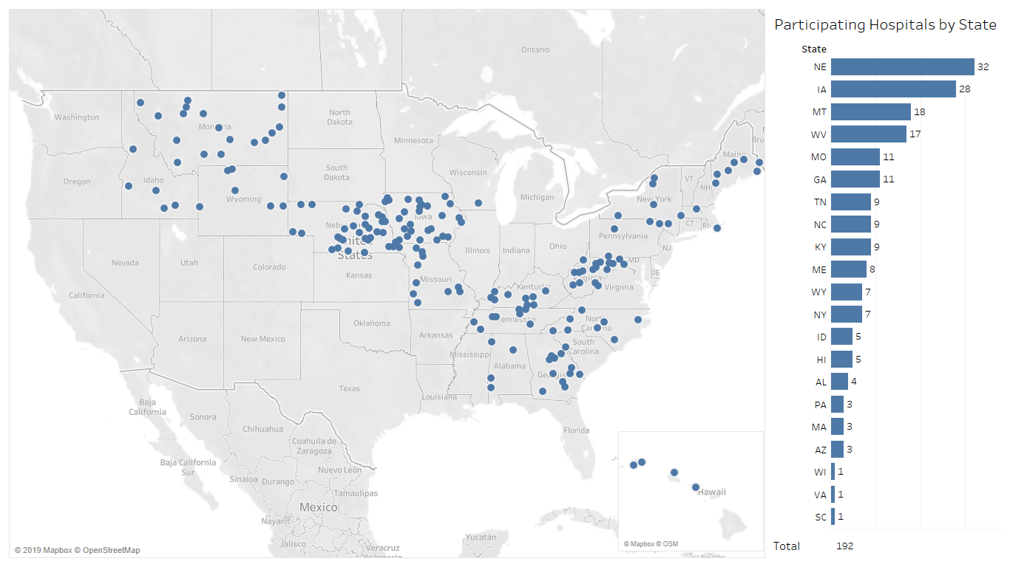
192 Hospitals Participating in Swing Bed Pilot
Source: Stroudwater Swing Bed Portal 4/1/2018 to 10/8/2019

Slide 5
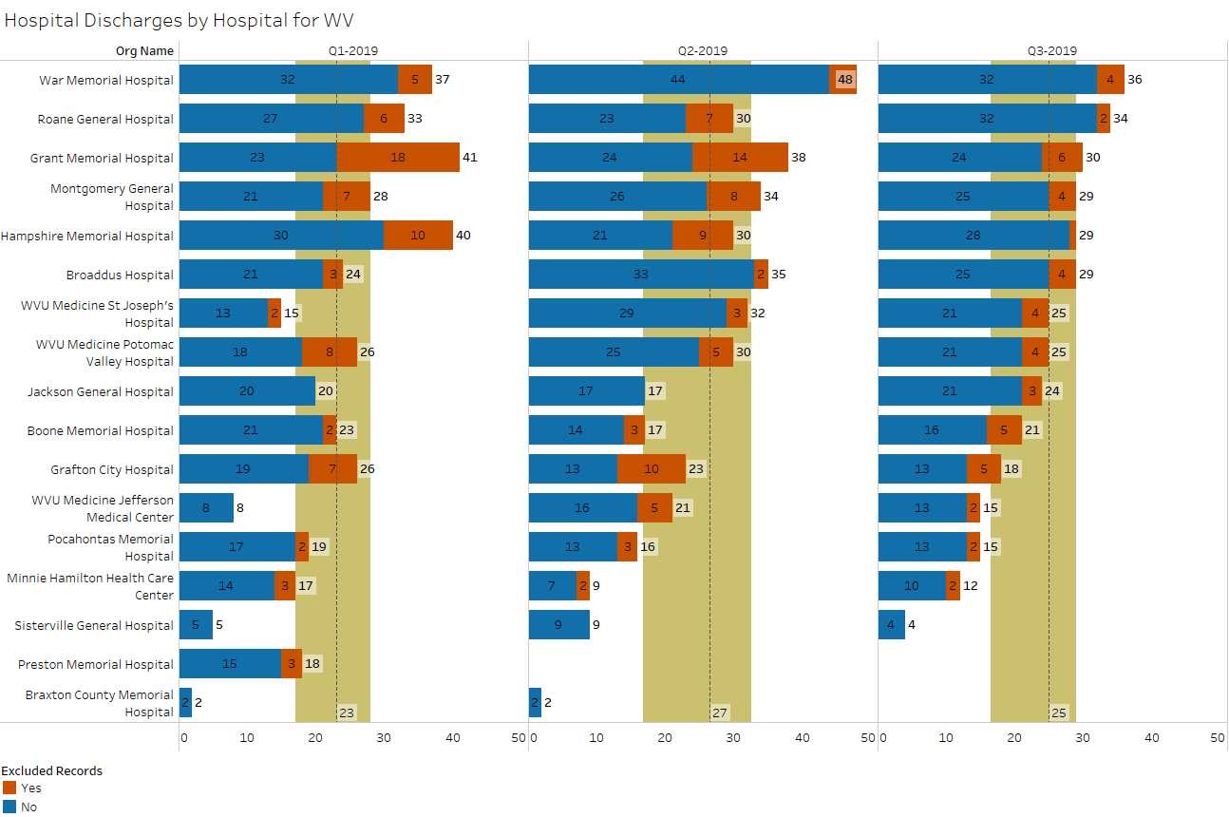
Swing Bed Discharges by Hospital
median
lower quartile
upper quartile
excluded records added
Source: Stroudwater Swing Bed Portal 4/1/2018 to 10/8/2019

Slide 6
Swing Bed Discharges by Hospital
Be prepared to talk about the reasons for exclusions for this past qtr.
If no or low exclusions, does that mean that we mostly take patients who need therapy?
War Memorial – why the decrease in Qtr. 3?
Grant Memorial. Grafton, Pocahontas & Minnie Hamilton – why the decrease in utilization for every quarter?
Jefferson – why the increase compared to the 1st qtr.?
Sistersville & Braxton – any potential to further increase the census?
Preston – why no data for the past 2 qtr. and Braxton for the past qtr.?

Slide 7
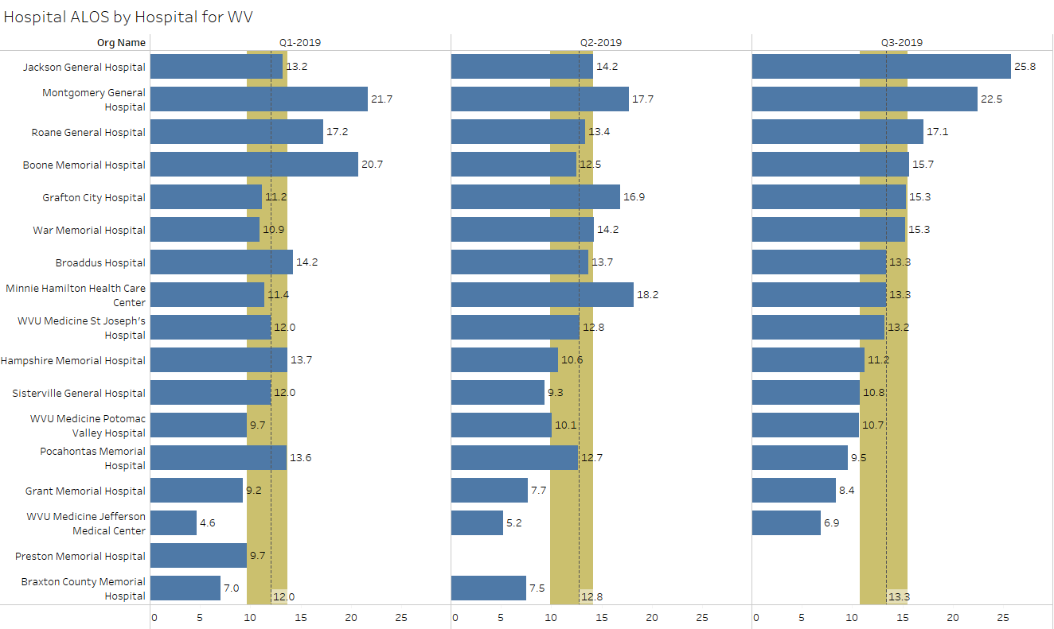
SB Average Length of Stay (ALOS)
median
lower quartile
upper quartile
excluded records added
Source: Stroudwater Swing Bed Portal 4/1/2018 to 10/8/2019

Slide 8
SB Average Length of Stay (ALOS)
The pilot project will report the ALOS as 12.5 days!
Pros & Cons of longer or shorter LOS:
Longer = more days = increased revenue
But longer also increases cost per episode of care which is under scrutiny
Shorter days below Nat ALOS = decrease days and revenue
Are we limiting who we accept to our program?
Are we discharging before the patients have met sustainable goals – could they have improved even more?
What is the self-care and mobility score improvements?
Jackson at 25.8 – if your charts were to be reviewed, do you feel there is good documentation to support a longer LOS? What has changed going up from 13.2 ALOS?
Potomac – consistently lower at 9.7 – 10.1 – 10.7 – let’s just discuss to make sure you are where you need to be
Pocahontas – why down from 13.6 to 12.7 to 9.5?
Grant, Jefferson, Preston & Braxton – all well below the ALOS – are you limiting the patients we take for those who are more functional? What kind of patients do you mostly admit? Do you feel you have a good system in place for discharges?

Slide 9
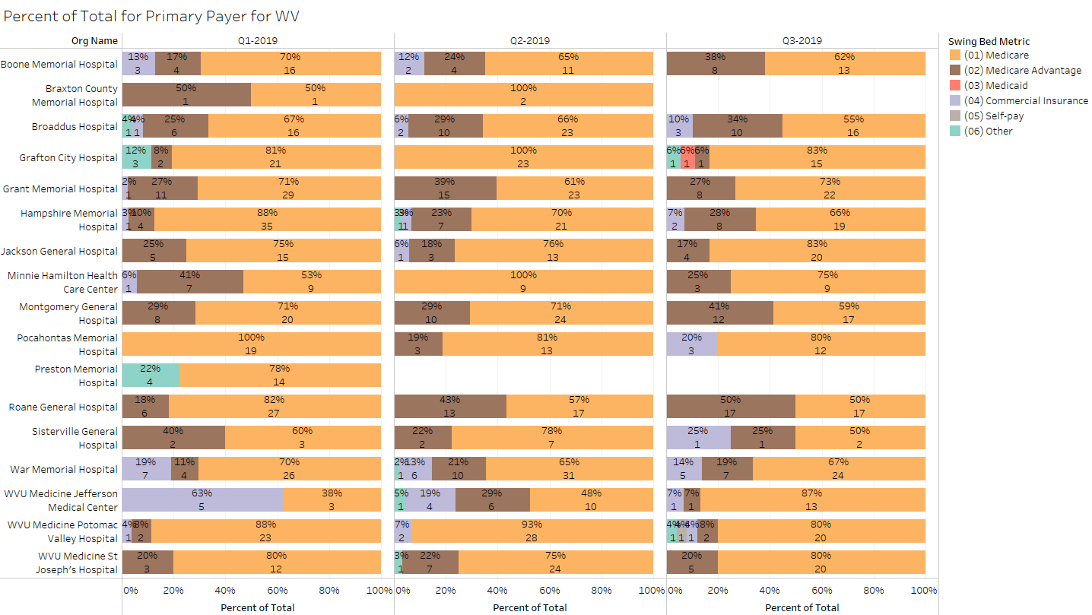
Percent of Total by Primary Payer
excluded records added
Source: Stroudwater Swing Bed Portal 4/1/2018 to 10/8/2019

Slide 10
Percent of Total by Primary Payer
All - Be ready to discuss who your Medicare Advantage and Commercial cases are and do they pay cost or a contracted per diem and if so, how much?
All - Who are your “Other” if you had any?
Grafton – you had a Medicaid ??
All - What is your hospital’s or system’s take on admitting from payors who do not pay cost like generic Medicare?
Pros & Cons of taking non-cost payers
Con – loose $$ on every case
Pro
dilutes your general cost/day with more total days
Increase utilization (better than $0 revenue for the day
Allows you to serve the referral sources equally regardless of generic Medicare, MA or commercial
Minnie Hamilton – why the decrease in MA from 7 – 0 -3
Why/how the increase for Montgomery (8-10-12), Roane (6-13-17), War Memorial (4-10-7) and St Joseph (4-7-5)?
Any attempts to identify referrals sources who pay cost?

Slide 11
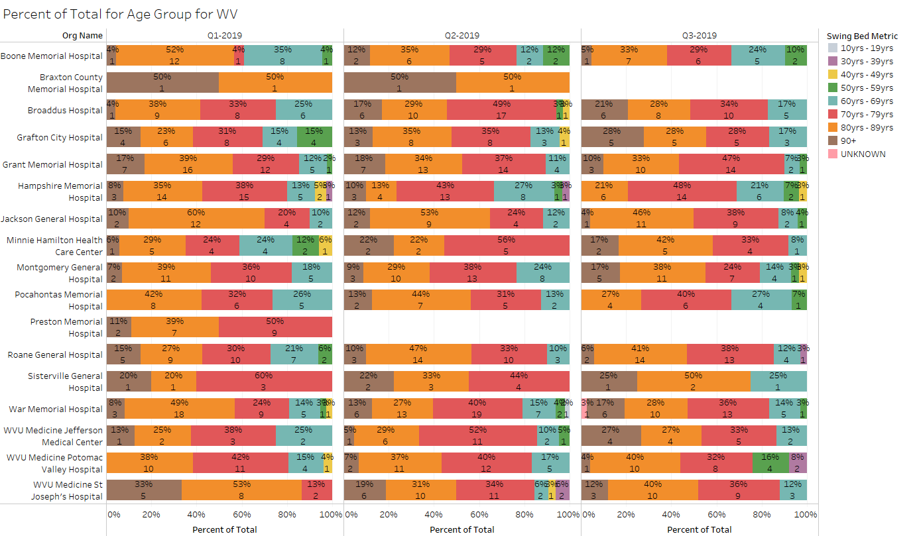
Percent of Total by Age Group
excluded records added
Source: Stroudwater Swing Bed Portal 4/1/2018 to 10/8/2019

Slide 12
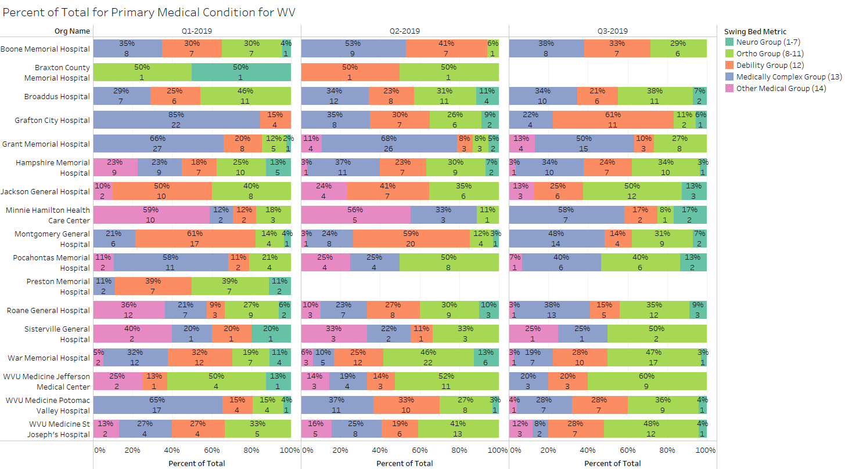
Percent of Total by Primary Medical Condition
excluded records added
Source: Stroudwater Swing Bed Portal 4/1/2018 to 10/8/2019

Slide 13
Percent of Total by Primary Medical Condition
All who had “Other” as a classification, be prepared to discuss the patients you classified into “Other” – why did they not fit into the other 4 classification? Look their records up for the 3rd quarter and have explanation and what you would change it to.
See slides # 34-35-36 for a reminder of definitions
Note: In PPS SB and SNFs there is no “other” classification – so I will be asking Stroudwater to change also.

Slide 14
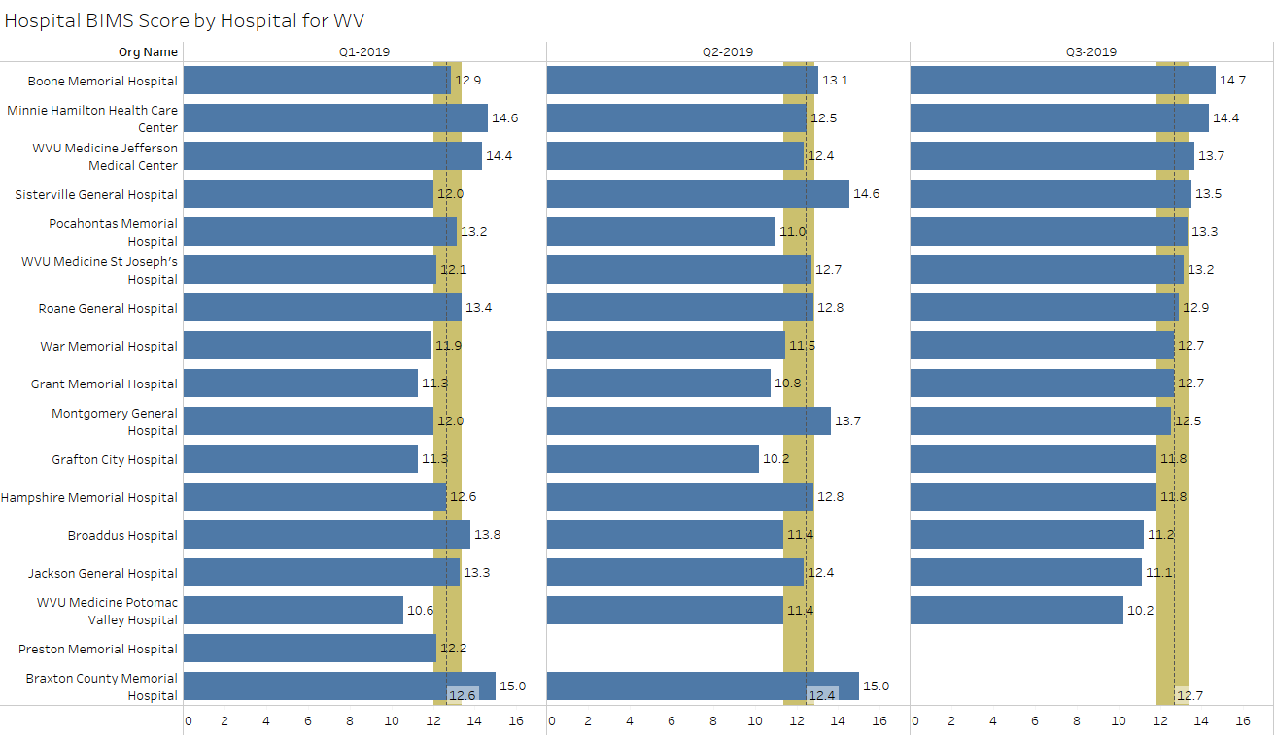
Average BIMS Score
median
lower quartile
upper quartile
excluded records added
Source: Stroudwater Swing Bed Portal 4/1/2018 to 10/8/2019

Slide 15
Average BIMS Score
Who does the BIMS Assessments?
What is their training?
When is BIMS conducted?
If the score is less than normal – is this care planned? Have we discussed with the physician and team?

Slide 16
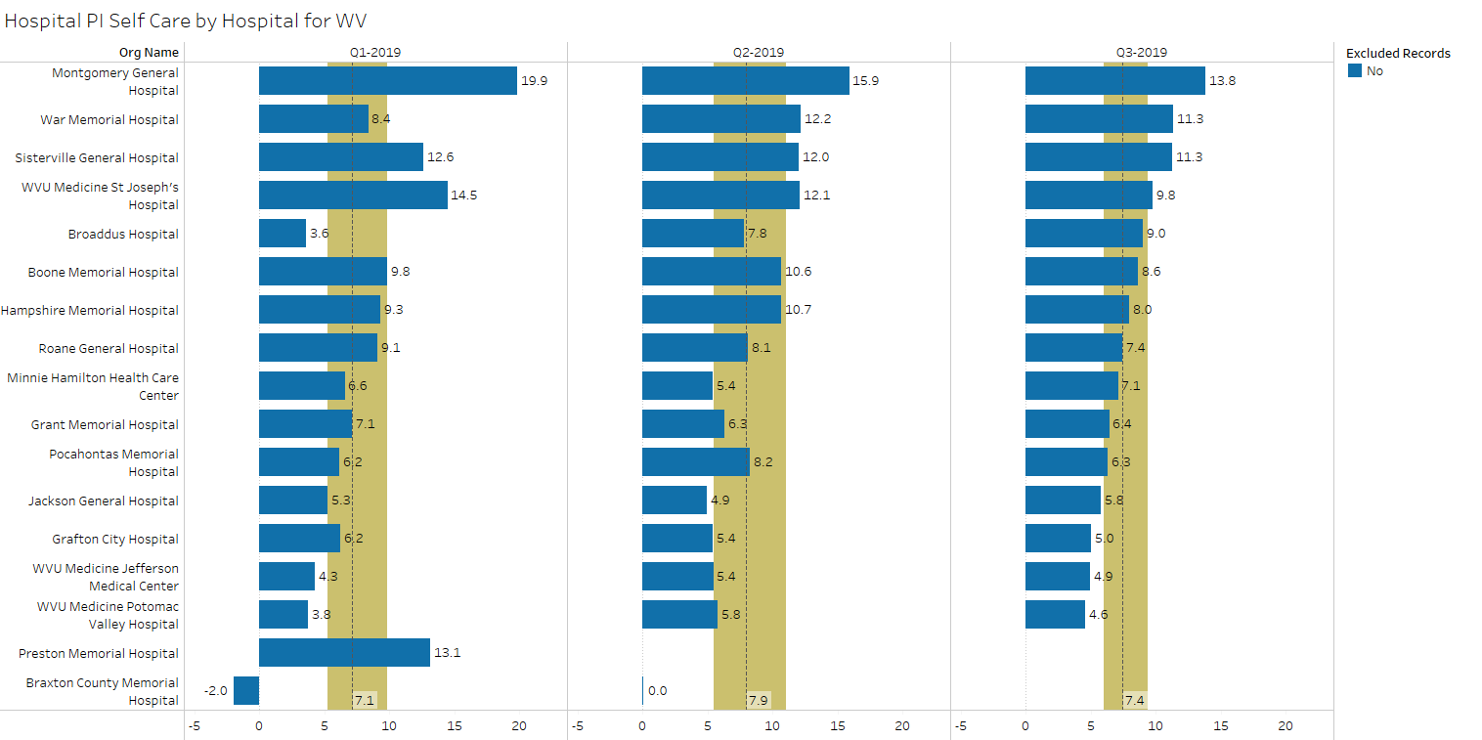
Performance Improvement Score for Self-Care
median
lower quartile
upper quartile
excluded records have been removed
Source: Stroudwater Swing Bed Portal 4/1/2018 to 10/8/2019

Slide 17
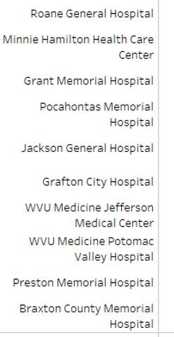
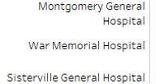
Performance Improvement Score for Self-Care
All below Nat. Avg. of 7.7 – what is your process for assessments?
Why do you think you are lower?
What are your opportunities for improvement?
Why do you think you have more improvement?

Slide 18
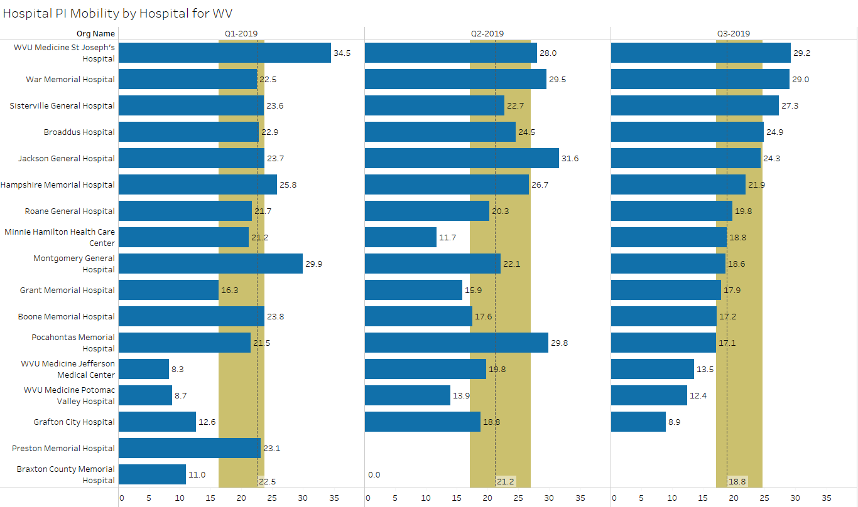
Performance Improvement Score for Mobility
median
lower quartile
upper quartile
excluded records have been removed
Source: Stroudwater Swing Bed Portal 4/1/2018 to 10/8/2019

Slide 19
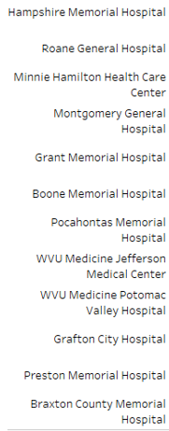
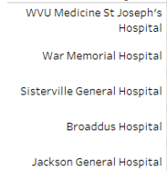
Performance Improvement Score for Mobility
All below Nat. Avg. of 23.1 – what is your process for assessments?
Why do you think you are lower?
What are your opportunities for improvement?
Why do you think you have more improvement?

Slide 20
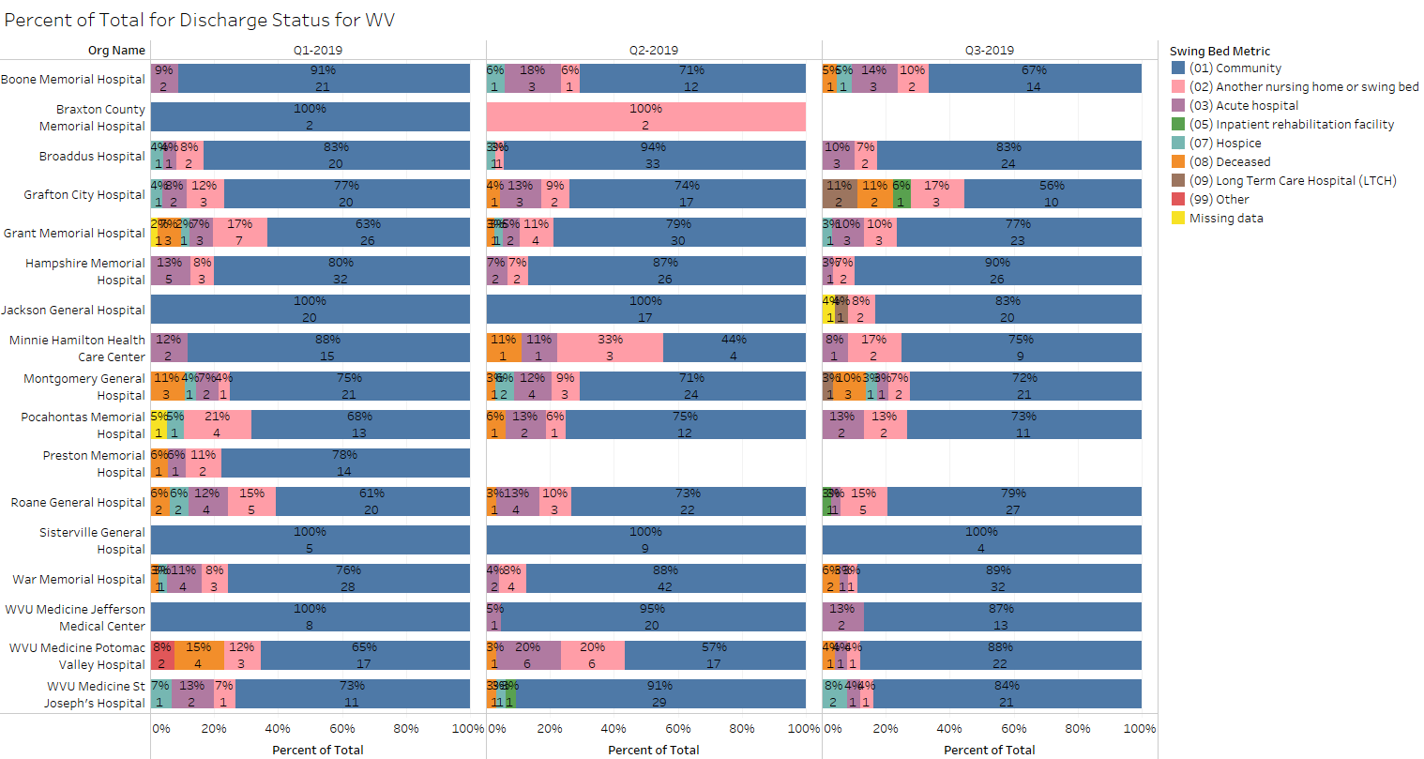
Percent of Total by Discharge Disposition
excluded records added
Source: Stroudwater Swing Bed Portal 4/1/2018 to 10/8/2019

Slide 21
Percent of Total by Discharge Disposition
As remained at or above the 73.5% National median of D/C to the community through the first 3 qtrs. for 2019
Questions to be asked are:
If very high, are we limiting who we admit?
Why is D/Cing to the community working for you?
Hampshire (80-87-90), War Memorial (76-88-89) -– what do you attribute the improvement
Every hospital had D/C to acute care – look up your D/Cs to acute and be ready to discuss – why were they transferred back? Could it have been prevented? …. Will be asking Stroudwater to add a “planned return to acute” to differentiate.
All had D/C to NH – was that new or return to a NH? – Why could they not return to home if that is where they came from?
Also will be asking Stroudwater to have a choice of new to NH or returning to their NH bed
For those of you with patients who died during their SB stay – please review and be ready to discuss if anticipated or unexpected. Could we have done anything differently

Slide 22
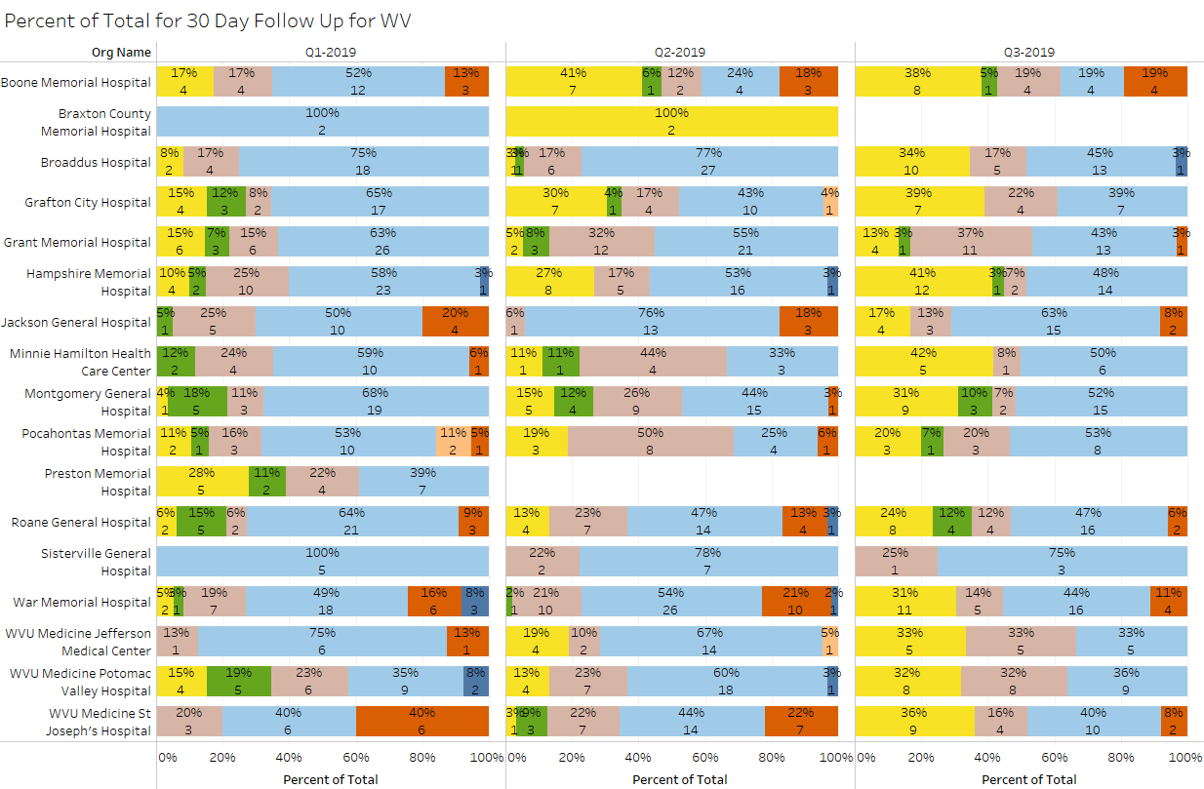
Percent of Total by 30 Day Follow Up
excluded records have been removed
Source: Stroudwater Swing Bed Portal 4/1/2018 to 10/8/2019

Slide 23
Percent of Total by 30 Day Follow Up
I have requested Stroudwater to report “missing items” as overdue only going forward - this includes those D/Ced but not yet due.
Those with patients who deceased within 30 days post discharge – was that expected? Could anything have been done differently?
What is your process for follow-up? Do you get more info than these questions?
What are your opportunities for improvement?

Slide 24
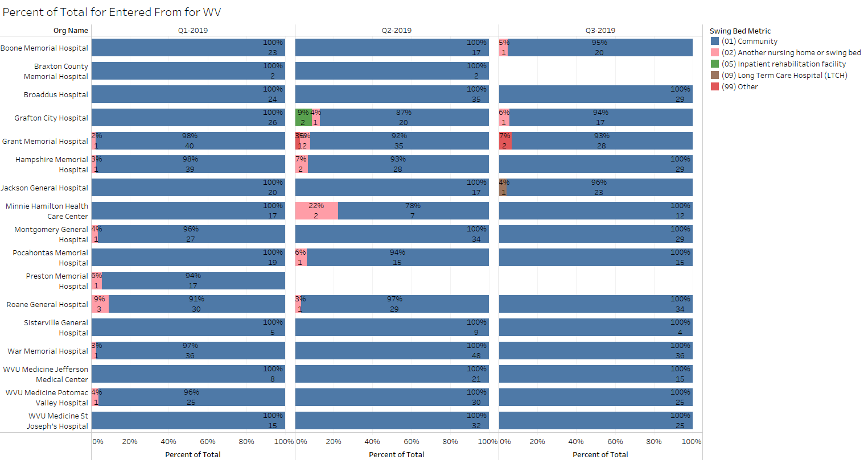
Percent of Total by Residence Pre-Acute Admission
excluded records added
Source: Stroudwater Swing Bed Portal 4/1/2018 to 10/8/2019

Slide 25
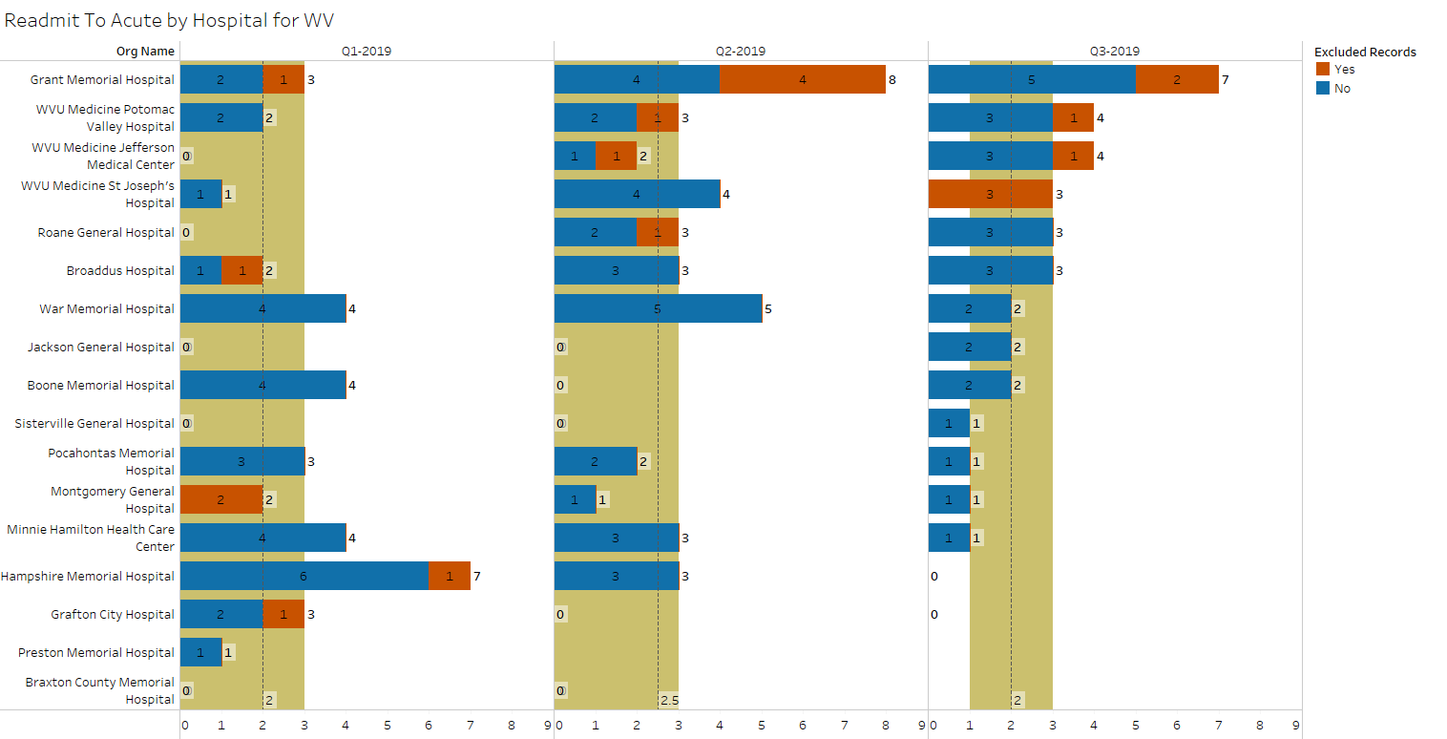
Number of Readmits to Acute
median
lower quartile
upper quartile
excluded records added
Source: Stroudwater Swing Bed Portal 4/1/2018 to 10/8/2019

Slide 26
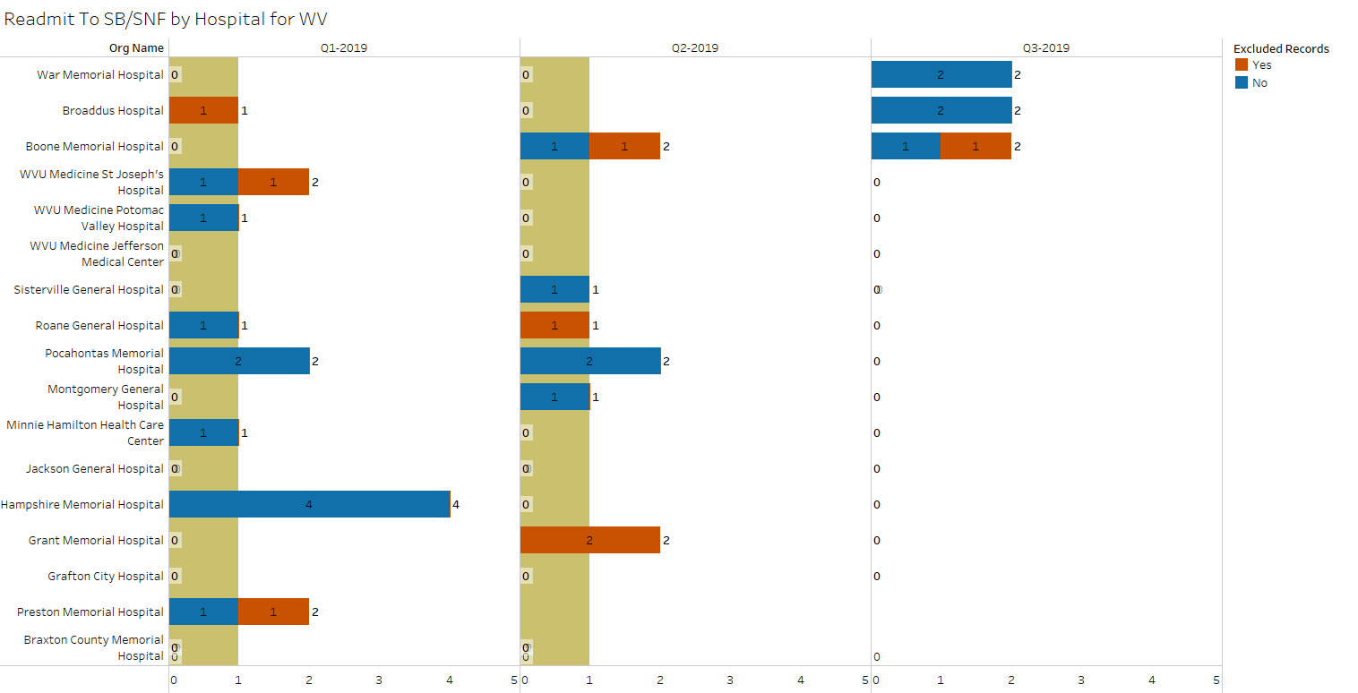
Number of Readmits to SB/SNF
median
lower quartile
upper quartile
excluded records added
Source: Stroudwater Swing Bed Portal 4/1/2018 to 10/8/2019

Slide 27
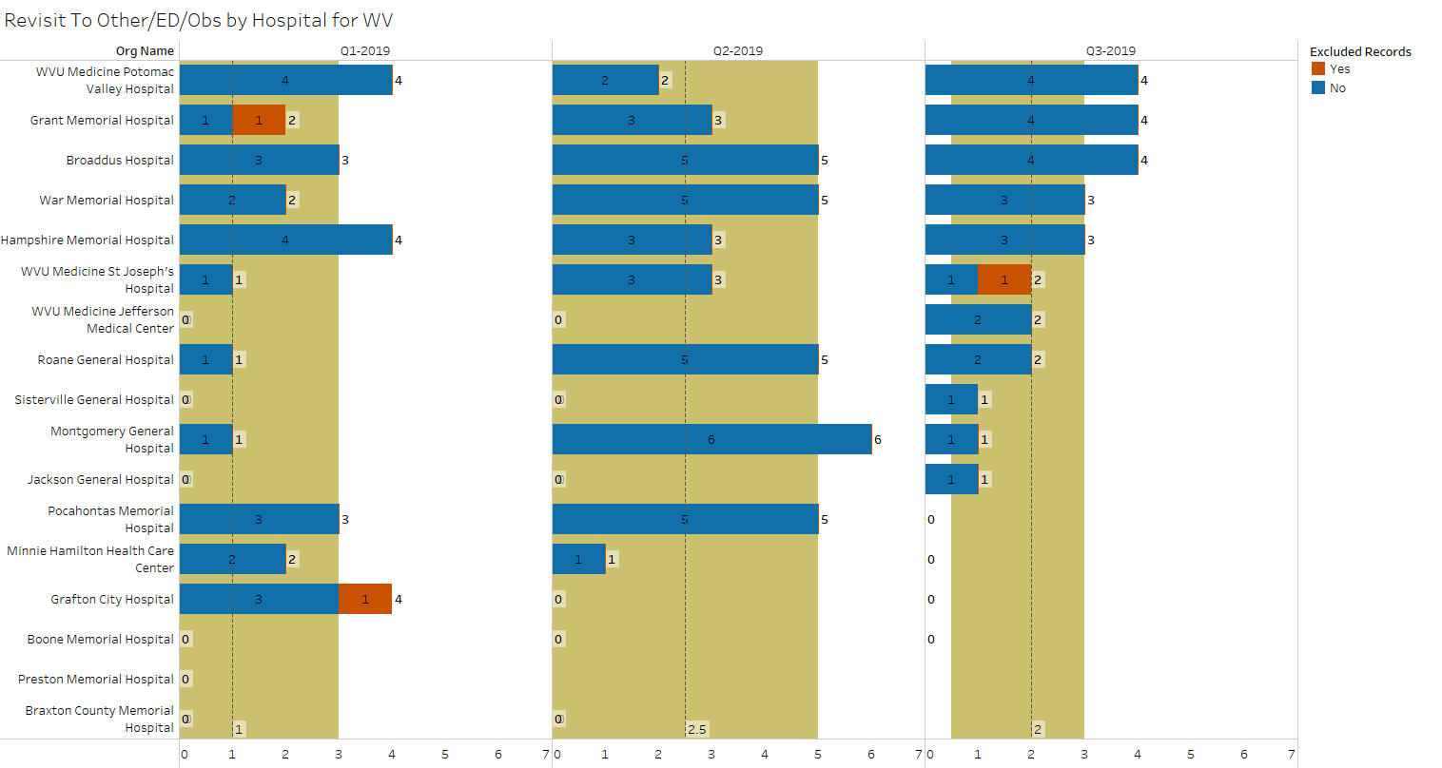
Number of Revisits to ED or Observation
median
lower quartile
upper quartile
excluded records added
Source: Stroudwater Swing Bed Portal 4/1/2018 to 10/8/2019

Slide 28
Number of Readmits to Acute, SB & ED/Observation
Grant Memorial, Potomac, Jefferson, St. Joseph, Roane & Broaddus all had readmits to acute within 30 days post SB D/C
War, Broaddus & Boone had readmission to SB/SNF
Potomac, Grant, Broaddus, War Memorial & Hampshire had ED/Obs revisits greater than the median of 2 for WV Network
When reviewing each case, could we have done anything to prevent re-entry in the system?
Remember that every readmission to acute, SB and ED/Obs. increases the cost of care!!!

Slide 29
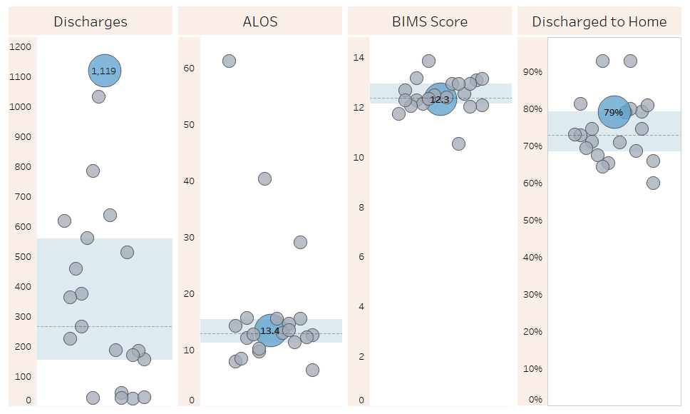
State Comparison for the last 12 months (10/2018 to 9/2019)
excluded records added
Source: Stroudwater Swing Bed Portal 4/1/2018 to 10/8/2019

Slide 30
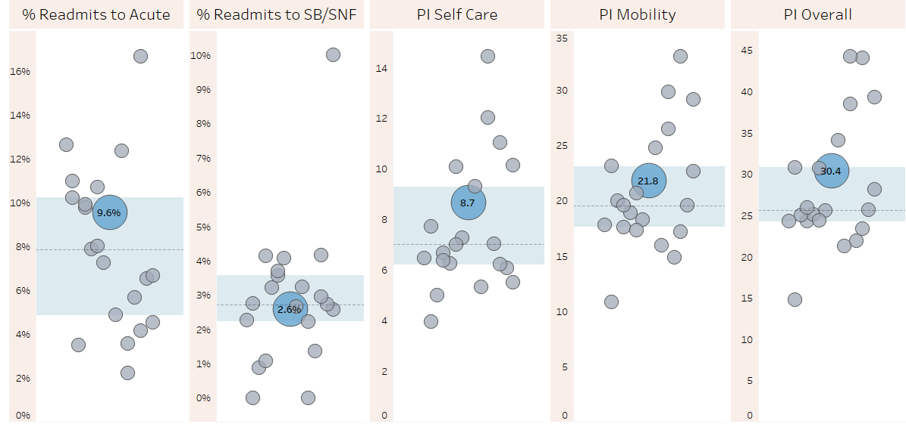
State Comparison for the last 12 months (10/2018 to 9/2019)
excluded records have been removed for PI scores
Source: Stroudwater Swing Bed Portal 4/1/2018 to 10/8/2019

Slide 31
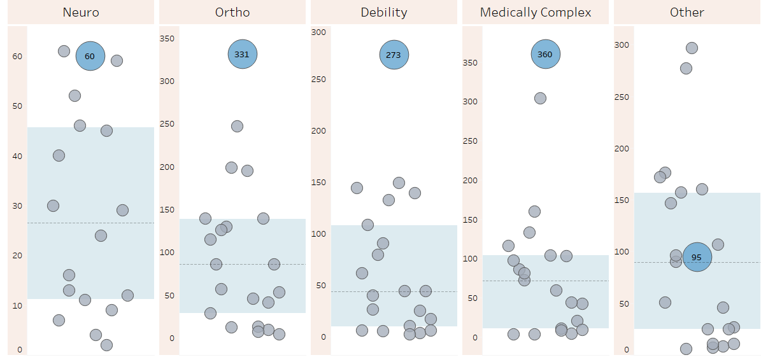
State Comparison for the last 12 months (10/2018 to 9/2019)- Reason for Admission (count of records)
excluded records added
Source: Stroudwater Swing Bed Portal 4/1/2018 to 10/8/2019

Slide 32
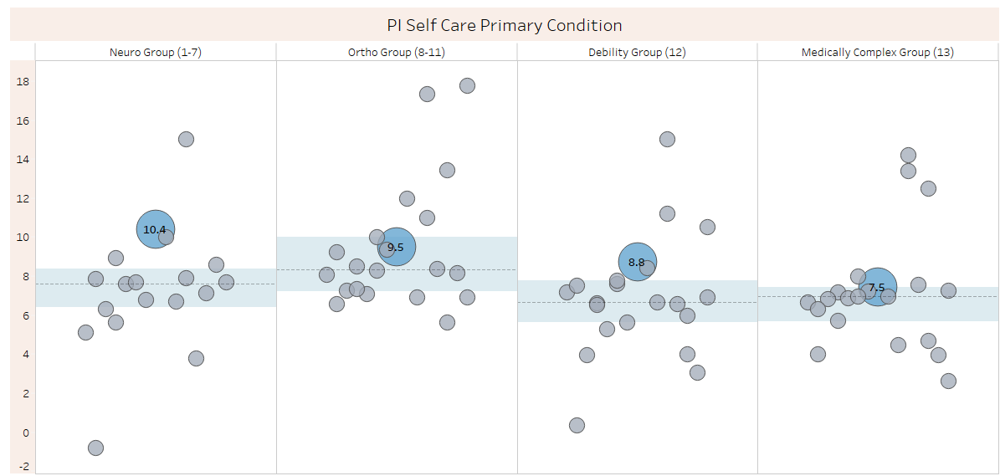
State Comparison for the last 12 months (10/2018 to 9/2019)- PI Self Care by Primary Condition
excluded records have been removed for PI scores
Source: Stroudwater Swing Bed Portal 4/1/2018 to 10/8/2019

Slide 33
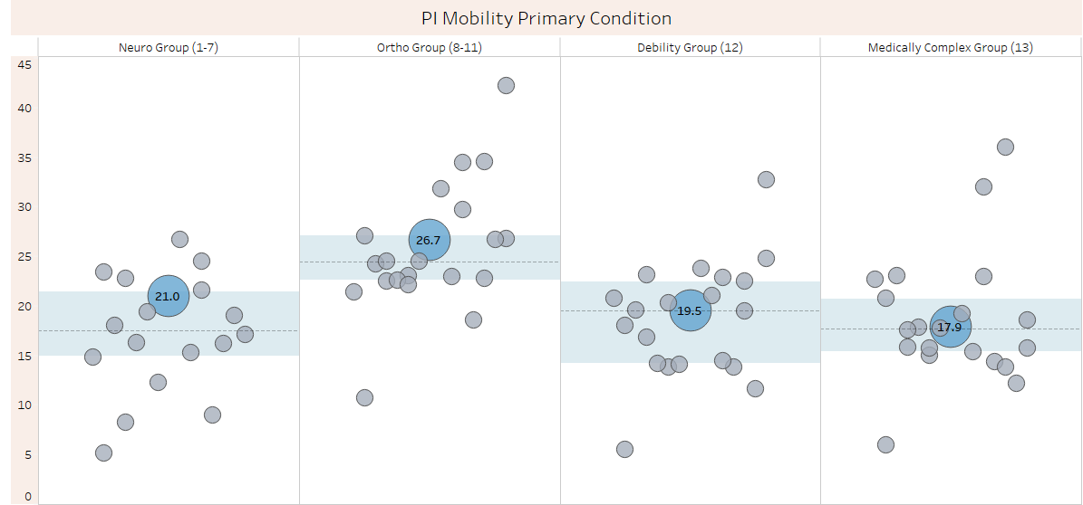
State Comparison for the last 12 months (10/2018-9/2019)- PI Mobility by Primary Condition
excluded records have been removed for PI scores
Source: Stroudwater Swing Bed Portal 4/1/2018 to 10/8/2019

Slide 34
Medical Condition Definition for Admission
Medical Condition/Reason – Definitions
Code 01, Stroke = if the patient’s primary medical condition category is due to stroke. Examples include ischemic stroke, subarachnoid hemorrhage, cerebral vascular accident (CVA), and other cerebrovascular disease.
Code 02, Non - Traumatic Brain Dysfunction = if the patient’s primary medical condition category is non-traumatic brain dysfunction. Examples include Alzheimer’s disease, dementia with or without behavioral disturbance, malignant neoplasm of brain, and anoxic brain damage.
Code 03, Traumatic Brain Dysfunction = if the patient’s primary medical condition category is traumatic brain dysfunction. Examples include traumatic brain injury, severe concussion, and cerebral laceration and contusion.
Code 04, Non - Traumatic Spinal Cord Dysfunction = if the patient’s primary medical condition category is non-traumatic spinal cord injury. Examples include spondylosis with myelopathy, transverse myelitis, spinal cord lesion due to spinal stenosis, and spinal cord lesion due to dissection of aorta.

Slide 35
Section I : Active Diagnosis
Medical Condition/Reason – Definitions (cont’)
Code 05, Traumatic Spinal Cord Dysfunction = if the patient’s primary medical condition category is due to traumatic spinal cord dysfunction. Examples include paraplegia and quadriplegia following trauma.
Code 06, Progressive Neurological Conditions = if the patient’s primary medical condition category is a progressive neurological condition. Examples include multiple sclerosis and Parkinson’s disease.
Code 07, Other Neurological Conditions = if the patient’s primary medical condition category is other neurological condition. Examples include cerebral palsy, polyneuropathy, and myasthenia gravis.
Code 08, Amputation = if the patient’s primary medical condition category is an amputation. An example is acquired absence of limb.
Code 09, Hip and Knee Replacement = if the patient’s primary medical condition category is due to a hip or knee replacement. An example is total knee replacement. If hip replacement is secondary to hip fracture, code as fracture.

Slide 36
Section I : Active Diagnosis
Medical Condition/Reason – Definitions (cont’)
Code 10, Fractures and Other Multiple Trauma , if the patient’s primary medical condition category is fractures and other multiple trauma. Examples include hip fracture, pelvic fracture, and fracture of tibia and fibula.
Code 11, Other Orthopedic Conditions = if the patient’s primary medical condition category is other orthopedic condition. An example is unspecified disorders of joint.
Code 12, Debility, Cardiorespiratory Conditions = if the patient’s primary medical condition category is debility or a cardiorespiratory condition. Examples include chronic obstructive pulmonary disease (COPD), asthma, and other malaise and fatigue.
Code 13, Medically Complex Conditions = if the patient’s primary medical condition category is a medically complex condition. Examples include diabetes, pneumonia, chronic kidney disease, open wounds, pressure ulcer/injury, infection, and disorders of fluid, electrolyte, and acid-base balance.

Slide 37
Next Step & THANK YOU!
Pull a team together to review the questions I have for your hospital thru out and be ready to respond and discuss
Email Paula Knowlton from Stroudwater at pknowlton@stroudwater.com for any technical questions about the Stroudwater portal
Does every hospital now have at least 2 people who can enter the data and run reports?
Write to me maryguyotconsulting@gmail.com with clinical questions or to share what you would like the web-based tool to be able to do
Writing to Paula or I, PLEASE clarify which hospital you are asking about
Planning to schedule follow-up conference call the week of 11/11 so please prepare accordingly
I will send out different times to all participants – first-come-first-serve
Enter data for all Oct., Nov. & Dec discharges by Jan. 8, 2020
Enter 30-day follow-up data entry for all patients who have been discharged for 30 to 33 days by Jan 8, 2020
Stroudwater may be setting up a webinar for Ira to present final data for the Pilot Project
Mark Your Calendars – Next on-site meeting is for January 29, 2020

Slide 38
Questions?

