Slide 1
Facilitator Training
for the
April 21, 2026
MRSE
West Virginia Healthcare Coalition SOUTH

Slide 2
Lisa Green Exercise and Training Coordinator Healthcare Education Foundation of WV/WVHA lgreen@hefwv.org 304-206-1170
Today’s Training is being recorded
The slides and recording will be placed on the MRSE website by end of day tomorrow

Slide 3
MRSE - Medical Response and Surge Exercise
The US Department of Health and Human Service (HHS) Administration for Strategic Preparedness and Response (ASPR) created the MRSE to assist jurisdictions, Healthcare coalitions like ours, and key response organizations with evaluating our current ability to effectively respond to an emergency when there is a significant patient surge.
The MRSE is a functional exercise. HSEEP describes functional exercises as an operations-based exercise designed to test and evaluate capabilities and functions while in a realistic, real-time environment. There will be NO MOVEMENT of patients or resources.

Slide 4
HCC MRSE Requirements
Plan, execute, evaluate, and report the findings and outcomes of a realistic medical surge exercise to improve the response readiness of health care partners in their jurisdiction.
1
Document actions or activities to identify areas of improvement and develop meaningful corrective actions.
2
Build new partnerships and strengthen existing ones with organizations across our health care response partners and emergency response communities to improve communication and coordination during future emergencies and disasters.
3

Slide 5
Meet Your Planning Team
EMS
Ian Lympany
WVU Medicine-Ruby
David Matic
Cabell Co. EMS
Lou Vargo
Ohio Co. EMS
Richard Davisson
Jackson Co. EMS
Tommy Bibb
Kanawha Co Emergency Ambulance Authority
Veronica Swope
Cabell Co. EMS
Emergency Management
HOSPITALS
Annie Carter
WVU Medicine-Ruby
Linda Murray
Marshall Health Network
Ian Lympany
WVU Medicine-Ruby
Doug Douglas
CAMC Health System
Diana Reel
WVU Medicine-Grant
Chad Jones
City of Charleston Dept. of Homeland Security & Em Management
Loyd Lowry
Summers Co. Em Management
Steve Wykoff
Upsher Co. Dept. of Homeland Security & Em Management
Health Departments
Leland Steele
Cabell-Huntington Health Department
Christopher Earnest
Marshall County Health Department

Slide 6
4 Overarching Objectives
HCC(s) engage health care partners and their executives to participate in the exercise and the After-Action Review within the HPP budget period.
HCC(s) demonstrate their ability to assess and meet critical resource needs (personnel, supplies, equipment, etc.) to manage patient surge during a community-wide emergency or disaster by the end of the MRSE.
HCC(s) effectively notify HCC health care partners of an incident and facilitate ongoing information sharing during a community-wide emergency or disaster.
HCC(s) demonstrate their ability to reduce patient morbidity and mortality through appropriate patient placement during a large patient surge by assisting with the identification and coordination of available patient care resources by the end of the MRSE

Slide 7
EMS Objectives 1. Within 15 minutes of the notification to activate the EOC, all staff members shall respond with the capability of responding or being unavailable. 2. Within 30 minutes of an “all hands” alert for county fire departments, each department will report to the EOC with their capability to respond with the number of resources and manpower. 3. EMS agency can quantify resource availability during a specified operational period during the exercise. 4. Ems agency can accurately triage and determine appropriate transport modality per WVOEMS protocol during the exercise period.

Slide 8
Emergency Management Objectives
Notify relevant agencies (not first responders, but EPA, EMD) of an emergency event within 25 minutes of the initial notification from the 911 center.
Assess how well emergency management communicates and coordinates with other emergency response agencies using WebEOC (or another system you use such as cell phones, email etc.) during a multi-jurisdictional incident to improve situation awareness and decision making.
Within 15 minutes of the order to activate the EOC, all staff members shall respond with the capability of responding or being unavailable.
Within 30 minutes of an “all hands” alert for county fire departments, each department will report to the EOC with their capability to respond with the number
of resources and manpower.

Slide 9
Public Health Objectives
1. Notify all agency staff within 30 minutes upon notification of a large-scale event. 2. All agencies will report to the state within one hour of notification, their available resources and any additional requests they may need manpower.

Slide 10
In-Home Healthcare Objectives
1. Determine what resources (staff and material) you would have available to support a coalition wide emergency if asked. 2. Test your staff's ability to communicate using the state-wide communications system within 1-hour of emergency notification.

Slide 11
Hospice Objectives Assess the medical supplies you have on-hand within 1 hour of request to support efforts to treat flood victims in local hospitals. Assess and report the number of staff available within 1 hour of request to triage and/or treat flood victims at local hospitals. Report within 1 hour, the number of available and staffed in-patient beds that your facility can treat upon request from a local hospital.

Slide 12
Long-Term Care Objectives
1. The LTC facility will test its emergency communication plan during the MRSE exercise, achieving 90% notification success to staff, residents’ families, and local emergency agencies within 30 minutes.
2. The LTC facility will shelter-in-place all residents and staff, relocating them to a designated safe area within 15 minutes of emergency notification and ensuring all emergency supplies are accessible.
3. The LTC facility will receive a (add a percentage to identify Mass surge) mass surge of residents by preparing accommodations, supplies, intake documentation, and staffing within 30 minutes of the notification.

Slide 13
Dialysis Objectives
1 Report the number of hemodialysis patients, within 1 hour of the reported event, that your facility can accommodate for treatments. 2 Determine how long it would take for a water buffalo to be on site, report within 1 hour of request 3 Determine how long it would take to get building generators on site to facilities that don't have them, report within 1 hour. 4 Determine where transportation resources can be found during a disaster if you needed to transport several patients to your facilities. manpower.

Slide 14

Your role as a Facilitator in 5 steps

Slide 15
Arrive in your command center by 7:30am
First thing you do is log in to the MRSE Website.
Pull up the Sign-In Sheet and be sure that every individual working in
the command center signs in upon arrival.
www.wvha.org/HEF
1

Slide 16
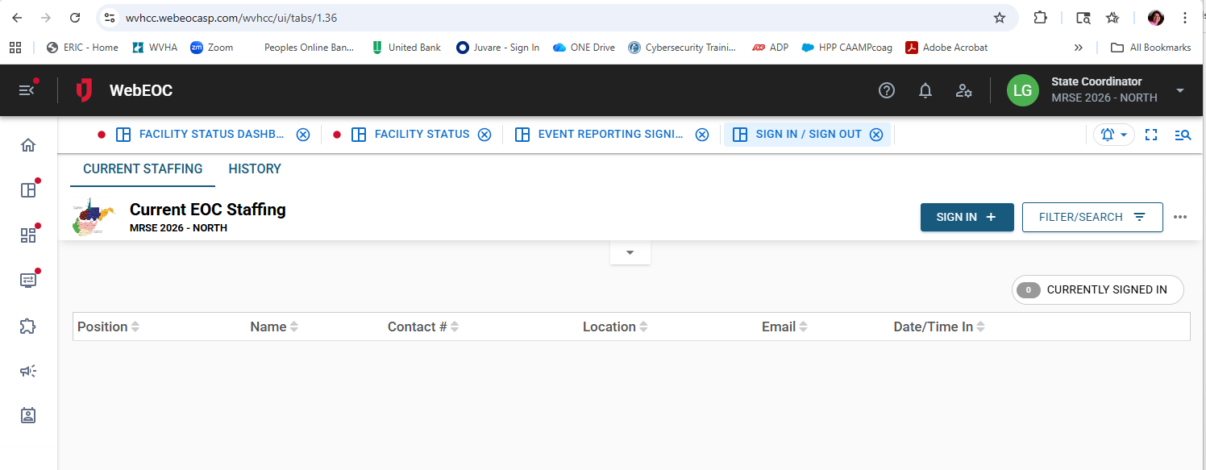

Sign-in to your facility on the MRSE WebEOC event Sign-in/Out Board.
Only one person per facility needs to sign in on the Sign/Out board.
Display WebEOC on a screen where all command staff can see it
2

Slide 17
Must be an active user on WebEOC
Read WebEOC inject notifications to your command center as they arrive.
Display WebEOC Significant Events Board
3
SAMPLE INJECT: Called in to the Facilitators Cell Phone number
THIS IS AN EXERCISE…and this is Medical Command with patients in route to your
facility. We are sending you 1 yellow and 1 Black. Patient ID #s are 1 and 66. ETA
is 22 minutes.

Slide 18
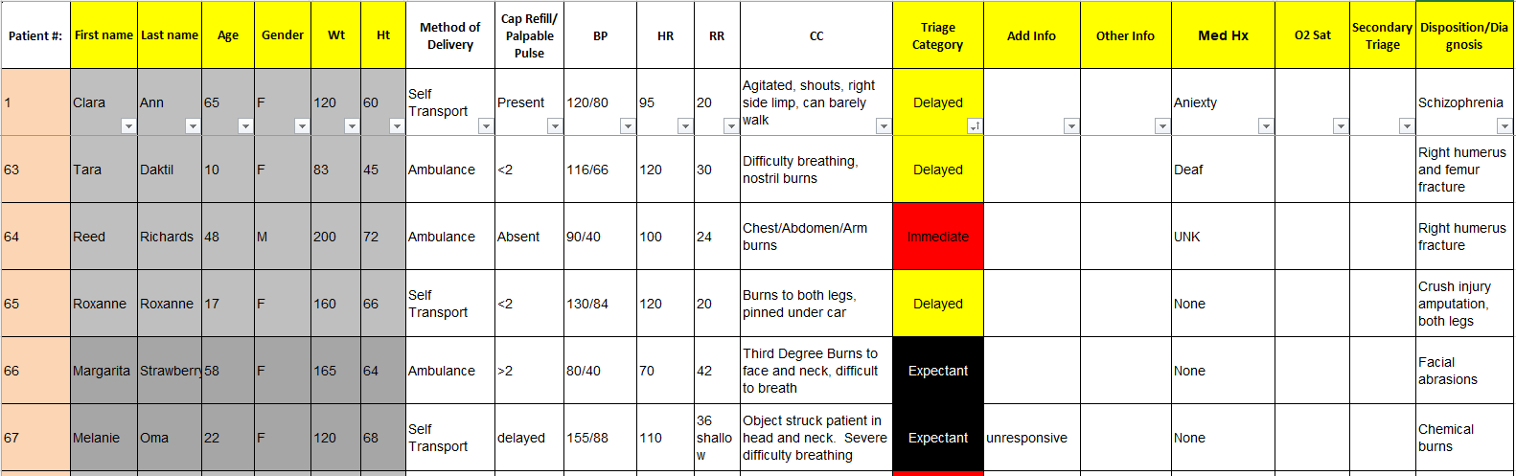

Victim Card List – Print at least one-color copy from the MRSE website.
www.wvha.org/HEF
Printing instructions can be found on the bottom of the excel spreadsheet in additional tabs.
Find the patient ID number and read the information to your command center.
4
How to read the Victim Card List

Slide 19
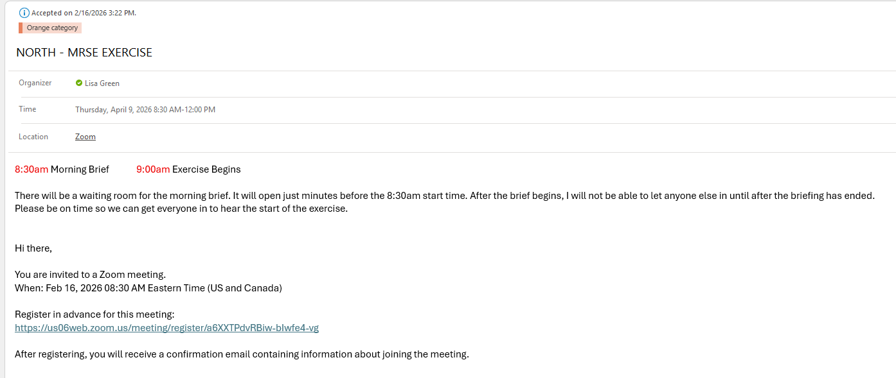
5
Direct your team to connect to the 8:30am briefing and the Noon Debrief on ZOOM.
Links for these were emailed to you as part of a calendar invite.

Slide 20

as a Facilitator
To guide your command staff through the exercise, keeping discussions on track and focused on the exercise’s objectives.
Be sure everyone can see WebEOC to follow along
Read injects to your team: You will receive injects (messages) from WebEOC on your email, and your cell phone by voice and text throughout the exercise.

Slide 21

The location for
ALL THINGS
MRSE
www.WVHA.ORG
https://wvha.org/hef/hospital-emergency-management/medical-response-surge-exercise-mrse/

Slide 22
DEMO MRSE Website
MRSE Facility Registration
Schedule of Trainings, Exercise day, AAR
MRSE Description
Roles, Benefits of Participation, Planning Team
All your Evaluators Forms
General Documents
Exercise Guide
Reporting Tool
Evaluation Plan

Slide 23
Important times to remember: 7:30am – arrive in command center 8:30am – Connect to the briefing on Zoom 9:00am – Start-Ex Noon- Connect to debrief on Zoom May 14th @ 10am – After Action Review Meeting -SOUTH June 15-19, 2026 – AAR report due out this week -SOUTH

Slide 24
Of Note:
Dialysis, and Health Departments will receive the majority or all their injects via WebEOC notifications by Text, Email and Calls.
Hospitals, EMS, LTC, Emergency Management, In-Home Health Care, Hospice, and Primary Care will receive most of their injects via personal calls from the Sim Cell.

Slide 25
A few Logistics
Evaluator Training – FRIDAY @ 2pm on ZOOM
Make sure your evaluator has the correct time and platform
WebEOC screen will time out after 30 minutes
No Changes will be made after 3pm today.
If your evaluator, facilitator, POC changes, it will be your responsibility to get them to forward you all the information on exercise day.

Slide 26
Summary
Arrive 7:30am
Log in to MRSE website and display sign in sheet
Get your team logged in to the 8:30am briefing call on Zoom
Find and print your Victim Card sheets to refer to
After the 8:30am Zoom, log in to WebEOC MRSE Event and display for all command staff to see
When injects are called in, you find the victim ID #s and read them to your team
***If you need to place a call to an agency that is not playing in the exercise, you will call the MOCC/SIMCELL instead. It will be on your Communications Directory that your evaluator will provide
Sign out of WebEOC
Log in to the Noon Hotwash on Zoom

Slide 27

Questions?

