Slide 1
Welcome to Evaluator Training
For the March 25, 2025, MRSE Exercise for WV Healthcare Coalitions

Slide 2
MRSE stands for Medical Response and Surge Exercise
The US Department of Health and Human Service (HHS) Administration for Strategic Preparedness and Response (ASPR) created the MRSE to assist jurisdictions, Healthcare coalitions like ours, and key response organizations with evaluating our current ability to effectively respond to an emergency when there is a significant patient surge.
The MRSE is a functional exercise. HSEEP describes functional exercises as an operations-based exercise designed to test and evaluate capabilities and functions while in a realistic, real-time environment. There will be NO MOVEMENT of patients or resources.

Slide 3
HCC MRSE Requirements
Plan, execute, evaluate, and report the findings and outcomes of a realistic medical surge exercise to improve the response readiness of health care partners in their jurisdiction.
1
Document actions or activities to identify areas of improvement and develop meaningful corrective actions.
2
Build new partnerships and strengthen existing ones with organizations across our health care response partners and emergency response communities to improve communication and coordination during future emergencies and disasters.
3

Slide 4
Two exercises within one
Statewide Exercise
NORTH
Healthcare Coalition
North Coalition MRSE
March 25, 2025
SOUTH
Healthcare Coalition
South Coalition MRSE
March 25, 2025
Cannot share patients, data or reports

Slide 5
Meet Your Planning Team
Emergency Management
Health Departments
Shawn Dunbrack
Sandy Green
Matthew Gregg
EMS
Leland Steele
Cabell-Huntington Health Department
Christopher Earnest
Marshall County Health Department
Paul Seaman Jan Care
Ian Lympany
Monongalia Emergency Medical Services
HOSPITALS
Hollis Lipscomb
Davis Medical Center
Linda Murray Cabell
Huntington Health
Doug Douglas
CAMC Health System

Slide 6


https://wvha.org/hef/hospital-emergency-management/medical-response-surge-exercise-mrse/
The location for ALL THINGS MRSE

Slide 7
General things on the MRSE website
MRSE Description
Roles, Benefits of Participation, Planning Team
Schedule of Trainings, Exercise day, AAR
Communications Directory – Coming Monday
General Documents
  Exercise Guide
  Recipient Review Guide
  Reporting Tool
  Evaluation Plan
DEMO MRSE Website

Slide 8
Evaluator Forms
LTC - Resource and Support Form
Primary Care - Resource and Support Form
Hospice - Resource and Support Form
Emergency Management - Resource and Support Form
In Home Health Care - Resource and Support Form
  Health Dept Resource Supply Form
  Health Dept Performance Measure
  EMS Resource and Support Form
  EMS Performance Measure
  Hospital Performance Measure
  Hospital Patient Distribution Summary Table
  Hospital Tracking and Transfer Form
  Hospitals must capture this
Non-Registered EMS Agency Sign In Sheet
Communications Directory on the MRSE Website
CTRL + P

Slide 9
Four Overarching
Required Objectives
1. HCC(s) engage health care partners and their executives to participate in the exercise and the After-Action Review within the HPP budget period.
2. HCC(s) demonstrate their ability to assess and meet critical resource needs (personnel, supplies, equipment, etc.) to manage patient surge during a communitywide emergency or disaster by the end of the MRSE.
3. HCC(s) effectively notify HCC health care partners of an incident and facilitate ongoing information sharing during a community-wide emergency or disaster.
4. HCC(s) demonstrate their ability to reduce patient morbidity and mortality through appropriate patient placement during a large patient surge by assisting with the identification and coordination of available patient care resources by the end of the MRSE

Slide 10
EMS Objectives
EMS crews will take inventory and confirm with EMS agency management that they have all MCI supplies per the WVOEMS equipment/medical list within 15 minutes of notification of incident. (Triage tags, unified command, regional medical command utilized, receiving hospital decompression.)
The requested primary EMS agencies will demonstrate the ability to commit resources (Ground and Aeromedical) within 10 minutes of notification.
EMS agencies will track the time it takes for available units to arrive on scene at multiple mass casualty incidents.
EMS agencies will demonstrate the ability to work within the Unified Command system on scene and coordinate with medical command centers for patients needing transport.

Slide 11
Public Health Objectives
Health Departments will report resource availability within 90 minutes to the Emergency Operations Center/911.
Upon notification of incident, Health Departments will assess available resources (human and material) within 90 minutes.

Slide 12
Emergency Management Objectives
Within one (1) hour issue statement to the public with the ‘Four W’s’, website and phone #s
Provide healthcare facilities with assistance in securing ambulance transportation within 15 minutes if requested
Within two (2) hours of notification of event, establish a Family Assistance Center (Reunification) site.
Within one (1) hour of notification of the incident, activate the county’s Emergency Operations Center (EOC)

Slide 13
7:30 am
Arrive at your Facility or Facilities Command Center
Set up your laptop
1.WebEOC – Facilitators will log in and display
2. 8:30am and Noon Zoom – You should have a calendar Invite already

Slide 14
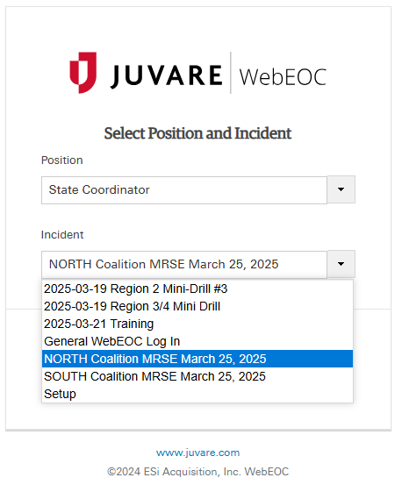





Log on
TO YOUR COALITIONS EVENT
NORTH Coalition MRSE March 25, 2025
SOUTH Coalition MRSE March 25, 2025
Facilitators Right Arm

Slide 15
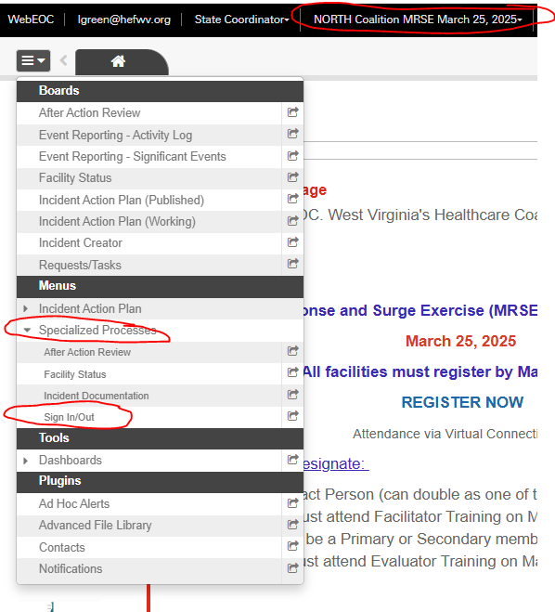
SIGN IN
TO YOUR COALITIONS EVENT

Slide 16
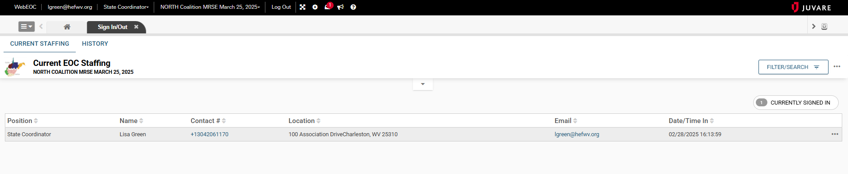
After you Sign In, it will look like this

Slide 17
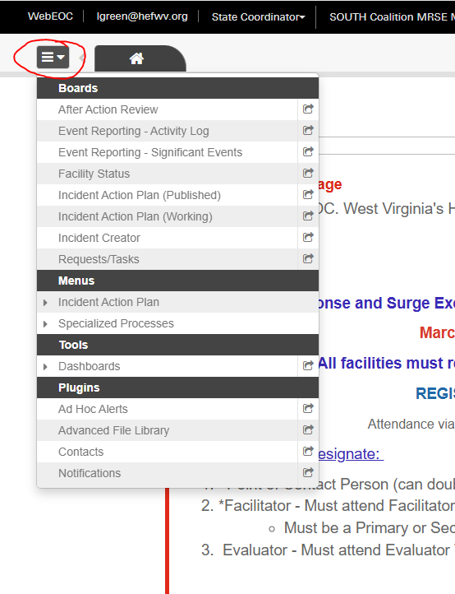
Create a Post stating Your agency’s name is signed in and ready to begin the exercise

Slide 18
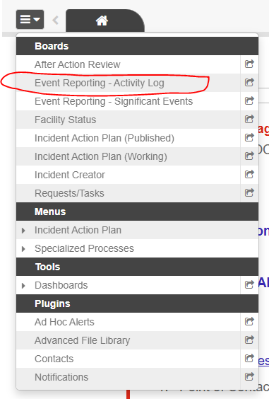
Begin Here to create a post

Slide 19
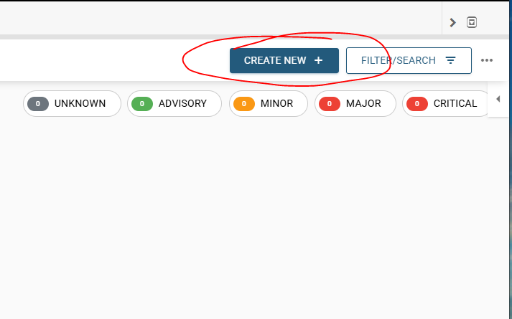
Click the Blue Button

Slide 20
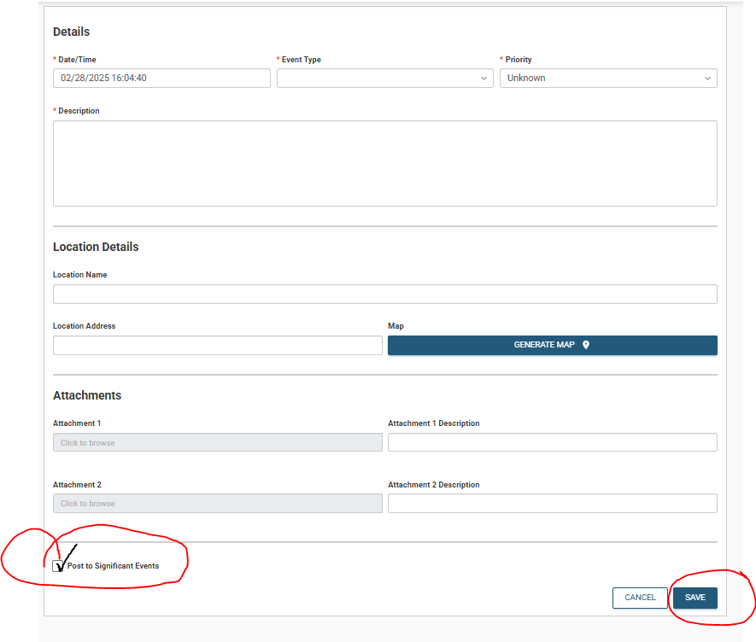
~ Complete the form
~ Check the box
~ Click Save

Slide 21
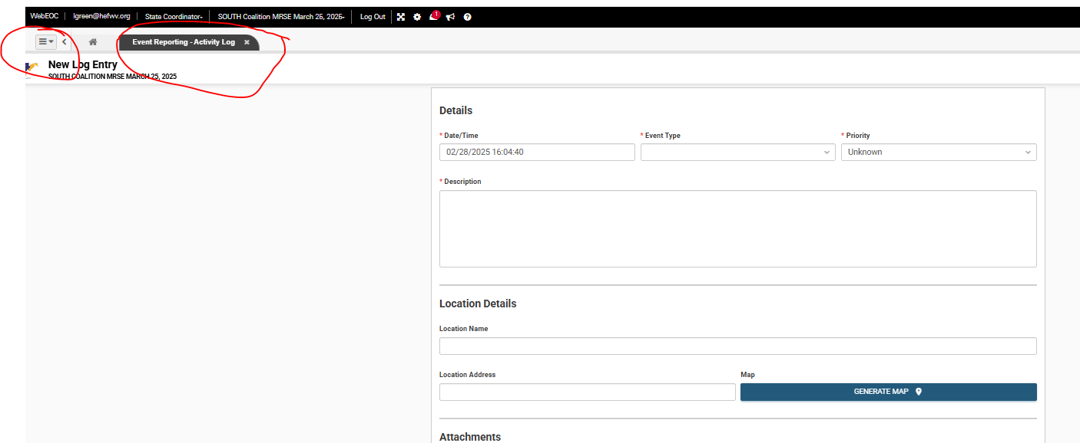
You’re still on the Event Reporting Activity Log Board

Slide 22
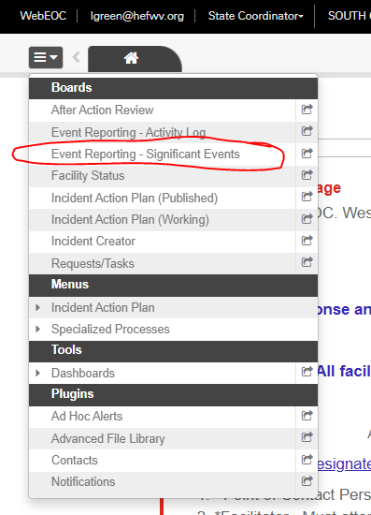
Back to Hamburger Menu
Click Event Reporting Significant Events

Slide 23
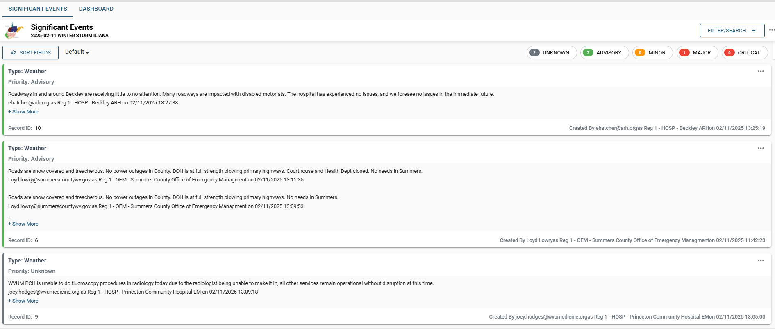
What it looks like

Slide 24
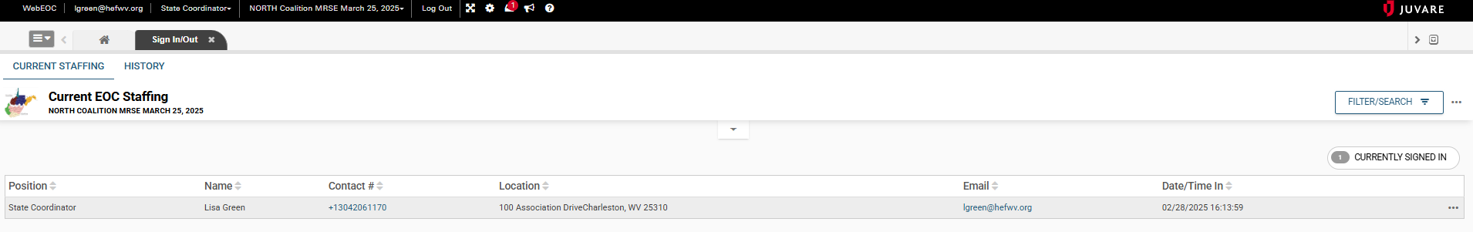
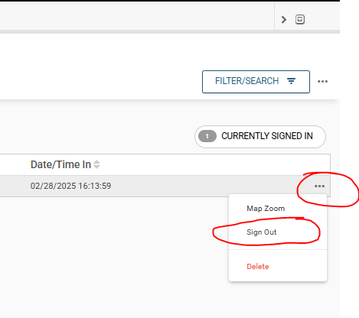
Sign out

Slide 25
8:30 AM
Briefing on Zoom
Register in advance for this meeting:
https://us06web.zoom.us/meeting/register/tZAtcuyhrj0qGdz0kb0IUMWGGsZ4FXGeQJx5

Slide 26

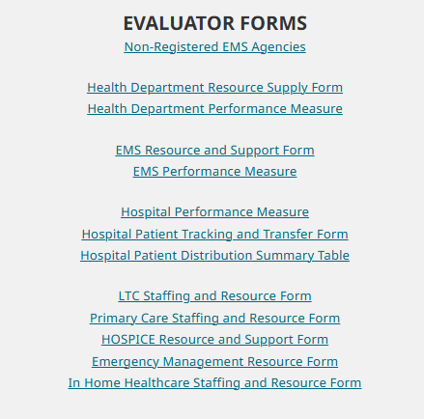
Evaluator Forms
Same Day but no later than
Friday, March 28th

Slide 27
Noon
Hotwash on Zoom
Register in advance for this meeting:
https://us06web.zoom.us/meeting/register/tZAtcuyhrj0qGdz0kb0IUMWGGsZ4FXGeQJx5

Slide 28
Summary
Arrive 7:30am
Be sure your Facilitator has the sign in sheet pulled up on the MRSE website and sign yourself in.
Remind your Facilitator to get logged in for the 8:30am briefing call on Zoom
After the 8:30am Zoom, your facilitator will log your facility in to WebEOC and display for all command staff to see
You will go to the MRSE website and pull up your online forms. You can fill them out as the exercise unfolds or take notes and fill out afterwards.
Be sure your facilitator logs on to the Noon Hotwash on Zoom – same link at the 8:30am Zoom

