Slide 1
Web EOC Emergency Management Communications and Notification System
​
West Virginia’s Training and Implementation Plan

Slide 2
Ways we will Train
Juvare Tutorials in the Advanced File Library​
‘One Task’ Tip Sheets via Email
​Mini Drills using the Notification System
Virtual Trainings by Coalition via Zoom
Virtual Trainings during Regional Meetings

Slide 3
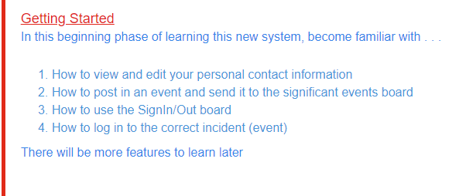
PRIMARY GOALS

Slide 4
The Advanced File Library Demo

Slide 5
Timeline
Log-Ins
One Task & Tutorials
Mini - Drill
Virtual Training
More Virtual Training
March 15 – April 4 by Region
April 10 – May 1st
May 3rd
May 5th
10am - SOUTH
2pm - NORTH
By Region
Beginning June 2023

Slide 6
HOW WE GET THERE
REPETITION
REPETITION
REPETITION
Contact your Regional Coordinator
Contact Lisa Green
lgreen@hefwv.org
Contact Samantha Stamper
sstamper@hefwv.org

Slide 7
Questions
Lisa Green - 304-353-9705
Samantha Stamper – 304-353-9728

Slide 8
WV-EMCE
West Virginia Emergency Management Coordinator Endorsement
April 18-19, 2023
Days Inn and Conference Center
Flatwoods, WV

Slide 9
WV-EMCE
BASIC
Introduction to WV Emergency Management Coordinator Endorsement (WV-EMCE) Program
Objectives-Foundational and Professional Components
Typical job description
Importance of the position
Emergency Management Standards Overview for Healthcare Organizations
Overview of the Hospital Emergency Operations Plan, Policies and Procedures
Components of the EOP
Emergency Management Policies
Stakeholders in Emergency Management Program Discussion
Importance of obtaining buy-in

Slide 10
WV-EMCE
ADVANCED
Effective Disaster Preparation and Response – Part 1
Effective Disaster Preparation and Response – Part 2
Disaster Strikes – Roles and Responsibilities – Agency, local, county, state and federal.
Establishing the Hospital Command Center (HCC)
Disaster Review Process/ AAR - What worked and where can we improve emergency management and disaster preparedness.
Healthcare Coalition - Role & Resources for the Emergency Coordinator/Manager

Slide 11
HVA Reports
SOUTH
Reviewed draft with leadership
Tweaking calculation
Available on SharePoint soon
NORTH
Available on Sharepoint by the end of April

