Slide 1
Veterans Administration An Overview
Todd Lake
Area Emergency Manager
Washington, DC

Slide 2
VA Mission Statement
President Abraham Lincoln Second Inaugural Address
(Only 700 Words)
With malice toward none; with charity for all; with firmness in the right, as God gives us to see the right, let us strive on to finish the work we are in; to bind up the nation’s wounds; to care for him who shall have borne the battle, and for his widow, and his orphan—to do all which may achieve and cherish a just and a lasting peace, among ourselves, and with all nations. Mission: To fulfill President Lincoln’s promise to care for those w To

Slide 3
New Mission Statement
The Mission Statement below was updated earlier this month to be more inclusive and honor ALL Veterans who serve our country:
“To fulfill President Lincoln’s promise to care for those who have served in our nation’s military and for their families, caregivers, and survivors.”

Slide 4
Veterans Administration
Veterans Health Administration
Veterans Benefits Administration
National Cemetery Administration

Slide 5
VHA
The Veterans Health Administration is America’s largest integrated health care system, providing care at 1,298 health care facilities, including 171 medical centers and 1,113 outpatient sites of care of varying complexity (VHA outpatient clinics), serving 9 million enrolled Veterans each year.

Slide 6
VHA Office of Emergency Management
Mission Statement
We provide expertise and leadership for the Veterans Health Administration enterprise through the integration of emergency management programs, functions, and supporting activities to prevent, protect, mitigate, respond, and recover from all hazards.

Slide 7
OEM Programs
)
Comprehensive Emergency Management Program
VHA's comprehensive emergency management program focuses on improving VHA disaster resiliency and response capabilities. One of the primary approaches to emergency program is to maintain continuity of essential VA health care functions and services during emergencies.
VHA Emergency Management Coordination Cell (EMCC)
The EMCC provides VHA the planning, logistical and expert guidance to support INTERNAL continuity of care and EXTERNAL 4th mission assignments resulting from emergency events and disasters. The EMCC is the coordinating unit for VHA Emergency Management resources and assets.

Slide 8
OEM Programs (Cont)
Disaster Emergency Medical Personnel System (DEMPS)
The DEMPS Program may be used for an internal Veterans Health Administration (VHA) mission, as well as supporting external 4th Mission assignments. DEMPS is VHA's main program for deployment of clinical and non-clinical staff to an emergency or disaster.
Disaster Logistics Management
Disaster Logistics Management is an OEM function that manages, operates and maintains some of VHA's most high-level assets. They are also responsible for coordinating equipment, materials and resources during an emergency response.

Slide 9
OEM Programs (Cont)
VHA Watch
VHA Watch is a program that maintains situational awareness for events, conditions and threats across the country to ensure absolute readiness and continuity of care for Veterans..

Slide 10
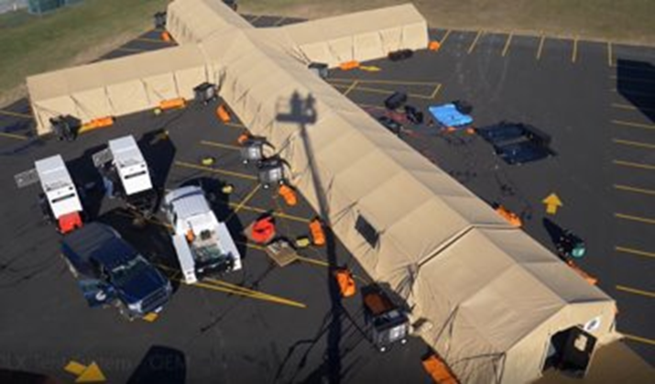
Deployable Resources Isolation Unit
(Comprehensive list sent to MS. Stamper)

Slide 11
Intensive Care Unit (ICU) (17) 53’ Flatbed Trailers

Slide 12
Mortuary Refrigeration Trailers – 14’ 12 remains capability

Slide 13
High Water Vehicles (HWV) Deep water fording up to 50” of water.

Slide 14
How can VA Help?
Staffing (Hurricanes/Flooding/Pandemic)
Mobile Facilities
Mental Health Services
Flooding rescue/retrieval
Quality Management
Partnership

Slide 15
How to get VA Help?
Contact State Department of Health and Human Resources
or
Contact State Office of Emergency Management
State will contact HHS
HHS will contact FEMA and request a Mission Assignment (MA)
HHS will assign the MA

Slide 16
Fourth Mission
The Department of Veterans Affairs fourth statutory mission is to support the Department of Defense and the Public Health Service during times of national emergency.
Public Law (P.L.) 97-174
Public Law 93-288 National Response Framework
Veterans Health Administration, Office of Emergency Management, has lead responsibility for the emergency management mission.
VA shares the Federal responsibility for preserving public health during domestic crises.
As a partner in the National Disaster Medical System, VA coordinates medical resources and shares staff and supplies with local health providers during public health emergencies.
VA works with other Federal agencies and the Red Cross, as part of the National Response Framework (Public Law 93-288, as amended), to disasters.
If necessary, VA would offer direct patient care to assist communities overwhelmed by large numbers of patients.
FEMA coordinates this plan, and the Secretary of Health and Human Services directs the public health care responses.

Slide 17
Federal Patient Movement NDMS & FCC Overview
Jeremie Dellapenta
VHA OEM AEM
Baltimore FCC Coordinator

Slide 18
NDMS Overview
NDMS Patient Movement Exercise - YouTube
HHS is the Lead Federal Agency for ESF 8.
HHS uses the National Disaster Medical System (NDMS) to support and coordinate Federal medical response to major emergencies and disasters.
NDMS is a federally coordinated healthcare system and an interagency partnership of HHS, DHS, DOD, and VA.

Slide 19
NDMS Overview
Medical Response
Health and medical assistance in domestic disasters by request.
Temporarily supplement federal, state, Tribal, territorial, and local capabilities with specialty teams.
Patient Movement
Aeromedical Evacuation System (military and civilian)
Military Sealift
Definitive Care
Inpatient medical services when such treatment may be unavailable due to a public health emergency.
Provided by a network of voluntarily-participating, non-Federal, pre-identified facilities.
Ground Transportation

Slide 20
FCC Overview – Mission
Primary Mission: Receive, triage, stage, track and transport patients affected by a disaster or national emergency to a participating NDMS partner facility capable of providing the required Definitive Care (per NRF ESF #8 tasking; VHA Directive 0320.04).
Secondary Mission: NDMS health care facilities may also receive military patients should the DoD and the VA be overwhelmed during a military contingency (per VHA Directive 0320.04).

Slide 21
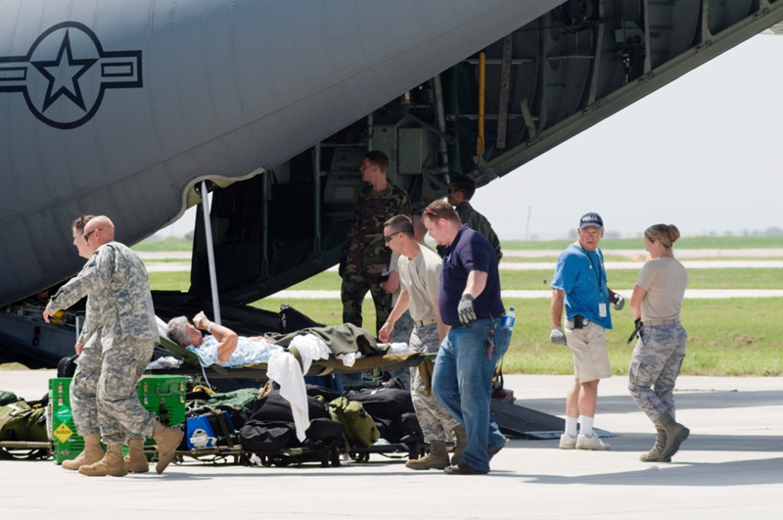
FCC Overview – Mission
VA Medical Center responsible for day-to-day coordination, planning, and operation of a Patient Reception Site for Federal Patient Movement
Local-state-federal initiative to provide evacuated patients with Definitive Care outside of disaster area
Major Functions:
Receive
Sort/Stage
Track
Transport
Social Services support
Follow-Up coordination

Slide 22
FCC Overview – Locations

Slide 23
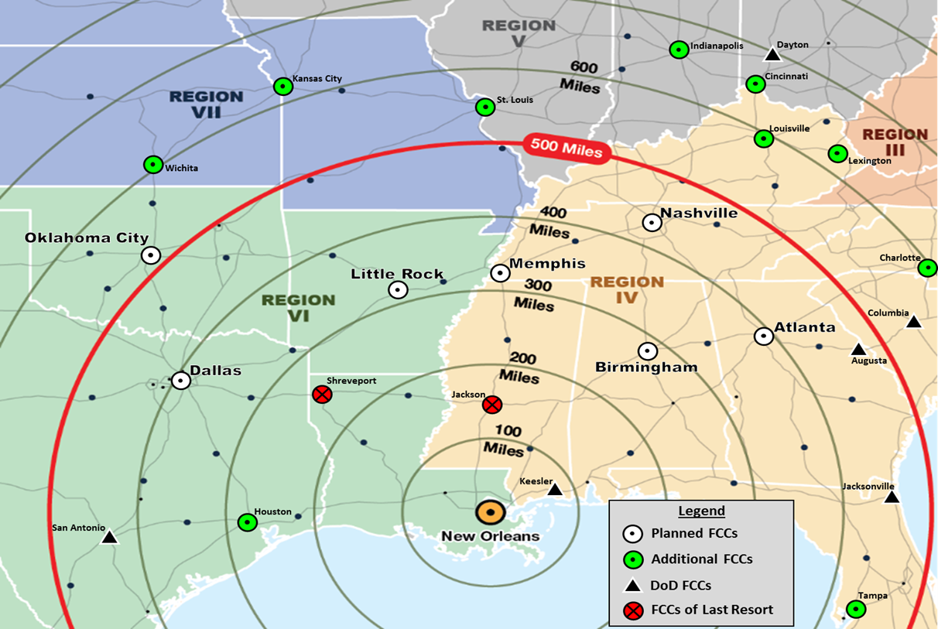
FCC Overview – SOP
General FCC SOPs:
The VAMC Director (or designee) is the FCC Director with overall mission responsibility.
FCCs are not activated unless the FCC agrees it can support mission.
Target radius of FCC activation is approx. 500mi. from incident.

Slide 24
FCC Overview – Alert/Activation
NDMS Patient Movement Coordination Group (HHS, DoD, VA, FEMA) activated​
EMCC Activated – FCC Branch Chief designated​
Readiness reports required from applicable FCCs​
FCC Coordinators must engage VA and community partners on capability​
Based on above FCCs and per NDMS engagement with applicable states – FCCs will be selected for Alert/Activation​
OEM will staff TRANSCOM and possibly the APOE for aircraft tracking visibility​
Additional AEM support will be provided to FCCs

Slide 25
FCC Overview – Movement
If FCC is viable, Global Patient Movement Requirements Centers match NDMS patients to an FCC based upon bed availability reporting and coordination with the FCC.
The FCC matches each NDMS patient with a bed in an NDMS facility that has the necessary health service support capabilities.
May or may not occur prior to patient arrival at the PRS.
Local patient reception and distribution operations are then coordinated directly between the FCC and the local participating NDMS facilities with assistance from other local organizations.

Slide 26
FCC Overview – Staffing Models
Community FCC
Mixed FCC
VA FCC

Slide 27
FCC Overview – Definitions
FCC | Federal facility located in a metro area responsible for PRA readiness. VAMHCS is the FCC.
FCC Alert | FCC *COULD* receive patients; no authorized reimbursement.
FCC Activation | FCC *COULD LIKELY* receive patients in the next 24 hours; reasonable patient reception costs authorized.
FCC Coordinator | VHA OEM AEM responsible for PRA readiness
FCC Director | VA Medical Center Director responsible for overall FCC management.
Patient Reception Area (PRA) | Geographic locale containing the necessary logistical and medical support to meet the NDMS mission. Baltimore is the PRA.
Patient Reception Site (PRS) | The location where patient reception occurs. BWI is the primary PRS; secondary is the Martin State Airfield.
Patient Reception Team (PRT) | ICS-organized group of clinicians, logistics, and admin support. May be civilian or VA personnel.

Slide 28
FCC Overview – Phases
Alert
Activation
Mobilization
Operations
Demobilization
Financial Reconciliation

Slide 29
FCC Overview - Patient Reception Site (PRS)

Slide 30
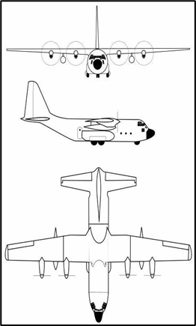
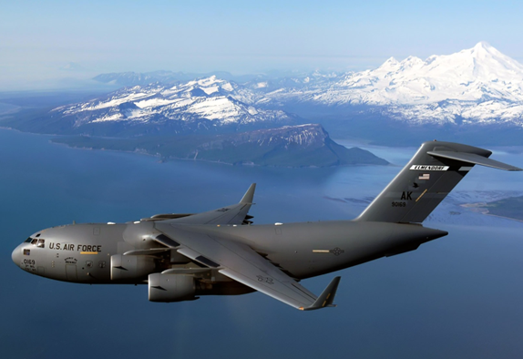
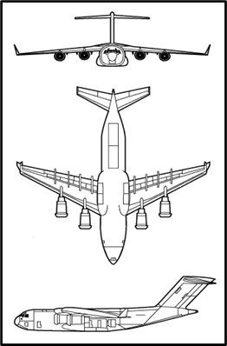
FCC Overview – DoD Aircraft
C-130
30 patients
Propellers
100ft/30m long
133ft/40m wingspan
39ft/12m high
75,745lbs/34,430kg empty
175,000lbs/79,380kg max
345mph/555kph max speed
C-17
50 patients
Jet engines
174ft/53m long
170ft/52m wingspan
55ft/17m high
277,000lbs/125,645kg empty
585,000lbs/265,350kg max
515mph/830kph max speed

