Slide 1
EMResource - BedSync
Juvare - EMSystems
BedSync Commercial

Slide 2



Ann Marie Brown
Account Executive - PH & HC
annmarie.brown@juvare.com
Natalie Monnett
Account Executive - PH & HC​
natalie.monnett@juvare.com
Meghan Staszak
Implementation Analyst
Meghan.staszak@juvare.com

Slide 3
NHSN’s Bed Capacity Initiative
Fully funded, no-cost opportunity for eligible facilities to automate their bed capacity data via BedSync.
Program currently runs through July 2028, though optimistic it will continue beyond.
Actively identifying facilities to participate and take advantage of available federal funding.

Slide 4




BedSync Overview
Fully-funded program
Real time data transfer from Hospital State CDC
Fully automated Up-to-date data for:
  NHSN Hospital Bed Capacity Project
  Hospital Respiratory Data (HRD) as required by CMS
Increase preparedness and capacity awareness
NHSN Bed Capacity Data
NHSN Bed Capacity Data
Hospital
State Repository
EMResource
National Repository
NHSN

Slide 5
Frequently Asked Questions
What happens to this program as of July 15, 2028?
  As of July 15, 2028, CDC funding for the project is scheduled to conclude. Continued funding beyond this point may be contingent upon demonstrated project status and progress. STTL clients will need to define a plan for financially supporting the project moving forward, particularly if extension criteria are not met.
How are other states getting facility buy-in?
  Some states have mandated regulatory reporting requirements
  The cost for mandatory HRD Reporting required by CMS is fully covered by Juvare under this project. No additional expense to your facility.
  Demonstration of ROI. Most facilities spend 2-4 hours per day gathering and submitting data to remain compliant with CMS. Removing this manual process by opting for this automation removes an estimated $30,000 to $60,000 in labor costs annually.

Slide 6
State/Territory Overview & Discussion
How Many Total Facilities Are Eligible?
  Acute-care hospitals (general acute care, critical access, oncology, orthopedic, pediatric, women’s, women’s and children’s),
  Federal acute-care hospitals (Veterans Health Administration, Defense Health Administration, Indian Health Services)
  Long-term acute-care hospitals
  Inpatient Psychiatric Facilities (IPF): includes freestanding facilities and CMS-certified inpatient psychiatric facility units located within a hospital
  Inpatient Rehabilitation Facilities (IRF): includes freestanding facilities and CMS-certified inpatient rehabilitation facility units located within a hospital

Slide 7
Frequently Asked Questions
Are we limited to only Bed Capacity data points?
  The program only requires the transmission of the Bed Capacity data points however Juvare will allow facilities to send as much data as they wish to the STTL deployment of EMResource to maximize value for the facilities
What impact will this have on the HRD data we are submitting?
  The impact of participating is limited to HRD data getting updated in EMResource every 15 minutes rather than once a day for any data elements that overlap. HRD Data will still submit to NHSN once daily as we have done historically
What happens if I choose not to participate?
  As of July 15, 2028, it is estimated that 40 states will be live and submitting data by this modality. Due to that the expectation is, and the CDC has vocalized support for, this program continuing as a mandatory program (likely merging with HRD) rather than optional.

Slide 8
Status Type Reconciliation
Hospital Bed Capacity Data Set - 79 Status Types
DOH - we need your help:
  We want to avoid duplicate Status Types!
  Which status types already exist in your region and should be repurposed for this project
  Which status types will need to get added
  Which Resource Types should be included
Your region will receive the full Bed Capacity Data Set
  Standardized with standardized descriptions and settings
  Most fields aren't editable

Slide 9
IT Information - FAQ
  Who should I talk to in IT to make this happen?
  Examples: EMR Analysts, Data Analytics team, Report Writer, Developer
  Ultimately, anyone that has built an API before
  Someone that can create a report and extract the data
  What EMRs can Juvare integrate with?
  Any EMR - Epic, Cerner, Meditech, etc
  Cloud-based EMRs - usually the EMR vendor charges a fee for an API – ADU is no-cost alternative
  What data elements should we include?
  NHSN Hospital Bed Capacity Data, 75 data elements, referenced in slides at the end
  How often should we push the data to EMResource?
  Every 15 minutes
  For now, CDC has asked us to send them data hourly
  What about security?
  No PHI
  ISO 27001 certified, TLS 1.2 encrypted
  Used by many Federal agencies, FedRAMP certified

Slide 10
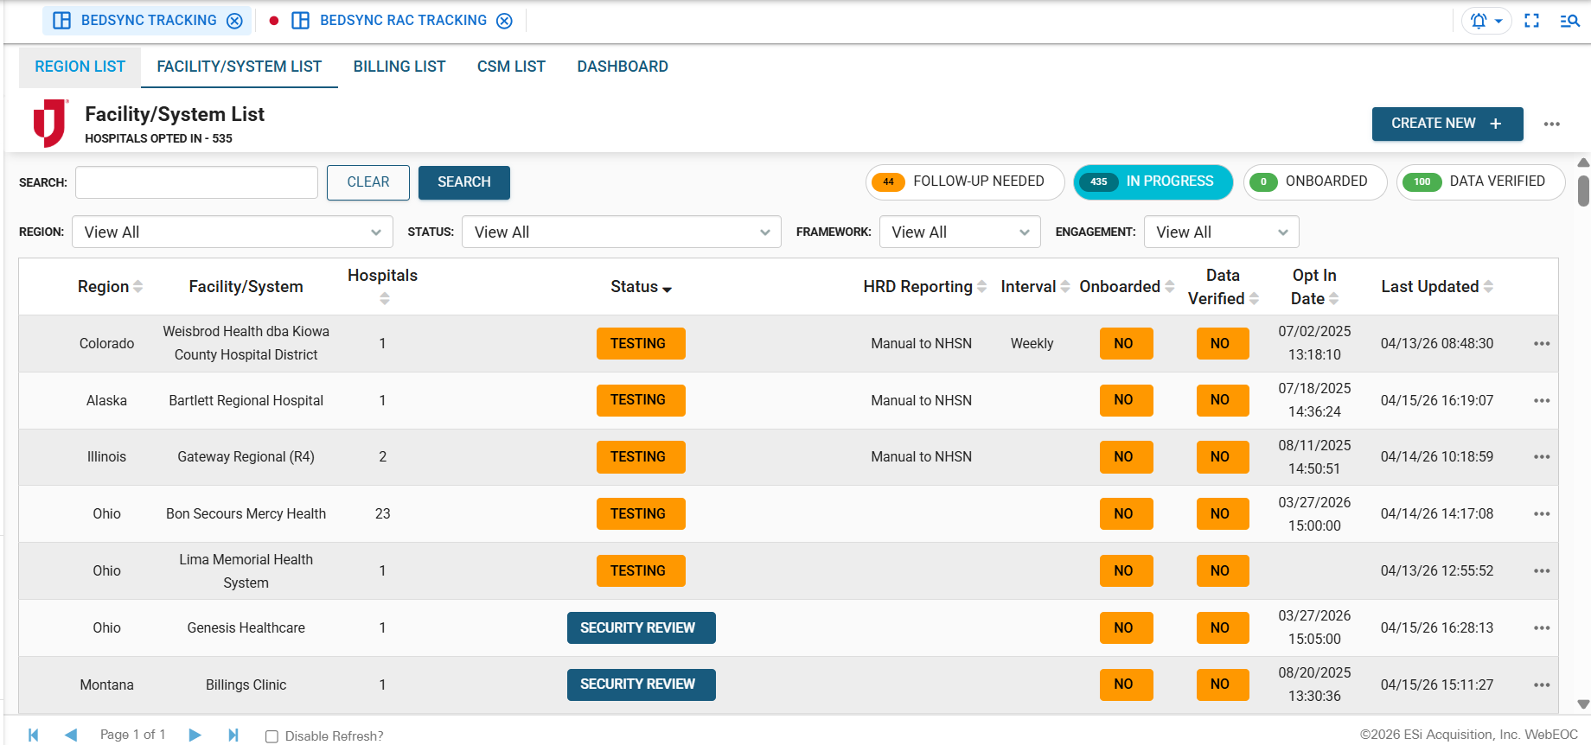
WebEOC Tracking

Slide 11
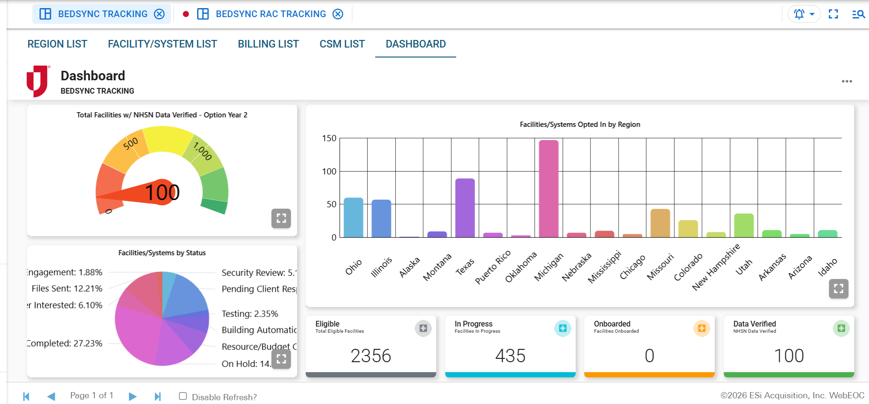
WebEOC Tracking

Slide 12
Next Steps
Facility Enroll Now!
Complete Facility Enrollment Form
Review any requirements – Security Review
Hospital Executive team – Approval ​
Additional BedSync Information:
  Juvare BedSync - https://www.juvare.com/emresource/bedsync/
  Hospital Enrollment form- https://forms.demo.juvare.com/JUVARE-hospital-enroll
  NHSN Bed Capacity - https://www.cdc.gov/nhsn/bed-capacity/index.html
  Hospital Respiratory Data (HRD) - https://www.cdc.gov/nhsn/psc/hospital-respiratory-reporting.html

Slide 13
Questions & Discussion

Slide 14

Thank you
Ann Marie Brown
Meghan Staszak
Senior Account Executive PH&HC
Solutions Implementation Analyst
AnnMarie.Brown@juvare.com
Meghan.Staszak@juvare.com
Phone: 336-689-5060

