Slide 1
CMS Appendix Z – Emergency Preparedness
Presented By: Jessica L. Picanzo, MSN, RN, EMT-P, CMTE
jpicanzo@ipro.org
June 18, 2026

Slide 2
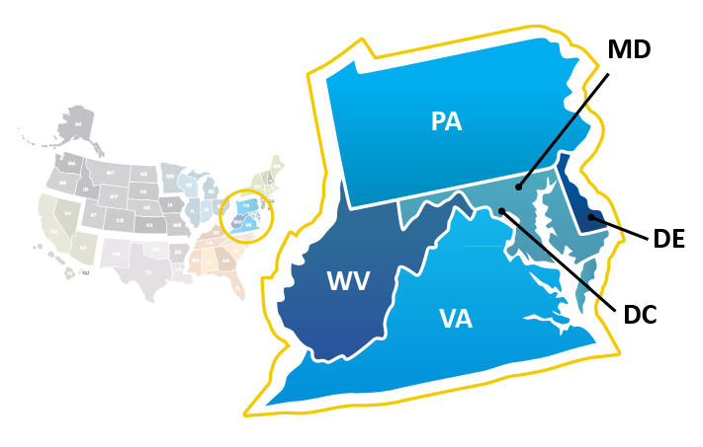
Mid-Atlantic
QIN-QIO
Supporting Providers who care for 7.5 million
Medicare Beneficiaries
In Delaware, the District of Columbia (DC), Maryland, Pennsylvania,
West Virginia, and Virginia.

Slide 3
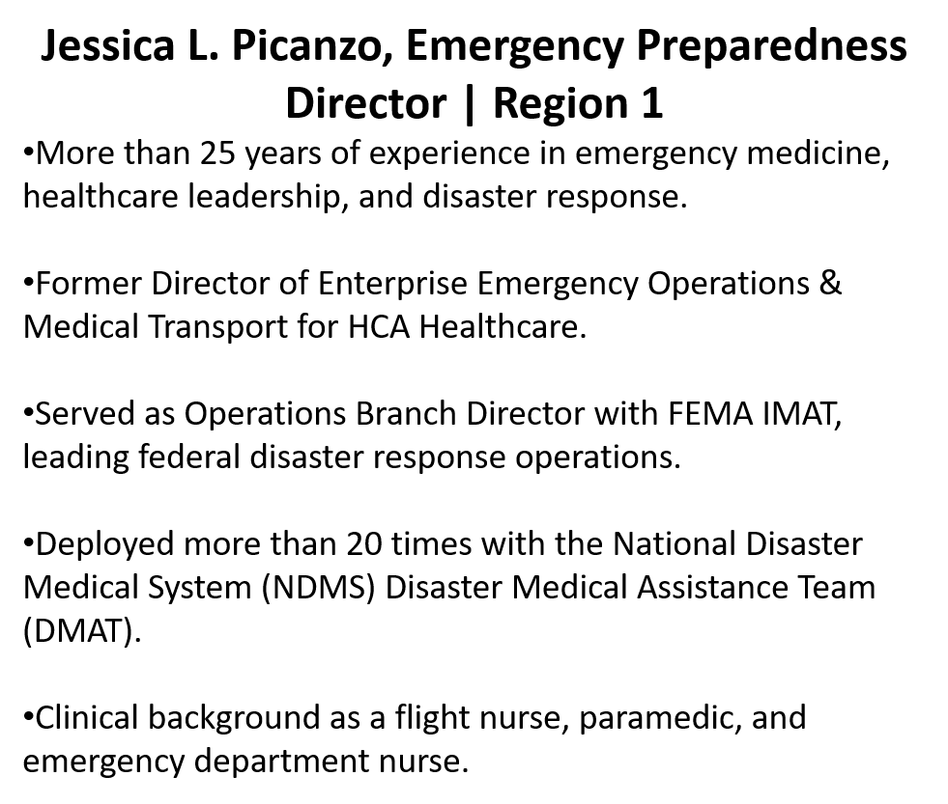
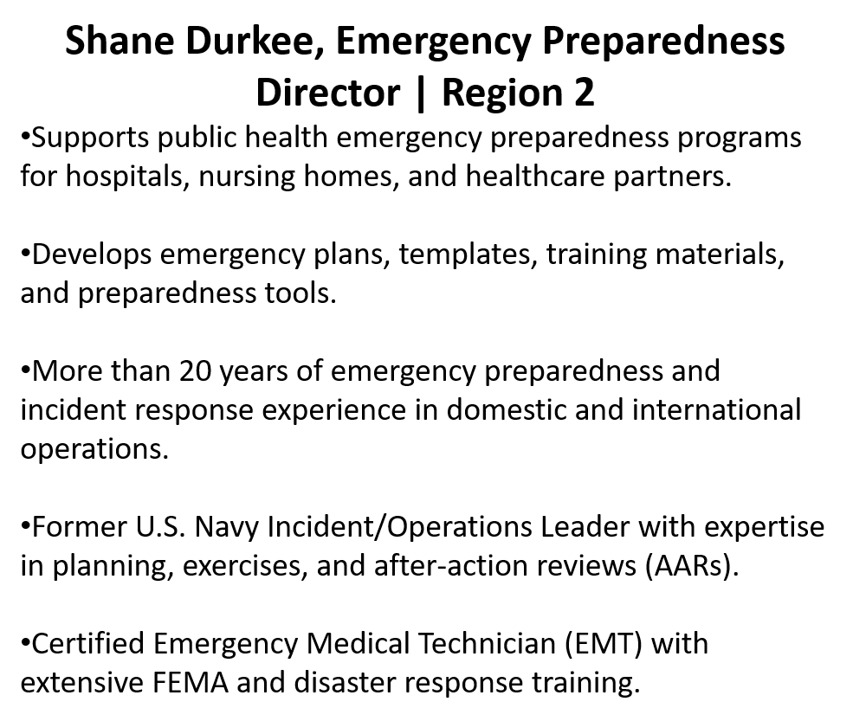
Emergency Preparedness Leadership Team | IPRO

Slide 4
CMS Appendix Z What Leaders Need to Know Key Updates
2019–2021 updates aligned Emergency Preparedness requirements with the CMS Burden Reduction Final Rule
✅ Emerging Infection Disease (EIDs) integrated into preparedness planning
✅ Training and exercise requirements vary by provider type
✅ Most providers now follow a biennial review cycle
✅ Greater flexibility in documentation methods
✅ Surveyors focus on evidence of preparedness—not just written plans
✅ Real emergencies may satisfy exercise requirements
The goal: Reduce administrative burden while maintaining preparedness and compliance.
Notes:
"When Appendix Z was originally implemented, the focus was largely on building emergency preparedness programs. Then COVID happened. Healthcare organizations across the country faced challenges related to staffing, supply chain disruptions, communication, surge capacity, and infectious disease response. CMS took those lessons learned and incorporated them into Appendix Z while also looking for opportunities to reduce unnecessary administrative burden. The result was a shift away from simply maintaining documents and toward demonstrating preparedness and operational readiness."
"So what does that actually look like for healthcare organizations today? Let's walk through the major program components."

Slide 5
Key Call Outs & Major Updates
Focus Area | Examples
Patient & Staff Safety | Evacuation, Shelter-in-Place, Staff & Patient Tracking
Operational Continuity | Alternate Energy, Subsistence Needs, Continuity Planning
Program Alignment | Risk Assessment & Communication Plan Integration
Workforce Planning | Volunteers & Emergency Staffing Strategies

Slide 6
Who Must Comply
🏥 Hospitals & Critical Access Hospitals (CAH)
All Medicare-certified providers must maintain a facility-based, all-hazards emergency preparedness program.
🏠 Long-Term Care
🏡 Home Health & Hospice
⚕️ Ambulatory & Outpatient
👥 Community-Based Programs

Slide 7
Emergency Plan E-004 – What Surveyors Expect
✓ Risk Assessment
Facility- and community-based
Reviewed at least every 2 years (annually for LTC)
✓ All-Hazards Planning
Natural disasters
Human-caused events
Utility/facility failures
Emerging Infectious Diseases (EIDs)
✓Documentation
Review date
Evidence of updates and revisions
EID considerations integrated into planning
Notes:
When surveyors review your Emergency Plan, they're really looking for three things. First, is it based on a current risk assessment? Second, does it truly follow an all-hazards approach, including infectious disease planning? And third, can you show evidence that you're reviewing and updating the plan? If those three pieces are present, you're already ahead of many organizations."

Slide 8
Risk Assessment (E‑0006)
Everything Starts Here
Assess | Consider | Incorporate | Leverage
Facility Risks | Staffing | Emerging Infectious Diseases | Healthcare Coalition Data
Community Risks | PPE & Supplies | Population Needs | State & Local Risk Assessments
All-Hazards Threats | Surge Capacity | Continuity Impacts | Community Partners
Your Risk Assessment should drive:
➡️ Emergency Plan (E-0004)
➡️ Policies & Procedures (E-0013)
➡️ Communication Plan (E-0029)
➡️ Training & Exercises (E-0036 / E-0039)
Notes:
"This is one of the most important E-Tags in Appendix Z because everything else flows from it. If a surveyor asks why you exercise on cyberattacks, why you have a generator policy, or why you stock certain PPE, the answer should trace back to your risk assessment."

Slide 9
Know Your Population
Emergency plans must address:
Population served (inpatient/outpatient)
Individuals at higher risk (mobility limits, chronic illness, cognitive impairment)
LTC and ICF/IID must include missing residents/clients
All plans must address evacuation, transfers, and continuity of care
Notes:
"Your risk assessment isn't about hazards. It's about hazards impacting your specific patients."

Slide 10
All Hazards Approach
Natural Events | Human-Caused Events | Facility Failures | Emerging Infectious Diseases (EIDs)
Severe Weather | Cyberattacks | Power Outages | Pandemic Influenza
Flooding | Active Threat / Violence | Water Disruptions | COVID-19
Wildfire | Civil Unrest | Medical Gas Failures | Ebola
Extreme Heat / Cold | Supply Chain Disruptions | HVAC/System Failures | Zika
Winter Storms | Communication Failures | IT System Outages | Future Novel Pathogens
CMS expects facilities to identify, assess, and plan for risks across all four hazard categories.
Notes:
"Most organizations are comfortable planning for Natural events, but CMS wants to know you're equally prepared for the other three."

Slide 11
Utilities & Infrastructure Resilience Planning
🌡️ Environment
Temperature control
HVAC disruptions
Patient safety
🏥 Clinical Infrastructure
Medical gas
Critical systems
Essential services
⚡ Power
Emergency power
Generator testing
Fuel supply
💧 Water
Potable water
Sanitation
Continuity of operations
Infrastructure failures become patient care failures if we are not prepared.
Notes:
"Surveyors aren't really evaluating your generator. They're evaluating whether you can continue caring for patients when critical infrastructure fails."

Slide 12
Communication Plan Requirements
Maintain current contact lists (staff, physicians, partners, officials)
Primary and alternate modes (phone, radio, satellite, etc.)
Share patient information for continuity; HIPAA 45 CFR 164.510 allowances
Report occupancy, needs, and ability to assist to authority having jurisdiction
Notes:
"One of the most common mistakes I see is organizations treating the Communication Plan as a phone list. CMS expects much more. They want to know how you'll communicate when your primary systems fail, how you'll maintain continuity of care, and how you'll coordinate with the broader healthcare response system."

Slide 13
Emerging Infectious Disease Planning
Operational Readiness | Workforce Readiness
PPE and critical supply availability | Staffing contingency plans
Screening and isolation processes (triage workflows) | Surge staffing strategies
Infection prevention capabilities/tele-triage options | Cross-training and role flexibility
Alignment with CDC and Public Health | Active Coordination with local health care coalition and public health
Notes:
I know there's some COVID fatigue in healthcare, but this slide really isn't about COVID. It's about making sure the next infectious disease event—whatever it may be—doesn't catch us unprepared

Slide 14
Continuity of Operations
Can you answer:
Who makes decisions if leadership is unavailable?
How long can you operate without utilities?
What triggers evacuation?
Where would patients go?
Notes:
"Surveyors love asking these questions because they quickly reveal whether a plan is operational or just a document."

Slide 15
Training and Testing Program
Exercise Requirements
Inpatient Providers | Outpatient Providers
2 exercises annually | 1 exercise annually
One may be a real-world event | Full-scale exercise every other year
Documentation required | Documentation required
Key Considerations
Real emergencies may satisfy exercise requirements
Staff should understand their roles and responsibilities
After-action improvements should be documented and tracked
Compliance is demonstrated through documentation
The goal isn't to complete an exercise. The goal is to validate readiness.
Notes:
"One of the biggest misconceptions I see is that CMS is measuring exercises. They're really measuring preparedness. The exercise is simply the mechanism to demonstrate that your plans work, your staff know their roles, and you've identified opportunities for improvement."

Slide 16
What Surveyors Want to See
Can You Demonstrate:
📝 Training records
🎯 Exercise participation
📊 After-Action Reports (AARs) with updating training plans
🔄 Improvement Plan follow-through
👥 Staff knowledge of the emergency plan
Notes:
Surveyors aren't going to be impressed by the number of exercises you've conducted. They're looking for evidence that your organization learned something and improved because of it."

Slide 17
What Surveyor's Focus On
📄 Documentation | 👥 Staff Knowledge
Plans & policies | Roles & responsibilities
Risk assessments | Emergency procedures
Training records | Response expectations
🎯 Program Validation | 🤝 Coordination
Exercises | Healthcare coalitions
AARs/IPs | Public health partners
Continuous improvement | Community response partners
Notes:
"Everything we've discussed today will eventually fall into one of these four buckets during a survey."

Slide 18
Survey Readiness Checklist
Question | Yes/No
Is your risk assessment current? | □
Has your emergency plan been reviewed and updated? | □
Can staff explain their roles during an emergency? | □
Are training and exercise requirements current? | □
Have improvement items been addressed? | □
Can you demonstrate community coordination? | □

Slide 19
What are CMS E-Tags?
E-Tag | Requirement
E-0004 | Emergency Plan
E-0006 | Risk Assessment
E-0029 | Communication Plan
E-0039 | Exercises
E-Tags are the survey standards CMS uses to evaluate compliance with Appendix Z Emergency Preparedness requirements.
E-Tags do not create new requirements.
They are the framework CMS uses to organize, evaluate, and cite Emergency Preparedness requirements during surveys.
Notes:
"Throughout this presentation we've talked about Emergency Plans, Risk Assessments, Communication Plans, and Exercises. CMS organizes each of those requirements under a specific E-Tag. During a survey, deficiencies are cited using these E-Tags.“
Facilities tend to think in program components while surveyors think in E-Tags. Understanding both perspectives helps organizations better prepare for surveys and demonstrate compliance. This isn’t that dis-similar to how The Joint Commission speaks.

Slide 20
How E-Tags Work Together
E-0006 Risk Assessment
E-0004 Emergency Plan
E-0013 Policies & Procedures
E-0029 Communication Plan
E-0036 / E-0039 Training & Exercises
This is where Appendix Z starts to make sense. These aren't independent requirements sitting on an island. They're connected pieces of one preparedness program. If your Risk Assessment isn't current, your Emergency Plan may be outdated. If your Emergency Plan is outdated, your training and exercises may not be validating the right hazards.

Slide 21
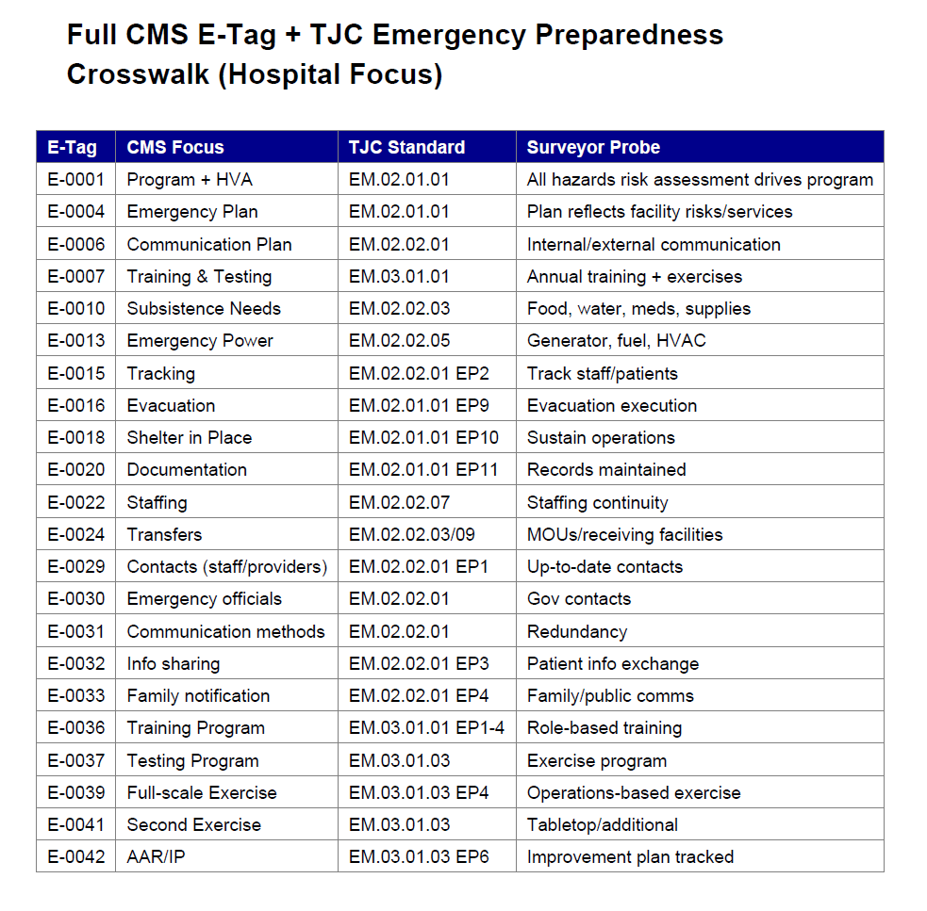
E-Tag – The Joint Commission Crosswalk

Slide 22
What Success Looks Like
1️⃣ A current risk assessment that reflects today's hazards, patient population, and operational risks.
2️⃣ Emergency plans and policies that are reviewed, updated, and aligned with identified risks.
3️⃣ Staff who understand their roles and can confidently respond during an emergency.
4️⃣ Exercises that validate readiness, identify gaps, and drive continuous improvement.
5️⃣ Documentation that demonstrates planning, preparedness, and ongoing program oversight.
6️⃣ The ability to maintain patient care and critical operations during a disruption.
Notes:
"Appendix Z isn't really about passing a survey. It's about ensuring your organization can continue caring for patients when normal operations are disrupted. If you can confidently say yes to these six areas, you're well on your way to both compliance and preparedness."

Slide 23
Reference Links (click to open)
CMS / Regulatory
CMS Health Care Provider Guidance
  https://www.cms.gov/medicare/health-safety-standards/quality-safety-oversight-emergency-preparedness/health-care-provider-guidance
CMS Emergency Preparedness Rule
  https://www.cms.gov/medicare/health-safety-standards/quality-safety-oversight-emergency-preparedness/emergency-preparedness-rule
CMS Core EP Rule Elements
  https://www.cms.gov/medicare/health-safety-standards/quality-safety-oversight-emergency-preparedness/core-ep-rule-elements
CMS Appendix Z (SOM, updated guidance PDF)
  https://www.cms.gov/files/document/r204soma.pdf
Operational / Clinical Resources
Frequently Cited EP Deficiencies (CMS PDF)
  https://www.cms.gov/files/document/frequently-cited-ep-deficiencies.pdf
CDC Project Firstline: Respiratory Virus Infection Control
  https://www.cdc.gov/project-firstline/hcp/infection-control/index.html
CDC Viral Respiratory Pathogens Toolkit for Nursing Homes
  https://www.cdc.gov/long-term-care-facilities/hcp/respiratory-virus-toolkit/index.html
ASPR TRACIE CMS EP Rule Resources
  https://asprtracie.hhs.gov/cmsrule
3/18/2026
Mid-Atlantic CMS QIN-QIO (Region 2)
34

Slide 24

Thank You!

Slide 25

Contact Us
Contact Us
Shane Durkee– Region 2, Director, Emergency Preparedness, sdurkee@ipro.org Cell:619-339-1252
Jessica L Picanzo – Region 1, Director, Emergency Preparedness, jpicanzo@ipro.org Cell: 615-967-1184
Learn more about the Northeast & Mid-Atlantic QIN-QIO: https://qi.ipro.org/
This material was prepared by the Northeast and Mid-Atlantic CMS QIN-QIO (Regions 1 & 2), a Quality Innovation Network-Quality Improvement Organization, under contract with the Centers for Medicare & Medicaid Services (CMS), an agency of the U.S. Department of Health and Human Services (HHS). Views expressed in this material do not necessarily reflect the official views or policy of CMS or HHS, and any reference to a specific product or entity herein does not constitute endorsement of that product or entity by CMS or HHS. Publication #13SOW-IPRO-R1&2-ALL-SA-A06-26-7126

Slide 26
Appendix

Slide 27
E-Tags Overview
E-0001 - Emergency Preparedness Program: Comply with all EP requirements; develop all-hazards program; review biennially.
E-0004 - Emergency Plan: Maintain all-hazards plan including disasters, EIDs, continuity.
E-0006 - Risk Assessment: Document facility/community risk assessment; strategies included.
E-0007 - Patient Population: Address at-risk, services, continuity, succession.

Slide 28
E-Tags Overview
E-0009 - Integrated Response: Collaboration with officials for integrated response.
E-0013 - Policies & Procedures: Develop P&Ps based on plan, risk, comms.
E-0015 - Subsistence & Energy: Provide food, water, meds; alternate energy sources.
E-0018 - Tracking: Track staff/patients during emergency.
E-0020 - Safe Evacuation: Policies for evacuation including care, transport.

Slide 29
E-Tags Overview
E-0022 - Shelter in Place: Shelter policies aligned with risk.
E-0023 - Medical Documentation: Preserve records; HIPAA compliant.
E-0024 - Volunteers: Use volunteers, emergency staffing.
E-0025 - Arrangements: MOUs for patient transfers.
E-0026 - 1135 Waiver: Role under waiver, ACS.

Slide 30
E-Tags Overview
E-0029 - Comms Plan: Written comms plan reviewed biennially.
E-0030 - Contacts List: Maintain updated contacts.
E-0033 - Info Sharing: Share/release patient info; HIPAA.
E-0034 - Status Reporting: Report occupancy, needs.
E-0036 - Training Program: Maintain training/testing program.

Slide 31
E-Tags Overview
E-0037 - Training: Initial/biennial training.
E-0039 - Exercises: Two exercises/year; AAR.
E-0041 - Power Systems: Emergency power per NFPA.
E-0042 - Integrated Systems: Unified program allowed.
E-0043 - Transplant: Protocols with OPOs.

