Slide 1
Hospital Drills and After-Action Reports
Presented By: Shane Durkee, MBA, NREMT
sdurkee@ipro.org
June 18, 2026

Slide 2
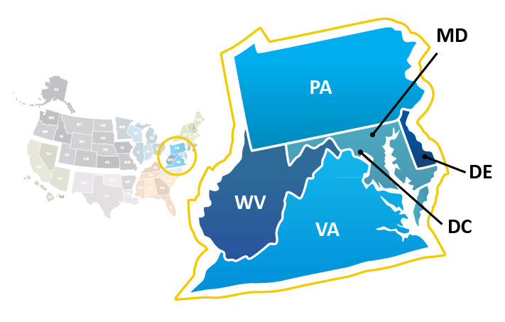
Mid-Atlantic
QIN-QIO
Supporting Providers who care for 7.5 million
Medicare Beneficiaries
In Delaware, the District of Columbia (DC), Maryland, Pennsylvania,
West Virginia, and Virginia

Slide 3
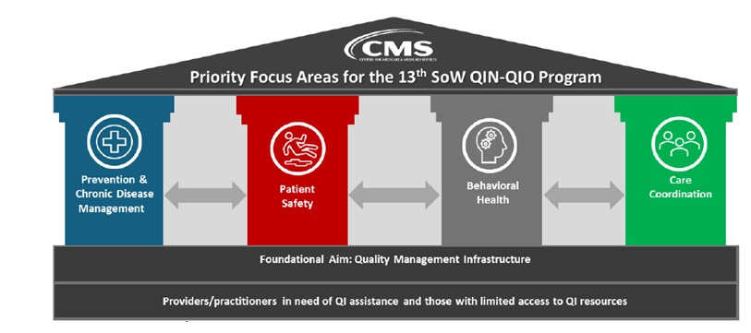
13th SOW Areas of Focus

Slide 4
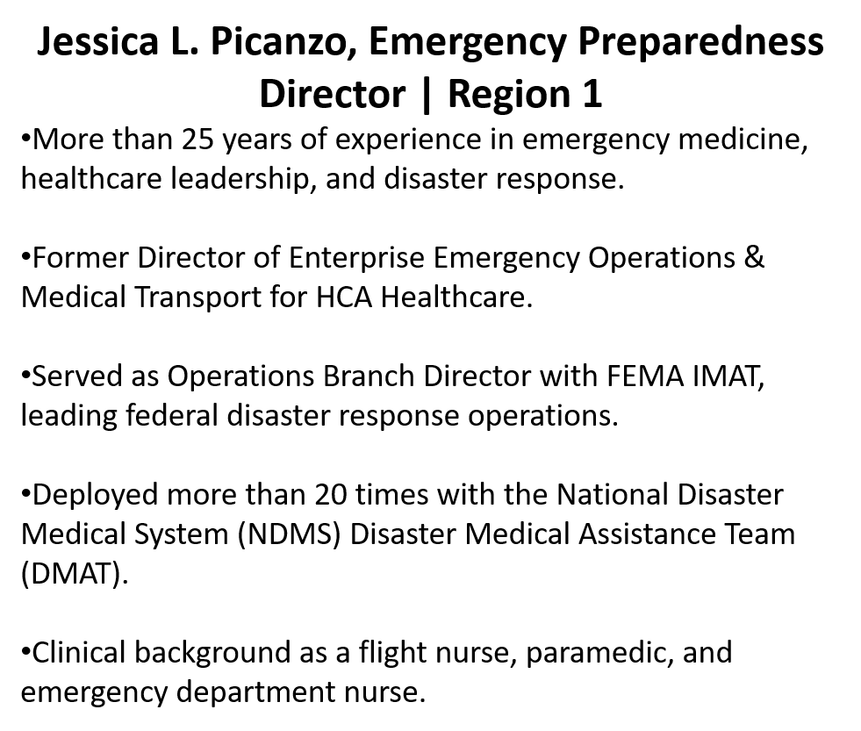
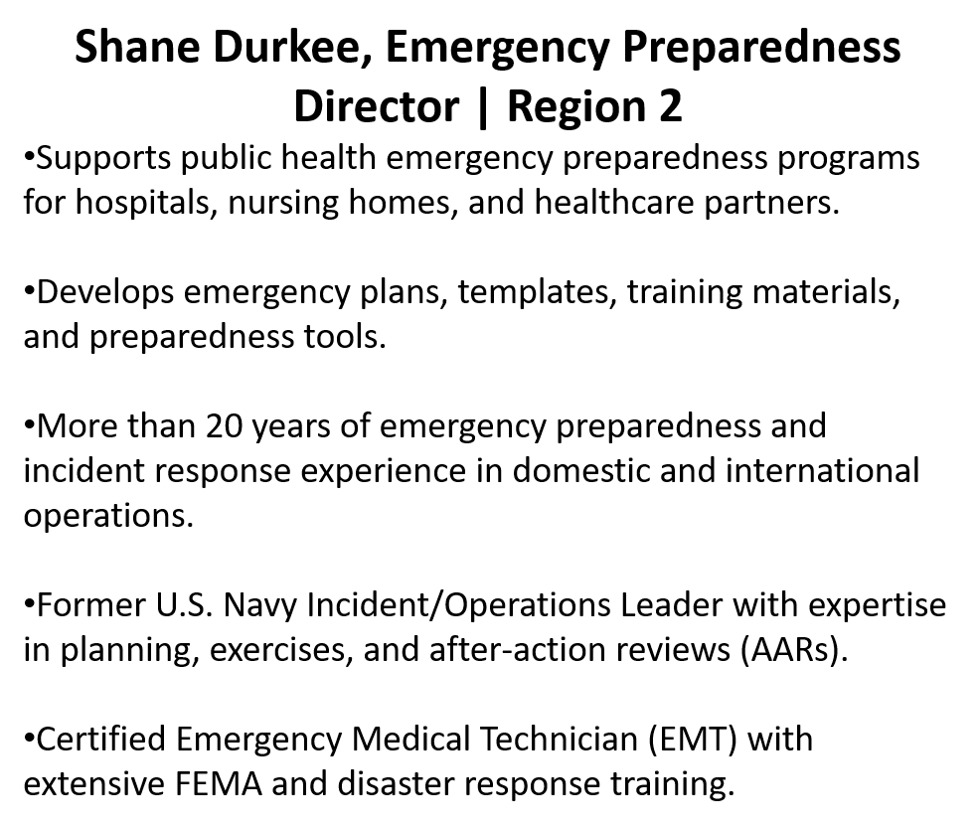
Emergency Preparedness Leadership Team | IPRO

Slide 5
Major Historical Emergency Incidents
Flooding
~2,300 flood events (2005–2024) recorded in West Virginia
2016 West Virginia Flood
  23 fatalities
  $1.1 billion in damages
  Thousands of homes damaged or destroyed
Industrial/Chemical Incident
2014 Elk River Chemical Spill
  Up to 300,000 residents affected
  169 illnesses reported
  14 hospitalizations due to contaminated water
Transportation/Hazmat Incident
2015 Mount Carbon Oil Train Derailment
  378,000 gallons of crude oil released
  Hundreds evacuated and one home destroyed

Slide 6
Key Takeaways for Healthcare Preparedness
West Virginia emergency incidents commonly involve:
  Flooding and severe storms
  Chemical spills and water contamination
  Transportation/hazmat incidents
  Infrastructure isolation in rural mountain areas
These hazards directly affect hospital operations, emergency medical services transport, water supply, and patient surge capacity.

Slide 7
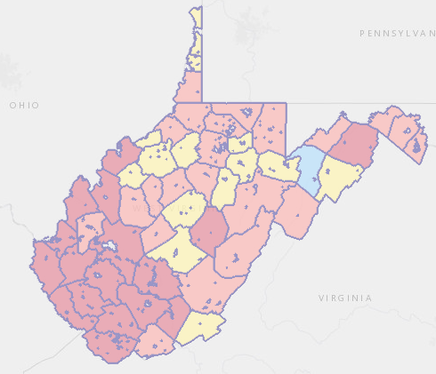
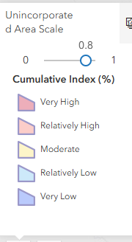
West Virginia Flood Hazard Hotspots
Interactive WV Hazard Map: https://wvfrf.org/wvre/map/?scaleid=6&gslid=&index=CUM_INDEX&type=pct

Slide 8
Learning Objectives
Understand the purpose and structure of hospital drills.
Learn how to plan, execute, and evaluate drills effectively.
Apply AAR processes to improve emergency preparedness.

Slide 9
What is a Hospital Drill?
A hospital drill is an operations-based exercise where staff actively perform emergency roles, make time-sensitive decisions, and test response systems.
Unlike a table-top exercise, a drill requires action: notifications, incident command activation, patient movement, communications, resource requests, or utility failure response.
For West Virginia hospitals, drills should reflect local hazards and the hospital’s hazard vulnerability analysis.
Notes:
Operational exercise where hospital staff perform emergency roles in real time.
Tests Incident Command, communications, clinical operations, logistics, and coordination.
Required under CMS Emergency Preparedness Rule.
Regulatory Reference: 42 CFR §482.15(d) – Training and Testing Program.

Slide 10
What a Hospital Drill is Not
It is not a discussion-only session.
It is not just reviewing the emergency plan in a classroom.
It is not writing the plan from scratch.
A drill is meant to validate whether the plan, staff, equipment, and coordination actually work under simulated conditions.

Slide 11
Why Conduct a Hospital Drill?
Hospitals use drills to test patient safety, continuity of operations, incident command, communications, evacuation, and surge processes.
The Centers for Medicare and Medicaid Services expects hospitals to test emergency preparedness capabilities through exercises, including community-based/full-scale or facility-based functional exercises.
Drills also identify gaps before a real event affects patients, staff, or infrastructure.
Notes:
Ensures hospitals can maintain patient care during disasters.
Validates emergency plan developed under risk assessment.
Demonstrates staff competency and operational readiness.
CMS Tags: E‑0004 Emergency Plan, E‑0006 Risk Assessment.

Slide 12
How Long Should a Drill Last?
Most hospital drills run one to four hours depending on scope.
A focused drill may test one function such as evacuation, decontamination, or generator failure.
A larger operational drill may move through several phases: notification, response, sustained operations, and recovery.
Keep the drill long enough to test decision-making, not just initial notifications.
Notes:
Community‑based full scale exercise with external partners.
Facility‑based functional exercise when community exercise not available.
Actual emergency events may substitute if documented.
CMS Tag: E‑0041 – Exercise Flexibility.

Slide 13
Who Participates in a Hospital Drill?
Players – staff who perform their actual roles during the drill.
Controllers – staff who manage the scenario timeline and provide injects.
Evaluators – observers who document what happened, what worked, and what failed.
Safety Officer – monitors exercise safety and stops unsafe actions.
Leadership – approves scope, participates when appropriate, and supports improvement actions.
Notes:
Hospital Incident Command staff.
Emergency Department and clinical leadership.
Facilities, IT, security, and logistics.
Community partners such as EMS, public health, emergency management.
CMS Tag: E‑0042 – Staff Training Requirements.

Slide 14
Key Roles During the Drill
Hospital Incident Commander: leads the response and sets priorities.
Operations: clinical care, triage, security, patient movement, evacuation, or shelter-in-place.
Planning: situation status, documentation, projected needs, and event tracking.
Logistics: staffing, supplies, protective personal equipment, fuel, food, communications, beds, and utilities.
Finance/Admin: labor tracking, contracts, and cost documentation.
Notes:
Incident Commander – overall command.
Operations – patient care, triage, evacuation.
Planning – documentation, situation status.
Logistics – staff, equipment, communications, utilities.
Finance/Admin – cost tracking and labor documentation.
Supports CMS compliance with coordinated response expectations.

Slide 15
Drill Planning Team
Emergency preparedness coordinator.
Clinical leadership from emergency department, nursing, surgery, lab, pharmacy, and respiratory.
Facilities, security, information technology, and communications.
Emergency medical services, emergency management, public health, and healthcare coalition partners when applicable.
Choose people who can validate real workflows and identify operational issues.
Notes:
Emergency Preparedness Coordinator leads planning.
Clinical and department leadership provide operational input.
Safety and facilities identify infrastructure risks.
Healthcare coalition partners coordinate regional response.
Supports CMS Community Coordination requirement – E‑0024.

Slide 16
Step 1: Get Leadership Buy-In
Define why the hospital is conducting the drill and what must be tested.
Tie the drill to Centers for Medicare and Medicaid Services compliance, hazard vulnerability analysis priorities, and recent regional incidents.
Identify whether the drill is discussion-based, functional, or full-scale; for this deck, the focus is an operational hospital drill.
Assign an executive sponsor who can support follow-up corrective actions.
Notes:
Senior leadership must support emergency preparedness activities.
Leadership ensures adequate resources for exercises.
Leadership participation improves response coordination.
CMS Tag: E‑0015 – Policies and Procedures oversight.

Slide 17
Step 2: Set Scope and Objectives
Choose three to five measurable objectives.
Examples: activate Hospital Incident Command within 10 minutes, account for patients within 20 minutes, communicate with county emergency medical services and public health, sustain operations during a water outage.
Avoid trying to test every part of the emergency plan in one drill.
Notes:
Objectives must be measurable and operational.
Example: Activate HICS within 10 minutes.
Example: Track all patients within 20 minutes.
Objectives must align with hospital emergency plan.
CMS Tag: E‑0004 Emergency Plan.

Slide 18
Step 3: Use West Virginia Hazard Priorities
Build the scenario around hazards relevant to West Virginia hospitals.
Examples: flooding, severe winter weather, road isolation, chemical contamination of water, power loss, infectious disease surge, or regional mass casualty events.
Use real incidents such as the 2016 flood and the Elk River chemical spill to make injects realistic and locally meaningful.
Notes:
Scenario must align with hospital Hazard Vulnerability Analysis (HVA).
Examples for WV hospitals: flooding, winter storms, water contamination.
Consider emerging infectious diseases and mass casualty incidents.
CMS Tag: E‑0006 Risk Assessment Requirements.

Slide 19
Step 4: Choose the Scenario
Select a scenario that matches the hospital’s hazard vulnerability analysis and current preparedness priorities.
Examples for West Virginia hospitals: flood-driven evacuation, potable water loss after contamination, winter storm staffing shortages, cyber outage affecting clinical operations, or respiratory surge.
Define what will be simulated and what will actually be performed.
Notes:
Develop a realistic scenario narrative.
Include operational decision points.
Coordinate with local emergency management and EMS.
Ensure scenario tests communication and resource coordination.
CMS Tag: E‑0029 Communication Plan.

Slide 20
Step 5: Build the Scenario Timeline
Create a short narrative and a sequence of timed injects.
Start with an alert, then escalate conditions every 10 to 20 minutes.
Each inject should force a decision or action, such as opening overflow space, requesting fuel, transferring patients, or switching to downtime documentation.
Controllers should know the expected actions before the drill starts.
Notes:
Create timed scenario injects every 10‑20 minutes.
Each inject forces operational decision making.
Examples: patient surge, utility failure, staff shortages.
Evaluators track decisions and response time.
CMS Tag: E‑0039 Exercise Documentation.

Slide 21
Step 6: Customize to the Hospital
Use your real departments, leaders, call-down tools, bed counts, vendors, and transfer partners.
Pre-stage the forms, status boards, radios, runner logs, patient tracking forms, and Hospital Incident Command System documents you want staff to use.
If the hospital is rural, include limited staffing, delayed emergency medical services, and long transfer times in the exercise design.
Notes:
Pre‑position HICS forms, communication tools, status boards.
Identify controllers and evaluators.
Ensure safety procedures during drill.
Brief participants on scenario assumptions.
Supports CMS training compliance.

Slide 22
Step 7: How to Run the Drill
1. Brief controllers and evaluators.
2. Start the scenario with a realistic trigger.
3. Notify staff and activate the command structure.
4. Issue injects on schedule.
5. Let participants solve problems using real plans and tools.
6. Capture decisions, delays, and unmet resource needs.
7. Stop the drill at the planned end point and move directly into the hotwash.
Notes:
Activate Hospital Incident Command.
Run scenario timeline and injects.
Allow participants to perform real operational tasks.
Controllers manage scenario progression.
Evaluators record actions and decisions.
CMS Tag: E‑0039 Training and Testing Program.

Slide 23
Sample Hospital Drill – Pre-Impact Phase
Scenario: Heavy rainfall causes river flooding across the service area. Roads are closing and emergency medical services warns of delayed transport times.
Injects:
  What triggers command activation?
  How are off-duty staff notified?
  What services are reduced, canceled, or moved?
  How will the hospital monitor weather, roads, and transfer routes?
Notes:
Regional flooding isolates hospital access roads.
EMS transports surge patients.
Hospital must activate command and manage surge.
Test coordination with county emergency management.
Based on real 2016 West Virginia Flood incident.

Slide 24
Sample Hospital Drill – Response Phase
Scenario: flooding cuts one access route, the emergency department sees a patient surge, and generator fuel delivery may be delayed.
Injects:
  How is patient flow managed?
  How are staffing shortages handled?
  Who coordinates with emergency medical services, emergency management, and regional hospitals?
  When does the hospital shelter in place versus transfer selected patients?
Notes:
Activate incident command.
Establish triage and treatment surge areas.
Coordinate with EMS and regional hospitals.
Track patients and staff.
CMS Tag: E‑0020 Patient Tracking.

Slide 25
Sample Hospital Drill – Recovery Phase
Scenario: The immediate threat has stabilized, but staffing, supplies, and infrastructure remain strained.
Injects:
• How is damage assessed?
• How are backlogged patients and delayed procedures managed?
• What communication goes to staff, families, media, and partners?
• What information must be documented for the after-action review?
Notes:
Assess facility damage and operational impact.
Restore clinical operations.
Communicate with staff, patients, and community.
Transition to After‑Action Review.
CMS Tags: E‑0015 Policies and Procedures

Slide 26
Tips for a Successful Drill
Keep objectives tight and realistic.
Use real equipment and real forms whenever possible.
Tell players what is simulated versus what must actually occur.
Do not coach players during the event unless safety is involved.
Assign evaluators to high-risk areas such as emergency department, command center, utilities, and patient movement.
Notes:
Document exercise objectives.
Maintain participant attendance records.
Capture evaluator observations.
Develop after‑action report and improvement plan.
CMS Tag: E‑0043 Exercise Documentation.

Slide 27
Evaluate the Drill
Use evaluators and note takers to capture strengths, gaps, and unmet resource needs.
Compare actions against the written plan, Hospital Incident Command System roles, and drill objectives.
Ask: what worked, what failed, what was delayed, and why?
The drill is not complete until findings move into the hotwash, after-action report, and improvement plan.
Notes:
Controllers manage scenario progression.
Evaluators observe and document performance.
Do not interfere with participant decision making.
Ensure safety and operational realism.
Findings feed directly into After‑Action Review.

Slide 28
Why Do We Do After-Action Review
Required (FEMA/CDC)
Quality improvement tool
Reflect on what happened
Provide closure
Reap the benefits
Explore specific components of response, e.g., equity, innovation
Notes:
Compare staff actions against emergency plan.
Identify strengths, weaknesses, and operational gaps.
Determine root causes of delays or failures.
Document findings for improvement planning.
CMS Tag: E‑0043 After Action Report.

Slide 29
Benefits of an After-Action Review (AAR)
Learning and Improvement: AARs help teams understand what worked and what didn’t, allowing them to make necessary adjustments and improve future performance.
Enhanced Communication: these reviews promote open and honest communication among team members, fostering a culture of transparency and collaboration.
Accountability: by documenting successes and areas for improvement, AARs hold team members accountable for their actions and decisions.
https://emilms.fema.gov/is_0870a/groups/126.html
Mid-Atlantic CMS QIN-QIO (Region 2)
Notes:
Learning and improvement: Helps teams identify what worked and what needs refinement.
Enhanced communication: Encourages open, honest discussion and shared understanding.
Accountability: Documents successes and areas for improvement for future planning.
Reference: FEMA IS-870A guidance.

Slide 30
Benefits of an After-Action Review (AAR)
Informed Decision-Making: the insights gained from AARs can inform better decision-making and strategy development for future projects.
Team Building: conducting AARs can strengthen team cohesion as members work together to analyze outcomes and develop solutions.
Crisis Preparedness: in crisis situations, AARs can highlight areas where emergency response plans need improvement, ensuring better preparedness for future incidents.
Notes:
Informed decision-making: Insights guide better planning and operational strategies.
Team building: Strengthens cohesion through collaborative problem-solving.
Crisis preparedness: Highlights gaps and strengthens readiness for future incidents

Slide 31
How Do You “do” an After-Action Review?
Soon after response/exercise ends
In person or virtual
Facilitator, notetaker
Questions
Notes:
Timing:
Can be done intermittently during a long response or after certain phases/milestones.
Ideally done soon after the response ends (within 3 months) or as certain functions are demobilized.
Format:
Can be conducted in person or virtually.
COVID-19 has shown that nearly everything can be done virtually.
Team Composition:
Can be as simple as a facilitator and a notetaker.
Can be as complex as a full team for design, data analysis, and report writing.
Avoid having a senior manager as the facilitator to encourage honest feedback.
Question Development:
Identify specific questions for different hotwash scenarios.
Basic questions to ask:
What went well (areas of strength)?
What didn’t go so well (areas for improvement)?
What’s the root cause of why it didn’t go so well?
Include questions to assess response efforts in communities of color and populations with access and functional needs.
Ask about new innovations in the response and whether they should be continued in day-to-day work.
For specific areas/functions, identify questions that dig deeper into processes and effectiveness.

Slide 32
Planner/Facilitator Responsibilities and Preparation
Determine scope of after-action review
Review the purpose or objectives
Define your questions
Identify unique questions for the focus area topic (e.g., vaccine questions, partner engagement questions)
Notes:
Scope Determination:
Overall response hotwash covering everything.
Focus on specific areas such as:
Partner Engagement
Vaccine clinics
Access and Functional Needs
Public messaging
Isolation & Quarantine and Providing Essential Services
Purpose/Objectives Review:
Review the purpose or objectives for the specific area.
Helps focus the hotwash discussion and develop specific questions.
Example for Vaccine Clinics:
Develop questions about:
Clinic setup
Clinic advertisement/communication to the public
Vaccine storage
Vaccine reporting
Question Development:
Include standard questions:
What went well?
What could have been done better?
How can we improve?
Include specific questions related to the scope/focus area.
Discuss areas where challenges were encountered.

Slide 33
What to Consider When Developing Questions
Coordination:
  Examine coordination within (internal)
  Examine coordination across/with partners (external)
Resources:
  Human resource capacity (availability of qualified and trained people)
  Relevance of plans and procedures
Technical aspects:
  Tangible: equipment, supplies, materials, facilities, physical environment
  Intangible: lack of plans, support structures

Slide 34
Facilitator Responsibilities and Preparation
Know your audience
Review the questions you will ask
Facilitate the discussion process by encouraging participation, managing time, clarifying issues
Be impartial
Summarize key discussion points
Assist, when asked, with report (clarification of points, etc.)
Notes:
Know Your Audience:
Determine if participants are from the beginning of the response or a specific period.
Familiarize yourself with the terms and work language used by the hotwash group.
Develop Questions:
Focus on specific areas such as:
Response coordination
Provision of essential services
Public communication and messaging
Reaching access and functional needs populations
Include general questions:
What went well?
What could have been done better?
How can we improve?
Facilitate the Discussion:
Guide participants through the discussion questions/areas.
Be mindful of the time and keep the agenda moving.
Allow participants to add feedback to an online hotwash follow-up survey.
Be Impartial:
Do not influence group or individual feedback.
Keep your opinions to yourself.
Clarify and Summarize:
Summarize key discussion areas to ensure clarity.

Slide 35
Facilitator – Conducting the After-Action (AAR) Review
Start and end on time
Display AAR presentation
  If have a Planner, they can display and advance slides
Follow the agenda
Introduction, Rules, Group Charter/Purpose
Use Facilitator Agenda to guide discussion

Slide 36
Modified Root Cause Analysis
Explore causes and contributing factors
  Success or failure
Identify root causes to prevent future problems
Problem identified that clearly requires deep examination or to identify cause and better understand it
Avoid “quick fixes”

Slide 37
Framework for Modified Root Cause Analysis
Use frameworks that evaluate tangible factors (equipment, environment).
Assess personnel-related factors (training, roles, communication).
Evaluate economic or external influences.
Review organizational and managerial elements affecting performance.

Slide 38
Deeper Dives
Identify topics requiring further exploration or extended discussion.
Address complex, controversial, or high‑interest issues.
Schedule follow‑up hotwash sessions when necessary.

Slide 39
Running Out of Time?
Okay to miss some questions
  May have covered them in earlier discussion
Other ways to capture information
  Follow-up survey
  Deeper dives
A must! Make sure to cover wrap-up (about two minutes): follow-up survey and mental health resources.
Notes:
It is acceptable to skip questions if they were covered earlier.
Use follow‑up surveys to capture additional information.
Plan deeper‑dive sessions for unresolved issues.
Always include wrap‑up: survey link and mental health resources.

Slide 40
Facilitation Best Practices
Stay neutral and avoid influencing participant statements.
Encourage participation (e.g., hand‑raising).
Watch the time and keep discussions focused.
Use active listening and summarize key points.

Slide 41
After the After-Action Review
Develop an action plan to address identified weaknesses.
Ensure follow‑up and integration of lessons learned.
Document findings and store them for future reference.
Reference: FEMA Hotwash documentation guidance.
https://training.fema.gov/is/flupan/references/02_course%20forms%20and%20templates/02_hot%20wash%20form-508.pdf

Slide 42
Reference
Regulatory and Federal Guidance
CMS Emergency Preparedness Requirements
https://www.cms.gov/medicare/cms-requirements-guidance/emergency-preparedness
FEMA Emergency Management Training & AAR Guidance
https://training.fema.gov
Healthcare Exercise and Drill Resources
ASPR TRACIE – Drills & Exercises
https://asprtracie.hhs.gov/exchange/pages/drills-and-exercises.aspx
ASPR TRACIE – Hospital Exercise Planning
https://asprtracie.hhs.gov/technical-resources
Public Health and Incident Case Studies
CDC Emergency Preparedness & Response
https://www.cdc.gov/disasters
ATSDR / CDC Incident Reports
https://www.atsdr.cdc.gov

Slide 43


Contact Us
Thank you for participating in this training.
For support or questions, contact sdurkee@ipro.org
This material was prepared by the Mid-Atlantic CMS QIN-QIO (Region 2), a Quality Innovation Network-Quality Improvement Organization, under contract with the Centers for Medicare & Medicaid Services (CMS), an agency of the U.S. Department of Health and Human Services (HHS). Views expressed in this material do not necessarily reflect the official views or policy of CMS or HHS, and any reference to a specific product or entity herein does not constitute endorsement of that product or entity by CMS or HHS. Publication # 13SOW-IPRO-WV-SH-A06-26-7061

