Slide 1
West Virginia Hospital Association
Incident Action Planning Workshop
Notes:
1

Slide 2
Schedule
Facilities
Emergencies
Introductions
Notes:
2

Slide 3
Objectives
Understand the role of NIMS and ICS
Review basic concepts and principles of the ICS
Practice the concept of management by objectives and the Incident Action Plan (IAP) development process.
Demonstrate competency using the ICS to establish an incident management organization and initiate development of an Incident Action Plan (IAP) using the planning process

Slide 4
Rationale for NIMS & ICS

Slide 5
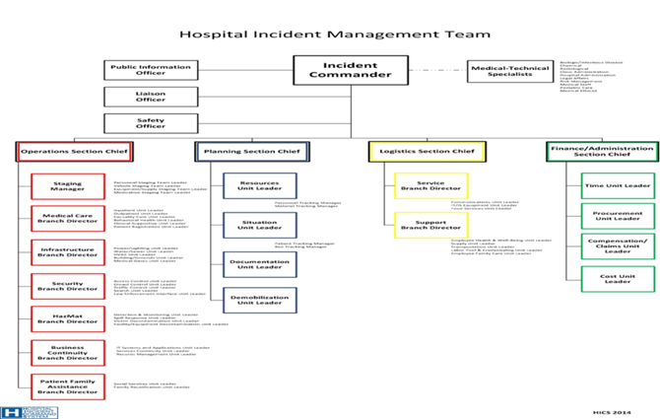
HICS or ICS?
The California Emergency Medical Services Authority (EMSA) developed HICS.
Includes:
  Incident Planning Guides
  Incident Response Guides
  Job Task Aids
Notes:
5

Slide 6
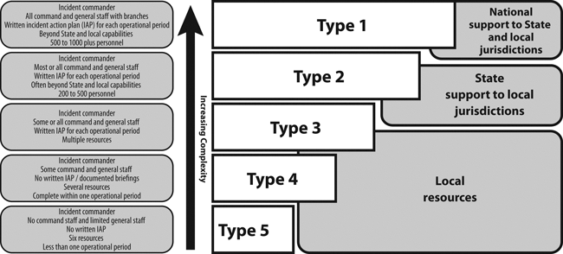
NIMS EVENT TYPING

Slide 7
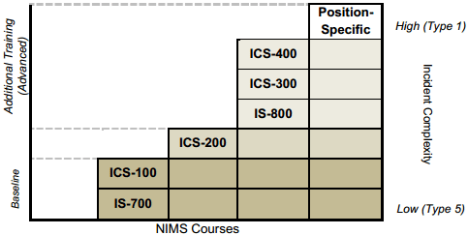
ICS TRAINING REQUIREMENTS

Slide 8

Homeland Security Presidential Directives (HSPDs)
HSPD-5
HSPD-8
Mandates

Slide 9
Emergency Operations Plan
Strategic in nature
Based upon Hazard Vulnerability Analysis (HVA)
  What hazards are you likely to see
    Build hazard specific annexes
      Develop Initial Incident Action Plans
Notes:
9

Slide 10
Emergency Operations Plan
The EOP outlines the organization’s strategy for
  Response
  Recovery
The hospital EOP provides overall direction and coordination of:
  Communications
  Resources and Assets
  Safety and Security
  Staff Responsibilities
  Utilities
  Patient Clinical and Support Activities
  Specifies use of the Incident Command System
Notes:
10

Slide 11
Relationships
IAP
HICS
EOP
Annex
Unit Procedures
Notes:
11

Slide 12

Emergency Operations Plan
The EOP is not a “disaster plan”
Notes:
12

Slide 13
Disaster Facts
In a study of 29 mass casualty disasters in the United States, fewer than 6% of the hospitals had supply shortages and only 2% had shortages of personnel.

Slide 14
Healthcare Impact of Major Events
Challenges occur when events:
  Were sustained
  Affected multiple communities simultaneously
  Impacted public services
  Threatened entire healthcare delivery system
  Stressed the federal response
Home care, long term care, private physicians’ offices, outpatient pharmacies, dialysis centers: closed
Discharged patients: nowhere to go
Hospitals become the community safety net
Notes:
14

Slide 15
Challenges for Critical Access Hospitals
Geographic isolation
More affected by variations in weather conditions
More affected by seasonal variations in populations (for instance, tourism)
Fewer human and technical resources (that is, health care professionals, medical equipment, and communication systems).

Slide 16
Katrina – The Hospital Experience
1,749 pts occupied 11 hospitals surrounded by flooded waters
Some hospitals housed 7,600 people (staff, family, refugees)
One hospital cared for 45 dogs, 15 cats, pair of guinea pigs
Tried to evacuate – no hospitals would accept pts; one evacuation was 320 miles away
Notes:
16

Slide 17
Katrina – The Hospital Experience
No power
No running water; toilets backed up
Shortage of staff
Ran out of food, medication & supplies
No Air Conditioning (>100˚F)
Emergency surgeries performed by
flashlight and NO anesthesia
Intubated patients were hand ventilated
or vents were jerry-rigged
Notes:
17

Slide 18
Oklahoma City Bombing, 1995
A call went out for “anyone with medical training” to report to various hospitals
Neonatal nurses drove 2 hours to help
Closest hospital received the most casualties, but had more than 500 medical personnel on hand
100 physicians ended up treating fewer than 50 patients at any given time
Notes:
18

Slide 19
Medical Personnel at the Scene
Notes:
19

Slide 20
Emergency Operation Plan Tiered Activation
ICS Useful
ICS Critical

Slide 21
Challenge for Hospitals
Management transition from
Board Room
Hospital Command Center
TO
Notes:
21

Slide 22
ICS is a Management Tool
Not Discipline Specific

Slide 23
ICS is a Management Tool
• A proven management system based on successful business, emergency response and military practices
• The result of decades of lessons learned in the organization and management of emergency incidents
Management by objective rather than management by position
Establishes a standardized organizational structure that improves integration among jurisdictions and disciplines
Useful in emergency and non-emergency situations.
Notes:
23

Slide 24
Key Features of ICS
Modularity
Span of control
Structure expands and contracts within the life cycle of an incident.

Slide 25
Flexibility and Standardization
  Standardization does NOT limit flexibility.
  ICS works for small, routine operations as well as catastrophic events.

Slide 26
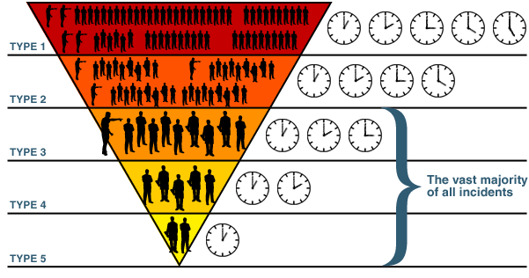
With ICS comes scalability
NIMS Event Typing

Slide 27
Modular Organization
ICS is a management system and not an organizational chart
ICS principal tenets
  Every incident or event requires that certain management functions be performed
    Determine objectives
    Identify strategies
    Assign necessary resources
  To prevent confusion the ICS organization does NOT correlate to the administrative structure of any agency
Notes:
27

Slide 28
Modular Organization
Incident command organizational structure is based on:
  Size and complexity of the
  incident
  Specifics of the hazard
  environment created by
  the incident
  Incident planning process
  and incident objectives

Slide 29
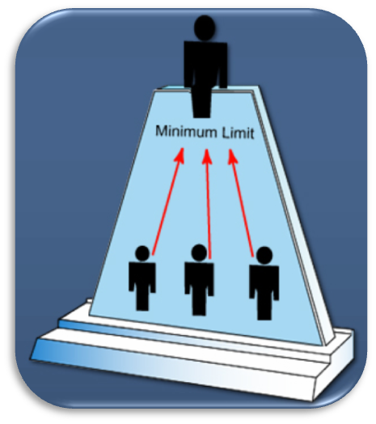
ICS Expansion and Contraction
Although there are no hard-and-fast rules, remember that:
  Only functions/positions that are necessary are filled.
  Each activated element must
  have a person in charge.
  An effective span of control
  must be maintained.

Slide 30
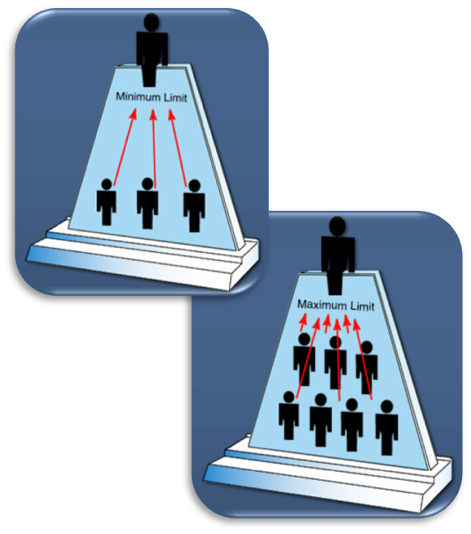
ICS Management: Span of Control
ICS span of control for any supervisor:
  Is between 3 and 7 subordinates
  Optimally does not exceed 5 subordinates

Slide 31
What Influences Span of Control?
  The type and complexity of incident or event
  The nature of the response or task, distance, and safety.

Slide 32
Key ICS Functions for Hospitals
Command
Operations
  Medical Branch
Planning
Logistics
Finance

Slide 33
Incident Commander
  Only position always filled
  May be able to accomplish all five management functions alone on small scale incidents
  On larger incidents, effective management may require other functions opened and staffed
Incident Commander
Public Information
Officer
Safety Officer
Liaison Officer
Medical / Technical
Specialist
Operations
Section Chief
Planning
Section Chief
Logistics
Section Chief
Finance / Admin.
Section Chief
Notes:
33

Slide 34
Incident Commander - Function
Provides overall leadership for incident response
Assumes responsibility for all activities and functions until delegated or assigned to other staff
Establishes incident objectives
Directs development of Incident Action Plan (IAP)
Notes:
34

Slide 35
Who is the Incident Commander
Predetermined line of succession or highest ranking trained person on site
Upon arriving at an incident, the higher ranking person may assume command, maintain command as is, or reassign command to a third party
This authority may be delegated by the agency executive when the scope of the incident is complex or beyond existing authorities
Notes:
T200-5-19

Slide 36
Agency Executive
Although elected officials/agency executives are expected to commit to NIMS by supporting training and exercise participation, they are not expected to assume the role of IC or direct tactical operations, nor do they assign resources that have not been requested by IC
Notes:
T700-6

Slide 37
Incident Management Roles
Incident Commander’s
Role
The Incident Commander:
Manages the incident.
Keeps the senior officials informed on all important matters pertaining to the incident which have an impact on ability to deliver services to the community.
Agency Executives’/Senior Officials’ Role
These officials provide the following to the Incident Commander:
Policy
Mission
Strategic direction
Authority

Slide 38
Operations Section
Incident Commander
Public Information
Officer
Safety Officer
Liaison Officer
Medical / Technical
Specialist
Operations
Section Chief
Planning
Section Chief
Logistics
Section Chief
Finance / Admin.
Section Chief
Develops and manages all incident-related tactical operations
The largest Section in terms of resources, both equipment and personnel
Notes:
38
T200-8
T700-17

Slide 39
Planning Section
Incident Commander
Public Information
Officer
Safety Officer
Liaison Officer
Medical / Technical
Specialist
Operations
Section Chief
Planning
Section Chief
Logistics
Section Chief
Finance / Admin.
Section Chief
Develops the Incident Action Plan for next operational period
Responsible for collecting, evaluating, and disseminating incident situation information and intelligence to Incident Command
Notes:
39
T100-21

Slide 40
Logistics Section
Incident Commander
Public Information
Officer
Safety Officer
Liaison Officer
Medical / Technical
Specialist
Operations
Section Chief
Planning
Section Chief
Logistics
Section Chief
Finance / Admin.
Section Chief
Responsibilities include:
  Acquiring resources from internal and external sources
  Make requests to the local EOC or the RHCC for assistance when needed
  Ensures that incident personnel are fed, housed, have communications, medical support and transportation
Notes:
40

Slide 41
Finance /Administration Section
Incident Commander
Public Information
Officer
Safety Officer
Liaison Officer
Medical / Technical
Specialist
Operations
Section Chief
Planning
Section Chief
Logistics
Section Chief
Finance / Admin.
Section Chief
Manages costs related to the incident, and provides accounting, procurement, time recording, and cost analysis
Notes:
41

Slide 42
Branches
Operations
Section
EMS
Branch
Law Enforcement
Branch
Public Works
Branch
Health &
Medical
Group
Shelter &
Mass Care
Group
Perimeter
Control
Group
Investigation
Group
Debris
Removal
Group
Utility
Repair
Group
Branches:
  Have functional or geographical responsibility for major parts of incident operations
  Typically identified by functional name
  Managed by a Branch Director

Slide 43
Medical Care Branch as developed by
EMSA
Responsible for providing acute and continuous care of the incident victims as well as those already in the hospital
Organize and manage the delivery of:
  Inpatient Care
  Outpatient Care
  Casualty Care
  Mental Health (patients/survivors)
  Clinical Support Services
  Patient Registration
Notes:
43

Slide 44
Divisions and Groups
Divisions
  Work within a geographical area
    E.G. 2nd floor Evacuation Division
Groups
  Perform a function are not limited geographically
    E.G. Evacuation Group
Notes:
44

Slide 45
Task Forces
Task Forces are a combination of mixed resources with common communications and objectives
Notes:
45

Slide 46
Strike Teams
Strike Teams are:
  Of the same kind and type
Notes:
46

Slide 47
Public Information Officer (PIO)
Incident Commander
Public Information
Officer
Safety Officer
Liaison Officer
Medical / Technical
Specialist
Operations
Section Chief
Planning
Section Chief
Logistics
Section Chief
Finance / Admin.
Section Chief
Advises the Incident Commander on information dissemination and media relations
Serves as the conduit between internal and external stakeholders, including the media
Keep staff informed
Notes:
47
T700-16

Slide 48
Safety Officer
Incident Commander
Public Information
Officer
Safety Officer
Liaison Officer
Medical / Technical
Specialist
Operations
Section Chief
Planning
Section Chief
Logistics
Section Chief
Finance / Admin.
Section Chief
Advises the Incident Commander on issues regarding incident safety
Monitors safety conditions and develops measures for ensuring safety of all assigned personnel
Notes:
48

Slide 49
Liaison Officer
Incident Commander
Public Information
Officer
Safety Officer
Liaison Officer
Medical / Technical
Specialist
Operations
Section Chief
Planning
Section Chief
Logistics
Section Chief
Finance / Admin.
Section Chief
Serves as a primary contact for supporting agencies and organizations that are assisting with the incident but are not components of the ICS structure
Notes:
49
T100-12
T200-17

Slide 50
Medical/Technical Specialist
Persons with specialized expertise in areas such as infectious disease, legal affairs, risk management, medical ethics, hazardous materials, etc., who may provide the Command Staff with needed advice
Incident Commander
Public Information
Officer
Safety Officer
Liaison Officer
Medical / Technical
Specialist
Operations
Section Chief
Planning
Section Chief
Logistics
Section Chief
Finance / Admin.
Section Chief
Notes:
50

Slide 51
Assistants
  Are subordinates of Staff positions.
  Should have capabilities or qualifications appropriate for assignment.

Slide 52
Hospital Command Center - HCC
A specific location where the hospital’s incident management team have access to resources necessary to accomplish their job

Slide 53
Palos HCC

Slide 54
Palos HCC

Slide 55
HCC Activation
Activating the EOP does not always require activation of the HCC
Activating the HCC will not always be emergent
Activation authorized by the Incident Commander
Activation may be virtual or actual

Slide 56
HCC Activation Triggers
Scope of the event
Potential/real impact on the hospital
Available resources
Special response needs
Virtual activation more common than actual activation
NIMS Event Typing

Slide 57

Secrets to Success
The successful use of HICS depends in part on only activating the Hospital Incident Management Team (HIMT) positions that the situation requires

Slide 58
Blending of HIMT Positions
Staff routinely perform multiple job roles on a daily basis
Blend some job roles into single Job Action Sheets (JAS)
During an emergency, people will need to assume more than one position on the HIMT at least initially
Perfect for Critical Access Hospitals or when fewer staff on hand

Slide 59
Blended HIMT Position
Some positions are more easily combined than others. It’s not uncommon for the Incident Commander to assume the role of the Public Information Officer (PIO) and the Liaison Officer.
Safety Officer or Medical Technical Specialists, should not be combined with other job responsibilities unless absolutely necessary.

Slide 60
How to Effectively Combine HIMT Positions
Based on your Hazard Vulnerability Assessment (HVA) use realistic scenarios
Identify essential positions for the hospital response against staff numbers and develop your (HIMT) chart and determine where positions will need to be combined
Create new combined Job Action Sheets (JAS) if desired
As additional staff are available, you can open up and staff your next priority key positions
The only position always activated is IC

Slide 61
How Not to Combine Positions
One for each position (78)
    Command – 4
    Med/Tech – 10
    Operations – 38
    Logistics – 12
    Planning – 9
    Finance - 5
Notes:
61

Slide 62
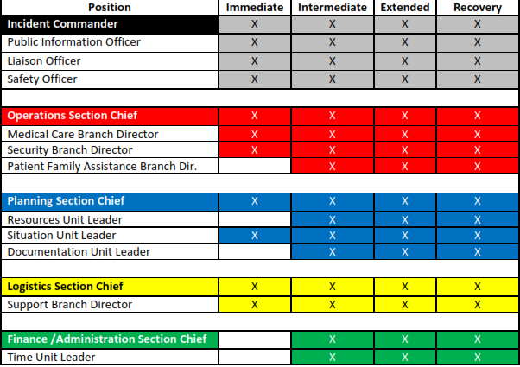
Hospital Incident Management Team Activation: Missing Person (example)

Slide 63
Task - Incident Management Structure Development
Instructions:
Working in teams, review the scenario on the next visual.
Identify the incident management structures (Sections, Divisions, Groups, Strike Teams, or Task Forces) that you would use to ensure a proper span of control for the resources you expect to devote to the incident.
Don’t forget to ensure normal hospital operations also continue.
For each organizational element, indicate the title of its supervisor.
Choose a spokesperson. Be prepared to present your organizational charts to the class in 15 minutes.

Slide 64
Activity
Scenario: A swim meet is being held at the Main Street pool with 300 team members and 150 observers. During a race, a sudden electrical storm sends a lightning bolt into a flagpole near the pool and the charge arcs to the water and damp pool deck. The pool is instantly electrified, and people immediately begin rescuing the injured. 911is called. Your facility is < 2 miles away.
Initial reports suggest >50 people are injured and some may be enroute to your facility by private car.

Slide 65
Activity Part Two
Based upon the scenario, assign members of your team to the Command, General Staff and key supervisory positions of the structure you developed.
If you do not have enough team members, combine functions and develop a new organizational chart which represents current staffing capabilities.
Prepare to discuss in 10 minutes.

Slide 66
Management by Objectives
At any incident or event, the situation must be assessed and response planned. Resources must be organized, assigned, and directed
to accomplish the
incident objectives.
As they work, resources
must be managed to adjust to changing. conditions.
Notes:
66

Slide 67
Developing Incident Objectives
The Incident Commander must identify incident objectives quickly after assuming command. Incident objectives are then organized into an Incident Action Plan (IAP).
The purpose of the IAP is to provide all incident supervisory personnel with direction based on the objectives set for that operational period.
Notes:
67

Slide 68
What’s an Operational Period?
  The designated time period in which tactical objectives are to be accomplished and reevaluated.
  Length depends on:
    Nature of incident
    Complexity

Slide 69
Prioritize Objectives
Incident objectives are established based on these priorities:
    Life Safety
    Incident Stabilization
    Property / Environmental Preservation
    Return to Normalcy
Notes:
69

Slide 70
Objectives must be SMART
Specific
Measurable
Achievable
Relevant
Timely
Notes:
70

Slide 71
Assessing Current Objectives
  Objectives don’t appear to being met, what could be the reasons?

Slide 72
Objectives, Strategies, and Tactics
Incident
Objectives
State what will be accomplished.
Establish the general plan or direction for accomplishing the incident objectives.
Strategies
Tactics
Specify how the strategies will be executed.
Notes:
72

Slide 73
Loss of External Power
Objective
(What will be accomplished)
Maintain
Emergency
Power
Strategies
(Plan to accomplish objective)
Manage
Emergency
Generator
Conserve
Electricity
Supplement
Generators
Fuel
Tactics
(How strategies will be executed)
Monitor engine temp
Monitor cooling system
Evaluate maintenance needs
Secure generator area
Make sure nothing interferes with operation
Fuel capacity
Current volume
Consumption rate
How long will it last
How long to get more
Red outlets
Discontinue nonessential use
Find aux. gen.
Determine how to incorporate into system

Slide 74
Task - Strategy and Tactics
700’ ship
23 persons on board
Winter Storm

Slide 75
Developing Appropriate Strategies
  Generate a list of alternative strategies.
  Select the strategy that:
    Is within acceptable safety norms.
    Makes good sense (is feasible, practical, and suitable).
    Is cost effective.
    Is consistent with sound environmental practices.
    Meets political considerations.

Slide 76
Executing Tactical Direction
  Establish Tactics: Describe what must be done.
  Assign Resources: Determine and assign the kind and type of resources needed for the selected tactics.
  Monitor Performance: Determine if the tactics and resources selected for the various strategies are both valid and adequate.

Slide 77
The Planning Cycle
Planning for each operational period begins with the Incident Commander or Unified Command developing/ updating incident objectives.
Objectives are based on the continued assessment of the situation and the progress made.
Your Planning Team may only be your IC, Ops and Plans Section Chief
Tactics
Meeting
Preparing for
the Planning
Meeting
Planning
Meeting
Preparing
for the
Tactics
Meeting
IAP Prep &
Approval
Command &
General Staff
Meeting
Operations
Briefing
IC/UC
Develop/Update
Objectives
Meeting
Execute Plan
& Assess
Progress
New Ops
Period Begins
Initial IC/UC
Meeting
Incident Brief
Using ICS-201
Initial Response
Initial Response
& Assessment
Notifications
Incident/Event
Notes:
Pages 29 - 32

Slide 78
Benefits of the Planning Process
What are
the benefits of the incident planning process?

Slide 79
NIMS/ICS Planning Process
Understand the Situation
Establish Incident
Objectives and Strategy
Events
Develop the Plan
Prepare and Disseminate
the Plan
Execute, Evaluate, and
Revise the Plan
Incidents
Notes:
79

Slide 80
Keys to Success Developing IAP
Determine Operational Period
Prioritize & Write S.M.A.R.T. Objectives
  Life Safety
  Incident Stabilization
  Property/Environmental Conservation
  Return to Normalcy
Build Organizational Chart to Meet Objectives

Slide 81
Written IAP Considered
What are the situations when you would consider developing a written Incident Action Plan?

Slide 82
IAP Valuable When:
Oral plans could result in miscommunication
Two or more jurisdictions or disciplines are involved
Large changes of personnel occur
Personnel are working through multiple operational periods
There is a full activation of the ICS organization
The incident has important legal, political, or public
ramifications
Complex communication issues arise
A written record of actions taken is needed for historical or administrative needs
Notes:
82

Slide 83
Logistics Support Factors
Why must personnel and logistical support factors be considered in determining tactical operations?

Slide 84
Cost-Benefit Analysis
What are some factors that you consider when assessing the costs and benefits of proposed tactical assignments?

Slide 85
Incident Safety
  Incident management must ensure the safety of:
  Personnel assigned to the incident
  Persons injured or threatened by the incident
  Volunteers assisting at the incident
  The general public who are within the operational area

Slide 86
Incident Safety Analysis (ICS-215A)

Slide 87
Common HICS Forms
HICS 200: Incident Action Plan (IAP) Cover Sheet
HICS 201: Incident Briefing
HICS 202: Incident Objectives
HICS 204: Assignment List
HICS 215A: Incident Action Plan (IAP) Safety Analysis

Slide 88
Additional HICS Forms
HICS 203: Organization Assignment List
HICS 205A: Communications List
HICS 206: Staff Medical Plan
HICS 221: Demobilization Check-Out
Incident Map, hospital and campus floor plans, maps, and evacuation routes,
facility grids or blueprints
Traffic Plan, Communication Plan, and Site Safety Plan(s)

Slide 89
Are All Forms Used?
The Planning Section Chief determines which ICS forms and attachments are included in the IAP based upon the IC’s direction.
For less complex incidents, the Incident Commander may only require the ICS – Incident Action Plan (IAP) Quick Start Fast Form.
ICS 202
ICS 203
Incident Objectives
Organization Assignment List
ICS 204
Safety
Messages
&
Maps
Assignment
List

Slide 90
Archiving
At the termination of the incident, all of the collated IAPs will be used to help outline the hospital’s response activities and decision-making processes
All other documentation materials will be collected and archived as well
Notes:
90

Slide 91
Practical Exercise

Slide 92
ICS Scenario # 1 – Tornado
A tornado warning has been issued with at least one tornado having touched down southwest of our location. It should be passing our location within 20 minutes and an immediate shelter-in-place order is given by the County EMA office.
Will you active the HCC?
Determine:
Operational period
Determine initial objectives
Develop first organizational chart

Slide 93
ICS Scenario # 2 – Flood
Heavier than forecast rains for the past 6 hours have created flash food conditions. The County EMA office advises they expect to see heavy rains continue with significant flooding in low-lying areas and impassable roads. Some employees have already called in they cannot get in to work.
Will you active the HCC?
Determine:
Operational period
Determine initial objectives
Develop first organizational chart

Slide 94
ICS Scenario # 3 – Hazmat
On the TV in the break room a special news report comes on about an explosion and subsequent out of control fire at an industrial facility within 5 miles of your facility. Initial reports suggest an unknown amount of chemicals may have been released and possibly are now burning. Wind direction currently puts your facility upwind.
Will you active the HCC?
Determine:
Operational period
Determine initial objectives
Develop first organizational chart

Slide 95
ICS Scenario # 4 – Loss of Power
The power suddenly is lost at your facility. Staff are used to the generators kicking in and a return with some power within minutes, but 30 minutes have passed and no power is on. Maintenance reports a power surge associated with the original outage has fried circuits and they estimate it will take 6-12 hours to repair.
Will you active the HCC?
Determine:
Operational period
Determine initial objectives
Develop first organizational chart

Slide 96
ICS Scenario # 5 – Windstorm
Early in the afternoon and caused by unstable weather a band of straight-line wind roared through north of the community. Winds of 115 mph were measured. Your power went out but emergency generators kicked in. Several windows were blown out in a number of out-patient buildings separate from the hospital. Damage reports on the news speak of widespread problems of roads blocked, power out and one major box store collapse with unknown numbers of people inside.
Will you active the HCC?
Determine:
Operational period
Determine initial objectives
Develop first organizational chart

Slide 97
ICS Scenario # 6 – Active Shooter
A man enters the main lobby, steps near a security staff member and shoots them and the receptionist, both gravely wounded. They move down a hallway, shooting 3 more people, killing one before disappearing into the facility. Additional gunshots can be heard. People in the lobby scatter, several calling 9-1-1. A local police officer arrives within minutes, confronts the gunman and kills them. You have at least 6 wounded and 2 dead victims.
Will you active the HCC?
Determine:
Operational period
Determine initial objectives
Develop first organizational chart
Notes:
97
A 40-year-old man enters your hospital’s main lobby, pulls a shotgun from under his jacket and shoots the lobby security officer. He then shoots a visitor who attempts to close the interior doors to the facility. As this occurs a hospital volunteer in the main lobby calls 911. An employee hears the noise and walks toward the main lobby to investigate. The shooter fires at the approaching employee, but the employee dives for cover and the shooter misses. The shooter continues into the building, while the employee calls the hospital’s main switchboard operator and reports a man has entered the building shooting at staff and visitors. The operator activates the Active Shooter Plan, notifying facility leadership and security, while making an overhead announcement to notify all staff of the incident in the main lobby area. The shooter proceeds through your hospital into patient care areas, shooting at people indiscriminately. Within ten minutes, law enforcement officers arrive and begin their tactical response. A patrol supervisor has set up their command post outside the hospital, where one of your security officers is acting as a liaison to the hospital’s Incident Commander. Law enforcement tactical team finds the shooter in a patient care area dead, with a single gunshot wound to the head, then conducts a building-wide sweep to clear any other potential threats. Several wounded people are known to be within your hospital and at least three others are dead. The emergency department is on diversion and at least one patient care area (where the shooter expired) has been evacuated and is designated as a crime scene and will not be released to return to normal patient care operations for several hours. Law enforcement remains on scene coordinating interviews and collecting evidence. Fire department and emergency medical services are also on scene. The Hospital Command Center (HCC) turns its attention to recovery: reopening the emergency department, rescheduling appointments and procedures, assessing the impact of canceled deliveries, and providing behavioral support to patients, families, and staff. A media briefing is scheduled in one hour.

Slide 98
ICS Scenario # 7 – Ill Patient
After assessing a elderly febrile adult male patient sitting in the waiting room it is determined they were in Saudi Arabia for a week and returned 10 days ago. Chief complaint is cough and shortness of breath.
Will you active the HCC?
Determine:
Operational period
Determine initial objectives
Develop first organizational chart
Notes:
98

Slide 99
Questions?
Jan Glarum
abetteremergency@gmail.com
Notes:
99

Slide 100
Quiz Questions
What are the 2 top priorities when developing incident objectives?
What does the acronym SMART stand for?
What is NIMS?
Name the Command positions.
Name the General Staff Positions.
What do you do if you don’t have enough people to staff all positions?

