Slide 1

Operationalizing your PFA Program:
7 Steps to Sustainability

Slide 2
Step 3:
Structure
Step 2: Preparing
Step 4:
Recruiting
Step 6:
Launching and running
Step 7:
Sustaining
Step 5:
Training
Step 1:
PFCC and PFAs
7 Steps to
Sustainability

Slide 3

Introductions
Your name
Your organization
Your SUPERHERO name

Slide 4
Step 3:
Structure
Step 2: Preparing
Step 4:
Recruiting
Step 6:
Launching and running
Step 7:
Sustaining
Step 5:
Training
Step 1:
PFCC and PFAs
Raising Awareness of the "why"
Leadership buy-in & planning
Key decisions regarding approach & logistics
PFA selection
Comprehensive training for PFAs & staff
Outlining agenda, meeting facilitation
In it for the long haul!
7 Steps to
Sustainability

Slide 5

Step 1: PFE and PFA Programs
Raising awareness of the “why”
Who are PFAs and how does a partnership approach relate to Patient- and Family Engagement (PFE)?

Slide 6
What is “culture”?
Group 1
Create a definition for “culture”
Group 2
Describe the culture of healthcare today: consider both the culture of healthcare providers and patients/families
Group 3
Discuss how one changes a culture

Slide 7
Culture defined…
Characteristic way of thinking, acting and doing
Responsible for routine actions
The way we do things around here
Culture eats strategy for lunch
Culture change always includes push back, even for those who would benefit the most
Defined by the worst behavior we tolerate

Slide 8
80% of culture is driven locally
20% of culture is driven globally

Slide 9

The million dollar question…
What does this exploration of culture have to do with us??

Slide 10
Patient- and Family-Centered Care
Respect and Dignity
Listen to and honor perspectives of patients and their defined families
Information Sharing
Provide timely, complete, and accurate information to allow for participating and decision-making.
Participation
Encourage and support participation in care; teach concepts of participation.
Collaboration
Collaborate with PFAs in policy and program development, implementation, and assessment; facility design and professional continuing education.
Notes:
Core concept: mutually-beneficial partnership

Slide 11
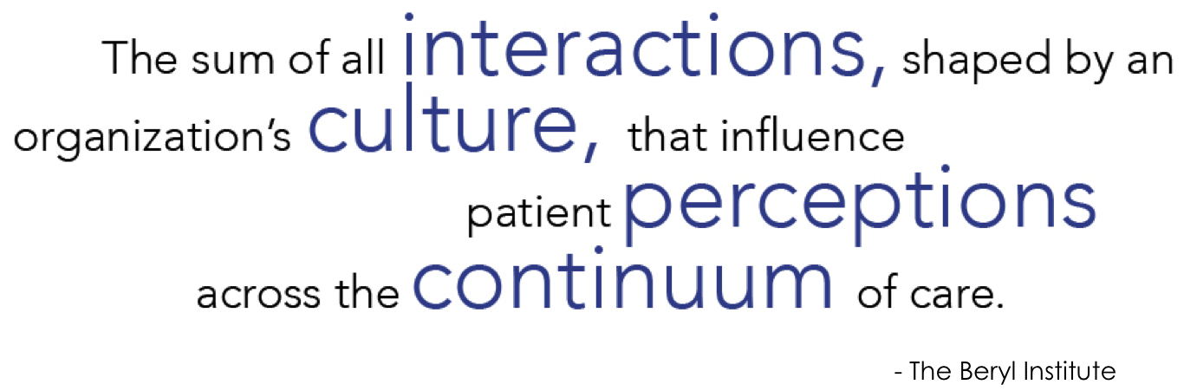

Slide 12



PFCC is the noun
PFE is the verb
Px is the outcome.
Adapted from PFCC Partners, Libby Hoy

Slide 13
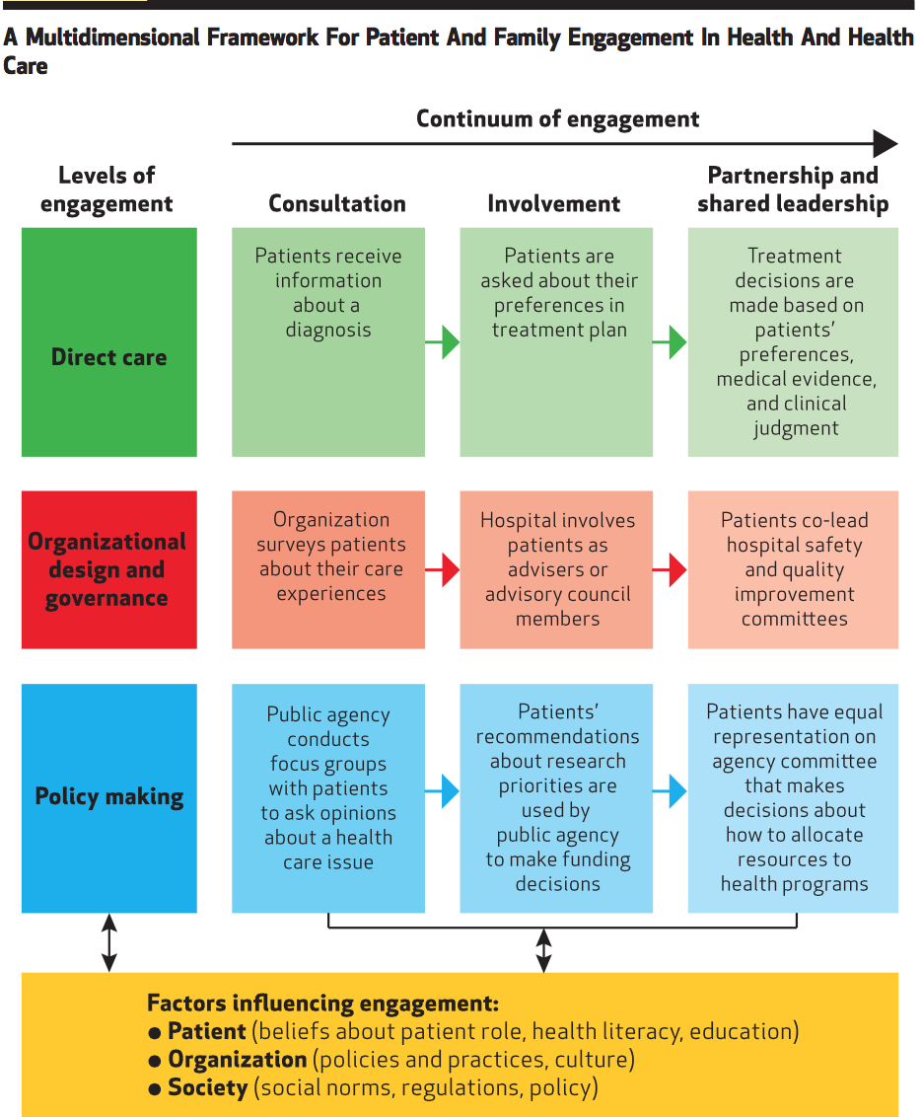

Slide 14

Who are “PFAs”?
Individuals who have received care and:
(Following training) offer insights/input to (healthcare) organizations
Strive to help organizations provide care/services based on patient- and family-identified needs rather than the assumptions of hospital staff about what patients and families want.
Adapted from AHRQ Guide: Working With Patient and
Families as Advisors (Implementation Handbook)

Slide 15

“What can we do to get more buy-in?”
“My organization is working to improve the patient experience and to become more patient- and family centered.”
“We don’t have everyone on board with the effort yet.”

Slide 16

Answer:
Start with a STORY!

Slide 17
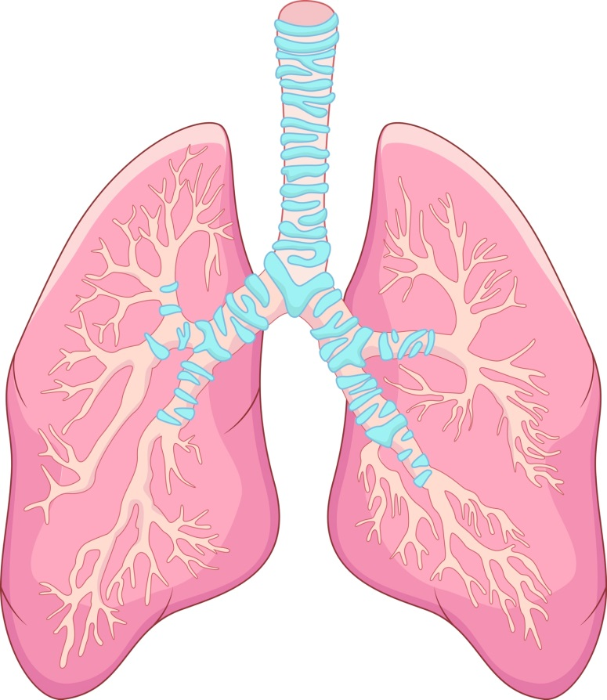

Meet your instructors!

Slide 18

PFA Story Telling
Reduce Burnout by helping providers to motivate & reconnect
+
Hardwire PFE/PFCC principles

Slide 19

How does your organization primarily receive patient/family feedback?
How does the feedback we get from PFAs differ?

Slide 20
Short Beak!

Slide 21

PFE Assessment:
Where are you in your PFA Program journey?

Slide 22
Step 3:
Structure
Step 2: Preparing
Step 4:
Recruiting
Step 6:
Launching and running
Step 7:
Sustaining
Step 5:
Training
Step 1:
PFCC and PFAs
Raising Awareness of the "why"
Leadership buy-in & planning
Key decisions regarding approach & logistics
PFA selection
Comprehensive training for PFAs & staff
Outlining agenda, meeting facilitation
In it for the long haul!
7 Steps to
Sustainability

Slide 23

Step 2: Preparing
Gain leadership support
The role of leadership
Sharing the vision
Benefits of a partnership approach

Slide 24

The role of leadership
In many ways, focus within PFA Programs follows the goals, initiatives and challenges on the radar of leadership.
Leaders can be helpful with even when time is limited.
Asks:
Continually encourage staff to seek input from community members/PFAs when working through any new ideas, challenges and/or upcoming plans
Offer thanks, guidance and motivation to community members and teams that engage PFAs

Slide 25

Share the vision before implementation
W
H
Y
P
F
A
s

Slide 26
Share the Vision: Benefits of Partnership
Foster cooperation
Expand PFCC
Develop relevant & responsive programs/policies
Motivate staff to improve patient experience
Reinforce patient safety concepts
From the organizational perspective…
Quality
Cost
Value
Adapted from: Leonhardt, K., Bonin, D., & Pagel, P. (2008). Guide for Developing A Community-Based Patient Safety Advisory Council. Rockville: Agency for Healthcare Research and Quality.

Slide 27
Share the Vision: Benefits of Partnership
Offer education on healthcare & hospital operations
Encourage participation in care
Equip patients/families to educate others
Provide venue to have opinions heard & valued
From the patient/family perspective…
Engagement
Experience
Education
Adapted from: Leonhardt, K., Bonin, D., & Pagel, P. (2008). Guide for Developing A Community-Based Patient Safety Advisory Council. Rockville: Agency for Healthcare Research and Quality.

Slide 28

Sharing the vision before implementation
Ask 1: Bring ideas, challenges and new plans for PFA feedback as far upstream as possible
Ask 2: Visit from time to time to offer thanks, guidance and motivation

Slide 29




Sharing the Vision:
Being mindful of PFA PTSD

Slide 30

NEXT: Gather Your Internal Team &
Plan Your Launch
Gather planning team
Set goals for PFA participation/engagement
Outline recruitment plan and launch date
Brainstorm topics, structure, logistics
Explore questions and concerns

Slide 31
ACTIVITY: Prepare your pitch!
You’re preparing for a presentation at your organization’s next leadership team meeting. They have graciously given you three minutes on their agenda to talk about your proposal to engage community members.
Prepare a short pitch that explains:
  The benefit of creating or expanding a PFA program for your organization
  The path you will choose
  (or next steps)
  Your ask

Slide 32
Step 3:
Structure
Step 2: Preparing
Step 4:
Recruiting
Step 6:
Launching and running
Step 7:
Sustaining
Step 5:
Training
Step 1:
PFCC and PFAs
Raising Awareness of the "why"
Leadership buy-in & planning
Key decisions regarding approach & logistics
PFA selection
Comprehensive training for PFAs & staff
Outlining agenda, meeting facilitation
In it for the long haul!
7 Steps to
Sustainability

Slide 33

Step 3: Structure
PFA Program models
Choosing your path
Planning the program structure
What is my role?

Slide 34

Choosing Your PFA Program Path
Focus Group
PFAC
PFAs on committees

Slide 35
What is a PFAC?
A Patient and Family Advisory Council (PFAC) partners patients and families with members of the healthcare team to provide guidance on how to improve the patient and family experience.
Through their unique perspectives, they give input on issues that impact care, ensuring that the next patient or family member’s journey is easier.
~Meghan West and Laurie Brown, BJC Healthcare

Slide 36
PFA Program Models
PFAs working more independently (i.e., on committees)
Faster launch
More direct mentoring needed
PFACs: staff request feedback from PFAs
Slower launch
Lower risk
Frontline engagement
High-level engagement
Focus Groups
Easier buy-in for resistant leaders
May lead to formation of PFAC
Detailed feedback re: 1 specific item

Slide 37

How do I choose the best path?
Considerations:
Leadership support
Resources
Current community engagement/relationship
Organizational culture
Greatest opportunity for impact

Slide 38

PFAs on internal committees/boards
Changes organizational culture:
  Promotes greater awareness and respect for patient/family experiences
Helps ensure the patient/family perspective is weighed in decision-making process
Gives leaders an opportunity to learn the “real-life” results of their decisions

Slide 39

Is there risk to placing a PFA at such a high level?
YES!
Beware of “checking the box”
Select a PFA who is suitable for this role
  Consider skill set, personality match, interests
Train PFAs AND staff

Slide 40
PFAs in focus groups
Short-term commitment (vs. PFAC)
May be made up of majority PFAs or combination of staff & PFAs
Match PFA personality/skill set/interests to project
Good for volunteers who prefer more “hands on” experience
Opportunity for trial run for potential PFAC volunteers

Slide 41
Standard Structure for PFACs
(otherwise they may not be PFACs)
Patients and family members (80%)
Staff (20%)
Visitors
*Dana Farber Model

Slide 42

PFAC leadership
CO-CHAIR 1: Clinical/Administrative Leader
CO-CHAIR 2: Patient/Family Advisor

Slide 43
Staff representation for PFAC
Select a multi-disciplinary group of staff:
Senior leader(s) (VP, COO, etc.)
Physicians
Clinic/unit directors
Front-line staff (RNs, PAs, etc.)
  Patient Advocates

Slide 44

Standard PFAC Structure
Structured agenda includes:
  Educational topic/program
  Feedback presentation
  Council business
PFAs are voting members
Council charter outlines:
  Time/frequency and length of meetings
    Average: monthly, 2 hour meetings

Slide 45

PFAC Mission and Charter:
Guides the work and sets expectations
Co-design WITH PFAs
Share samples with PFAs/PFACs
Customization to be done in collaboration with PFAs—either in PFAC meeting or by choosing a task group
“Living Document”
This will take time!

Slide 46
What is my role?
Participate in structured training (organizational context)
Provide relevant feedback
Serve as liaison to community
Identify opportunities for PFA feedback
Provide guidance / mentorship
Operationalize feedback
PFAs
Staff

Slide 47
Sample Projects & Initiatives
PFAs working more independently
Patient/family stories at new employee orientation & other events
Falls committee
Hospital board
Patient experience committee

Slide 48
Sample Projects & Initiatives
Focus Group
EMR Implementation
Chemotherapy education program
Public relations messaging
Marketing

Slide 49
Sample Projects & Initiatives
PFAC
New patient information (brochures, letters, etc.)
Way-finding
Patient/staff education
Facility design

Slide 50

Small Group Exercise
Using the structure checklist, discuss the path that is the best fit for your organization
Discuss opportunities in your organization to engage PFAs around the following topics:
Communication
Patient/Family Education
Staff/Provider Ed
Facility Design
Wayfinding
Policies/Operations

Slide 51
PFA Evolution of Engagement
PFAC Table
Task Groups, Speaking at organizational events
Peer Rounding, “Secret Shadowing”
PFAs in RCAs, on hospital board
Interviewing staff/leaders; otherwise integrated into operations
Feedback re: topics brought to PFAC
Over-arching projects or events
Long-standing approaches to QI

Slide 52
Step 3:
Structure
Step 2: Preparing
Step 4:
Recruiting
Step 6:
Launching and running
Step 7:
Sustaining
Step 5:
Training
Step 1:
PFCC and PFAs
Raising Awareness of the "why"
Leadership buy-in & planning
Key decisions regarding approach & logistics
PFA selection
Comprehensive training for PFAs & staff
Outlining agenda, meeting facilitation
In it for the long haul!
7 Steps to
Sustainability

Slide 53

Step 4: Recruiting
Recruitment strategies
Selecting effective patient and family advisors: keys to success
Volunteer application process

Slide 54

Where do I find my PFAC people?
Physicians, colleagues
    Advisor recruitment email template available
Open House
Press Ganey/HCAHPS
Peer support groups
Volunteer services
Patient satisfaction surveys
Newsletters
Websites

Slide 55

Recruitment & Visibility
Assess the team
Consider timelines for potential applicants
Consider the community
Do what fits best for you

Slide 56
What characteristics would your ideal advisors possess?

Slide 58
Choosing Effective PFAs
An effective advisor :
Has personal patient experience or has acted as a caregiver
Has processed through grief or loss
Can generalize personal experience to provide feedback on overall patient experience
Has time to commit to regular meeting attendance as well as outside volunteer opportunities

Slide 59
Choosing Effective PFAs
An effective advisor :
Possesses soft skills necessary for working in a collaborative environment:
Active listening
Clear, tactful verbal communication
Willingness to speak in front of group/leadership
Shows concern for more than one issue

Slide 60

Before Initiating the Application Process…
Offer the opportunity to visit a PFAC meeting
  You get to know them
  They get to know you
Prep applicant with goals and expectations
--verbally on the phone
--in writing upon arriving at PFAC meeting
Boundaries are important!

Slide 61

Application Process
Standardized application process for all PFAs will help you to:
Identify applicant’s motivation
Learn about applicant’s personal story
Recognize applicant’s strengths
Assess chemistry with other council members & staff
Protect the integrity of the group from the start

Slide 62

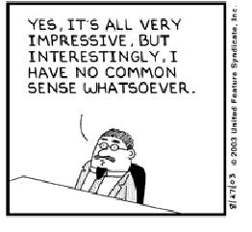
Interviewing a PFA
DANGER! Skip this step at your own risk!!

Slide 63

Interviewing a PFA
Panel members use PFA application as a guide
    Assess ability to articulate history, interest, strengths
Describe program structure, activities and goals
3. Outline time-commitment and discuss any obstacles/concerns
4. Answer questions
5. Explain next steps

Slide 64
Saying “no”
Best approach is gentle honesty
Share the concerns of the group
  They “are not a good fit at this time”
Other steps you can take:
  Ask applicant if he/she would consider other volunteer opportunities/provide information on volunteering in other areas
  Offer suggestions on steps he/she might take to become better suited to PFA role
  Offer the option of applying again in the future

Slide 65

Saying “yes”
Interview panel discusses applicant, makes recommendation to exec team
Application and feedback from panel provided to PFAC members (or staff heading focus group/internal committee)
Ask PFAs to review application, open floor for questions or concerns
Vote: All in favor…

Slide 66
Step 3:
Structure
Step 2: Preparing
Step 4:
Recruiting
Step 6:
Launching and running
Step 7:
Sustaining
Step 5:
Training
Step 1:
PFCC and PFAs
Raising Awareness of the "why"
Leadership buy-in & planning
Key decisions regarding approach & logistics
PFA selection
Comprehensive training for PFAs & staff
Outlining agenda, meeting facilitation
In it for the long haul!
7 Steps to
Sustainability

Slide 67

Step 5: Training
Why train PFAs?
Training components

Slide 68
Why Train PFAs?
Standardization leads to:
Consistent experience for PFAs, staff and presenters
An established and understood system for reporting and sharing best practices
Training before engagement leads to:
Confident PFAs and comfortable staff
More respectful interactions
A fast track to effective conversations and useful feedback/participation

Slide 69

Why do you think staff might be resistant to PFA feedback?

Slide 70

What are the greatest challenges patients/families experience when providing feedback in a healthcare environment?

Slide 71

Training paves the road for success by identifying and working through potential barriers at the start

Slide 72

Questions?

Slide 73

Welcome Back!
Your Questions and Take-Aways

Slide 74
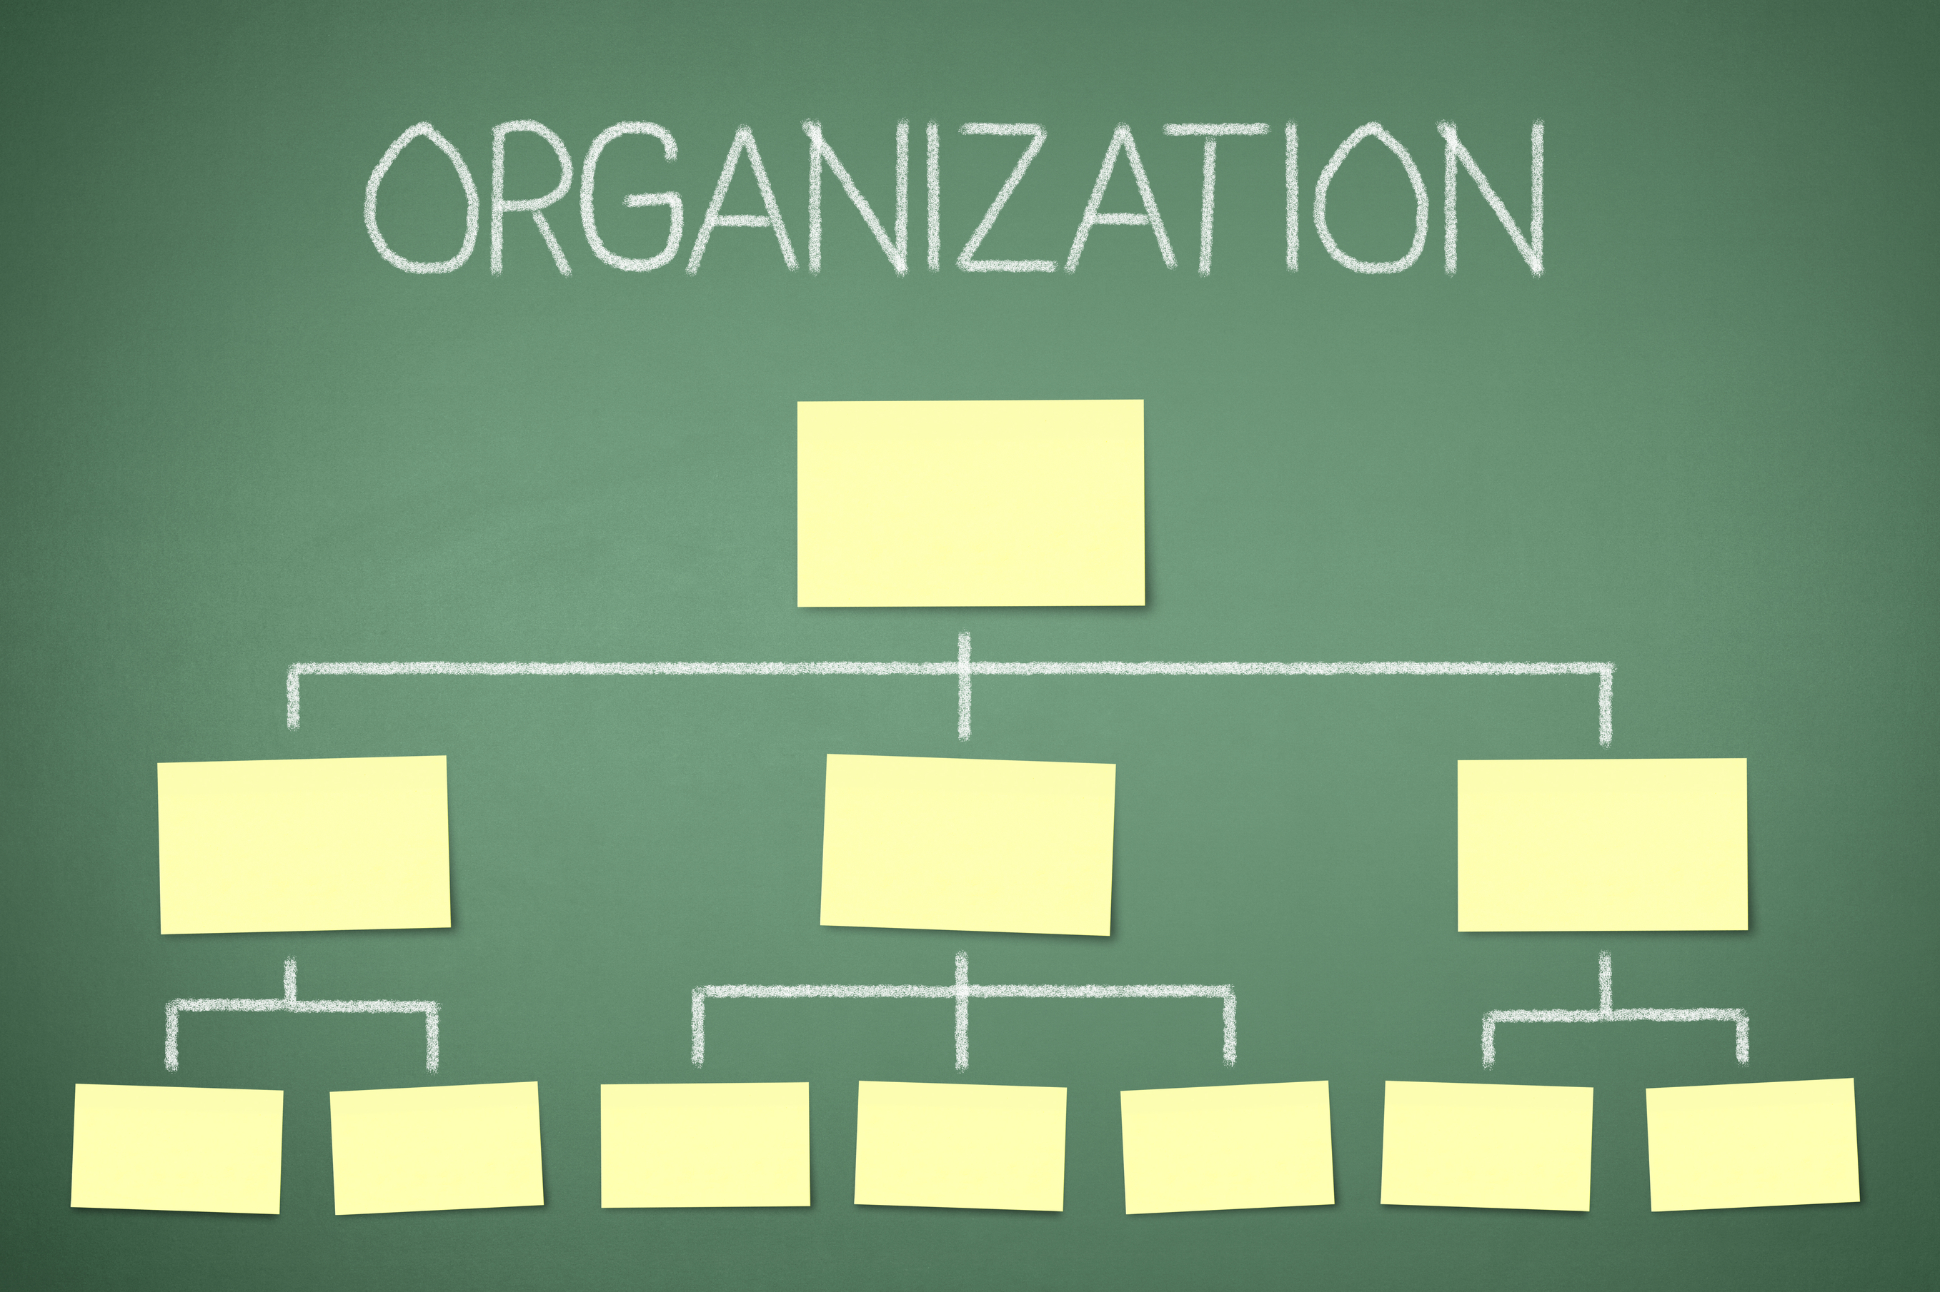
Why is this important?
Training Component: Organizational Structure

Slide 75

Training Component: PFA Program Background
Abbreviations
PFAC: Patient and Family Advisory/Advocacy Council
PAC: Patient Advisory Council
FAC: Family Advisory Council
PFA: Patient/Family Advisor
PFE: Patient and Family Engagement
PFCC: Patient- and Family- Centered Care

Slide 76

Program Specific Training
Internal committees/board representatives
Cultural considerations
Background info/context for group
Goals
Focus Group
History/context of project
Project goal

Slide 77

PFAC-Specific Training Components
When possible, train staff and PFAs together
Content:
Past successes
PFAC vision
Standardized procedures for running PFAC meetings and reporting activities
PFAC communication strategies
Opportunities to talk through
barriers to partnership
On-going projects/programs
Communication is KEY!

Slide 78
Role Play
Communication and the environment of mutual respect
Round One:
1 reporter
1 “PFA”
Round Two:
1 reporter
1 “staff member”
PFAC success and sustainability
Words that discourage partnership
Words that build partnership

Slide 79

Focusing on PFA Communication

Slide 80


Effective PFA Communication
Make observations: “I saw trash on the floor”
Make requests: “Would it be possible to…?
Engage in open dialogue: “Have you tried…?”
Show empathy: “I’m sure you’ve thought about this…”
Show appreciation for challenges
Make evaluations: “Your hospital is dirty”
Argue for change: “You should…”
Make demands
Make judgments: “Doctors don’t care”
Wear the expert hat
Become impatient with lack of change

Slide 81

Focusing on Staff Communication

Slide 82
Effective Staff
Communication
Listen for opportunities/remain open: “We tried that but perhaps we can approach it differently…”
Make requests: “Would you mind taking more time/doing more research and getting back to us with recommendations…”
Engage in open dialogue about a story: “What did you learn from that that can help us improve?”
Show empathy and
  appreciation for challenges
Make excuses and/or argue against change: “That won’t work…”
Talk down to someone
Make judgments: “You wouldn’t understand”
Use jargon
Become impatient with stories or lack of background knowledge

Slide 83
Step 3:
Structure
Step 2: Preparing
Step 4:
Recruiting
Step 6:
Launching and running
Step 7:
Sustaining
Step 5:
Training
Step 1:
PFCC and PFAs
Raising Awareness of the "why"
Leadership buy-in & planning
Key decisions regarding approach & logistics
PFA selection
Comprehensive training for PFAs & staff
Outlining agenda, meeting facilitation
In it for the long haul!
7 Steps to
Sustainability

Slide 84
BREAK!

Slide 85

Step 6: Launching and running
  PFA participation on internal committees
  Choosing a PFAC focus
  PFAC missions & charters
  The PFA statement
  “Closing the loop”

Slide 86
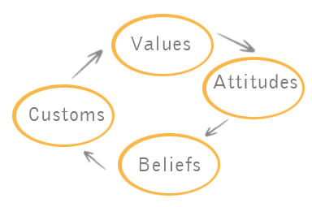
Preparing for PFA participation on internal committees/boards
Speak with a representative from the requesting entity:
Goal for including PFAC member in meeting/project
  Adjust expectations when necessary
Request member be introduced at start by entity rep and assign a “buddy”
  May provide script

Slide 87

The role of partnership in deciding a PFAC focus
What would PFAC members like to focus on?
  Discuss potential projects at least annually
Where/when is the greatest potential for impact?
What is our leadership most interested in accomplishing and how can the PFAC get involved?

Slide 88

The PFA Statement:
When what matters is out of the PFA Program scope

Slide 89

Key to PFA Satisfaction
During the meeting:
What can we do to support you/help with this effort?
When will you be back to share the progress you’ve made/ask for more feedback?
CLOSE THE LOOP!
Follow-up visit:
Which (if any) suggestions were utilized?
What was the outcome?
  Share finished product
  (if applicable)

Slide 90

Formulating the first PFAC meeting agenda
Include the following items and a time estimate for each:
One feedback topic
  You may use one of the ideas your group generated this morning
One educational topic
PFAC business items (i.e., approving meeting minutes)
Any other “special” items you’d like to include
Keep in mind, this is the very first PFAC meeting for staff and PFAs!

Slide 91

The culture of your PFAC will guide the ship!
Example: OPAC and ESPFAC

Slide 92
Step 3:
Structure
Step 2: Preparing
Step 4:
Recruiting
Step 6:
Launching and running
Step 7:
Sustaining
Step 5:
Training
Step 1:
PFCC and PFAs
Raising Awareness of the "why"
Leadership buy-in & planning
Key decisions regarding approach & logistics
PFA selection
Comprehensive training for PFAs & staff
Outlining agenda, meeting facilitation
In it for the long haul!
7 Steps to
Sustainability

Slide 93

Step 7: Sustaining your PFA Program
In it for the long haul!
  Supporting your PFAs
  Supporting staff
  Delegation of Duties
  Measuring and Reporting

Slide 94

Supporting Staff
Help to identify opportunities where partnership can save time/effort and increase joy at work
Check-in to see how the work is going:
  “What’s going well?”
  “What could we do differently?”
Recognize staff who are champions for the work

Slide 95

Supporting your PFAs
Maintain open lines of communication
Offer opportunities for PFAs to support each other
Provide development/learning opportunities
Recognize & celebrate
accomplishments

Slide 96
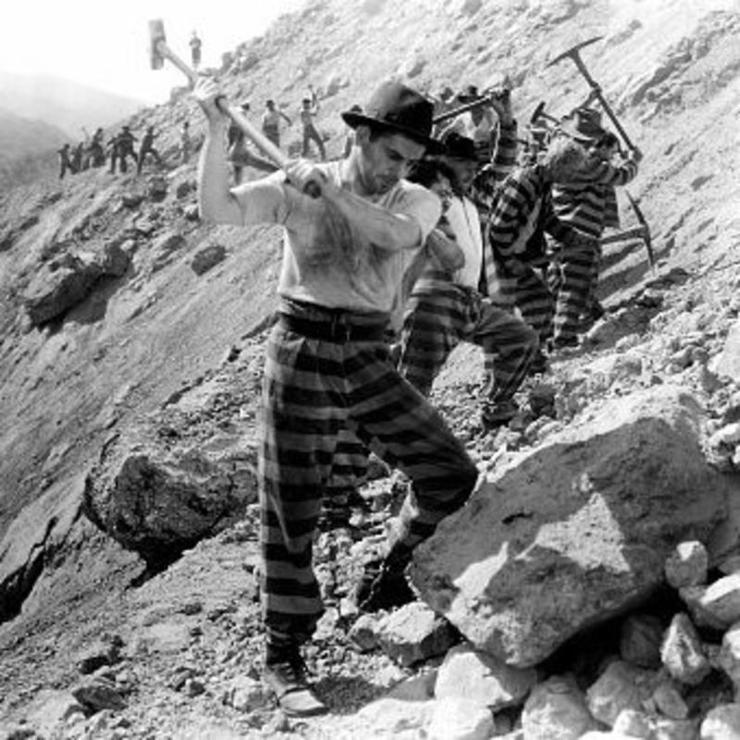
Division of Labor for PFACs
What duties do you/ could you delegate to volunteers and other staff to help keep your PFAC running?
Added benefit: improved staff & PFA engagement!

Slide 97
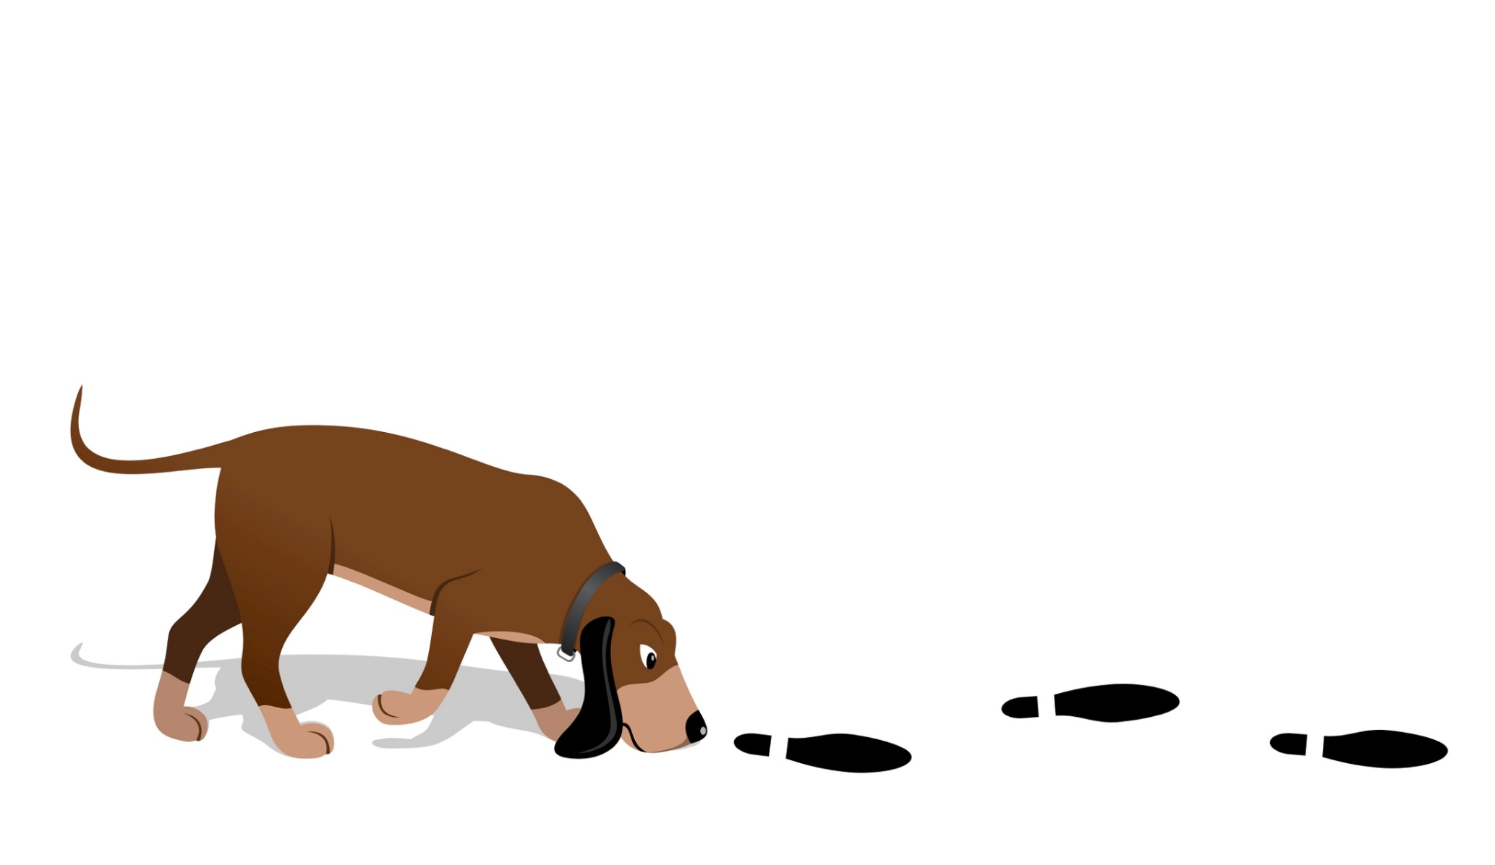
Issue Tracker
Quantify impact of PFAC feedback
    Benchmarking
      Baseline measures
      Goal setting
    Collect updated measures in 3, 6, 9, 12 mos.
Example: Wellspan (York, PA) :
                PFAC feedback on billing letter

Slide 98
Issue Tracker
Accountability:
Logs PFAC activities
Issue/Project | Type | Date Presented | Presenter | Baseline Metrics
Falls prevention for ABMT patients | F | 8/15/14 | J. Loftis | Avg. # falls per pt. per mo.=0.5
HCAHPS and Press-Ganey overview | E | 9/12/14 | P. Turner | NA

Slide 99
Issue Tracker
Impact:
Records feedback & interventions
Collects baseline and follow-up metrics
Follow-up Date | Change(s) Made | Follow-up Metrics
12/20/14 | Nurse education re: PFCC and falls prevention; cue sheets for nurses | Avg. # falls per pt. per mo.=0.25
3/21/14 | NA | NA

Slide 100
Accountability: Annual Report
Program Overview
Accomplish-ments
Future direction

Slide 101
Accountability: Annual Report
Consider including:
Number of councils in operation
Number of advisor volunteers & total hours of volunteer service
Number of projects, initiatives, and special events to which advisors have contributed
Evaluation scores: advisors & presenters
http://www.ipfcc.org/advance/topics/annual-reports.html

Slide 102

Measurement for…
PFAC Impact
Survey staff who come to the PFAC for feedback
  How useful was the feedback you received?
  Did your experience with the PFAC change your perception of patient/family-centered care?
Process Improvement
Survey patient/family advisors re: their experience & satisfaction
  Is meeting time convenient?
  Do you believe your feedback is listened to and valued?

Slide 103

Summary: What is a PFA Program?
“Oh, It’s a RESOURCE!”
Effective PFAs become an irreplaceable resource to the organization--providers, staff and leaders rely on PFAs for insight and guidance
Poorly planned PFA Programs can feel like “one more thing to do” and are often unsustainable
The difference? The 7 steps!

Slide 104
Collaboration
is not about gluing together
existing egos. It’s about the
ideas that never existed until
after everyone entered the room..

Slide 105
Questions?

Slide 106
ACTION PLANNING!

Slide 107

Allison Chrestensen
PFE Consultant, NCQC
allison@tandemhcs.com
(919) 627-2180
Tiffany Christensen
PFE Specialist, NCQC
tchristensen@ncha.org
(919) 677-4119

